Slide 1

Digital Work Order Form
🔧
From Paper to Mobile
A comprehensive business case for transforming maintenance operations through digital innovation

Slide 2

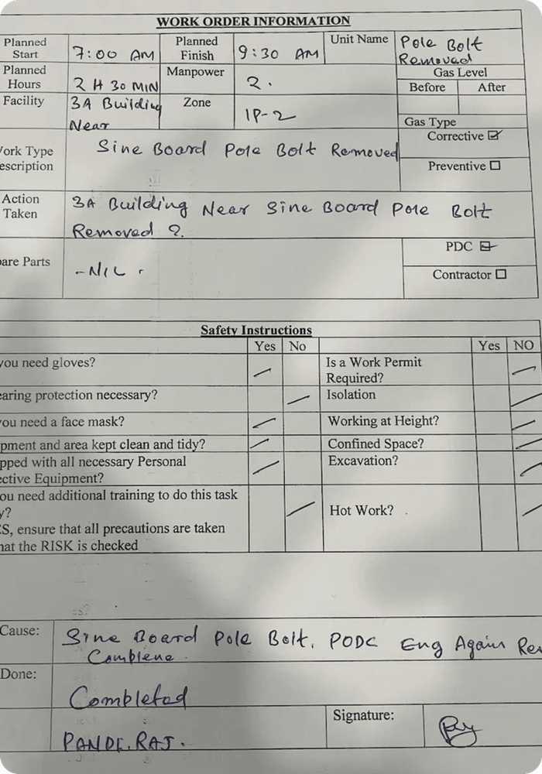
The Problem
📄
600 hours annually spent on manual data entry
❌
Data loss risk - forms lost, damaged, or illegible
✏️
15% error rate from manual transcription
📦
High storage costs for 720 pages annually
⏱️
2-3 day lag before processing begins
👁️
No real-time visibility into work status

Slide 3
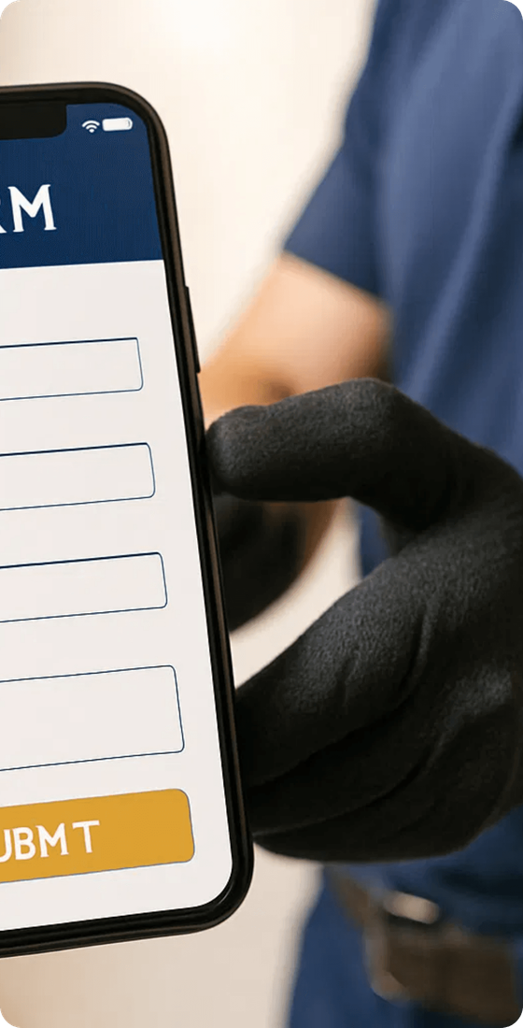
The Solution
📱
Mobile-friendly webpage for contractors
⚡
Instant submission via WhatsApp
💾
Auto-save functionality (no data loss)
📸
Photo evidence attachment capability
✓
Real-time data validation
🕐
24/7 accessibility from any device
🎨
Professional branding with company colors

Slide 4


Annual Time Savings
Metric
Current
Digital
Savings
Per Form
~2.4 hours
0 hours
2.4 hrs/form
Per Month
~12 hours
0 hours
12 hours
Per Year
145 hours
0 hours
145 hours
Labor Cost Savings
$208/month
$0
$2,500/year
TOTAL ANNUAL SAVINGS
$5,000
OMR 1,925

Slide 5

Total Annual Cost Savings
MANUAL DATA ENTRY
PAPER & PRINTING
$2,500
OMR 962.50
$500
OMR 192.50
STORAGE SPACE
ERROR CORRECTION
$200
OMR 77
$1,800
OMR 693
TOTAL ANNUAL SAVINGS
$5,000
OMR 1,925
Achieved through automation, efficiency gains, and error reduction

Slide 6

Data Accuracy & Compliance
PAPER FORMS
DIGITAL FORM
15%
→
<1%
Error Rate
Error Rate
✓
Automatic timestamping & audit trail
📸
Photo evidence for verification
🔒
Structured data for compliance
🔍
Searchable digital records
⚙️
Fewer rework cycles from errors

Slide 7

Speed & Visibility
Operational efficiency gains with instant submission and real-time data availability
Aspect
Paper Forms
Digital Solution
Submission Lag
2-3 days
Instant
Data Availability
End of month
Real-time
Visibility
None until submitted
Full tracking
Follow-ups
Manual calls required
Automated

Slide 8

Implementation Timeline
1️⃣
2️⃣
3️⃣
4️⃣
Pilot Phase
Full Rollout
Training
Optimization
Week 1-2 Test with 2-3 contractors
Week 3-4 Deploy to all contractors
<5 minutes per contractor
Ongoing Monitor & refine
KEY ACTIVITIES
SUPPORT
• Gather feedback • Measure metrics • Refine system • Set up WhatsApp group
• Dedicated team available • FAQ documentation • Quick training sessions • Real-time assistance

Slide 9
Risk Mitigation
❓
CONCERN
📡
CONCERN
Will contractors be tech-savvy enough?
What if there's no internet connection?
✓
SOLUTION
✓
SOLUTION
The form is extremely simple—fill in fields and click submit. No technical knowledge required. Training takes less than 5 minutes.
The form auto-saves locally. Once connection is restored, the data is submitted automatically. No data loss.
🔒
CONCERN
💾
CONCERN
What about data security and privacy?
Do we need a backup system?
✓
SOLUTION
✓
SOLUTION
WhatsApp messages are end-to-end encrypted. For added security, we can implement additional authentication or use a dedicated backend system.
All WhatsApp messages are archived in the company WhatsApp group. Additionally, we can implement cloud backup storage for redundancy.

Slide 10
Long-Term Benefits
Strategic advantages that position the maintenance team for future growth and operational excellence
1
2
Scalability
Data Analytics
The system grows automatically with your business. No additional manual effort required as you add new contractors or expand operations.
Structured data enables reporting on maintenance trends, contractor performance, and facility issues to improve preventive maintenance scheduling.
3
4
System Integration
Feature Expansion
Future integration with maintenance management systems (CMMS), automated alerts, and real-time management dashboards.
Ready for geolocation tagging, voice input, and multi-language support to enhance accessibility and functionality.

Slide 11

Paper vs. Digital
📄
Paper
📱
Digital
✗
Processing Speed
✓
Processing Speed
2-3 days
Instant
✗
Data Accuracy
✓
Data Accuracy
85%
99%+
✗
Annual Cost
✓
Annual Cost
$5,000
$0
✗
Accessibility
✓
Accessibility
Limited
24/7
✗
Scalability
✓
Scalability
Manual
Automatic
✗
Environmental Impact
✓
Environmental Impact
High waste
Zero waste

Slide 12
Return on Investment
ANNUAL SAVINGS
IMPLEMENTATION COST
PAYBACK PERIOD
$5,000
Minimal
Immediate
OMR 1,925
Already built and ready
Benefits start day one
Labor, materials, and error costs
ONGOING COST
EMPLOYEE SATISFACTION
CONTRACTOR EXPERIENCE
$0
↑ Increased
↑ Improved
No recurring fees
Less tedious data entry
Faster feedback and tracking
Financial Impact
Strategic Value
Saves $5,000 annually (OMR 1,925) with zero implementation cost. Immediate positive ROI with ongoing operational benefits.
Positions maintenance team for future growth and enables data-driven decision making through analytics.

Slide 13
Next Steps
1
Approve Pilot Program
2
Train Contractors
Get stakeholder approval to proceed with 2-week pilot with select contractors
Conduct quick training sessions (less than 5 minutes per contractor)
3
Measure Baseline Metrics
4
Gather Feedback
Establish current performance metrics (time, accuracy, errors) for comparison
Collect contractor and team feedback to identify improvements
5
Roll Out Company-Wide
6
Monitor & Optimize
Deploy to all contractors with full training and support
Continuously track performance and refine the system based on usage patterns
Ready to transform your maintenance operations? Let's get started today!

