Slide 1

askadil.org
Solicitor Directory
Building the UK's first searchable directory
of Muslim & Islamic-specialist solicitors
Educate First, Litigate Second.
An initiative in association with the Muslim Council of Britain
March 2026

Slide 2
THE PROBLEM
No public, searchable Muslim
lawyer directory exists in the UK.
Dormant sites
No public directories
Matching platforms fail
muslimlawyer.co.uk & muslimsolicitors.co.uk are the same entity — no named lawyers, no updates since 2019.
AML, MLAG, and Muslim Lawyers' Hub are networks for lawyers, not directories for the public.
SolicitorConnect claims 500+ specialists but only 11 firms are visible. Enquiry-based, not browsable.
~12,000 Muslim solicitors practise in England & Wales (6% of profession) — but the public has no way to find them.

Slide 3
THE OPPORTUNITY
A first-mover advantage in an
unserved market.
~12,000
361
0
1st
Muslim solicitors
in England & Wales
Barristers
self-identified as Muslim
Public searchable
directories
AskAdil would be
first of its kind
Sources: Law Society diversity data, Bar Council, CILEX

Slide 4
RESEARCH AUDIT
We audited every Muslim lawyer
resource in the UK.
Resource | Type | Named Lawyers? | Status
Muslim Lawyer UK | Referral service | None | Dormant (2019)
SolicitorConnect | Matching platform | 11 firms only | Early-stage
AML / MLAG / Hub | Professional networks | No public directory | Active (networking)
Duncan Lewis | Law firm dept | 2 (may have left) | Page outdated
Legal 500 | Rankings | Finance only | Active (limited)
Conclusion: The market is wide open. No competitor offers what AskAdil can build.

Slide 5
COMPILED DIRECTORY
38 firms with verified contact details.
15
12
14
8
8
Islamic Family
Law / Divorce
Islamic Wills &
Inheritance
Islamic Finance
& Conveyancing
Employment
Discrimination
Multi-service
Islamic Law
Priority firms for outreach:
I Will Solicitors (Islamic Wills leader) | Aramas Family Law (Chambers-ranked) | White Horse Solicitors (Islamic Finance) | Kuddus Solicitors (All HPP panels) | Rahman Lowe (Legal 500, discrimination)

Slide 6
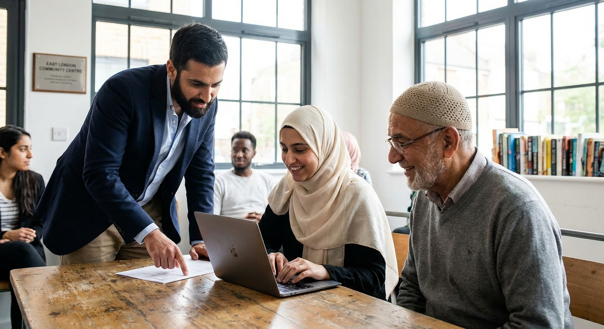
GEOGRAPHIC COVERAGE
Firms across every major
Muslim population centre.
London
9 firms
Ascentim, White Horse, Kuddus, Duncan Lewis, Farani Taylor, Rahman Lowe
Birmingham
5 firms
I Will Solicitors, Aman, Touchwood, Witan, Duncan Lewis
Manchester
6 firms
Aramas, MWG, O'Donnell, ASL, Myerson, Reeds
Yorkshire
5 firms
Batley Law, Makin Dixon (10 offices), YHM, Slater Heelis
Lancashire
3 firms
Blakewater (Blackburn), Curtis Law, AFG Law (Bolton)
Nationwide
6 firms
Stowe, Irwin Mitchell, Reeds (22 offices), Taylor Rose, I Will

Slide 7
ISLAMOPHOBIA SUPPORT
Dedicated resources for
anti-Muslim discrimination.
First Contact
Specialist Solicitors
Key Barristers
Tell MAMA: 0800 456 1226
IRU: 020 3904 6555
Muslim Safety Net: 0303 330 0288
Bindmans LLP (Prevent, hijab)
Rahman Lowe (Legal 500)
Kesar & Co (Legal Aid)
Mishcon de Reya (Tell MAMA lawyers)
Karon Monaghan KC (Matrix)
Imran Khan KC (Nexus)
Schona Jolly KC (Matrix)
377% surge in Islamophobia incidents (2023-24) | 45% of all religious hate crimes target Muslims | Avg tribunal settlement: £43,234

Slide 8
REFERRAL PATHWAYS
Matching victims to the right support.
Hate Crime / Attack
Workplace Discrimination
School / Hijab Issue
→
Tell MAMA + Police + Saunders Law
→
IRU + ACAS + Landau Law (no-win-no-fee)
→
IRU + Mishcon de Reya
Housing Discrimination
Police / State
Prevent / Counter-terror
→
Shelter + Hodge Jones & Allen
→
Bhatt Murphy + DPG Law + EHRC
→
CAGE + Bindmans + IHRC

Slide 9
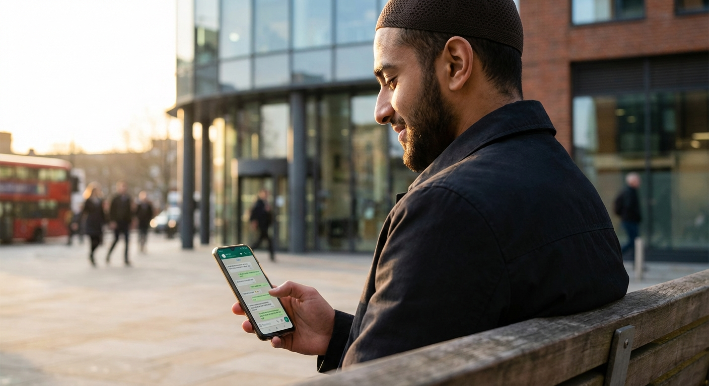
HOW IT WORKS
AI-powered referral through
the AskAdil chatbot.
1
2
3
4
User asks
AskAdil matches
Referral
Follow-up
"I need help with
Islamic divorce
in Manchester"
Specialism + Location
+ Language
+ Availability
Top 2-3 matched
solicitors with contact
details & context
Track referral quality,
collect feedback,
improve matching

Slide 10
ROADMAP
Four phases to a comprehensive platform.
Phase 1
Now
Phase 2
Apr-Jun 2026
Phase 3
Jun-Sep 2026
Phase 4
Sep 2026+
Manual Referral
Outreach & Consent
Self-Registration & SRA
Full Platform
Embed 38 firms in RAG
Chat-based referrals
Disclaimer copy
Contact priority firms
Verify details & consent
Engage AML/MLAG/Hub
"List your practice" portal
SRA API integration
Name-matching outreach
Search & filter UI
Reviews & ratings
Barristers extension

Slide 11
MONETISATION
Freemium directory with
multiple revenue streams.
Free Tier
Premium £49-149/mo
Basic listing (name, address, phone)
Practice areas shown
Link to firm website
Included in chat referrals
Standard placement
Enhanced profile (photo, bio, cases)
Priority "Featured" placement
Direct enquiry form (leads to email)
Analytics dashboard (views, clicks)
"MCB Verified" trust badge
Review management tools

Slide 12
REVENUE PROJECTIONS
Conservative growth to £237K annual revenue.
Key Assumptions
20% paid conversion at maturity
1,000 listed firms (of ~12K Muslim solicitors)
£99/mo average premium fee
Subscriptions only (excl. lead gen, events, data)
Total addressable: £350K/yr with all streams

Slide 13
REVENUE MIX AT MATURITY
Target: £250-350K annual revenue (2028+)
45%
Premium Subscriptions
~£113K — £49-149/mo enhanced profiles
25%
Lead Generation
~£63K — £5-25 per qualified enquiry
15%
Sponsored Content
~£38K — Articles, newsletters, guides
10%
Events
~£25K — Webinars, roadshows, conference
5%
Data & API
~£13K — Market reports, API licensing

Slide 14
VALUE PROPOSITION
Why solicitors will pay to be
on AskAdil.
Unique Audience
Pre-qualified Leads
MCB Trust Signal
The only directory specifically serving British Muslims via AI chatbot. No competitor exists.
Users have already described their legal issue. Firms get warm, contextual enquiries — not cold clicks.
Association with the Muslim Council of Britain provides credibility no generic directory can match.
Community Reach
10x Cheaper than Google
Growing Market
Access to MCB's network of 500+ affiliated mosques and community organisations.
Google Ads cost £5-15 per click (£500-1,500/mo). AskAdil Premium is £99/mo for unlimited visibility.
Muslim solicitors grew from 5% to 6% of profession. Community demand for culturally-aware legal help is rising.

Slide 15
SRA COMPLIANCE
Regulatory framework ensures
compliance from day one.
Permitted
Prohibited
Charge for enhanced profiles / advertising
Charge per lead (non-PI areas)
Charge for sponsored content
Charge for events / sponsorship
All require: written agreements + client disclosure
Referral fees for personal injury (LASPO ban)
Payment influencing chat recommendations
Unlabelled sponsored content
Undisclosed commercial arrangements
Editorial independence: AskAdil chat recommends based on best-fit (specialism, location, language) — never payment status.

Slide 16
GROWTH STRATEGY
Multiple channels to scale
from 38 to 1,000+ firms.
SRA API
High
MCB Network
High
Self-Registration
High
Query 200K+ solicitors by name/location.
Match against Muslim surnames.
Invite to opt in.
500+ affiliated mosques.
Community recommendations.
Warm introductions.
"List your practice" portal.
Promote via AML, MLAG, Hub.
Lawyers opt in directly.
LinkedIn Mining
Medium
Islamic Banks
Medium
Law Society FOI
Low
Search AML/MLAG followers.
Identify self-identified
Muslim legal professionals.
Al Rayan, Gatehouse etc.
maintain solicitor panels.
Pre-vetted for competence.
Anonymised diversity data
by religion + practice area
+ region. Market sizing.

Slide 17
NEXT STEPS
From research to referrals.
1
Embed the 38-firm directory into AskAdil's RAG knowledge base for immediate chat referrals
2
Begin outreach to Tier A firms — I Will Solicitors, Aramas, White Horse, Kuddus, Rahman Lowe
3
Engage AML, MLAG, and Muslim Lawyers' Hub as distribution partners
4
Register for SRA API access and prototype name-matching pipeline
5
MCB board discussion: governance model for commercial directory operations
askadil.org
An initiative in association with the Muslim Council of Britain

