Slide 1
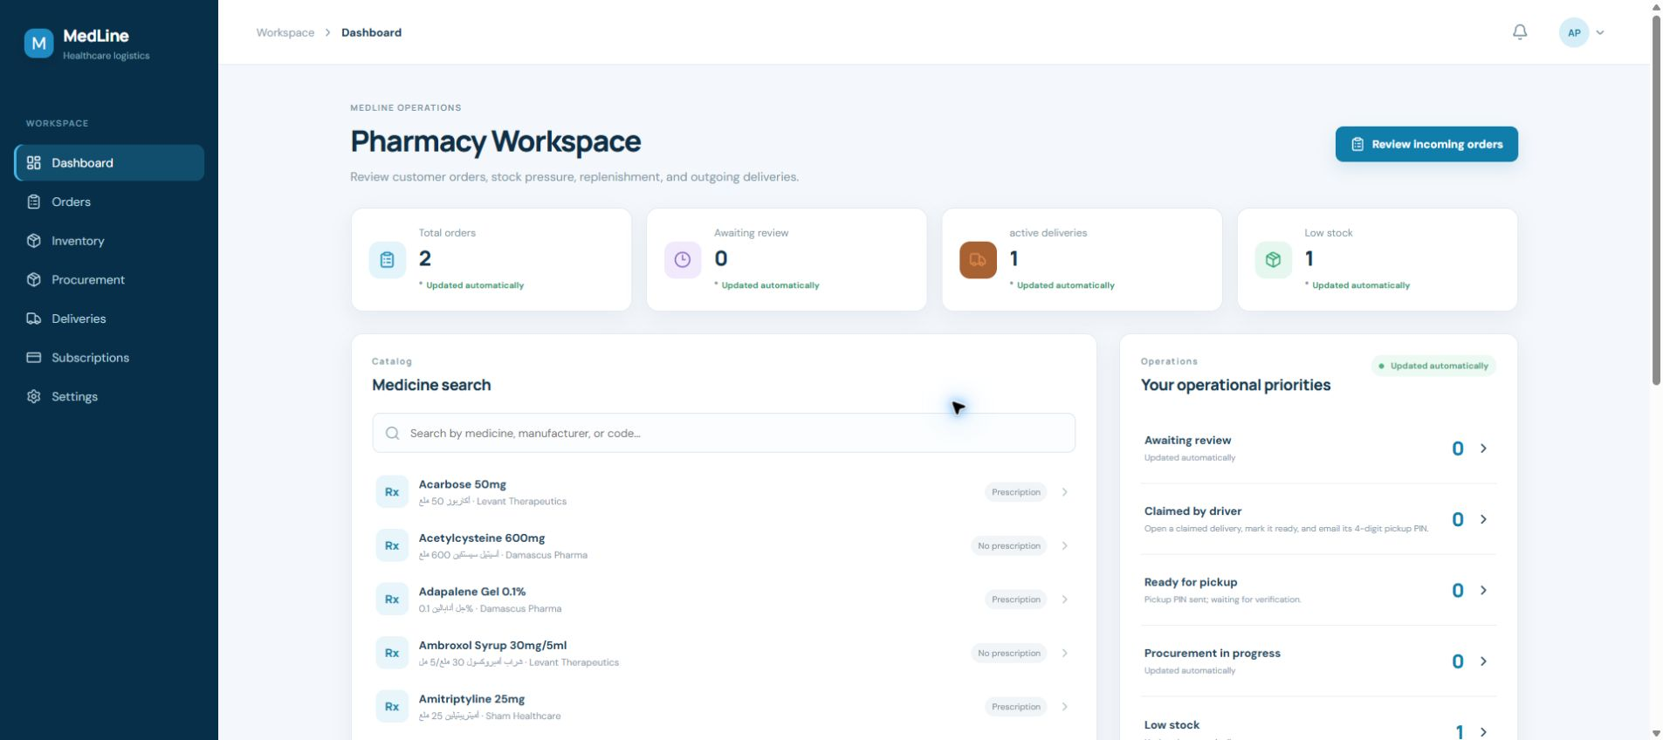
UNIVERSITY COMMITTEE PRESENTATION
MedLine
Secure medication delivery and medical logistics from inventory to recipient.
30 MINUTES
4 SPEAKERS
5 ROLES
A live, role-aware system | Demonstration baseline: 24 August 2026
Speaker 1 opens | Speaker 4 closes with Q&A
Notes:
Speaker 1 - 00:00-00:30 (30 seconds) Good morning. We are presenting MedLine, a role-aware medication delivery and medical logistics system. It connects patients, pharmacies, warehouses, drivers and administrators through one controlled workflow. In the next thirty minutes, four speakers will show the user experience, the operational workflows, the secure delivery handoffs and the controls that keep every status consistent. Do not begin with technical detail. Establish the one-sentence thesis: MedLine makes a complex medication journey visible, secure and auditable from inventory to recipient. [Sources] - MedLine repository: README.md and docs/DOMAIN_SPECIFICATION.md (reviewed 24 August 2026) - Local portal capture: tmp/committee-materials/assets/pharmacy-dashboard.png (captured 24 August 2026)

Slide 2
MEDLINE / UNIVERSITY COMMITTEE EDITION
SPEAKER 1 | 00:30-01:30
Thirty minutes, one connected story
Each speaker answers the question created by the previous section.
1
00:00-07:00
Why MedLine exists
Problem, roles and architecture
2
07:00-14:00
How partners fulfil
Patient, pharmacy, stock and procurement
3
14:00-21:30
How delivery is proven
Road route, pickup, arrival and recipient PIN
4
21:30-30:00
How the system is governed
Admin, assurance, theater data and Q&A
02
Notes:
Speaker 1 - 00:30-01:30 (1 minute) Explain the division of responsibility. Speaker 1 introduces the problem, users and architecture. Speaker 2 follows the patient order into pharmacy and warehouse fulfilment. Speaker 3 takes over when a driver sees a route and proves the two physical handoffs. Speaker 4 shows administration, security, deterministic data and the production boundary, then leaves time for questions. The handoff discipline matters: do not repeat the previous section. End each section with the question the next speaker answers. We have reserved the last sixty to ninety seconds inside the final slide for committee questions, so the full run remains within thirty minutes. [Sources] - MedLine committee narrative: tmp/committee-materials/narrative.txt (prepared 24 August 2026) - MedLine repository: docs/REQUIREMENTS_TRACEABILITY.md (reviewed 24 August 2026)

Slide 3
MEDLINE / UNIVERSITY COMMITTEE EDITION
SPEAKER 1 | 01:30-03:30
The problem is coordination, not one isolated screen
Medication fulfilment crosses clinical, commercial and physical trust boundaries.
FRAGMENTED DECISIONS
INVISIBLE HANDOFFS
INCONSISTENT STATUS
Prescriptions, stock, prices and approvals are often separated.
A successful dispatch does not prove pickup or recipient delivery.
Different clients can drift unless one server controls every transition.
MEDLINE RESPONSE
One API controls roles, prices, stock, status, verification and history.
03
Notes:
Speaker 1 - 01:30-03:30 (2 minutes) Frame the problem as coordination. A patient order is not simply a shopping cart: some medicines require item-specific prescription evidence; a pharmacy must decide what can be supplied; stock may need replenishment from a warehouse; a driver needs a real road route and recipient context; and two physical handoffs must be verified. The main design risk is inconsistent truth. If web, mobile and backend each invent their own status, the same order could look accepted in one place and completed in another. MedLine addresses that by making Laravel the authority. The user interfaces explain the workflow, but the API validates every role, ownership rule, quantity boundary and state change. Transition: who sees which part of this system, and how are those parts connected? [Sources] - MedLine repository: docs/DOMAIN_SPECIFICATION.md and docs/ARCHITECTURE_DECISIONS.md (reviewed 24 August 2026)

Slide 4
MEDLINE / UNIVERSITY COMMITTEE EDITION
SPEAKER 1 | 03:30-07:00
Five experiences, one authoritative workflow engine
Role-specific interfaces reduce noise; server-side policy provides security.
PATIENT
MYSQL
LARAVEL 12 API
orders, stock, events
PHARMACY
Authentication + authorization
REVERB + JOBS
WAREHOUSE
Workflow transitions + pricing
live updates, queues
Transactions + row locks
DRIVER
Audit + private files
PROVIDERS
routing, email, push
ADMIN
React web + Flutter mobile consume the same contract.
04
Notes:
Speaker 1 - 03:30-07:00 (3 minutes 30 seconds) Walk from left to right. Patients discover pharmacies, create orders, attach prescriptions, track delivery and submit ratings or complaints. Pharmacies review prescriptions and quantities, manage their own inventory and working hours, request warehouse replenishment and control pickup verification. Warehouses manage traceable batches and exact procurement allocations. Drivers see only compatible work plus their own assignments, road routes, recipient contact and progress actions. Administrators remain deliberately unassociated with a pharmacy or warehouse; they govern system-wide approval, pricing, recovery, moderation and audit. At the center, Laravel 12 with Sanctum is the trust boundary. It enforces ownership, status transitions, rate snapshots, reservations, PIN verification and idempotency. MySQL stores authoritative state. Reverb, queues and the scheduler carry realtime and asynchronous work. OpenStreetMap routing, SMTP, FCM and optional SMS are replaceable provider adapters. The key sentence is: the client shows the workflow; the API enforces it. Handoff to Speaker 2: now that we know who owns each responsibility, what does an order look like from discovery through fulfilment? [Sources] - MedLine repository: README.md, docs/ARCHITECTURE_DECISIONS.md and backend/routes/api.php (reviewed 24 August 2026)

Slide 5
MEDLINE / UNIVERSITY COMMITTEE EDITION
SPEAKER 2 | 07:00-09:00
The patient sees one understandable journey
Discovery, evidence, pricing, consent and tracking remain connected.
1
2
3
4
5
DISCOVER
BUILD
PRICE
DECIDE
TRACK
Approved, open pharmacy + catalog
Medicines, quantities and item evidence
Road distance, vehicle rate, fee and total
Accept a full or reduced offer
Follow the related delivery to completion
Important: an accepted order is not completed until recipient verification and settlement succeed.
05
Notes:
Speaker 2 - 07:00-09:00 (2 minutes) Describe the patient experience without reading every control. The patient first searches the bilingual medicine catalog and selects an approved pharmacy that is open according to stored working hours. The cart can contain several medicines and quantities. Every prescription-required line has its own private evidence, so one document cannot accidentally approve unrelated items. Before submission, the patient chooses ASAP or scheduled delivery and a permitted vehicle. The application displays the stored road distance, the rate per kilometre, the delivery fee, tax and total. After pharmacy review, the patient may receive a partial offer - for example, two units instead of three - and must explicitly accept or reject it. Finally, the patient tracks the related delivery and can rate or complain. Emphasize the distinction at the bottom: order acceptance is commercial/clinical approval; completion occurs only after final delivery verification and settlement. [Sources] - MedLine repository: docs/API_WORKFLOWS.md and docs/DOMAIN_SPECIFICATION.md (reviewed 24 August 2026)

Slide 6
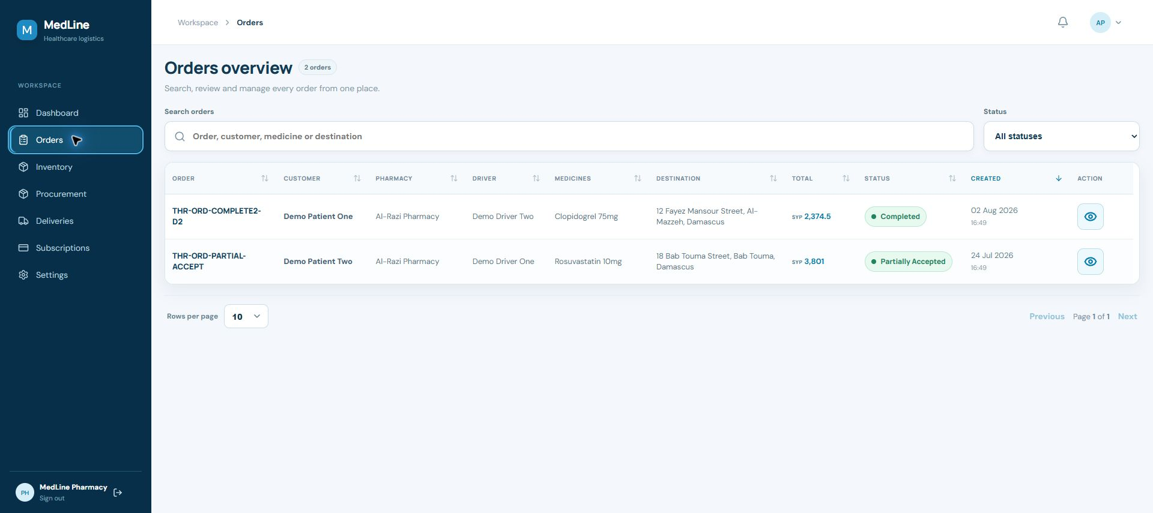
MEDLINE / UNIVERSITY COMMITTEE EDITION
SPEAKER 2 | 09:00-11:00
Pharmacy review is item-specific and quantity-bounded
The queue keeps patient, medicine, destination, price and status together.
1
Review evidence
Approve/reject each required prescription.
2
Decide quantity
Never exceed the requested amount.
3
Resolve order
Accept, reject or send a reduced offer.
Reduced offers need a note and at least one real quantity reduction.
06
Notes:
Speaker 2 - 09:00-11:00 (2 minutes) Use the order queue as evidence that the pharmacy can work from one operational view. Open records include the patient, pharmacy, medicine summary, delivery destination, total, status and creation time. The pharmacy then opens the record and reviews every medicine independently. If a prescription is required, the pharmacist must decide that item before the order can move to quantity review. A rejection requires a patient-facing reason. Accepted quantity is always bounded between zero and the quantity requested. A full acceptance is valid only when all requested quantities are available. A partial offer is valid only when at least one line is truly reduced and a note explains why. The patient then owns the consent decision. This protects both clinical evidence and commercial consent while preserving one audit trail. [Sources] - MedLine repository: backend/app/Http/Controllers/Api and docs/API_WORKFLOWS.md (reviewed 24 August 2026) - Local portal capture: tmp/committee-materials/assets/pharmacy-orders.png (captured 24 August 2026)

Slide 7
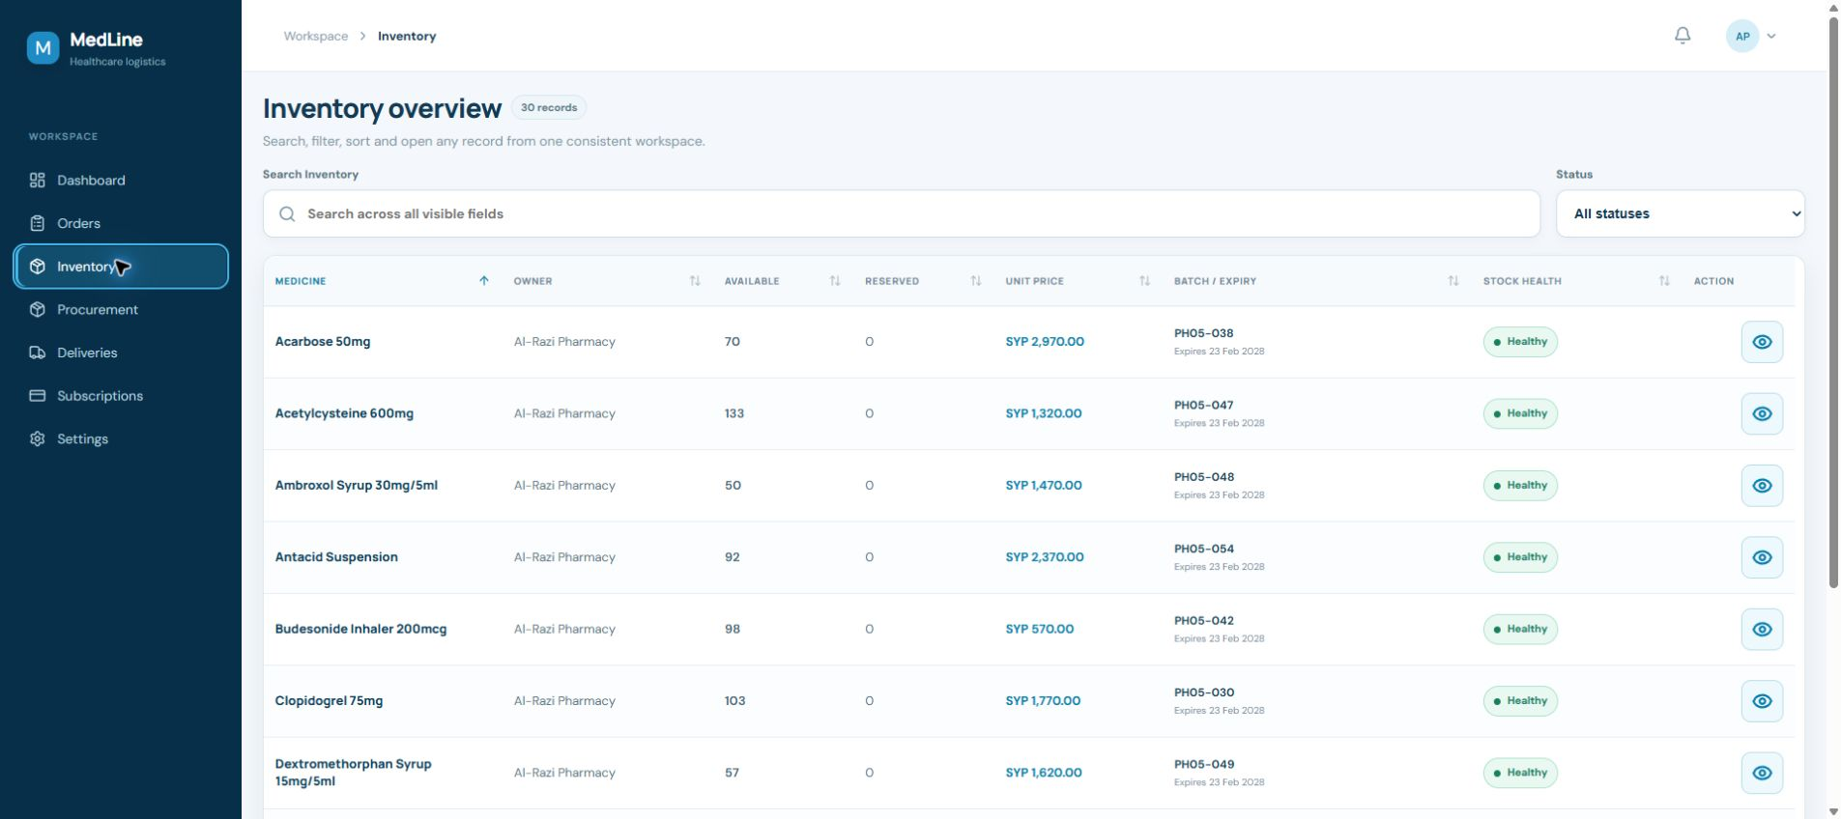
MEDLINE / UNIVERSITY COMMITTEE EDITION
SPEAKER 2 | 11:00-13:00
Stock is traceable from warehouse batch to pharmacy shelf
Procurement mirrors order consent while adding exact batch allocation.
PHARMACY
requests quantities
WAREHOUSE
allocates batches
PHARMACY
accepts partial offer
DELIVERY
moves accepted stock
Completion consumes reserved warehouse units and adds pharmacy inventory in one settlement.
07
Notes:
Speaker 2 - 11:00-13:00 (2 minutes) Show that inventory is not a single number. Pharmacy inventory exposes available and reserved quantity, price, batch/expiry information and a stock-health label. Warehouse stock is held as batches with lot number, manufacture date, expiry date, received date, storage location, quantity, reserved quantity, unit price and active state. When a pharmacy needs replenishment, it creates a multi-item procurement request against eligible warehouse stock. The warehouse allocates exact requested units across one or more batches. Full acceptance requires complete allocation. Partial fulfilment follows the same consent principle as patient orders: the pharmacy chooses whether to accept the reduced offer. When the related delivery is verified, the system consumes the warehouse reservations and creates or updates the destination pharmacy inventory inside one transaction. This makes the movement traceable rather than simply changing two totals independently. [Sources] - MedLine repository: docs/API_WORKFLOWS.md and docs/ERD.md (reviewed 24 August 2026) - Local portal capture: tmp/committee-materials/assets/pharmacy-inventory.png (captured 24 August 2026)

Slide 8
MEDLINE / UNIVERSITY COMMITTEE EDITION
SPEAKER 2 | 13:00-14:00
Statuses define who may act - and when
The PDF contains the complete dictionary; this slide shows the logic.
PATIENT ORDER
evidence -> review -> consent -> accepted
Exceptions: rejected / cancelled / completed
PROCUREMENT
warehouse review -> allocation -> consent
Exceptions: rejected / completed
DELIVERY
available -> claimed -> pickup -> transit -> arrived -> delivered
Exceptions: failed / cancelled / reassigned event
A status is not cosmetic text: it is a permission boundary and a consistency rule.
08
Notes:
Speaker 2 - 13:00-14:00 (1 minute) Do not read the full status dictionary aloud; the companion PDF contains every status and meaning. Explain the pattern instead. Patient-order state represents prescription evidence, pharmacy decision and patient consent. Procurement state represents warehouse decision, batch allocation and pharmacy consent. Delivery state represents physical possession and handoff progress. Terminal outcomes remain explicit, and recovery is never hidden. A rejected or cancelled record stays terminal. A failed delivery can return to available only through the administrator's audited reassignment action. The status determines which role may act, what prerequisites are already satisfied and which records must move together. Handoff to Speaker 3: after an order or procurement request is accepted, how does the driver see, price and securely complete the physical delivery? [Sources] - MedLine repository: docs/DOMAIN_SPECIFICATION.md and backend delivery/order/procurement controllers (reviewed 24 August 2026)

Slide 9
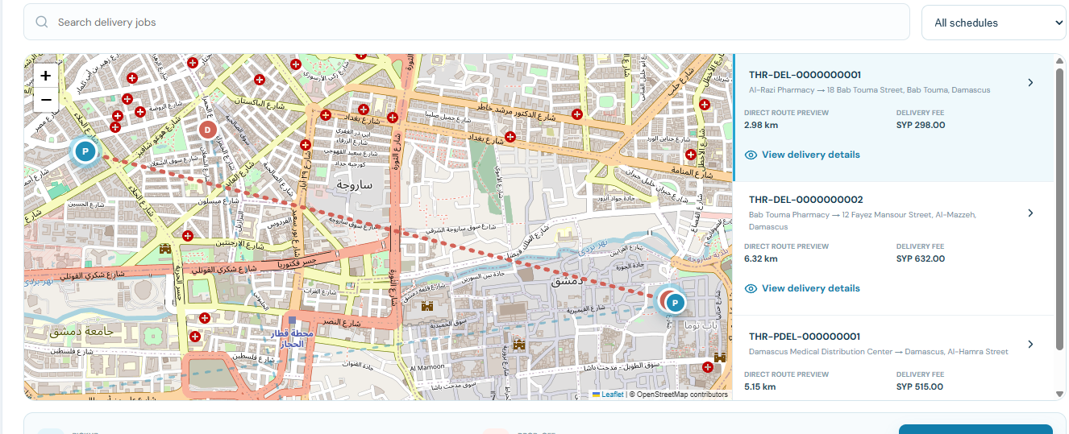
MEDLINE / UNIVERSITY COMMITTEE EDITION
SPEAKER 3 | 14:00-16:00
Drivers choose orders from the real road route
Vehicle compatibility, stored route distance and fee are visible before acceptance.
6.32 km
stored driving distance
SYP 632
route-based fee example
ONE WINNER
Acceptance is serialized under a database lock.
09
Notes:
Speaker 3 - 14:00-16:00 (2 minutes) The driver map does not use straight-line or 'air' distance. Available jobs show a stored road route between pickup and drop-off, filtered to the driver's approved vehicle type. Before accepting, the driver can inspect the medicine manifest, schedule, pickup partner, destination, recipient contact, distance, rate per kilometre and route-based fee. The route distance and applicable rate are snapshotted on the order. If an administrator changes prices later, historical deliveries keep the original calculation. When a driver accepts, the API locks the delivery and driver records. Only one eligible driver can win the same available order, and that driver becomes unavailable for another simultaneous job. The map is therefore both a decision tool and evidence for how the fee was calculated. [Sources] - MedLine repository: backend routing/pricing services and delivery controllers (reviewed 24 August 2026) - Local portal reference: codex-clipboard-3O8zkT.png (captured during MedLine development)

Slide 10
MEDLINE / UNIVERSITY COMMITTEE EDITION
SPEAKER 3 | 16:00-17:45
Pickup verification proves the driver received the medicines
The pharmacy or warehouse initiates a purpose-specific four-digit check.
PHARMACY / WAREHOUSE
DRIVER
1 Send pickup PIN
2 Receives a fresh code
A branded email is sent to the assigned driver. In demo mode, delivery is redirected to one controlled inbox.
The driver shows the code in person. The API stores only a password hash, with expiry, resend cooldown and bounded attempts.
3 Verify code after physical handoff
RESULT -> in_transit automatically
10
Notes:
Speaker 3 - 16:00-17:45 (1 minute 45 seconds) Explain the first trust boundary. After a driver claims the order, the pharmacy or warehouse controls pickup. The partner clicks Send pickup PIN. The system generates a new four-digit code, stores only its password hash, records an expiry and sends the value to the assigned driver through the notification system. Demo email redirection can send the message to one controlled inbox without changing the driver's account email. Outside the system, the partner hands over the medicines. The driver shows the received code, and the partner enters it. Attempts are bounded; codes expire and have a resend cooldown. A pickup code cannot be reused for recipient delivery. Most importantly, successful verification moves the delivery directly from pickup_started to in_transit. There is no separate driver Start delivery action. [Sources] - MedLine repository: delivery verification controller, notification classes and docs/NOTIFICATION_OPERATIONS.md (reviewed 24 August 2026)

Slide 11
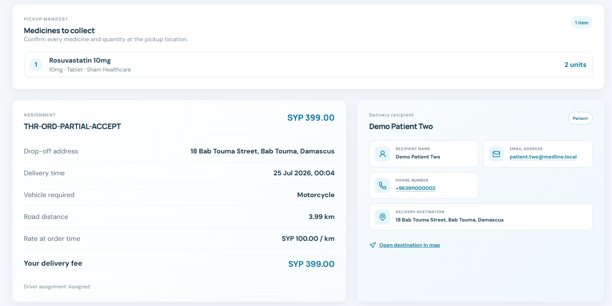
MEDLINE / UNIVERSITY COMMITTEE EDITION
SPEAKER 3 | 17:45-19:45
In transit, the driver sees exactly who and where to serve
Recipient context and the road route stay connected to the active assignment.
IN TRANSIT
Pickup already verified
MARK ARRIVED
Driver confirms destination arrival
RECIPIENT PIN
Separate code proves final handoff
Name | email | phone | delivery destination
11
Notes:
Speaker 3 - 17:45-19:45 (2 minutes) Once pickup is verified, the delivery is already in transit. The driver's detail view keeps the manifest, the pickup partner, route snapshot, road distance, rate and delivery fee together with the recipient name, email, phone number and delivery destination. This prevents the driver from switching between unrelated screens and gives enough context to complete the assignment. The driver's next progress action is Mark arrived. Arrival does not complete the delivery; it only records that the driver reached the destination. The driver then initiates a second, independent recipient PIN. That code is sent to the patient or destination pharmacy, redirected to the demo inbox during the presentation. After in-person confirmation, the driver enters the recipient's code. Successful verification settles the delivery and its parent order or procurement record consistently. [Sources] - MedLine repository: delivery detail endpoints and verification workflow (reviewed 24 August 2026) - Local portal reference: codex-clipboard-cmrFG3.png (captured during MedLine development)

Slide 12
MEDLINE / UNIVERSITY COMMITTEE EDITION
SPEAKER 3 | 19:45-21:30
The main delivery path is sequential; recovery is explicit
Every transition identifies an actor, prerequisite and recorded result.
available
claimed
pickup_started
in_transit
arrived
delivered
verified pickup starts transport automatically
FAILED
ADMIN REASSIGNMENT EVENT
Driver records a reason. Location is cleared.
Ownership/PIN state resets; stored status returns to available.
12
Notes:
Speaker 3 - 19:45-21:30 (1 minute 45 seconds) Read the main path once: available, claimed, pickup_started, in_transit, arrived and delivered. Available means no driver owns the job. Claimed means an eligible approved driver owns it. Pickup_started means a pickup code was sent and physical handoff is awaiting verification. In_transit begins automatically when pickup succeeds. Arrived means the driver reached the destination. Delivered means recipient verification and settlement completed. Exception paths remain visible. An eligible unclaimed delivery can be cancelled. A driver can mark an active job failed only with a reason; location is cleared. Reassignment is an administrator event, not a permanent status: it returns only a failed delivery to available while clearing ownership and sensitive verification state. That makes recovery deliberate and auditable. Handoff to Speaker 4: with all five roles acting on one workflow, how does administration govern the platform and how do we demonstrate every scenario safely? [Sources] - MedLine repository: current delivery controller and docs/DOMAIN_SPECIFICATION.md (reviewed 24 August 2026)

Slide 13
MEDLINE / UNIVERSITY COMMITTEE EDITION
SPEAKER 4 | 21:30-23:30
Administration combines approval, intervention and accountability
The administrator is system-wide and is not associated with any pharmacy or warehouse.
PARTNERS
SUBSCRIPTIONS
CATALOG + PRICING
applications, corrections, suspension
payment review and access windows
medicines and versioned vehicle rates
USERS
DELIVERY RECOVERY
AUDIT + SUPPORT
roles, activation and suspension
failed-job reassignment
complaints, ratings and critical actions
correction_required = recoverable review loop, not rejection
13
Notes:
Speaker 4 - 21:30-23:30 (2 minutes) The administrator sees system-wide queues and health rather than a pharmacy's own workload. Partner applications and verification documents can be approved, rejected or returned for correction. Subscription access combines payment review with an activation period, grace and expiry. The administrator manages the global medicine catalog, versioned vehicle rates, user activation, complaints, rating visibility and auditable delivery recovery. Correction_required is an important review state. It preserves the application or payment proof and tells the partner what must be fixed without forcing a new record. Suspension is separate from rejection and can be used when an already approved organization or user must temporarily lose access. The seeded administrator intentionally has no pharmacy or warehouse association. This avoids ownership ambiguity and demonstrates that governance scope comes from the admin role, not from pretending to be a partner. [Sources] - MedLine repository: backend admin routes/controllers and docs/DOMAIN_SPECIFICATION.md (reviewed 24 August 2026)

Slide 14
MEDLINE / UNIVERSITY COMMITTEE EDITION
SPEAKER 4 | 23:30-25:30
Safety comes from layered controls and consistent transactions
Security protects access; consistency protects the truth users see.
ACCESS
Sanctum | role middleware | ownership checks
MUTATION
transactions | row locks | idempotency | throttles
EVIDENCE
private storage | signed links | validation | scanner gate
HANDOFF
hashed PINs | expiry | cooldown | bounded attempts
ACCOUNTABILITY
events | audit | notifications after commit
Production still requires approved policy, HTTPS, provider secrets, retention decisions and pilot validation.
14
Notes:
Speaker 4 - 23:30-25:30 (2 minutes) Explain the layers from top to bottom. Sanctum authenticates users; role middleware and ownership checks decide which records they may access. Critical mutations use database transactions, row locks, idempotency keys, named throttles and bounded retries. Prescriptions, payment proofs, identity documents and complaint evidence stay outside public storage and use short-lived authorized access. Upload validation and a fail-closed scanner adapter provide a production integration point. The two handoff PINs are purpose-specific, stored only as hashes, expire, cool down between resends and lock after bounded failed attempts. Critical administrator decisions, downloads, pricing changes, recovery and workflow actions are audited. Notifications are dispatched after the business transaction, so provider failure cannot roll back a successful stock or order change. Be explicit about the production boundary: the implementation is security-conscious, but legal policy, approved providers, HTTPS, secrets, retention approval, release signing and pilot validation still require owners. [Sources] - MedLine repository: docs/SECURITY_OPERATIONS.md, docs/PRIVACY_AND_RETENTION.md and docs/NOTIFICATION_OPERATIONS.md (reviewed 24 August 2026)

Slide 15
MEDLINE / UNIVERSITY COMMITTEE EDITION
SPEAKER 4 | 25:30-27:30
Deterministic theater data covers every scenario
The non-production reset is destructive by design and validates its own invariants.
100
10
2 + 2
19 + 7
bilingual medicines
Damascus pharmacies
warehouses + rated drivers
orders + procurement scenarios
Recommended live path
Speaker 1
REHEARSAL RULES
00-07
role-aware dashboard
Speaker 2
- Reset before the session, never during it. - Keep services and demo inbox ready. - Pre-open one role tab per speaker. - Use slide screenshots if the network slows.
07-14
order -> inventory -> procurement
14-21:30
Speaker 3
route -> pickup -> arrival -> recipient
21:30-30
Speaker 4
admin -> audit -> seed coverage -> Q&A
15
Notes:
Speaker 4 - 25:30-27:30 (2 minutes) The theater seeder is intentionally deterministic and destructive in non-production. It deletes existing application data, creates a complete demo world and verifies consistency before finishing. The current dataset includes exactly one hundred bilingual medicines, ten approved/subscribed Damascus pharmacies - including Central Pharmacy on Al-Hamra Street - two warehouses with batch stock, two approved drivers with ratings, two patients and an administrator who is not associated with any partner. It includes nineteen patient-order scenarios and seven procurement scenarios spanning all current statuses, plus deliveries, subscriptions, working hours, prescriptions, notifications, complaints, ratings, inventory movements and audit records. Two pre-staged verification scenarios use code 2468; newly initiated codes are freshly generated and emailed. Reset and verify before the committee session, never during it. Keep the services and demo inbox ready, pre-open one signed-in tab per role and use the slide screenshots if the network or emulator becomes slow. [Sources] - MedLine repository: backend/database/seeders/DatabaseSeeder.php and scripts/medline.ps1 (reviewed 24 August 2026)

Slide 16
MEDLINE / UNIVERSITY COMMITTEE EDITION
SPEAKER 4 | 27:30-30:00
MedLine turns a complex journey into one controlled workflow
Close with the synthesis, then invite questions without exceeding thirty minutes.
5
2
1
0
role-specific experiences
secure physical handoffs
authoritative API
manual start-delivery steps
The interface explains. The API enforces. The event history proves.
Secure | auditable | bilingual | route-aware | consistent
Questions?
Speaker 1: problem / architecture | Speaker 2: fulfilment | Speaker 3: delivery | Speaker 4: governance
16
Notes:
Speaker 4 - 27:30-30:00 (2 minutes 30 seconds, including questions) Close in four sentences. First: the patient sees real pharmacies, prescription-aware ordering, transparent route pricing and tracked fulfilment. Second: pharmacies and warehouses see bounded decisions, traceable stock and subscription-controlled access. Third: drivers see compatible jobs, real road routes, recipient context and two secure proofs of physical handoff. Fourth: administrators see approvals, recovery, pricing history, complaints, moderation and audit. Then state the synthesis: MedLine is not a collection of disconnected screens. It is one server-controlled workflow whose web and mobile experiences remain consistent because every important transition is validated and recorded by the API. Verified pickup starts in-transit automatically, so the driver's next action is simply Mark arrived. Invite questions. Direct architecture questions to Speaker 1, patient/pharmacy/warehouse questions to Speaker 2, route and PIN questions to Speaker 3, and administration/security/readiness questions to Speaker 4. Keep the total session at thirty minutes. [Sources] - MedLine repository and local implementation baseline reviewed 24 August 2026 - MedLine Committee Solution Guide, sections 1-30

