Slide 1


Programming 3

Slide 2
Crash Course - Plan
April – Topics/Exercises
May – Review/Exams
June – Weaknesses

Slide 3
Things to consider from the start – Self Development
Rule book
Splitting up the topics
Using external resources for having a bigger picture
Primary source:
Prof. Script
LearnCPP Website: Learn C++ – Skill up with our free tutorials (learncpp.com)
Udemy Course, most of you already know about it ☺
Power of Chat GPT (Learning Techniques)

Slide 4
Breaking down the chapters
Pointers
Classes and objects
Inheritance
Polymorphism
Overloading Operators
STL
Templates
Functors/Binders

Slide 5
Breaking down the past exam (Disclaimer)
Question 1 – Acting like a complier
Question 2 – Using your cheat sheet
Question 3/4/5/ – Real Programming
There is a cheap way but not fully recommended :P

Slide 6
Question 1
To get fluent:
Minimum Info:
Classes and Objects
Inheritance
Polymorphism
Sometimes (STL) but not complicated comparatively

Slide 7
Question 2
How to optimize your cheat sheet its maximum potential
Draft 1 – Find all the keywords from the script (Recommended – Split all the big topics in different notebooks on your IPAD/Paper Based Notebook)
Draft 2 – After looking over all the past exams, find the common questions asked by the Prof. And replace that with draft 1
Draft 3 – You will notice over the period of time, some concepts would get very easy to remember, because you would be using it in real life programming questions (So Remove those extra Info.)
Final Draft – Make sure to put all the past exam questions especially the theory on your cheat sheet.

Slide 8
Question 3/4/5
Start reading other peoples code
Weekly Exercises
First try your best, then use Chat GPT
(Don’t Forget to document your progress, what you achieved and what Chat GPT did)

Slide 9
3 three W’s
What is the meaning of .....
Why do we need .....
What are the variations in the area of ..... (How can it be used in different cases)

Slide 10
Pointers
What is the meaning of Pointers
Why do we need Pointers
What are the variations in the area of Pointers (How can be used in different cases)

Slide 11
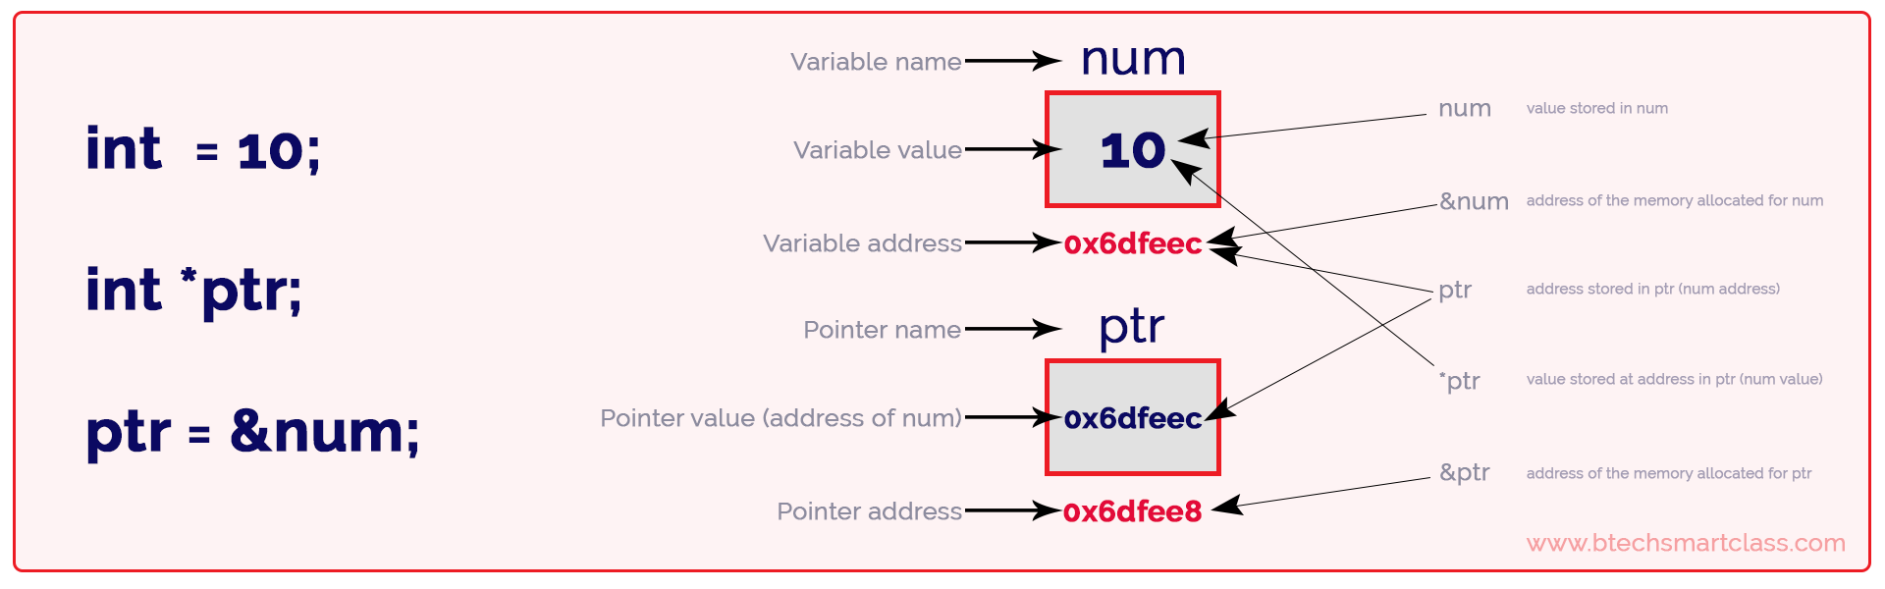
What is a Pointer
Pointers simply represents a variable that stores another variable’s address (That's all)

Slide 12
Why do we need Pointers
Memory Management: Pointers give programmers direct access to memory.
Dynamic Data Structures: Pointers are essential for creating complex data structures like linked lists, trees, graphs, and more.
Function Arguments and Return Types: Pointers allow functions to modify the value of arguments passed to them, enabling the function to return multiple values.
Efficiency and Performance: Pointers can lead to more efficient programs.

Slide 13
Time for the IDE

Slide 14
Power of Chat GPT (Learning Techniques) – Going beyond Scope
Show me a simple example how ..... Are used in C++
Show me 10 different example where .... are used in different ways
Show me a few limitations the concepts of .... bring along using Code examples in C++

Slide 15
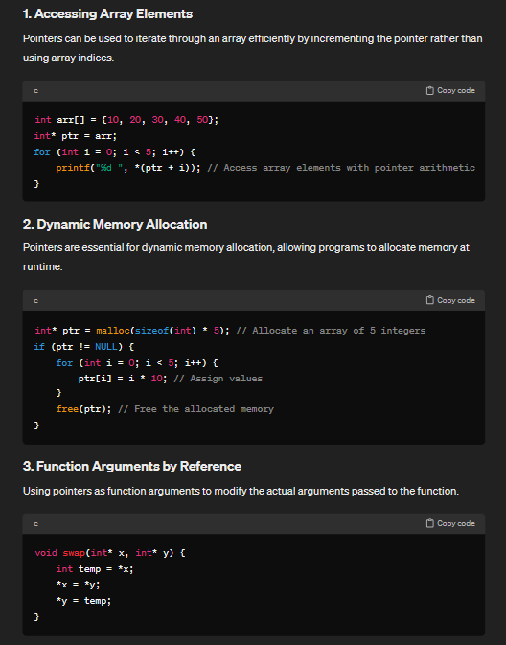
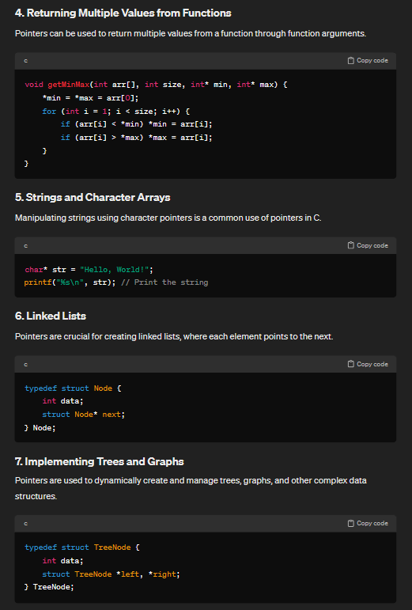

Slide 16
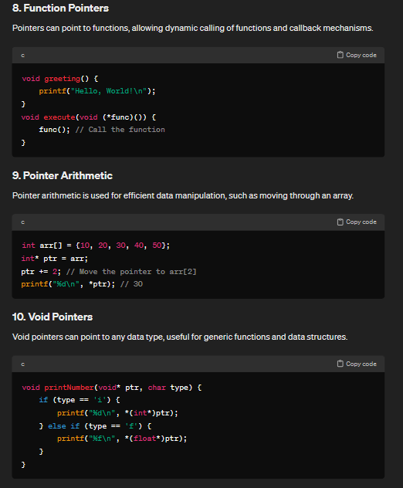

Slide 17
Homework
Go over Prof. Script and the pointer chapter of Udemy
Mark down all the things that were confusing, Don’t worry if you get the concepts straightway (To solve any problem, first step is to find where is the problem)
Find in all the past papers, where do you see the pointers been used (Just those lines)
Don’t worry if you don’t understand everything – Its just getting started ☺

Slide 18

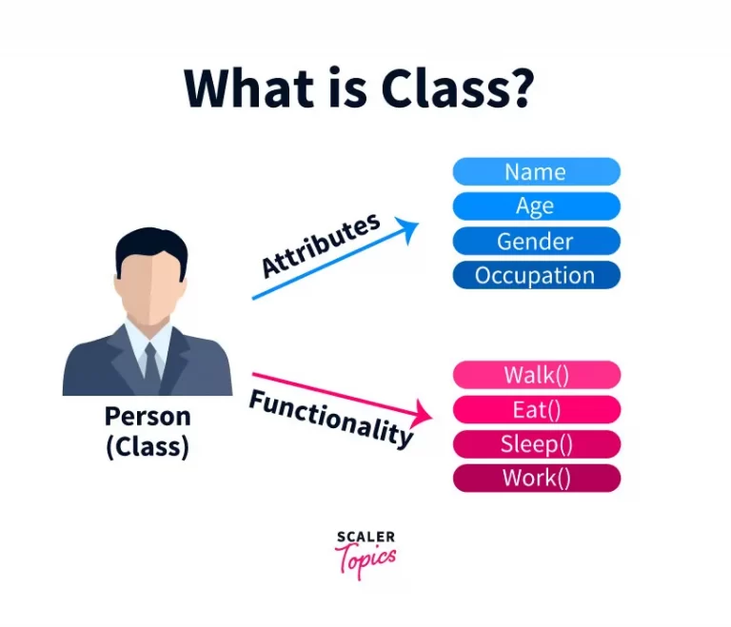

Day 2 – Classes and Objects

Slide 19
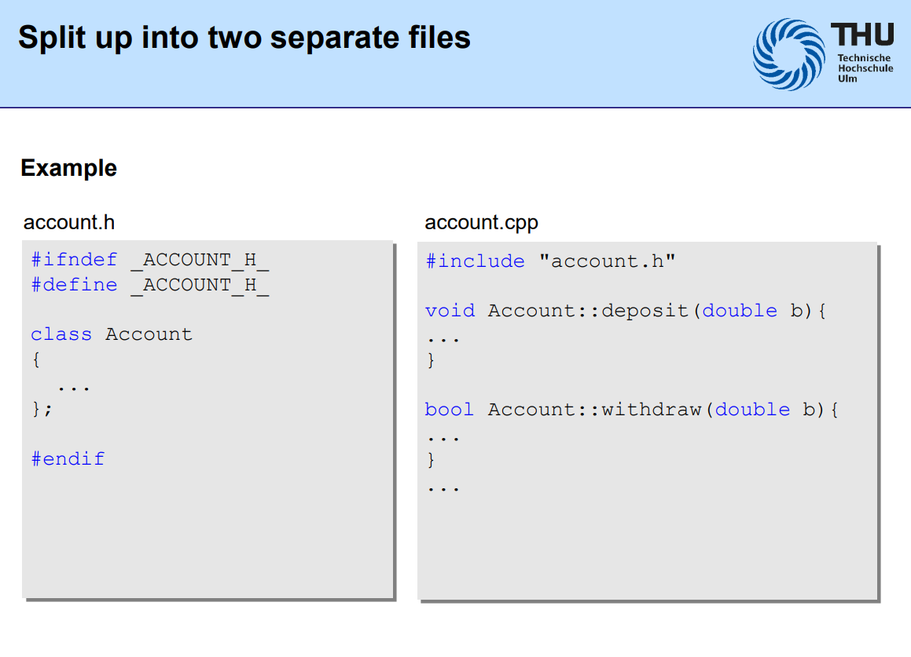

Slide 20
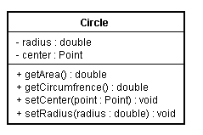
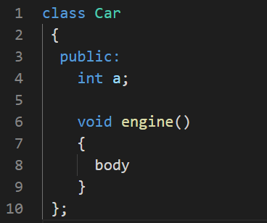
What is a class
In C++, a user-defined class is a way for programmers to create their own data types

Slide 21
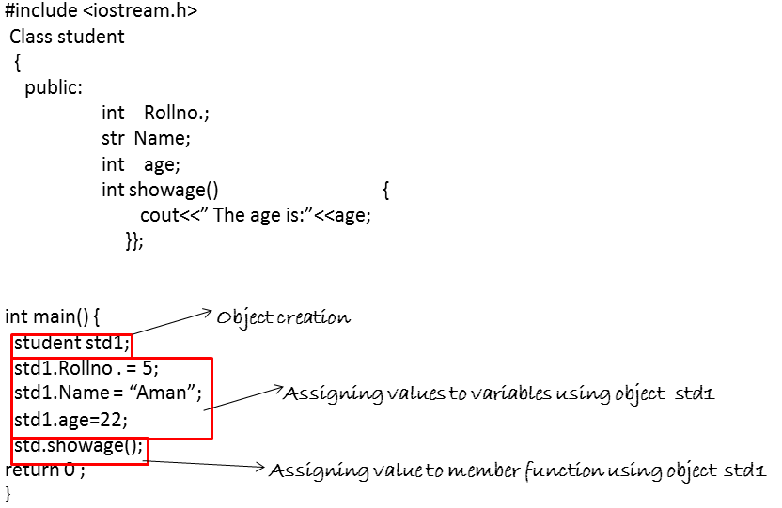
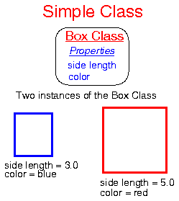
What is an Object and why do we need it

Slide 22
More Types of Constructors
Default
User Defined
Copy

Slide 23
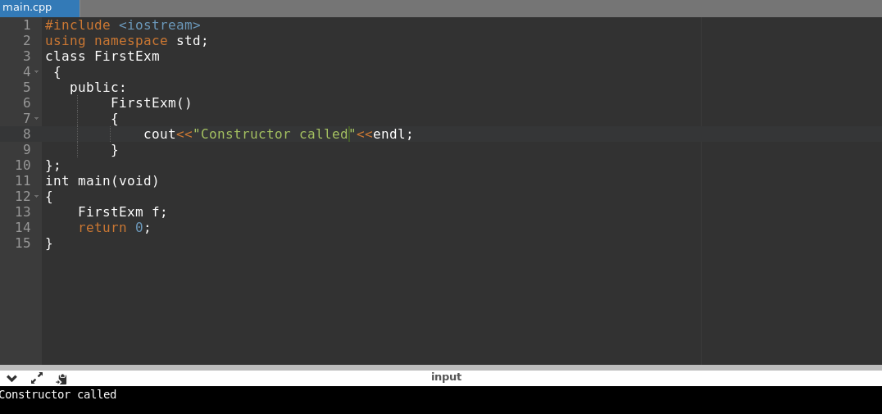
Constructor

Slide 24
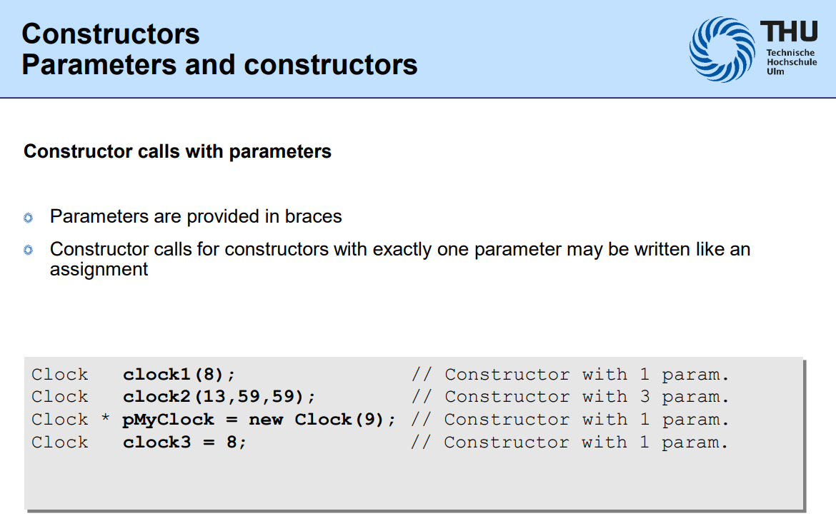

Slide 25
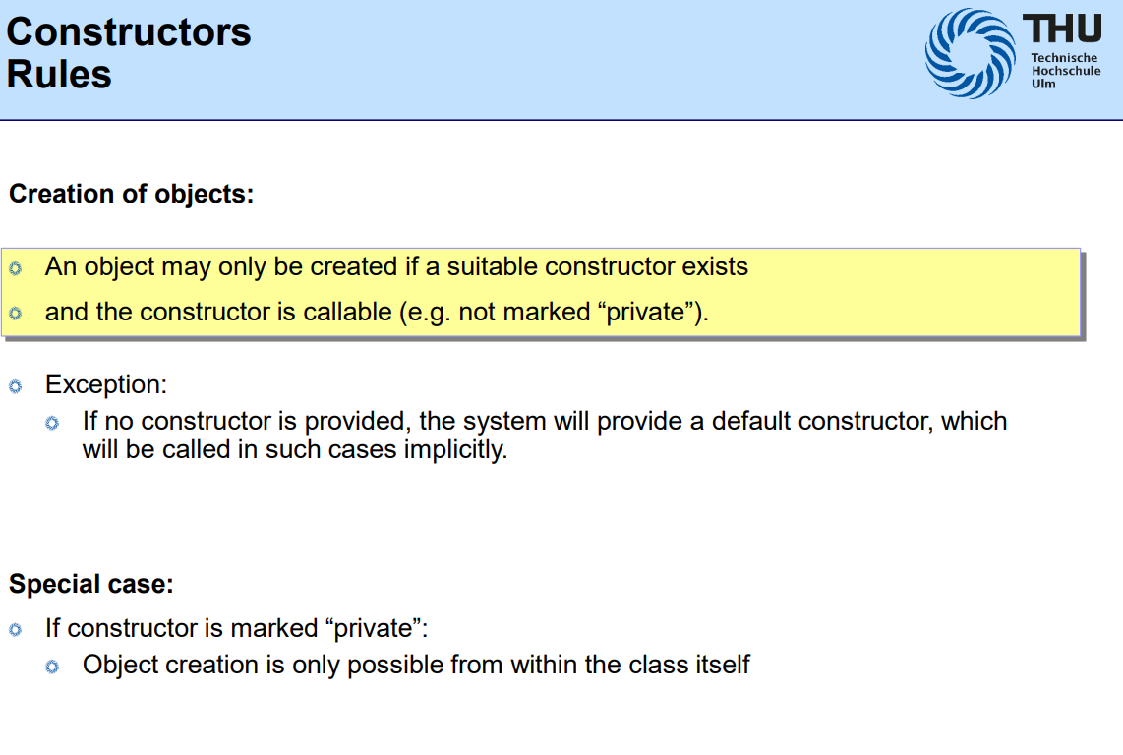

Slide 26
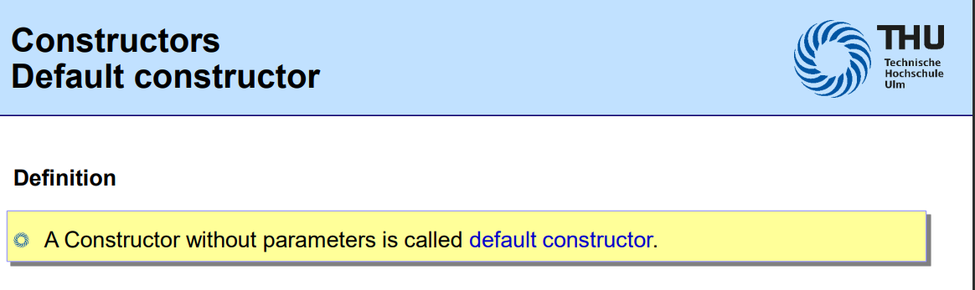

Slide 27
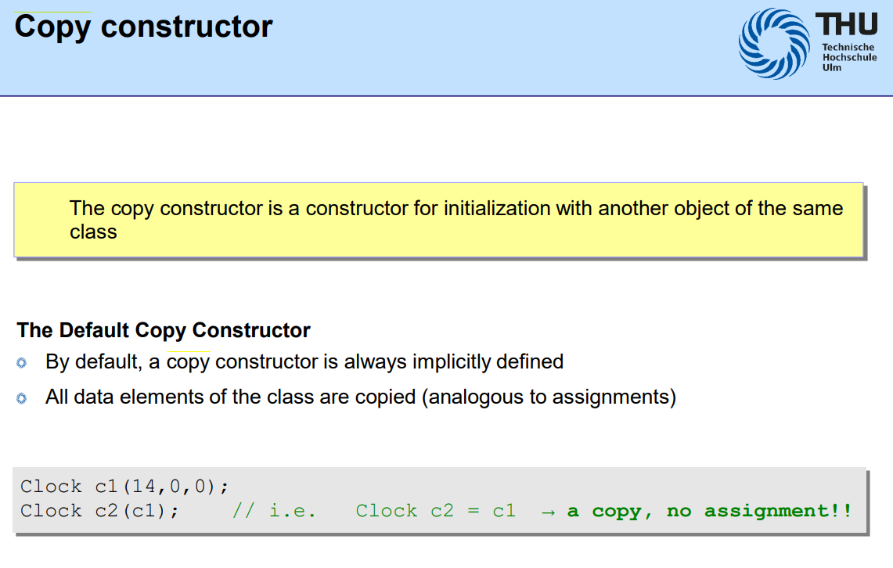

Slide 28
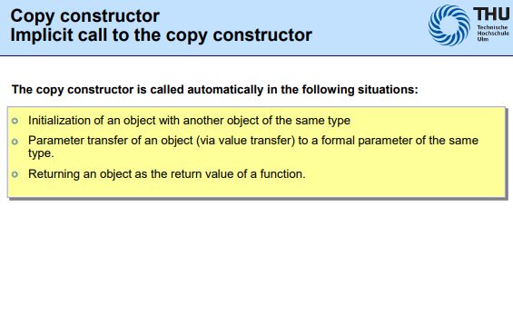

Slide 29
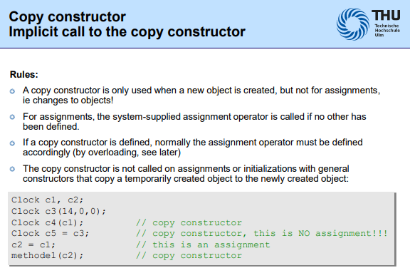

Slide 30
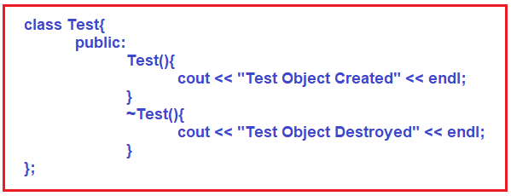
Destructor

Slide 31
Iinheritance

Slide 32
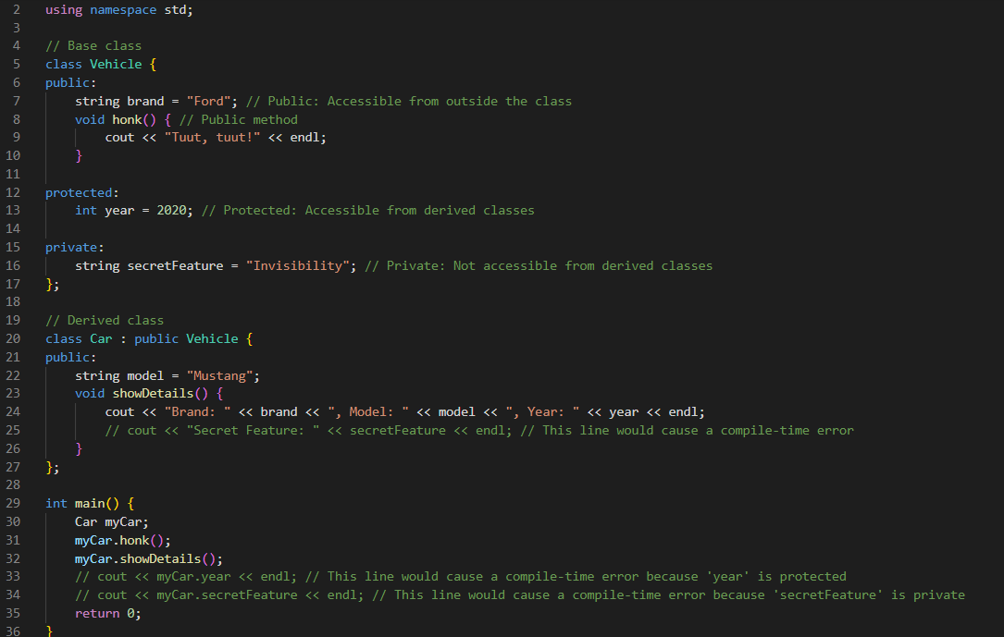

Slide 33
What we have achieved so far Exam Time

Slide 34


Polymorphism

Slide 35
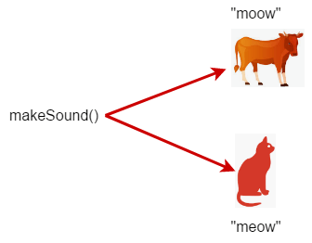

Slide 36
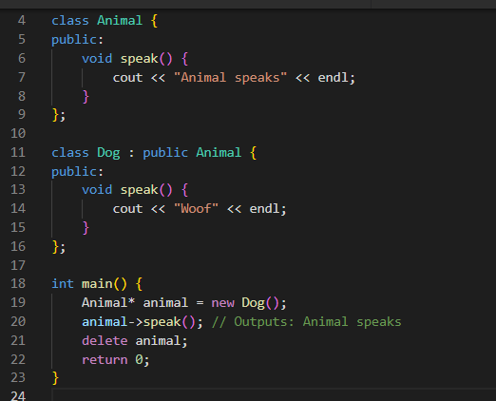

Slide 37
Virtual Keyword – In Action

Slide 38
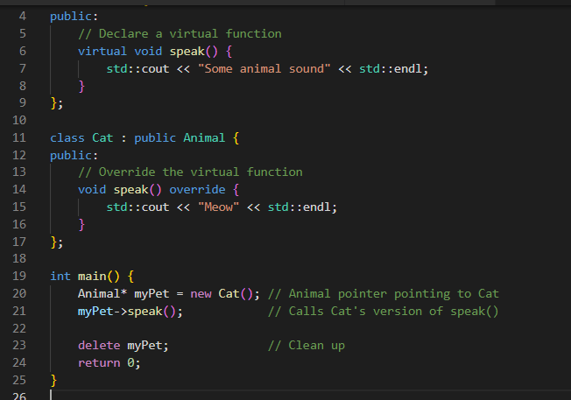

Slide 39
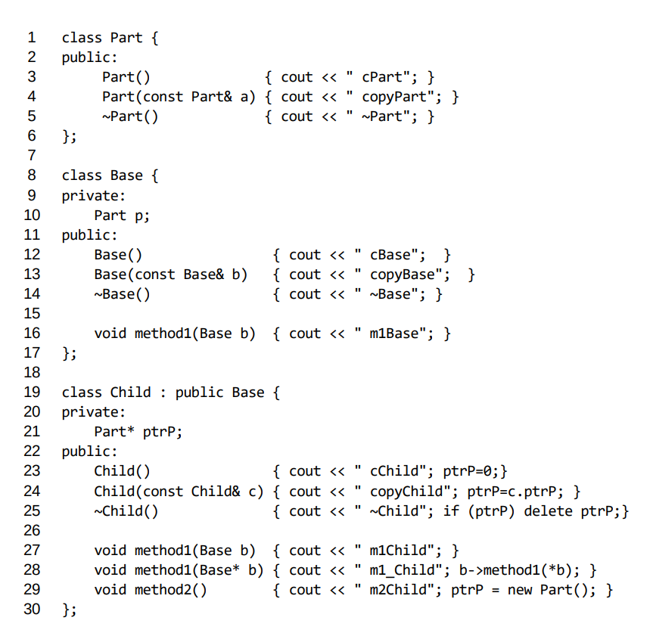















Slide 40
Time for the IDE

Slide 41

DAY 3

Slide 42
Revision + In depth

Slide 43
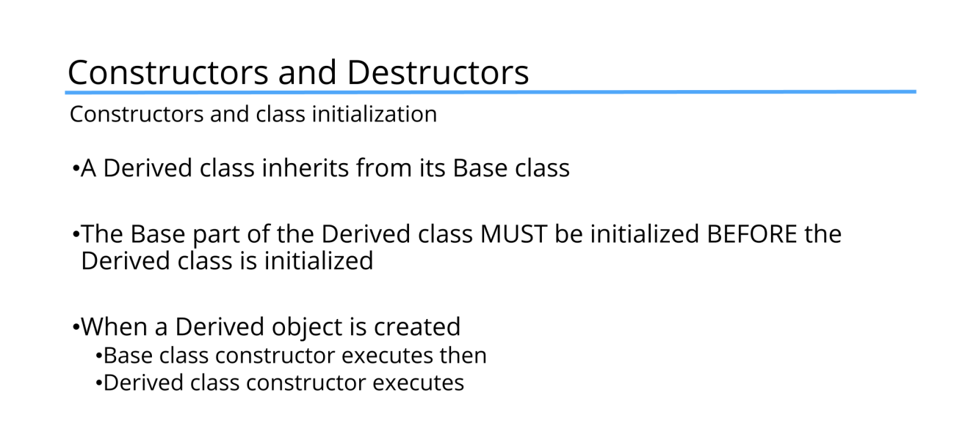

Slide 44
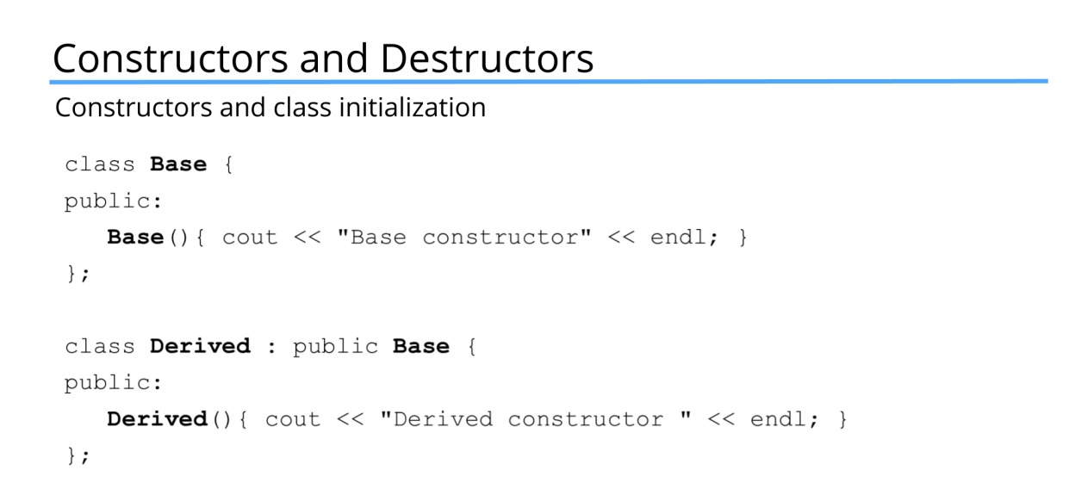
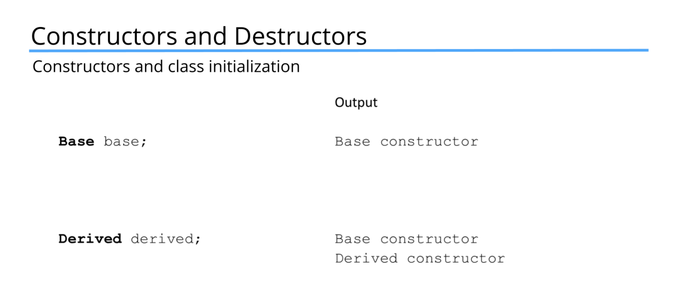

Slide 45
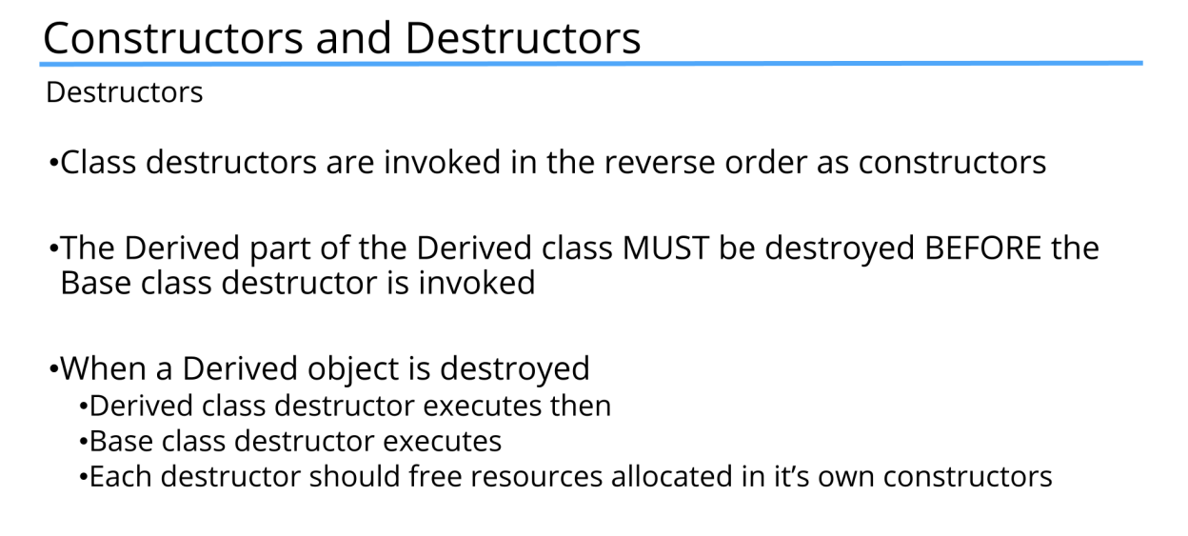

Slide 46
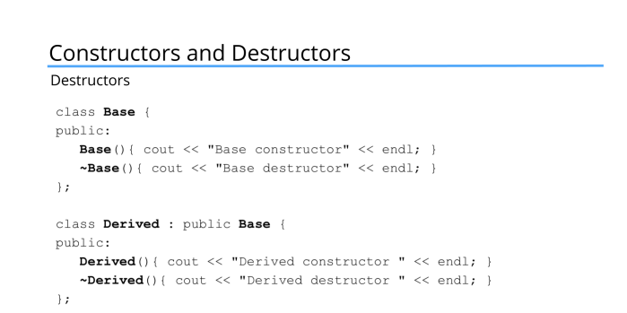
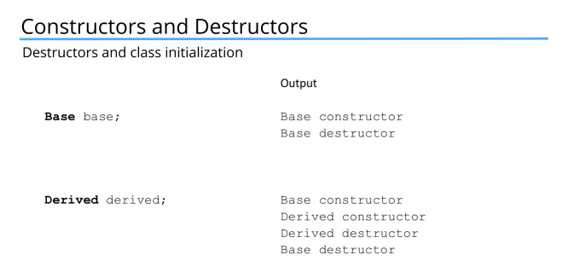

Slide 47
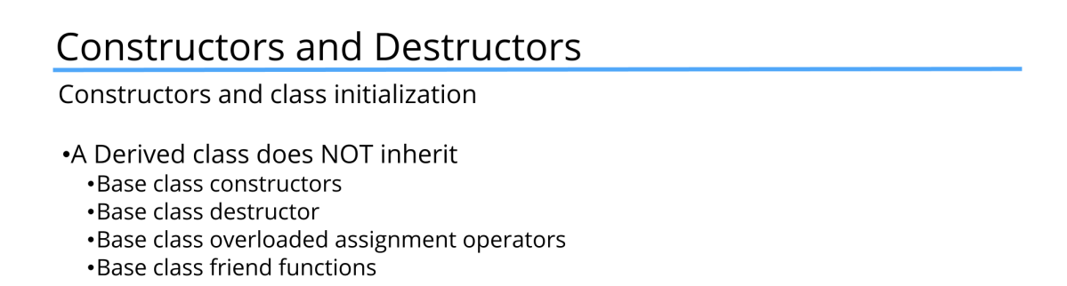

Slide 48
Quick (Virtual Function Revision) - IDE

Slide 49
Shallow COpy
In a shallow copy, the copying process copies the values of the data as they are, including any pointers. This means if the original object had pointers pointing to dynamically allocated memory, the copy will have pointers pointing to the same memory address. This can lead to issues such as double frees or dangling pointers when one of the objects is destroyed and deallocates the memory that the other object's pointer still refers to.

Slide 50
IDE

Slide 51
Deep Copy
A deep copy, on the other hand, not only copies the values of the data but also duplicates anything that is pointed to by the pointers in the object. This means if the original object had pointers to dynamically allocated memory, the copy will create its own separate copy of that memory. Each object will thus manage its own dynamically allocated memory, preventing the issues that arise with shallow copies

Slide 52
IDE

Slide 53
Overloading Operators

Slide 54
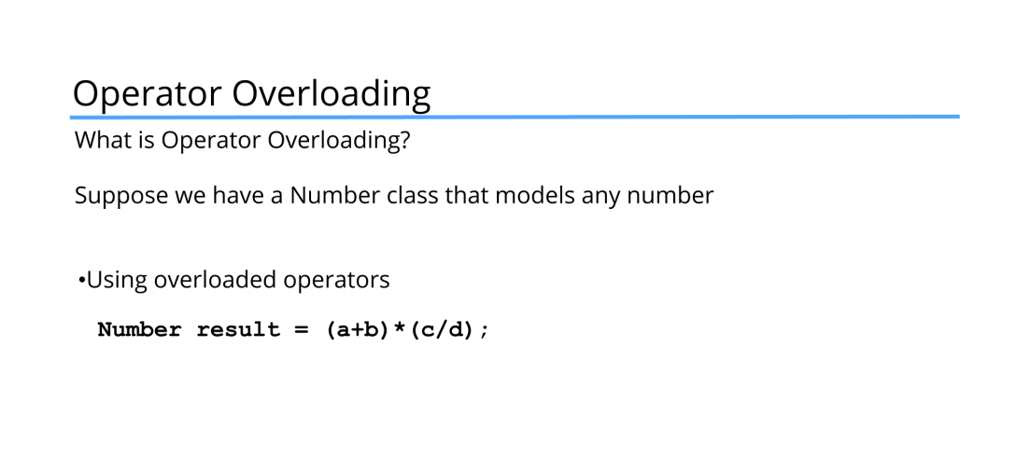

Slide 55
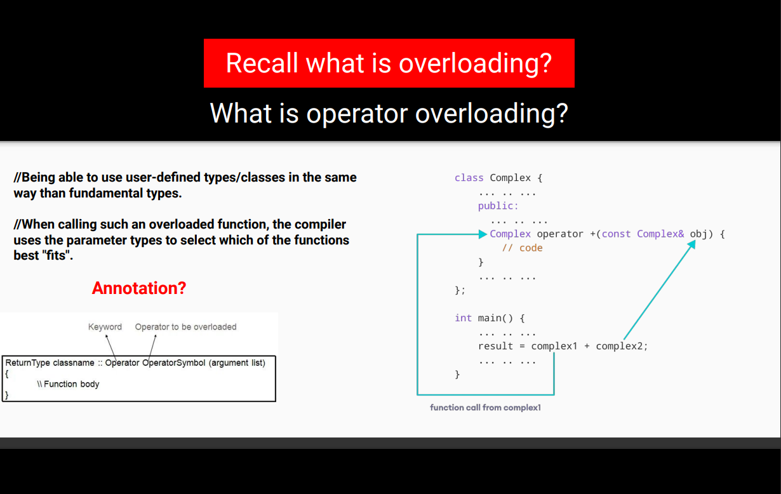

Slide 56
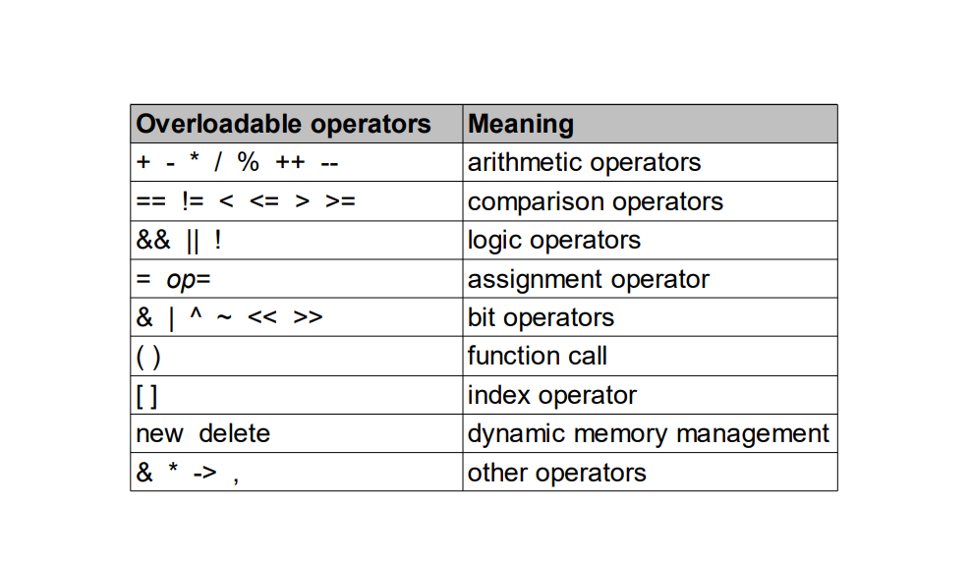

Slide 57
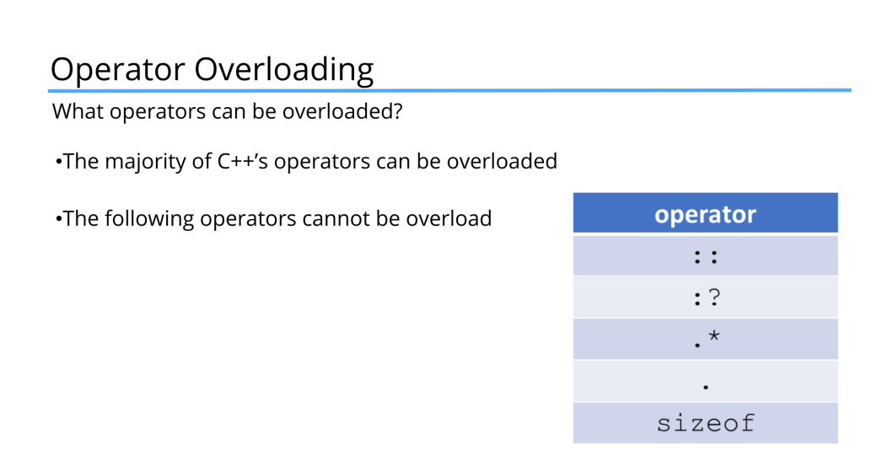

Slide 58
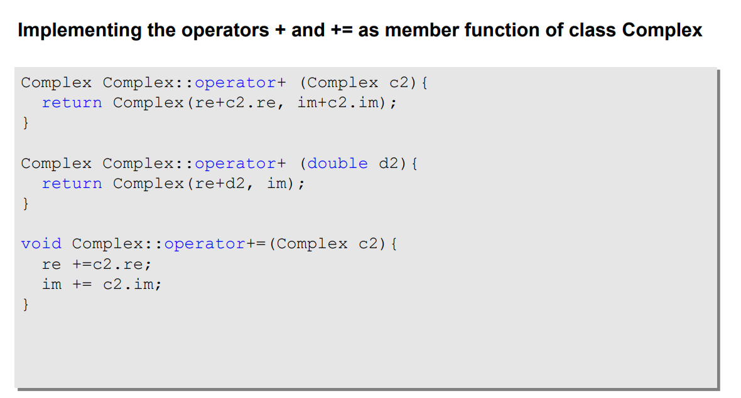

Slide 59
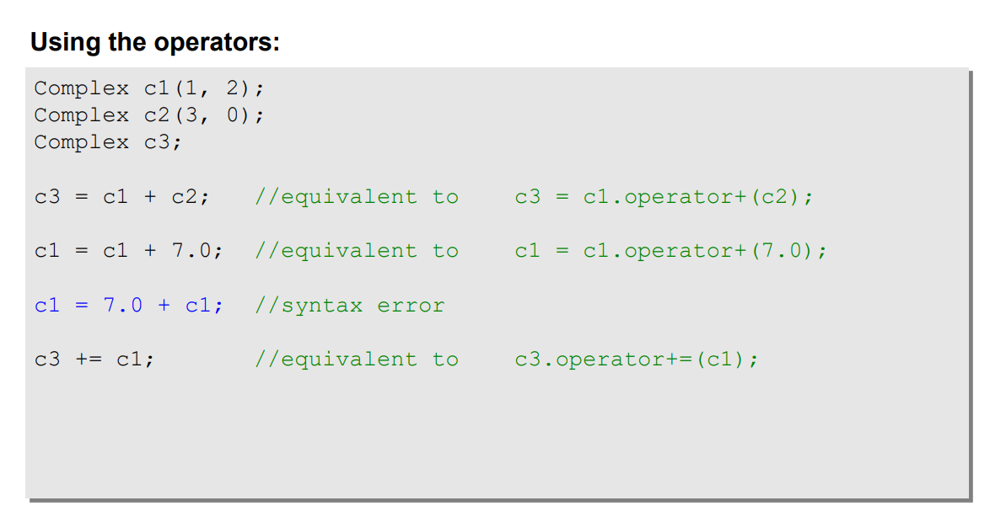

Slide 60
IDE

Slide 61
IDE

Slide 62
STL

Slide 63
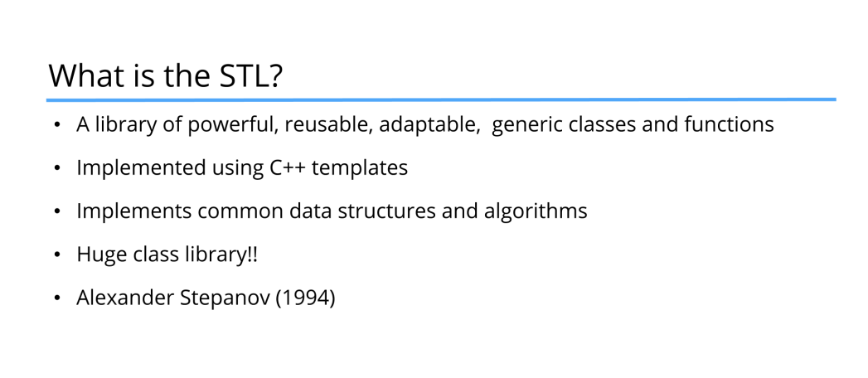

Slide 64
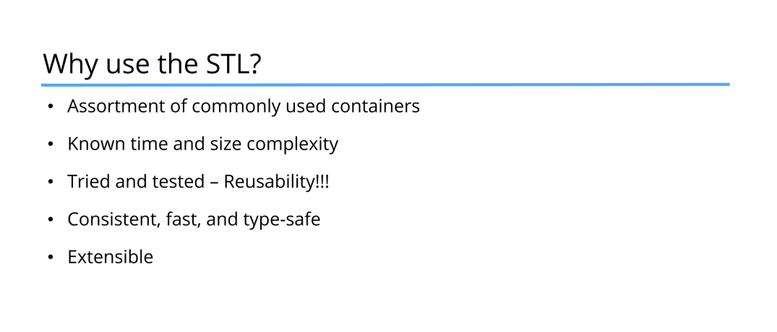

Slide 65
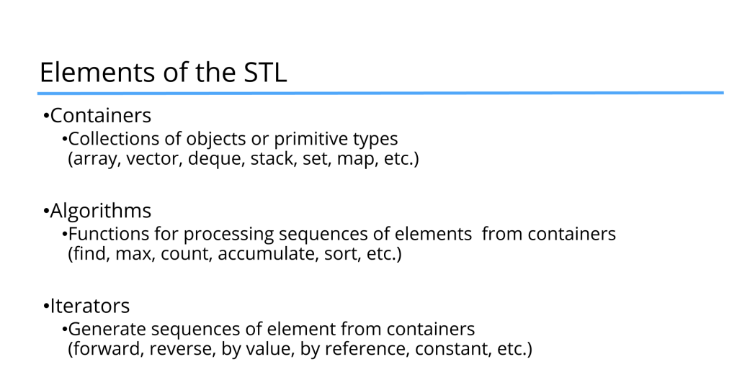

Slide 66
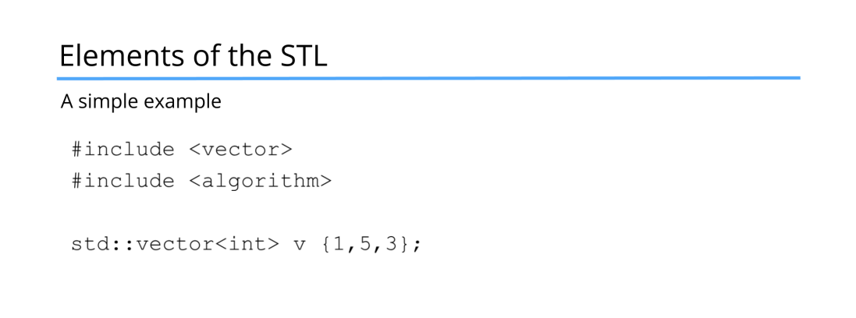

Slide 67
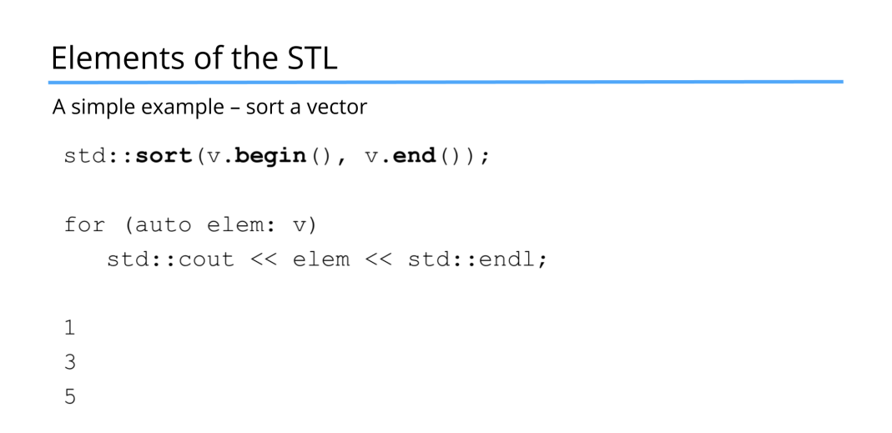

Slide 68
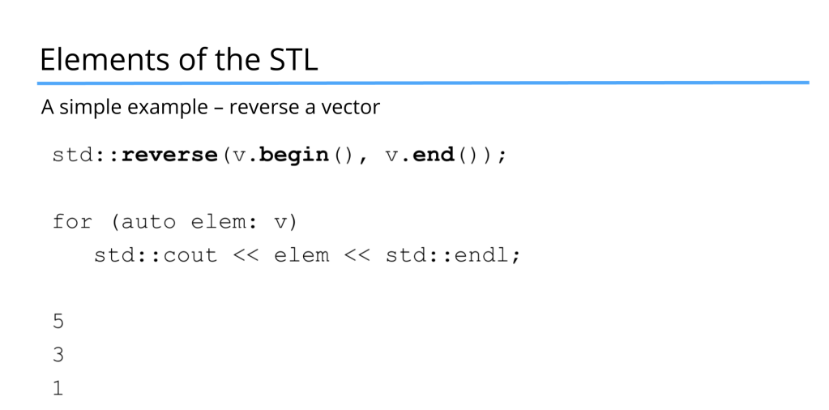

Slide 69
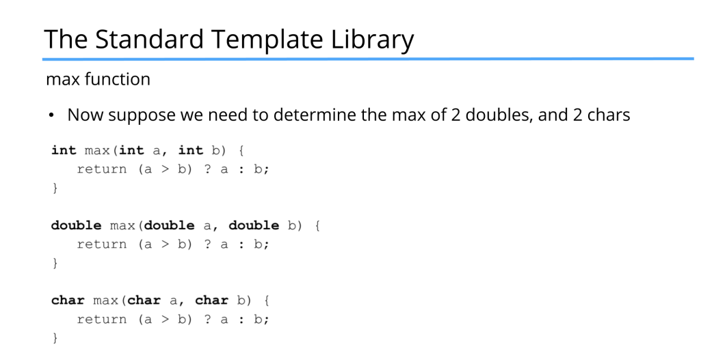

Slide 70
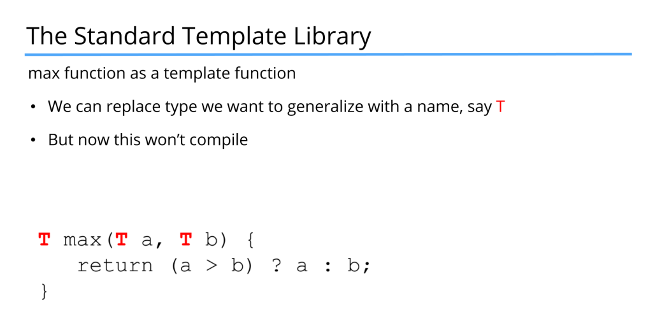

Slide 71
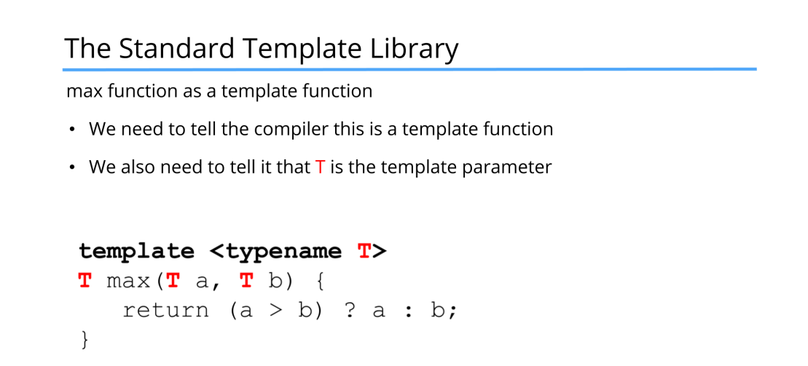

Slide 72
IDE

Slide 73
Day 4

Slide 74
Further Topics
Inheritance
Polymorphism
Overloading Operators
Summary – With Code
Test Yourself

Slide 75
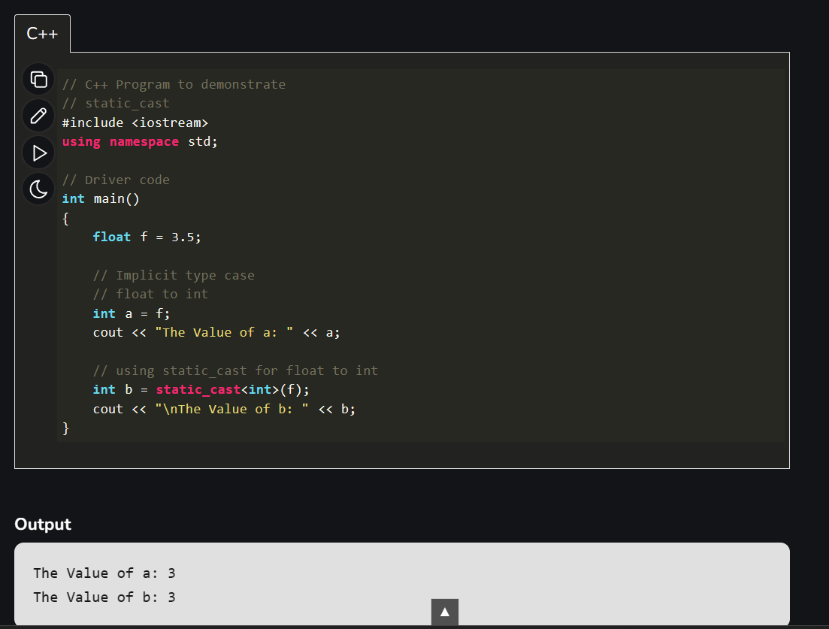

Static cast
Compile-time cast
Handles implicit conversions between types (e.g., int to float, pointer to void*)
Calls explicit conversion functions when necessary

Slide 76
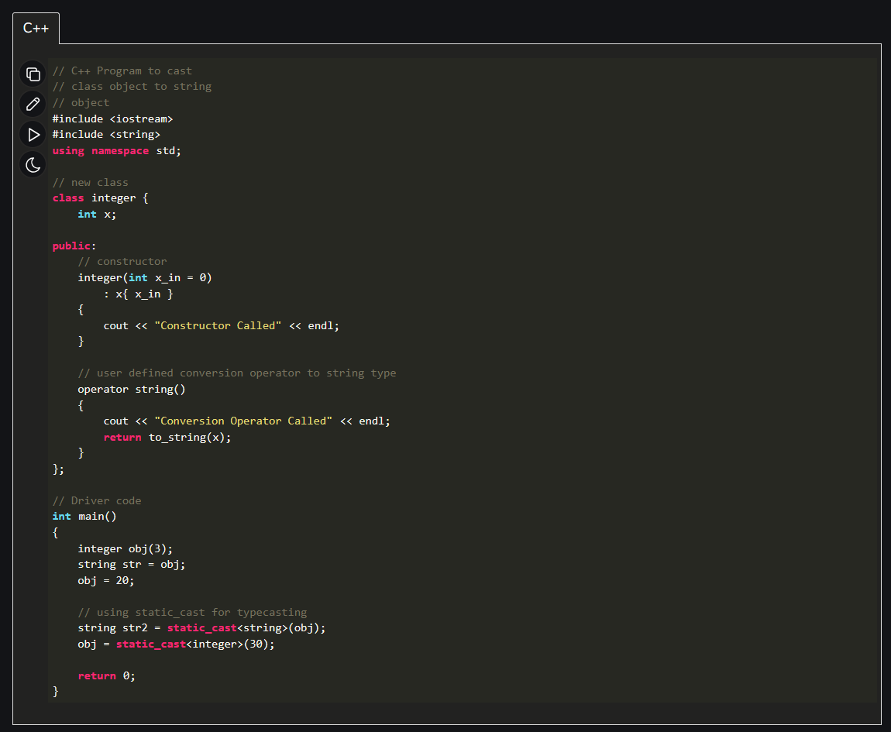

Slide 77
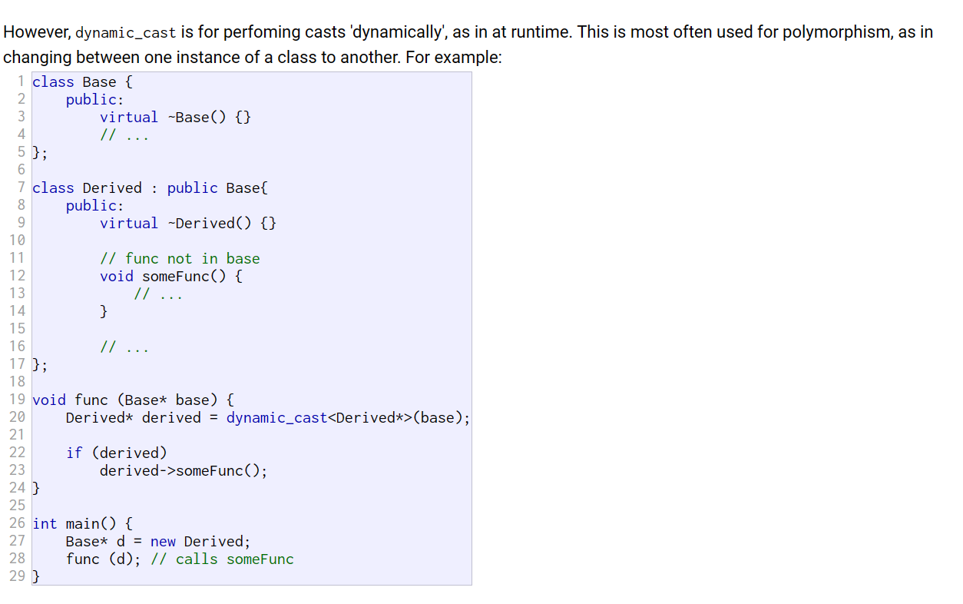
Dynamic Cast

Slide 78
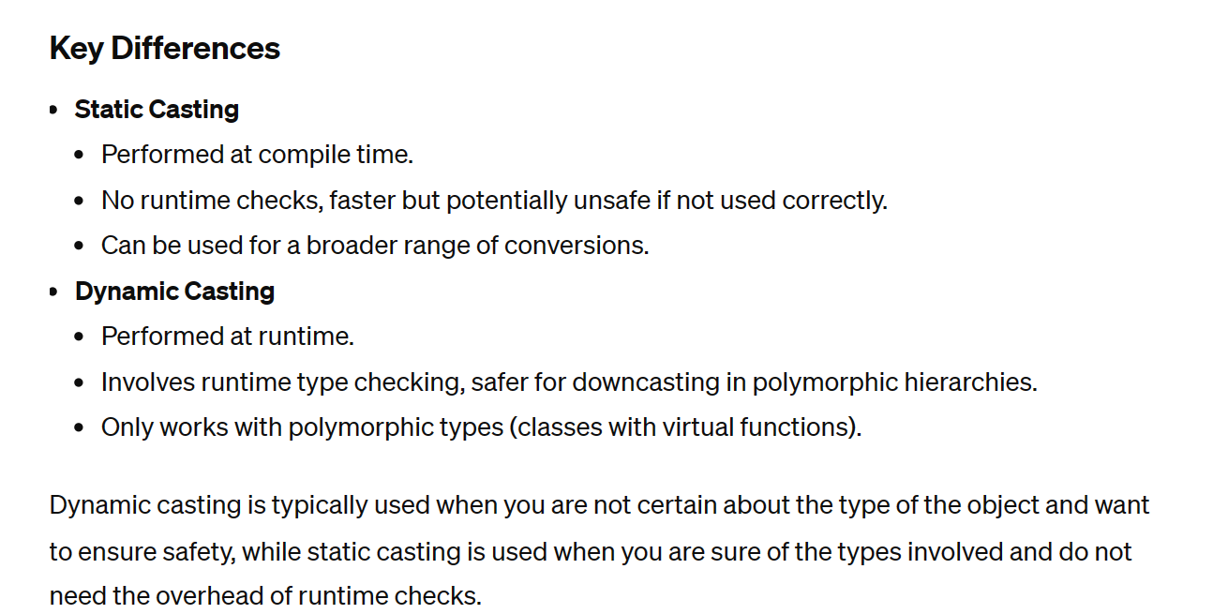

Slide 79
IDE – Casting

Slide 80
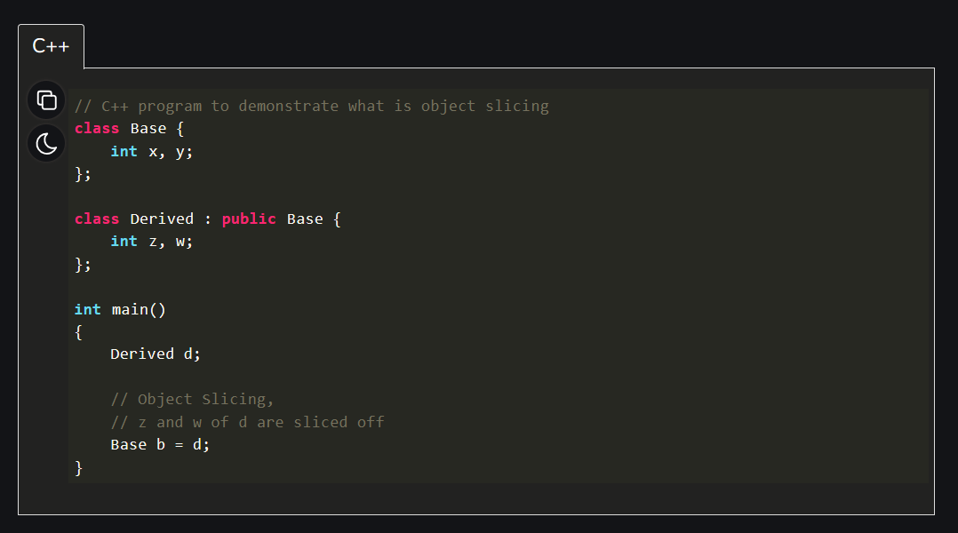
Object Slicing
Object Slicing in C++ - GeeksforGeeks

Slide 81

Rule of 3

Slide 82

Friend Class and Function in C++

Slide 83


Slide 84
IDE – Friend Function

Slide 85
IDE (Rule of 3) + Vectors

Slide 86
Assignment 6

