Slide 1


Bachelor Thesis AI-Based Face Recognition on the STM32N6570-DK Platform
Aqeel, Muazzam Bin

Slide 2


Agenda
Motivation and Goals
STM32N6570-DKBoard
System Overview
Software Pipeline: Face Detection and Recognition
Graphical User Interface
Power-Saving Sleep Mode
Cryptography and Secure Storage
Results
Future Improvements

Slide 3
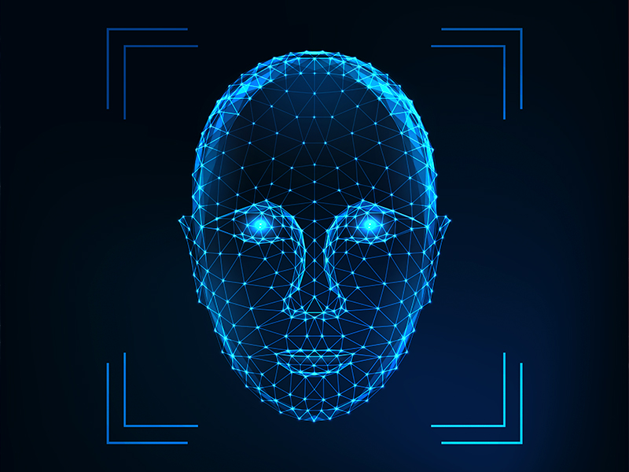
Motivation and Goals
Artificial-Intelligence based Face Recognition
Prior thesis – Mr. Ijiehon
Raspberry Pi M.2 HAT+ with Hailo-8L Based AI Accelerator
Low-power embedded system
GUI Based Application with Two-Step Authentication
Power Saving Mode
Cryptographic Encryption
Multi-User Management
External Flash Management and Automation
Debug and Performance Monitoring
Modular Code Architecture

Slide 4
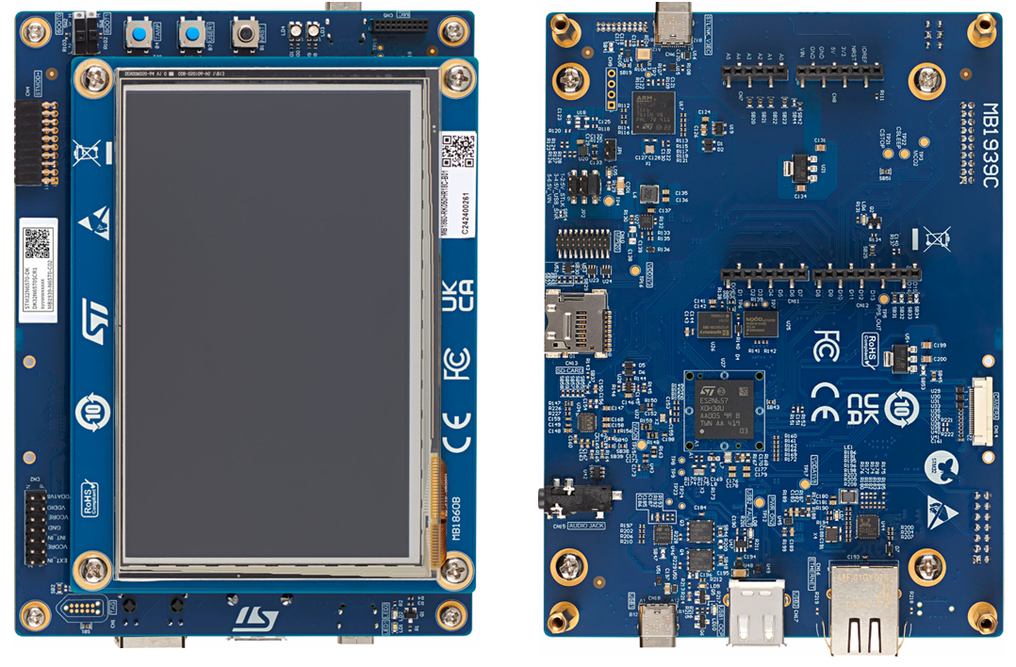
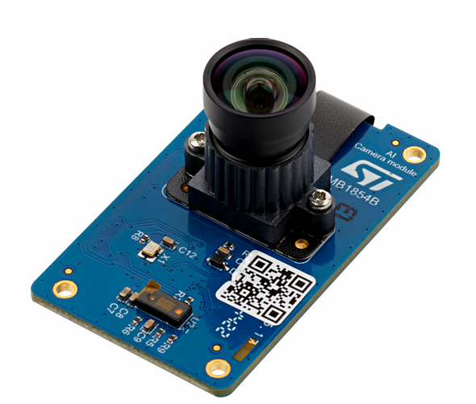
STM32N6570-DKBoard
Arm Cortex-M55 processor
ST Neural-ART Accelerator
B-CAMS-IMX Camera
1 Gbit Octo-SPI Flash memory (125 MB)

Slide 5
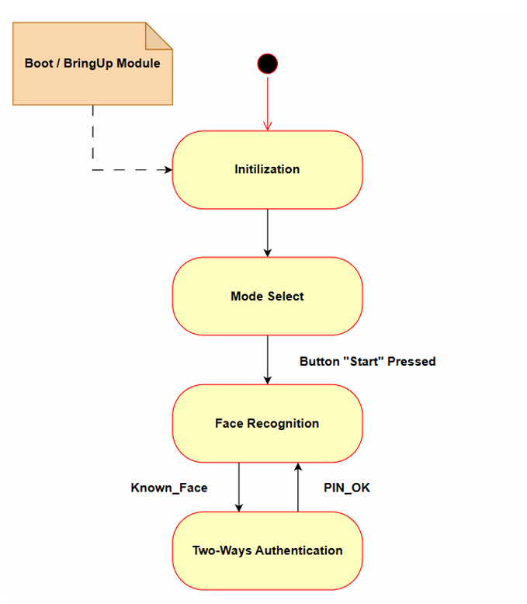
System Overview

Slide 6
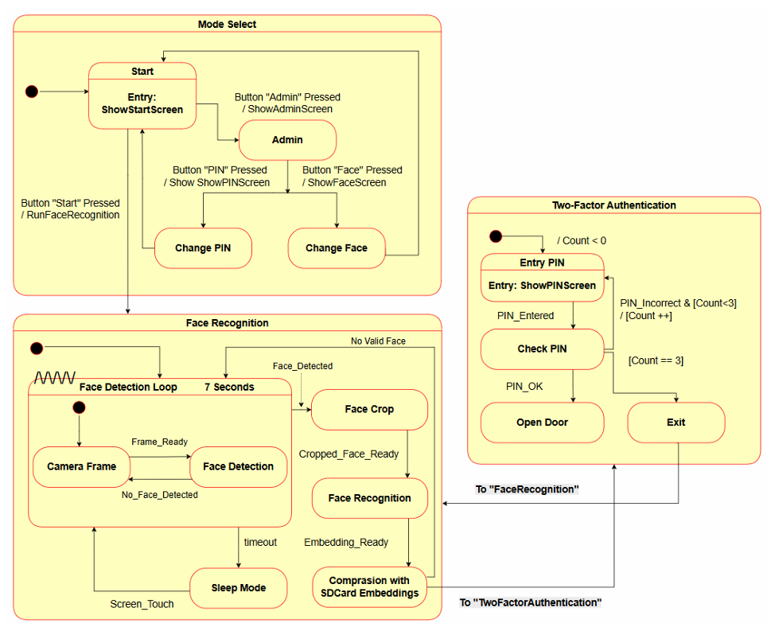

Slide 7
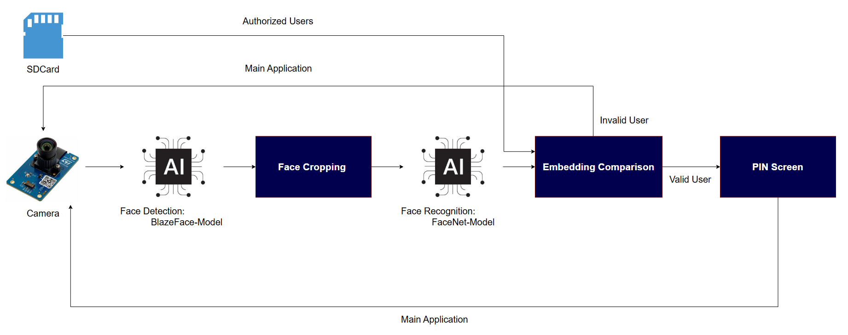
Software Pipeline: Face Detection and Recognition

Slide 8
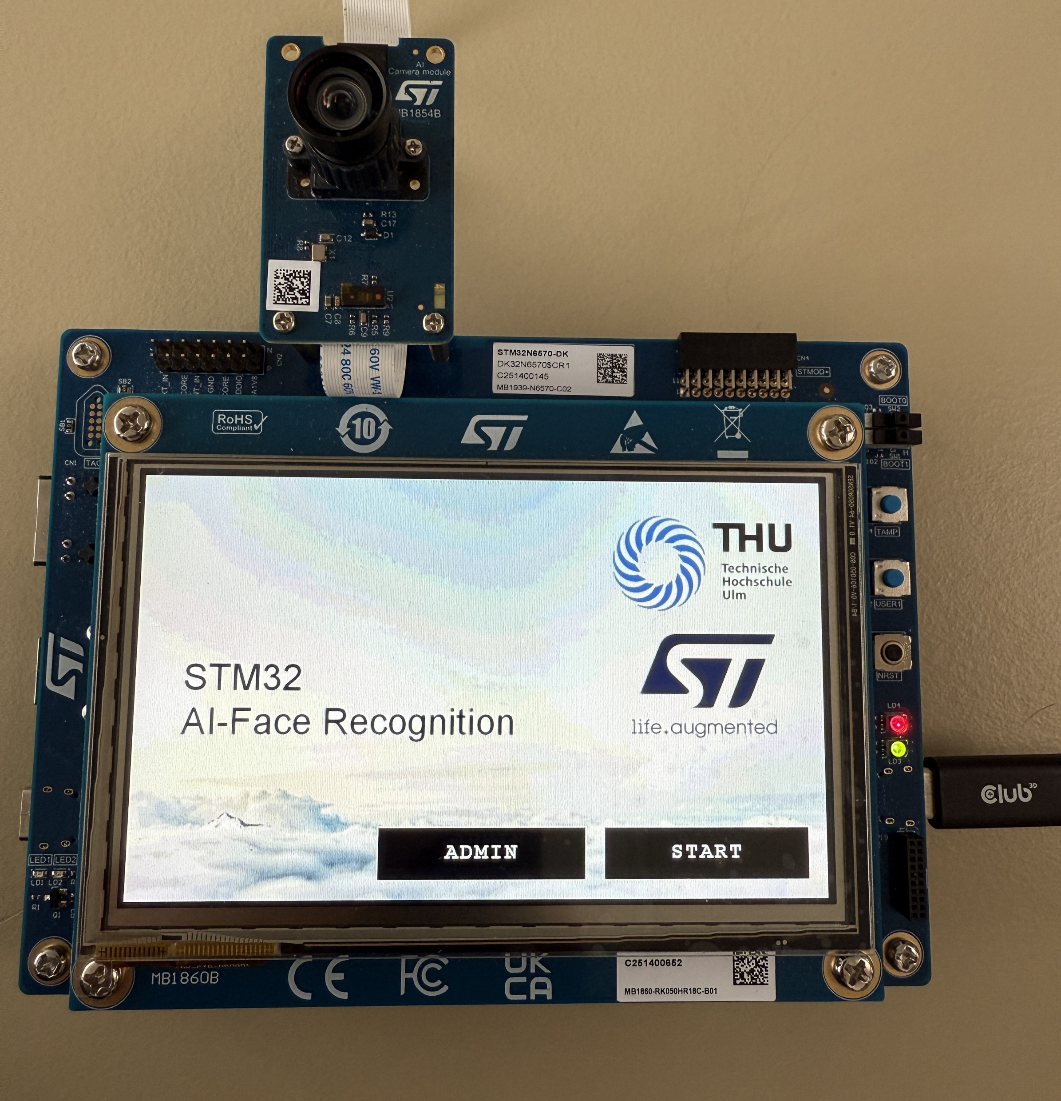
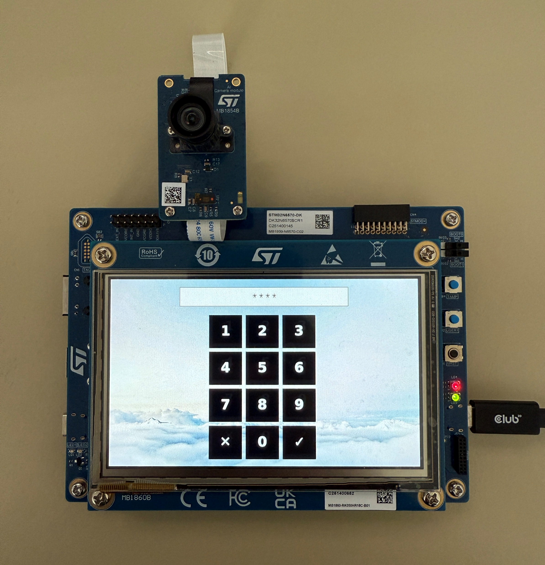
Graphical User Interface

Slide 9
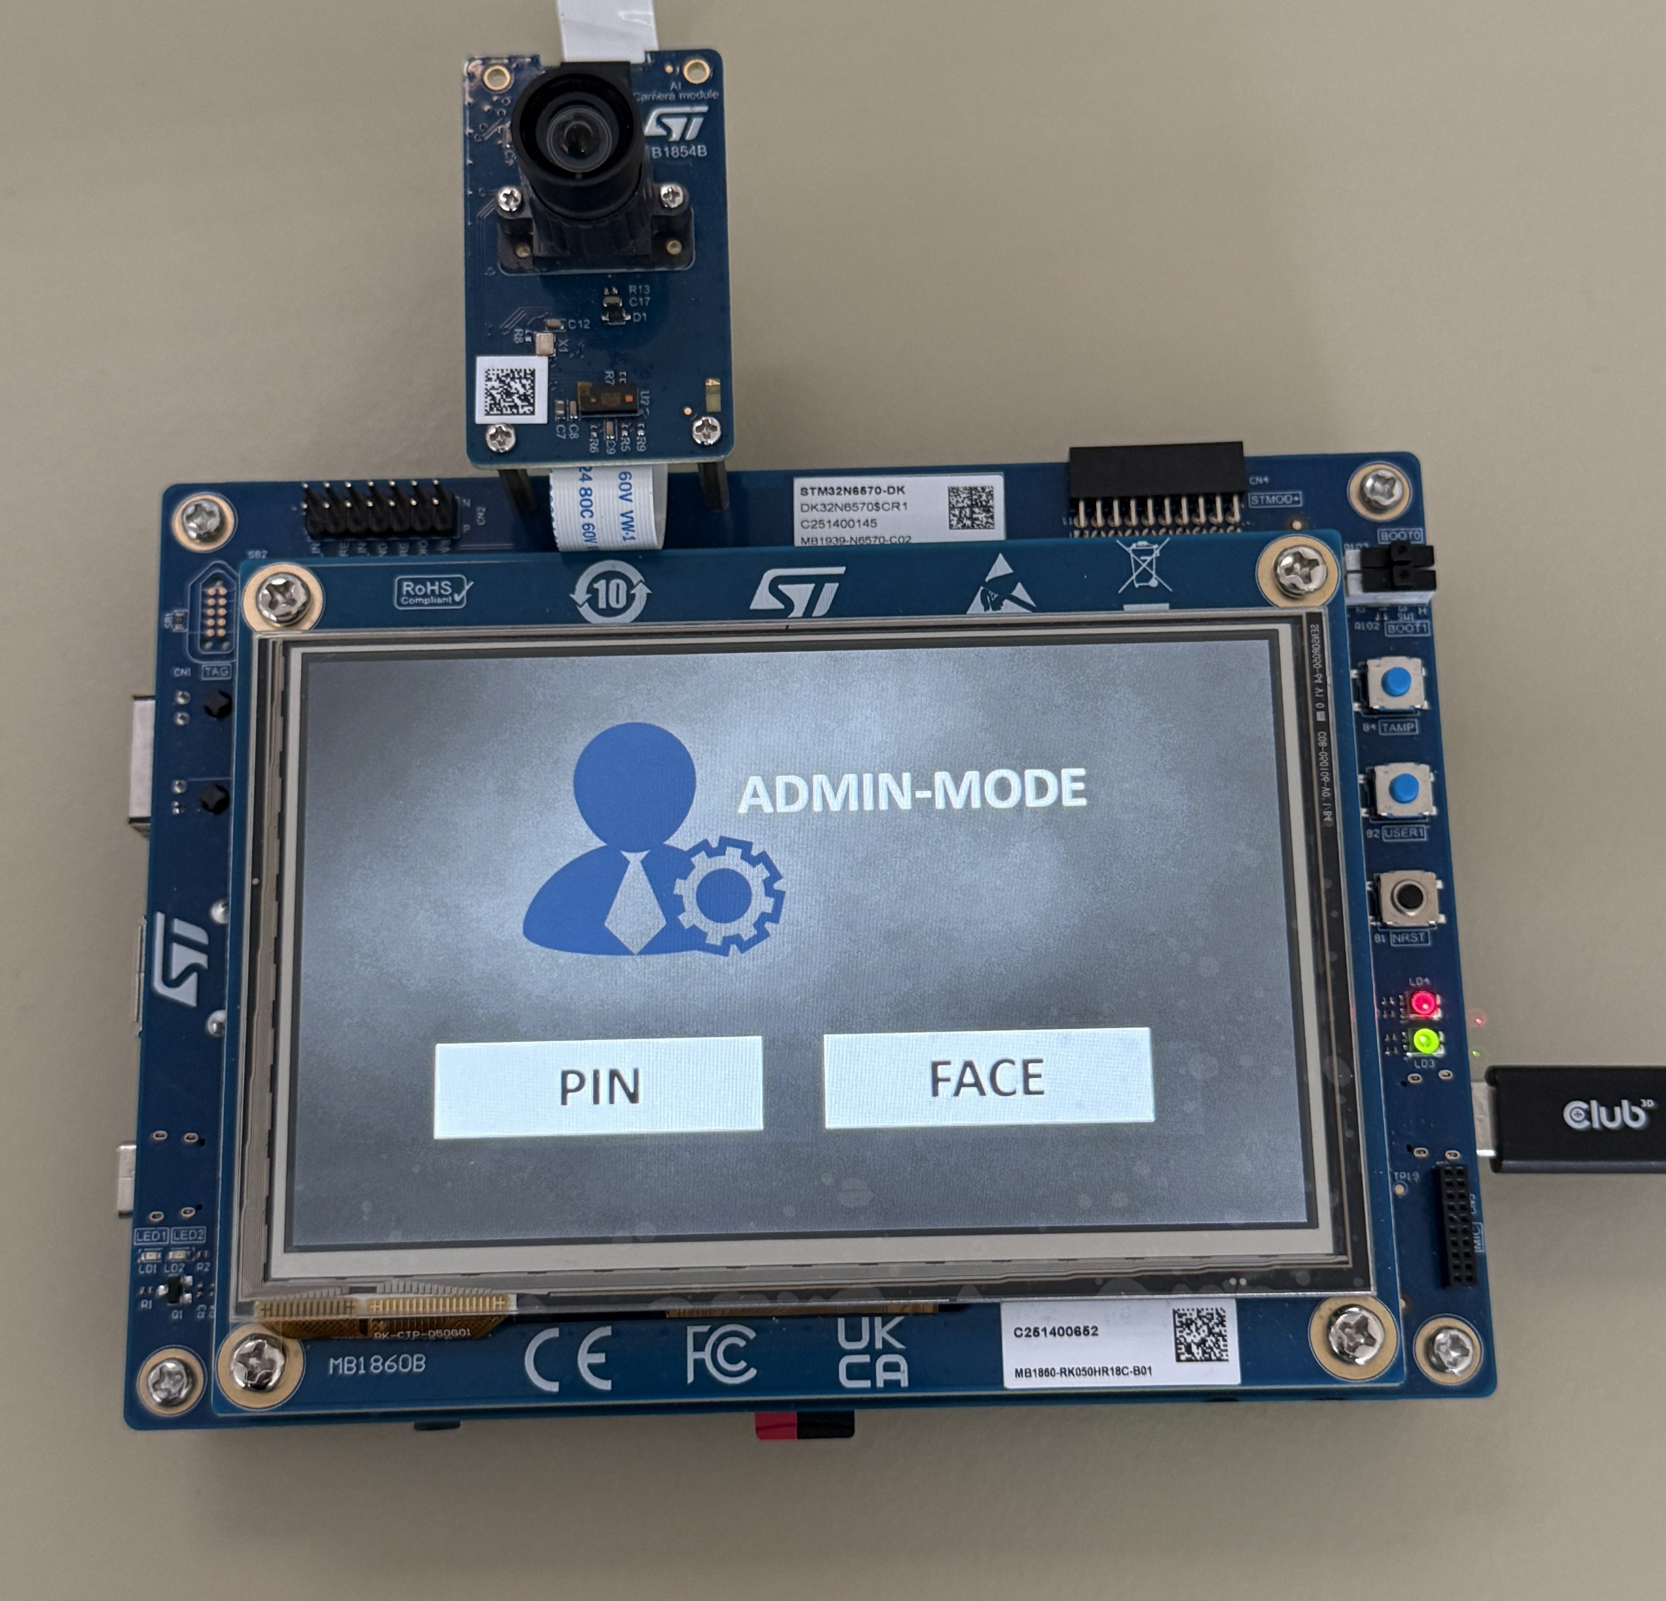
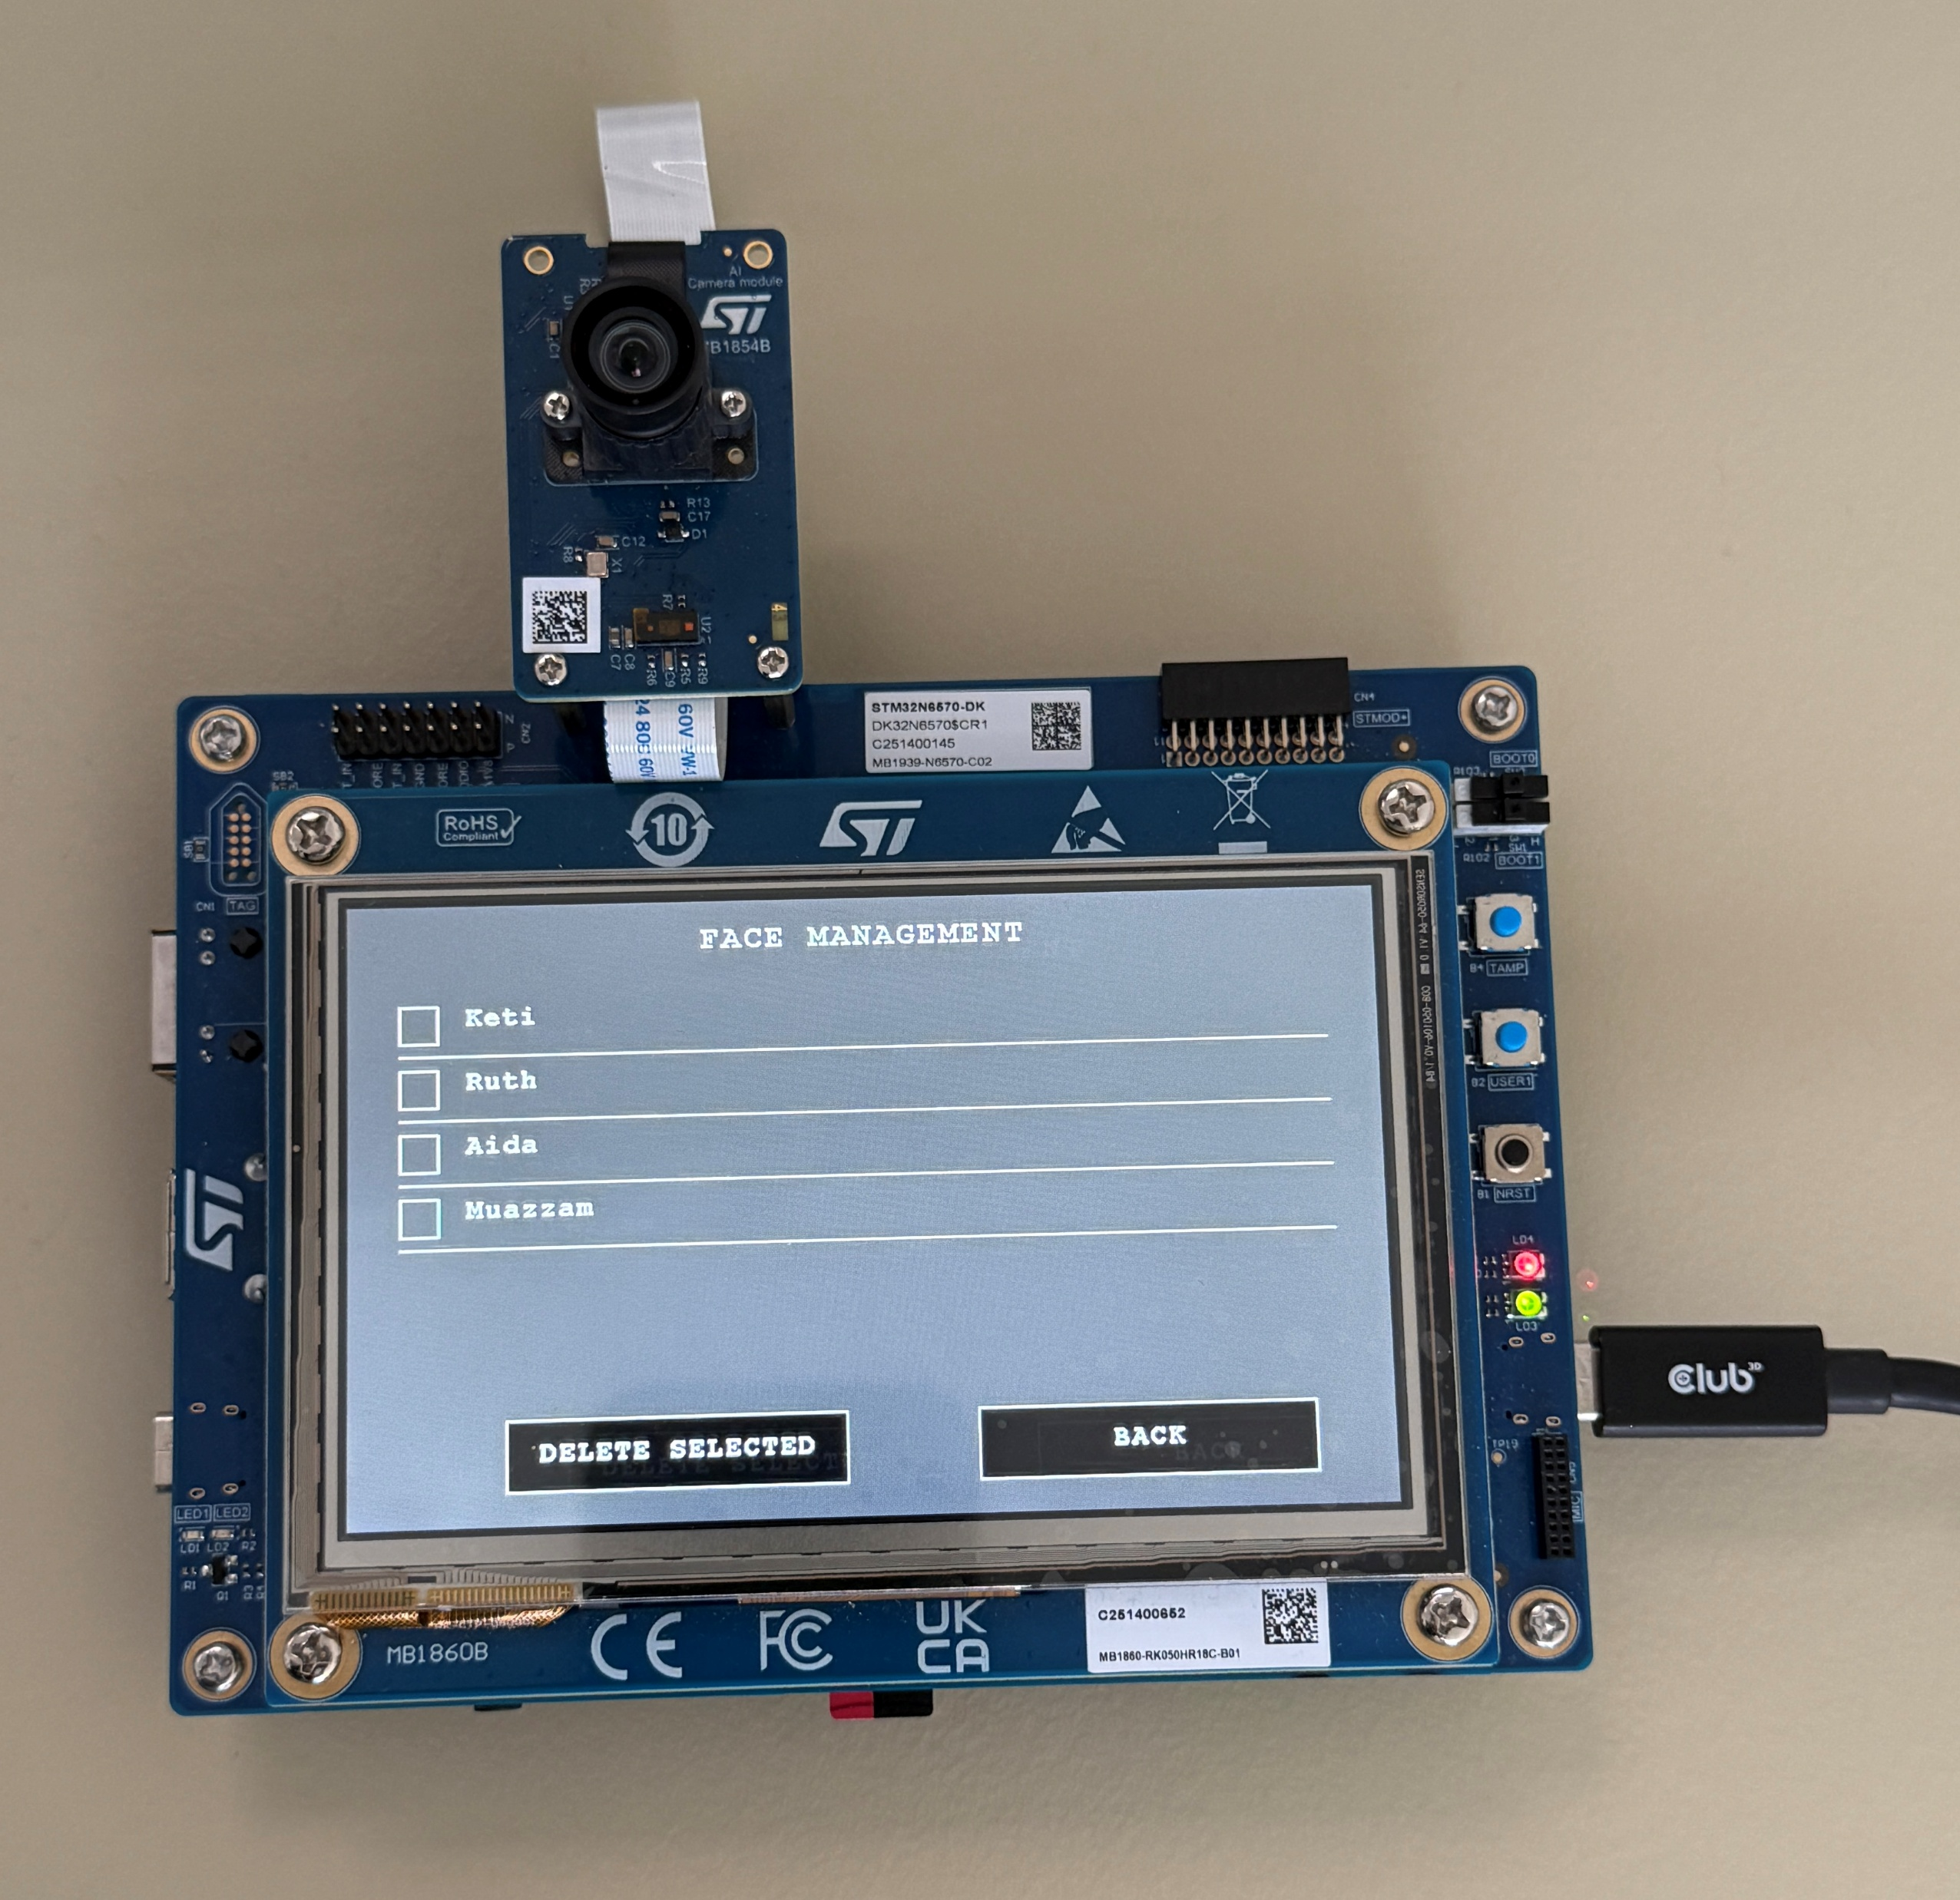
Graphical User Interface

Slide 10
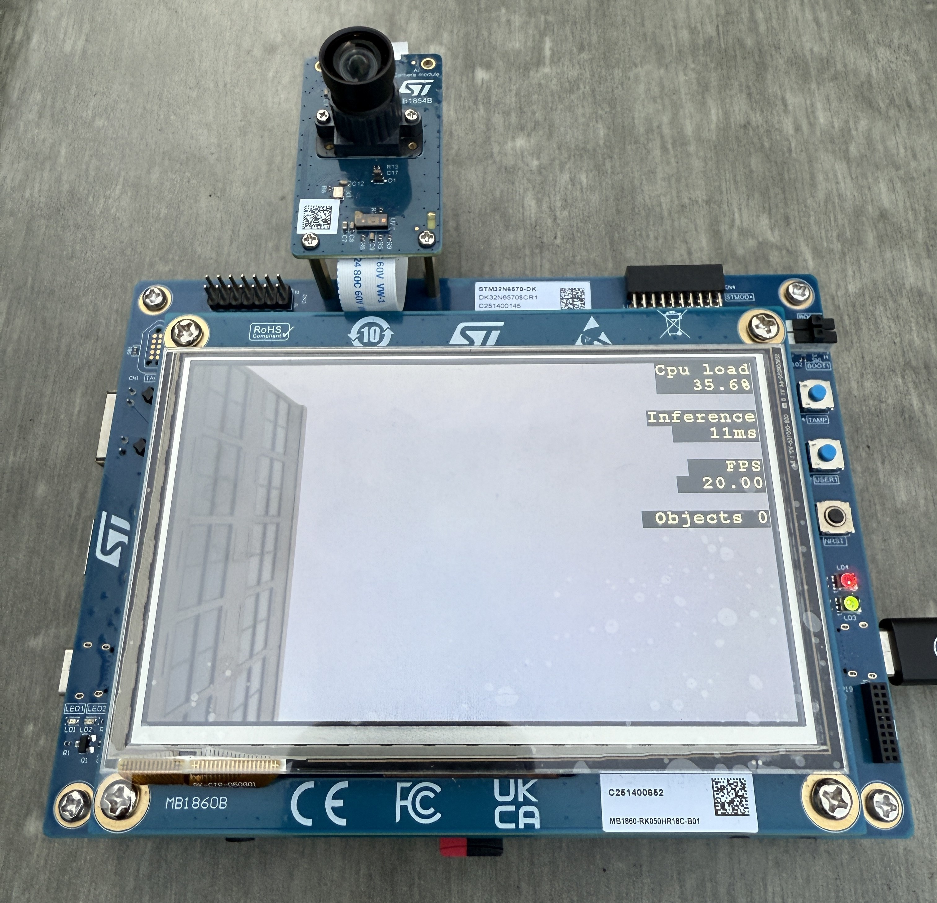
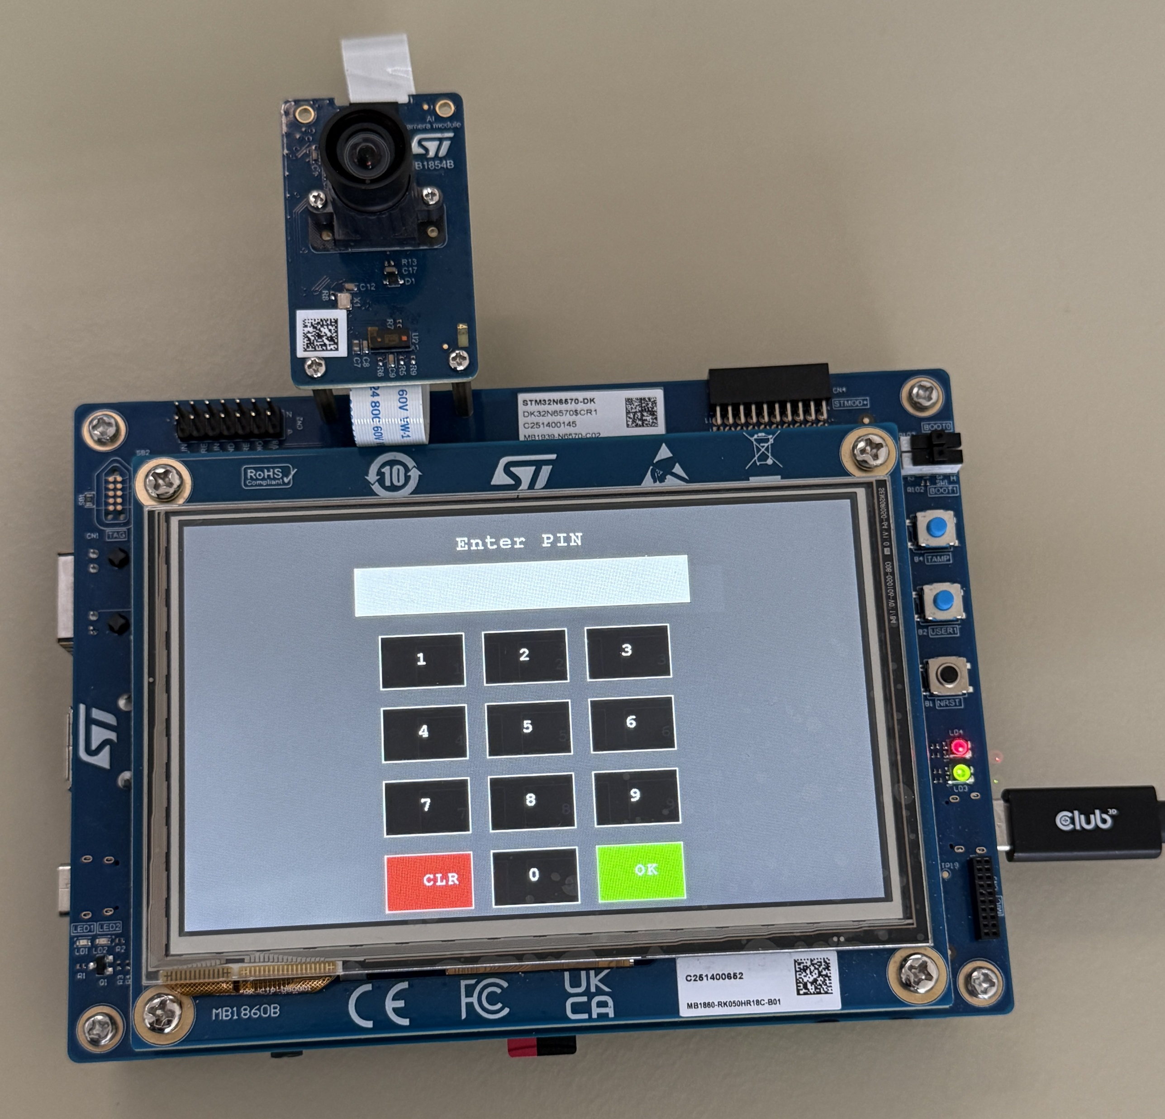
Graphical User Interface

Slide 11
Power-Saving Sleep Mode
Event-driven Custom Sleep Mode
Camera paused
Display Controller paused
Backlight paused
System State Preserved
Wake-Up Trigger
Touchscreen interrupt reacts instantly
Restores
Camera, Display and Backlight

Slide 12
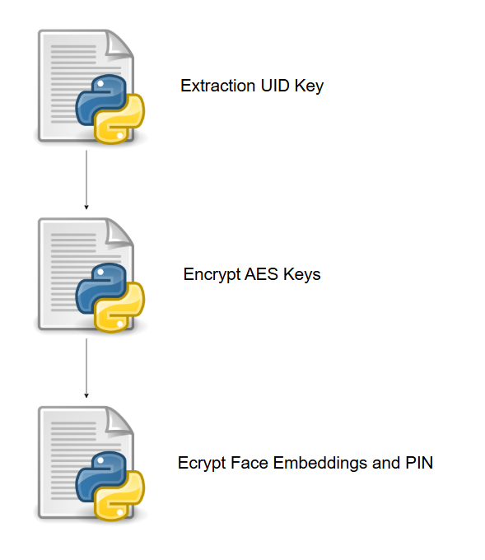
Cryptography and Secure Storage
Encryption (Features)
Unique Identifier key (UID)
AES Encryption
Process
Extract UID
Encrypt AES keys using the UID-derived key
Encrypt face embeddings and PIN

Slide 13
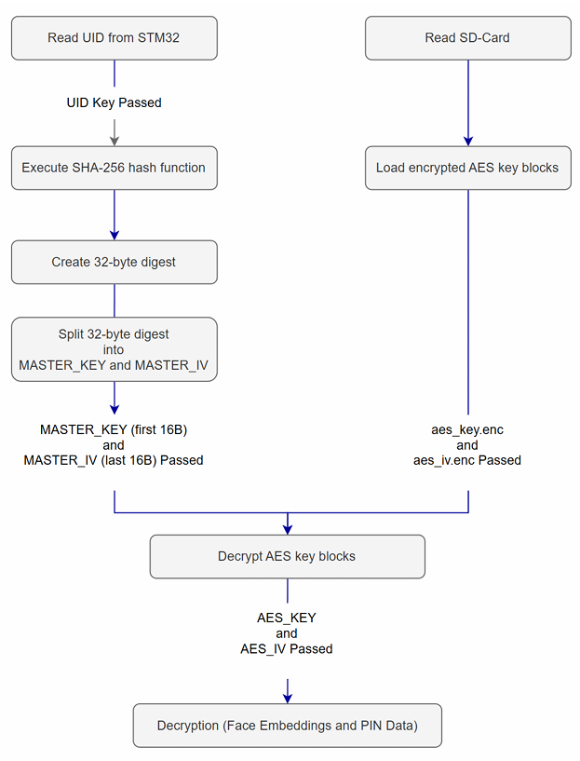
Decryption

Slide 14
Results

Slide 15
Future Improvements

Slide 16
Thank you

