Slide 1

Programming 3 - (C++)
Muazzam – CTS 7

Slide 2
About me
Completed one semester:
Bachelors: Business Informatics – Hochschule Furtwangen
Currently Enrolled:
Bachelors: Computer Science (CTS - 7) – THU
Focus Topics:
Computer Graphics & Vision
Mobile Computing
Interests:
Quantum Computing
Software Design/Optimization
Work Experience:
Software Developer & System Integration Engineer – Currently
At Harman Automotive – Ulm
C++ Tutor – 10 Months
At THU
Strategic Business Analyst – 6 months
At Hartman Group – Heidenheim
IT Operations Engineer – 14 months
At TeamViewer – Göppingen

Slide 3
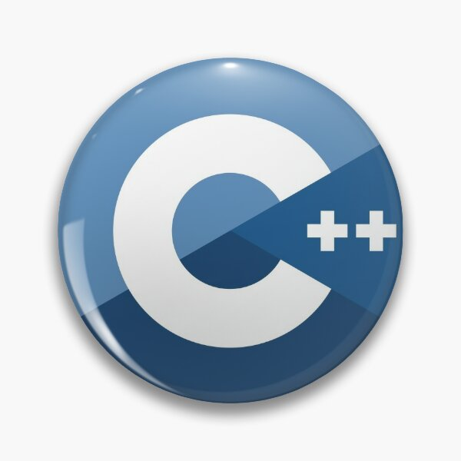
Sessions – Plan
Week 1 - Introduction to C++ / Pointers
Week 2 - Pointers / References
Week 3 – Classes & Objects
Week 4 – Inheritance
Week 5 – Polymorphism
Week 6 – Operator Overloading
Week 7 – Conversion / Revision
Week 8 – Templates
Week 9 – STL
Week 10 – STL
Week 11 – Smart Pointers
Week 12 – Buffer
Week 13 – Exam Practice
Week 14 – Exam Practice

Slide 4

Industry Demand
Extensive Libraries and Frameworks
High Performance
Close to Hardware
Cross-Platform
The Learning Curve – My Experience

Slide 5
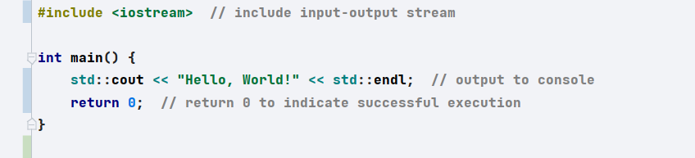
Introduction to C++
Object-Oriented Programming (OOP)
Memory Management:
Standard Template Library (STL)
Application of C++
Notes:
C++ has evolved significantly over the years with major updates like C++11, C++14, C++17, and C++20. These updates have introduced features like:
Lambda Expressions: For inline function definitions.
Smart Pointers: Automatic memory management to reduce memory leaks.
Concurrency: Multi-threading and parallelism for performance improvements.
Range-based Loops: Simplified syntax for iterating over data structures.

Slide 6
Suggestions
Rule book
Splitting up the topics
Using external resources for having a bigger picture
Primary source:
Prof. Script
LearnCPP Website: Learn C++ – Skill up with our free tutorials (learncpp.com)
Udemy Course, most of you already know about it ☺
Power of Chat GPT (Learning Techniques)

Slide 7
Question 1
To get fluent:
Minimum Info:
Classes and Objects
Inheritance
Polymorphism
Sometimes (STL) but not complicated comparatively

Slide 8
Question 2
How to optimize your cheat sheet its maximum potential
Draft 1 – Find all the keywords from the script (Recommended – Split all the big topics in different notebooks on your IPAD/Paper Based Notebook)
Draft 2 – After looking over all the past exams, find the common questions asked by the Prof. And replace that with draft 1
Draft 3 – You will notice over the period of time, some concepts would get very easy to remember, because you would be using it in real life programming questions (So Remove those extra Info.)
Final Draft – Make sure to put all the past exam questions especially the theory on your cheat sheet.

Slide 9
Question 3/4/5
Start reading other peoples code
Weekly Exercises
First try your best, then use Chat GPT
(Don’t Forget to document your progress, what you achieved and what Chat GPT did)

Slide 10
3 three W’s
What is the meaning of .....
Why do we need .....
What are the variations in the area of ..... (How can it be used in different cases)

