Slide 1

Programming 3 - (C++)
Muazzam – CTS 7

Slide 2
About me
Completed one semester:
Bachelors: Business Informatics – Hochschule Furtwangen
Currently Enrolled:
Bachelors: Computer Science (CTS - 7) – THU
Focus Topics:
Computer Graphics & Vision
Mobile Computing
Interests:
Quantum Computing
Software Design/Optimization
Work Experience:
Software Developer & System Integration Engineer – Currently
At Harman Automotive – Ulm
C++ Tutor – 10 Months
At THU
Strategic Business Analyst – 6 months
At Hartman Group – Heidenheim
IT Operations Engineer – 14 months
At TeamViewer – Göppingen

Slide 3
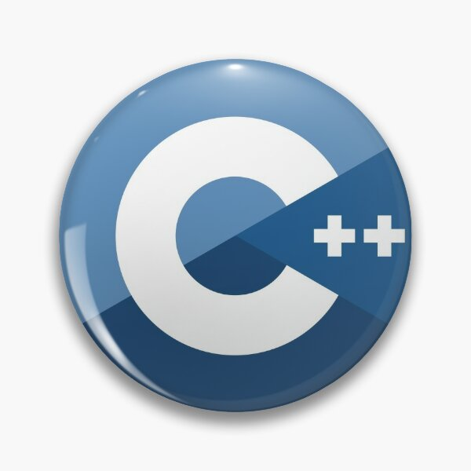
Sessions – Plan
Week 1 - Introduction to C++ / Pointers
Week 2 - Pointers / References
Week 3 – Classes & Objects
Week 4 – Inheritance
Week 5 – Polymorphism
Week 6 – Operator Overloading
Week 7 – Conversion / Revision
Week 8 – Templates
Week 9 – STL
Week 10 – STL
Week 11 – Smart Pointers
Week 12 – Buffer
Week 13 – Exam Practice
Week 14 – Exam Practice

Slide 4

Industry Demand
Extensive Libraries and Frameworks
High Performance
Close to Hardware
Cross-Platform
The Learning Curve – My Experience

Slide 5
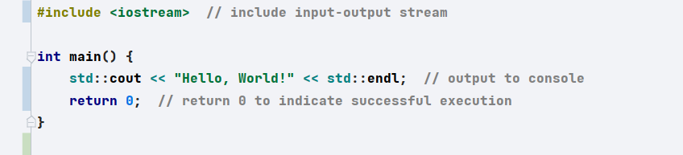
Introduction to C++
Object-Oriented Programming (OOP)
Memory Management:
Standard Template Library (STL)
Application of C++
Notes:
C++ has evolved significantly over the years with major updates like C++11, C++14, C++17, and C++20. These updates have introduced features like:
Lambda Expressions: For inline function definitions.
Smart Pointers: Automatic memory management to reduce memory leaks.
Concurrency: Multi-threading and parallelism for performance improvements.
Range-based Loops: Simplified syntax for iterating over data structures.

Slide 6
Suggestions

