Slide 1
Pointers & References
Programming 3 - Muazzam Aqeel

Slide 2
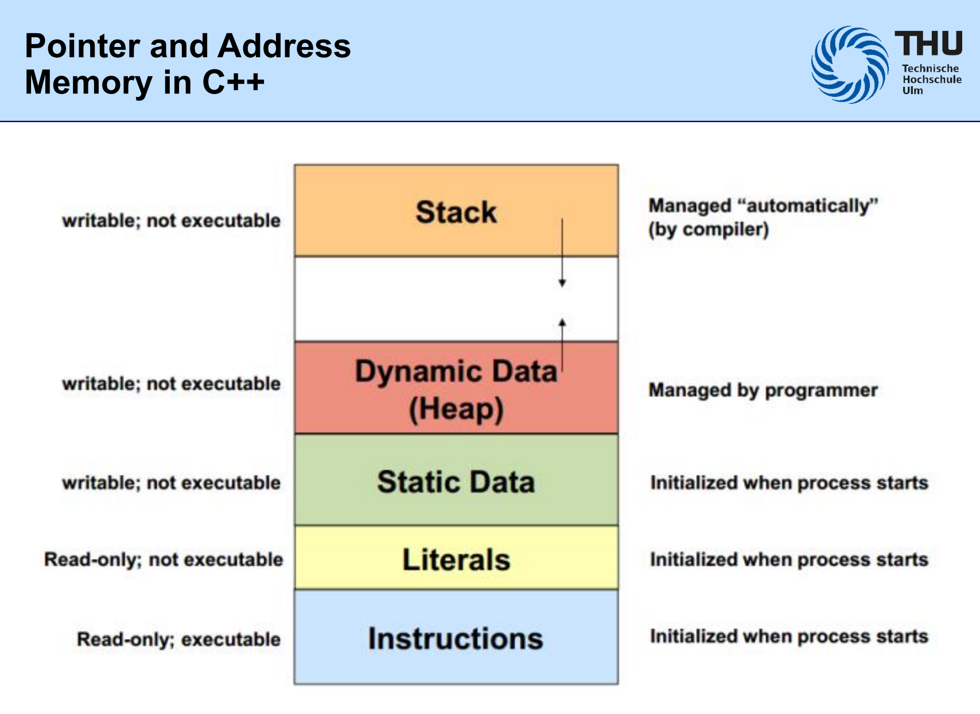
Stack:
Memory managed automatically by the compiler.
Used for local variables and function calls.
Memory is writable but not executable.
Dynamic Data (Heap):
Memory managed manually by the programmer (via `new`, `delete`, etc.).
Used for dynamically allocated memory.
Memory is writable but not executable.
Static Data:
Memory for global and static variables.
Initialized when the process starts.
Memory is writable but not executable.
Literals
Memory region for constant values like string or numbers.
Initialized when the process starts.
Memory is read-only and not executable.
Instructions
Memory region for executable code (program instructions).
Initialized when the process starts.
Memory is read-only but executable.

Slide 3
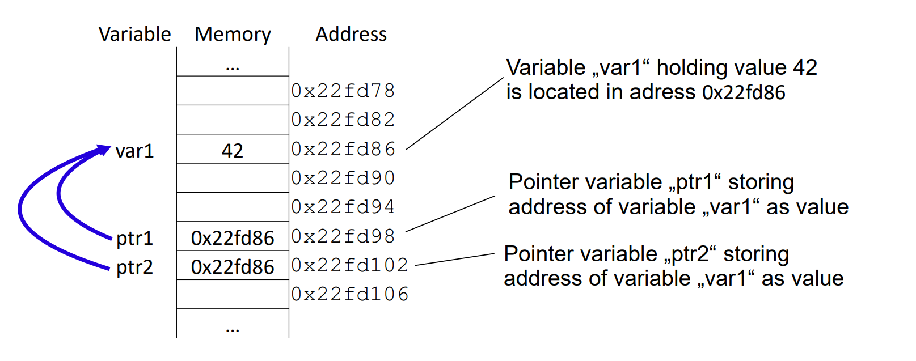
What is a pointer
A pointer is a variable that can store the address in memory of another variable (or in general an address of any space in memory).
The stored variable (the memory area whose address is stored) can be accessed indirectly via the "pointer

Slide 4
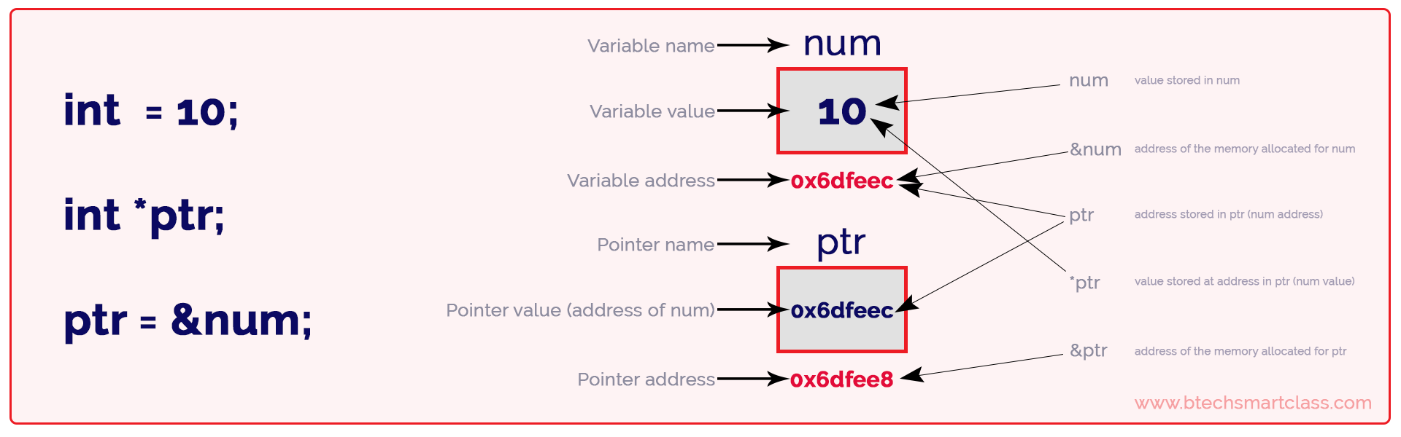

Slide 5
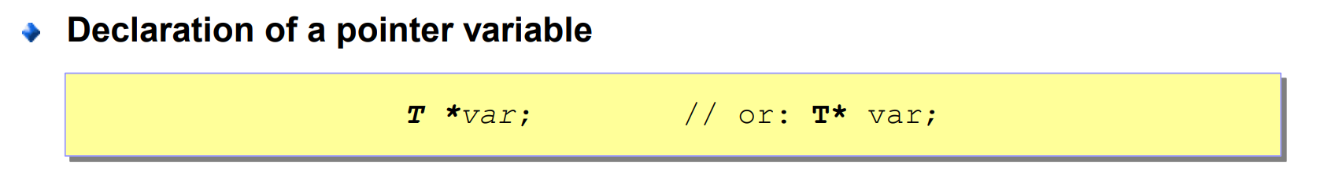
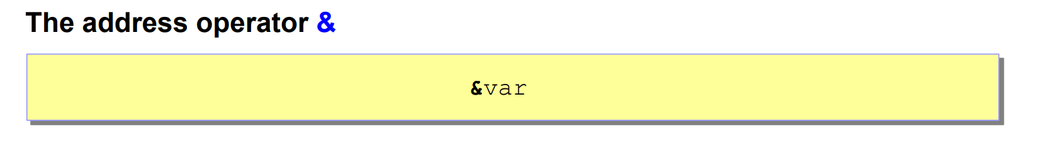
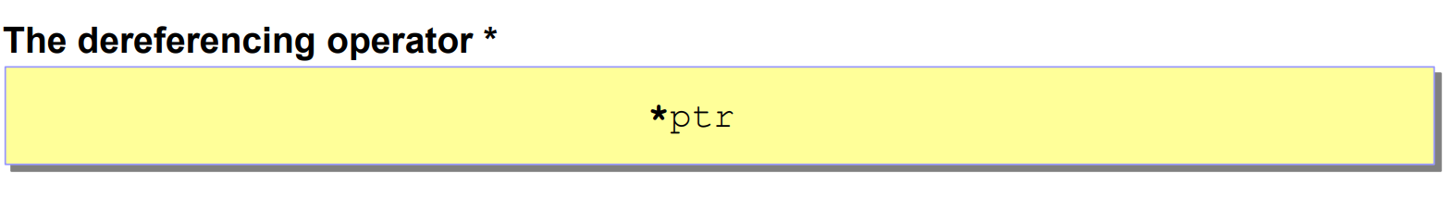
Expect For Pointer Type void * Null-Pointer (Value of the pointer equals 0)
Notes:
Exceptions:
Pointer type void
Void-pointer is a type specification for pointers, where the real type of the pointer will be provided later. At declaration time, the type is not yet known.
A pointer of type void * can not be dereferenced
Any pointer type may be assigned to a pointer of type void * (but not vice versa).
Null-Pointer (Value of the pointer equals 0)
It is guaranteed that address 0 never contains a data object
Indicates that the pointer does not refer to a valid object
The literal constant 0 (i.e., number zero) may be assigned to each pointer variable

Slide 6
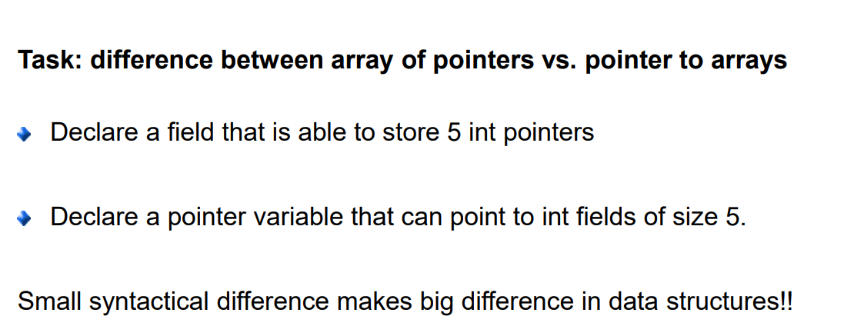

Slide 7
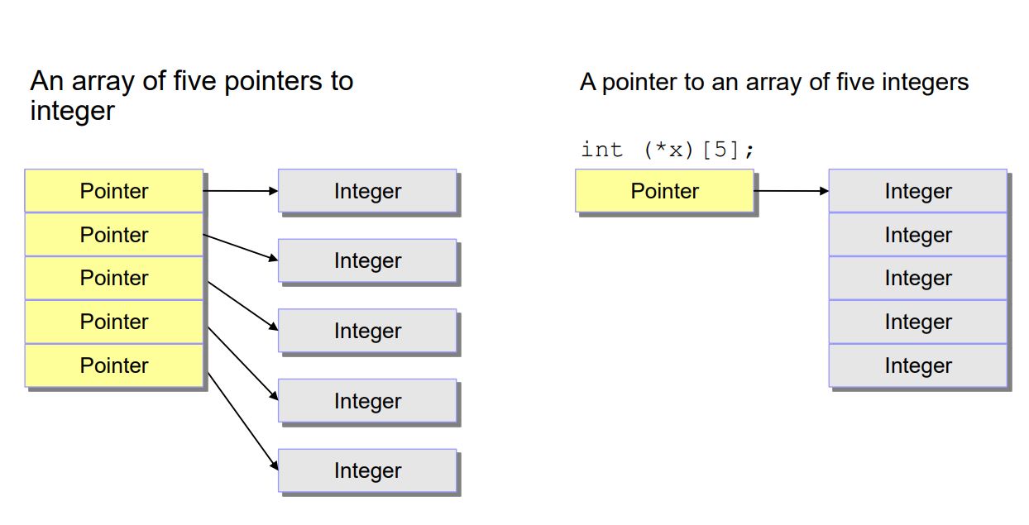
Notes:
An Array of five Pointers to Integer
#include <stdio.h>
int main() {
// Declare an array of 5 integer pointers
int *arr[5];
// Declare five integers
int a = 10, b = 20, c = 30, d = 40, e = 50;
// Point the pointers to the integers
arr[0] = &a;
arr[1] = &b;
arr[2] = &c;
arr[3] = &d;
arr[4] = &e;
// Print values using the pointers
for (int i = 0; i < 5; i++) {
printf("Value pointed to by arr[%d] = %d\n", i, *arr[i]);
}
return 0;
}
Pointer to an array of five integers
#include <stdio.h>
int main() {
// Declare an array of 5 integers
int arr[5] = {10, 20, 30, 40, 50};
// Declare a pointer to an array of 5 integers
int (*ptr)[5] = &arr;
// Print values using the pointer to array
for (int i = 0; i < 5; i++) {
printf("Value of arr[%d] = %d\n", i, (*ptr)[i]);
}
return 0;
}

Slide 8
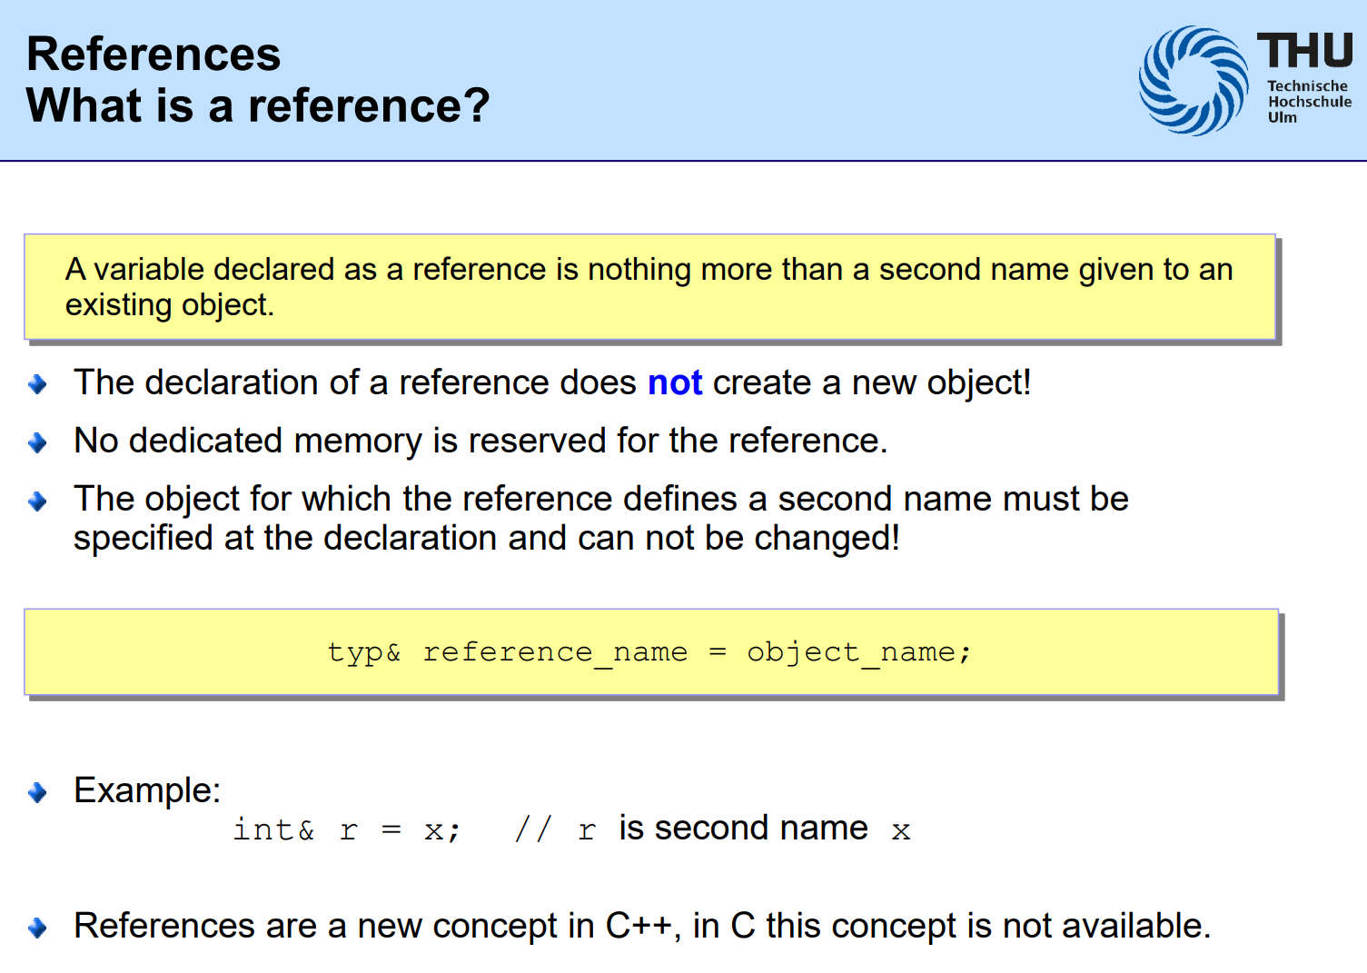

Slide 9
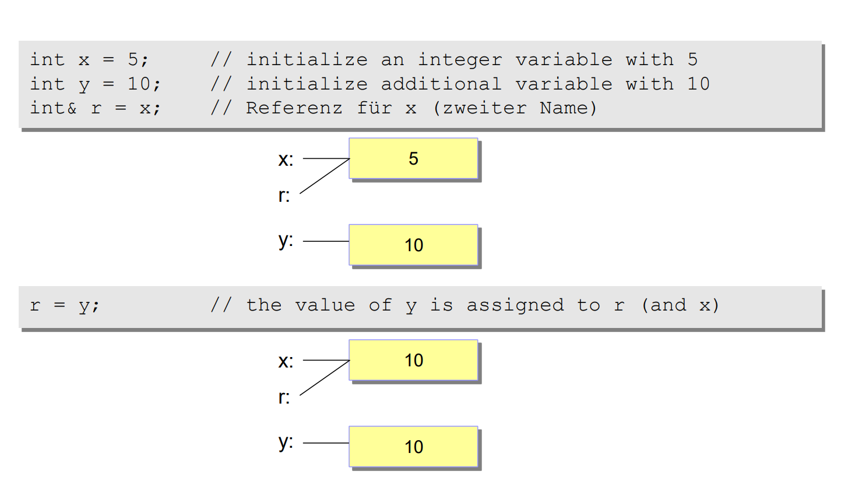

Slide 10
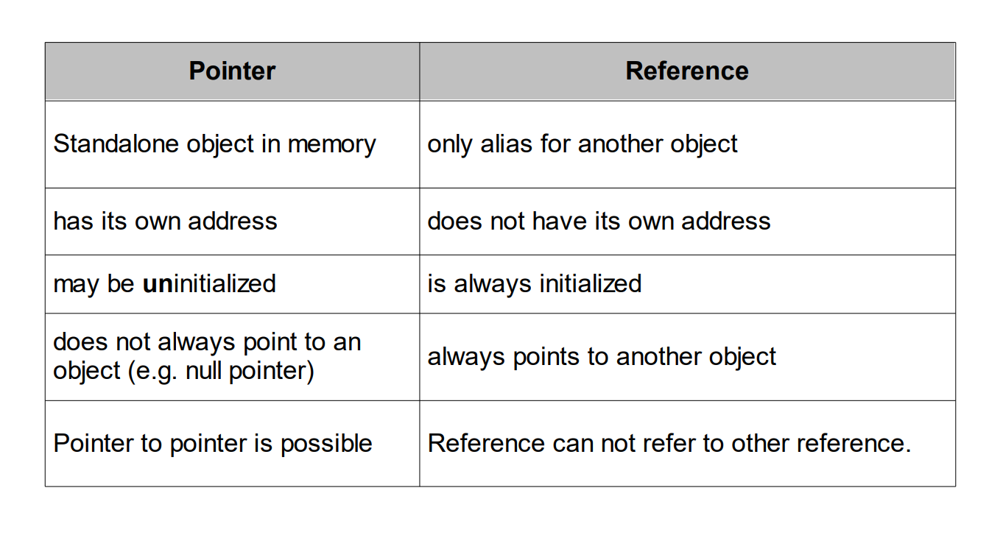

Slide 11
Weekly Work

Slide 12
Steps – Mastering Pointers
Use pointers with all the data types you know
Understand Pointers Arithmetic's
Dynamic Memory Management
Pointers to Pointers
Function Pointers
Optional – Pointers with Structures

Slide 13
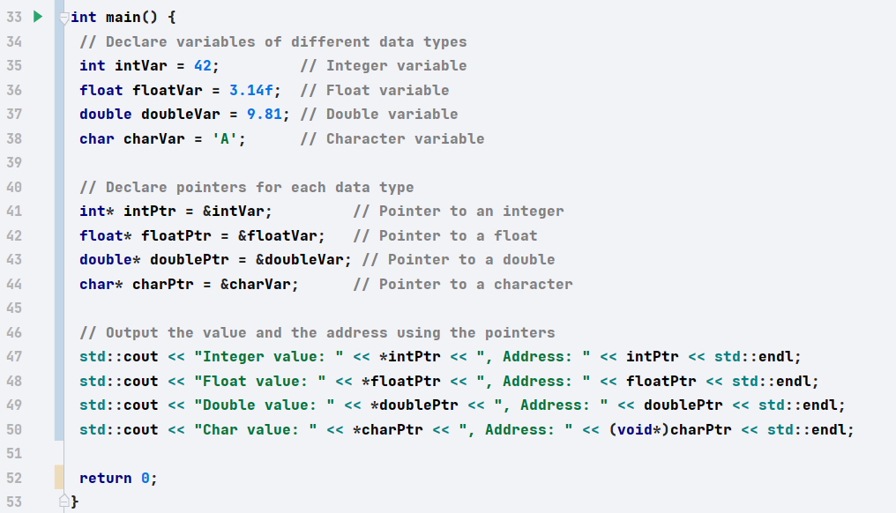

Slide 14
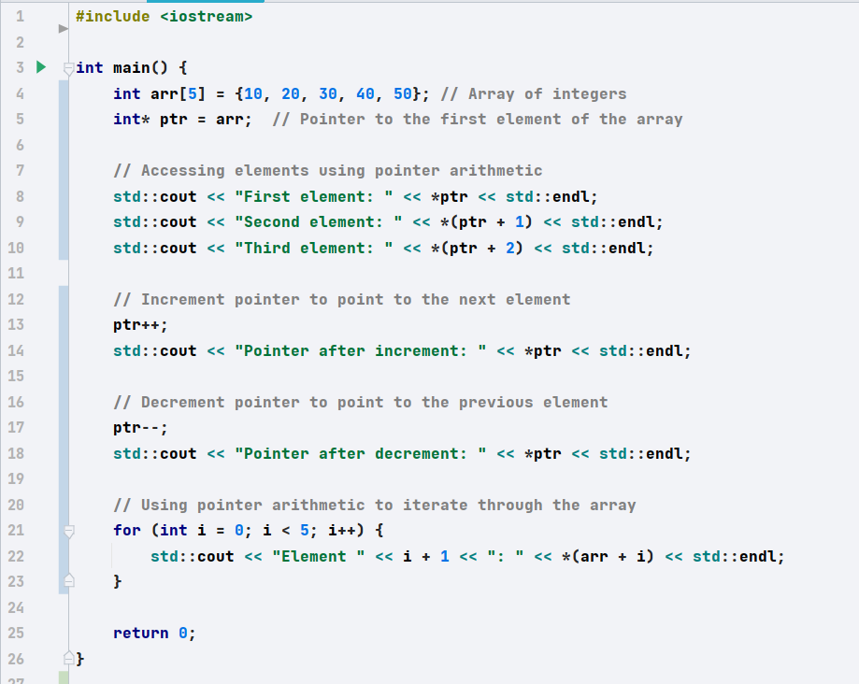

Slide 15
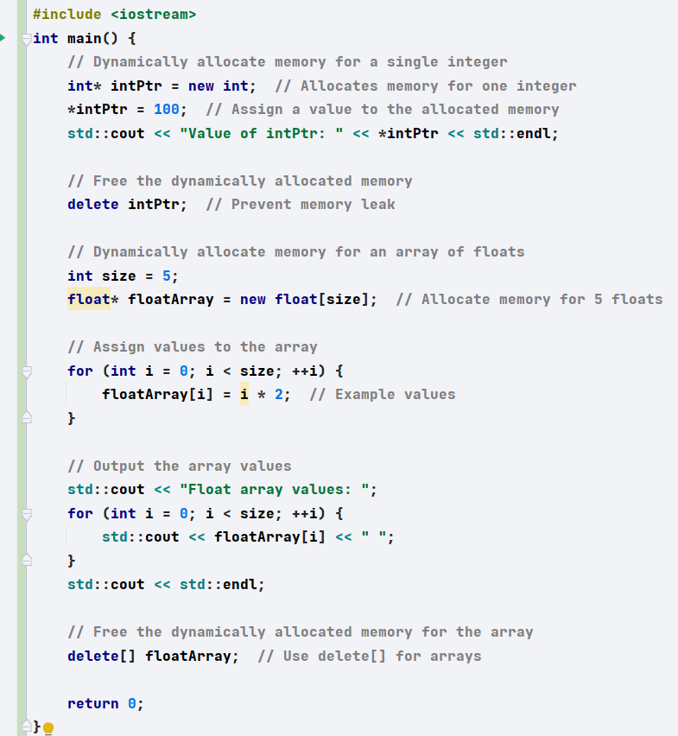

Slide 16
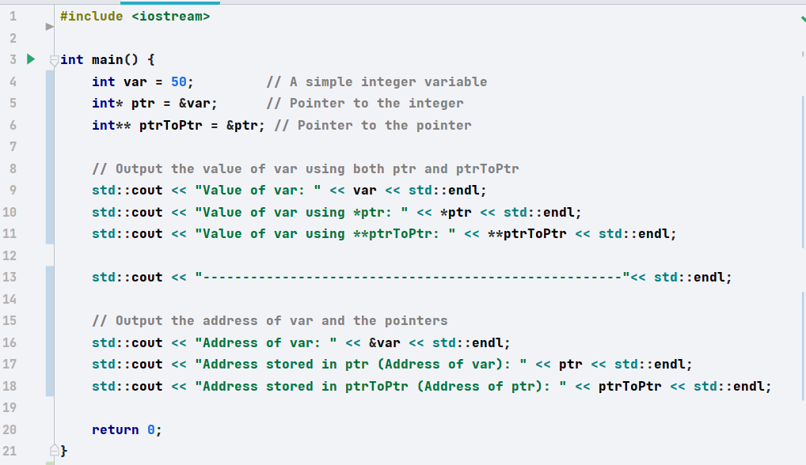

Slide 17
