Slide 1

Polymorphism

Slide 2
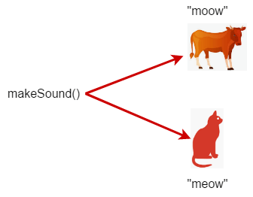
What is Polymorphism
Polymorphism comes from the Greek word "poly" (meaning "many") and "morph" (meaning "form").
In programming, it refers to a function or object having many forms or behaviours depending on the situation.
Types
Early binding
Late binding

Slide 3
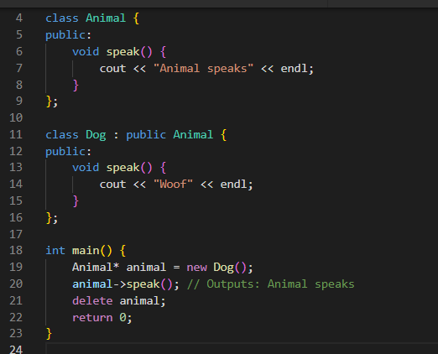

Slide 4
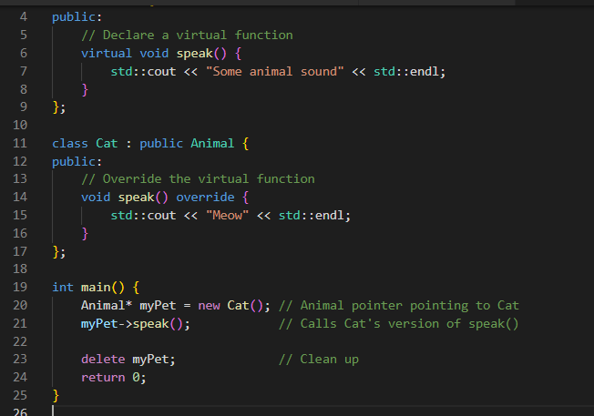
Virtual Keyword – In Action

Slide 5
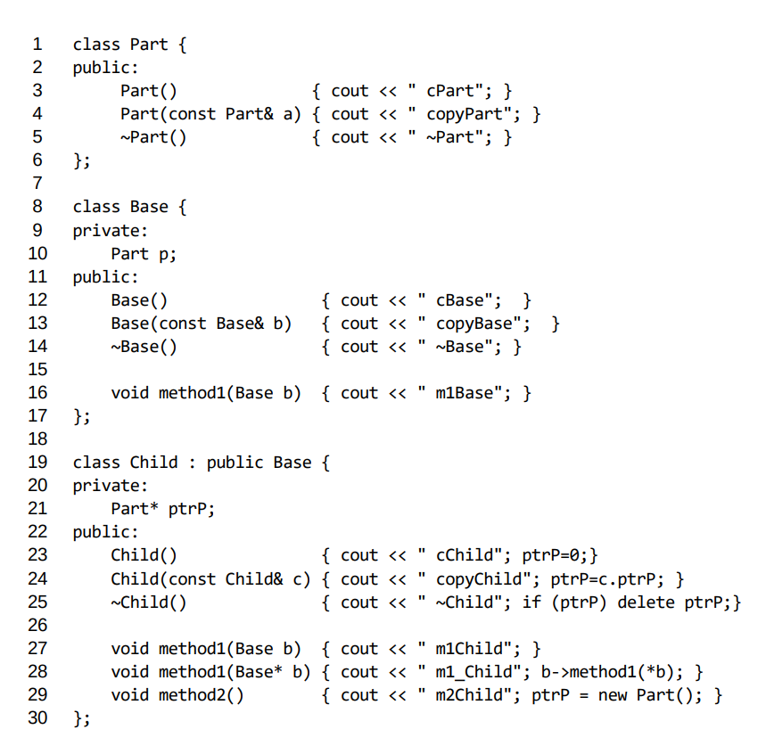
Time to check your progress

Slide 6
Early Binding / Static Binding
Definition: The method to be called is determined at compile time, meaning the decision is made when the program is compiled OR The method of that class, which is specified in the code as type of the pointer, will be called.
Works: In early binding, the compiler knows the method to be invoked based on the type of reference or pointer used. The function call is fixed before the program is run.
Performance: Early binding is generally faster since the method call is resolved at compile time

Slide 7
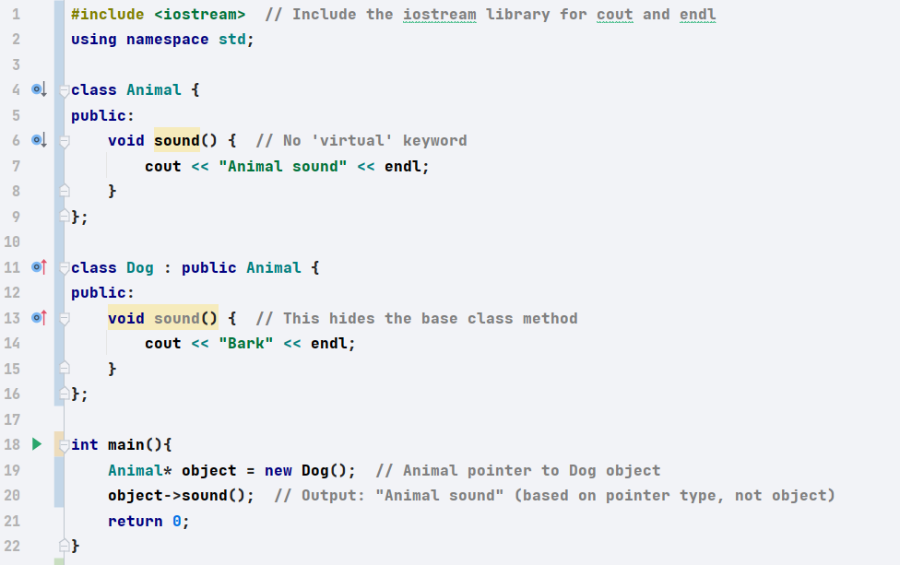
Important Properties
No virtual keyword in the base class methods.
Method calls are resolved at compile-time based on the type of the pointer, not the actual object type it was initialized with.

Slide 8
Dynamic Binding / Late Binding
Definition: The method to be called is determined at run time, based on the actual object type rather than the reference or pointer type
Refers to the process where the method to be executed is determined at run time, rather than at compile time.
Particularly in cases of method overriding
How It Works: The method call is resolved during the execution of the program, typically with the help of virtual functions in object-oriented programming. This allows the program to decide the correct method based on the actual type of the object at runtime.
Notes:
Performance: Late binding can be slower compared to early binding because it involves decision-making at runtime.

Slide 9
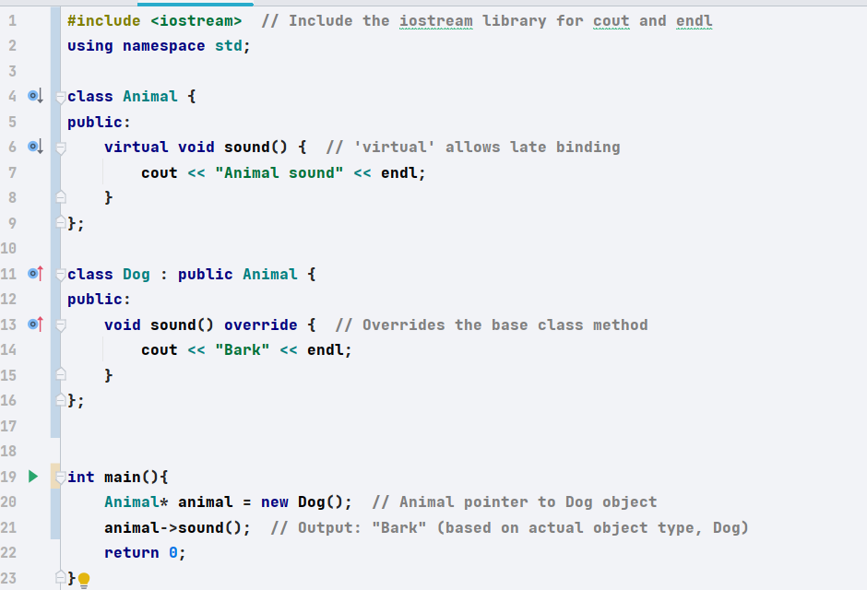
Important Properties
Virtual keyword in the base class methods.
Method calls are resolved at run-time based on the actual object type, even if the pointer is a base class pointer.

Slide 10

Virtual Destructors

Slide 11
Why do you need it?
A virtual destructor is important in C++ when you're dealing with inheritance
Especially if you're going to delete objects through a pointer to a base class.
Without a virtual destructor, the destructor of the derived class won't be called, leading to resource leaks.

Slide 12
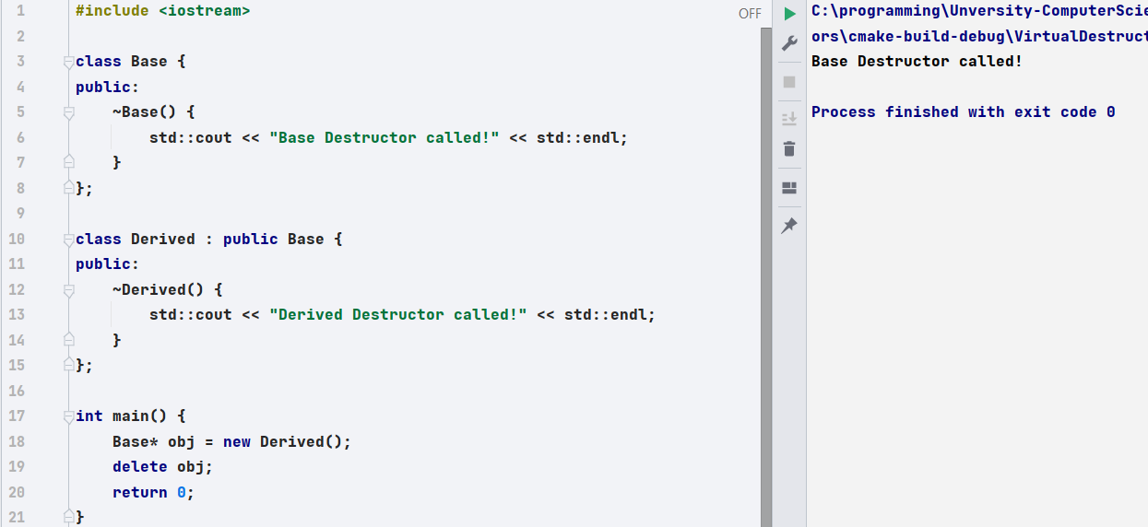
Any problems?

Slide 13
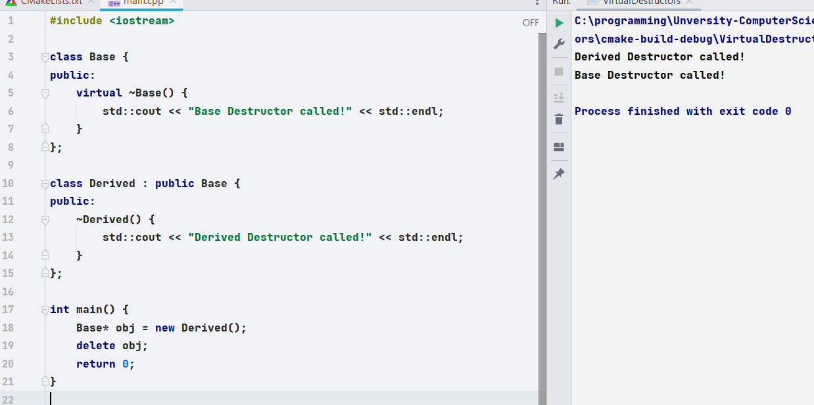
Problem Solved?

Slide 14
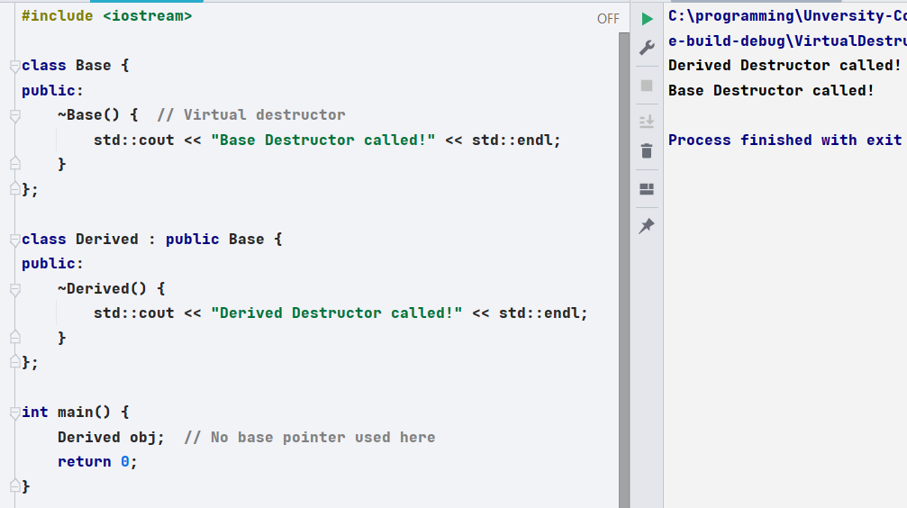
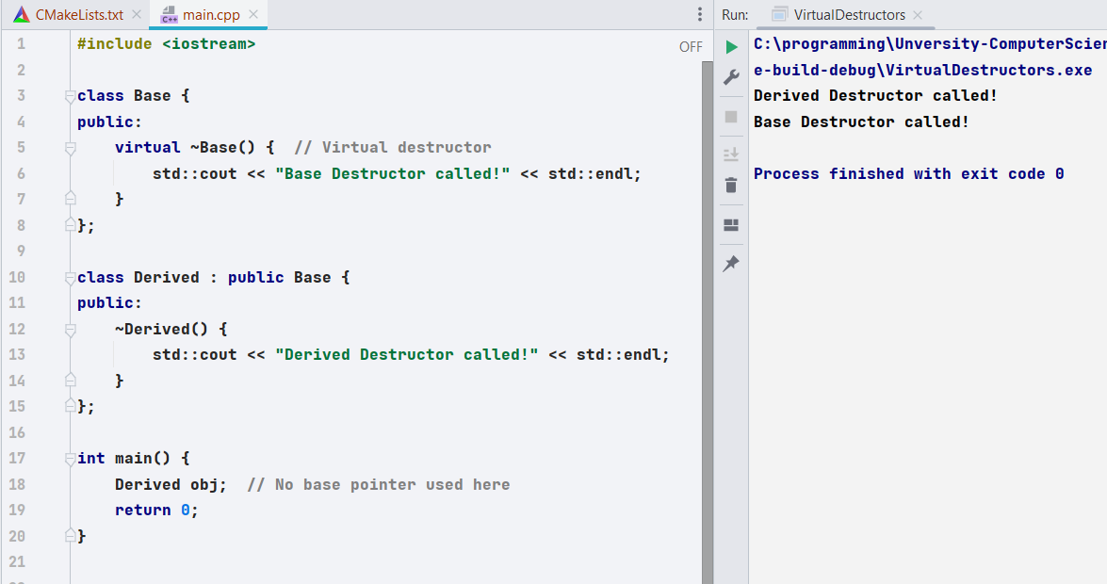
Not required here, when handling objects
Notes:
When you declare Derived obj;, you're creating a local object of type Derived. The object is destroyed automatically when it goes out of scope.
In this case, the destructors are called in the correct order:
First, the Derived class destructor will be called.
Then, the Base class destructor will be called automatically

Slide 15

When Do You Need a Virtual Destructor?
You only need a virtual destructor when:
You have a pointer to the base class that points to a derived class object, and you are deleting the derived object through the base class pointer.
Always declare the destructor of any base class virtual!

Slide 16
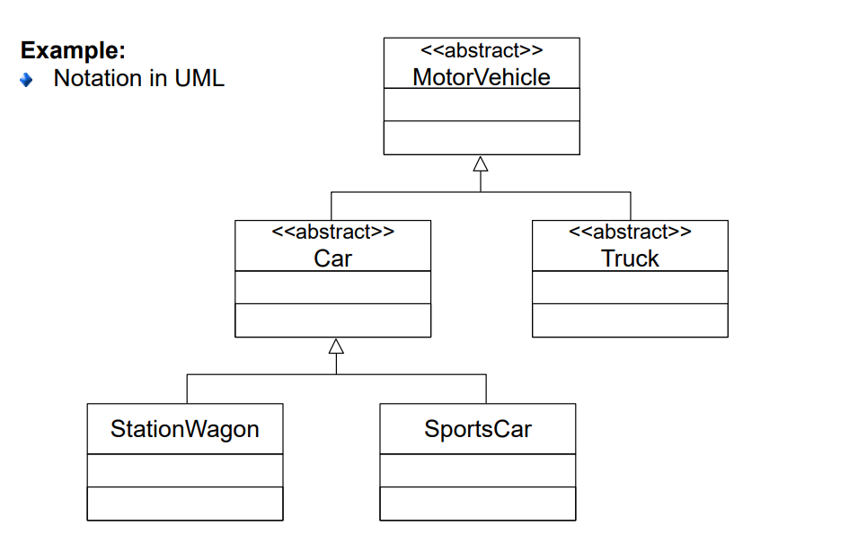
Abstract Classes
Abstract classes serve to summarize common properties of different classes and thus provide a "generic term".
They are not suitable for producing concrete objects
A class is abstract, if it contains at least one so-called pure virtual method

Slide 17
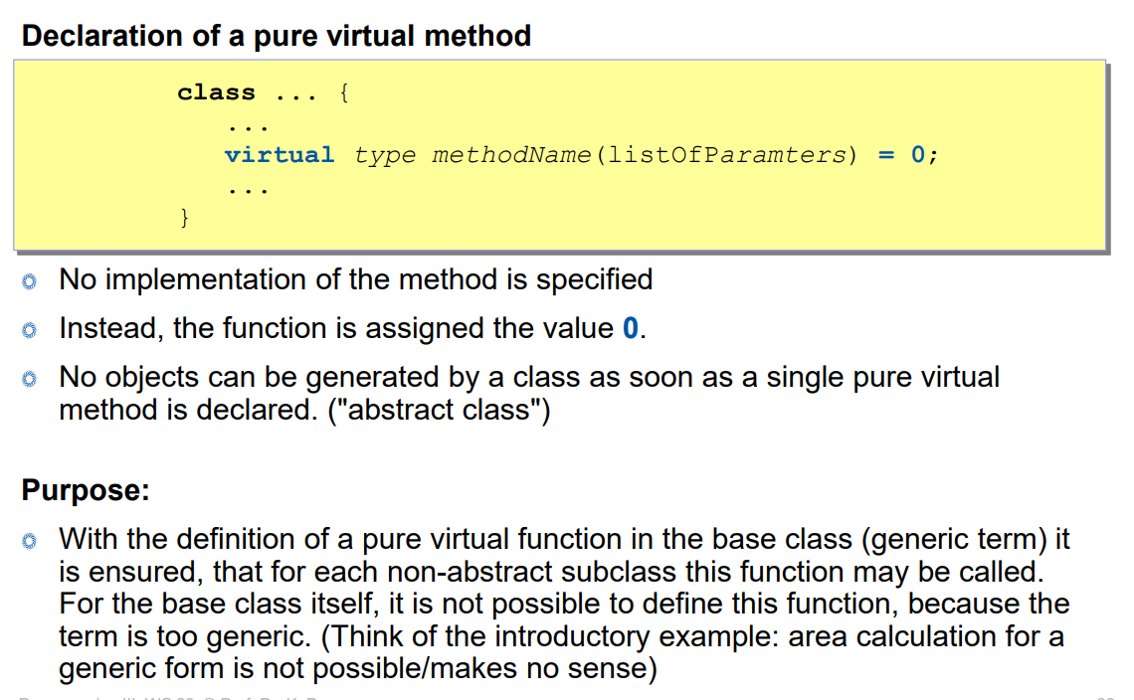

Slide 18
Don’t Forget
Each abstract class shall declare a virtual destructor.

