Slide 1

Standard Library Template (STL)

Slide 2
What is STL?
It is designed to make common programming tasks easier by providing reusable, efficient, and type-safe components
Divided into three main components
Containers
Iterators
Algorithms

Slide 3
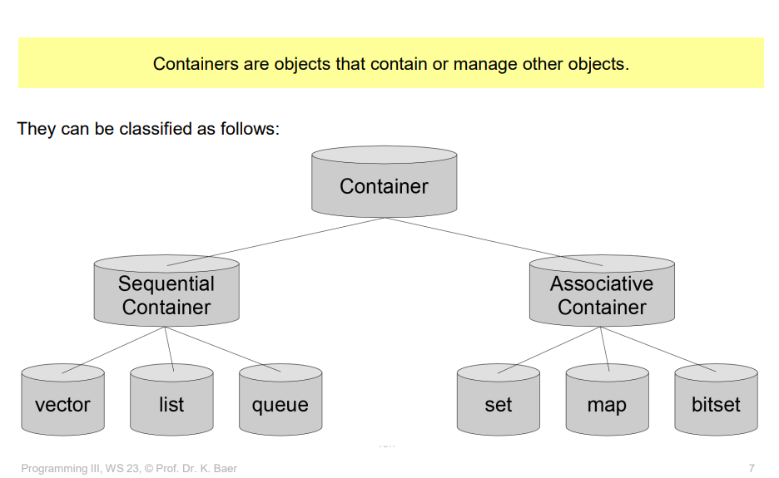
Containers

Slide 4
Sequential Containers
Definition: Sequential containers store data in a linear order, where each element is positioned next to its neighbor.
Purpose: They are used when the order of data matters, and you need fast access or modification at specific positions.
Examples: Vectors, Deque, List

Slide 5
Sequential Containers
Feature | vector | deque | list
Fast Access | Random access to elements. | Random access to elements. | Only sequential access.
Insert/Delete | Efficient at the end. | Efficient at both ends. | Efficient anywhere.
Memory Usage | Contiguous memory block. | Contiguous blocks. | Node-based memory.

Slide 6
Vector
#include <vector>
#include <iostream>
using namespace std;
int main() {
vector<int> grades = {90, 85, 88};
grades.push_back(95); // Add at the end
}
Result: 90 85 88 95
Deque
#include <deque>
#include <iostream>
using namespace std;
int main() {
deque<int> line = {1, 2, 3};
line.push_front(0); // Add at the front
line.push_back(4); // Add at the back
}
Result: 0 1 2 3 4
List
#include <list>
#include <iostream>
using namespace std;
int main() {
list<int> tasks = {1, 2, 3};
tasks.push_back(4); // Add at the end
tasks.push_front(0); // Add at the front
}
Result: 0 1 2 3 4

Slide 7
Associative containers
Definition: Associative containers store data as key-value pairs or unique elements, enabling fast retrieval based on keys rather than positions.
Purpose: They are used when quick lookups, insertions, or deletions based on keys are needed, regardless of the order of elements.
Examples: set, map, multiset, multimap

Slide 8
Set #include <set>
#include <iostream>
using namespace std;
int main() {
set<int> numbers = {4, 2, 8, 6};
numbers.insert(5); // Insert a new number
for (int num : numbers)
cout << num << " "; // Print all elements in ascending order
}
2 4 5 6 8
Multiset
#include <multiset>
#include <iostream>
using namespace std;
int main() {
multiset<int> scores = {50, 60, 50, 70};
scores.insert(60); // Insert duplicate value
for (int score : scores)
cout << score << " "; // Print all elements (duplicates included)
} 50 50 60 60 70
Map
#include <map>
#include <iostream>
using namespace std;
int main() {
map<string, int> age = {{"Alice", 30}, {"Bob", 25}};
age["Charlie"] = 35; // Add a new key-value pair
}
Alice: 30
Bob: 25
Charlie: 35

Slide 9
Multimap
#include <map>
#include <iostream>
using namespace std;
int main() {
multimap<string, int> grades = {{"Alice", 85}, {"Bob", 90}};
grades.insert({"Alice", 95}); // Add another grade for Alice
}
Alice: 85
Alice: 95
Bob: 90

Slide 10
Iterators
One Iterator is an object (like a pointer) that points to an element within the container.
We can use iterators to iterate through the contents of the container.
They can be visualized as something similar to a pointer pointing to a specific location, and we can use them to access the content in that location.
Iterators play a crucial role in connecting algorithms to containers, as well

Slide 11
IDE – Iterators

Slide 12
Algorithms
STL algorithms are pre-defined functions in C++ to perform common tasks.
Operate on containers using iterators
Examples of tasks:
Searching (std::find)
Sorting (std::sort)
Counting (std::count)
Transformation (std::transform)
Summation (std::accumulate)

Slide 13
Why Use STL Algorithms?
Efficiency: Highly optimized and faster than custom implementations.
Simplicity: Reduces code and improves readability.
Reusability: Works with all STL containers (vector, list, map, etc.).
Generic Programming: Operates on a wide range of data types and structures.

Slide 14
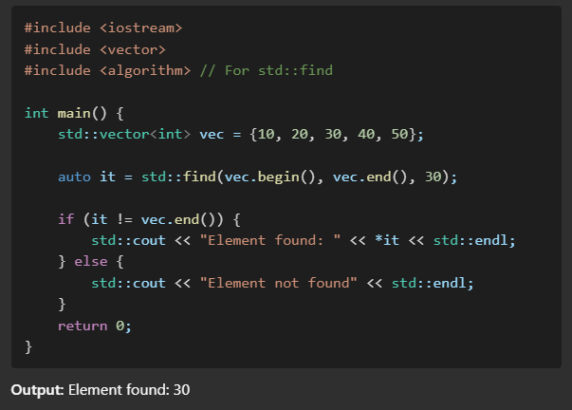
Find

Slide 15
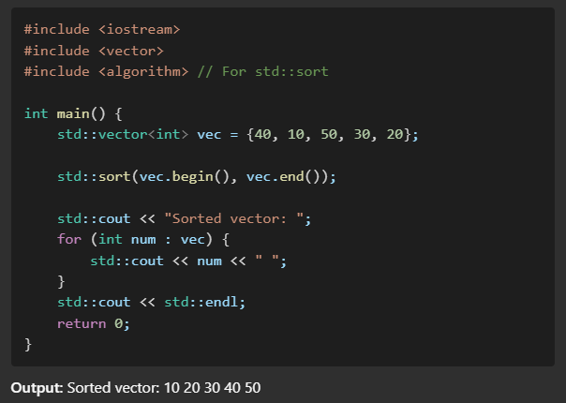
Sort

Slide 16

Functional Objects

Slide 17
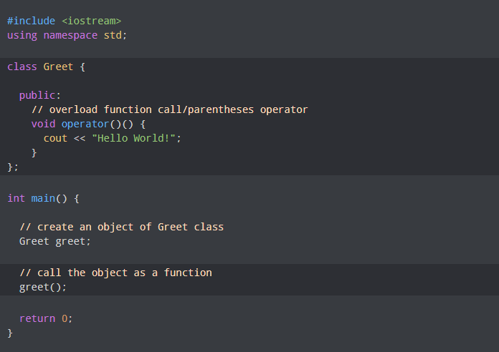

Slide 18
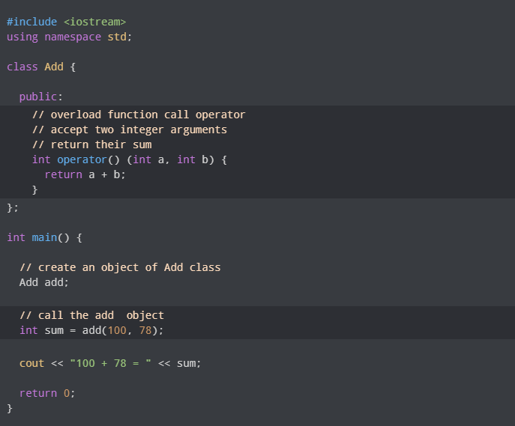

Slide 19
IDE – Functors

Slide 20
IDE (Container + Algorithm + Functors )

Slide 21
Lamda Functions
Until Next time

