Slide 1

Templates

Slide 2
Teamplates?
A C++ template is a powerful feature added to C++.
It allows you to define the generic classes and generic functions and thus provides support for generic programming.
Templates can be represented in two ways:
Function templates
Class templates

Slide 3
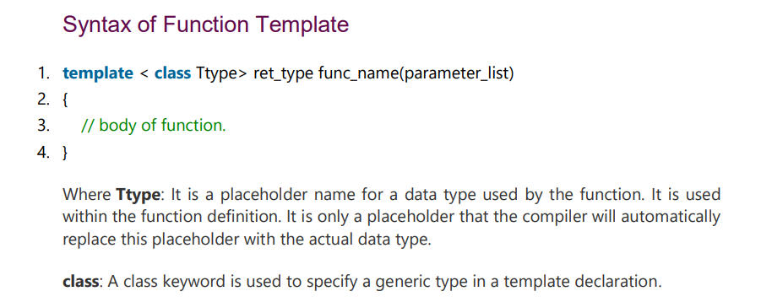

Slide 4
