Slide 1
Student Management System

Slide 2
Team Members
Mubahil Ahmad (211037)
Syed Ali Zain (211113)
Ahsan Ahmed (211059)
Shahrukh Khan (211061)

Slide 3
Environment
This project is entirely coded in standardized syntax of C++
Compiler which is used to run and compile this project is DEV C++

Slide 4
Purpose
Student Management System (SMS) is designed to store, maintain and manage all the data required by any institute.

Slide 5
Objective
It is used to store data, which can be accessed anytime.
We can also search, modify or update our required data

Slide 6
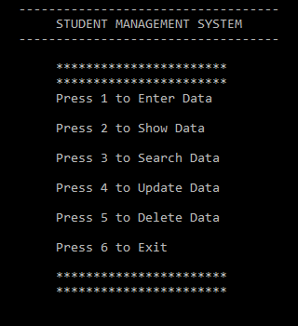
Road Map
After successful compilation , this output will appear on your screen.

Slide 7
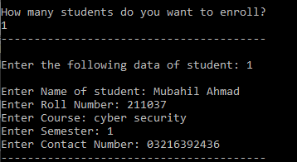
Enter Data
To Enter data you have to press 1, and this will appear
Here enter details which are being
asked.
like name, roll number, semester, contact number

Slide 8
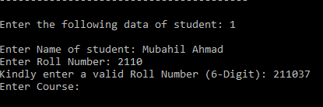
Input Validation & GetLine Function
We have used input validation for proper roll number and contact numbers.
Moreover we can store multiple words using getline function.

Slide 9
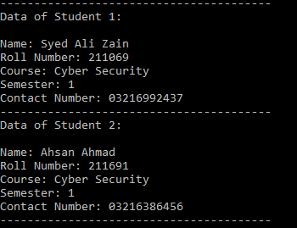
Show/Access Data
To See, pre-existing data on program you need to press 2, and this will appear
By pressing 2
Data pre-stored in the program can
Be accessed

Slide 10

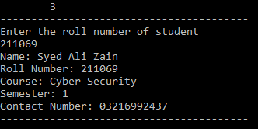
Search Data
By pressing 3, you can search data of student by a key, and roll number is used as a key here
As you can see, by entering roll number, data is accessed

Slide 11
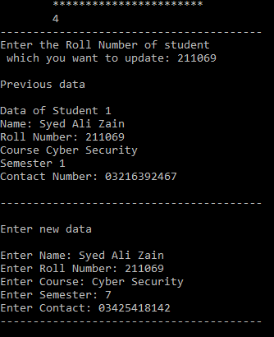
Update Data
By Entering 4, you can easily update/modify data
In this feature, program will first display
Old data/record so we can update it
Accordingly.

Slide 12


Delete Data
By Entering 5, you can Delete Data
In this feature, program will first display
Two options,
Press 1 to delete entire existing record
Press 2 to delete some selective data
Here by pressing 2,
And by using selective roll no, we can delete data

Slide 13
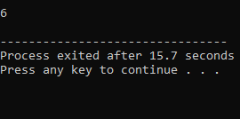
Exit
By Simply Entering 6, you can exit
After performing your desire operations you can exit
Student management system
By pressing 6

Slide 14
Thank You!

