Slide 1

AGRIASSIST: SMART FARMER ADVISORY,
MARKET INTELLIGENCE & VENDOR RECOMMENDATION SYSTEM
Presented By
MUBARAK S
Domain
AgriTech / Decision Support System
Institution
J. J. College of Engineering & Technology
Academic Year
2025 - 2028
Software Track · Console-Based Python Application

Slide 2




INTRODUCTION & OBJECTIVE
Introduction
Agriculture is India's backbone — yet most small farmers lack structured guidance. • 140 million+ small and marginal farmers across India. • Decisions made on tradition and word-of-mouth, not data. • Middlemen capture most of the profit, leaving farmers underpaid. • No access to scheme eligibility, input guidance, or market data. • Rural connectivity limits app or web-based solutions.
Crop Guidance
Season & soil-based crop recommendation
Scheme Advisory
PM-KISAN, insurance & subsidies
Profit Prediction
Cost, revenue & ROI estimate
Objective
Build a zero-dependency, offline-capable Python advisory system that gives every farmer the decision power of an expert agricultural officer.
Market Intel
Best buyer & price comparison

Slide 3
PROBLEM STATEMENT
Current farmer reality in India:
140M+
<40%
○ No structured advisory — crops chosen by guesswork or peer pressure, not soil or seasonal science.
○ Middlemen dependency compresses farmer income to 30–40% of market price.
Small Farmers
Income Retained
○ Fertilizer and pesticide misuse harms soil health and adds avoidable cost every season.
5+
0
○ Government schemes (PM-KISAN, Crop Insurance) go unclaimed due to poor awareness.
Unclaimed Schemes
Structured Advisory
○ No pre-season cost/profit estimate — farmers commit budgets without financial visibility.
Need for the System A reliable, accessible, offline-capable advisory tool that consolidates crop science, financial planning, and market data into one guided console session — available at Krishi Vigyan Kendras and Common Service Centres.

Slide 4
PROPOSED SOLUTION
We propose
HOW IT WORKS
AgriAssist — a console-based Python decision-support system that accepts 6 farmer inputs and delivers a complete season advisory covering crop, inputs, finance, market, and risk — in one offline session.
1
Farmer enters 6 inputs
2
Profile validated & stored
Key Features:
❖ Weighted crop scoring engine (soil + water + season)
3
12 modules run in sequence
❖ Government scheme eligibility checker
4
Each module reads prior output
❖ Fertilizer & pesticide matching by soil and crop
❖ Vendor & buyer ranking with price comparison
Advisory Report assembled
5
❖ Full cost, revenue & profit estimation
❖ Multi-factor risk score with breakdown
6
Report printed / saved as .txt

Slide 5
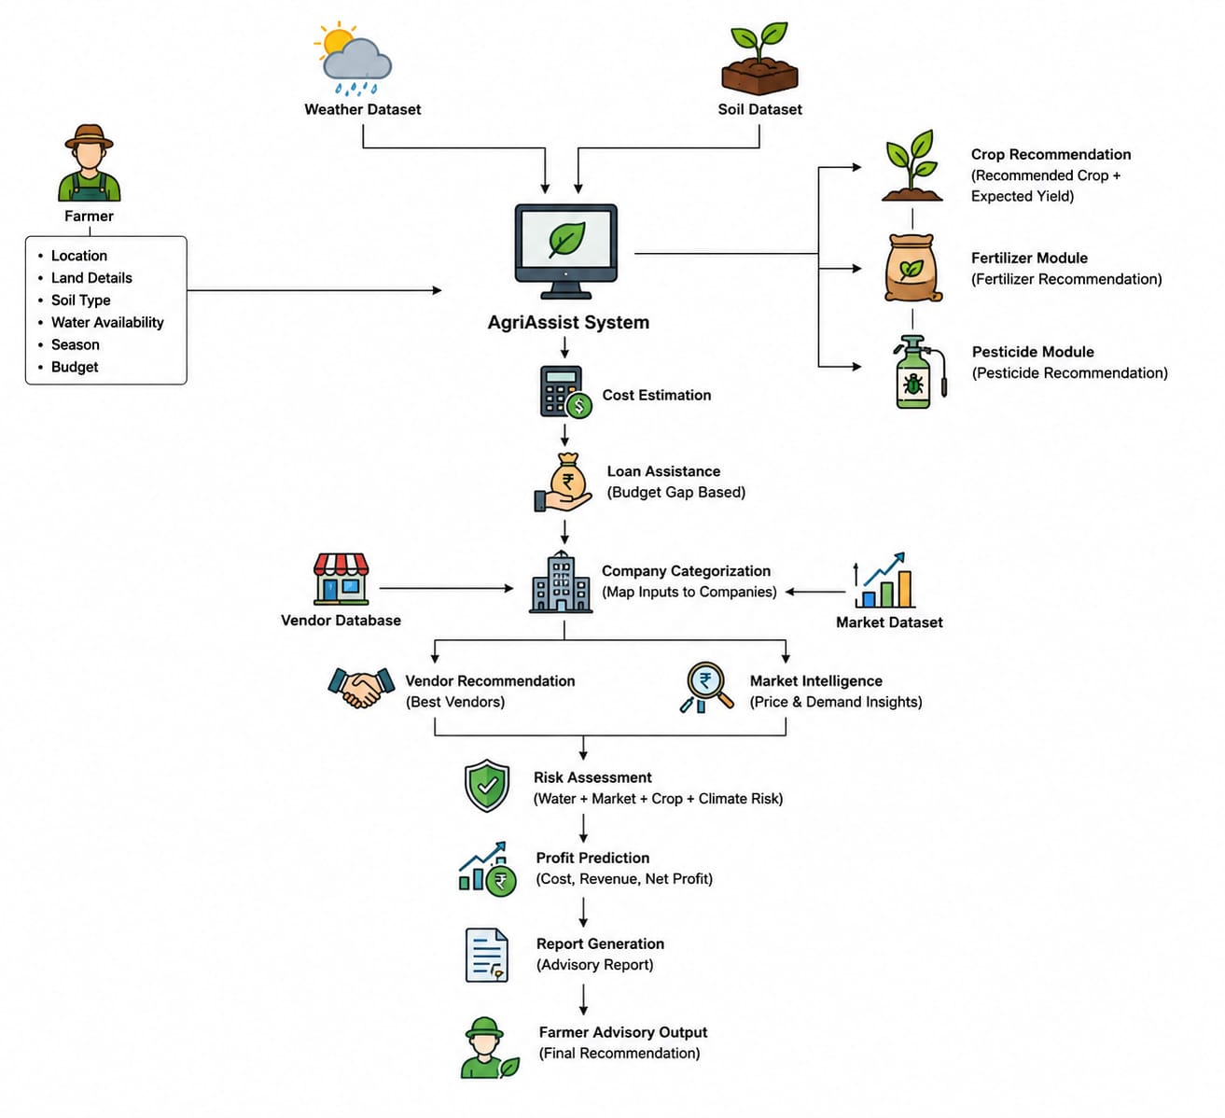
SYSTEM ARCHITECTURE
System Architecture for AgriAssist — Smart Farmer Advisory System
2. DATA LAYER
3. MODULE ENGINE
4. OUTPUT LAYER
5. REPORT LAYER
AgriAssist
No server · No database · No internet required — fully offline console application

Slide 6
TECHNICAL METHODOLOGY
Data Design
Module Execution Flow
□ 7 static JSON datasets loaded at startup
1. Profile Collection
2. Crop Engine
□ Crops, schemes, fertilizers, pesticides, loans, vendors, market prices
6 validated inputs from farmer
Score & rank all 10 crops
□ Flat-file design — no database server needed
3. Fertilizer + Pesticide
4. Scheme Advisor
Module Engine
Match to crop & soil type
Eligibility rules check
□ 12 modules run in strict dependency order
□ Each module receives output of prior module
5. Profit Predictor
6. Loan Module
□ Python classes + dataclasses for clean structure
Cost, revenue, ROI
Budget gap & loan options
Scoring Logic
7. Risk Assessment
8. Report Generator
□ Crop scoring: Soil(40) + Water(35) + Season(25) = 100pts
3-factor risk score
Final advisory output
□ Risk: Water risk + Market risk + Budget risk = 0-100%
□ Profit = Revenue − (Cultivation + Fertilizer + Pesticide)

Slide 7



EXPECTED OUTCOMES
What AgriAssist delivers to a farmer in one session:
Optimal Crop
Input Plan
Scheme Benefits
Best crop for current soil, water & season — with suitability score and 2 alternatives.
Correct fertilizer & pesticide with dosage, company name, and total cost per farm.
Up to 5 government schemes checked — PM-KISAN, Crop Insurance, Irrigation Subsidy & more.
Profit Forecast
Best Buyer
Risk Score
Full cost breakdown, expected revenue, net profit & ROI% before the season starts.
Ranked vendor list with price premium, rating & contact — no middleman required.
0–100% overall risk with water, market & budget sub-scores and plain-language verdict.
All outputs compiled into one printable Farmer Advisory Report

Slide 8
IMPACT & DISSEMINATION
Social Impact
• Reduces farmer dependence on middlemen.
• Surfaces government scheme benefits that go unclaimed.
• Empowers small & marginal landholders with expert-level advisory.
• Can be operated by CSC staff on behalf of low-literacy farmers.
567%
5+
ROI on sample farm
Schemes per farmer
₹0
100%
Economic Impact
• Sample scenario: Rs.2,98,375 net profit vs Rs.50,000 budget.
• Vendor recommendation delivers 6–10% above-market price.
• Input cost reduction through correct fertilizer/pesticide match.
Cost to deploy
Offline capable
Dissemination Plan
• Pilot at Krishi Vigyan Kendras (KVKs).
• Deploy at Common Service Centres (CSCs) in rural blocks.
• Partner with NGOs and Farmer Producer Organisations (FPOs).
• Zero cost deployment — standard Python 3.10+ on any laptop.
KVKs
CSCs
FPOs
NGOs
Agriculture Centres
Rural Service Centres
Farmer Collectives
Field Organisations

Slide 9
RESOURCES & TIMELINE
Project Timeline — 1 Weeks
Technical Resources
D 1
D 2
D 3
D 4
D 5
D 6
✓ Python 3.10+ (free)
1
2
3
4
5
6
✓ VS Code IDE (free)
✓ JSON datasets (built-in)
Foundation
Core Modules
Integration
Enhancement
Testing
Submission
✓ Any Windows/Linux laptop
Shared models, datasets, folder structure, stubs
Member 1 & 2 modules built and unit-tested
All modules wired through main.py controller
Member 3 skeleton completed, new modules added
5 farmer scenarios tested, edge cases fixed
Documentation, demo, presentation ready
✓ No internet required
Team Resources
✓ Member 1 — Crop Intelligence
✓ Member 2 — Finance & Govt
✓ Member 3 — Market & Report

Slide 10
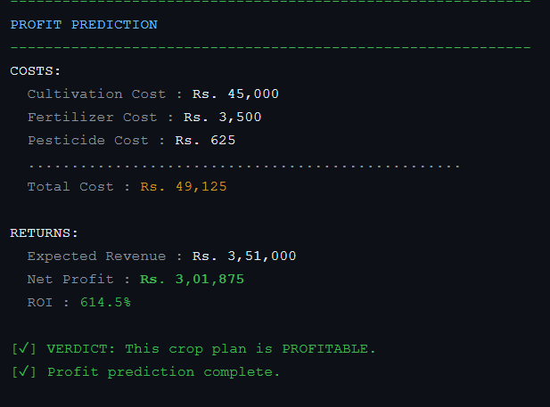
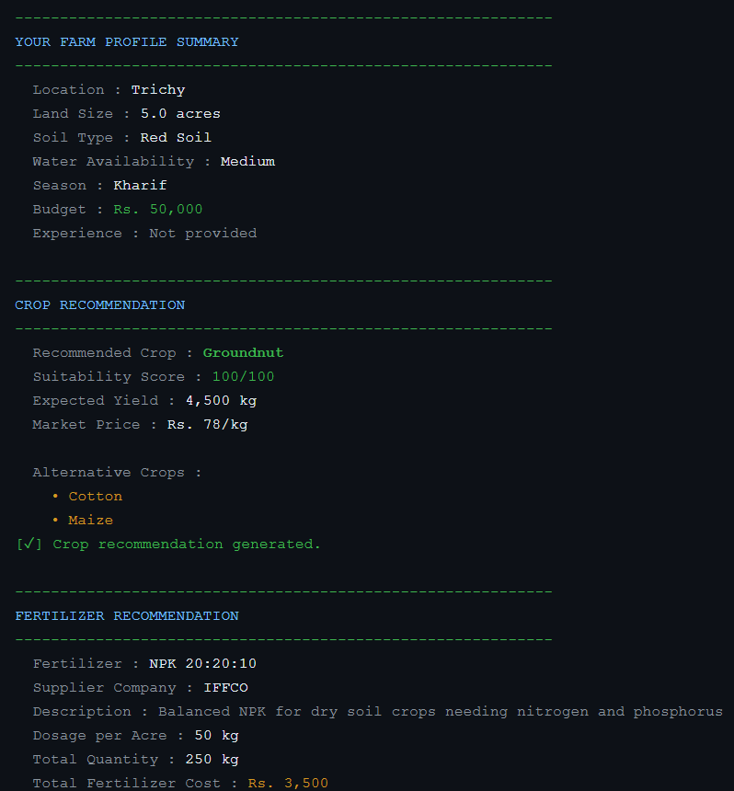
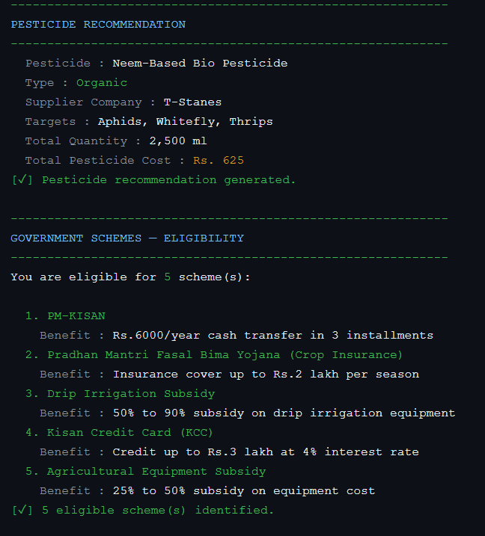
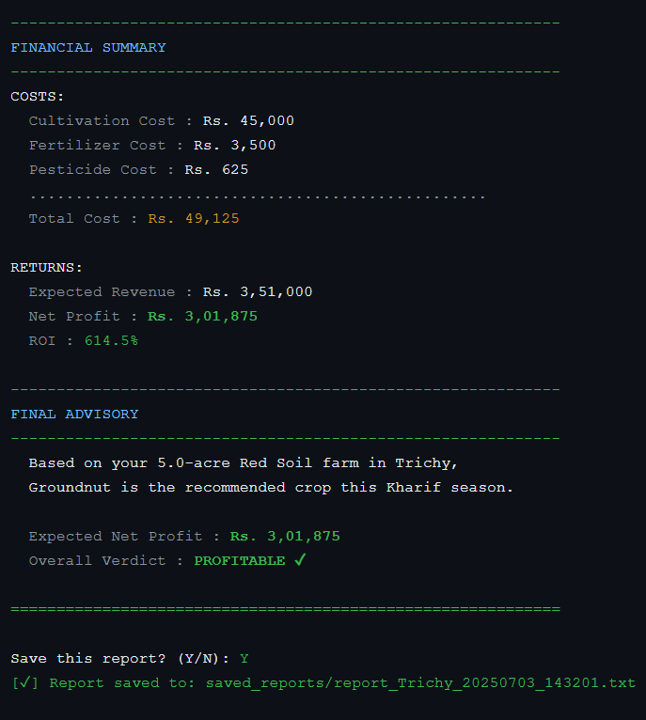
OUTPUT
6

Slide 11
CONCLUSION
Designed a 12-module console advisory system for small and marginal Indian farmers.
Combines crop science, government scheme awareness, financial planning, and market intelligence.
100% offline — runs on any laptop with Python, zero infrastructure required.
Delivers a complete Farmer Advisory Report in one guided session.
Scalable from academic project to KVK/CSC pilot deployment.
AgriAssist
AgriAssist
Final Outcome
A smart, interpretable, and accessible farmer advisory framework — built for rural India.
Thank You! QUESTIONS & DISCUSSION · Presented by: MUBARAK S

