Slide 1
INTEGRATED DIGITAL HOUSE RENTAL
AND TAX MANAGEMENT SYSTEM
RHTMS
A prototype platform connecting property owners, tenants, housing offices
and tax offices across the residential rental lifecycle.
Software Project Management — Final Presentation
Prepared by: Mubarek Hussein
16 September 2026
Institution / Department: [Insert] | Course: [Insert] | Supervisor: [Insert]

Slide 2
BACKGROUND
Background and Motivation
Residential rental registration and taxation in Addis Ababa involve multiple offices: a housing administration bureau and a separate tax/revenue process.
During our field investigation, we found the Addis Ababa Housing Development and Administration Bureau already operates a digital portal ("RHRCAS" / Mesob One-Stop-Shop) for landlord, tenant, house, and contract records, observed directly at two housing offices during our visit.
However, based on our interviews, tax-side verification of a rental agreement still depends on the physical, printed agreement being presented at the tax office — the two offices are not connected by a shared digital record.
Legal grounding referenced in this project: Housing Rent Control and Management Proclamation No. 1320/2016; Addis Ababa Directive No. 184/2025 (Residential Rent Control and Management); Income Tax (Amendment) Proclamation No. 1395/2025.
This motivated RHTMS: a prototype that models the full lifecycle — registration, housing approval, tenant registration, agreement, tax assessment, and payment — as one connected, role-based system.
RHTMS — Integrated Digital House Rental and Tax Management System
1

Slide 3
PROBLEM STATEMENT
Problem Statement
Based on our interviews and observations, we identified the following problems:
  The existing housing portal and the tax office are not connected — a physical agreement must be carried between offices for tax verification.
  No single, role-based workflow connects property owner, tenant, housing officer, and tax officer around one shared record.
  Verifying a rental agreement's authenticity outside an office visit is difficult — there is no independent, self-service check.
  Rental-income tax calculation is easy to get wrong when the exact rule isn't clearly specified — our own early prototype briefly used an incorrect flat rate before it was corrected against a real published source (see Slide 16).
Scope note: these findings come from a limited set of stakeholder interviews and site observations, not a comprehensive survey of every housing or tax office in Ethiopia.
RHTMS — Integrated Digital House Rental and Tax Management System
2

Slide 4
EXISTING PROCESS
Existing Process and Identified Gaps
Existing step (observed) | What we found | Gap our project addresses
Housing/contract registration | A digital portal (RHRCAS) already records landlords, tenants, houses, and contracts | Not connected to the tax office's own process
Tax verification | The physical, printed agreement is presented at the tax office | No digital handoff or shared record between housing and tax
Agreement authenticity check | Done visually / manually by office staff | No independent, self-service verification (e.g., QR code)
Cross-office status visibility | Not observed during our visits | No shared dashboard across owner, tenant, housing, and tax roles
Rental-income tax calculation | Handled by tax office staff | Risk of an incorrectly specified or applied rate without a structured, sourced model
Important: this does not mean the existing process is purely paper-based — a real digital housing portal exists (see Slide 6). The gap is the missing connection between housing records and tax verification.
RHTMS — Integrated Digital House Rental and Tax Management System
3

Slide 5
REQUIREMENTS GATHERING
Stakeholder Investigation and Data Collection
Stakeholder group | Who we spoke with
Tenant | Osman Muhammad
Property Owner | Solomon Hailu
Housing Officers | Getalem (Kirkos sub-city) · Meqdes (Lemi Kura sub-city)
Tax Officers | Yimam Yimer · Dula (Arada sub-city)
Purpose of the interviews:
  Understand the existing rental registration and agreement process.
  Identify housing approval activities and tax document verification steps.
  Find manual, disconnected, or repetitive steps.
  Understand how tenants/owners interact with offices.
Main findings (based on our interviews and observations):
A digital housing portal already exists and is used at the housing offices we visited (Kirkos, Lemi Kura).
Tax offices (Arada) still rely on the physical agreement being brought in for verification and assessment.
There is no shared digital record linking housing-side registration to tax-side assessment.
These findings directly shaped our requirements: QR-based public verification, role-based dashboards connecting housing and tax officers, and a structured, sourced tax-bracket assessment tied to the agreement record.
These interviews and observations are a limited stakeholder sample used to inform this prototype's design — not a claim of representing every tenant, owner, or office in Ethiopia.
RHTMS — Integrated Digital House Rental and Tax Management System
4

Slide 6
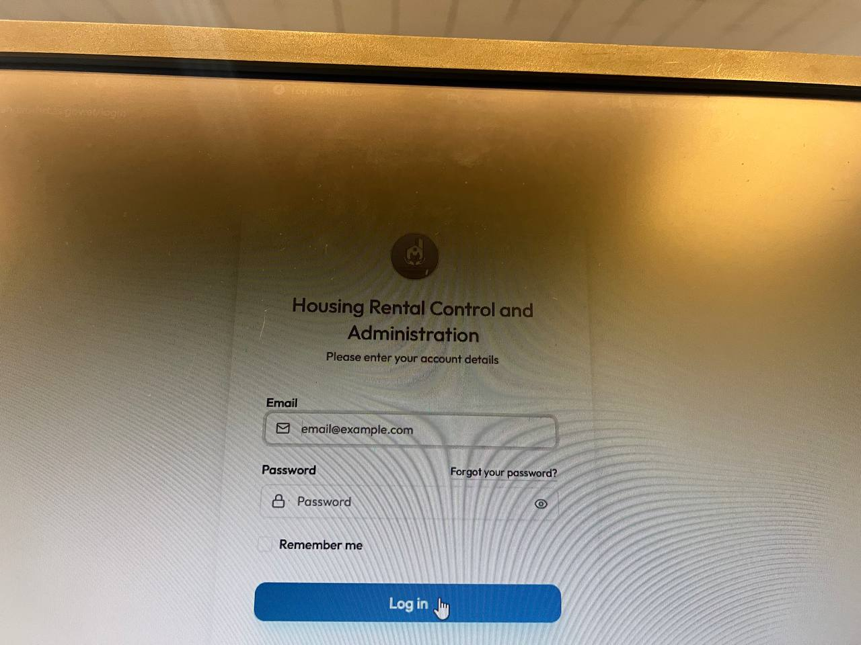
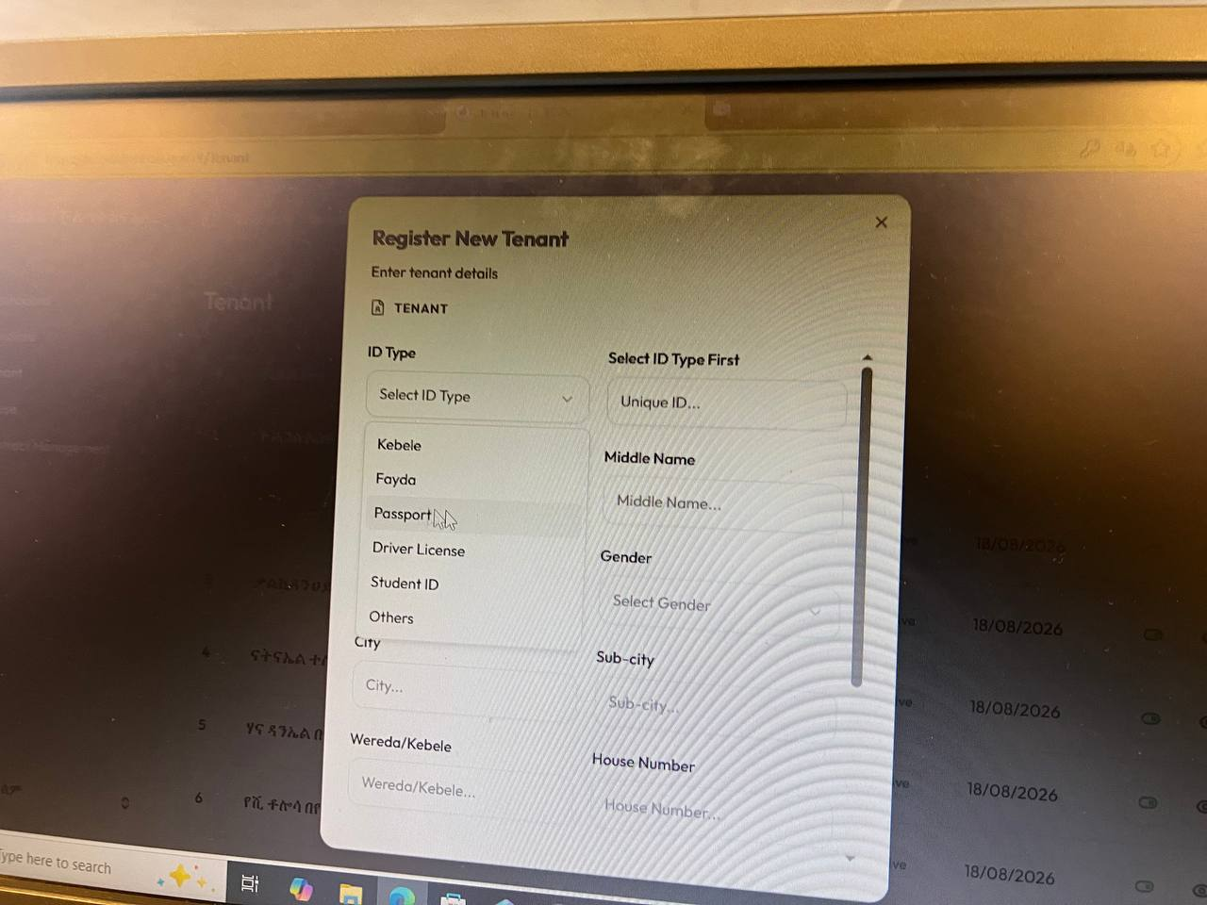
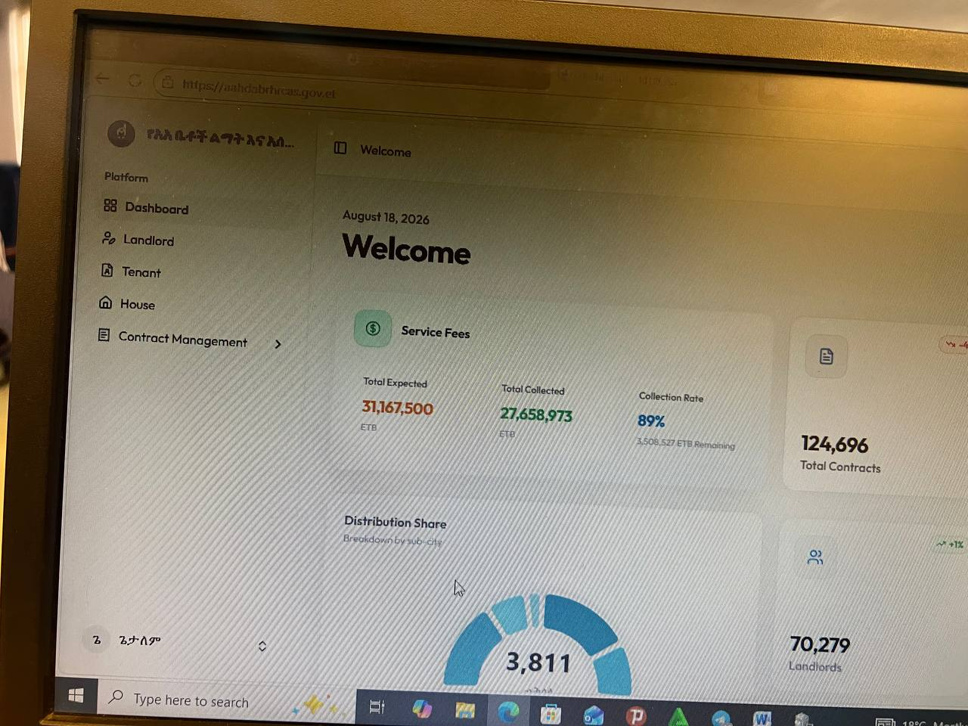
EXISTING PROCESS EVIDENCE
Existing System: A Digital Portal Already In Use
The housing bureau's existing portal login screen, observed during our site visit.
Its "Register New Tenant" form — structured data entry already exists for tenant records.
Its live dashboard: 124,696 total contracts, 70,279 landlords, 89% service-fee collection rate.
This confirms the existing process is not purely manual: a real, operational government digital portal already handles landlord, tenant, house, and contract records at real scale.
Identified limitation (from our interviews): this portal's records are not connected to the tax office's own verification and assessment step — that gap is what RHTMS's prototype targets.
RHTMS — Integrated Digital House Rental and Tax Management System
5

Slide 7
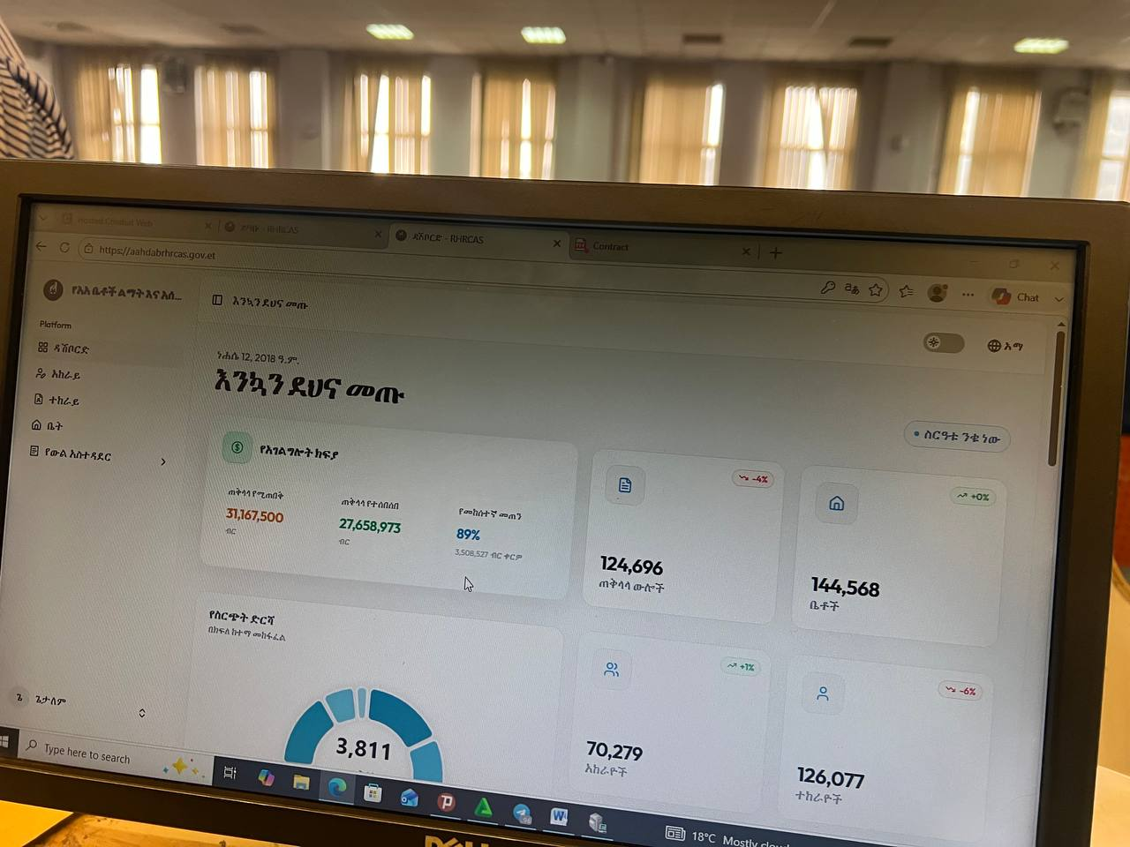
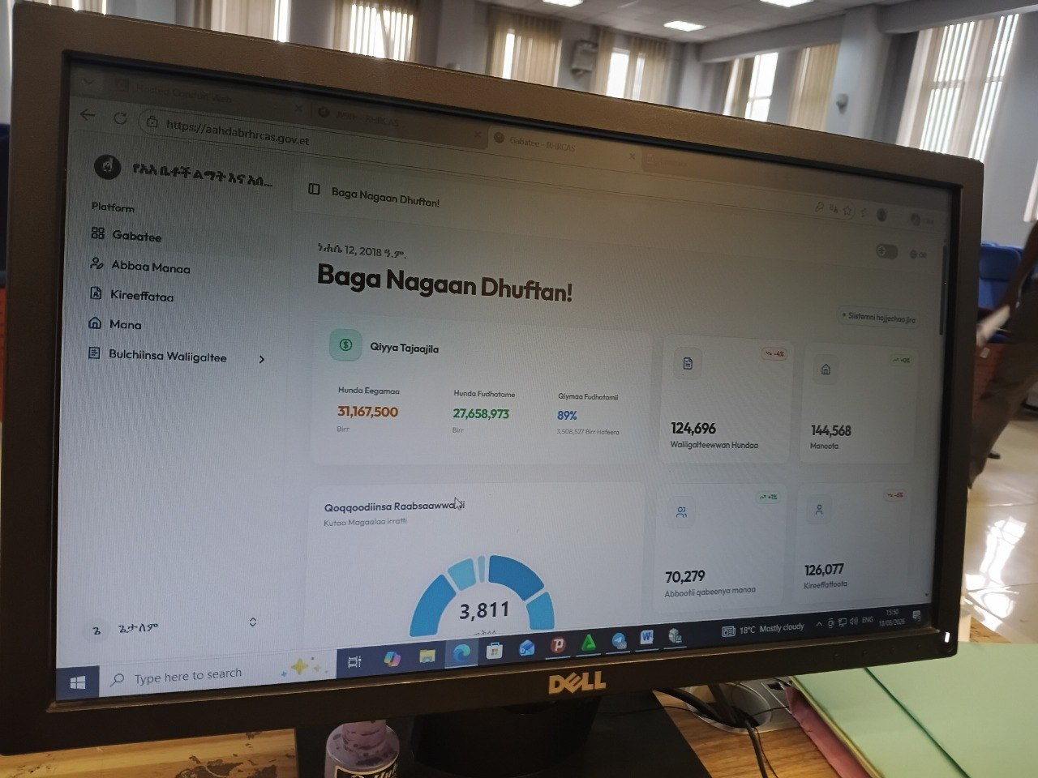
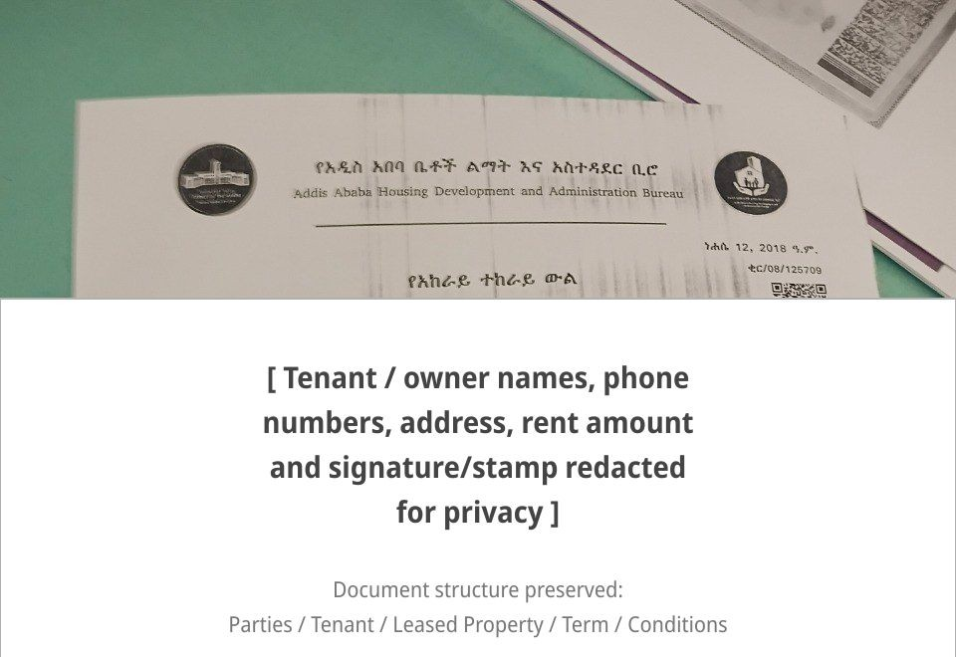
EXISTING PROCESS EVIDENCE
Multilingual Support and the Physical Agreement Handoff
The same existing portal already serves English, Amharic, and Afaan Oromoo:
English
Amharic (አማርኛ)
Afaan Oromoo
This directly echoes RHTMS's own English / Amharic / Afaan Oromoo interface (Slide 17).
This physical agreement is prepared and presented during the existing administrative and tax-related process — consistent with what our tenant, owner, and officer interviews described.
This is observed evidence, not a claim that RHTMS has legally replaced this physical document or any government system.
It motivated two concrete features: QR-based public contract verification, and a shared, structured tax-assessment record tied directly to the digital agreement.
A rental agreement issued by the Addis Ababa Housing Development and Administration Bureau. Personal details (names, phone numbers, address, rent amount, signature/stamp) are redacted for privacy; only the document header/template is shown.
RHTMS — Integrated Digital House Rental and Tax Management System
6

Slide 8
PROPOSED SOLUTION
Proposed Solution and Project Objectives
Proposed solution
  One shared, role-based, database-backed prototype connecting property owners, tenants, housing officers, and tax officers around the same agreement record — from registration through tax assessment.
General objective
  Design and implement a digital platform modeling the residential rental lifecycle, connecting the roles identified in our stakeholder investigation under role-based access.
Specific objectives
  Property registration, housing review/approval, tenant registration, and rental agreements with price validation.
  A verifiable digital contract (QR code) and a sourced, progressive rental-income tax assessment.
  Role-based access control with record-level ownership checks and a full audit trail.
  An interface in English, Amharic, and Afaan Oromoo.
RHTMS — Integrated Digital House Rental and Tax Management System
7

Slide 9
SCOPE AND ROLES
Scope, Stakeholders, and System Roles
Property Owner
Tenant
Housing Officer
Registers properties, creates rental agreements, pays service fees, views tax status
Is registered onto agreements, pays rent-related fees, requests termination
Reviews/approves properties and agreements, reviews penalties
Tax Officer
Super Admin
Public / Verifier
Assesses rental-income tax against the active bracket table
Manages users, tax brackets, penalty/price rules, audit log
Scans a contract's QR code to confirm it is genuine — no login required
In scope: the roles and workflow above, as a prototype. Out of scope: direct integration with the government RHRCAS portal or any real payment/banking network (see Limitations, Slide 19).
RHTMS — Integrated Digital House Rental and Tax Management System
8

Slide 10
SYSTEM WORKFLOW
Main System Workflow (Implemented)
Property registration
Housing approval
Tenant registration
Rental agreement
Owner submits
Approve / reject / correction
Self or owner-initiated
+ price validation
Service fee (simulated)
Housing approval
Contract + QR verification
Tax assessment
Mock payment provider
= activation, same event
Public, no login needed
Progressive brackets
Tax payment (simulated)
Notification
Compliance / penalty
Termination
Mock payment provider
In-app, event-triggered
Recorded, reviewed
Dual-party + officer approval
Every payment step is a simulated/mock provider (CBE, Telebirr, Bank Transfer, Cash) — no real transaction occurs. All other steps shown are implemented against the real database.
RHTMS — Integrated Digital House Rental and Tax Management System
9

Slide 11
REQUIREMENTS
Functional Requirements
Requirement | Status | Evidence
User authentication | Implemented | Auth.js credentials + JWT sessions
Role-based access control | Implemented | Central permission map + middleware role gate
Property registration & approval | Implemented | Owner submit → officer approve/reject/correction
Tenant registration | Implemented | Self-service or owner-initiated
Rental agreement + price validation | Implemented | Configured expected price ranges
Rental price-increase regulation | Implemented | 2-year wait, 11.5% cap — see Slide 16
Tax assessment | Implemented (prototype) | Progressive brackets, sourced (see Slide 16)
Payment record management | Prototype / Simulated | Mock multi-provider abstraction
QR / public verification | Implemented | Public /verify/[token] page
Notifications | Partially implemented | In-app only; no SMS/email or scheduling
Audit logs | Implemented | Actor, action, before/after value
Reports & admin configuration | Implemented | Live revenue figures, rule management
Real government/bank integration | Not implemented (planned) | See Future Work
RHTMS — Integrated Digital House Rental and Tax Management System
10

Slide 12
REQUIREMENTS
Non-Functional Requirements
Category | Requirement | Status
Security | Only authorized users act on records they own or their role covers | Implemented — see Slide 18
Auditability | Every sensitive change is traceable | Implemented — AuditLog
Data integrity | Historical records never silently overwritten | Implemented — versioned agreement history
Usability | Interface usable in the user's preferred language | Implemented — English/Amharic/Afaan Oromoo
Maintainability | Business rules changeable without a code deploy | Implemented — configurable database rules
Reliability | Core logic verified without a browser | Implemented — automated validation scripts
Performance / Scalability | Response time and load under many users | Not formally tested — future validation needed
RHTMS — Integrated Digital House Rental and Tax Management System
11

Slide 13
ARCHITECTURE
System Architecture
User
The property owner, tenant, housing officer, tax officer, or admin, using a browser
Next.js / React Interface
App Router pages, role-based dashboards, forms, client interactions
Application / Business Services
Authentication, role-based authorization, validation, workflow and tax-calculation logic
Prisma ORM
Typed queries, migrations, data access layer
PostgreSQL Database
Single source of truth for all persisted data
A layered, modular-monolith architecture — one deployable application, internally separated by responsibility. Not a microservices system.
RHTMS — Integrated Digital House Rental and Tax Management System
12

Slide 14
DATA MODEL
Database / Major Entities
Identity & Access
Property
User, OwnerProfile, TenantProfile, StaffProfile
Property, Ownership, PropertyDocument, PropertyReview, SubCity, Woreda
Agreement
Tax
RentalAgreement, AgreementVersion, AgreementReview, RentalPriceRule
TaxRule, TaxBracket, TaxAssessment
Compliance & Payments
Admin / Audit
PenaltyRule, Penalty, Payment
Notification, AuditLog, SystemConfiguration
23 Prisma models in total. Key design choice: agreement price changes are versioned (AgreementVersion), never overwritten, and tax rates are stored as editable TaxBracket rows, not hard-coded.
RHTMS — Integrated Digital House Rental and Tax Management System
13

Slide 15
PROJECT MANAGEMENT
Project Management and Team Collaboration
Task assigned / discussed
Communication
  The team communicated through a Telegram group — sharing progress and informing others when work was completed.
Version control
  GitHub was used for code collaboration. The repository uses feature branches (e.g. develop, feat/*) alongside main, with work reviewed before being integrated.
Review and change process
  Issues and changes were discussed before or during implementation; feedback and approval were communicated through the team group and the development workflow itself.
No formal Scrum ceremonies (sprints, daily stand-ups, retrospectives) were used — this reflects our actual, lighter-weight process, not an oversight.
Member implements changes
Changes shared through GitHub
Team review and feedback
Comments, corrections, or approval
Changes integrated into the project
RHTMS — Integrated Digital House Rental and Tax Management System
14

Slide 16
IMPLEMENTATION
Implementation Status and Major Developed Features
Property lifecycle — registration, housing review (approve/reject/correction), status-gated agreement creation.
Agreement lifecycle — creation, price validation, service-fee payment, housing approval → activation, contract/QR issuance, renewal, termination.
Tax (prototype) — progressive rental-income tax brackets, sourced from PwC Worldwide Tax Summaries — Ethiopia; corrected during development from an earlier, incorrect flat-rate assumption.
Rental price-increase regulation — a 2-year waiting period and an 11.5% cap on any rent increase, kept strictly separate from the tax calculation above.
Payments (simulated) — a mock multi-provider abstraction (CBE, Telebirr, Bank Transfer, Cash); no real transaction occurs.
Notifications — in-app, triggered by real business events (approvals, payments, tax assessment, penalties).
Localization — English, Amharic, Afaan Oromoo across the implemented workflow.
Admin console — user management, tax-bracket/penalty/price-rule management, audit log, live revenue reports.
RHTMS — Integrated Digital House Rental and Tax Management System
15

Slide 17
SECURITY
Security, Authentication, and Role-Based Access Control
Authentication — Auth.js (NextAuth v5), credentials provider with bcrypt-hashed passwords, JWT session strategy.
Role-based access control — a central permission map defines what each of the 5 roles may do; every server action re-checks it.
Record-level authorization — ownership checks stop one owner from reading or writing another owner's property or agreement.
Route-level role enforcement — every dashboard is gated in request middleware so one role cannot open another role's dashboard by navigating directly to its URL.
Development lesson: during a final review, a cross-role dashboard access issue was identified — a role-specific page guard was not being reliably re-checked on every request. It was corrected by enforcing the check in request middleware and re-verified across all five roles. This reflects that role-based access requires continuous testing, not a one-time implementation.
Audit trail — every write to a sensitive record is logged with actor, action, and before/after values.
PROPERTY_OWNER
TENANT
HOUSING_OFFICER
TAX_OFFICER
SUPER_ADMIN
RHTMS — Integrated Digital House Rental and Tax Management System
16

Slide 18
TESTING
Testing and Validation
Area | Validation method | Result
Type safety | npm run typecheck (tsc) | Pass
Code quality | npm run lint (ESLint) | Pass
Localization | verify:i18n script — catalog + key parity across 3 locales | Pass — 424 keys matched
Tax calculation | verify:tax — bracket, boundary, zero-rate, invalid-input tests | Pass
Rent-increase rule | verify:rent-increase — waiting period, cap, decrease cases | Pass
End-to-end lifecycle | verify:workflow — 16-step scripted run against the real database | Pass
Role-based access, logout, QR verification | Manual HTTP/session-level testing (curl with real sessions) | Confirmed
Full UI/browser regression, load/performance testing | Not performed in this project | Requires further validation
RHTMS — Integrated Digital House Rental and Tax Management System
17

Slide 19
LIMITATIONS
Limitations and Future Improvements
Limitations
  Payment integrations are simulated — no real bank or mobile-money connection.
  No direct integration with the existing government housing portal (RHRCAS) observed during our investigation.
  Tax brackets are sourced, but a small rounding difference can occur exactly at a bracket boundary.
  The rent-increase figures (2 years, 11.5%) are project-owner-supplied requirements, not independently verified against a cited proclamation article.
  No production deployment; performance/load testing not yet performed.
Future Work
  Explore integration with authorized government systems, where permitted.
  Real payment-provider integration behind the existing interface.
  Expanded stakeholder testing and formal performance/security testing.
  SMS/email notifications, document upload, and a tenant-initiated request-to-rent flow.
RHTMS — Integrated Digital House Rental and Tax Management System
18

Slide 20
CONCLUSION
Our stakeholder investigation found that Addis Ababa's housing offices already use a digital portal, but tax verification still depends on a physical agreement moving between offices, with no shared record connecting the two.
RHTMS is our prototype response: a single, role-based platform carrying a property and its agreement from registration through housing approval, tax assessment, and termination.
Across development, we identified and corrected real defects in our own implementation — a terminology error, a cross-role access-control gap, and an incorrect tax-rate model — and implemented the rental price-increase rule as a feature kept strictly separate from tax.
Key contribution: a working, evidence-based prototype — grounded in real stakeholder interviews and a real observed system, with disclosed limitations and a clear boundary between what is implemented, what is simulated, and what remains future work.
Our current prototype supports a connected, role-based, auditable rental and tax workflow — built and corrected through an evidence-based development process.
RHTMS — Integrated Digital House Rental and Tax Management System
19

