Slide 1
Internet Technology
Lecture 1

Slide 2
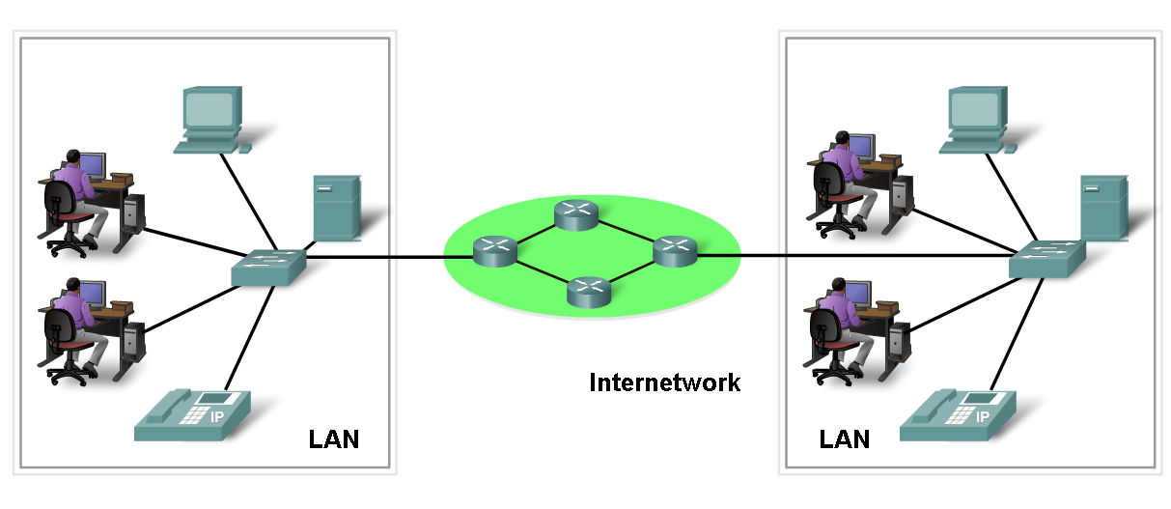
2- Network definition
Network:
Group of components or devices which are connected together to give the user a certain service (application).

Slide 3
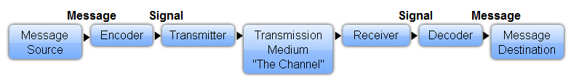
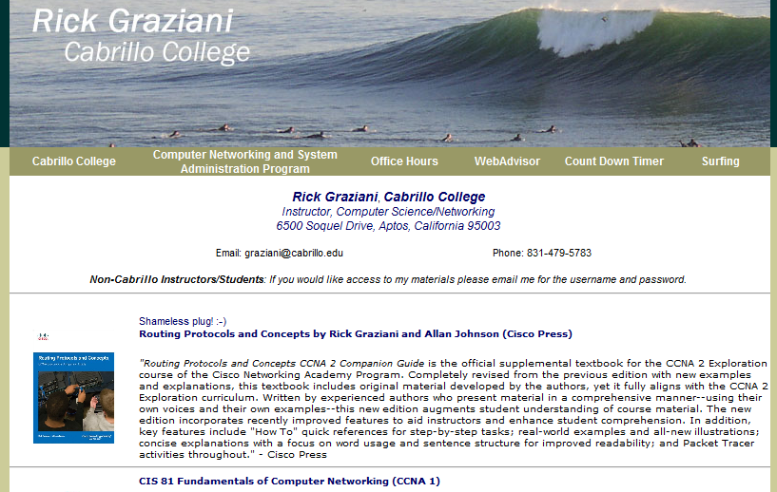
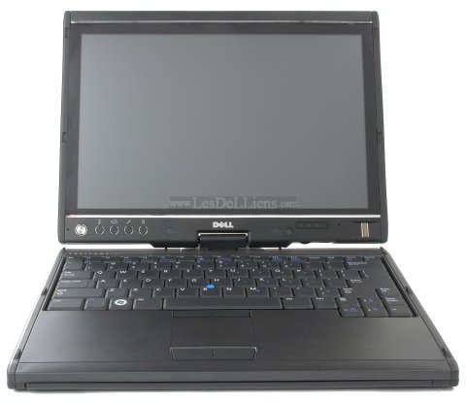
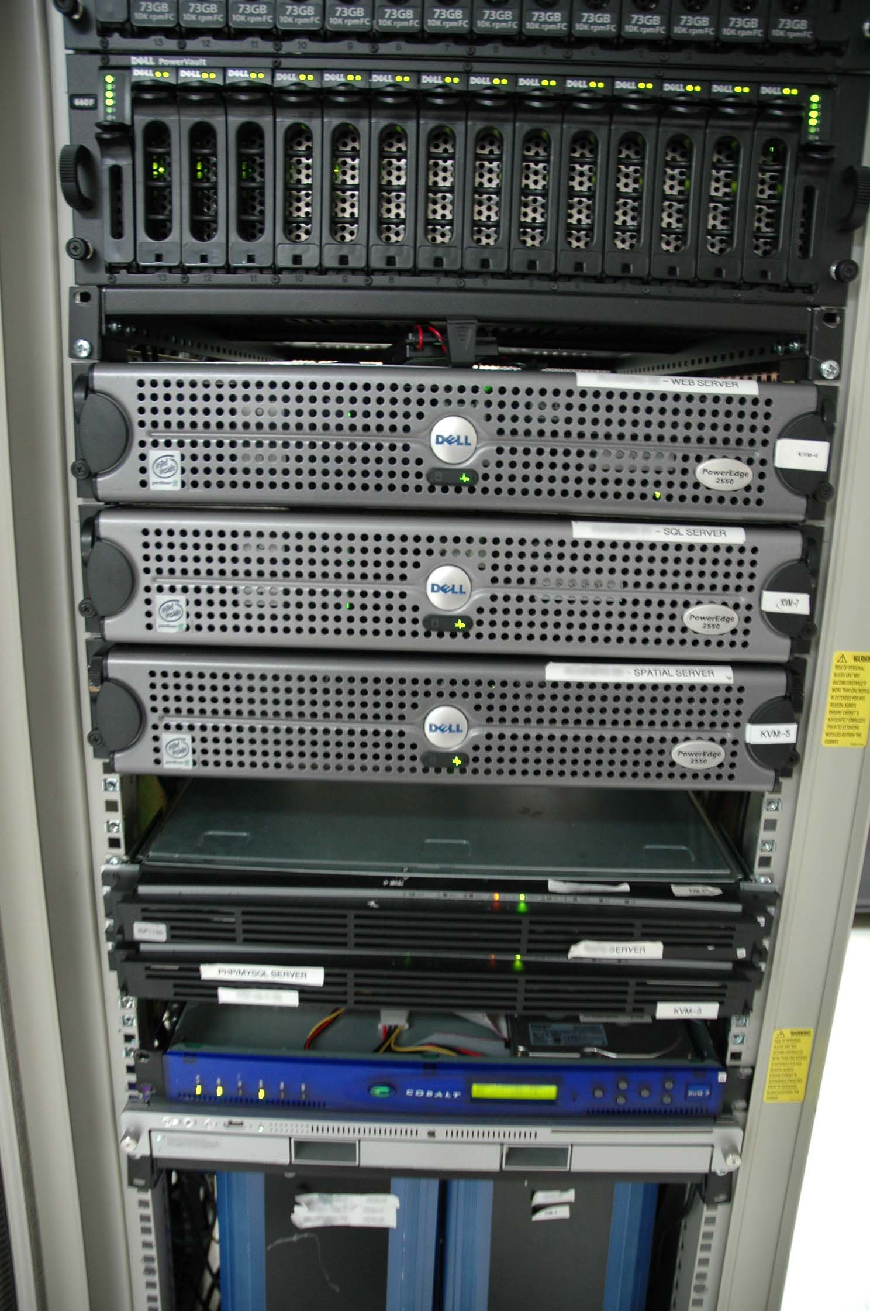

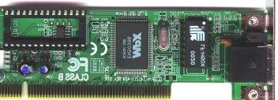
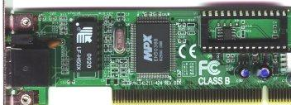
1- Elements of Communication

Slide 4
3- Network components
Network has three main components
  End devices (servers and hosts)
  - Source of applications (network aware applications)
  - ex: HTTP (Hyper Text Transmission Protocol),
  FTP (File Transfer Protocol),
  SMTP (Simple Mail Transfer Protocol)
  POP3 (Post Office Protocol 3)
  Telnet
  Network Devices
  - Devices that interconnect different computers together
  - ex: Repeaters, hub, bridge, switch, router, NIC and modems
  Connectivity
  - Media that physically connect the computers and network devices
  - ex: Wireless and cables

Slide 5
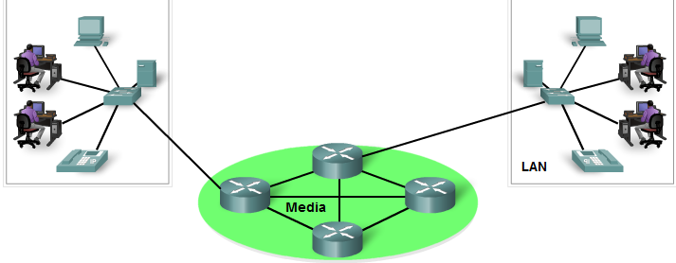
Intermediary Devices
switch or hub
switch or hub
routers
Intermediary devices:
  Provide connectivity to the network (switches/hubs)
  Connect individual networks (routers)
Examples:
  Network Access Devices (Hubs, switches, and wireless access points)
  Internetworking Devices (routers)
  Security Devices (firewalls)

Slide 6
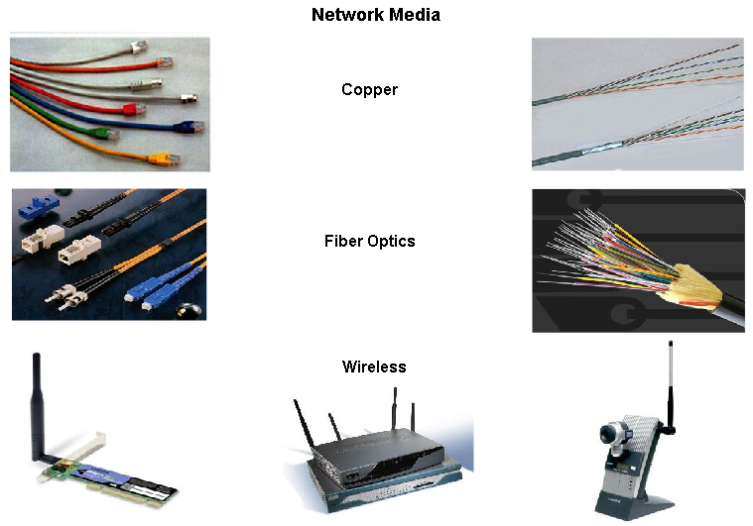
Network Media
Network media: The medium provides the channel over which the message travels from source to destination.
  Metallic wires - encoding into patterns of electrical impulses.
  Fiber optics – encoding into pulses of light (infrared or visible light ranges)
  Wireless – encoding patterns of electromagnetic waves.
(Later: OSI Physical Layer)

Slide 7
Network Media
Different media considerations:
  Distance it can carry the signal
  Environment it works in
  Bandwidth
  Cost of medium and installation
  Cost of connectors and equipment

Slide 8
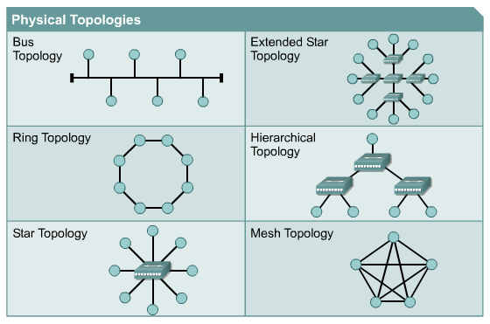
4- Network Topologies
Topology: How devices are connected together
  Physical Topology: It describes how devices are physically cabled
  Logical Topology: It describes how devices communicate across
  physical topology

Slide 9

Physical VS. Logical Topology
10-Base-2
10-Base-5
Physical Topology is
Bus
Logical Topology is
Bus

Slide 10
5- Network Types
LAN (Local Area Network):
It is a group of network components that work within small area.
It characterized by high data speeds (up to 10Gbps) using:
Ethernet, Fast Ethernet, GigaEthernet,10Gigabit Ethernet
and ATM.
MAN (Metropolitan Area Network):
It is a group of LANs that are interconnected within small area.
It characterized by very high data speeds (up to 40Gbps) using:
Metro Ethernet, ATM over SONET and SDH.
WAN (Wide Area Network):
It is a group of LANs that are interconnected within large area
It characterized by slow data speeds (up to 155Mbps & 622Mbps
using:
analog dial-up, digital dial-up (ISDN), leased lines, X.25, DSL,
Frame-Relay & ATM.

Slide 11
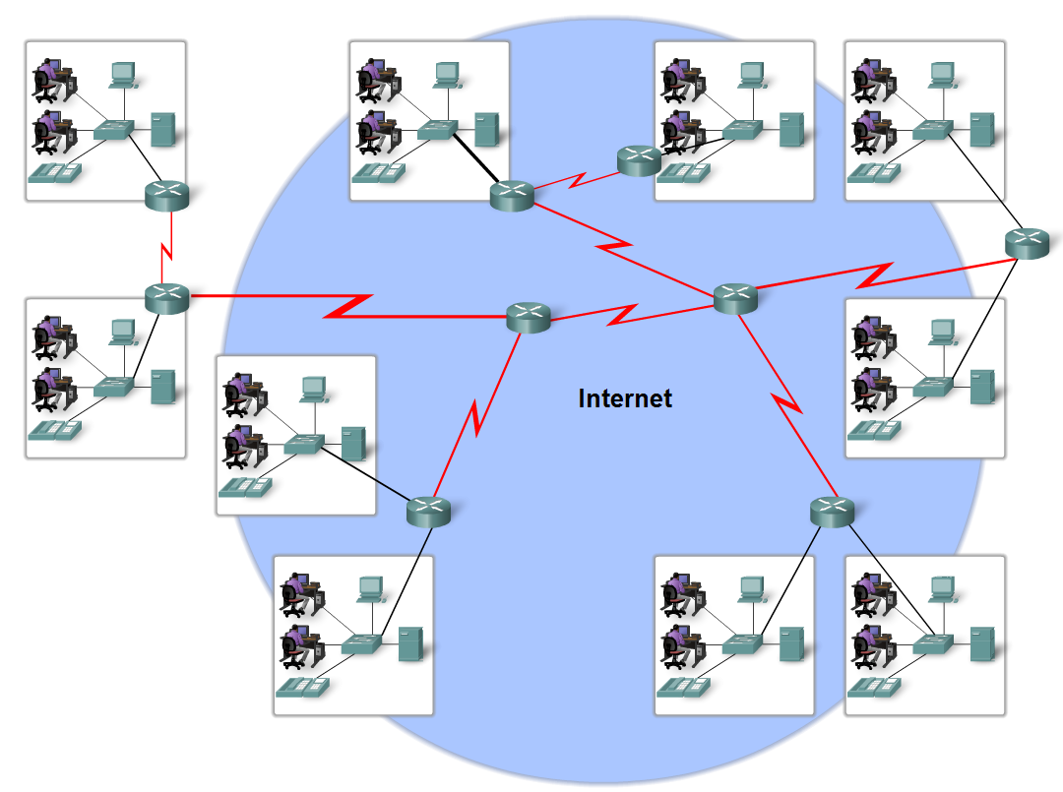
Network Types
Define the Internet
  The internet is defined as a
  global mesh of interconnected networks

Slide 12
Internet Architecture
Hosts, links, routers, switches
  LAN, MAN, WAN structures
  Client–server vs peer-to-peer architecture

Slide 13
6- Reference Models
A framework (guideline) for network implementation and troubleshooting
Divides complex functions into simpler components
Importance of reference model:
  Vendor interoperability “standardization”.
  Better understanding of data transfer
Reference model types :
  OSI (Open System Interconnection ).
  TCP/IP (DOD Model)

Slide 14
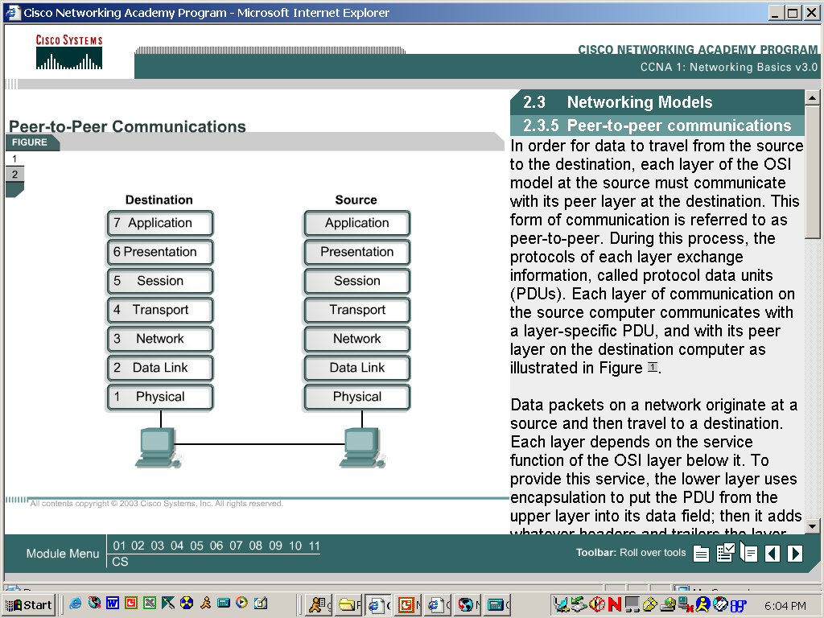
OSI-RM

Slide 15
Layer 7 - The Application Layer
7 Application
It’s the S\w on our pcs that is used to represent a user interface to the network & so aids the user to make applications.
Examples:
Email (SMTP,POP3)
Web browsers (HTTP)
FTP
Telnet
6 Presentation
5 Session
4 Transport
3 Network
2 Data Link
1 Physical

Slide 16
Layer 6 - The Presentation Layer
7 Application
This layer is responsible for presenting the data in the proper format .
Examples:
ASCII, AVI,JPG,….
6 Presentation
5 Session
4 Transport
3 Network
2 Data Link
1 Physical

Slide 17
Layer 5 - The Session Layer
7 Application
Ensure that all information required for opening a session is available.
Give orders for: establishment, management, and termination of the session.
6 Presentation
5 Session
4 Transport
3 Network
2 Data Link
1 Physical

Slide 18
Layer 4 - The Transport Layer
Responsible for actual mechanism of:
Establishment of connection.
Management of connection:
2.1) segmentation.
2.2) sequencing.
2.3) end-to-end check.
2.4) error detection &correction.
2.5) flow control.
Termination of connection.
Examples:
TCP (transmission control protocol).
UDP (User Datagram Protocol).
7 Application
6 Presentation
5 Session
4 Transport
3 Network
2 Data Link
1 Physical

Slide 19
Layer 3 - The Network Layer
7 Application
Responsible for:
End-to-end delivery.
Logical addressing .
EX: IPv4,IPv6,IPX,APPLETALK
3. Routing (choose the best path to destination.)
EX: RIP,OSPF,IS-IS,EIGRP
6 Presentation
5 Session
4 Transport
3 Network
2 Data Link
1 Physical

Slide 20
Layer 2 - The Data Link Layer
7 Application
6 Presentation
Responsible for:
Hop-to hop data delivery.
Hop-to-hop addressing (MAC Address in Ethernet).
Hop-to-hop error detection
Hop-to-hop flow control.
5 Session
4 Transport
3 Network
2 Data Link
1 Physical

Slide 21
Layer 1 - The Physical Layer
7 Application
6 Presentation
It’s responsible for all Physical properties of the network :
1. Cable length.
2. Cable type.
3. Bit rate.
4. Voltage levels.
5. H/W interface types.
5 Session
4 Transport
3 Network
2 Data Link
1 Physical

Slide 22
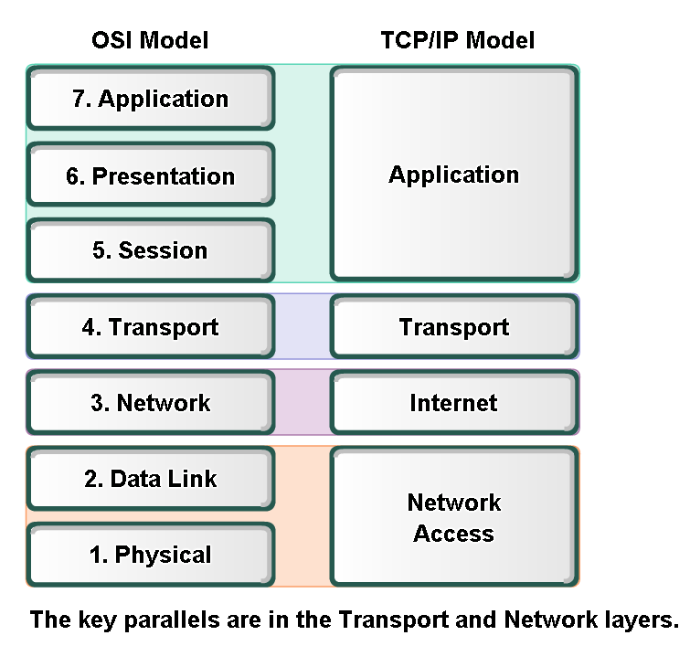
Layers with TCP/IP and OSI Model
Compare OSI and TCP/IP model

Slide 23
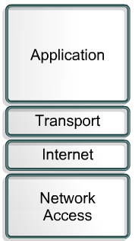
TCP/IP Model
How each layer is implemented.

Slide 24
TCP/IP Model
Application Layer – HTTP, FTP, SMTP
  Transport Layer – TCP reliability, UDP speed
  Network Layer – IP addressing & routing
  Link Layer – Ethernet, Wi-Fi

Slide 25
Routers & Routing
Forward packets between networks
  Use routing tables
  Routing protocols: RIP, OSPF, BGP

Slide 26
IP Addressing
IPv4: 32-bit, dotted decimal
  IPv6: 128-bit, larger address space
  Subnetting concepts

Slide 27
DNS (Domain Name System)
Translates domain names to IPs
  Root, TLD, authoritative servers
  DNS caching & lookup process

Slide 28
HTTP / HTTPS
HTTP methods: GET, POST, PUT, DELETE
  Stateless protocol
  HTTPS adds TLS encryption

Slide 29
Email Protocols
SMTP – sending email
  POP3 – downloading email
  IMAP – synchronizing email

Slide 30
Network Devices
Router – connects networks
  Switch – connects devices in LAN
  Firewall – filters traffic
  Access Point – wireless connectivity

Slide 31
Internet Performance Metrics
Bandwidth – maximum data rate
  Latency – delay
  Jitter – variation in delay
  Packet loss – missing packets

Slide 32
Network Security Basics
Encryption – protects confidentiality
  Firewalls – block unauthorized access
  VPN – secure remote access
  Attacks: DDoS, phishing, malware

Slide 33
Cloud Computing Basics
IaaS – infrastructure
  PaaS – platform
  SaaS – software services
  Benefits: scalability, reliability

