Slide 1
Chapter three

Slide 2
Ethernet describes the physical and data link layer.
Ethernet is a way of connecting Devices together in a LANs. It defines wiring and signaling for the Physical layer of the OSI model. For the Data Link layer, it defines frame formats and protocols.
Ethernet is not a single protocol but an entire collection of different standards. These standards come from the IEEE and all of them start with 802.3 in their name.
The term Ethernet LAN refers to a combination of computers, switches, and different kinds of cables that use the Ethernet standard to communicate over the network.

Slide 3
Introduction to Ethernet
Here’s an overview with some popular Ethernet standards:
Bandwidth | Common Name | Informal name | IEEE name | Cable Type
10 Mbps | Ethernet | 10BASE-T | 802.3 | UTP 100m
100 Mbps | Fast Ethernet | 100BASE-T | 802.3u | UTP 100m
1000 Mbps | Gigabit Ethernet | 1000BASE-LX | 802.3z | Fiber 5000m
1000 Mbps | Gigabit Ethernet | 1000BASE-T | 802.3ab | UTP 100m
10 Gbps | 10 Gigabit Ethernet | 10GBASE-T | 802.3an | UTP 100m

Slide 4
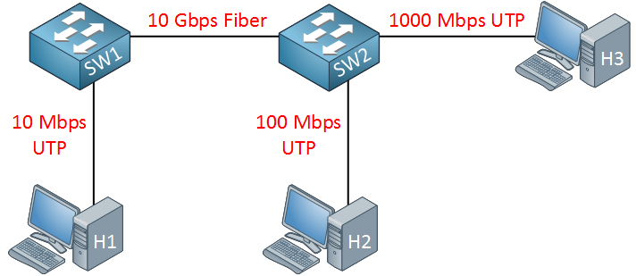
Physical Layer
You can mix different Ethernet standards in your network. Here’s an example:
There are two cables we can use for Ethernet:
UTP (Unshielded Twisted Pair)
Glass fiber

Slide 5
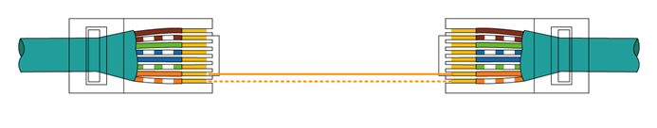
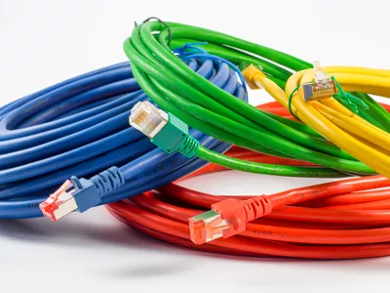
Physical Layer
UTP Cabling
UTP cables use copper to transmit an electrical signal. The advantage of UTP is that it’s cheap and easy to work with. One of the disadvantages is that you can only use it up to 100 meter.
To use an electrical signal to transmit data, we need two things:
An electrical circuit.
Something to communicate a 1 or 0 to the other side.

Slide 6
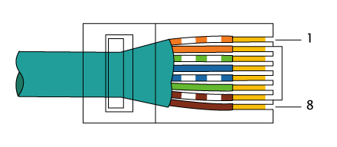
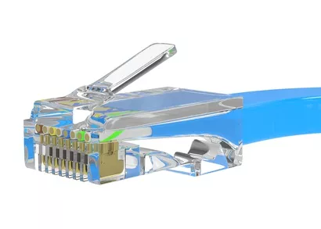
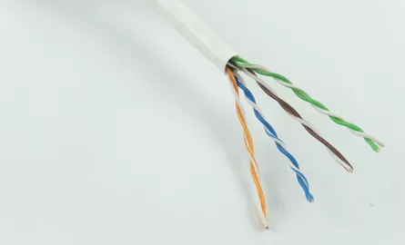
Physical Layer
UTP Cabling
As you can see side, the UTP cable has 4 wire pairs with 2 wires each. Each wire pair has two matching colors. For example, blue and blue-white. On the end of the UTP cable, we use an RJ45 connector:
The RJ45 connector has 8 spots where the wires can be inserted, called “pins”. We count the pin numbers from left to right, looking at the bottom of the RJ45 connector.
The cable with connectors is then connected to a NIC (Network Card) or a switch port:

Slide 7
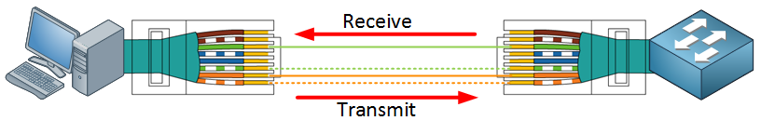
Physical Layer
UTP Cabling
1- Straight Through Cable
10BASE-T and 100BASE-T both use only two wire pairs in a UTP cable, one for transmission and the other for receiving.
On the left side, we use the orange/orange-white wires to transmit data (pin 1 and 2), the green/green-white wires (pin 3 and 6) are used to receive data. On the other end, we receive data on the orange/orange-white wires (pin 1 and 2) and transmit on the green/green-white wires (pin 3 and 6).
We call this the straight through cable, the wires on both ends are connected one-to-one.

Slide 8
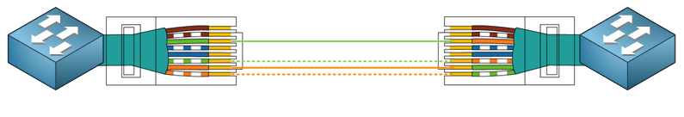
Physical Layer
UTP Cabling
2- Crossover Cable
What if we want to connect two switches to each other? If both of them transmit on pins 3 and 6, we get a collision on the wire.
To make sure we send/receive on the correct pins, we use a different type of cable called a crossover cable.
The UTP cable is still the same but on one end of the cable, we have the wires in a different order in the RJ45 connector like this:
Modern switches don’t care if you use a straight-through or crossover cable, they use something called auto-mdix to figure out what cable you used and use the correct wires automatically.

Slide 9
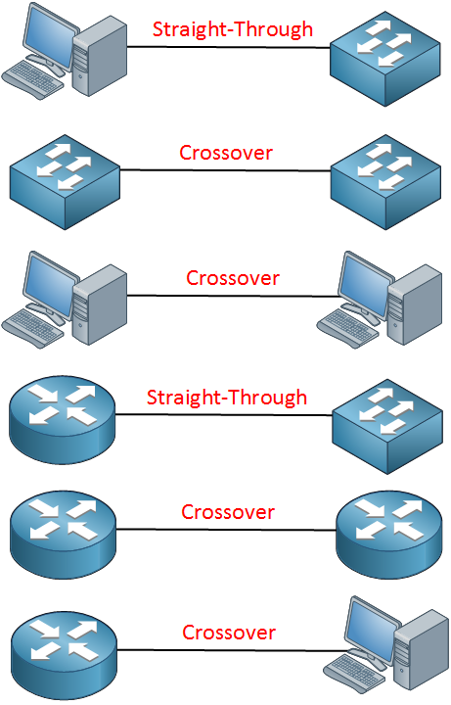
Physical Layer
UTP Cabling
Cable Selection
When do we use a straight through or crossover cable? Something to keep in mind is that computers, printers, routers, access points and such use pin 1 and 2 to transmit their data. Switches use pin 3 and 6 to transmit data.

Slide 10
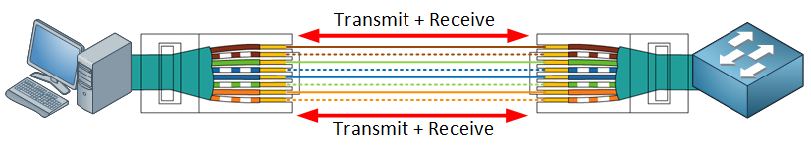
Physical Layer
UTP Cabling
1000BASE-T (Gigabit Cabling)
In the examples above we had two wire pairs, one for transmission and the other one for receiving. Gigabit Ethernet, however, uses all 4 wire pairs.
Instead of using different wire pairs for transmission / receiving, it is able to transmit and receive simultaneously on each wire pair.

Slide 11

Physical Layer
Fiber Cabling
An alternative to UTP is fiber cabling.
Instead of an electrical signal, we transmit light from one end to another through glass or plastic.
One of the advantages is that there is less signal loss over long distances. With a UTP cable, the maximum distance is 100 meters. Fiber cables allow you distances up to many
kilometers / miles.
You also don’t have any issues with EMI.

Slide 12
Address Resolution Protocol (ARP)
ARP (Address Resolution Protocol) is a network protocol used to find out the hardware (MAC) address of a device from an IP address.
It is used when a device wants to communicate with some other device on a local network (for example on an Ethernet network that requires physical addresses to be known before sending packets). The sending device uses ARP to translate IP addresses to MAC addresses. The device sends an ARP request message containing the IP address of the receiving device. All devices on a local network segment see the message, but only the device that has that IP address responds with the ARP reply message containing its MAC address. The sending device now has enough information to send the packet to the receiving device.
ARP request packets are sent to the broadcast addresses (FF:FF:FF:FF:FF:FF for the Ethernet broadcasts and 255.255.255.255 for the IP broadcast).

Slide 13
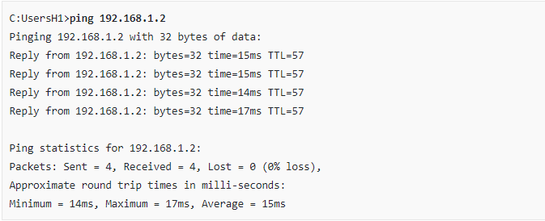
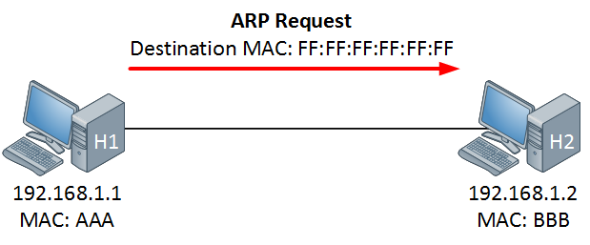
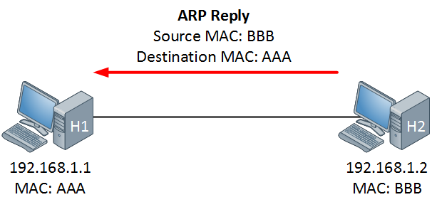
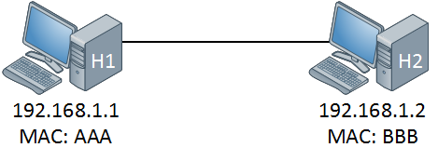
Ping (Packet Internet Groper) uses the ICMP(Internet Control Message protocol) and IP uses the network layer (layer 3).

Slide 14
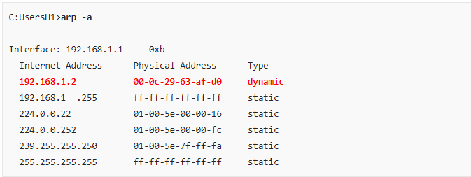
In the example above you see an example of an ARP table on a H1. As you can see there is only one entry, this computer has learned that the IP address 192.168.1.2 has been mapped to the MAC address 00:0C:29:63:AF:D0.

Slide 15
Cisco IOS
Cisco Internetwork Operating System
Cisco technology is built around the Cisco Internetwork Operating System (IOS), which is the software that controls the routing and switching functions of internetworking devices.
A solid understanding of the IOS is essential for a network administrator.
As with a computer, a router or switch cannot function without an operating system. Cisco calls its operating system the Cisco Internetwork Operating System or Cisco IOS.

Slide 16
Switch or Router Memory Components
ROM - Read Only Memory – Bootstrap/POST
FLASH Memory- IOS Images are kept here
- Erasable reprogrammable ROM
- Contents are kept on Power down or reload
RAM - Random Access memory
- Routing Tables
- Running Configuration
- Contents are lost on reboot
NVRAM(Non-Volatile ) - Start up configuration
- Configuration Register
- Contents are kept on reload

Slide 17
Interfaces
Interfaces have the following characteristics and functions:
Connect router to network for frame entry and exit
Can be on the motherboard or on a separate module
Types of interfaces:
Ethernet
Fast Ethernet
Serial
Loopback
Console
Aux

Slide 18
Access to Cisco IOS CLI
Most Cisco devices (including routers and switches) use a CLI (Command Line Interface) to configure the network device.
The CLI is an interface, based on text. You type in configuration commands and use show commands to get the output from the router or switch. There are also GUIs (Graphical User Interface) for the routers, switches and firewalls but the majority of the work is done on the CLI
In this lesson, I’ll explain how to access the CLI and the basics of how Cisco IOS works.

Slide 19
Access to Cisco IOS CLI
Before we can enter any commands, we need access to the CLI. There are three options:
Console
Telnet
SSH
The console is a physical port on the switch that allows access to the CLI. We typically use this the first time we configure the switch. Telnet and SSH are both options for remote access.

Slide 20
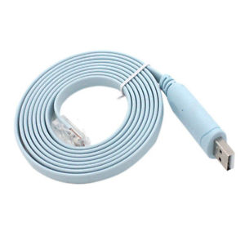
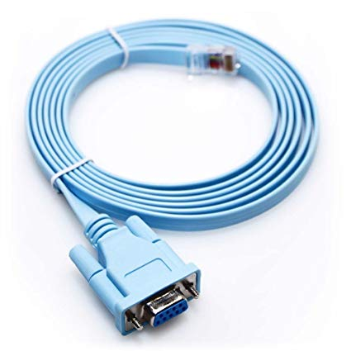
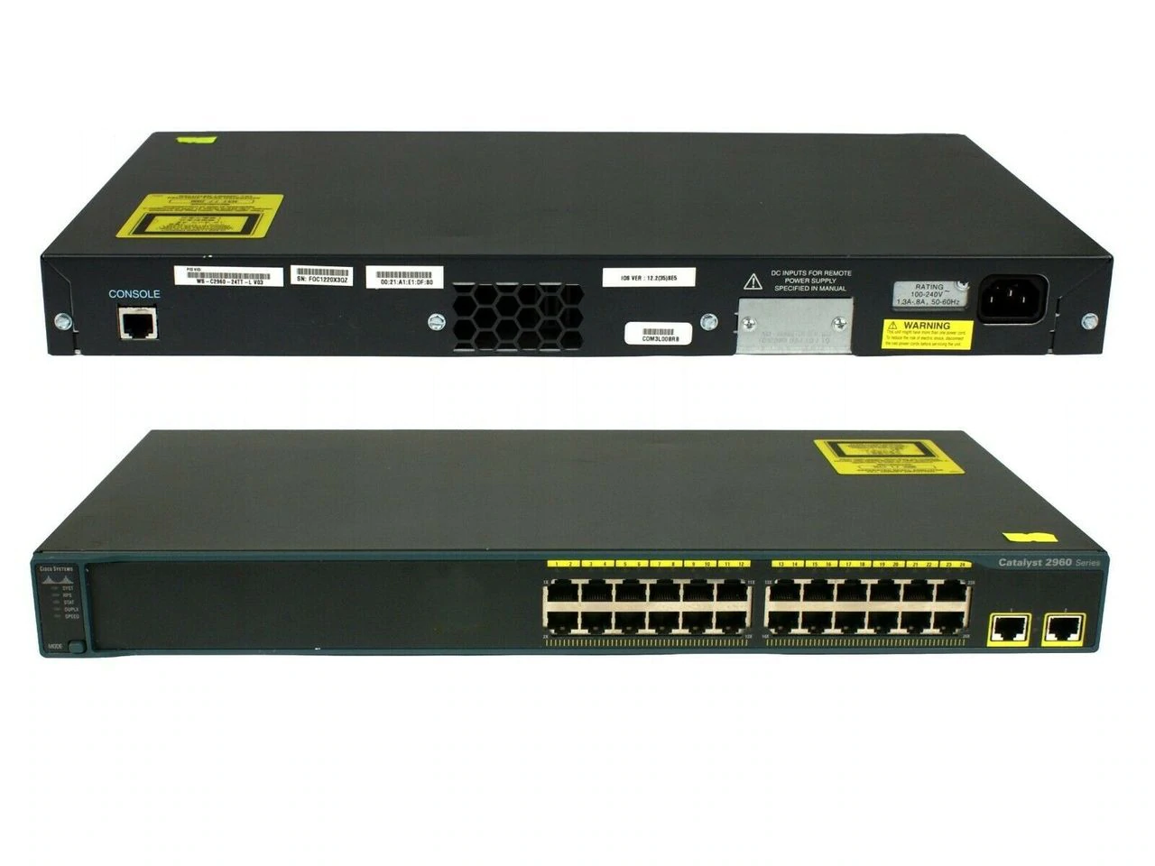
Access to Cisco IOS CLI
Console Cabling

Slide 21
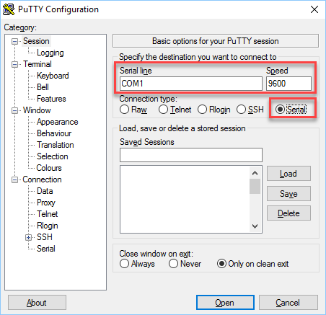
Access to Cisco IOS CLI
Terminal Emulator
There are many terminal emulator applications. If you are new to this, the best one to start with is Putty. It’s free and allows you to connect using a serial connection, telnet and SSH. Once you have downloaded it, you will see the main screen:

Slide 22
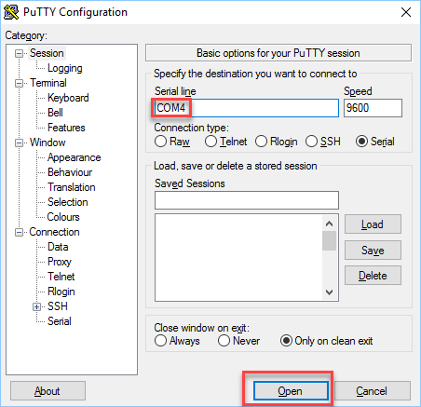
Access to Cisco IOS CLI
Terminal Emulator
Above you can see that on my computer, I have to use COM4. Change the COM port and click on Open to start the console:
Now is a good time to power on your switch or in case it is already powered on, pull the plug so it can reload.

Slide 23
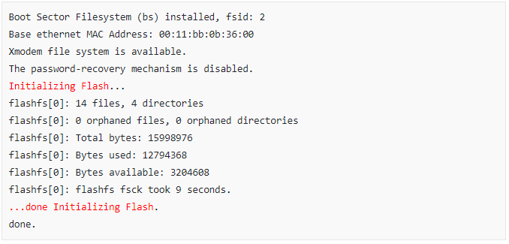
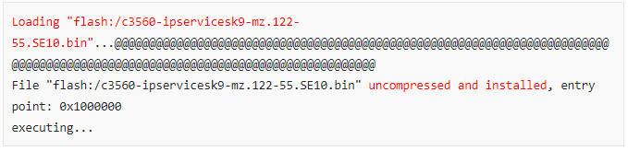
First Boot
When the switch boots, you will see a lot of stuff on the console. First, it will initialize the flash memory:

Slide 24
Now it’s up to us to configure the switch.
User and Enable mode (Privileged Exec Mode)
Once the switch has booted and we have pressed the enter key, we end up in what we call the user mode or user EXEC mode. In this mode, we have permission to use some simple commands but we are restricted to configure anything or use some more advanced commands.

Slide 25
Lesson 10: Introduction to Cisco IOS CLI
Cisco Certified Network Associate (CCNA 200-301)
Network Access
Now it’s up to us to configure the switch.
User and Enable mode (Privileged Exec Mode)
Right now, the command line will show you this:
The > symbol tells us that we are currently in user mode. To get full access to the switch, we have to enter privileged mode, also called enabled mode. Here is how to do this:
Switch>
Switch>enable
Switch#

Slide 26
Now it’s up to us to configure the switch.
Show commands
The show command is probably the most used command for Cisco IOS. We can use it to fetch any information from the switch.
Privileged Mode Command :
show startup-config
show running-config
show version
show interfaces
show interfaces FastEthernet 0/1
show ip interface brief
Switch#show version

Slide 27
Now it’s up to us to configure the switch.
Configuration
Right now, the command line will show you this:
The > symbol tells us that we are currently in user mode. To get full access to the switch, we have to enter privileged mode, also called enabled mode. Here is how to do this:
Switch>
Switch>enable
Switch#configure terminal
Switch(config)#
With the configure terminal command, we enter configuration mode. Now we can make changes to the switch.

Slide 28
Now it’s up to us to configure the switch.
Configuration
Let’s start with something simple, let’s change the name of our switch with the hostname command:
Switch>
Switch>enable
Switch#configure terminal
Switch(config)#hostname SW1
You can see this is applied immediately. Our switch is now called SW1.

Slide 29
Now it’s up to us to configure the switch.
Configuration
A message-of-the-day (MOTD) banner can be displayed on all connected terminals.
Enter global configuration mode by using the command config t
Switch>
Switch>enable
Switch#configure terminal
Switch(config)#banner motd # Welcome to a2z Initiative #

Slide 30
Now it’s up to us to configure the switch.
Configuration
Let’s start with soTyping exit from one of these specific configuration modes will return the router to global configuration mode. Pressing Ctrl-Z returns the router to all the way back privileged EXEC mode.
Switch>
Switch>enable
Switch#configure terminal
Switch(config)#exit
Switch#exit
Switch>

Slide 31
Now it’s up to us to configure the switch.
Saving Configurations
Configurations in two locations - RAM and NVRAM.
The running configuration is stored in RAM.
Any configuration changes to the router are made to the running-configuration and take effect immediately after the command is entered.
The startup-configuration is saved in NVRAM and is loaded into the router's running-configuration when the router boots up.
To save the running-configuration to the startup configuration, type the following from privileged EXEC mode (i.e. at the "Router#" prompt.)
Switch#copy running-config startup-config

Slide 32
Basic Switch Configuration
User Mode and Privileged Mode Security:
In this lesson, we’ll take a look at how you can secure user mode and privileged (enable) mode. By default, there is no authentication required. If you connect a Cisco console cable to your switch or router, here’s what happens:
Switch con0 is now available
Press RETURN to get started.
Switch>
Switch>enable
Switch#
We have full access right away. This is something you might want to change, which is what I’ll explain in this lesson.

Slide 33
User Mode Security:
Simple Password
The most simple option to protect user mode is to add a password. Here’s how to do this:
Switch(config)#line console 0
First, we need to enter the console settings. Here’s where we have to add two commands:
Switch(config-line)#password cisco
Switch(config-line)#login
We configure a password (cisco) and use the login command to tell Cisco IOS to prompt for this password.

Slide 34
User Mode Security:
Simple Password
Next time you open the console, this will happen:
Switch con0 is now available
Press RETURN to get started.
User Access Verification
Password:
Switch>
The CLI will ask you for the password. At least we have some form of authentication but we can do better…

Slide 35
User Mode Security:
Username and Password
Instead of a single password, it’s also possible to use usernames and passwords instead. This is a better option if you have multiple people that need to access your router or switch. Here’s how to do this:
Switch(config)#line console 0
Switch(config-line)#login local
Switch(config-line)#exit
Switch(config)#username admin password cisco
Under the console settings, we use the login local command to tell the switch to refer to a local database of usernames and passwords for authentication. In the global config, we create a username “admin” with password “cisco”.

Slide 36
User Mode Security:
Username and Password
Next time you open the console, here’s what you see:
Switch con0 is now available
Press RETURN to get started.
User Access Verification
Username: admin
Password:
Switch>
The switch asks for our username and password.

Slide 37
Enable Mode Security:
Username and Password
What about enable mode / privileged mode? We can also add a password there. You need to do this from the configuration mode:
Switch#configure terminal
Switch(config)#enable password cisco
Let’s see if our password “cisco” works. Let’s get out of enable mode
And jump right back in:
The switch now asks for the password.
Switch#disable
Switch>enable
Password:

Slide 38
Password Encryption:
In the examples above, we used passwords but there is one problem…they all show up in clear text in our configuration. Take a look below:
Switch#show running-config | include password
no service password-encryption
enable password cisco
username admin password 0 cisco
Cisco IOS has a command that lets you encrypt all clear text passwords in your configuration. Here’s how:
Switch(config)#service password-encryption

Slide 39
Password Encryption:
The service password-encryption command will encrypt every password that is plain text. Here you can see the result:
Switch#show running-config | include password
service password-encryption
enable password 7 13061E010803
username admin password 7 110A1016141D
Cisco IOS has a command that lets you encrypt all clear text passwords in your configuration. Here’s how:

Slide 40
Password Encryption:
The service password-encryption command will encrypt every password that is plain text. Here you can see the result:
Now you might get a warm fuzzy feeling that everything is encrypted but in reality, this is a very poor (broken) encryption algorithm. There are websites that let you decrypt these encrypted strings on the fly. If you want to try this, here’s one of those websites.
We need something stronger…

Slide 41
Secret:
Cisco IOS supports something called a secret as an alternative to the password. Let’s try this for the enable mode:
Switch(config)#enable secret ?
0 Specifies an UNENCRYPTED password will follow
5 Specifies a MD5 HASHED secret will follow
8 Specifies a PBKDF2 HASHED secret will follow
9 Specifies a SCRYPT HASHED secret will follow
LINE The UNENCRYPTED (cleartext) 'enable' secret
level Set exec level password
Above you can see this switch supports MD5, PBKDF2 and SCRYPT hashes. Older IOS devices only support MD5 authentication.

Slide 42
Secret:
Cisco IOS supports something called a secret as an alternative to the password. Let’s try this for the enable mode:
Switch(config)#enable secret cisco
Switch#show running-config | include secret
enable secret 5 $1$CANW$U9Y8O6KeFhrFR4l1Qo07h/
You now find an MD5 hash in the configuration. The “5” that you see behind “enable secret” is the algorithm that we use, 5 means MD5.
MD5 is not considered secure nowadays. It’s very easy to brute force simple passwords. For example, try this website for the MD5 hash that was created for my secret “cisco”. It will only take a few seconds to recover.

Slide 43
Secret:
Let’s try one of the other algorithms that are considered secure nowadays. Here’s how you can select the algorithm for the enable mode:
Switch(config)#enable algorithm-type ?
md5 Encode the password using the MD5 algorithm
scrypt Encode the password using the SCRYPT hashing algorithm
sha256 Encode the password using the PBKDF2 hashing algorithm
Let’s try the PBKDF2 (SHA256) hashing algorithm:

Slide 44
Secret:
Let’s try the PBKDF2 (SHA256) hashing algorithm:
Switch(config)#enable algorithm-type sha256 secret cisco
When we look at our configuration, we’ll see the new hash:
Switch#show running-config | include secret
enable secret 8 $8$dvX/fx/FJ0Snk2$HhqrOUaEtBgk4zJvG2IQuAJNUicZmmELelC/L6.Fcl2
The “8” behind “enable secret” refers to the PBKDF2 hashing algorithm that we used.

Slide 45
Secret:
Let’s try the PBKDF2 (SHA256) hashing algorithm:
In the example above I changed the hashing algorithm for the enable mode but we can also do this for usernames. Here’s an example:
Switch(config)#username zain algorithm-type sha256 secret cisco
My username now uses SHA256 as well for password “cisco”. Here’s what it looks like:
Switch#show running-config | include rene
username zain secret 8 $8$dyzsAmZjA3w.aY$YBZn8LBI6CK04ij5ZmqQ/88OrFdc3jzGb6v7SSQI0cw

Slide 46
Remote Access with SSH & Telnet
Remote Access with Telnet
There are two common protocols for remote management to your Cisco IOS router or switch: telnet and SSH.
Telnet is easy to configure but not used often anymore since it is insecure, everything you do is sent in plaintext while SSH uses encryption. However, some older devices might only support telnet, so it’s good to know how to configure it. Besides remote management, the telnet client is also very useful to test access-lists, routing and if certain ports are listening or not.
In this lesson, I’ll show you everything there is to know about telnet.

Slide 47
Telnet Configuration
To access a Cisco device using telnet, you first need to enable remote login. Cisco devices usually supports 16 concurrent virtual terminal sessions, so the first command usually looks like this:
SW1(config) line vty 0 15
To enable remote login, the login command is used from the virtual terminal session mode:
SW1(config-vty) login
Next, you need to define a password. This is done using the password command from the virtual terminal session mode:
SW1(config-vty)password PASSWORD
Let’s try First, we will try to access the router or switch without enabling telnet on a device:

Slide 48
Telnet Configuration
Let’s see if it works:
PC#telnet 192.168.12.1
Trying 192.168.12.1 ... Open
User Access Verification
Password:
SW1>
Above you can see that I was able to telnet from R2 to R1. Once you see “open” you know that it has successfully established a TCP connection.

Slide 49
Telnet Configuration
Local Database:
Instead of using a single password, it’s also possible to use usernames and passwords that are stored in a local database on the router or switch. Multiple users are able to log in with the same password but it’s easier to see who has accessed your device if you use multiple usernames. Here’s how to do this:
SW1(config)#line vty 0 4
SW1(config-line)#no password
SW1(config-line)#login local

Slide 50
Telnet Configuration
Local Database:
We need to use the login local command to tell the router/switch to use the local database for authentication. Let’s create a user account:
SW1(config)#username admin password my_password
We now have an admin user with a password. Let’s test this:
PC#telnet 192.168.12.1
Trying 192.168.12.1 ... Open
User Access Verification
Username: admin
Password:
SW1>

Slide 51
Lesson 12: Remote Access with SSH & Telnet
Telnet Configuration
This router supports multiple protocols. Above you can see that telnet and SSH are two supported protocols. It is possible to support multiple protocols but let’s configure the router or switch so that it will only support telnet:
SW1(config-line)#transport input telnet

Slide 52
Remote Access with SSH
In a previous lesson, I explained how you can use telnet for remote access to your Cisco IOS devices. The problem with telnet is that everything is sent in plaintext, for that reason you shouldn’t use it.
SSH (Secure Shell) is a secure method for remote access as is includes authentication and encryption. To do this, it uses a RSA public/private keypair.
To enable secure access to your Cisco device, you can use SSH instead of Telnet. SSH uses encryption to secure data from eavesdropping.
There are two versions: version 1 and 2. Version 2 is more secure and commonly used.

Slide 53
SSH Configuration
To enable SSH, the following steps are required:
  1. set up a hostname and and a domain name.
  2. configure local username and password.
  3. generate RSA public and private keys.
  4. allow only SSH access.
The following example shows the configuration of the first three steps:

Slide 54
SSH Configuration
the name of the RSA keypair will be the hostname and domain name of the router or switch. Let’s configure a hostname:
SW1(config)#hostname SW1
And a domain name:
SW1(config)#ip domain-name A2Z.LOCAL
Now we can generate the RSA keypair:
SW1(config)#crypto key generate rsa
The name for the keys will be: SW1.A2ZLOCAL
How many bits in the modulus [512]: 1024
% Generating 2048 bit RSA keys, keys will be non-exportable...
[OK] (elapsed time was 3 seconds)

Slide 55
SSH Configuration
As you can see above, SSH version 1 is the default version. Let’s switch to version 2:
SW1(config)#ip ssh version 2
SSH is enabled but we also have to configure the VTY lines:
SW1(config)#line vty 0 4
SW1(config-line)#transport input ssh
SW1(config-line)#login local
This ensures that we only want to use SSH (not telnet or anything else) and that we want to check the local database for usernames. Let’s create a user:
SW1(config)#username admin password my_password

Slide 56
Enabling IPv4 for Remote Access
To allow Telnet or SSH access to the switch, and to allow other IP-based management protocols (for example, Simple Network Management Protocol, or SNMP) to function as intended
the switch needs an IP address, as well as a few other related settings. The IP address has
nothing to do with how switches forward Ethernet frames; it simply exists to support overhead management traffic.

Slide 57
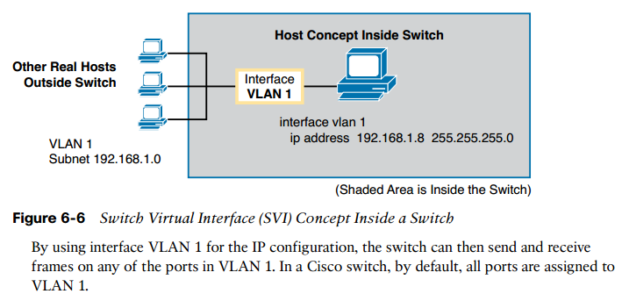
Host and Switch IP Settings

Slide 58
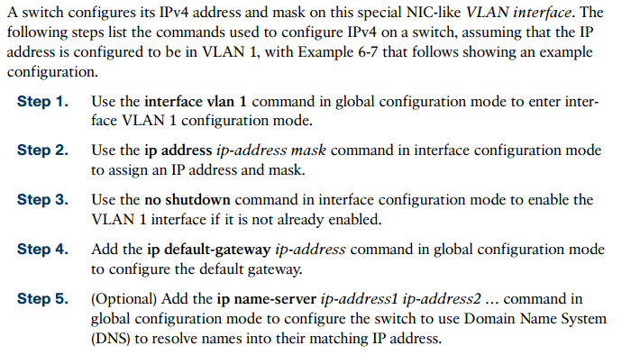
Configuring IPv4 on a Switch

Slide 59
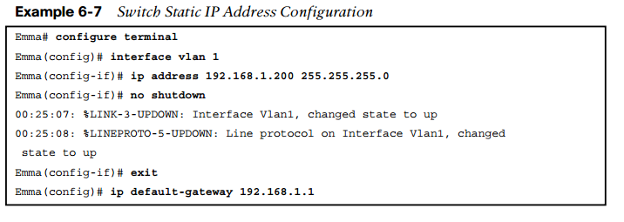
Configuring IPv4 on a Switch

