Slide 1
Nourish to Flourish: Empowering Communities through Food Education and EBT Access
PHYAP Project by Morsal Mubarak

Slide 2
Table of contents
01
02
03
Introduction
Solutions
Timeline + more
In this section, it talks about what hunger and homelessness is. Then it talks about the physical and mental impacts of hunger. Finally, it ends off with strong data about food insecurity in the US, in the States, and in counties near us.
In this section, it talks about different types of solutions that could be implemented to help decrease the food insecurity rate. It expands on the solutions and helps bring them to image.
In this section, it ends off the presentation with a timeline. It talks about the steps needed to get to this final point, talks about the budget, and ends it off with more resources available to use.

Slide 3
01
Introduction
Introducing food insecurity to those with no background knowledge

Slide 4
Introduction to hunger and homelessness
Hunger is when you have a lack of food and aren’t filled to the point where enough energy is produced for your body to function properly. Hunger isn’t just qualified as wanting to eat, it’s also not being able to eat due to food insecurity and the lack of food and nutrition. Hunger can be due to the lack of money, resources, etc.
Homelessness is not just facing hunger, but also lacking the proper resources to get onto your feet. Homelessness can result to hunger, but it also connects to thirst, no shelter, etc. Homelessness is harder to overcome because you need more resources that focus on giving you a shelter and proper food. Homelessness usually starts with higher house rates and not a stable job that gives you enough income.

Slide 5
Impacts on your health
Physical Health
Mental Health
Impacts the immune system, more likely to get sick
Longer effects are chronic diseases and disabilities that could lead up to death
Hunger weakens your bones, muscles, and skin
Lowers your energy and performance
Big increase in stunted growth
Depression
Anxiety
Posttraumatic stress disorder
Can lead to addictions–smoking, drugs, alcohol
Can not stay focused
Can lead to being introverted–you feel like you don’t fit into society so you tend to stay to yourself

Slide 6
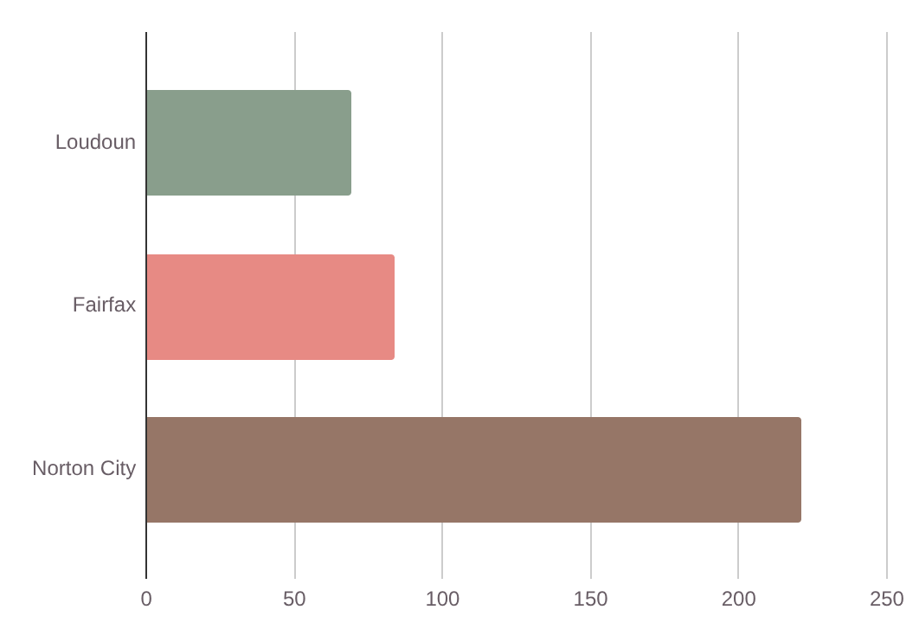
Food insecurity in Fairfax vs other counties
6.9%
8.4%
Loudoun
Fairfax
Loudoun County has the highest household average income which of course leads to a lower rate.
Fairfax County has the highest population of all Virginia counties. The food insecurity rate is lower here due to more resources.
22.1%
Norton City
Counties in Southwest Virginia tend to have higher food insecurity rates.
Comparing the food insecurity rates of different counties near us.

Slide 7
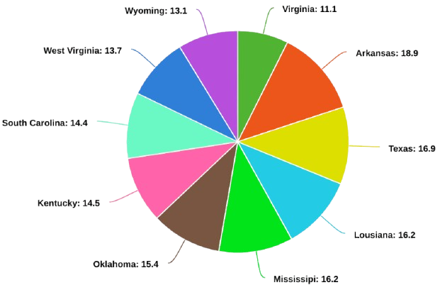
47.4 million people face hunger in the US.
1 million people in Virginia face hunger.
1210 people face hunger in Falls Church.
Food Insecurity in Virginia compared to other states

Slide 8
02
Solutions
Solutions that could be used in our community in order to decrease food insecurity rates.

Slide 9
EBT Education Workshops
Fun fact: hunger and homelessness awareness week is a week before Thanksgiving
As students navigate past high school, and are preparing for college, a big issue comes up with those who fall into the food insecurity category. Where will their next meal come from? How will they get effective meals everyday? Many students can face food insecurity in college and they may not know how to overcome it. That’s why I believe we should have an EBT Education Workshop for young adults getting to the next stage of their education.
An EBT Card sets an amount of money for you to spend on food. You can only get this card if you apply and you meet the requirements.
Creating a workshop for this specific purpose is essential for young adults in need of assistance. This workshop will be held for a week on the last month of school. It’ll be after school so students can make time for it. A zoom meeting can also be placed for students that are not able to make it in person.
The workshops will have a step-by-step tutorial on how to apply for an EBT card, how to location food pantries near them, prioritizing NEED vs WANT, and how to shop and cook on a budget.
Notes:
Justice high school partners with Food for Neighbors which helps feed students in Justice outside of school. Through the money raised and the food collected, the Wolf Shack is created. Thats basically where students go after school and grab food, toiletries, or school supplies that they need. Its open for everyone. This is a great idea however this might not be available for students when they graduate high school. Food pantries, food banks, and organizations are important, but we also need a more stronger solution like this EBT Education workshop.

Slide 10
Week Workshop Draft
01 | Apply for EBT Card | On the first day of the week, we’ll help the young adults apply for an EBT Card step by step.
02 | Need vs Want | On the second day, we will help them identify whether they need or want something to manage the amount of money spent.
03 | Food pantries near you | On the third day, each student will find at least two pantries or food banks near them.
04 | How to shop +cook on a budget | On the fourth day, we can help them figure out how to eat and make healthy meals while being limited.
05 | Healthy Eating Starter Kit | On the last day, the workshop will be more engaging. Each student will get a cookbook that aids them in making healthy food. There will be a featured meal that each student will make together.

Slide 11
03
Timeline + more
Talk about the steps needed to create the workshop, talks about budget and more.

Slide 12
Content by theme
When + where?
Who?
Budget
Outreach materials:
Print 50 colored posters with information about where, when, and what the workshop is about. (Around $15).
Guest Speaker:
Guest speaker will be paid around 50-100 dollars per day. They will only be there for 2 days, and the workshop will not go past 2 hours a day.
Cookbook:
Order around 35 cookbooks for students attending the fifth day. (Around $450)
Meal cooked:
Around 100 dollars will be used on the fifth day for the ingredients needed to cook the featured healthy meal.
As stated before, the workshop will be held for a week after school on the last month of school. This way students going to college will have a better idea on what to do.
A nutritionist will be invited on the fourth and fifth day of the workshop to help create and talk about eating healthy on a budget.
$665-765 needed.

Slide 13
Food Bank Resources
Food Banks Near Us:
Falls Church Community Service Council
Miriam’s Kitchen
Food For Neighbors
So Others Might Eat
Little Yellow Free Pantry
Food for Others

Slide 14
Thank you

Slide 15
Resources
Feeding America: 3 devastating effects of hunger on the body
Feeding America: Our Vision: An America without Hunger
Feeding America: Food Insecurity among the Overall Population in Virginia (before COVID-19)
ATCAA: How Hunger Affects Health
Feeding America: Food Insecurity among the Overall Population in Falls Church city County
Federation of Virginia Food Banks: Hunger in Virginia.
Feeding America: Fact about Hunger in America.
Feed The Children: The Ten States Facing the Most Hunger

