Slide 1
SimBox Traffic Bypass (Telecom) Fraud Detection Presented By: Mubashar A. Hassan

Slide 2
AGENDA
Introduction
Data & Preprocessing
Model
Outlook

Slide 3
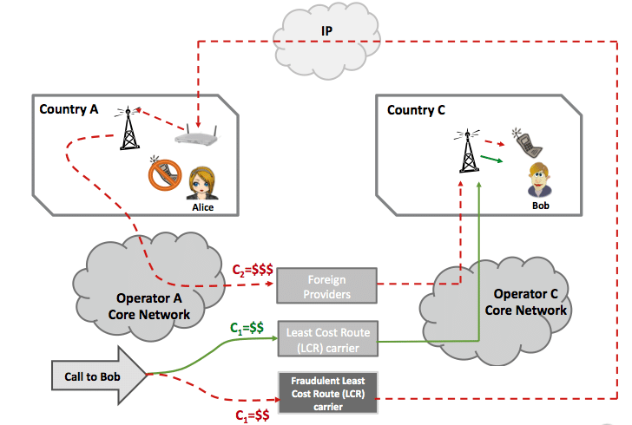
INTRODUCTION
Fraudsters use devices with multiple SIM cards to route international calls as local calls, bypassing higher international rates
Results in significant revenue loss and degraded network quality for telecom operators
Highly imbalanced data make detection difficult.

Slide 4
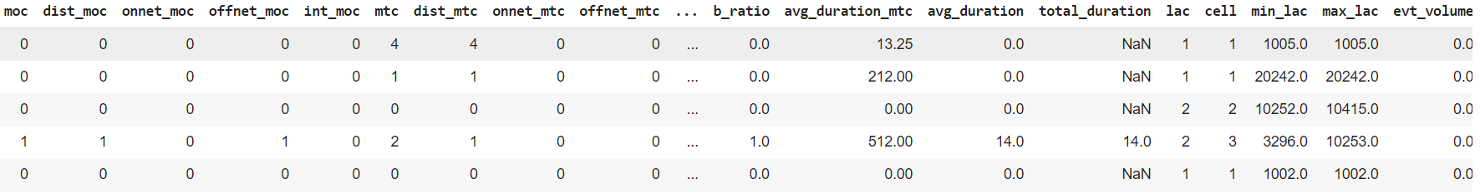
Data & Preprocessing
Utilized call and SMS records to gather information on customer activities
Created detailed profiles for each MSISDN (mobile number) based on one week of data
Extracted features such as call duration, frequency, and patterns for fraud detection
Clean and replace data

Slide 5

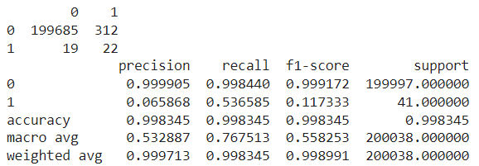
Model-BASE
Imbalance Issue:
Faced significant class imbalance with over 59 million normal and only 189 fraud instances
Approaches to Handle Imbalance:
Used SMOTE to generate synthetic data
Employed cost-sensitive learning, which performed better
Models Used:
Logistic Regression: Predicted more false positives
XGBoost: Performed better than logistic regression but still had high false positives, risking the suspension of innocent customers
Logistic Regression
XGBoost

Slide 6
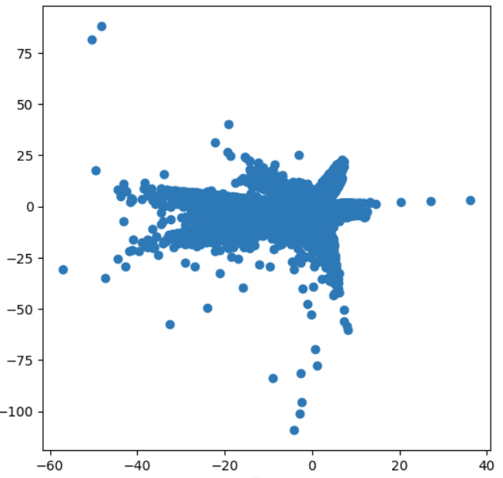
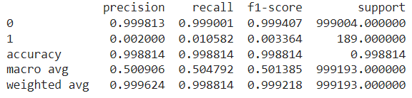
ModeL (VAE) (1/2)
Model Choice: Used a Variational Autoencoder (VAE) trained on normal customer profiles
Reconstruction Loss: Calculated reconstruction loss on actual data; higher loss indicates anomalies
Threshold Setting: Set a threshold on loss to identify fraud cases
Improved Detection: Successfully identified fraud cases missed by the current rule-based system
Still predicts some false positive cases

Slide 7
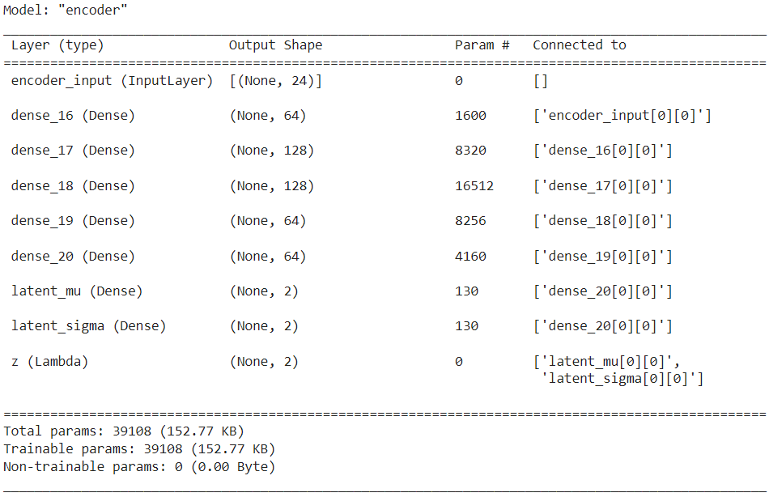
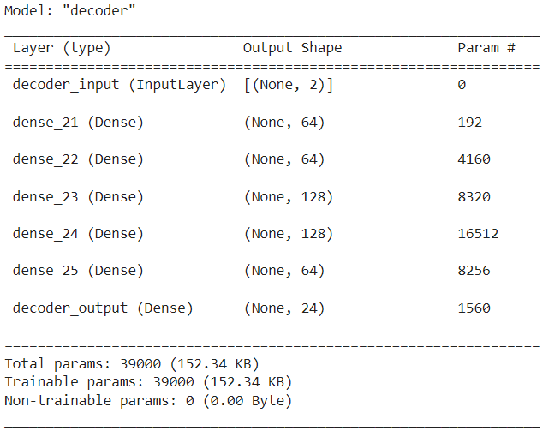
ModeL (VAE) (2/2)

Slide 8
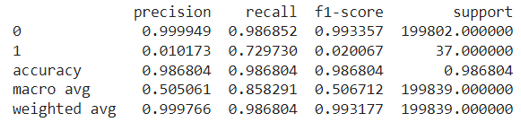
ModeL (SMOTE - NN) (1/2)
Model Choice: Used SMOTE for data generation and Neural Network for classification
Hyperparameter tuning: Used Keras Tunner for hyperparameter tuning
Improved Detection: Achieved the best performance from previous models
Still getting False Positive cases

Slide 9
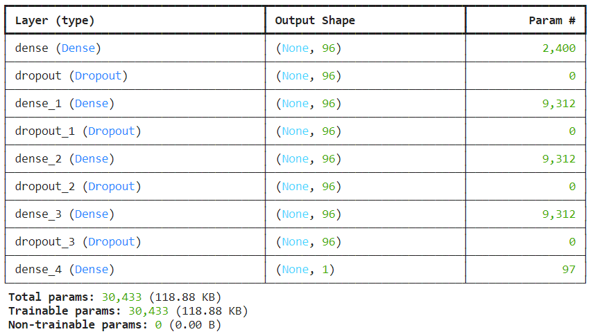
ModeL (SMOTE - NN) (2/2)

Slide 10
Comparison
 | F1-Score
Baseline Model | 0.004
VAE Model | 0.003
SMOTE & NN | 0.02

Slide 11
outlook
Need to work on Training data transformation to check if it can improve the model proformance
Need to working on classification
Need to rework on profiling
Need more resources to process data

Slide 12
THANK YOU

