Slide 1
Predicting the Age of Abalone Using Regression Models A Comparative Study of Linear, Ridge, and Lasso Regression
MUHAMMAD MUBASHAR SHAHZAD
Registration No. SM3600012
Scientific and Data Intensive Computing (SDIC)
University of Trieste

Slide 2
Introduction
Objective: To predict the age of abalone using physical measurements.
Dataset: Abalone dataset with 4177 instances and 8 features.
Target Variable: Rings (predicting Age by adding 1.5).

Slide 3
Dataset Overview
Features:
Sex (Categorical)
Length (Continuous)
Diameter (Continuous)
Height (Continuous)
Whole weight (Continuous)
Shucked weight (Continuous)
Viscera weight (Continuous)
Shell weight (Continuous)
Target: Rings (Integer, Age = Rings + 1.5)

Slide 4
Data Loading and Initial Exploration
Step 1: Loading the dataset using Pandas.
Code Snippet: `pd.read_csv('abalone.csv')`
Initial DataFrame: Show the first few rows of the dataset.
Handling Missing Values: Mention that there are no missing values in the dataset.

Slide 5
Data Preprocessing
Step 2: Converting Categorical Variable
Sex column converted to numerical using one-hot encoding.
Step 3: Creating Age Column
Adding 1.5 to the Rings column to get the age.

Slide 6
Exploratory Data Analysis (EDA)
Step 4: Visualizations
Histograms of numerical features.
Box plots to check for outliers.
Step 5: Correlation Analysis
Heatmap of correlation matrix to understand relationships between features and target.

Slide 7
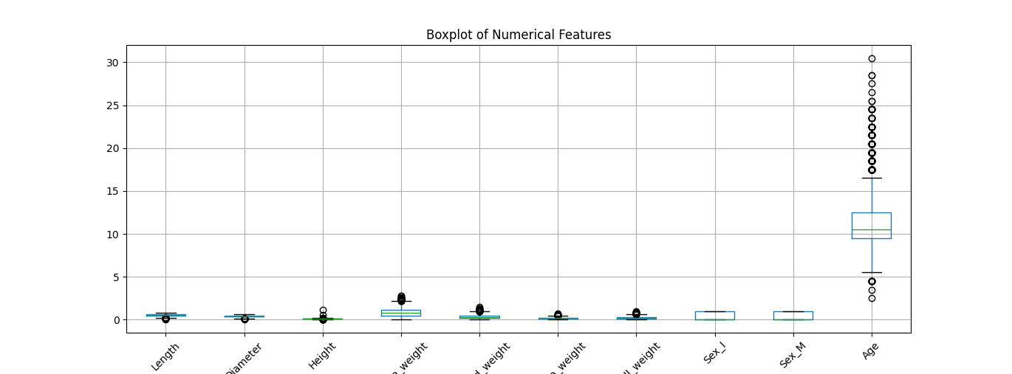
Results
Figure 1: Locust load testing results for a maximum of 10 users

Slide 8
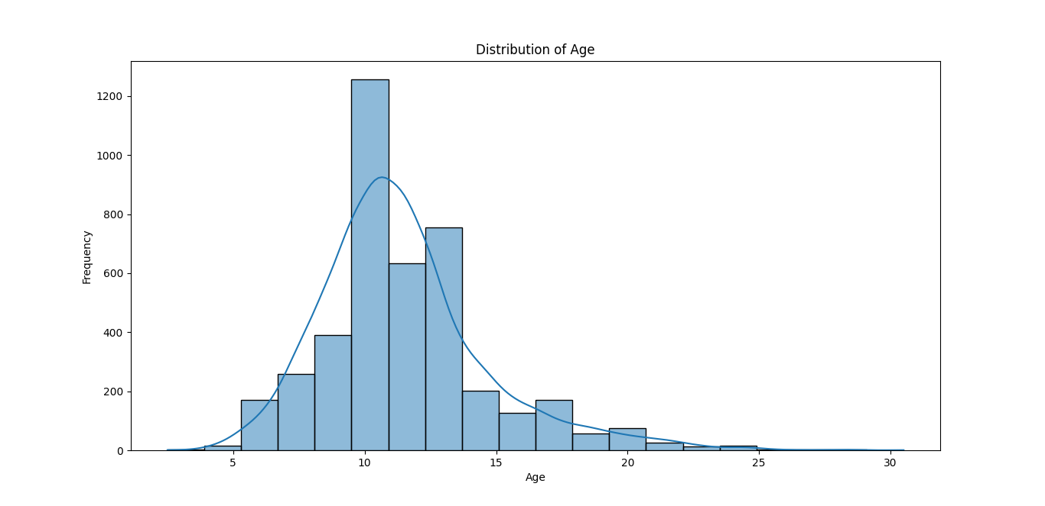
Figure 2: Locust Locust load testing results for a maximum of 20 users

Slide 9
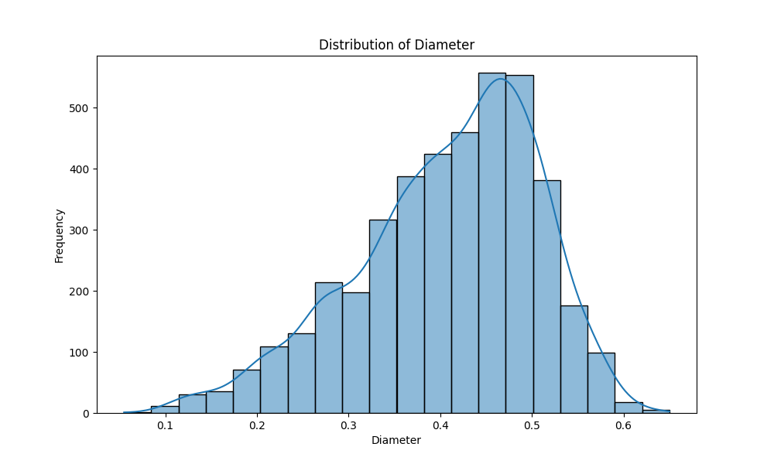
Figure 3: Locust Locust load testing results for a maximum of 20 users

Slide 10
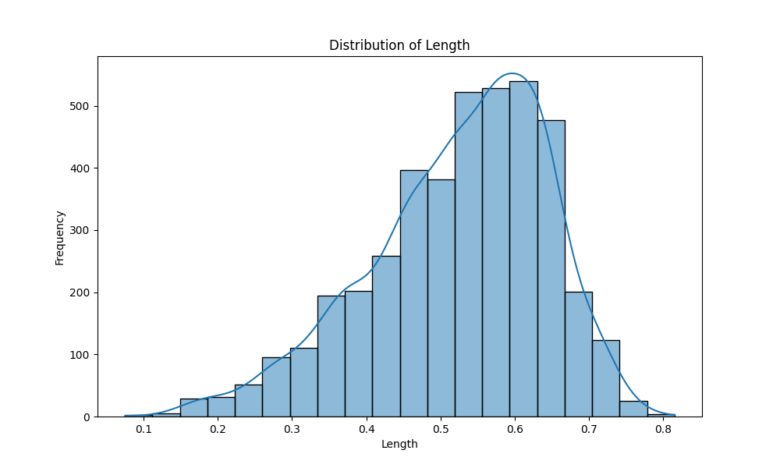
Figure 4: Comparison of 10 users, 20 users and 30 users performance

Slide 11
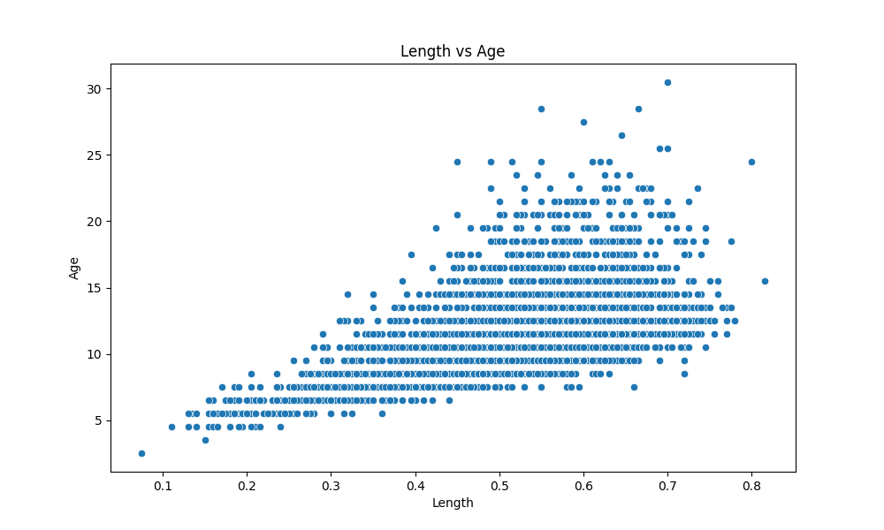
Setting Up Kubernetes on Windows Using VM and Minikube
Initial Setup
Create Linux VM on Windows
Tool: VirtualBox 7.0
Steps:
Install VirtualBox.
Create a Linux VM.
Install Ubuntu on the VM.

Slide 12
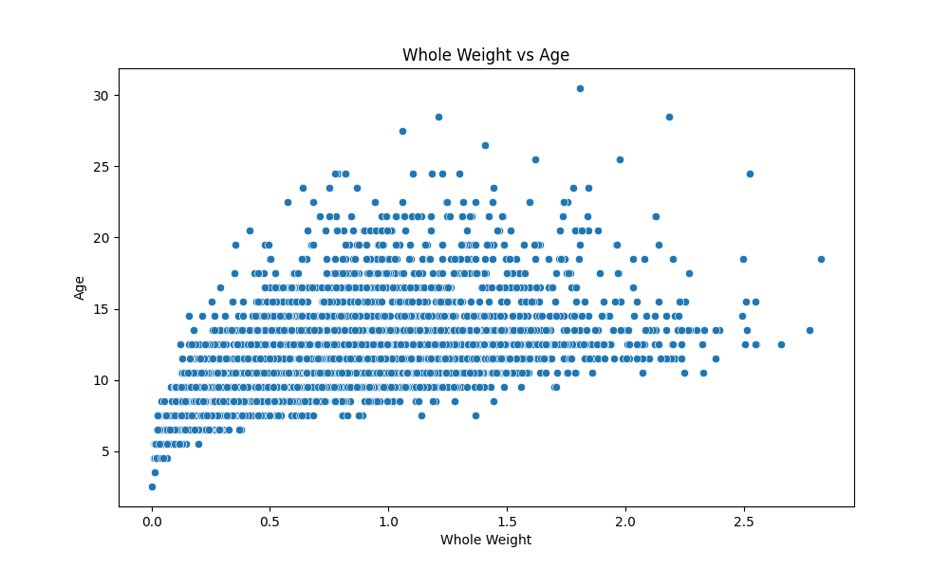
Install Kubernetes and Kubectl
Installing Kubectl on Ubuntu
Command ssudo apt-get install -y kubectl
kubectl version –client
Output:
Confirms installation with client version details.
Setup Kubernetes Cluster:
URL: https://192.168.49.2:8443

Slide 13
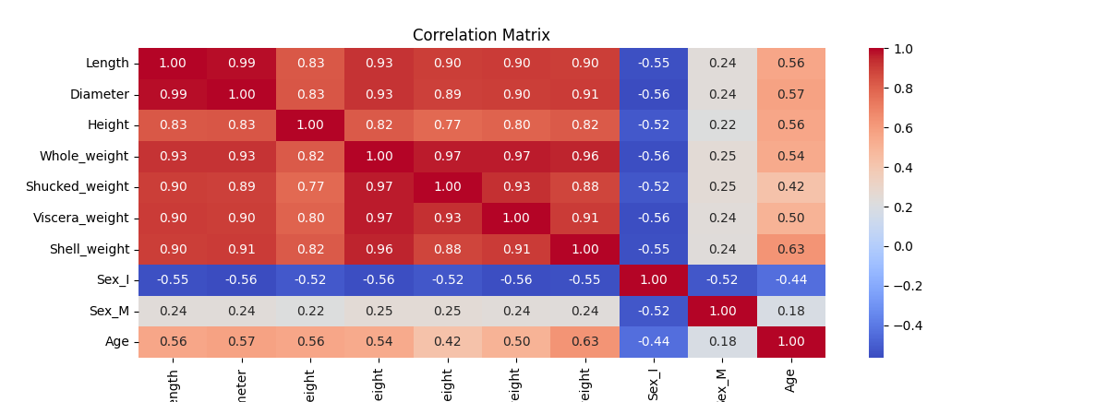
Create Chart Directory Structure:
cloud-file-storage-chart/
├── charts/
├── templates/
│ ├── deployment.yaml
│ ├── service.yaml
│ ├── persistentvolume.yaml
│ ├── persistentvolumeclaim.yaml
│ └── configmap.yaml
└── values.yaml

Slide 14
Feature Scaling and Train-Test Split
Step 6: Scaling the Features
Normalization using StandardScaler.
Step 7: Splitting the Data
Train-Test split (80-20) using `train_test_split`.

Slide 15
Model Training - Linear Regression
Model: Linear Regression
Training: Fit the model on training data.
Evaluation: MSE and R-squared on test data.
Results:
MSE: 4.8912
-R2: 0.5482

Slide 16
Model Training - Ridge Regression
Model: Ridge Regression
Training: Fit the model on training data.
Evaluation: MSE and R-squared on test data.
Results:
MSE: 4.8911
R2: 0.5482

Slide 17
Model Training - Lasso Regression
Model: Lasso Regression
Training: Fit the model on training data.
Evaluation: MSE and R-squared on test data.
Results:
MSE: 7.6826
R2: 0.2903

Slide 18
Model Comparison
Linear Regression:
MSE: 4.8912
R2: 0.5482
Lasso Regression:
MSE: 7.6826
R2: 0.2903
Ridge Regression:
MSE: 4.8911
R2: 0.5482

Slide 19
Residual Analysis - Summary
Linear Regression:
Mean: -0.009
Std: 2.21
Min: -6.01
Max: 9.78
Lasso Regression:
Mean: -0.023
Std: 2.77
Min: -5.24
Max: 12.18
Ridge Regression:
Mean: -0.008
Std: 2.21
Min: -6.02
Max: 9.77

Slide 20
Residual Analysis - Visualizations
Residual vs Predicted Values for Ridge Regression
Residual vs Predicted Values for lasso Regression
Q-Q Plot of Residuals for Ridge Regression
Q-Q Plot of Residuals for lasso Regression

Slide 21
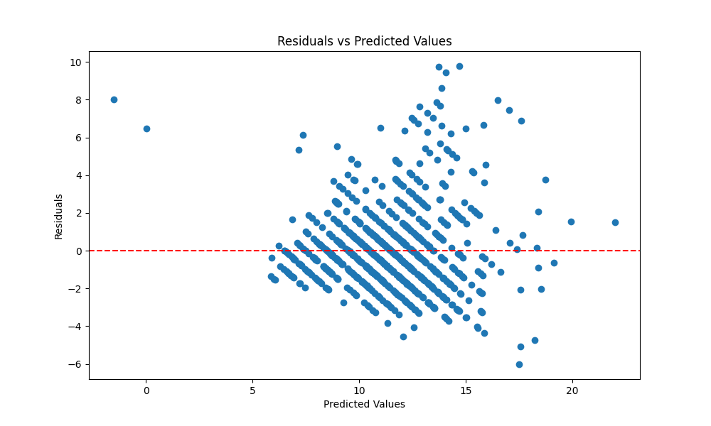

Slide 22
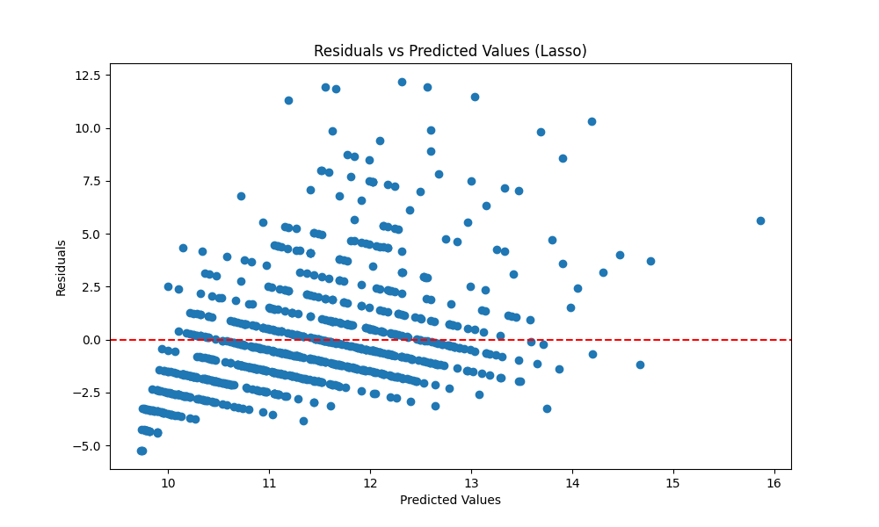

Slide 23
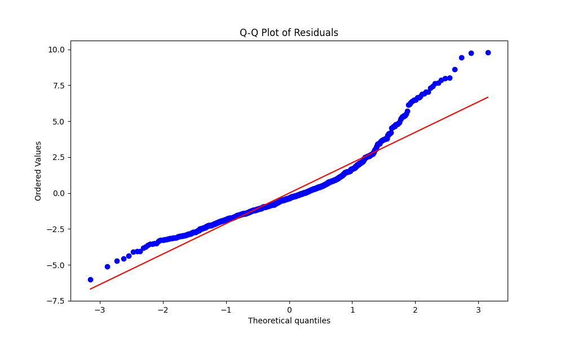

Slide 24
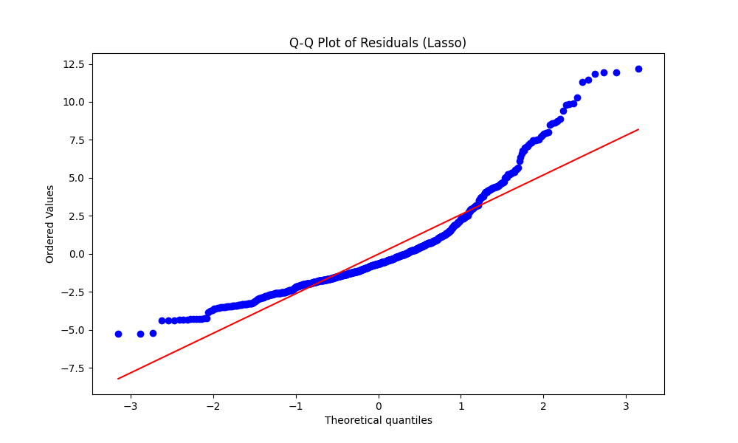

Slide 25
Conclusion
Model Performance:
Linear and Ridge Regression models performed similarly, better than Lasso.
Ridge Regression is preferred due to handling multicollinearity effectively.
Ridge Regression: MSE (4.8911), R² (0.5482).
Residuals Analysis:
Similar residual patterns for Linear and Ridge, capturing data patterns well.
Some outliers indicate underestimation or overestimation.
Lasso showed higher residual variability, indicating less generalization.

Slide 26
Future Work and Acknowledgements
Future Work:
Explore advanced regression techniques and feature engineering.
Consider a Generalized Linear Model (GLM) for better handling different distributions of the target variable.
Acknowledgements:
Thanks to the UCI Machine Learning Repository for the Abalone dataset.

Slide 27
Questions & Answers
Open the floor for any questions from the audience.

Slide 28


