Slide 1
Predicting the Age of Abalone Using Regression Models A Comparative Study of Linear, Ridge, and Lasso Regression
MUHAMMAD MUBASHAR SHAHZAD
Registration No. SM3600012
Scientific and Data Intensive Computing (SDIC)
University of Trieste

Slide 2
Introduction
Objective: To predict the age of abalone using physical measurements.
Dataset: Abalone dataset with 4177 instances and 8 features.
Target Variable: Rings (predicting Age by adding 1.5).

Slide 3
Dataset Overview
Features:
Sex (Categorical)
Length (Continuous)
Diameter (Continuous)
Height (Continuous)
Whole weight (Continuous)
Shucked weight (Continuous)
Viscera weight (Continuous)
Shell weight (Continuous)
Target: Rings (Integer, Age = Rings + 1.5)

Slide 4
Data Loading and Initial Exploration
Step 1: Loading the dataset using Pandas.
Code Snippet: `pd.read_csv('abalone.csv')`
Initial DataFrame: Show the first few rows of the dataset.
Handling Missing Values: Mention that there are no missing values in the dataset.

Slide 5
Data Preprocessing
Step 2: Converting Categorical Variable
Sex column converted to numerical using one-hot encoding.
Step 3: Creating Age Column
Adding 1.5 to the Rings column to get the age.

Slide 6
Exploratory Data Analysis (EDA)
Step 4: Visualizations
Histograms of numerical features.
Box plots to check for outliers.
Step 5: Correlation Analysis
Heatmap of correlation matrix to understand relationships between features and target.

Slide 7
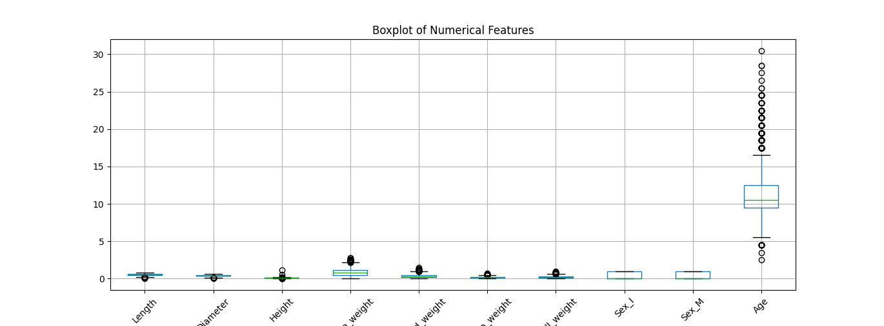
Results
Figure 1: Locust load testing results for a maximum of 10 users

Slide 8
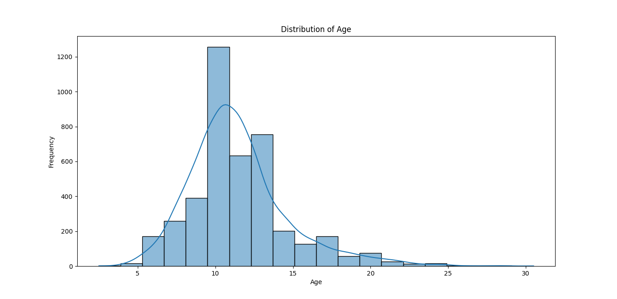
Figure 2: Locust Locust load testing results for a maximum of 20 users

Slide 9
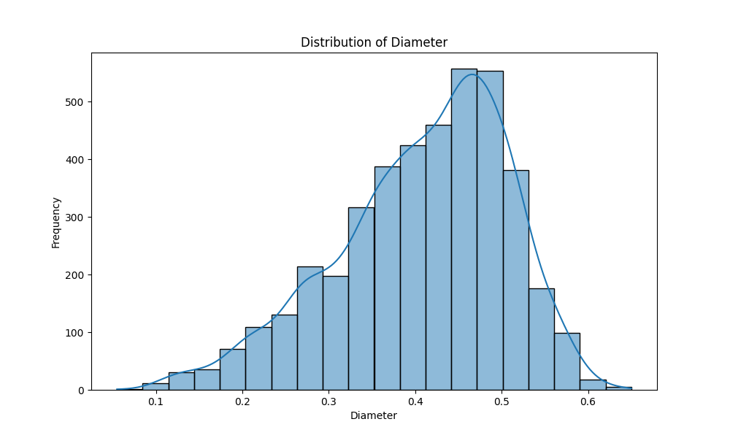
Figure 3: Locust Locust load testing results for a maximum of 20 users

Slide 10
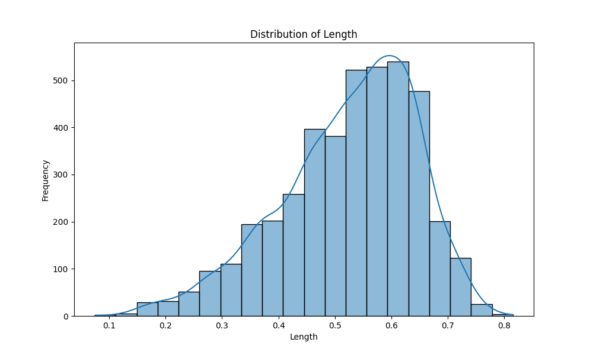
Figure 4: Comparison of 10 users, 20 users and 30 users performance

Slide 11
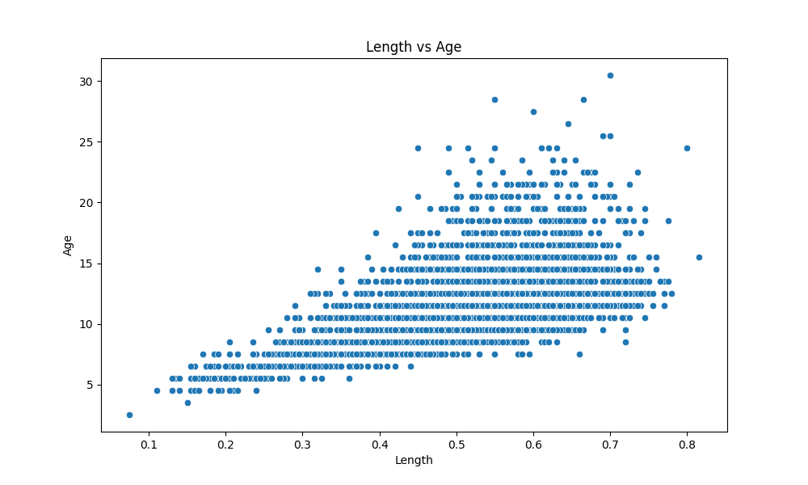
Setting Up Kubernetes on Windows Using VM and Minikube
Initial Setup
Create Linux VM on Windows
Tool: VirtualBox 7.0
Steps:
Install VirtualBox.
Create a Linux VM.
Install Ubuntu on the VM.

Slide 12
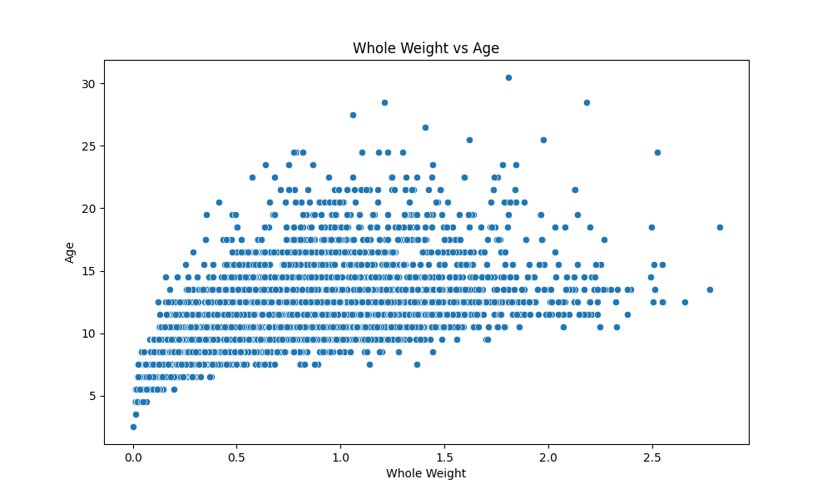
Install Kubernetes and Kubectl
Installing Kubectl on Ubuntu
Command ssudo apt-get install -y kubectl
kubectl version –client
Output:
Confirms installation with client version details.
Setup Kubernetes Cluster:
URL: https://192.168.49.2:8443

Slide 13
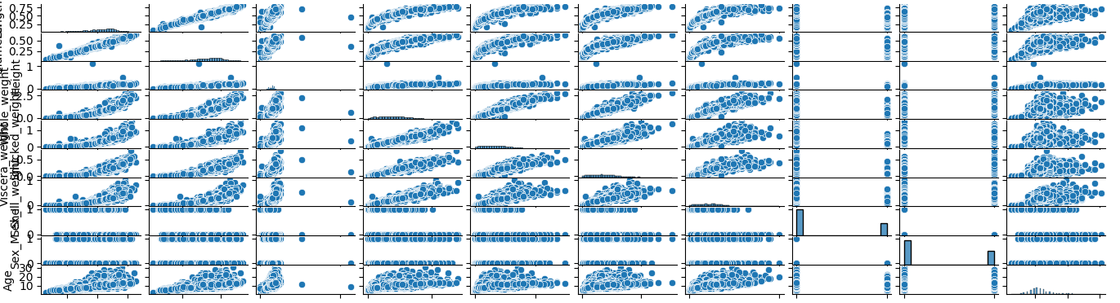
Install Helm
Install Helm for Kubernetes Package Management
Commands
wget https://get.helm.sh/helm-v3.7.1-linux-amd64.tar.gz
tar -zxvf helm-v3.7.1-linux-amd64.tar.gz
sudo mv linux-amd64/helm /usr/local/bin/
helm version
Verify Installation
helm search repo wordpress
Deploying with Helm
Helm Chart Deployment

Slide 14
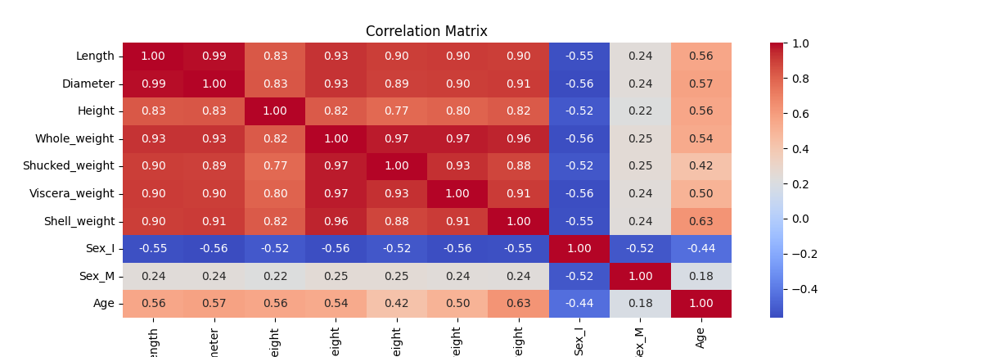
Create Chart Directory Structure:
cloud-file-storage-chart/
├── charts/
├── templates/
│ ├── deployment.yaml
│ ├── service.yaml
│ ├── persistentvolume.yaml
│ ├── persistentvolumeclaim.yaml
│ └── configmap.yaml
└── values.yaml

Slide 15
Feature Scaling and Train-Test Split
Step 6: Scaling the Features
Normalization using StandardScaler.
Step 7: Splitting the Data
Train-Test split (80-20) using `train_test_split`.

Slide 16
Model Training - Linear Regression
Model: Linear Regression
Training: Fit the model on training data.
Evaluation: MSE and R-squared on test data.
Results:
MSE: 4.8912
-R2: 0.5482

Slide 17
Model Training - Ridge Regression
Model: Ridge Regression
Training: Fit the model on training data.
Evaluation: MSE and R-squared on test data.
Results:
MSE: 4.8911
R2: 0.5482

Slide 18
Model Training - Lasso Regression
Model: Lasso Regression
Training: Fit the model on training data.
Evaluation: MSE and R-squared on test data.
Results:
MSE: 7.6826
R2: 0.2903

Slide 19
Model Comparison
Linear Regression:
MSE: 4.8912
R2: 0.5482
Lasso Regression:
MSE: 7.6826
R2: 0.2903
Ridge Regression:
MSE: 4.8911
R2: 0.5482

Slide 20
Conclusion
Summary: Linear and Ridge Regression perform similarly and better than Lasso Regression.
Recommendation: Choose Ridge Regression if multicollinearity is a concern; otherwise, Linear Regression is also a good choice.
Future Work: Consider other regression techniques or feature engineering for improved performance.

Slide 21
Questions & Answers
Open the floor for any questions from the audience.

Slide 22


