Slide 1
Project Presentation
on
Auto assistant system for visually impaired persons
Using Object Detection
&
Google text to speech
By: Aditya Singh Mandrawal

Slide 2
Presentation Flow
Motivation 6. Methodology
Introduction 7. Limitation
Drawback 8. Implementation Results
YOLO 9. Advantages & Applications
Block Diagram 10. Summary

Slide 3
Motivation
Many people suffer from temporary or permanent disabilities.
Current scenario:
Disable person has to depend on another person
A blind man stick is not able to detect the obstacle in path
Using wheelchair the safety of person is not guaranteed

Slide 4
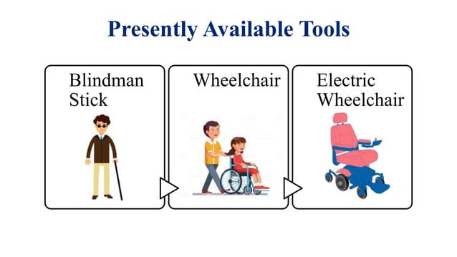

Slide 5
Introduction
Visually impaired individuals face many difficulties when they involve in self navigating.
Manual or electrical wheelchairs satisfies disability, where the patients can use it independently.
So, the core idea is to design an Auto-Assistance system.
Constraints:Working with Small object with similar shape and size, and different back-ground colour etc.
Auto-Assistance system is designed to work in the Indoor environment like hospital, public garden area etc.

Slide 6
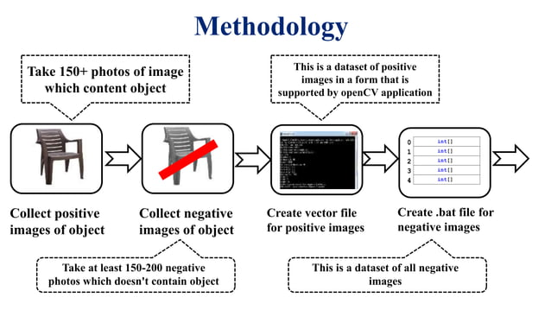

Slide 7
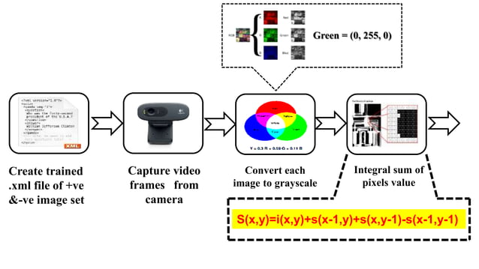

Slide 8
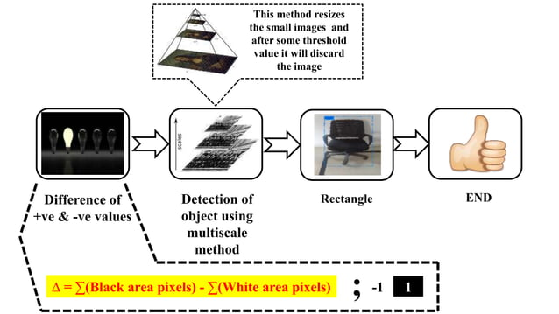

Slide 9
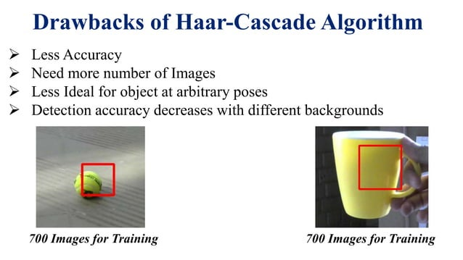

Slide 10
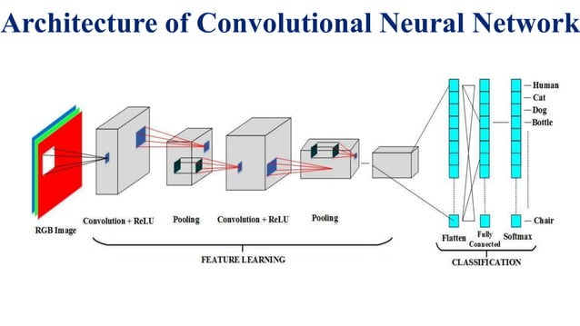

Slide 11
Literature Survey
Simple Convolutional Neural Network on Image Classification (IEEE-2017)
Tianmei Guo et.el proposed about CNN which has less computation cost and examined different methods and optimization algorithms for learning rate set and image classification parameters. Shallow network for good recognition effect has been verified.

Slide 12
Why YOLO ?
YOLO (You Only Look Once) is a network for object detectionthat consists of determining the location on the image where certain objects are present.
Classifies object along with class probabilities for real time applications.
It uses single CNN network for both localization and classification of objects using bounding box.
The YOLO design enables end-to-end training and real time speeds while maintaining high average precision.

Slide 13
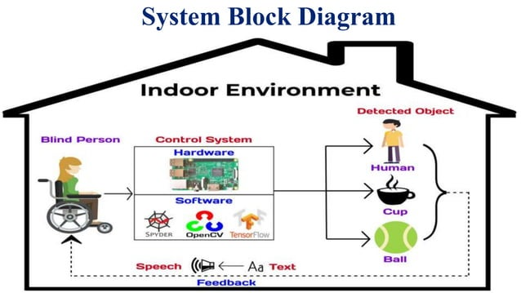

Slide 14
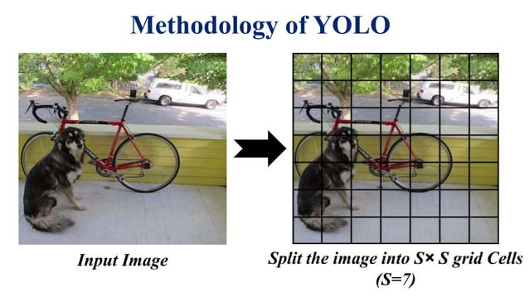

Slide 15
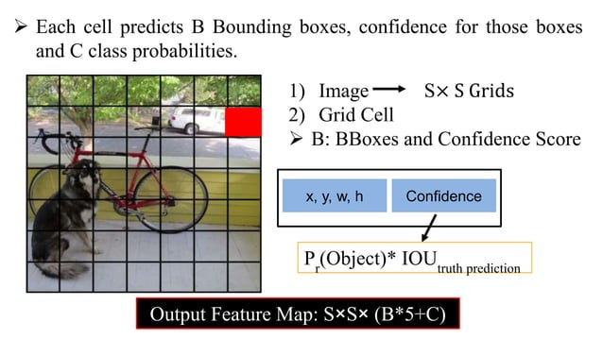

Slide 16
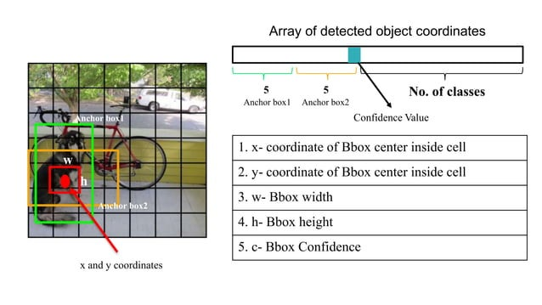

Slide 17
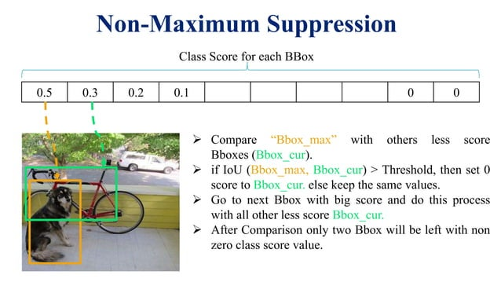

Slide 18
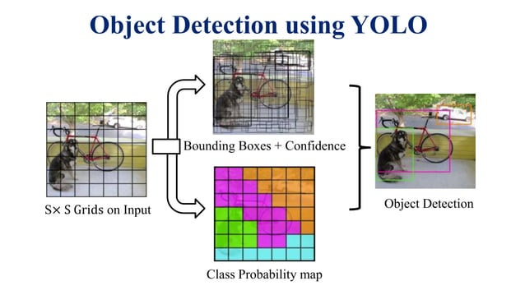

Slide 19
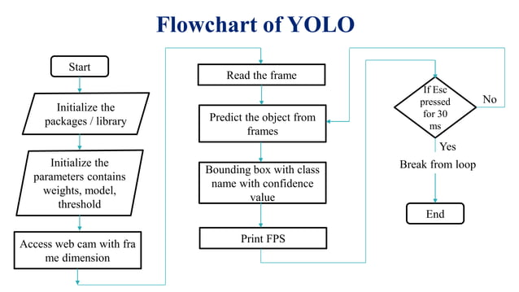

Slide 20
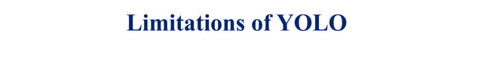
Limited accuracy for small objects.
Challenges with overlapping objects in dense scenes.
Localization accuracy can be less precise.
High computational complexity during training.
Lack of inherent consideration for temporal information.

Slide 21
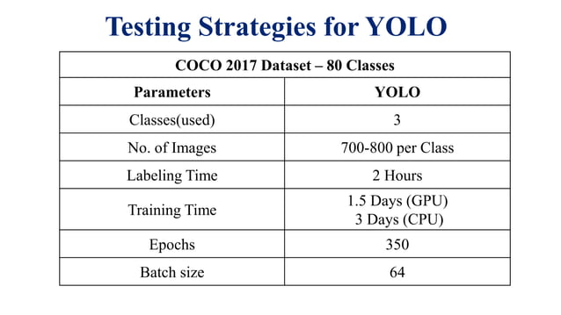

Slide 22
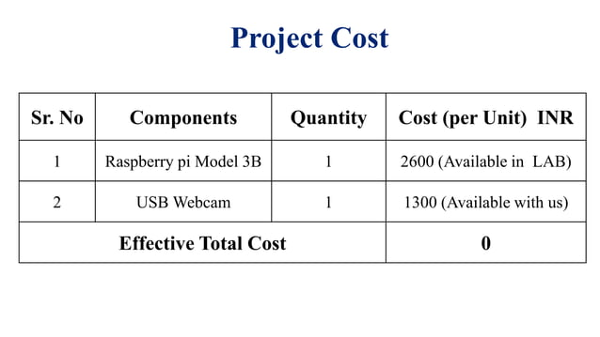

Slide 23
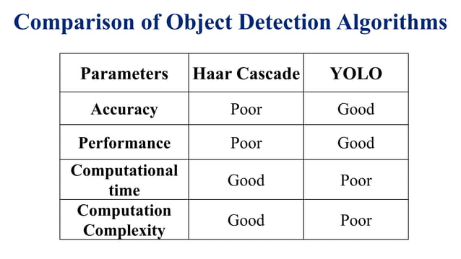

Slide 24
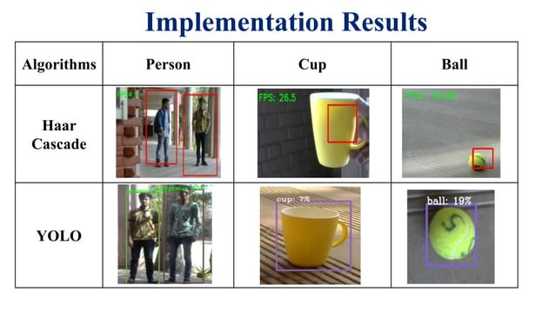

Slide 25
Advantages and Applications
Advantages:
Impaired person becomes self-reliant
Low costLess maintenance
Easy and convenient
Comfortable and safe
Application:
Hospital
Public garden area

Slide 26
References
M. Özçelikörs, A. Çoşkun, M. G. Say, A. Yazici, U. Yayan and M. Akçakoca, "Kinect based Intelligent Wheelchair navigation with potential fields," 2014 IEEE International Symposium on Innovations in Intelligent Systems and Applications (INISTA) Proceedings, Alberobello, 2014, pp. 330-337.
https://pjreddie.com/darknet/yolo/
https://github.com/opencv/opencv/tree/master/data/haarcascades
https://www.pyimagesearch.com/2017/09/18/real-time-object-detection-with-deep-learning -and-opencv/

Slide 27
Thank you

