Slide 1
Passive Gravity Compensation
for
Graceful Degradation
of
Hexapod Robots
STRP Check-In 2 | Simulation & Experimental Results
PRINCIPLE INVESTIGATOR
TABSHEER ALI ASKARI
PRESENTED BY
ABEER ANSARI MUBASHIR BAIG RAUF ABDULLAH
Notes:
[0:00-0:15] Since the last check-in the work has been almost entirely in
simulation: we integrated the torsion spring, built the measurement chain to
see what it does to the motors, and ran 214 runs across five phases. This is
the results talk.

Slide 2
Since Check-In 1 — Cleaner Measurements
Four changes to the simulator before any spring result could be trusted.
▸ Locked to simulated time
The gait loop and the torque logger both run off /clock, so command and measurement are sampled on the same timebase — no wall-clock jitter in the logs.
▸ Removed the start-up stall
The run now begins from a pose already inside the gait cycle instead of a dead stop. That removed the start-up transient: smaller opening torque peak, less noise in the first cycle, and lower tracking error, because the controller never has to catch up from rest.
▸ Commanded-effort plugin
We log the effort the motor is actually commanded to produce, per joint — not the total joint wrench. So a "34% reduction" is 34% off what the motor sees, which is the number that matters for sizing and for battery life.
▸ Effort-vs-angle + recorded video
All 12 joints logged at 50 Hz against joint angle, plus a video of every run. A torque peak can now be traced to a timestamp, a joint angle, and a body pose.
SIMULATION SETUP
Parameter | Value
Platform | THex Quadruped, 4 × 3 DoF
Mass m | 1.39847 kg (13 links)
Actuator limit | ±0.9414 N·m / joint
Control | Position PID, 10 Hz gait
Logging | 50 Hz, all 12 joints
Simulator | Gazebo Harmonic 8.14 (DART)
Middleware | ROS 2 Humble
Gravity | 9.8 m/s² (CoT); 9.78 IMU
▸ Net effect: every number in the rest of this deck is motor-commanded effort, on a jitter-free timebase, with no start-up transient contaminating the first gait cycle.
STRP Check-In 2 · Simulation & Results · 2 / 13
Notes:
[0:15-0:38] Four infrastructure changes first. Sim-time locking removed log
jitter. Starting from inside the gait cycle instead of a stall removed the
opening torque spike and dropped tracking error. The commanded-effort plugin
matters most: we now measure what the motor is asked for, not the total joint
wrench, so every reduction percentage is a real motor saving.

Slide 3
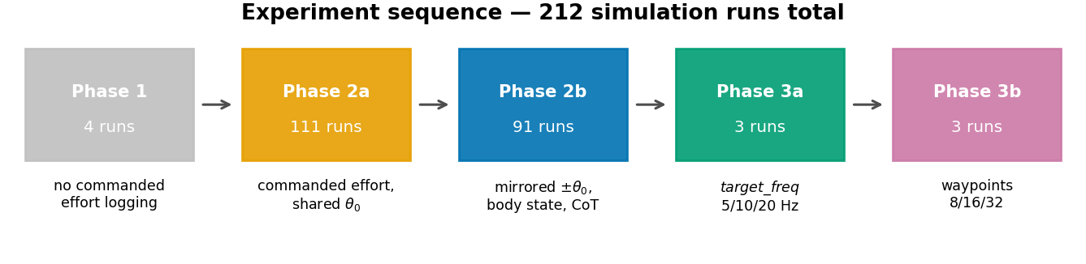
Experiment Roadmap — 214 Simulation Runs
Five phases, 12 July → 30 July. Each phase fixed a measurement problem found in the one before it.
Phase | Directory | Runs | What it added | Date
1 — Baseline | experiment_old/ | 6 | First working gait; no commanded-effort logging, no settle phase | 12 Jul
2a — Shared sweep | experiment_before symeetry/ | 111 | Spring integrated; commanded-effort logging; kx × θ₀ grid, one θ₀ for all knees | 27 Jul
2b — Mirrored sweep | experiment_new/ | 91 | ±θ₀ mirrored per leg; body state, forward displacement, cost of transport | 30 Jul
3a — Speed (frequency) | experiment_speed_freq/ | 3 | target_freq = 5 / 10 / 20 Hz — same trajectory, different replay speed | 30 Jul
3b — Speed (resolution) | experiment_speed_steps/ | 3 | NUM_DATA_POINTS = 8 / 16 / 32 — same speed, different waypoint count | 30 Jul
 | Total | 214
STRP Check-In 2 · Simulation & Results · 3 / 13
Notes:
[0:38-0:55] 214 runs. Phase 1 baseline gait; Phase 2a the first spring sweep,
111 runs; Phase 2b re-ran it mirrored after we found a symmetry bug, 91 runs,
and added cost of transport; Phase 3 was two speed levers. Everything from 2a
on has commanded-effort logging, so 2a and 2b are directly comparable.

Slide 4
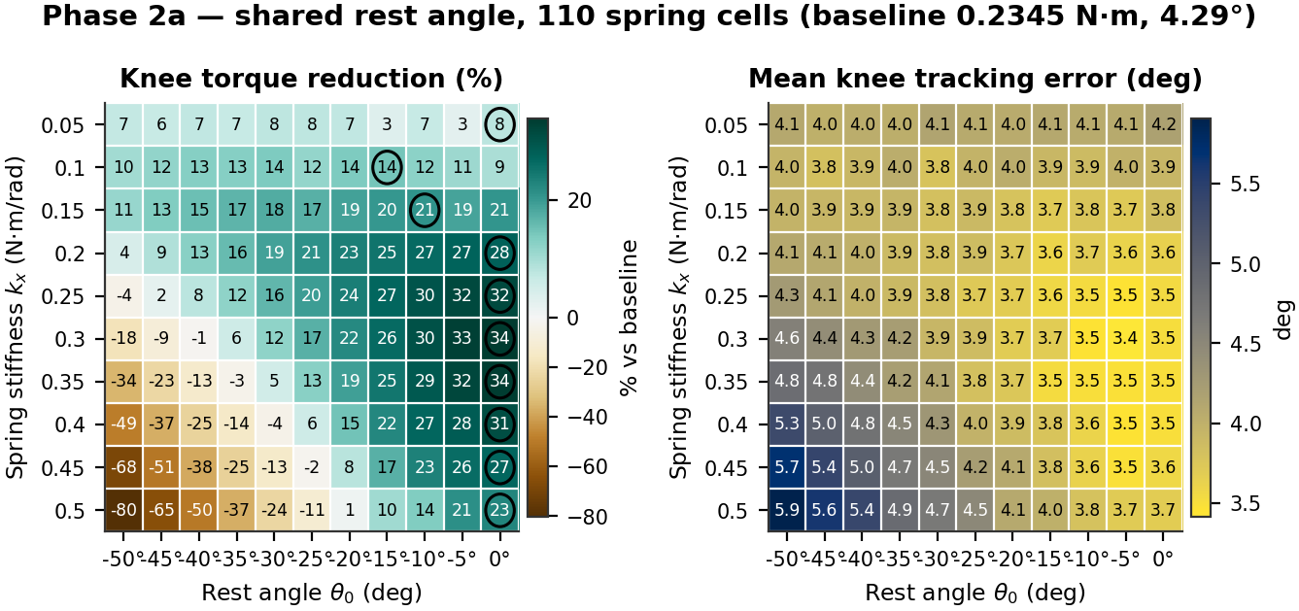
Sweep 1 — One Shared Rest Angle (111 runs)
A linear torsion spring in parallel with each knee: τ_motor = τ_required − kx · (θ₀ − θ). Two knobs — stiffness kx, rest angle θ₀.
▸ Grid: kx = 0.05 → 0.50 N·m/rad (10 values) × θ₀ = 0° → −50° (11 values) = 110 spring cells + 1 baseline.
▸ The same θ₀ was applied to all four knees.
TOP 5 OF 110 CELLS · baseline mean knee effort 0.2345 N·m
# | kx | θ₀ | Mean effort | Reduction | Track err
1 | 0.30 | 0° | 0.1548 | 34.0% | 3.51°
2 | 0.35 | 0° | 0.1556 | 33.6% | 3.50°
3 | 0.30 | −5° | 0.1571 | 33.0% | 3.41°
4 | 0.35 | −5° | 0.1595 | 32.0% | 3.48°
5 | 0.25 | 0° | 0.1599 | 31.8% | 3.53°
▸ Every one of the top five sits at θ₀ = 0° or −5°, and the far side of the grid collapses to −89%. That is not a coincidence — it is the problem.
STRP Check-In 2 · Simulation & Results · 4 / 13
Notes:
[0:55-1:22] The spring model is one line: motor torque equals required torque
minus spring torque. Two parameters, so we swept both - 111 runs. Best cell
takes 34% off mean knee effort, 0.2345 down to 0.1548 newton-metres. But the
top five all cluster at zero or minus five degrees, and the far side of the
grid collapses to minus 89%. Something was wrong with how we applied the rest
angle.

Slide 5
The Symmetry Problem
The legs are mirrored, but we were giving all four knees the same rest angle — so Sweep 1 was handicapped before it started.
MEASURED STANCE OPERATING POINT
TWO DISTINCT FAILURE MODES
Knee | Stance angle q_op | Holding torque | Side
FR | +37.2° | −0.246 N·m | right
BR | +42.9° | −0.248 N·m | right
FL | −38.4° | +0.258 N·m | left
BL | −40.8° | +0.264 N·m | left
What the spring does | What the motor must do | Result
Lifts a little | Carries the rest | Better than nothing
Lifts exactly right | Carries nothing | Best case
Lifts too hard | Pushes back down | Over-assist — effort climbs
Pulls the wrong way | Carries load and fights spring | Wrong sign — always worse
Left and right knees sit at opposite angles and need holding torques of opposite sign. A single shared θ₀ can only serve both sides at θ₀ = 0°, where the lever arm is just −q_op — which happens to carry the right sign for each side.
Move away from 0° and the two sides fail in opposite ways.
Right knees get over-assisted; left knees get wrong-signed assist, where no stiffness can help.
▸ 50 of 440 knee-cells (11.4%) were wrong-signed — roughly an eighth of the sweep was uninterpretable.
▸ A single rule — harmful when the assist ratio kx(θ₀−q_op)/HOLD is below 0% or above 200% — predicts 92.7% of all 440 knee-cells with zero false positives.
▸ Fix: mirror the sign per side. Right knees θ₀ = −|θ₀|, left knees θ₀ = +|θ₀|.
▸ So Sweep 1's "optimum" at θ₀ = 0° was never a discovered optimum — it was the only rest angle a shared-θ₀ design could use. The sweep was answering a question we had accidentally constrained.
STRP Check-In 2 · Simulation & Results · 5 / 13
Notes:
[1:22-1:52] The right knees stand at plus 37 and plus 43 degrees, the left at
minus 38 and minus 41, with holding torques of opposite sign. One shared rest
angle can only help both sides at zero. Away from zero the right knees get
over-assisted - correct direction, too strong, so the motor pushes back - and
the left knees get assist in the wrong direction, where no stiffness helps. 51
of 440 knee-cells wrong-signed. The fix: give each side the sign it needs.

Slide 6
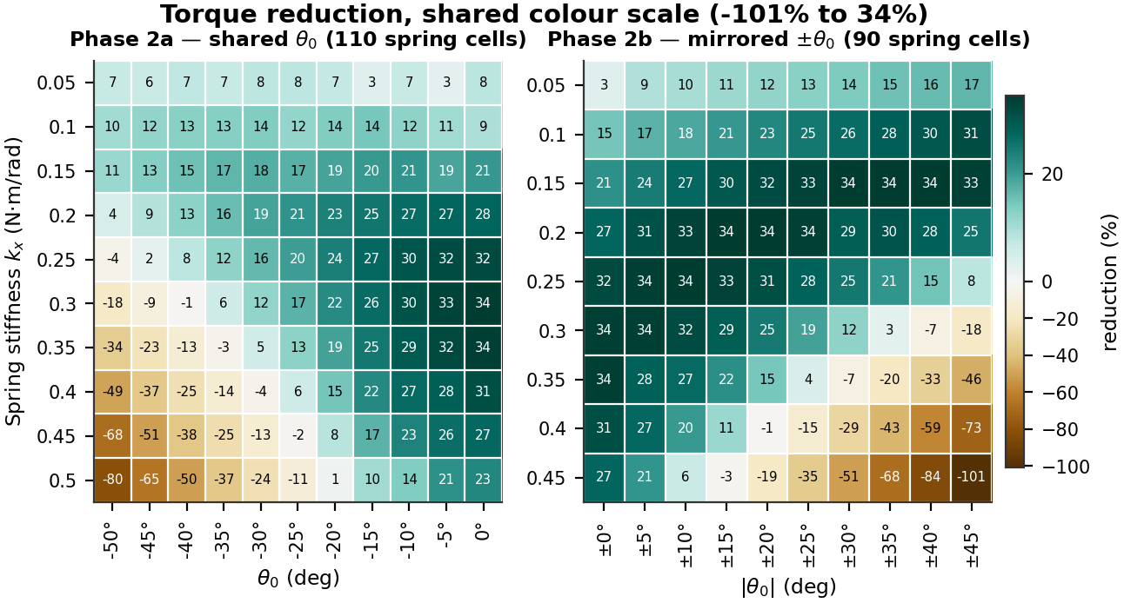
Sweep 2 — Mirrored Rest Angle (91 runs)
Same spring, same gait, sign of θ₀ matched to each leg: kx = 0.05→0.45 (9) × |θ₀| = 0°→45° (10) = 90 cells + baseline.
Metric | Sweep 1 — shared | Sweep 2 — mirrored | Change
Best torque reduction | 34.0% | 34.39% | +0.4 pts
Wrong-sign cells | 51 / 440 (11.6%) | 0 / 360 (0%) | eliminated
Spread at own optimum | 3.96 pts | 2.71 pts | 1.5× tighter
Spread at recommended | — | 1.15 pts | 3.4× tighter
kx=0.30 / θ₀=0° regression check | 34.0% | 33.7% | within noise
The headline number barely moved — and that is the point.
Mirroring did not buy us a bigger reduction. It bought us a sweep where all 90 cells are physically interpretable instead of an eighth being broken, and where the recommended setting helps all four knees equally.
STRP Check-In 2 · Simulation & Results · 6 / 13
Notes:
[1:52-2:14] Re-running mirrored: 34.4% versus 34.0%. Almost identical, and that
is the honest result. Mirroring did not buy a bigger number - it bought a
sweep where all 90 cells are interpretable instead of an eighth being broken,
and per-knee spread at the optimum drops from 6.1 points to 1.1.

Slide 7
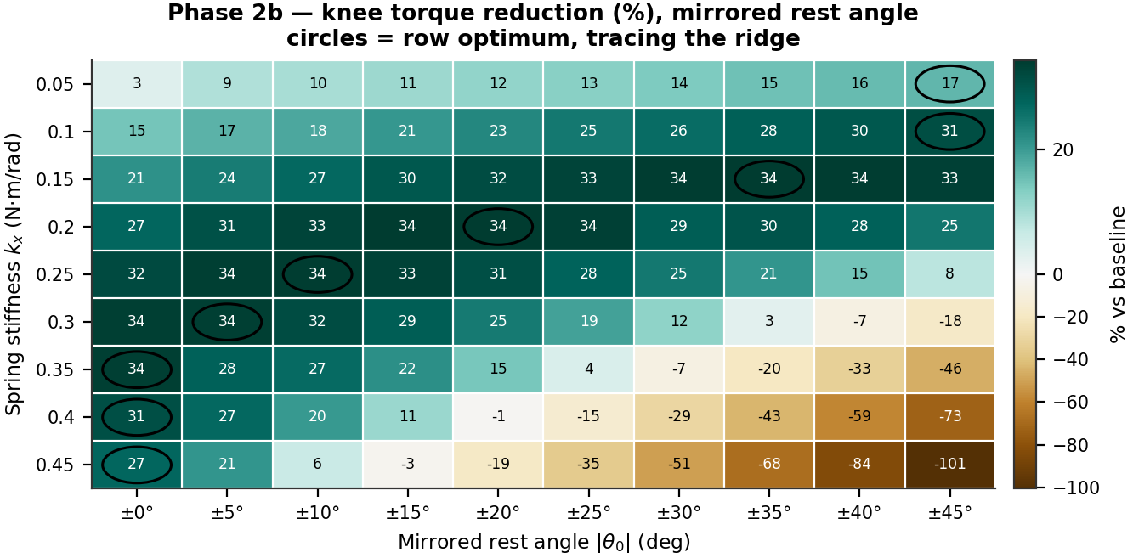
A Ridge, Not a Peak — One Effective DOF
Assist torque is kx · (|θ₀| + |q_op|); the two parameters multiply, so the optimum is a hyperbola.
▸ Best cell: kx = 0.15 N·m/rad, |θ₀| = ±35° → 34.39% reduction (0.2352 → 0.1543 N·m).
▸ Five very different parameter pairs all land within 0.8 points of each other. The design has one effective degree of freedom, not two — the spring only has to deliver about 0.25 N·m of assist; how that is split between stiffness and preload is a manufacturing convenience.
▸ Over-assist is the failure mode at the bottom-right: correctly signed spring, too strong, so the motor starts fighting it — down to −101% at kx=0.45 / ±45°. Interpretable, not broken.
▸ Caveat we have to state: the ridge exits the grid at both ends. Below kx = 0.10 the best |θ₀| is 45°, the grid edge — that branch is unmapped.
kx (N·m/rad) | 0.05 | 0.10 | 0.15 | 0.20 | 0.25 | 0.30 | 0.35 | 0.40 | 0.45
Best |θ₀| | ±45° | ±45° | ±35° | ±20° | ±10° | ±5° | ±0° | ±0° | ±0°
Reduction at that cell | 16.6% | 31.2% | 34.4% | 34.3% | 34.0% | 33.7% | 33.6% | 31.0% | 27.4%
STRP Check-In 2 · Simulation & Results · 7 / 13
Notes:
[2:14-2:45] The most useful structural result. Assist torque is stiffness times
angle, so the two parameters trade off - the optimum is a hyperbolic ridge, not
a point. As stiffness rises the best rest angle falls, and everything from 0.15
to 0.35 delivers 33.6 to 34.4 percent. So the defensible claim is not "the
optimum is 0.15 and 35 degrees" - it is that a correctly sized assist of about
0.25 newton-metres removes a third of knee effort, and this whole locus
delivers it. Good for manufacturing tolerance.

Slide 8
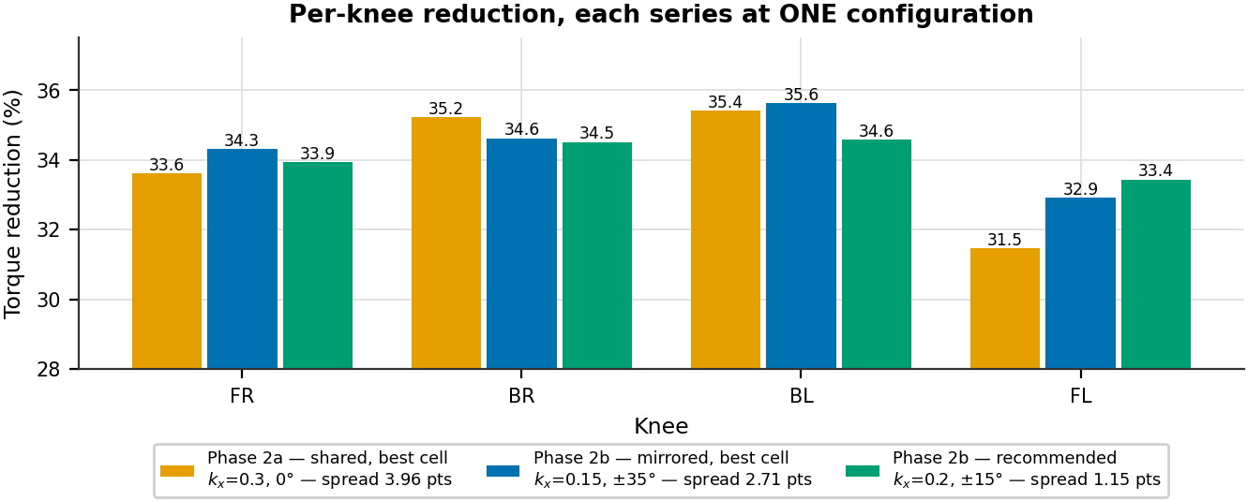
Per-Knee Symmetry — What Mirroring Bought
Spread = best knee minus worst knee, in percentage points of torque reduction.
Configuration | FR | BR | BL | FL | Spread
Sweep 1 optimum (0.30, 0°) | 33.6 | 35.2 | 35.4 | 31.5 | 3.96 pts
Sweep 2 recommended (0.20, ±15°) | 33.9 | 34.5 | 34.6 | 33.4 | 1.1 pts
Sweep 2 torque optimum (0.15, ±35°) | 34.3 | 34.6 | 35.6 | 32.9 | 2.7 pts
Over-assist corner (0.45, ±45°) | −99.5 | −97.9 | −95.3 | −110.9 | 15.6 pts
Across the whole grid the spread runs from 1.1 to 15.6 points, median 8.9. The recommended cell is the most bilaterally symmetric of all 90 — it happens to sit near all four knees' individual optima at once.
▸ 0 wrong-sign cells in 360 checked, versus 50 of 440 before mirroring.
▸ FL is consistently the weakest knee and BL the strongest. That is not a mirroring failure — the four legs have genuinely different measured holding torques (0.246 → 0.264 N·m) and stance angles. Only per-knee stiffness would remove the last point of it.
▸ Why this matters for hardware: at Sweep 1's optimum the knees span 31.5–35.4%, so one spring cannot serve every leg equally. At 1.15 points, it can.
STRP Check-In 2 · Simulation & Results · 8 / 13
Notes:
[2:45-3:05] Why symmetry matters for hardware: at Sweep 1's optimum the four
knees span 31.5 to 35.4 percent, so one spring cannot serve every leg equally.
That is a 3.96 point spread; the mirrored recommendation is 1.15, tightest of
all ninety cells. The residual is real, not a bug - the four legs measure
slightly different holding torques.

Slide 9
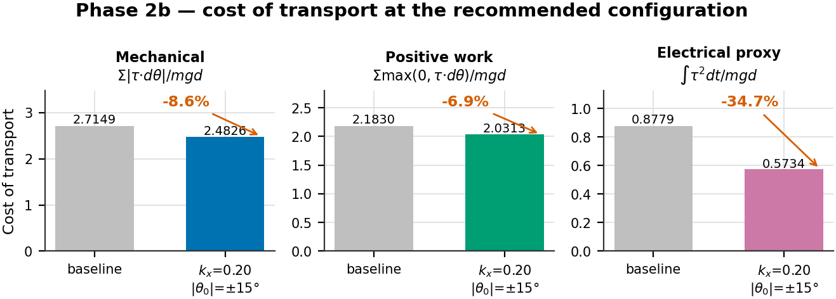
Cost of Transport — Three Definitions
CoT = E / (m·g·d), m = 1.398 kg, g = 9.8 m/s², all 12 joints. The three variants differ only in how the energy E is counted.
Energy definition | Baseline | Best cell | Best value | Change | r vs torque red.
Mechanical Σ|τ·dθ| | 2.7149 | 0.25 / ±15° | 2.3012 | −15.2% | −0.787
Positive work Σmax(0, τ·dθ) | 2.1830 | 0.25 / ±15° | 1.8178 | −16.7% | −0.366
Electrical proxy ∫τ²dt | 0.8779 | 0.20 / ±15° | 0.5734 | −34.7% | −0.986
A motor holding a static load burns current but does zero mechanical work. The spring's whole job is to cancel static holding torque — so mechanical CoT is measuring the wrong thing and understates the benefit ~5×. The I²R proxy tracks the torque saving at r = −0.986.
STRP Check-In 2 · Simulation & Results · 9 / 13
Notes:
[3:05-3:40] Cost of transport, over all twelve joints and the whole robot.
Mechanical work says the spring saves only 7% - that looks like a failure, but
it is an artifact: mechanical work is torque times angle change, so a motor
holding a static load registers zero work while still burning current, and
cancelling static holding torque is the spring's entire job. The electrical
proxy, integral of torque squared, is the copper-loss surrogate - it drops
34.7%, tracking the torque reduction at r equals minus 0.986. That is the
efficiency number we quote. It is a proxy: joules would need the servo's torque
constant and resistance.

Slide 10
Metric by Metric — What Moves, What Doesn't
Left: baseline vs the torque-optimal cell, with each metric's correlation to torque reduction across all 90 cells.
Metric | Baseline | At optimum (0.15, ±35°) | Change | r vs red. | Independent?
Mean knee effort (N·m) | 0.2352 | 0.1543 | −34.4% | — | headline
RMS effort (N·m) | 0.2863 | 0.2126 | −25.7% | −0.996 | collinear
p99 demand (N·m) | 0.9311 | 0.8745 | −6.1% | −0.852 | partly
Peak demand (N·m) | 0.9831 | 0.9502 | −3.3% | — | partly
Torque variance | 0.0266 | 0.0214 | −19.5% | −0.596 | partly
Saturation (%) | 0.69 | 0.75 | +0.06 pts | −0.457 | yes
Mean tracking error | 4.299° | 3.395° | −21.0% | −0.996 | collinear
Forward displacement (m) | 0.3256 | 0.3297 | +1.3% | +0.192 | yes
RECOMMENDED CONFIGURATION
kx = 0.20 N·m/rad, |θ₀| = ±15°
Property | Value | Rank of 90
Electrical CoT | 0.5734 | #1
RMS effort | 0.2121 N·m | #1
Per-knee spread | 1.1 pts | #1
Actuator saturation | 0.31% | 15–24 of 90
Torque reduction | 34.12% | 0.27 pts off #1
p99 demand | 0.8636 N·m | 8% under rating
Mechanical CoT | 2.4826 | −8.6% vs base
Tracking error | 3.54° | −17.6%
Displacement | 0.3309 m | at grid mean
▸ RMS falls less than mean (−25.7% vs −34.4%): the spring removes the DC gravity bias, not the AC dynamic component. The continuous thermal benefit is real but smaller than the headline.
▸ Tracking error is collinear at r = −0.996 — it restates the effort result and cannot be used as independent evidence that gait quality survived. Saturation and displacement are the only genuinely independent checks, and both stay healthy.
Not the winner on torque reduction — but #1 of 90 on electrical cost, RMS effort and bilateral symmetry.
STRP Check-In 2 · Simulation & Results · 10 / 13
Notes:
[3:40-4:12] Two honest flags. RMS effort falls 26% while mean falls 34% - the
spring cancels the constant gravity bias, not the dynamic component, so the
thermal benefit is smaller than the headline. And tracking error correlates at
minus 0.996 with effort, so it is the same measurement restated - not
independent proof the gait survived. Saturation and displacement are the only
independent checks, and both are fine. On the right: our recommended
configuration is not the torque winner - it is first of ninety on electrical
cost, RMS, symmetry and saturation.

Slide 11
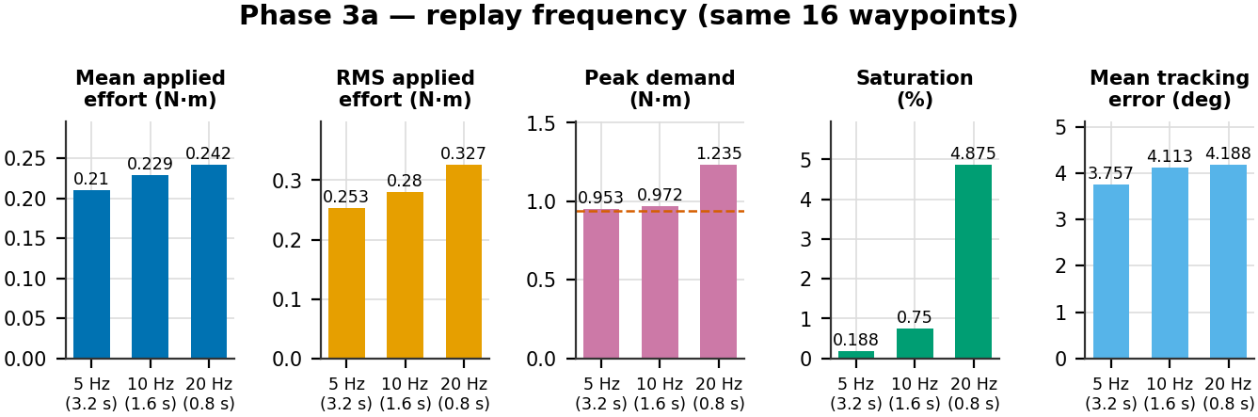
Speed Lever 1 — Replay Frequency
The same 16 waypoints, played faster or slower. Per-step jump is 2.989° in all three runs — so only speed changed.
target_freq | Cycle time | Mean effort | RMS effort | Peak demand | Saturation | Tracking err (mean/RMS/peak)
5 Hz (slower) | 3.2 s | 0.2101 (−8.3%) | 0.2535 (−9.6%) | 0.953 (−1.9%) | 0.19% (¼×) | 3.76° / 6.58° / 21.0°
10 Hz (baseline) | 1.6 s | 0.2292 | 0.2804 | 0.972 | 0.75% | 4.11° / 6.81° / 20.8°
20 Hz (faster) | 0.8 s | 0.2424 (+5.8%) | 0.3265 (+16.5%) | 1.235 (+27.1%) | 4.88% (6.5×) | 4.19° / 6.92° / 21.2°
▸ Speeding up is expensive at the peak, not at the mean: the same 2.989° jump in half the time makes the D-term react harder. Mean effort barely moves because it is set by the unchanged stance holding torque.
STRP Check-In 2 · Simulation & Results · 11 / 13
Notes:
[4:12-4:40] Two speed levers, both with no spring. First, replay frequency -
same sixteen waypoints, faster or slower; the command log confirms the per-step
jump is 2.989 degrees in all three, so only speed changed. 20 Hz costs 27% more
peak torque and multiplies saturation by six and a half; 5 Hz drops saturation
to a quarter. Mean effort barely moves - it is set by stance holding torque.

Slide 12
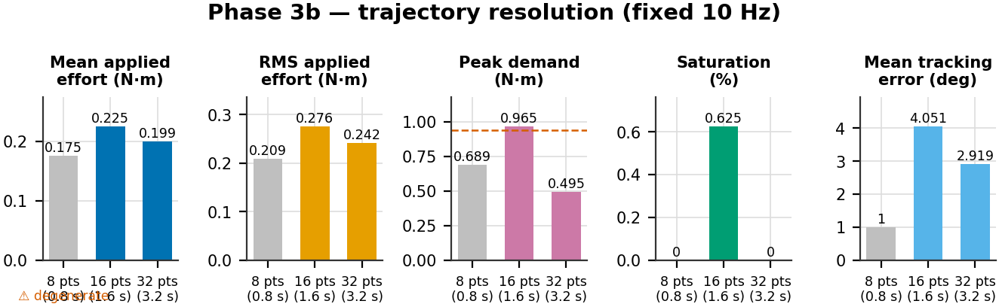
Speed Lever 2 — Trajectory Resolution
Sampling the same Bézier swing arc with more or fewer waypoints, at a fixed 10 Hz. This is the lever that actually fixes peak torque.
NUM_DATA_POINTS | Cycle | Mean effort | RMS | Peak demand | Sat. | Track err | Step jump
8 ⚠ degenerate | 0.8 s | 0.1749 | 0.2090 | 0.689 | 0.00% | 1.00° | 0.483°
16 (baseline) | 1.6 s | 0.2246 | 0.2756 | 0.965 | 0.63% | 4.05° | 2.989°
32 (finer) | 3.2 s | 0.1994 | 0.2419 | 0.495 (−48.7%) | 0.00% | 2.92° | 1.610°
MATCHED AT ≈3.2 s CYCLE TIME
5 Hz replay → peak demand 0.953
32 waypoints → peak demand 0.495
At the same cycle time, finer sampling halves peak torque where slower replay does nothing. Slowing down gives the controller more time to chase the same discontinuity; finer sampling shrinks the discontinuity itself.
⚠ The N = 8 trap. n_swing = int(8 × 0.25) = 2, so linspace samples only t = 0 and t = 1 — both already at stance height. The foot never lifts; it slides. Its "better" numbers are a drag, not a step. Hard cliff: any lift needs 3 swing samples, i.e. N ≥ 12. Excluded from all conclusions.
STRP Check-In 2 · Simulation & Results · 12 / 13
Notes:
[4:40-5:20] Second lever, resolution - same speed, more waypoints on the same
curve. A trap first: at eight points the swing phase gets two samples, both
endpoints, both at stance height, so the foot never lifts, it slides. Its
numbers look good because it is doing less, so we excluded it - the cliff is
exact at twelve points. The valid comparison is 16 versus 32, and it is the
strongest result here: peak demand down 48.7%, saturation to zero, with no
spring. And at matched cycle time, finer sampling halves peak torque while
slower replay does nothing - slowing down only gives the controller longer to
chase the same discontinuity; finer sampling removes it.

Slide 13
Where We Stand
SUPPORTABLE CLAIMS
✓ A mirrored parallel knee spring removes ~34% of mean knee motor torque and ~26% of RMS effort — 91 runs, combined across four knees.
✓ Electrical (copper-loss) cost of transport falls ~35%, 0.878 → 0.573.
✓ Mirroring gives 0 wrong-sign cells in 360 (was 50/440) and cuts bilateral asymmetry from 3.96 to 1.15 points.
✓ The design has one effective DOF — a locus of (kx, θ₀) all deliver ~34%.
✓ Finer trajectory sampling cuts peak demand −49%, independent of the spring.
WHAT WE DO NOT CLAIM
✗ Mechanical work does not drop in proportion to torque — only 6.2% against 34.4%. Any efficiency claim from mechanical CoT alone understates this device ~5×.
✗ Electrical CoT in joules — the proxy needs the servo's kt and R first.
✗ Tracking error as independent proof of gait quality — collinear at r = −0.996.
✗ A smaller motor. Peak demand is control-limited, not spring-limited: baseline p99 is 0.931 N·m against a 0.941 N·m rating, and no spring setting fixes that.
✗ n = 1 per cell — differences under ~1 point are not statistically separable.
LITERATURE CONTEXT
Published passive-compliance savings span 17–50%: compliant feet ~17%, hexapod gait + torque optimisation 22–39%, nonlinear elastic joints up to 50%, trajectory-optimised biped coupling >50%.
Our ~34% sits solidly in that range using the simplest possible hardware — a fixed linear spring, no clutch, no adaptive mechanism.
NEXT STEPS
→ Three repeats at the ridge to make sub-1-point differences separable.
→ Extend the grid to |θ₀| > 45° at low stiffness — the ridge exits the box there.
→ Raise NUM_DATA_POINTS 16 → 80 to remove the 10 Hz step discontinuity, then re-measure peak torque.
→ Add an explicit fall / body-tilt gate instead of inferring success from displacement.
→ Get kt and R from the servo datasheet to convert the electrical proxy to joules.
STRP Check-In 2 · Simulation & Results · 13 / 13
Notes:
[5:20-6:00] What we stand behind: 34% mean knee torque, 35% electrical cost of
transport, zero wrong-sign cells, 1.1 point symmetry, one-degree-of-freedom
design surface. What we do not claim, before being asked: mechanical work only
drops 6%, so no efficiency claim from it; the electrical figure is a proxy, not
joules; tracking error is not independent evidence; and this does not justify a
smaller motor, because peak demand is limited by the 10 Hz stepped setpoint.
Our 34% sits inside the published 17-to-50% range, with the simplest hardware
in it. Next: repeats at the ridge, extend the grid, raise trajectory
resolution, and get the motor constants for real joules.

