Slide 1
LEADING WITH EFFECTIVENESS · FROM SESSION TO ACTION
Maintenance Department
Leading with Effectiveness + Field Service Standards
OUR DEPARTMENT VISION
“To create a world-class service support and to make a happy customer.”
Cascade Session · Department Presentation · Field Service Engineer Training
Notes:
Combined deck: Part 1 carries the leadership session into our department vision. Part 2 turns that vision into the field service standards every engineer follows.

Slide 2
WHAT THIS DECK COVERS
Two parts, one continuous line
From why we lead this way, to exactly how we work in the field
01
02
Leading with Effectiveness
Field Service Standards
Our vision, the key shifts from the session, and the habits we commit to as a department.
How that vision becomes daily practice: preparation, conduct, workflow, and prevention.
The link
A happy customer is not an accident. It is the result of a proactive mindset (Part 1) applied through disciplined field practice (Part 2) — every visit, every machine, every region.
GENROBOTICS · MAINTENANCE DEPARTMENT
1
Notes:
Set expectations: Part 1 is the why and the mindset; Part 2 is the how — the standards each engineer is accountable for.

Slide 3
GENROBOTICS VISION
“Crafting robotics and AI solutions to empower and redefine possibilities of mankind.”
Every function at Genrobotics — including Maintenance — exists to make this true in practice, not just on paper.
GENROBOTICS · MAINTENANCE DEPARTMENT
2
Notes:
Anchor everything to the company vision before we talk about our own.

Slide 4
OUR DEPARTMENT VISION
Maintenance Department
“To create a world-class service support
and to make a happy customer.”
This is our one-sentence answer to: “Why does the Maintenance Department matter to Genrobotics' vision?” Every habit and standard in this deck exists to make this vision real for our internal and external customers.
World-class service
Happy customer
Every region, every machine
GENROBOTICS · MAINTENANCE DEPARTMENT
3
Notes:
Read the vision out loud. This sentence is what every standard in Part 2 is built to deliver.

Slide 5
THE ALIGNMENT LADDER
One line, from company purpose to daily work
Company Vision
Crafting robotics and AI solutions to empower and redefine possibilities of mankind.
↓
Department Vision
World-class service support that makes every customer a happy customer.
↓
Team Goals
Faster response, higher first-time-fix rate, and fewer repeat breakdowns this quarter.
↓
Individual KPIs
Each engineer owns response time, PM adherence, and customer feedback score.
GENROBOTICS · MAINTENANCE DEPARTMENT
4
Notes:
Show the unbroken line: if an engineer's KPI does not ladder up to a happy customer, it is the wrong KPI.

Slide 6
KEY LEARNINGS FROM THE SESSION
Three shifts that matter most for Maintenance
1
2
3
Be Proactive
Begin with the End in Mind
Put First Things First
Own our response instead of just reacting to breakdowns. Widen the gap between an alarm and our action.
Define what a “happy customer” and “world-class service” actually look like, before we plan the work.
Protect time for preventive maintenance and planning, not just firefighting the urgent breakdown.
GENROBOTICS · MAINTENANCE DEPARTMENT
5
Notes:
These three shifts are the bridge into Part 2 — every field standard traces back to one of them.

Slide 7
LEARNING 1 · BE PROACTIVE
Reactive fixing vs. proactive service
The gap between an alarm and our response is where we choose which department we are
REACTIVE MAINTENANCE
PROACTIVE MAINTENANCE
“It broke, so we fix it.” No pattern tracking.
We track failure patterns and act before the next one.
Spares ordered only after a failure.
Critical spares pre-positioned based on planned schedules.
Customer finds out from the downtime, not from us.
Customer is informed and reassured before they need to ask.
Energy spent blaming machines, vendors, or shifts.
Energy spent on what we can influence — our prep, our checks.
GENROBOTICS · MAINTENANCE DEPARTMENT
6
Notes:
Ask the team: which column describes our last five jobs, honestly?

Slide 8
LEARNING 3 · PUT FIRST THINGS FIRST
The Time Matrix, applied to maintenance work
I · URGENT & IMPORTANT
II · NOT URGENT, IMPORTANT
Line-down breakdowns, safety-critical failures, emergency escalations.
Preventive maintenance, spares planning, training, root-cause analysis.
III · URGENT, NOT IMPORTANT
IV · NOT URGENT, NOT IMPORTANT
Some ad-hoc requests and interruptions that feel urgent to the requester.
Redundant paperwork, re-checking verified items, idle waiting.
Goal: shrink Quadrant I over time by investing deliberately in Quadrant II.
GENROBOTICS · MAINTENANCE DEPARTMENT
7
Notes:
Quadrant II is where preventive maintenance lives. Part 2 of this deck is essentially a Quadrant II playbook.

Slide 9
FROM LEARNING TO PRACTICE
How this shows up in our daily work
Learning
Behaviour we change
What the team will see
Be Proactive
Log and review failure patterns weekly, not just close tickets.
A shared breakdown log reviewed every Monday.
Begin with the End in Mind
State the “happy customer” outcome before starting a job.
A one-line job objective on every work order.
Put First Things First
Block protected time for PM and coaching each week.
PM slots that aren't moved for non-emergencies.
Think Win-Win
Agree turnaround expectations with the customer up front.
Fewer disputes over what “urgent” means.
GENROBOTICS · MAINTENANCE DEPARTMENT
8
Notes:
This is the hinge slide: mindset on the left, visible team behaviour on the right.

Slide 10
OUR 30-DAY PRACTICE
Making the shift real, one week at a time
WEEK 1
WEEK 2
WEEK 3
WEEK 4
State It
Trace It
Practice It
Review It
Share our one-sentence department vision with every shift and toolbox talk.
Check that each team goal and KPI ladders up to “world-class service, happy customer.”
Protect one Quadrant II block per person: PM planning, coaching, or root-cause review.
Revisit the breakdown log and PM adherence; sharpen the plan for next month.
GENROBOTICS · MAINTENANCE DEPARTMENT
9
Notes:
Commit publicly to the four weeks. Week 3 is where Part 2's standards get practised.

Slide 11
PART 02
Field Service Standards
How every engineer turns our vision into a happy customer — before, during and after every service.
GENROBOTICS · MAINTENANCE DEPARTMENT
10
Notes:
Transition: mindset done — now the operating standard.

Slide 12
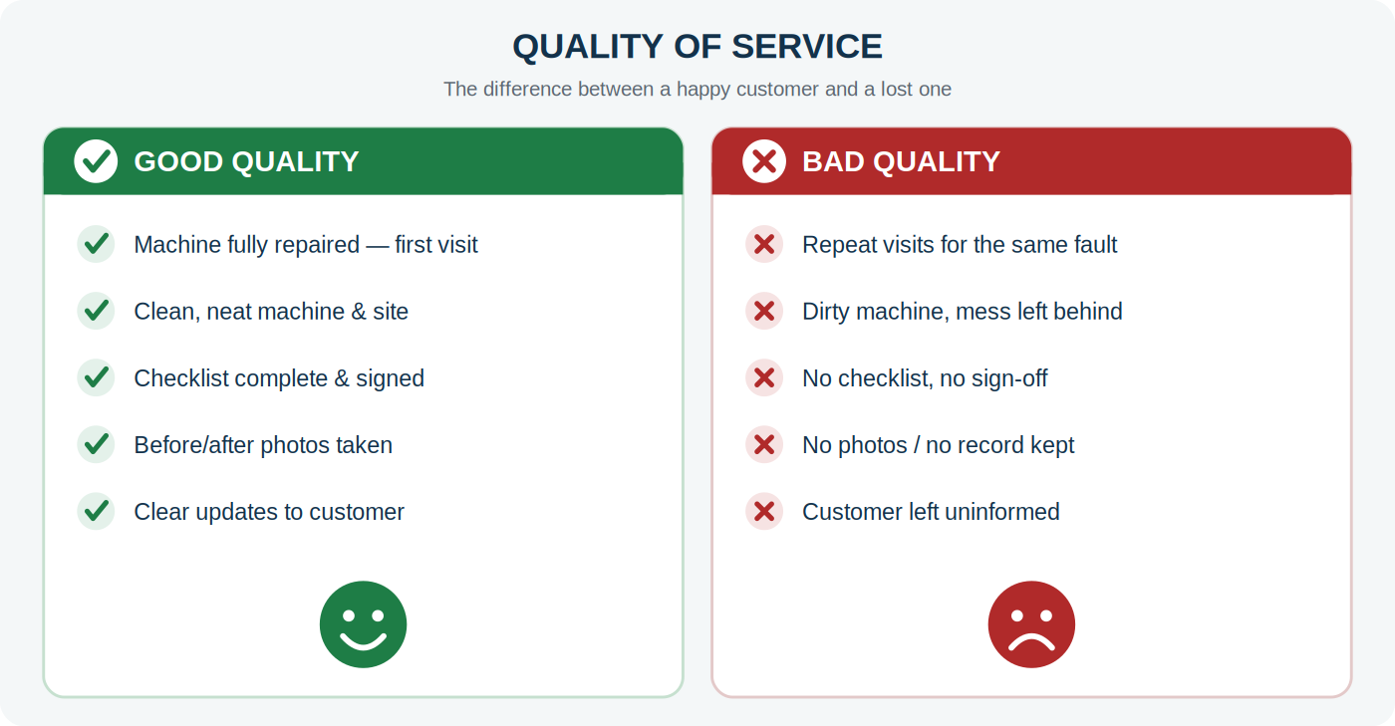
WHAT GOOD LOOKS LIKE
Good service vs bad service
The difference between a customer who stays and one we lose
GENROBOTICS · MAINTENANCE DEPARTMENT
11
Notes:
Every item in the green column is a standard in this deck. Every item in red is a preventable failure.

Slide 13
CONDUCT
Do’s and Don’ts
Read this before every visit until it is second nature
✔ DO
✘ DON’T
Confirm the appointment and your arrival time.
Reach the site without informing the customer.
Video-call inspect first and carry the right spares.
Travel first, discover the spare is missing after.
Wear full uniform, ID card and safety gear.
Work in casual clothes or without safety gear.
Test fully and demonstrate the machine working.
Pack up the moment the part is replaced.
Fill the report and take the customer’s sign-off.
Leave without documentation or acknowledgement.
Say “I will check and confirm” when unsure.
Give false assurances or promise dates you can’t keep.
GENROBOTICS · MAINTENANCE DEPARTMENT
12
Notes:
Ten do's and don'ts are in the handbook; these six are the ones that cause the most complaints.

Slide 14
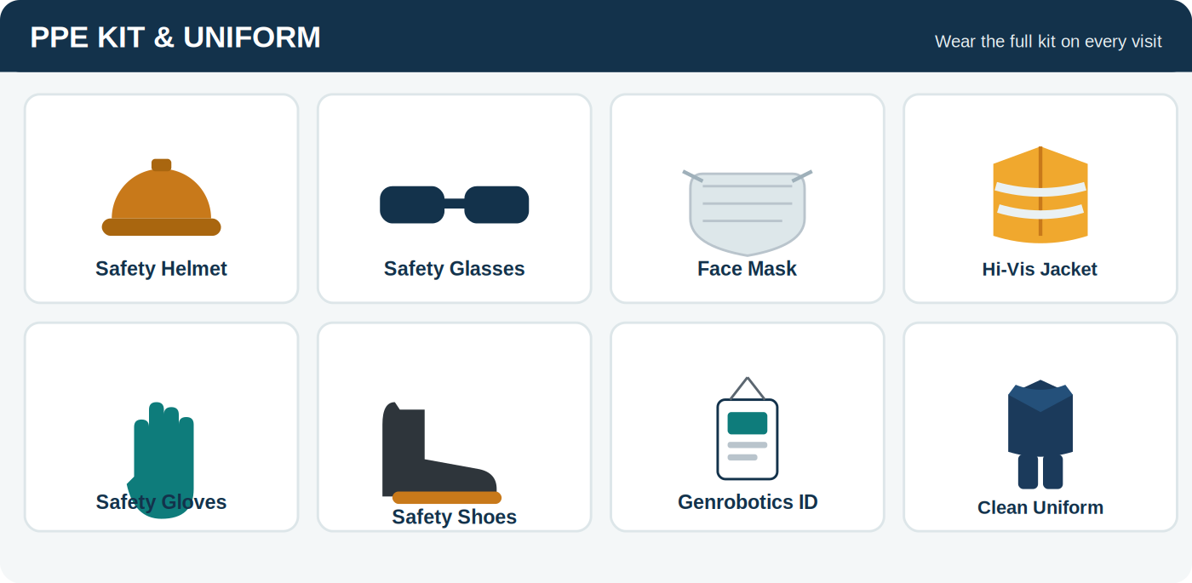
DRESS CODE · SECTION 3
PPE kit and uniform
The customer forms an opinion in the first ten seconds
GENROBOTICS · MAINTENANCE DEPARTMENT
13
Notes:
Safety gear is not optional: Bandicoot and G-Mammoth work happens around manholes, confined spaces and heavy equipment.

Slide 15
SAFETY FIRST
Non-negotiable safety rules
No shortcut is worth an injury — on any site, on any day
Confined space
!
Never enter or work at a manhole until it is confirmed gas-free and ventilated.
Isolate power
!
Lock off power and release hydraulic / stored pressure before opening the machine.
Full PPE
!
Helmet, gloves, safety shoes, mask — and reflective jacket at roadside sites.
Never rush
!
Barricade roadside work. Never skip a safety step to finish faster.
GENROBOTICS · MAINTENANCE DEPARTMENT
14
Notes:
Read each of these aloud. These are the rules we never bend, regardless of customer pressure or time.

Slide 16
COMMUNICATION STANDARDS · SECTION 4
Bad service is usually bad communication
A repair can take time — silence is what makes it feel worse
1
2
3
4
Before
On arrival
During
After
Confirm the appointment and your ETA. If you will be late, say so in advance.
Greet, introduce yourself, show your ID, and explain what you will do.
Simple language, no jargon. Say what you found and how long it will take.
Explain what was repaired, show it running, and state the next step clearly.
Handling an angry customer
Stay calm, never argue. Listen fully and acknowledge the frustration first. Never blame the customer, the operator or the machine — and never criticise Genrobotics or a colleague. If you cannot resolve it, escalate to the Maintenance Manager rather than promise what you can’t keep.
GENROBOTICS · MAINTENANCE DEPARTMENT
15
Notes:
Communication is the cheapest lever we have for customer satisfaction.

Slide 17
TEAM COLLABORATION · SECTION 5
No engineer works alone
One team, one goal — covering each other across regions
Communicate openly
Inter-region support
Keep the team, your manager and head office updated. Never go silent.
If an engineer is on leave or unavailable and a complaint comes up in that region, the nearest engineer from a neighbouring region steps in.
No customer waits just because “the usual engineer is not available.”
Raise problems early
A difficulty shared early is solved before it reaches the customer.
Share ideas
Escalate the right way
A fix that worked or a faster method should benefit every engineer.
1. The region’s engineer is informed FIRST.
2. Engineer assesses — video call, issues, spares.
Inform leave in advance
3. Plan discussed with the team head.
So the region is covered and pending complaints are handed over.
4. Response executed, team updated to closure.
GENROBOTICS · MAINTENANCE DEPARTMENT
16
Notes:
Cross-region cover and correct escalation are what make us feel like one department instead of scattered individuals.

Slide 18
PLAN & STOCK · SECTIONS 6–7
Plan the month, stock the spares
Preparation is what makes first-time-right possible
6
Monthly regional plan
7
Minimum spare stock
Map every unit in your region: product, serial, customer, AMC status, next PM due.
Keep the fast-movers ready — the parts that fail most often.
List all PM visits due this month; cluster them by area to save travel.
Set a minimum and a reorder level; raise the request before you hit zero.
Maintain a defined kit per product line, plus consumables that never run out.
Assign weekly targets — and keep buffer days for emergency breakdowns.
Use FIFO; store spares clean, dry and undamaged.
Review weekly with the manager; roll missed visits forward immediately.
Log every spare issued or consumed so stock figures stay accurate.
Build a regional directory: local service centres, emergency spare sources, OEM vendors.
Return damaged spares — repairable parts feed a reconditioned pool.
GENROBOTICS · MAINTENANCE DEPARTMENT
17
Notes:
Sections 6 and 7 of the handbook. The regional directory matters most when an emergency spare is needed fast.

Slide 19
THE STANDARD SERVICE WORKFLOW · SECTION 8
Every service call follows three stages
Skipping the “before” stage is the number-one cause of wasted trips
8.1
8.2
8.3–8.4
BEFORE
DURING
AFTER
Video-call inspection, written issue list, spares confirmed in stock, travel plan approved.
→
Safety, verify fault, root-cause, repair, full test, clean, demonstrate, sign-off.
→
Evidence saved, damaged spares returned, system updated, expenses filed, follow-up call.
The job is not closed until every issue is resolved, the checklist is complete, evidence is saved — and the customer confirms they are satisfied.
GENROBOTICS · MAINTENANCE DEPARTMENT
18
Notes:
Three stages. Most failures happen because stage one was skipped.

Slide 20
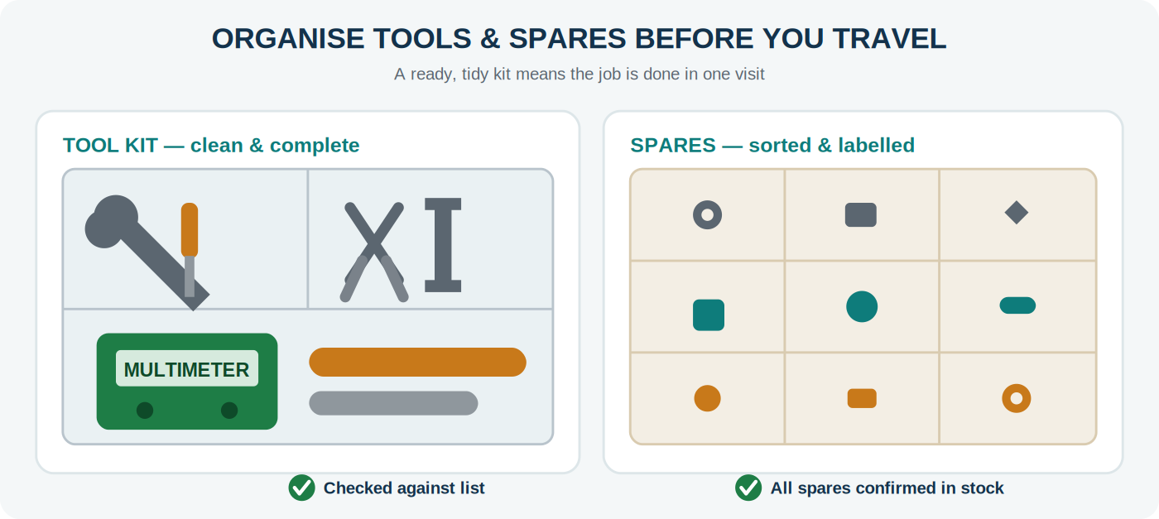
8.1 · BEFORE THE SERVICE
Prepare before you travel
Confirm the spare is in your hand before you book the trip
1
Video-call inspection
See the fault live. Note the exact model and serial. Some issues close on the call.
2
List out the issues
Write every reported and observed problem. Confirm the list back to the customer.
3
Confirm spares
Match each issue to its part and physically confirm stock. Never assume.
4
Travel plan
Club nearby visits. Get the advance estimate approved. Confirm your ETA.
Reaching the customer and then discovering the required spare is missing is the single most damaging service failure. Always confirm spares first.
GENROBOTICS · MAINTENANCE DEPARTMENT
19
Notes:
Stage one decides whether the job is first-time-right.

Slide 21
8.2 · DURING THE SERVICE
The on-site sequence
Follow the same order at every site so nothing is skipped
Arrive on time, greet, show ID
Inform & get approval if needed
Capture “after” photos / videos
1
6
11
13
Wear PPE, assess site safety
Repair with the correct spare
Demonstrate & brief the operator
2
7
12
Checklist & sign-off
Complete the product checklist, fill the report, record spares used, and take the customer’s signature.
Never leave until every listed issue is confirmed resolved.
Capture “before” photos / videos
Collect damaged spares
3
8
Verify the fault yourself
Test every listed issue
4
9
Diagnose the root cause
Clean & present the machine
5
10
GENROBOTICS · MAINTENANCE DEPARTMENT
20
Notes:
Thirteen steps, same order, every site. The last one is the one most often skipped under time pressure.

Slide 22
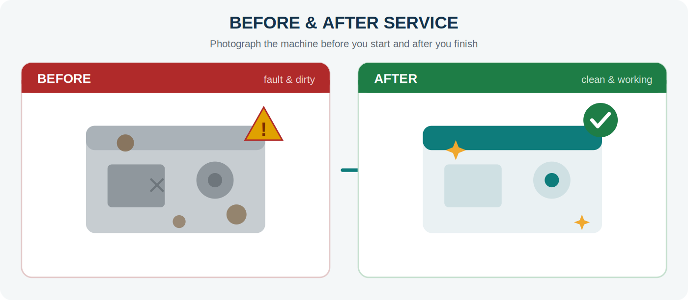
8.3 · EVIDENCE, SPARES AND PRESENTATION
Photograph everything. Return every damaged part.
Three practices that are mandatory on every single service
A · Evidence
B · Damaged spares
C · Presentation
Before and after photos/videos saved against the complaint in the system — not on a personal phone.
Collect every removed part, tag it, and send it back. Repairable parts get reused.
Clean and wipe down the machine and accessories. Hand it back looking cared-for.
GENROBOTICS · MAINTENANCE DEPARTMENT
21
Notes:
Evidence protects the company on warranty and disputes, and helps diagnose repeat faults.

Slide 23
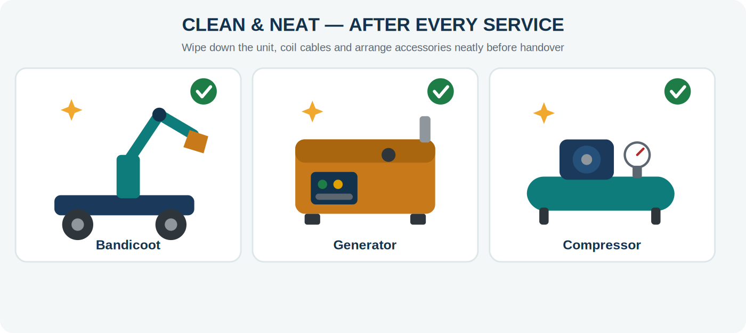
8.3‑C · FINAL PRESENTATION
Hand every machine back clean and neat
A clean, neat product signals quality work and builds trust
Wipe down the machine and all accessories
Remove grease, oil, dust and tape residue
Arrange cables and accessories tidily
GENROBOTICS · MAINTENANCE DEPARTMENT
22
Notes:
Applies to every unit: Bandicoot, Mobility Plus, G-Mammoth, Wilboar, generators and compressors.

Slide 24
8.4 & 9 · CLOSE-OUT AND EXPENSES
Close the job properly
The visit isn’t finished when the machine starts — it’s finished when the record is complete
After the service
Travel & expense
Confirm the checklist is complete and every issue resolved.
Before
Plan the route, estimate the cost, and get the fund request approved.
Close the complaint in the system with the root cause.
Attach before/after photos and videos to the record.
During
Keep every bill — travel, fuel, toll, stay, food, local purchase. Photograph them immediately.
Record spares consumed; log damaged parts for return.
Report the root cause so the fleet can be protected.
After
Enter actuals in Field Expense Pro, attach bills, reconcile advance vs spent, submit on time.
Follow-up call: confirm the machine still runs well.
No bill = no claim
GENROBOTICS · MAINTENANCE DEPARTMENT
23
Notes:
Delayed expense submission delays the next fund release for everyone on the team.

Slide 25
PREVENTIVE MAINTENANCE · SECTION 10
The best complaint is the one that never happens
This is Quadrant II work — where a reactive team becomes a reliable one
Bandicoot / Mobility Plus
The preventive mindset
Robotic arm & bucket wear, camera, lighting, hydraulic hoses, cylinders, gas-sensor & safety systems.
Every breakdown teaches you what to check early on other units.
Look beyond the reported fault — catch wear before it fails.
Educate the operator: most repeat complaints come from incorrect use.
G-Mammoth
Suction system, pump, hoses & couplings, tank & valves, chassis mounting, hydraulics, fluid levels.
Wilboar
Drive and cutting mechanism, structural fasteners, hydraulics, electricals, wear parts, lubrication.
⚠ Safety first
Switch off, isolate power and release stored pressure before any PM task.
For generators, let the engine cool and disconnect the battery.
Never bypass a machine’s safety features during testing.
Generators / Compressors
Fuel & oil, filters, battery, cooling, load testing, wiring & terminals, running-hour servicing.
GENROBOTICS · MAINTENANCE DEPARTMENT
24
Notes:
Link back to the Time Matrix: PM is Quadrant II. Protect the time or Quadrant I never shrinks.

Slide 26
PRODUCT CHECKLISTS · SECTION 12
Same checklist before and after — every product
Tick OK or write the complaint. Never leave until every point is closed.
Bandicoot
Physical condition · crane, bucket & arm operation · legs · camera · gas sensor · light · wheels · pro-lift · conduit · wire rope
A
Mobility Plus
Take in/out · loading & unloading · trolley · dumper · hydraulic pressure · jack · limit switches · auto mode · reverse camera · vehicle
B
G-Mammoth
Tank condition · suction/desilting · pump · hoses & couplings · valves · hydraulics · boom · jetting · chassis & PTO · fluids
C
Wilboar
Physical condition · drive/travel · cutting mechanism · hydraulics · electricals · sensors · wear parts · frame · lubrication · tracks
D
Generator
Mounting · fuel & leaks · engine oil · coolant · filters · battery · starting · wiring & panel · load test · running hours
E
10 points per product · Before check + After check + complaints list + customer sign-off
GENROBOTICS · MAINTENANCE DEPARTMENT
25
Notes:
Full fillable forms are in the training handbook, Section 12 — one printable page per product.

Slide 27
BRINGING THE TEAM ALONG
What, why, and how each person contributes
WHAT
WHY
HOW EACH PERSON CONTRIBUTES
Toolbox briefings on our department vision; a visible PM and breakdown log; product checklists on every job; a monthly review of the Quadrant II time we protected.
Because a happy customer isn't an accident — it's the result of proactive checks, planned work, correct spares, and clear communication, done consistently.
Every engineer owns their PM checklist, their response time, their evidence and expense records — and raises one improvement idea per month.
GENROBOTICS · MAINTENANCE DEPARTMENT
26
Notes:
Close Part 2 by making ownership explicit and personal.

Slide 28
IN ONE LINE
World-class service.
Happy customer.
That is our vision, our contribution to Genrobotics, and the standard we hold ourselves to — on every machine, in every region, starting this week.
Maintenance Department · Leading with Effectiveness · Field Service Standards
Notes:
Close on the vision sentence. Mindset plus standards equals a happy customer.

