Slide 1

CUSTOMER SHOPPING BEHAVIOR
Customer
Shopping
Behavior
Analysis
A data-led report on purchase patterns, customer segments, product preferences, and subscription behavior.
REPORT VIEW
Purchase patterns, customer value, and the path from loyalty to durable growth.
Customer Shopping Behavior Analysis

Slide 2
Executive summary: the business is broad, but loyalty is the strongest signal
3,900
Scale
Purchases across four product categories and 25 items.
$59.76
Commercial baseline
Average purchase amount; average review rating is 3.75.
$157,890
Largest revenue engine
Male customers contribute $157,890 versus $75,191 from female customers.
73%
Growth opportunity
Of customers are non-subscribers; loyal customers account for 3,116 of the 3,900 records.
Customer Shopping Behavior Analysis
02

Slide 3
What the dataset contains—and how it was prepared
The analysis starts with transactional data broad enough to connect customer profile, purchase context, and product economics.
01
02
03
Capture
Clean
Prepare
Demographics, products, purchase amounts, season, size, color, discount behavior, subscription status, shipping, payment method, ratings, and purchase frequency.
18 columns were standardized. 37 review ratings were missing and imputed using the median rating within each product category.
Snake_case standardization, age-group and purchase-frequency features, and a redundancy check between discount and promo-code fields.
Analysis layer: the cleaned data was loaded into PostgreSQL for SQL analysis.
Customer Shopping Behavior Analysis
03

Slide 4
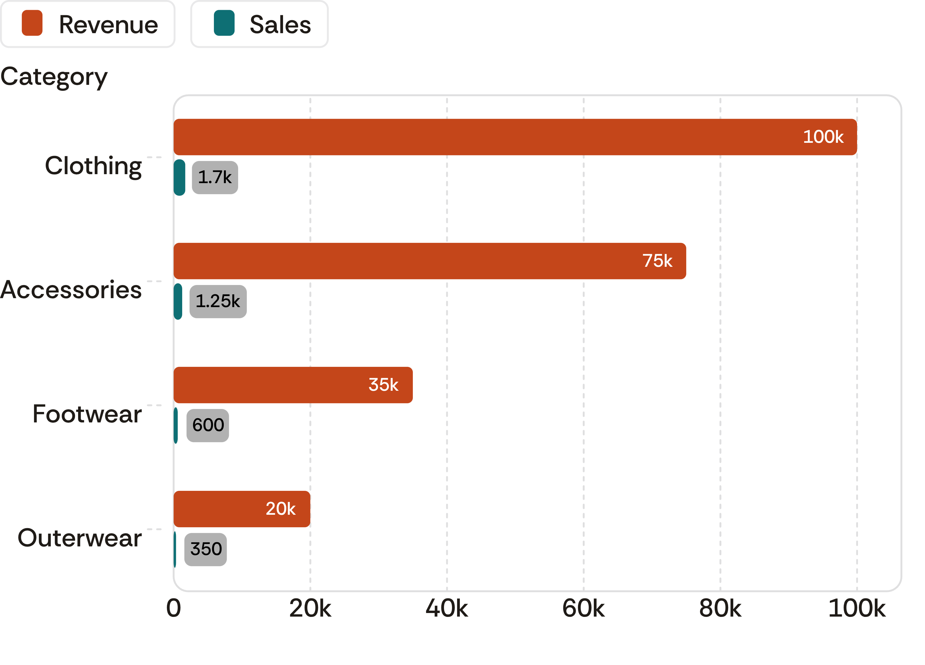
Clothing leads the category economics
Clothing generates roughly $100K in revenue and about 1,700 sales, ahead of accessories, footwear, and outerwear in the dashboard readout.
Revenue and sales by category
Clothing is the largest category by both revenue and sales, with accessories second.
Customer Shopping Behavior Analysis
04

Slide 5




Product demand is concentrated in familiar wardrobe staples
Top products by category
Top-rated products
Jewelry, sunglasses, and belts lead accessories. Blouses, pants, and shirts lead clothing. Sandals, shoes, and sneakers lead footwear. Jackets and coats lead outerwear.
Gloves score 3.86, sandals 3.84, boots 3.82, hats 3.80, and skirts 3.78 on average.
Discount dependence
Commercial read
Hats have the highest discounted-purchase rate at 50.00%, followed by sneakers at 49.66% and coats at 49.07%.
Demand is concentrated in recognizable wardrobe staples, while discount dependence varies materially by product.
Customer Shopping Behavior Analysis
05

Slide 6
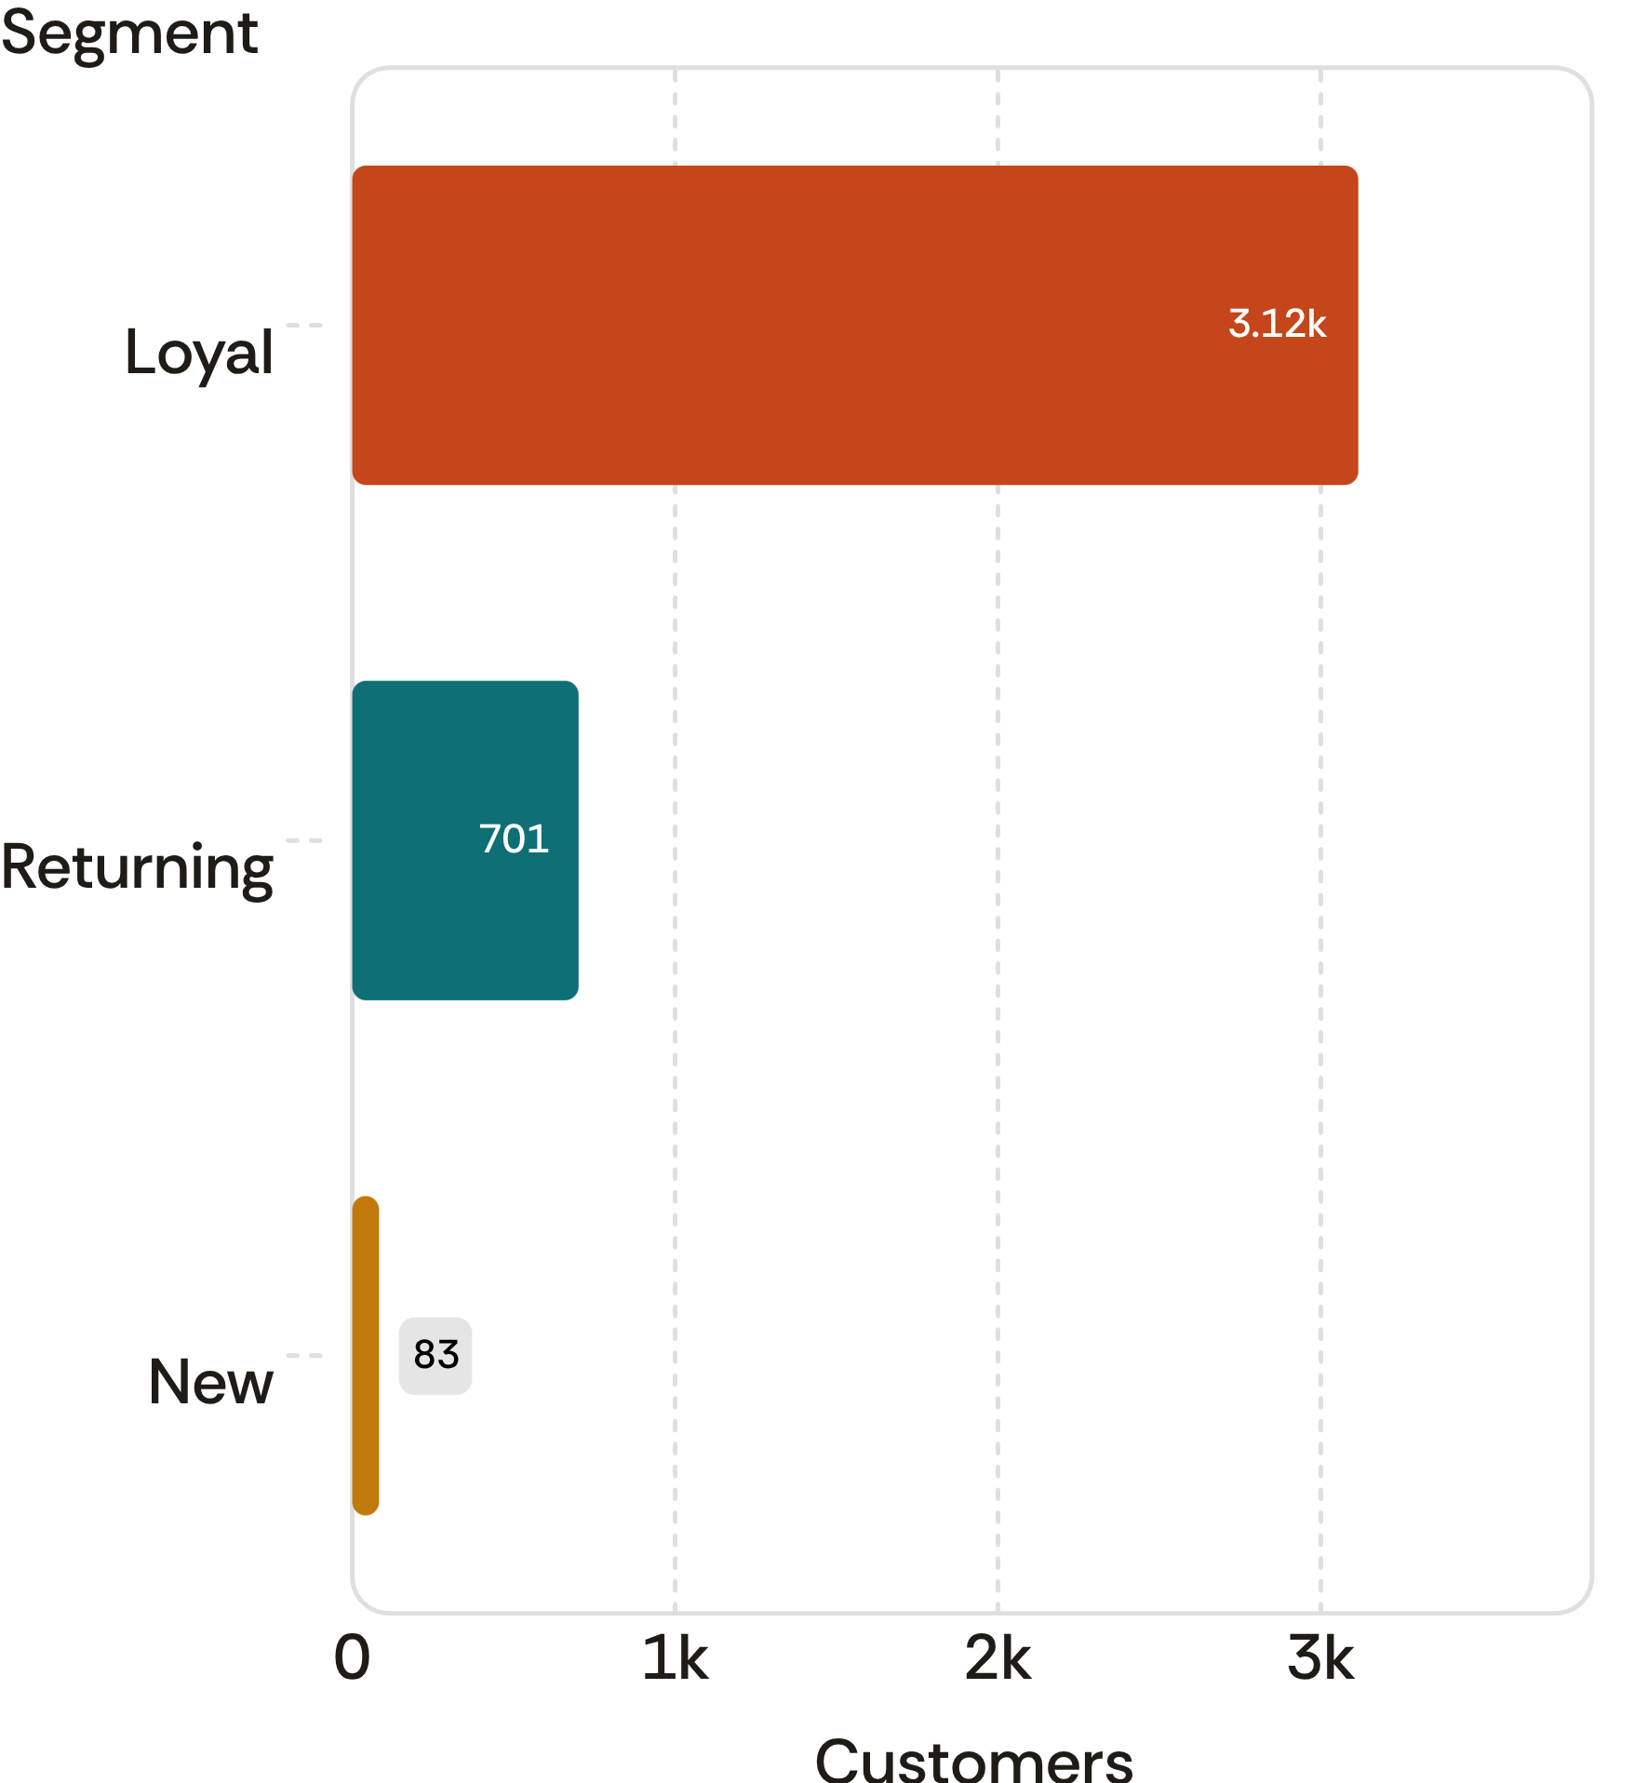
Customer value is strongest among loyal buyers, not subscribers
Subscription growth should focus on converting existing repeat behavior into a paid or recurring relationship, not only on increasing basket size.
Customer segments
Repeat buyers
958 subscribers and 2,518 non-subscribers have more than five purchases.
Revenue split
Subscribers contribute $62,645 versus $170,436 from non-subscribers.
Average spend
Nearly flat at $59.49 versus $59.87.
The customer base is dominated by loyal buyers, while new customers are a small minority.
Customer Shopping Behavior Analysis
06

Slide 7
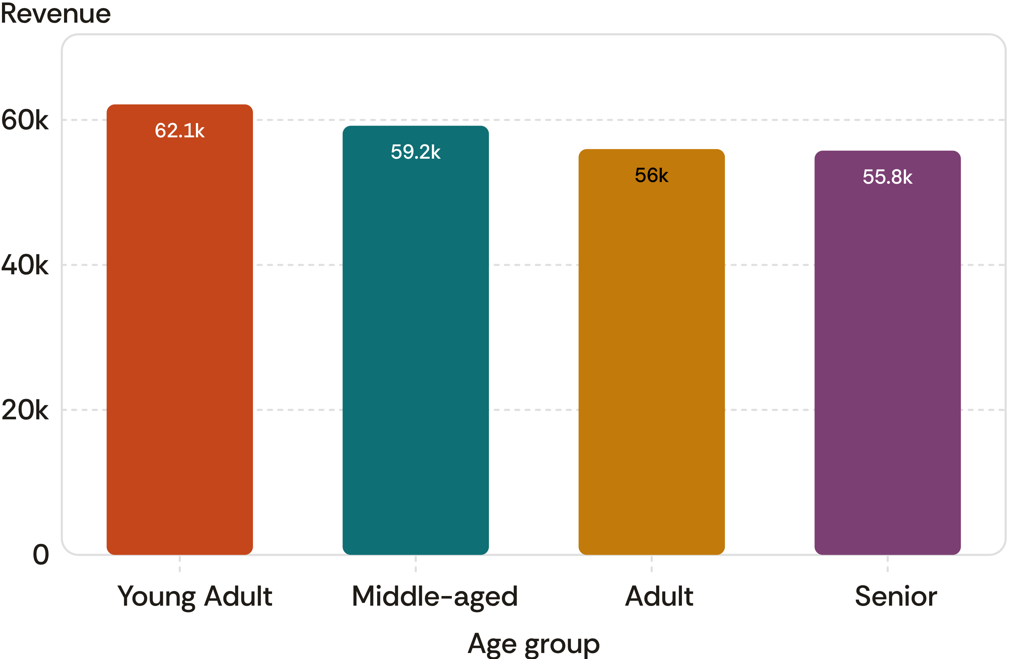
Young adults are the largest age-based revenue pool
Revenue by age group
Young adults contribute the highest revenue, with the other age groups forming a relatively close tier.
$62,143
Shipping signal
Express-shipping orders average $60.48 versus $58.46 for standard shipping.
Young-adult revenue
Value targeting can combine the largest age-based revenue pool with customers who select express shipping.
Customer Shopping Behavior Analysis
07

Slide 8
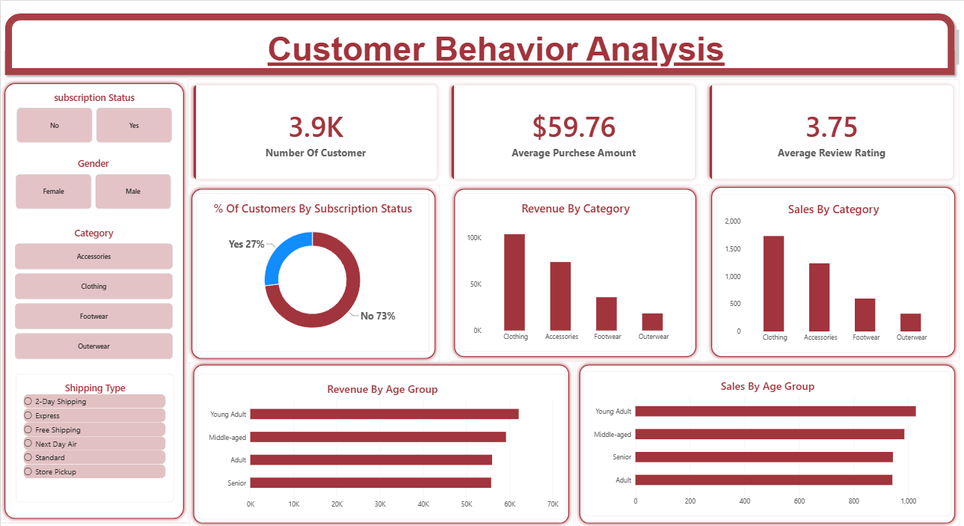
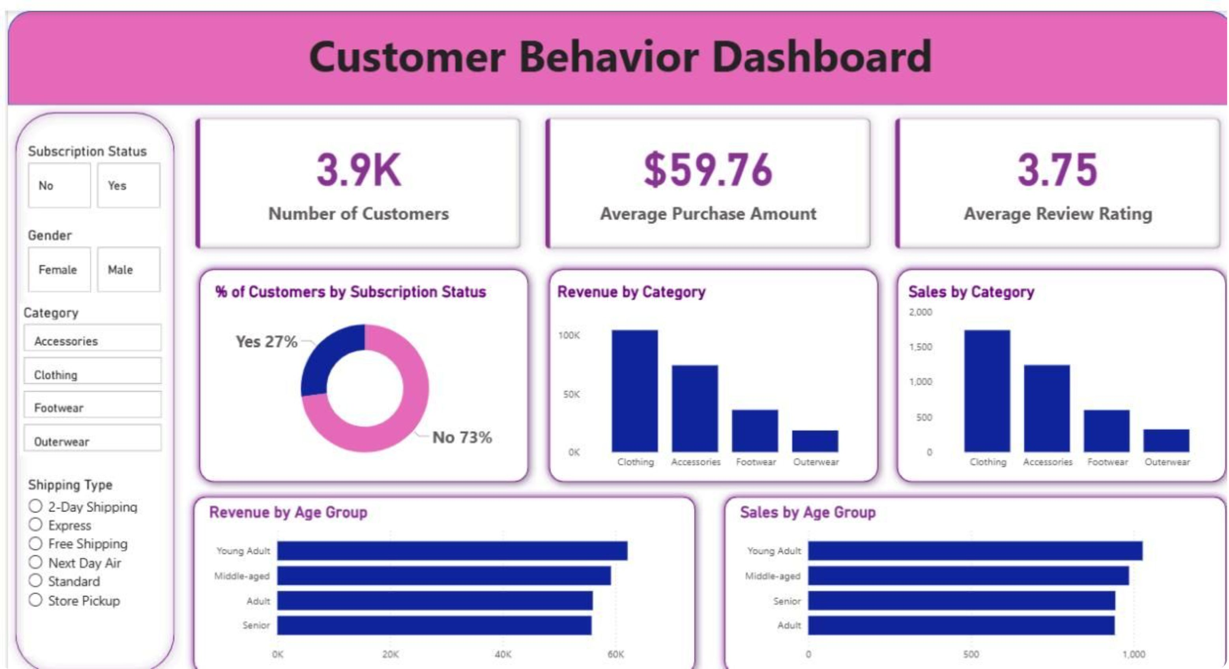
The dashboard turns the analysis into a repeatable management view
Use the dashboard as a decision surface for category performance, subscription mix, age distribution, shipping preferences, and purchase economics.
Dashboard view for category performance, customer segments, subscription mix, age distribution, shipping preferences, and purchase economics.
Customer Shopping Behavior Analysis
08

Slide 9
Recommended actions: convert loyalty into durable growth
The opportunity is to build on proven repeat behavior, protect category economics, and target the pools already showing value.
01
Boost subscriptions
Create exclusive benefits for repeat buyers and test offers against the 73% non-subscriber base.
02
Reward loyalty
Use purchase history to move returning customers toward the loyal segment.
03
Rebalance discounts
Protect margin on discount-dependent products while keeping proven demand triggers.
04
Merchandise the winners
Feature top-rated products and the category leaders in campaigns and onsite discovery.
05
Target by value
Prioritize young-adult revenue pools and customers who select express shipping.
Customer Shopping Behavior Analysis
09

