Slide 1

How could your articles:
Contain more of the research objects you used?
Have richer presentations of data?
Be more open and reusable?

Slide 2
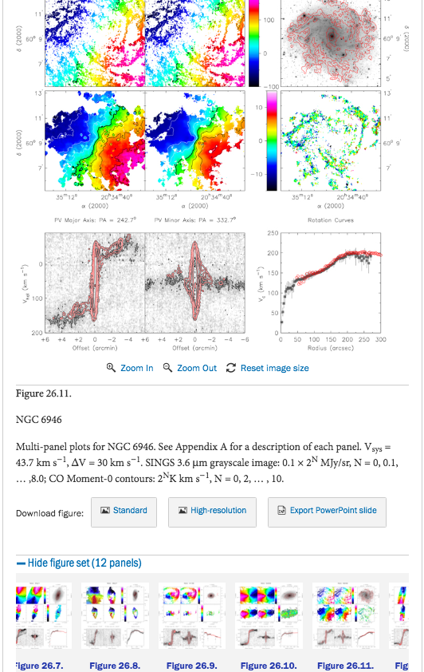
Interactive Data
Interactive Figures,
Animated Figures,
And more...

Slide 3
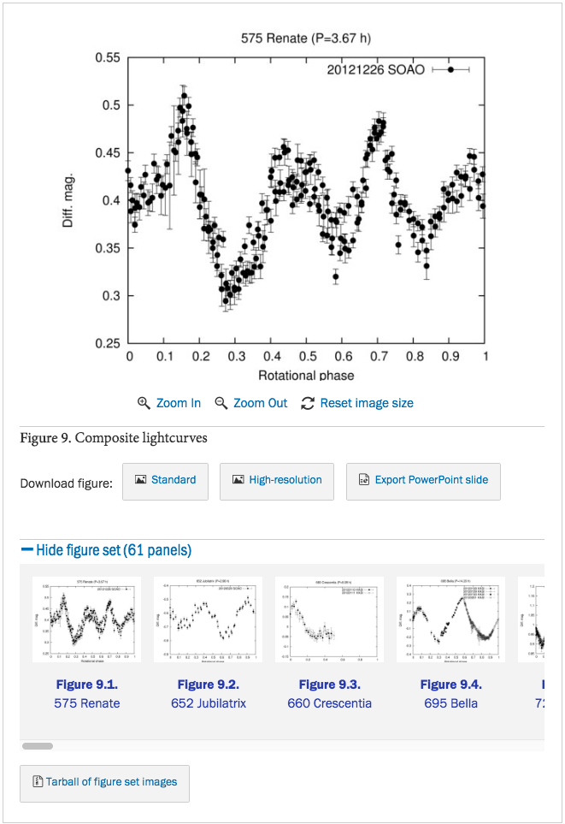
Interactive Figures
We’ve previously supported large atlas of figures and linked movies as supplemental material;
Now we have moved all interactive elements from supplementary materials to the main online figures;
Expanded the types of interactive data elements, adding javascript driven graphics;
Improved Video by adding an inline streaming YouTube like player, and converting from author formats to standard MP4 codecs.

Slide 4
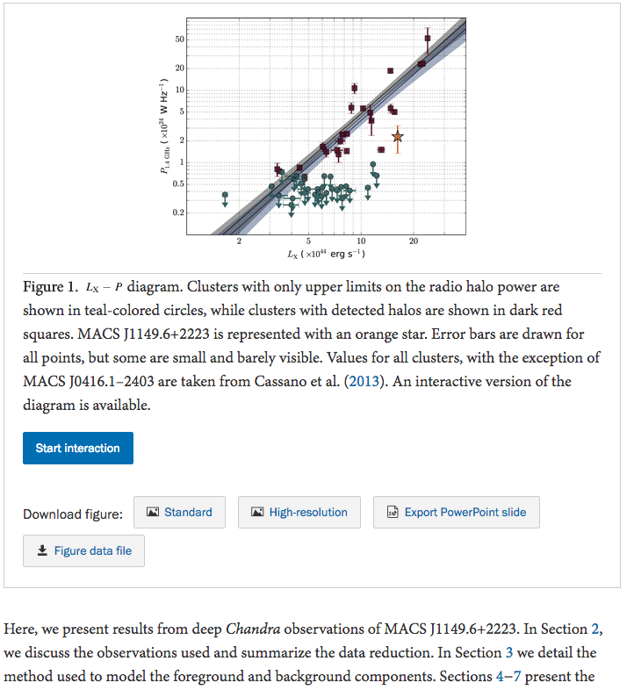
Interactive Figures
Interactive figures have buttons to initiate interaction or access to full data;
Interactive figures require download buttons to access author provided background data;

Slide 5
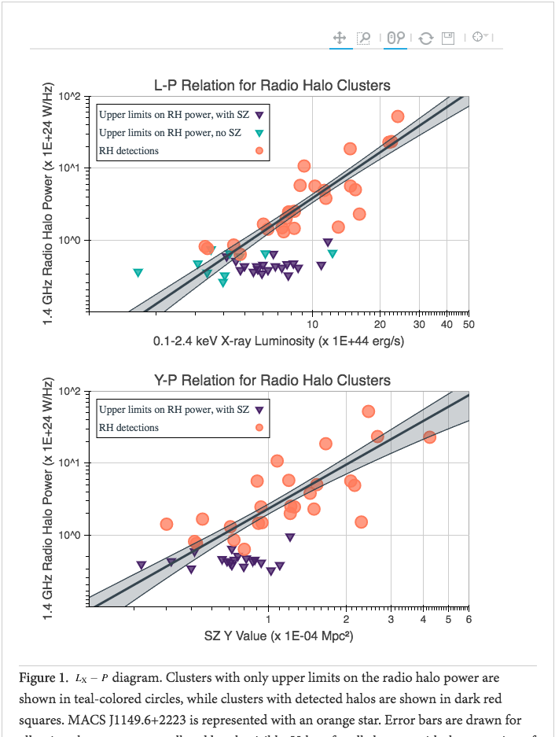
Interactive Figures
Bokeh JS Graphics
Python based viz library
Ogrean et al. 2016
10.3847/0004-637X/819/2/113
gogrean/InteractiveFigs

Slide 6
Interactive Figures
Pan, zoom, select, and save the data
Shared axis
Individual tool tips with additional object data presented

Slide 7
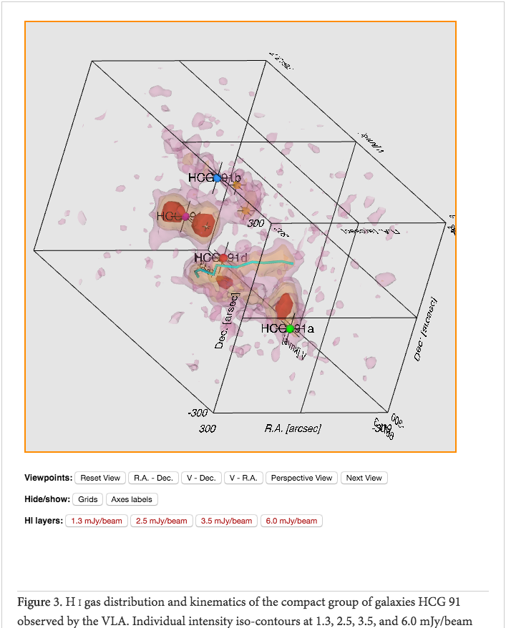
Interactive Figures
Interactive 3D objects
X3D -- royalty free ISO standard
“The X3D Pathway”
Vogt et al. 2015, ApJ
10.3847/0004-637X/818/2/115
http://fpavogt.github.io/x3d-pathway/

Slide 8
Interactive Figures
Pan, zoom and rotate the object
Custom javascript user interface for projections, layers, and annotations

Slide 9
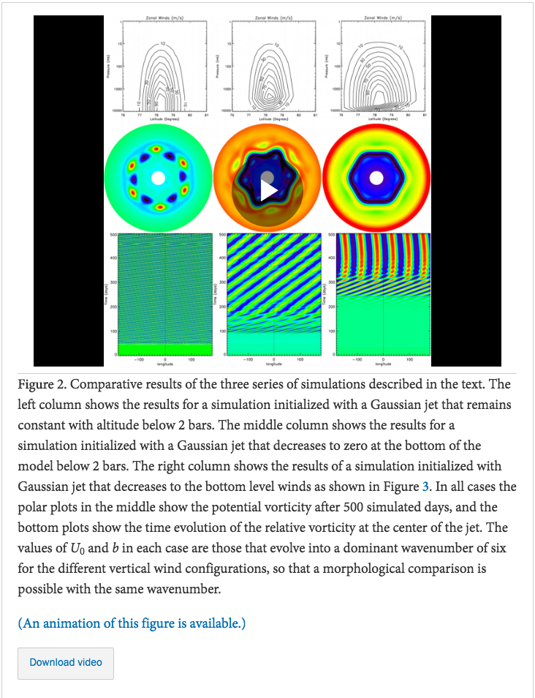
Animated Figures
Published over 2100 videos in journal articles back to 1998;
Moving these from supplementary materials to online Animated Figures.
Improved Video by adding an inline streaming YouTube like player, and converting from author formats to standard MP4 codecs.

Slide 10
Animated Figures
Animated Figures now referred to by Figure number;
All interactive elements have start interaction and download buttons.
Working with individual authors as part of post-acceptance data review to improve animated Figures in their presentation and format.

Slide 11
Atlas of Figures
(Figure Sets)
Supported large “atlas” of related figures since 2005;
Published over 600 such “figure sets,” some containing thousands of individual figures;
Moved these from supplemental materials into main article;
Same features as other elements: trigger interactivity & download options.

Slide 12
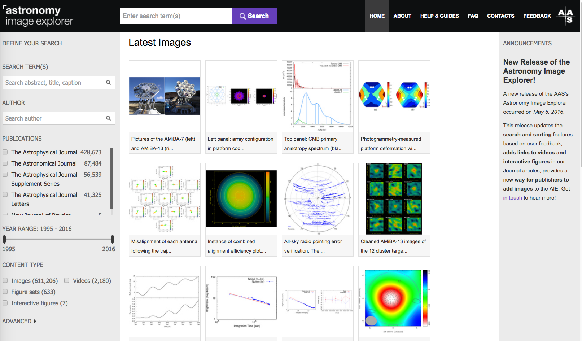
Interactive & Animated Figures:
You can find a full listing at http://astroexplorer.org

Slide 13
Summary
User built, customizable javascript driven graphics;
Online animated Figures with YouTube viewport;
Rich interactive presentation of large data sets;
Building a platform to present high density and high dimensionality data with the article.

