Slide 1
ASSIGNMENT
Food which is being eaten by the people during this COVID-19 pandemic

Slide 3
Count of Breakfast | Column Labels
Row Labels | Female | Male | Grand Total
Dairy products and bread | 6 | 19 | 25
18 to 25 | 3 | 14 | 17
No | 2 | 14 | 16
Non veg with rice or Roti | 2 | 11 | 13
Diet (e.g veg plus boil chicken) | 1 | 3 | 4
Non veg with rice or Roti | 1 | 6 | 7
Vegetable with rice or Roti |  | 2 | 2
Vegetable with rice or Roti |  | 3 | 3
Non veg with rice or Roti |  | 1 | 1
Vegetable with rice or Roti |  | 2 | 2
Yes | 1 |  | 1
Vegetable with rice or Roti | 1 |  | 1
Vegetable with rice or Roti | 1 |  | 1
25 to 35 | 1 | 3 | 4
No | 1 | 3 | 4
Dal and rice | 1 |  | 1
Dal and rice | 1 |  | 1
Non veg with rice or Roti |  | 1 | 1
Non veg with rice or Roti |  | 1 | 1
Vegetable with rice or Roti |  | 2 | 2
Non veg with rice or Roti |  | 2 | 2
35 to 55 | 2 | 2 | 4
No | 2 | 2 | 4
Diet(eg veg plus boil chicken) | 1 |  | 1
Diet (e.g veg plus boil chicken) | 1 |  | 1
Non veg with rice or Roti | 1 |  | 1
Vegetable with rice or Roti | 1 |  | 1
Vegetable with rice or Roti |  | 2 | 2
Non veg with rice or Roti |  | 1 | 1
Vegetable with rice or Roti |  | 1 | 1
Vegetable only | 5 | 8 | 13
18 to 25 | 2 | 1 | 3
No | 2 | 1 | 3
Vegetable with rice or Roti | 2 | 1 | 3
Non veg with rice or Roti |  | 1 | 1
Vegetable with rice or Roti | 2 |  | 2
25 to 35 | 2 | 4 | 6
No | 2 | 4 | 6
Non veg with rice or Roti |  | 3 | 3
Non veg with rice or Roti |  | 1 | 1
Vegetable with rice or Roti |  | 2 | 2
Vegetable with rice or Roti | 2 | 1 | 3
Non veg with rice or Roti | 1 |  | 1
Vegetable with rice or Roti | 1 | 1 | 2
35 to 55 | 1 | 2 | 3
No |  | 2 | 2
Non veg with rice or Roti |  | 2 | 2
Diet (e.g veg plus boil chicken) |  | 2 | 2
Yes | 1 |  | 1
Vegetable with rice or Roti | 1 |  | 1
Vegetable with rice or Roti | 1 |  | 1
Above 55 |  | 1 | 1
No |  | 1 | 1
Vegetable with rice or Roti |  | 1 | 1
Vegetable with rice or Roti |  | 1 | 1
Only milk | 1 | 5 | 6
18 to 25 |  | 2 | 2
No |  | 2 | 2
Diet(eg veg plus boil chicken) |  | 1 | 1
Diet (e.g veg plus boil chicken) |  | 1 | 1
Vegetable with rice or Roti |  | 1 | 1
Non veg with rice or Roti |  | 1 | 1
25 to 35 |  | 3 | 3
No |  | 3 | 3
Vegetable with rice or Roti |  | 3 | 3
Diet (e.g veg plus boil chicken) |  | 1 | 1
Non veg with rice or Roti |  | 2 | 2
35 to 55 | 1 |  | 1
No | 1 |  | 1
Vegetable with rice or Roti | 1 |  | 1
Vegetable with rice or Roti | 1 |  | 1
Milkshake | 3 | 3 | 6
18 to 25 | 1 | 2 | 3
No | 1 | 2 | 3
Dal and rice |  | 1 | 1
Vegetable with rice or Roti |  | 1 | 1
Non veg with rice or Roti | 1 |  | 1
Diet (e.g veg plus boil chicken) | 1 |  | 1
Vegetable with rice or Roti |  | 1 | 1
Diet (e.g veg plus boil chicken) |  | 1 | 1
25 to 35 | 1 | 1 | 2
No | 1 | 1 | 2
Non veg with rice or Roti | 1 |  | 1
Diet (e.g veg plus boil chicken) | 1 |  | 1
Vegetable with rice or Roti |  | 1 | 1
Diet (e.g veg plus boil chicken) |  | 1 | 1
Above 55 | 1 |  | 1
Yes | 1 |  | 1
Diet(eg veg plus boil chicken) | 1 |  | 1
Diet (e.g veg plus boil chicken) | 1 |  | 1
Grand Total | 15 | 35 | 50

Slide 4
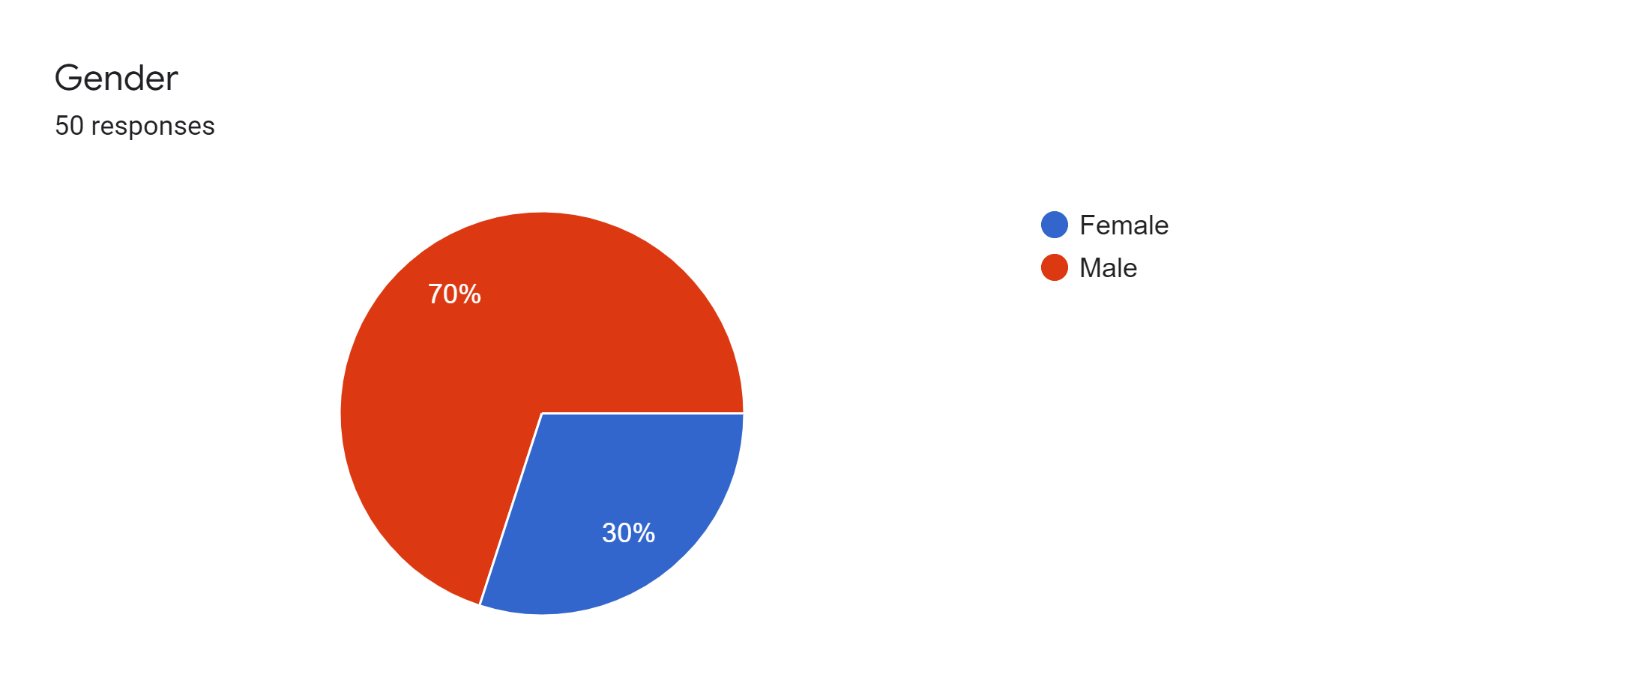

Slide 5
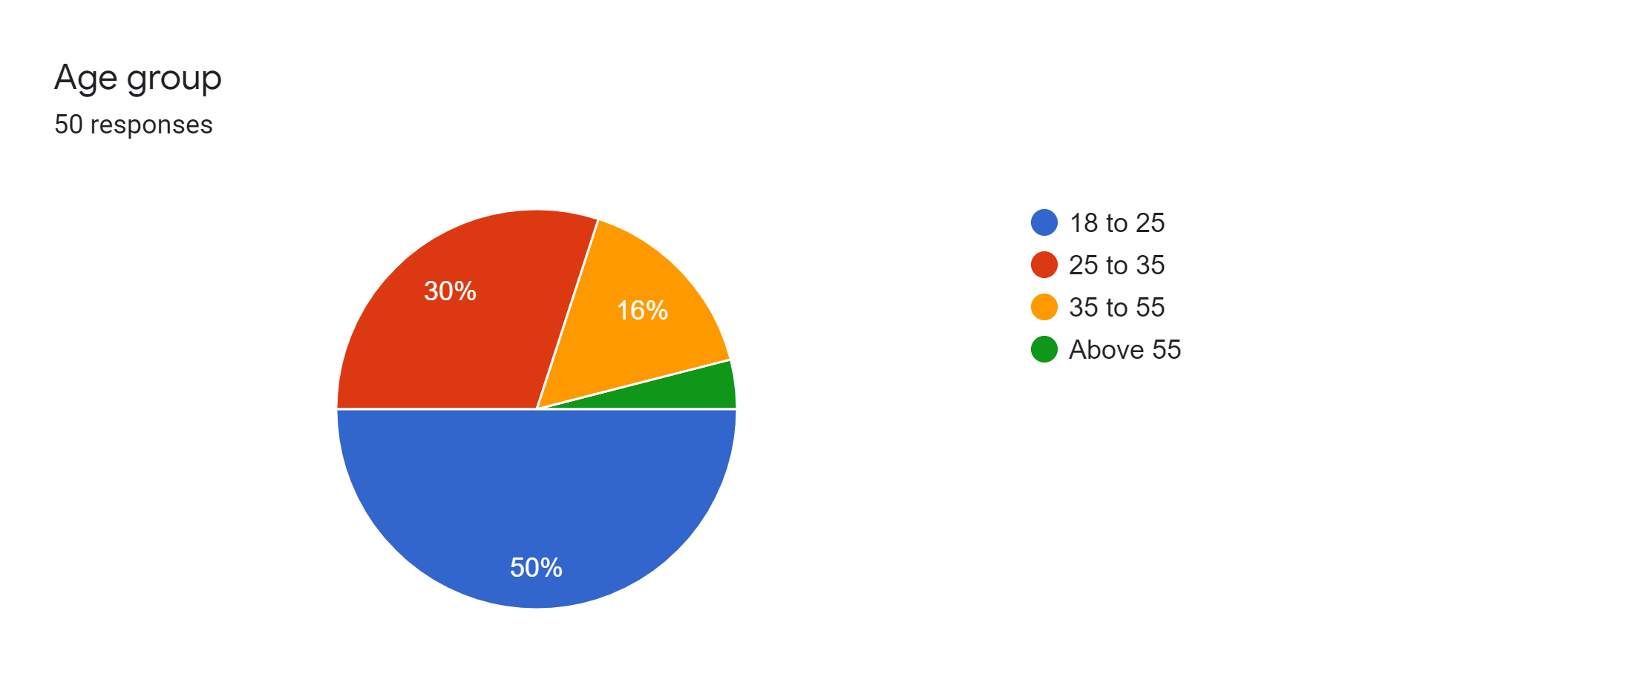

Slide 6
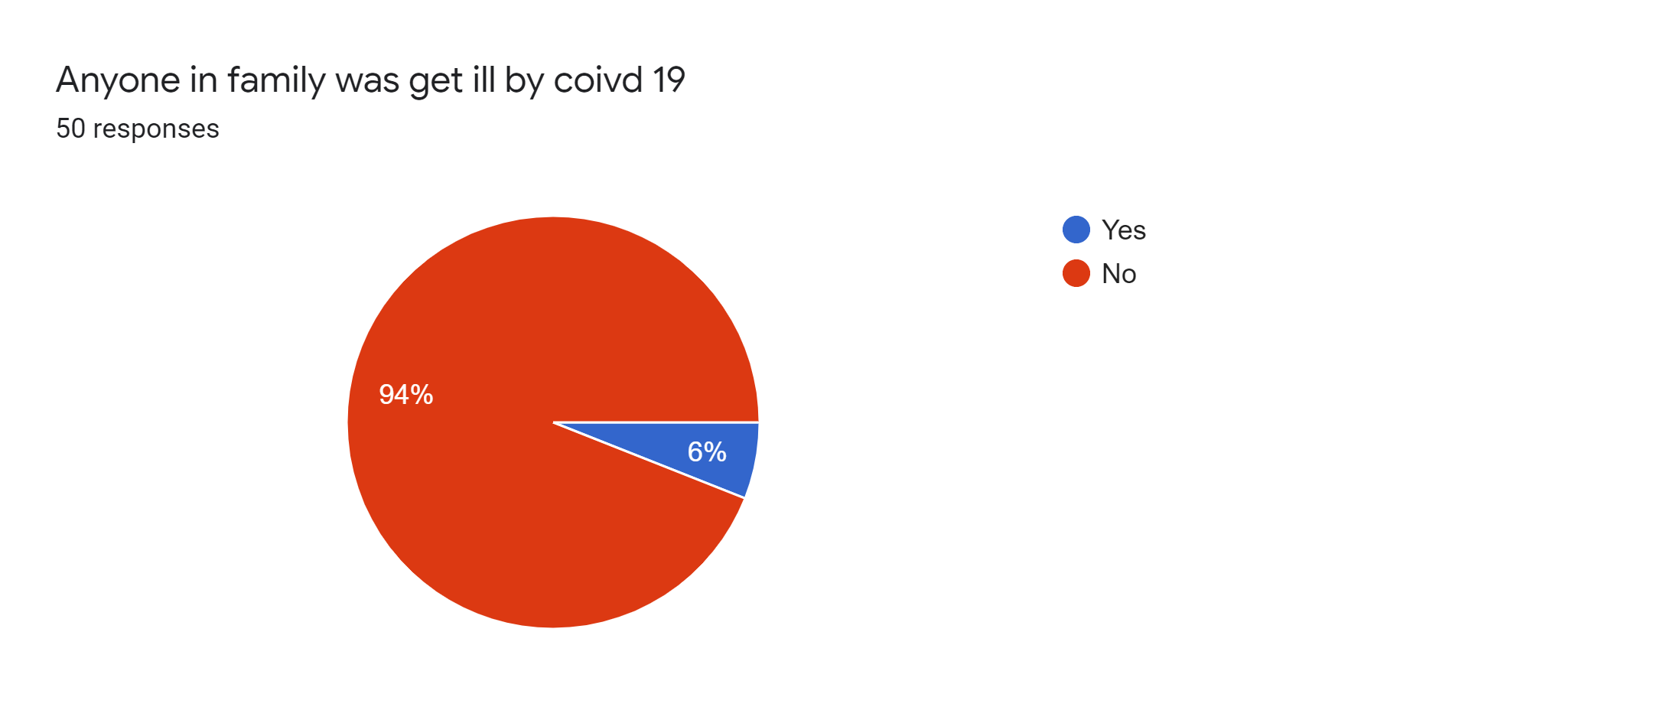

Slide 7
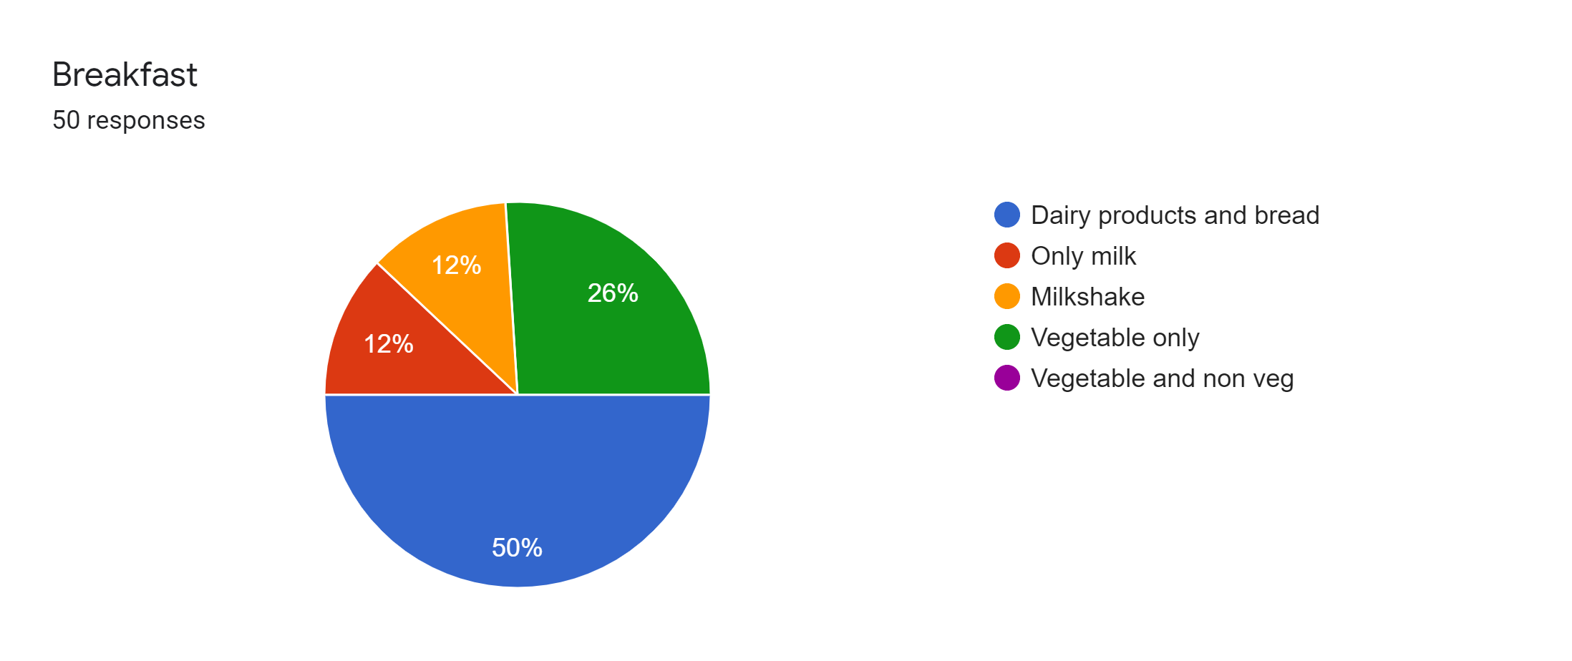

Slide 8
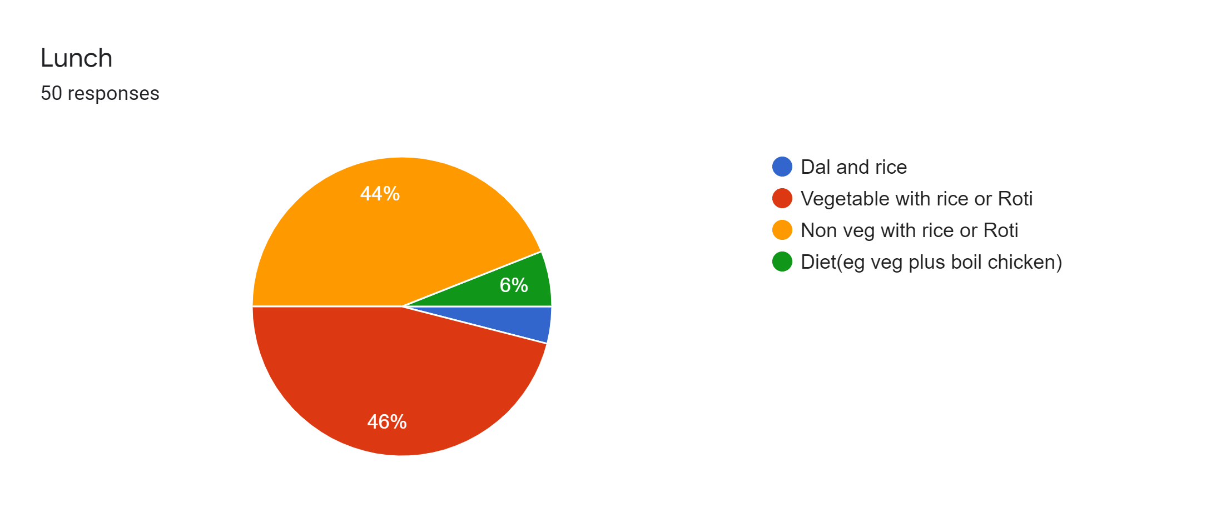

Slide 9
