Slide 1
LOGO
XX学校
这回我们毕业啦
其实是答辩的标题地方
我们毕业啦
其实是答辩的标题地方
答辩人
李某某
指导老师
XX教授

Slide 2
论文绪论
研究背景
研究方法
研究结果
CONTANTS
问题讨论
论文总结

Slide 3

论文绪论
It was the best of times, it was the worst of times; it was the age of wisdom, it was the age of foolishness.

Slide 4
论文绪论
研究背景
研究方法
研究结果
问题讨论
论文总结
“
It was the best of times, it was the worst of times; it was the age of wisdom, it was the age of foolishness. It was the epoch of belief, and it was the epoch of incredulity. It was the season of light, and it was the season of darkness. It was the spring of hope, and it was the winter of despair.
It was the best of times, it was the worst of times; it was the age of wisdom, it was the age of foolishness. It was the epoch of belief, and it was the epoch of incredulity. It was the season of light, and it was the season of darkness. It was the spring of hope, and it was the winter of despair.
It was the best of times, it was the worst of times; it was the age of wisdom, it was the age of foolishness. It was the epoch of belief, and it was the epoch of incredulity. It was the season of light, and it was the season of darkness. It was the spring of hope, and it was the winter of despair.
”

Slide 5
论文绪论
研究背景
研究方法
研究结果
问题讨论
论文总结
1
It was the best of times, it was the worst of times; it was the age of wisdom, it was the age of foolishness. It was the epoch of belief, and it was the epoch of incredulity. It was the season of light, and it was the season of darkness. It was the spring of hope, and it was the winter of despair.
2
It was the best of times, it was the worst of times; it was the age of wisdom, it was the age of foolishness. It was the epoch of belief, and it was the epoch of incredulity. It was the season of light, and it was the season of darkness. It was the spring of hope, and it was the winter of despair.
3
It was the best of times, it was the worst of times; it was the age of wisdom, it was the age of foolishness. It was the epoch of belief, and it was the epoch of incredulity. It was the season of light, and it was the season of darkness. It was the spring of hope, and it was the winter of despair.

Slide 6
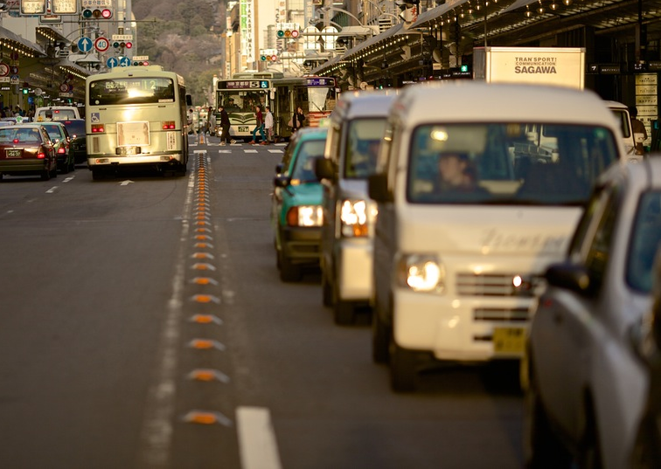
论文绪论
研究背景
研究方法
研究结果
问题讨论
论文总结
It was the best of times, it was the worst of times; it was the age of wisdom, it was the age of foolishness. It was the epoch of belief, and it was the epoch of incredulity. It was the season of light, and it was the season of darkness. It was the spring of hope, and it was the winter of despair.
It was the best of times, it was the worst of times; it was the age of wisdom, it was the age of foolishness. It was the epoch of belief, and it was the epoch of incredulity. It was the season of light, and it was the season of darkness. It was the spring of hope, and it was the winter of despair.

Slide 7
研究背景
It was the best of times, it was the worst of times; it was the age of wisdom, it was the age of foolishness.

Slide 8
论文绪论
研究背景
研究方法
研究结果
问题讨论
论文总结
ADD TITLE
It was the best of times, it was the worst of times; it was the age of wisdom, it was the age of foolishness.
ADD TITLE
It was the best of times, it was the worst of times; it was the age of wisdom, it was the age of foolishness.
ADD TITLE
It was the best of times, it was the worst of times; it was the age of wisdom, it was the age of foolishness.

Slide 9
论文绪论
研究背景
研究方法
研究结果
问题讨论
论文总结
TEXT
keyword
TEXT
keyword
keyword
TEXT
keyword
TEXT
TITLE
TITLE
TITLE
TITLE
It was the best of times, it was the worst of times; it was the age of wisdom, it was the age of foolishness. It was the epoch of belief, and it was the epoch of incredulity. It was the season of light, and it was the season of darkness. It was the spring of hope, and it was the winter of despair.
It was the best of times, it was the worst of times; it was the age of wisdom, it was the age of foolishness. It was the epoch of belief, and it was the epoch of incredulity. It was the season of light, and it was the season of darkness. It was the spring of hope, and it was the winter of despair.
It was the best of times, it was the worst of times; it was the age of wisdom, it was the age of foolishness. It was the epoch of belief, and it was the epoch of incredulity. It was the season of light, and it was the season of darkness. It was the spring of hope, and it was the winter of despair.
It was the best of times, it was the worst of times; it was the age of wisdom, it was the age of foolishness. It was the epoch of belief, and it was the epoch of incredulity. It was the season of light, and it was the season of darkness. It was the spring of hope, and it was the winter of despair.

Slide 10
论文绪论
研究背景
研究方法
研究结果
问题讨论
论文总结
TEXT
TEXT
TEXT
TEXT
TEXT
It was the best of times, it was the worst of times; it was the age of wisdom, it was the age of foolishness. It was the epoch of belief, and it was the epoch of incredulity. It was the season of light, and it was the season of darkness. It was the spring of hope, and it was the winter of despair.

Slide 11
研究方法
It was the best of times, it was the worst of times; it was the age of wisdom, it was the age of foolishness.

Slide 12
论文绪论
研究背景
研究方法
研究结果
问题讨论
论文总结
TEXT
TEXT
TEXT
TEXT
It was the best of times, it was the worst of times; it was the age of wisdom, it was the age of foolishness. It was the epoch of belief, and it was the epoch of incredulity.
It was the best of times, it was the worst of times; it was the age of wisdom, it was the age of foolishness. It was the epoch of belief, and it was the epoch of incredulity.
It was the best of times, it was the worst of times; it was the age of wisdom, it was the age of foolishness. It was the epoch of belief, and it was the epoch of incredulity.
It was the best of times, it was the worst of times; it was the age of wisdom, it was the age of foolishness. It was the epoch of belief, and it was the epoch of incredulity.

Slide 13
论文绪论
研究背景
研究方法
研究结果
问题讨论
论文总结
ADD YOUR TITLE
It was the best of times, it was the worst of times; it was the age of wisdom, it was the age of foolishness. It was the epoch of belief, and it was the epoch of incredulity. It was the season of light, and it was the season of darkness. It was the spring of hope, and it was the winter of despair.
ADD YOUR TITLE
It was the best of times, it was the worst of times; it was the age of wisdom, it was the age of foolishness. It was the epoch of belief, and it was the epoch of incredulity. It was the season of light, and it was the season of darkness. It was the spring of hope, and it was the winter of despair.

Slide 14
论文绪论
研究背景
研究方法
研究结果
问题讨论
论文总结
ADD TITLE
ADD TITLE
It was the best of times, it was the worst of times; it was the age of wisdom, it was the age of foolishness.
It was the best of times, it was the worst of times; it was the age of wisdom, it was the age of foolishness.
ADD TITLE
ADD TITLE
It was the best of times, it was the worst of times; it was the age of wisdom, it was the age of foolishness.
It was the best of times, it was the worst of times; it was the age of wisdom, it was the age of foolishness.

Slide 15
研究结果
It was the best of times, it was the worst of times; it was the age of wisdom, it was the age of foolishness.

Slide 16
论文绪论
研究背景
研究方法
研究结果
问题讨论
论文总结
It was the best of times, it was the worst of times; it was the age of wisdom, it was the age of foolishness.
It was the best of times, it was the worst of times; it was the age of wisdom, it was the age of foolishness.

Slide 17
论文绪论
研究背景
研究方法
研究结果
问题讨论
论文总结
TEXT
TEXT
TEXT
It was the best of times, it was the worst of times; it was the age of wisdom, it was the age of foolishness. It was the epoch of belief, and it was the epoch of incredulity. It was the season of light, and it was the season of darkness. It was the spring of hope, and it was the winter of despair.
毕业论文题目

Slide 18
论文绪论
研究背景
研究方法
研究结果
问题讨论
论文总结
It was the best of times, it was the worst of times; it was the age of wisdom, it was the age of foolishness.

Slide 19
问题讨论
It was the best of times, it was the worst of times; it was the age of wisdom, it was the age of foolishness.

Slide 20
论文绪论
研究背景
研究方法
研究结果
问题讨论
论文总结
ADD TITLE
ADD TITLE
It was the best of times, it was the worst of times; it was the age of wisdom, it was the age of foolishness.
s
It was the best of times, it was the worst of times; it was the age of wisdom, it was the age of foolishness.
T
TEXT
w
o
ADD TITLE
ADD TITLE
It was the best of times, it was the worst of times; it was the age of wisdom, it was the age of foolishness.
It was the best of times, it was the worst of times; it was the age of wisdom, it was the age of foolishness.

Slide 21
论文绪论
研究背景
研究方法
研究结果
问题讨论
论文总结
ADD YOUR TITLE
1
It was the best of times, it was the worst of times; it was the age of wisdom, it was the age of foolishness. It was the epoch of belief, and it was the epoch of incredulity. It was the season of light, and it was the season of darkness. It was the spring of hope, and it was the winter of despair.
TEXT
ADD YOUR TITLE
It was the best of times, it was the worst of times; it was the age of wisdom, it was the age of foolishness. It was the epoch of belief, and it was the epoch of incredulity. It was the season of light, and it was the season of darkness. It was the spring of hope, and it was the winter of despair.
2
3
ADD YOUR TITLE
It was the best of times, it was the worst of times; it was the age of wisdom, it was the age of foolishness. It was the epoch of belief, and it was the epoch of incredulity. It was the season of light, and it was the season of darkness. It was the spring of hope, and it was the winter of despair.

Slide 22
论文总结
It was the best of times, it was the worst of times; it was the age of wisdom, it was the age of foolishness.

Slide 23
论文绪论
研究背景
研究方法
研究结果
问题讨论
论文总结
ADD YOUR TITLE
A
It was the best of times, it was the worst of times; it was the age of wisdom, it was the age of foolishness. It was the epoch of belief, and it was the epoch of incredulity. It was the season of light, and it was the season of darkness. It was the spring of hope, and it was the winter of despair.
ADD YOUR TITLE
B
It was the best of times, it was the worst of times; it was the age of wisdom, it was the age of foolishness. It was the epoch of belief, and it was the epoch of incredulity. It was the season of light, and it was the season of darkness. It was the spring of hope, and it was the winter of despair.
ADD YOUR TITLE
C
It was the best of times, it was the worst of times; it was the age of wisdom, it was the age of foolishness. It was the epoch of belief, and it was the epoch of incredulity. It was the season of light, and it was the season of darkness. It was the spring of hope, and it was the winter of despair.

Slide 24
THANKS
NAME
DAMEN

Slide 25
呆梦
R
It was the best of times, it was the worst of times; it was the age of wisdom, it was the age of foolishness.

Slide 26
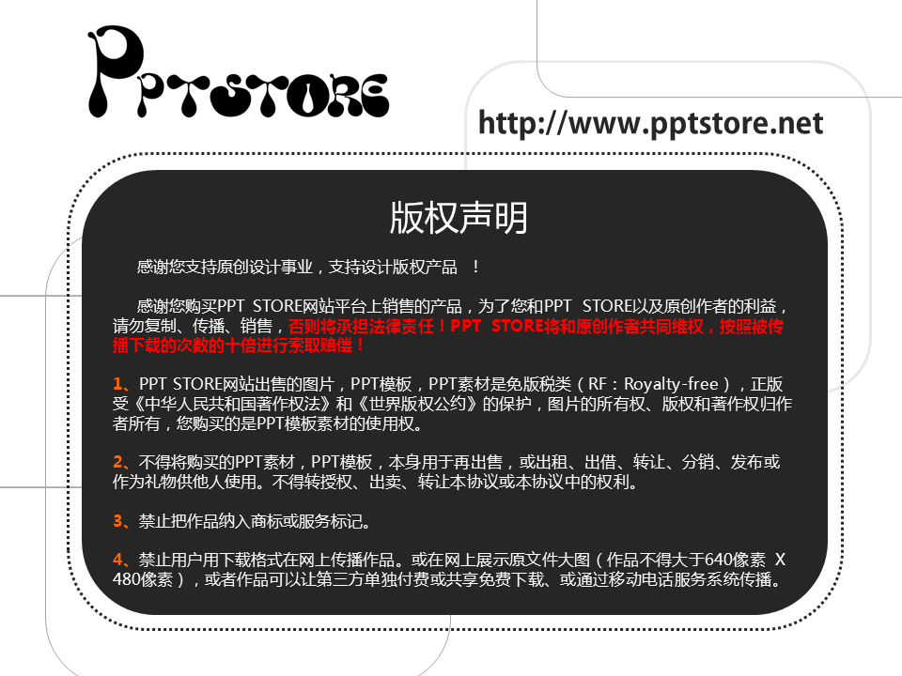
Notes:
原创PPT发布说明
1、为保护您作品的版权，请将版权声明页对应4:3或者16:9规格插入到原创PPT中。
2、推荐使用2010版本OFFICE制作原创PPT，发布作品存为2003和2007以上版本两个格式，压缩后上传。
3、在上传PPT的截图时，推荐使用2010版本OFFICE另存为jpg图片的功能，第1页为封面，第2页为封面结合缩略图，图片宽度为640像素。
4、上传PPT作品时，可以使用2010版本OFFICE将PPT另存为wmv格式视频，上传到优酷，在PPT STORE添加原创PPT时，嵌入视频地址。

Slide 27


Notes:
原创PPT发布说明
1、为保护您作品的版权，请将版权声明页对应4:3或者16:9规格插入到原创PPT中。
2、推荐使用2010版本OFFICE制作原创PPT，发布作品存为2003和2007以上版本两个格式，压缩后上传。
3、在上传PPT的截图时，推荐使用2010版本OFFICE另存为jpg图片的功能，第1页为封面，第2页为封面结合缩略图，图片宽度为640像素。
4、上传PPT作品时，可以使用2010版本OFFICE将PPT另存为wmv格式视频，上传到优酷，在PPT STORE添加原创PPT时，嵌入视频地址。

