Slide 1
Ondes acoustiques
AGREGATION 2019

Slide 2
Approximation acoustique
Conservation de la masse :
$$0=\frac{∂ρ}{∂t}+\operatorname{div}\left(ρ\vec{v}\right) = \frac{∂ρ_{1}}{∂t}+ρ_{0}\operatorname{div}{{\vec{v}}_{1}}+ρ_{1}\operatorname{div}{{\vec{v}}_{1}}+\left(\vec{v}⋅\vec{grad}\right)ρ_{1}$$

Slide 3
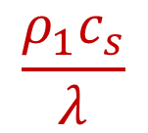
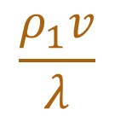
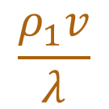
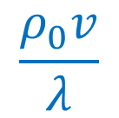
Approximation acoustique
Conservation de la masse :
$$0=\frac{∂ρ}{∂t}+\operatorname{div}\left(ρ\vec{v}\right) = \frac{∂ρ_{1}}{∂t}+ρ_{0}\operatorname{div}{{\vec{v}}_{1}}+ρ_{1}\operatorname{div}{{\vec{v}}_{1}}+\left(\vec{v}⋅\vec{grad}\right)ρ_{1}$$
$$\frac{ρ_{1}c_{s}}{λ}$$
$$\frac{ρ_{0}v}{λ}$$
$$\frac{ρ_{1}v}{λ}$$
$$\frac{ρ_{1}v}{λ}$$

Slide 4
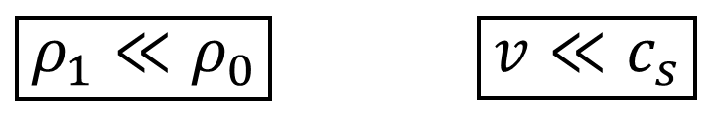
Approximation acoustique
Conservation de la masse :
$$0=\frac{∂ρ}{∂t}+\operatorname{div}\left(ρ\vec{v}\right) = \frac{∂ρ_{1}}{∂t}+ρ_{0}\operatorname{div}{{\vec{v}}_{1}}+ρ_{1}\operatorname{div}{{\vec{v}}_{1}}+\left(\vec{v}⋅\vec{grad}\right)ρ_{1}$$
$$\frac{ρ_{1}c_{s}}{λ}$$
$$\frac{ρ_{0}v}{λ}$$
$$\frac{ρ_{1}v}{λ}$$
$$\frac{ρ_{1}v}{λ}$$
$\boxed{ρ_{1}≪ρ_{0}}$ $\boxed{v≪c_{s}}$

Slide 5
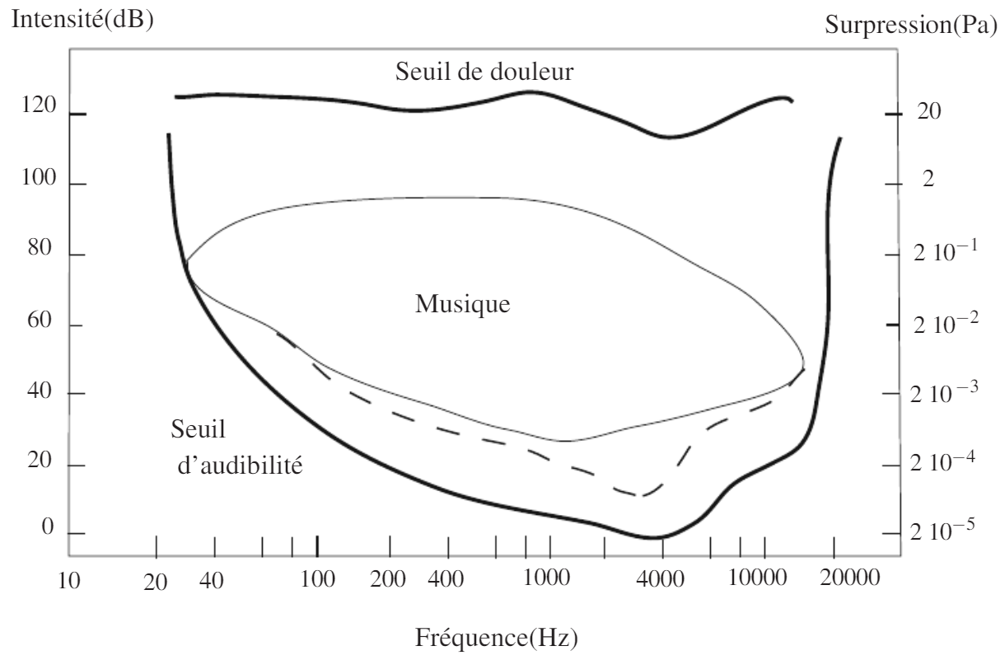
Audition humaine

Slide 6


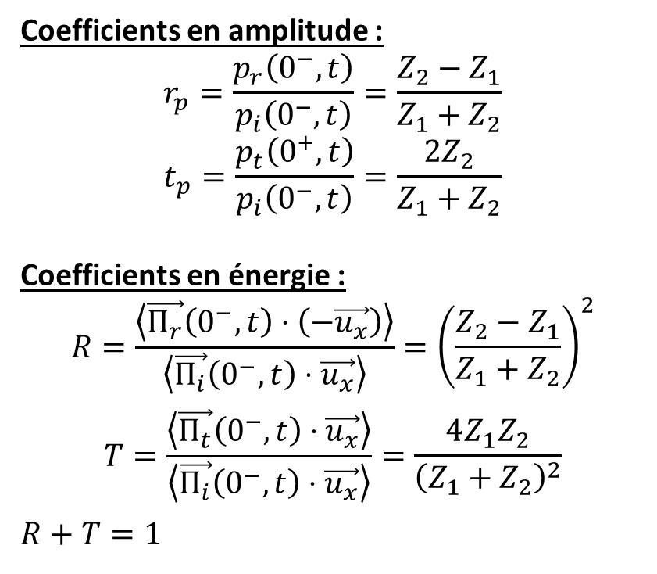




Interface entre deux fluides
Coefficients en amplitude :
$$r_{p}=\frac{p_{r}\left(0^{−},t\right)}{p_{i}\left(0^{−},t\right)}=\frac{Z_{2}−Z_{1}}{Z_{1}+Z_{2}}$$
$$t_{p}=\frac{p_{t}\left(0^{+},t\right)}{p_{i}\left(0^{−},t\right)}=\frac{2Z_{2}}{Z_{1}+Z_{2}}$$
Coefficients en énergie :
$$R=\frac{\left\langle \vec{Π_{r}}\left(0^{−},t\right)⋅\left(−\vec{u_{x}}\right)\right\rangle }{\left\langle \vec{Π_{i}}\left(0^{−},t\right)⋅\vec{u_{x}}\right\rangle }={\left(\frac{Z_{2}−Z_{1}}{Z_{1}+Z_{2}}\right)}^{2}$$
$$T=\frac{\left\langle \vec{Π_{t}}\left(0^{−},t\right)⋅\vec{u_{x}}\right\rangle }{\left\langle \vec{Π_{i}}\left(0^{−},t\right)⋅\vec{u_{x}}\right\rangle }=\frac{4Z_{1}Z_{2}}{{\left(Z_{1}+Z_{2}\right)}^{2}}$$
$$R+T=1$$
$$p_{i},\vec{v_{i}}$$
$$p_{r},\vec{v_{r}}$$
$$Z_{1}$$
$$Z_{2}$$
$$p_{t},\vec{v_{t}}$$
$$x$$

