Slide 1
Évolution temporelle d’un système quantique à deux niveaux
AGREGATION 2019

Slide 2
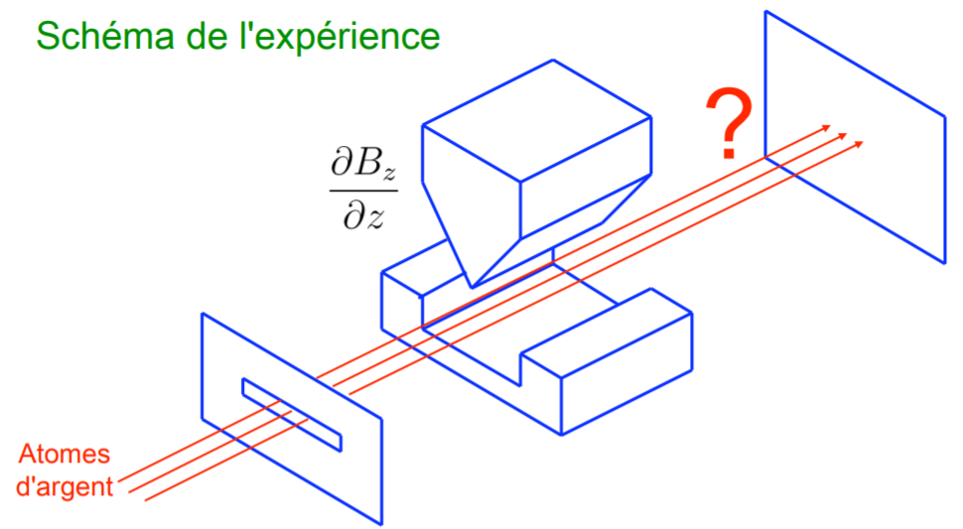
Expérience de Stern et Gerlach
Source : Notes de cours de J. Dalibard

Slide 3
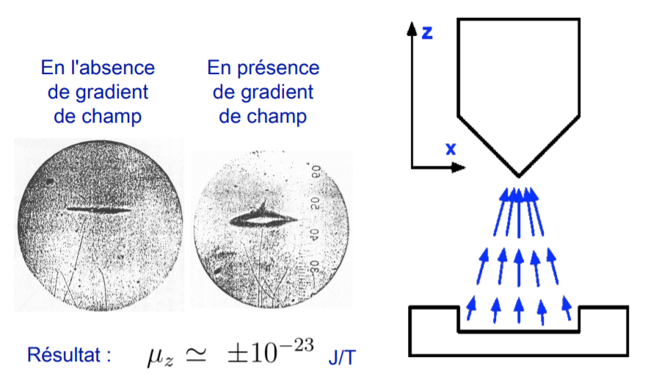
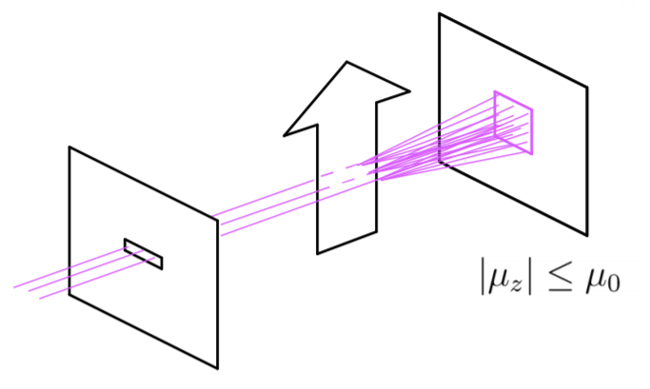
Expérience de Stern et Gerlach
Signal attendu classiquement :
Signal expérimental :
Source : Notes de cours de J. Dalibard

Slide 4
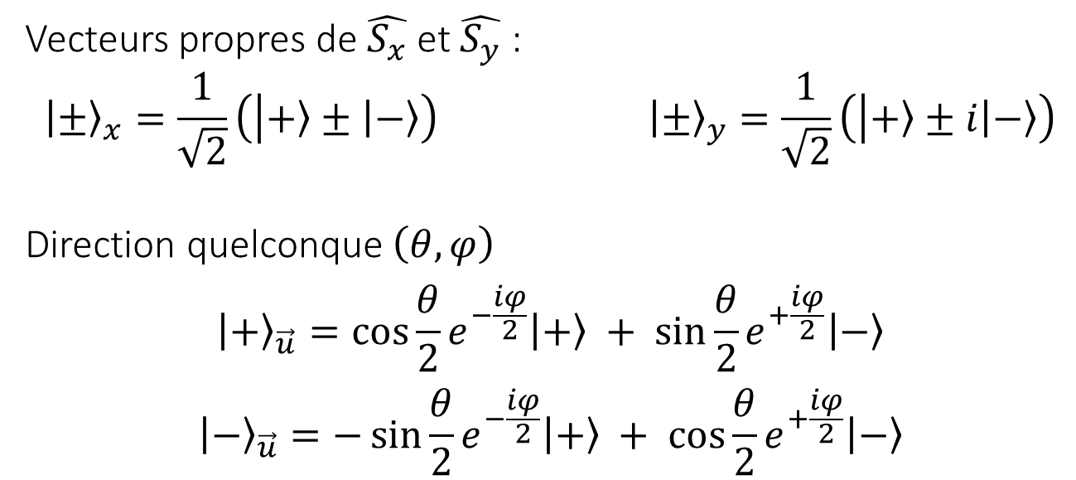
Vecteurs propres
Vecteurs propres de $\hat{S_{x}}$ et $\hat{S_{y}}$ :
$${\left.\left|±\right.\right\rangle }_{x}=\frac{1}{\sqrt{2}}\left(\left|\left.+\right\rangle ±\left|\left.−\right\rangle \right.\right.\right) {\left.\left|±\right.\right\rangle }_{y}=\frac{1}{\sqrt{2}}\left(\left|\left.+\right\rangle ±i\left|\left.−\right\rangle \right.\right.\right)$$
Direction quelconque $\left(θ,φ\right)$
$${\left.\left|+\right.\right\rangle }_{\vec{u}}=\cos{\frac{θ}{2}}e^{−\frac{iφ}{2}}\left|\left.+\right\rangle \right. + \sin{\frac{θ}{2}}e^{+\frac{iφ}{2}}\left|\left.−\right\rangle \right.$$
$${\left.\left|−\right.\right\rangle }_{\vec{u}}=−\sin{\frac{θ}{2}}e^{−\frac{iφ}{2}}\left|\left.+\right\rangle \right. + \cos{\frac{θ}{2}}e^{+\frac{iφ}{2}}\left|\left.−\right\rangle \right.$$

Slide 5
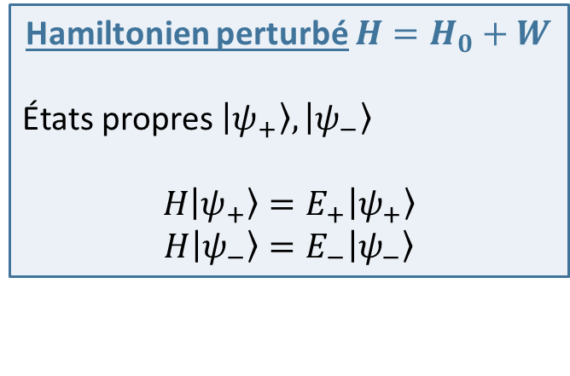
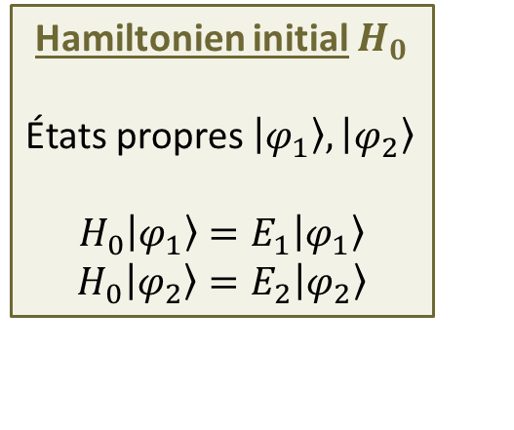
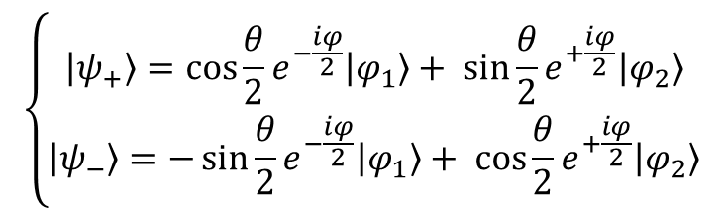
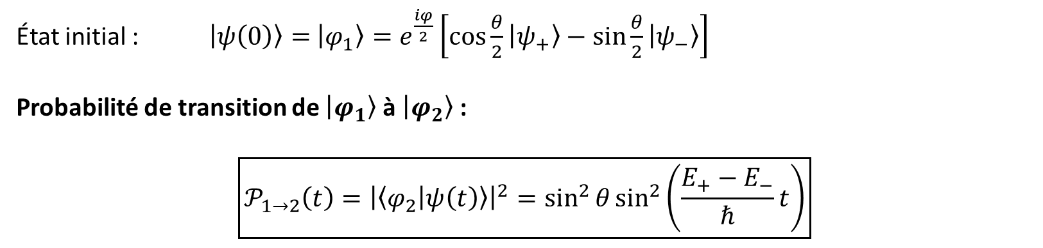
Oscillations de Rabi
Hamiltonien initial $H_{0}$
États propres $\left|\left.φ_{1}\right\rangle \right.,\left|\left.φ_{2}\right\rangle \right.$
$$H_{0}\left|\left.φ_{1}\right\rangle \right.=E_{1}\left|\left.φ_{1}\right\rangle \right.$$
$$H_{0}\left|\left.φ_{2}\right\rangle \right.=E_{2}\left|\left.φ_{2}\right\rangle \right.$$
Hamiltonien perturbé $H=H_{0}+W$
États propres $\left|\left.ψ_{+}\right\rangle \right.,\left|\left.ψ_{−}\right\rangle \right.$
$$H\left|\left.ψ_{+}\right\rangle \right.=E_{+}\left|\left.ψ_{+}\right\rangle \right.$$
$$H\left|\left.ψ_{−}\right\rangle \right.=E_{−}\left|\left.ψ_{−}\right\rangle \right.$$
$$\left\{\begin{aligned}\left|\left.ψ_{+}\right\rangle \right.=\cos{\frac{θ}{2}}e^{−\frac{iφ}{2}}\left|\left.φ_{1}\right\rangle \right.+ \sin{\frac{θ}{2}}e^{+\frac{iφ}{2}}\left|\left.φ_{2}\right\rangle \right. \\ \left|\left.ψ_{−}\right\rangle \right.=−\sin{\frac{θ}{2}}e^{−\frac{iφ}{2}}\left|\left.φ_{1}\right\rangle \right.+ \cos{\frac{θ}{2}}e^{+\frac{iφ}{2}}\left|\left.φ_{2}\right\rangle \right.\end{aligned}\right.$$
État initial : $\left|\left.ψ\left(0\right)\right\rangle =\right.$ $\left|\left.φ_{1}\right\rangle \right.=e^{\frac{iφ}{2}}\left[\cos{\frac{θ}{2}}\left|\left.ψ_{+}\right\rangle \right.−\sin{\frac{θ}{2}}\left|\left.ψ_{−}\right\rangle \right.\right]$
Probabilité de transition de $\left|\left.φ_{1}\right\rangle \right.$ à $\left|\left.φ_{2}\right\rangle \right.$ :
$$\boxed{𝒫_{1→2}\left(t\right)={\left|\left\langle φ_{2} | ψ\left(t\right)\right\rangle \right|}^{2}=\sin^{2}{θ}\sin^{2}\left(\frac{E_{+}−E_{−}}{ℏ}t\right)}$$

Slide 6
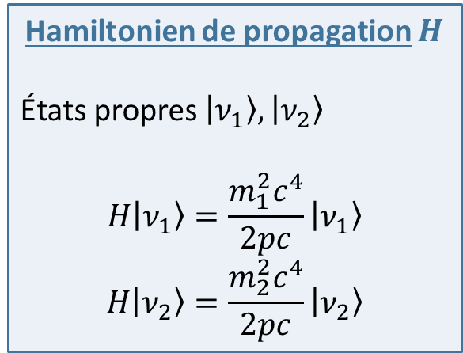
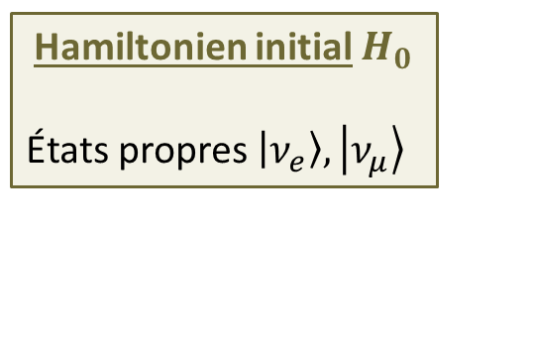
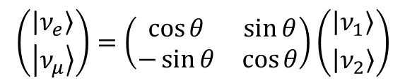
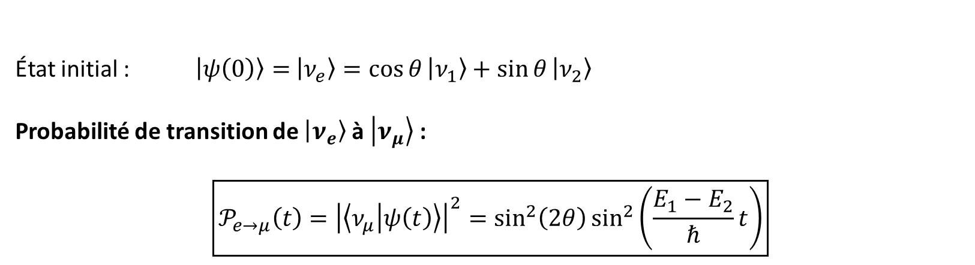
Oscillation des neutrinos
Hamiltonien de propagation $H$
États propres $\left|\left.ν_{1}\right\rangle \right.,\left|\left.ν_{2}\right\rangle \right.$
$$H\left|\left.ν_{1}\right\rangle \right.=\frac{m_{1}^{2}c^{4}}{2pc}\left|\left.ν_{1}\right\rangle \right.$$
$$H\left|\left.ν_{2}\right\rangle \right.=\frac{m_{2}^{2}c^{4}}{2pc}\left|\left.ν_{2}\right\rangle \right.$$
Hamiltonien initial $H_{0}$
États propres $\left|\left.ν_{e}\right\rangle \right.,\left|\left.ν_{μ}\right\rangle \right.$
$$\left({\left|\left.ν_{e}\right\rangle \right. \atop \left|\left.ν_{μ}\right\rangle \right.}\right)=\left(\begin{matrix}\cos{θ} & \sin{θ} \\ −\sin{θ} & \cos{θ}\end{matrix}\right)\left({\left|\left.ν_{1}\right\rangle \right. \atop \left|\left.ν_{2}\right\rangle \right.}\right)$$
État initial : $\left|\left.ψ\left(0\right)\right\rangle =\right.$ $\left|\left.ν_{e}\right\rangle \right.=\cos{θ}\left|\left.ν_{1}\right\rangle \right.+\sin{θ}\left|\left.ν_{2}\right\rangle \right.$
Probabilité de transition de $\left|\left.ν_{e}\right\rangle \right.$ à $\left|\left.ν_{μ}\right\rangle \right.$ :
$$\boxed{𝒫_{e→μ}\left(t\right)={\left|\left\langle ν_{μ} | ψ\left(t\right)\right\rangle \right|}^{2}=\sin^{2}\left(2θ\right)\sin^{2}\left(\frac{E_{1}−E_{2}}{ℏ}t\right)}$$

Slide 7
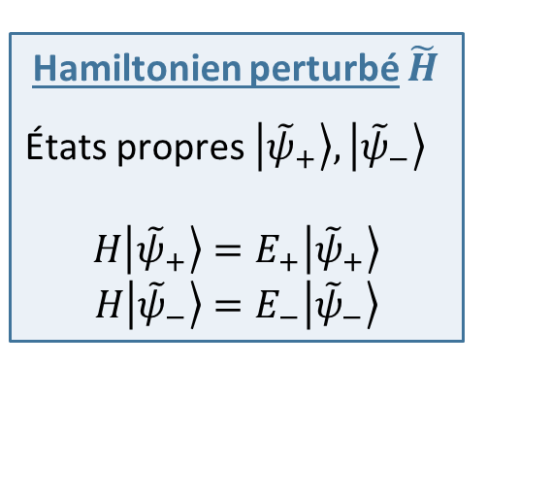
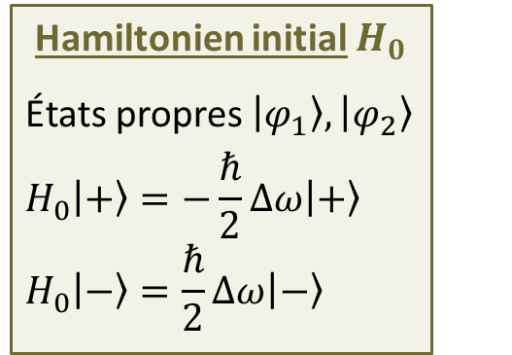
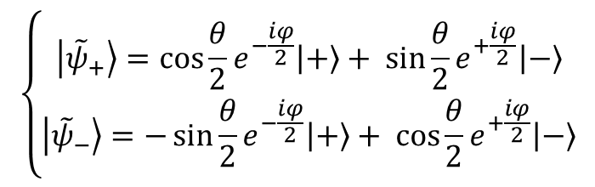
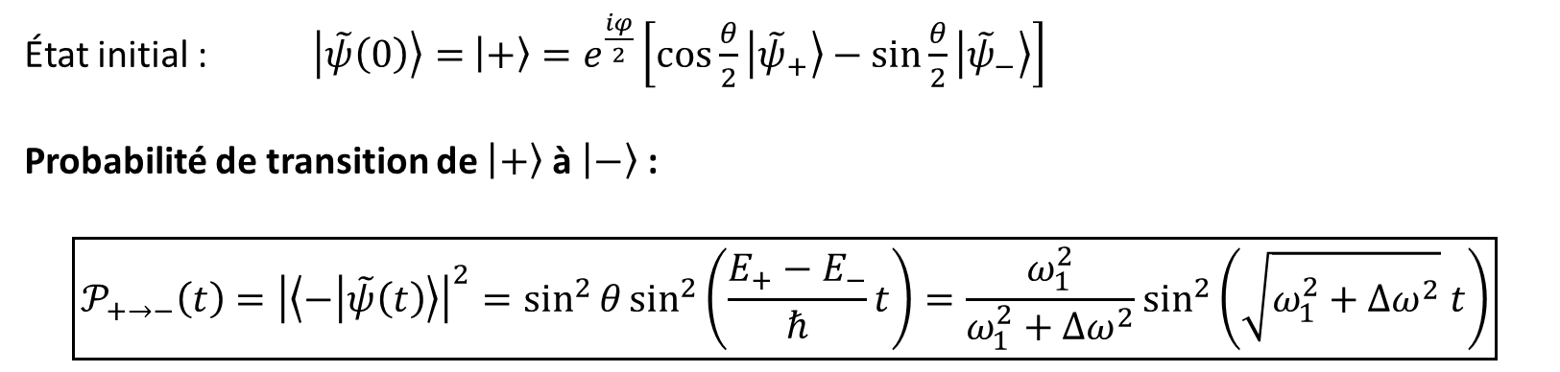
Oscillations forcées
Hamiltonien initial $H_{0}$
États propres $\left|\left.φ_{1}\right\rangle \right.,\left|\left.φ_{2}\right\rangle \right.$
$$H_{0}\left|\left.+\right\rangle \right.=−\frac{ℏ}{2}Δω\left|\left.+\right\rangle \right.$$
$$H_{0}\left|\left.−\right\rangle \right.=\frac{ℏ}{2}Δω\left|\left.−\right\rangle \right.$$
Hamiltonien perturbé $\tilde{H}$
États propres $\left|\left.{\tilde{ψ}}_{+}\right\rangle \right.,\left|\left.{\tilde{ψ}}_{−}\right\rangle \right.$
$$H\left|\left.{\tilde{ψ}}_{+}\right\rangle \right.=E_{+}\left|\left.{\tilde{ψ}}_{+}\right\rangle \right.$$
$$H\left|\left.{\tilde{ψ}}_{−}\right\rangle \right.=E_{−}\left|\left.{\tilde{ψ}}_{−}\right\rangle \right.$$
$$\left\{\begin{aligned}\left|\left.{\tilde{ψ}}_{+}\right\rangle \right.=\cos{\frac{θ}{2}}e^{−\frac{iφ}{2}}\left|\left.+\right\rangle \right.+ \sin{\frac{θ}{2}}e^{+\frac{iφ}{2}}\left|\left.−\right\rangle \right. \\ \left|\left.{\tilde{ψ}}_{−}\right\rangle \right.=−\sin{\frac{θ}{2}}e^{−\frac{iφ}{2}}\left|\left.+\right\rangle \right.+ \cos{\frac{θ}{2}}e^{+\frac{iφ}{2}}\left|\left.−\right\rangle \right.\end{aligned}\right.$$
État initial : $\left|\left.\tilde{ψ}\left(0\right)\right\rangle =\right.$ $\left|\left.+\right\rangle \right.=e^{\frac{iφ}{2}}\left[\cos{\frac{θ}{2}}\left|\left.{\tilde{ψ}}_{+}\right\rangle \right.−\sin{\frac{θ}{2}}\left|\left.{\tilde{ψ}}_{−}\right\rangle \right.\right]$
Probabilité de transition de $\left|\left.+\right\rangle \right.$ à $\left|\left.−\right\rangle \right.$ :
$$\boxed{𝒫_{+→−}\left(t\right)={\left|\left\langle − | \tilde{ψ}\left(t\right)\right\rangle \right|}^{2}=\sin^{2}{θ}\sin^{2}\left(\frac{E_{+}−E_{−}}{ℏ}t\right)=\frac{ω_{1}^{2}}{ω_{1}^{2}+Δω^{2}}\sin^{2}\left(\sqrt{ω_{1}^{2}+Δω^{2}} t\right)}$$

