Slide 1

IPWAVE Basic Protocols Project @ IETF-108 Hackathon
IETF 108, Online July 20, 2020
Champion: Jaehoon Paul Jeong pauljeong@skku.edu
Sungkyunkwan University

Slide 2
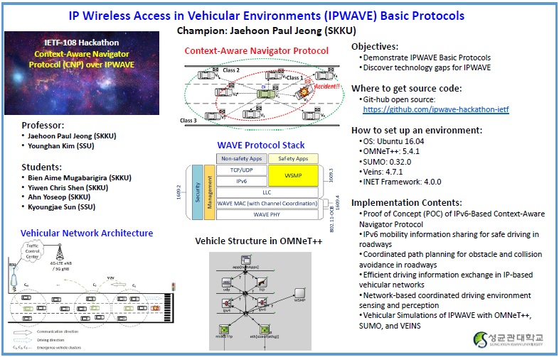
IPWAVE Hackathon Project Poster

Slide 3
Introduction
CNP Protocol for IP-Based Vehicular Network Motivation
Use case of IPWAVE Problem Statement Document [draft-ietf-ipwave-vehicular-networking-16]
Subjects of This Draft
Support the light-weight message exchange for vehicle safety
Two-type message:
Awareness: Cooperative Context Message (CCM)
Emergency context: Emergency Context Message (ECM)

Slide 4
Context Awareness in IP-Based Vehicular Networks
CAM
Context Awareness in IP based Network
Via lightweight messages Context aware Messages (CAM)
Emergency Context Message (ECM)
ECM

Slide 5
Vehicle Mobility Information (1/2)
VMI options:
Type
Either: CCM and ECM
0
1
2
3
0
1
2
3
4
5
6
7
8
9
0
1
2
3
4
5
6
7
8
9
0
1
2
3
4
5
6
7
8
9
0
1
Type | Length | Message | Reserved 1
Reserved 2
Mobility Information

Slide 6
Vehicle Mobility Information (2/2)
CCM
Included in an NA message that a vehicle transmits periodically to announce its existence and routing information to its one-hop neighboring vehicles
ECM
Included in an NA message that a vehicle transmits to immediately announce an emergency situation to its one-hop neighboring vehicles
ECM has a higher priority than the CCM
If a vehicle has an ECM and a CCM to send, it SHOULD transmit the ECM earlier than the CCM

Slide 7
Emergency Context-Awareness and response
Cooperative Context Message (CCM)
Deliver a vehicle’s motion information
Position, Speed, Acceleration/Deceleration, direction
Diver’s action (e.g., braking and accelerating)
Emergency Context Message (ECM)
Emergency situation notification
Accident, dangerous situation
ECM has higher priority over CCM

Slide 8
Simulation Working Flow
SUMO
TRACI
OMNeT++
OMNeT++
Veins (Vehicle in Network Simulation)
SUMO: Simulation of Urban Mobility
Simulation scenario in veins: (ScenarioManagerLaunchd)
set
get
set
get
- Vehicle Speed
- Lanes
- Position
- Vehicle Speed
- Lanes
- Position
- Vehicle Speed
- Vehicle Lane
- Position...
- Vehicle Speed
- Vehicle Lane
- Position...
Algorithms
V-Local Sensing
V-Tracking Area: MCTA
Context Awareness
Adaptation and
interaction
navigation scheme
Response
algorithm
Collision Risk
assessment
Motion planner

Slide 9
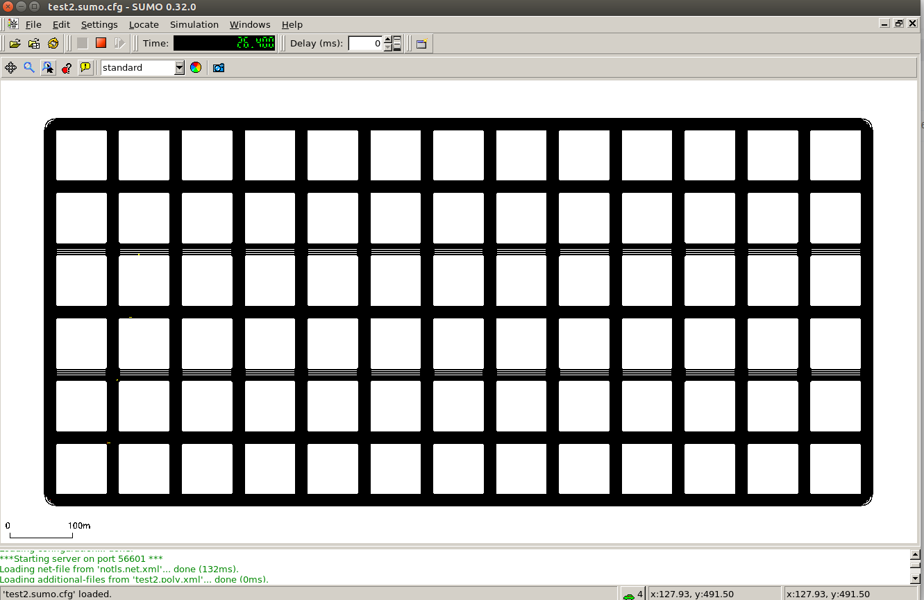
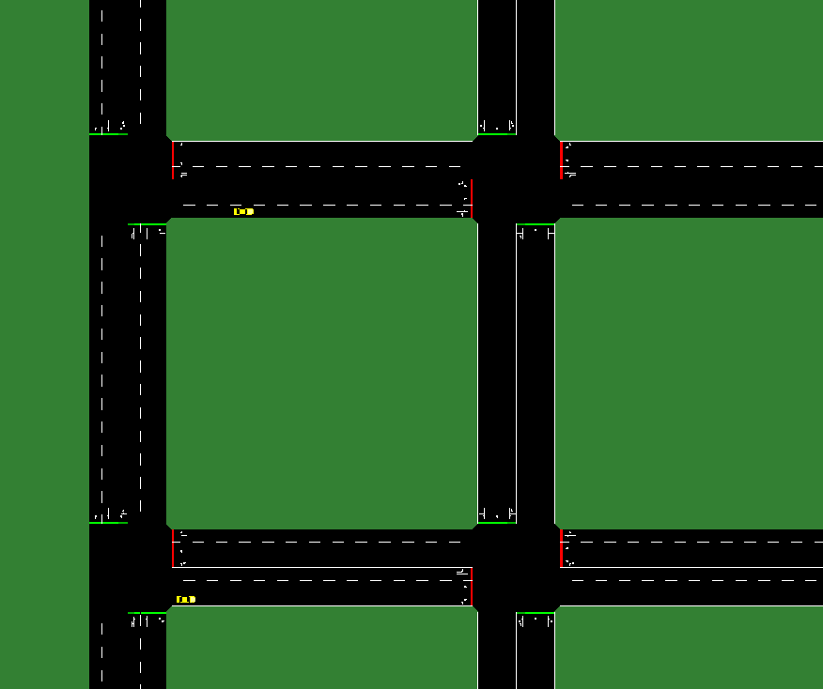
Road Network Architecture (1/2)
A 14*7 grid map with 3 lanes for a road network

Slide 10
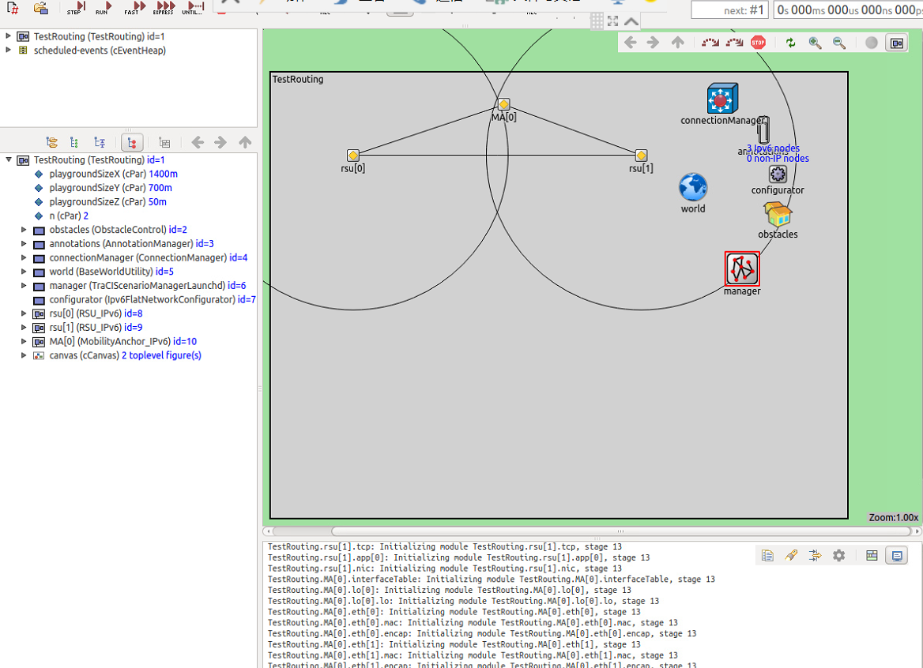
Road Network Architecture (2/2)
Two RSUs :
Belong to one subnet.
Connect with each other through Ethernet.
Multiple Vehicles :
Some are outside the coverage of RSUs.
Mobility Anchor:
Manage RSUs and Vehicles.

Slide 11
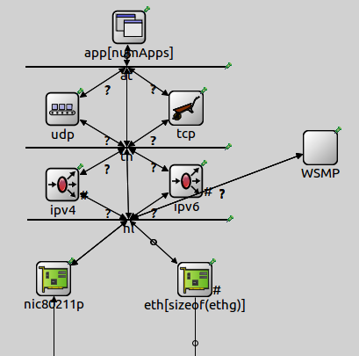
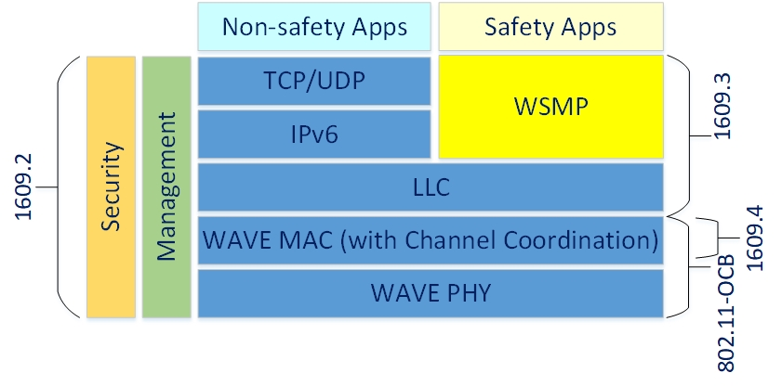
Vehicular Network Architecture
WAVE Stack
Vehicle Structure

Slide 12
Lessons from IETF-108 Hackathon Project
Proof of Concept (POC) of IPWAVE-CNP Protocol
IPWAVE- Context-Aware Navigator Protocol (CNP)
Design and Implementation of IPWAVE-CNP in OMNeT++ and SUMO
Design of IPWAVE-CND Framework in OMNeT++
Implementation of IPv6 over IEEE 802.11-OCB
Proposal of Mobility Information sharing through Ligh-Weight packets in IPWAVE-CNP
MI sharing through CCM and ECM Messages
Coordinated Collision-Avoidance

Slide 13
Appendix
-Hackathon Development Environment
-Open-Source Depository of IPWAVE Basic Protocols Project
-Demonstration Video Clip of IPWAVE Basic Protocols Project

Slide 14
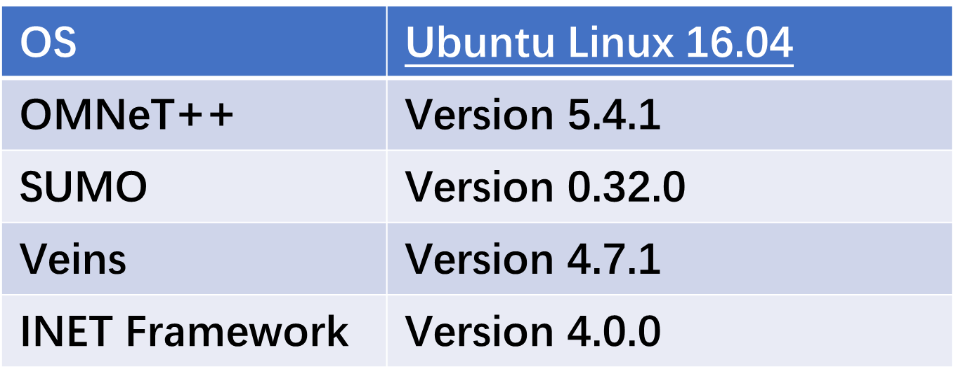
Hackathon Development Environment

Slide 15
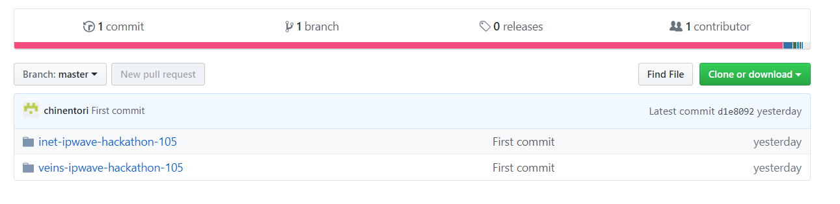
Open-Source Depository of IPWAVE Basic Protocols Project
Github link:
https://github.com/ipwave-hackathon-ietf

Slide 16
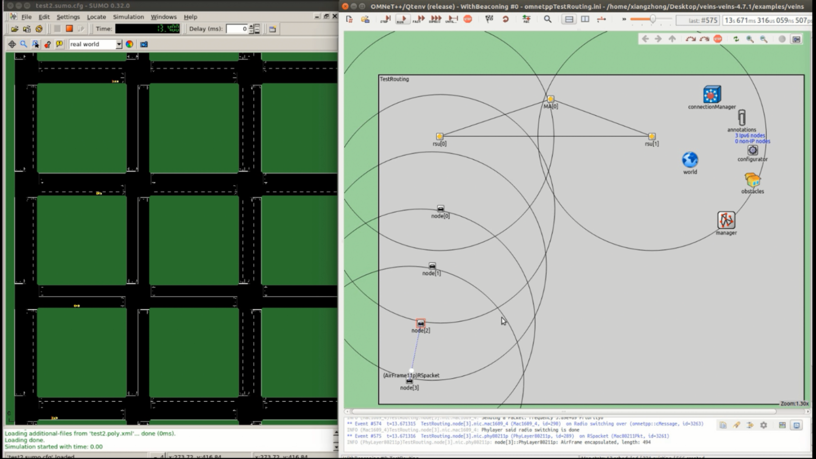
Demonstration Video Clip of IPWAVE Basic Protocols Project
Youtube link:
https://youtu.be/5OnpnYUiLhg

