Slide 1
Machine Learning Models to predict AD disease
Team: Brick Carrier
Xinyu Wang(xw474)
Chengjie Lin(cl2445)
Deepak Agarwal(da475)

Slide 2
Data description
Like a typical clinical scenario,
Input data is not uniformly filled
Multiple visits at different timesteps and intervals of the those visits is not regular.
The number of visits for each subject is also not same.
In a nutshell, the patient data has many irregularities which brings out the need of data preprocessing techniques.

Slide 3
General Input Preprocessing
Input data filtering
1. Remove less-meaningful data
NaN
NaN
data
NaN
NaN
NaN
NaN
Remove such columns where NaN is present more than 70% of the times

Slide 4
Input Preprocessing (Contd)
2. Remove same-value column for eg. TEMPQC_UCSFFSL_’ had PASS present 99% of times and across different diagnosed categories
PASS
FAIL
PASS
PASS
PASS
PASS
PASS
Remove such columns where same data is present for different diagnosis categories, making it unworthy

Slide 5
Input Preprocessing (Contd)
3. Performed PCA as the final step after step 1 and step 2
Final number of features reduced from 1892 to 338

Slide 6
Output Processing
1. Deleted subject data having NaN for all visits
2. Deleted subject data with at least one column being NaN for all visits
3. For train data, final number of rows reduced from 2506 to 1682
4. For test data, final number of rows reduced from 867 to 825

Slide 7
Input and output imputation
1. Delete all NaN input first
2. Order the input samples by its PTID_KEY
3. Perform linear imputation

Slide 8
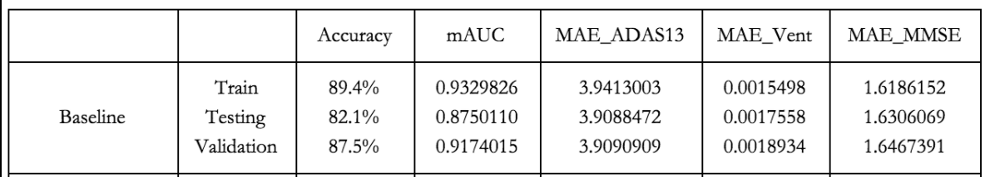
Base Algorithm
Based on LOCF: Last Output Carry Forward
Doesn’t make use of historical data
Simple to implement

Slide 9
Alternative Models
Based on literature review, we came up with these alternative models for the three continuous variable predictions
Supervised Learning
SVM: Support Vector Machines
Deep learning
Data-modified LSTM
T-LSTM

Slide 10
SVM
General Strategy
We will use the Support Vector Regression (SVR) to predict the 3 continuous variables and use Support Vector Classification(SVC) and predicted continuous variables from previous SVR to predict the one categorical variables.

Slide 11
SVM (Contd)
To transform this time series prediction into a regular supervised learning., we ordered the input samples and output with patient id (PTID_KEY) as before, then we took cross-product of these two csv based on the same PTID_KEY.
. For each of the input sample, we added a feature T(time interval of the input and the output), which is the Date in output minus ExamDate in input with unit of month.

Slide 12
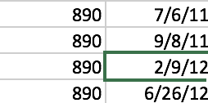
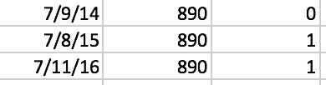
SVM (Contd)
Example:
Cross-product, then minus date
7/9/14 - 6/26/12 = 25 months, which will be used as a new feature

Slide 13
SVM (Contd)
3.Once we get 3 continuous variables (ADAS13, Ventricles_Norm, MMSE) from Support Vector Regression from above section, we can use these 3 variables as 3 features, along with other 7 selected feature, to generate new input data to predict the categorical variable using Support Vector Classification.

Slide 14
Why LSTM: Time-series data
1. The time-series nature of the data leads to the use of LSTM
3. Many-to-one model
4. Can the data fit right into the LSTM model?

Slide 15
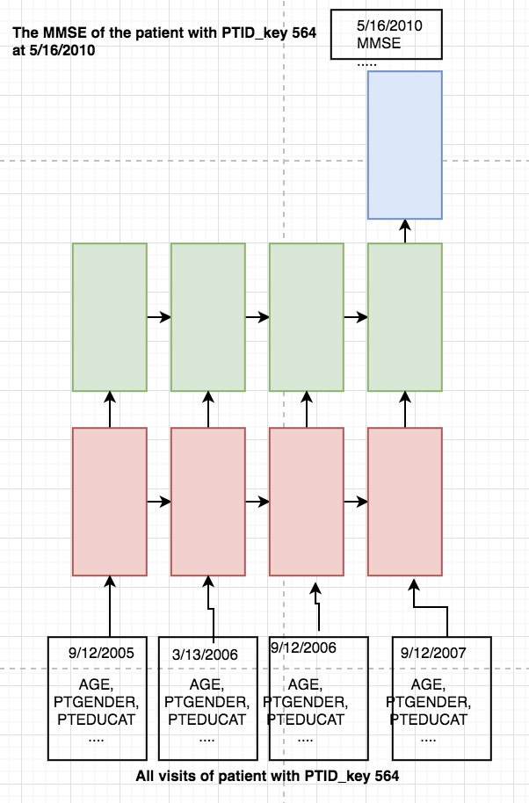
LSTM network unrolled
What we want: Each patient stands for a datapoint. The total visits of a patients are the total timesteps of this datapoint. As shown on the left, for patient with PTID_key 564, there are 4 visits, which means 4 timesteps in this datapoint

Slide 16
LSTM dilemma
The problems: P1. the time interval between two visits is different. P2. For a many-to-one model, the output of it should
have the same timestamp as the last timestep.. P3. Different patients has different number of visits,
which means that in the training process, the number
of timesteps
in each datapoint is different.
(various timesteps in datapoints )

Slide 17
How to solve the dilemma
1. Modify the data
- data-modified LSTM
2. Modify the architecture
- architecture-modified LSTM

Slide 18

Data-modified LSTM
How we modify the data
1. To solve P3: Masking the input with maximum number of visit.
Insert: 675 ?????? LMCI -1 -1 -1
2. To solve P2 and P1: To eliminate the time factor in the data. We transformed the time difference between the input data and output result into a feature of input data.

Slide 19
The disadvantage of data--modified LSTM
It simply uses the time difference as new feature, which lacks solid explanation and proof of concept from the theory point of view.
Can we find some modified LSTM that relatively applied to the problems mentioned above from the architecture aspect.
1. Phased LSTM [1]
2. DeepCare [2]
3. Adaptive Computation Time [4]
4. Time-aware LSTM [3]

Slide 20
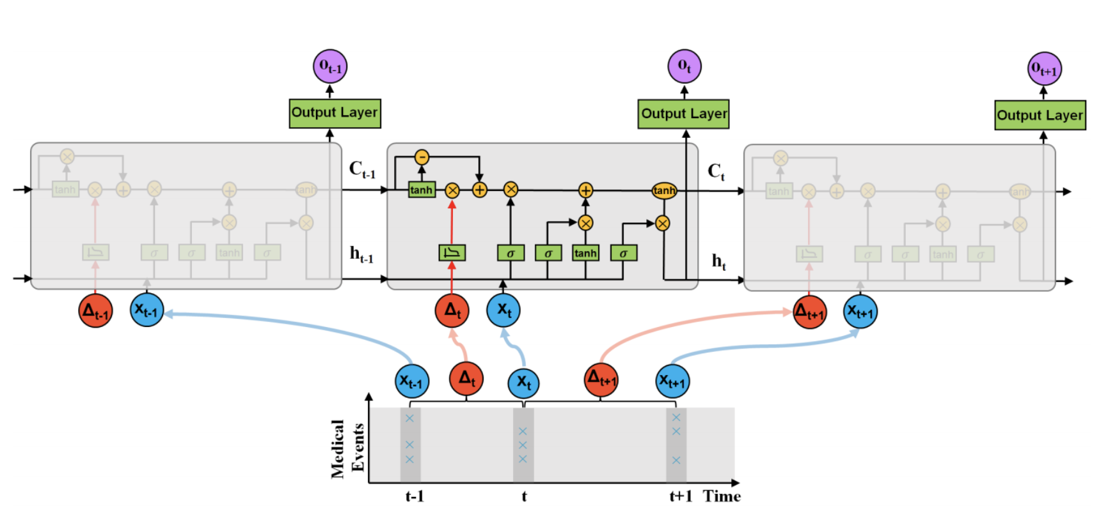
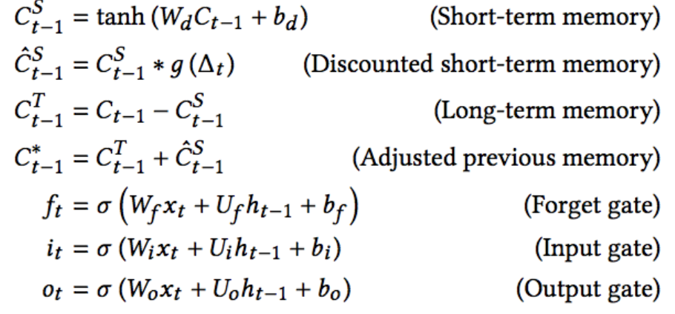
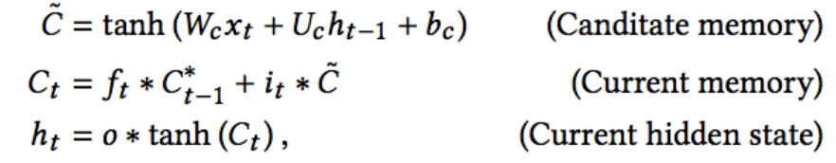
Time-aware LSTM

Slide 21
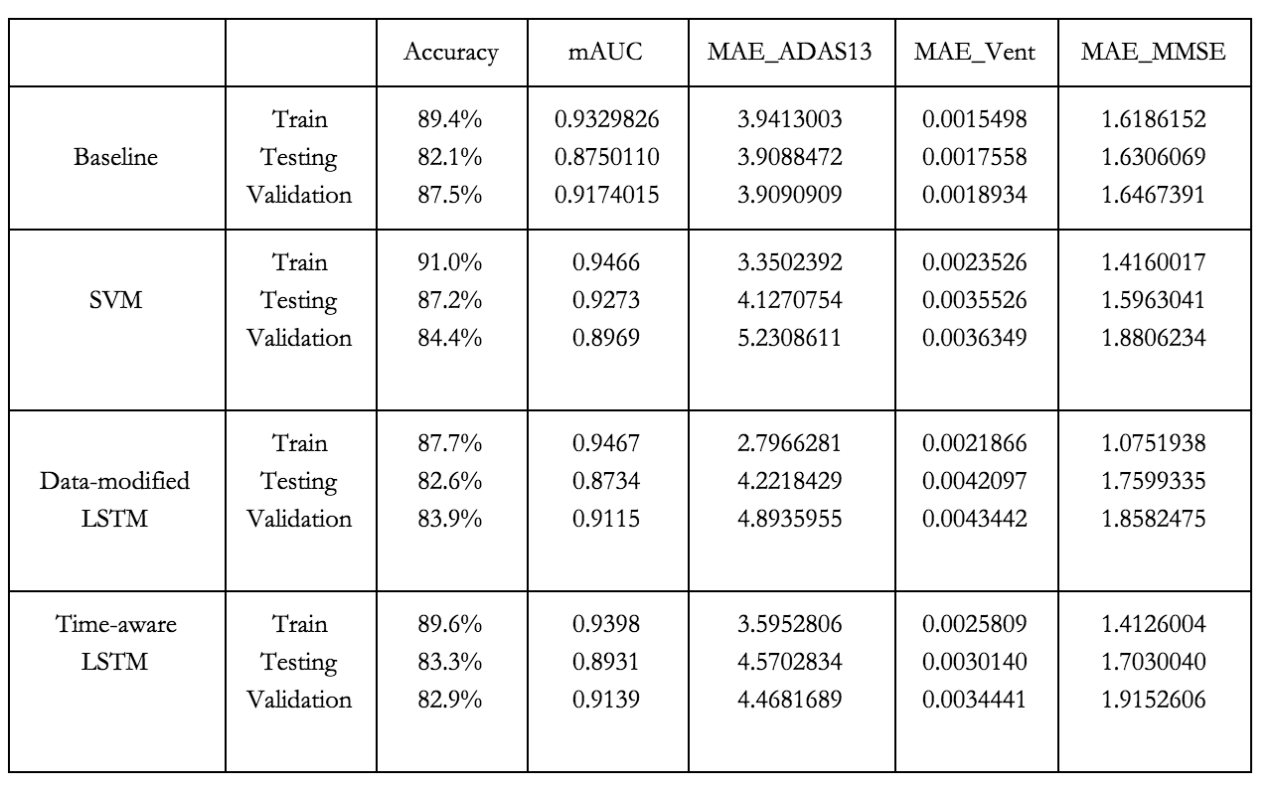
Results of all the models

Slide 22
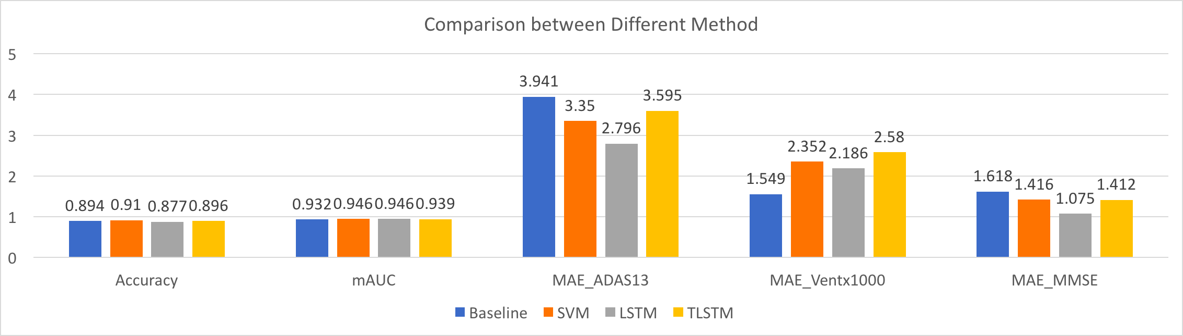
Benchmark
Training Result

Slide 23
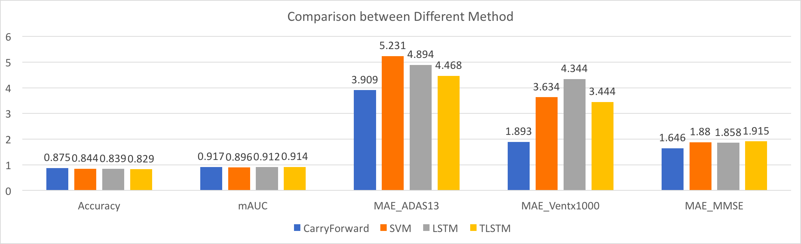
Benchmark
Validation Result

Slide 24
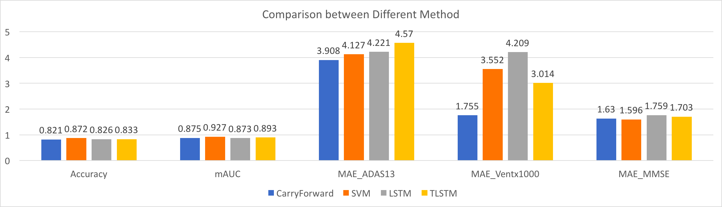
Benchmark
Test Result

Slide 25
Analysis
Overfitting models
Dropout layer to LSTM and Cross-Validation for LSTM and SVM
Overfitting problem cannot be eliminated totally

Slide 26
Conclusion
Persistence model still gives a good accuracy without taking into account of historical data
Our models have a incremental performance as we moved from SVM to Data-modified LSTM to T-LSTM
T-LSTM has more scope of improvement

Slide 27
Reference
[1] Daniel Neil. Phased LSTM: Accelerating Recurrent Network Training for Long or Event-based Sequences. arXiv:1610.09513. Oct 2016
[2] Trang Pham, Truyen Tran, Dinh Phung and Svetha Venkatesh. DeepCare: A Deep Dynamic Memory Model for Predictive Medicine. arXiv:1602.00357. November 10, 2017
[3] Inci Baytas. Patient Subtyping via Time-Aware LSTM Networks. KDD 2017 Research Paper. August 2017. Retrieved from: http://www.kdd.org/kdd2017/papers/view/patient-subtyping-via-time-aware-lstm-networks
[4] Alex Graves. Adaptive Computation Time for Recurrent Neural Networks. arXiv:1603.08983. February 2017

Slide 28
Any Questions?
Thank You !!!

