Slide 1
Please make a copy!
File -> Make a Copy
Remember to include your workbook and this presentation in your submission!

Slide 2
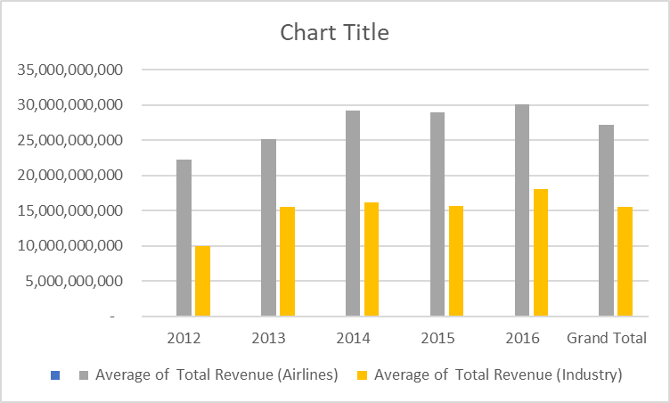
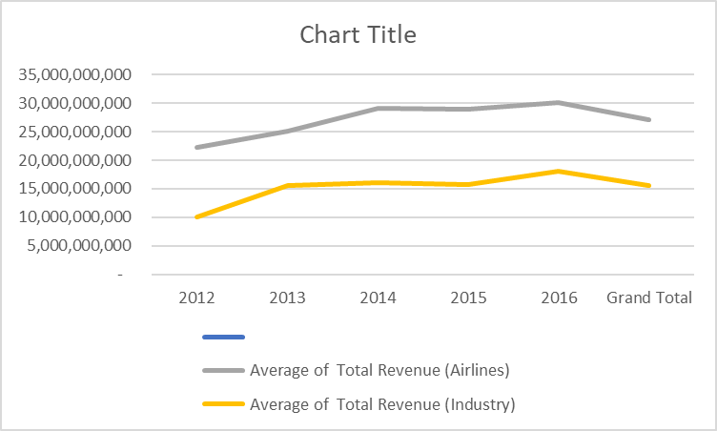
How Does Airlines Industry Revenue Compares to the Overall Industry Average Revenue
How Does Airlines’ Average Revenue Compares to the Overall Industry Revenue
Explanation:
From the Chart it is evident that the airlines industry generates more average revenue per year than the overall industry revenues. We have taken both bar chart and line graph to make the deduction.

Slide 3
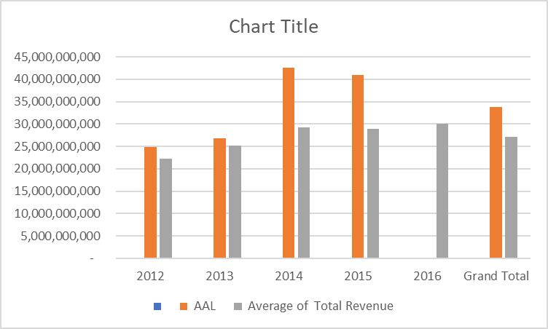
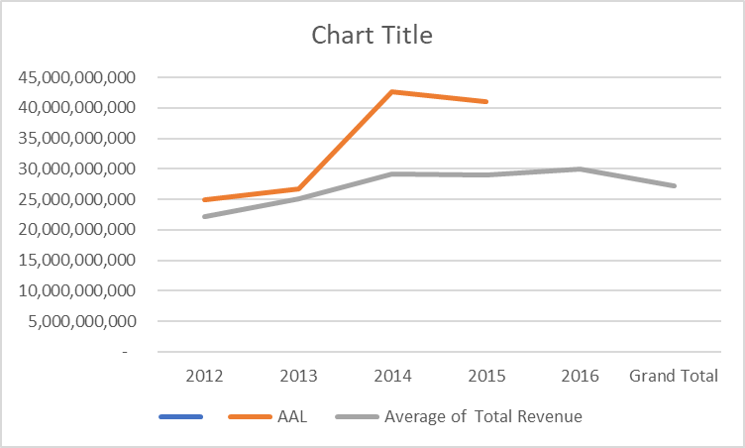
How Does American Airlines’ Average Revenue Compares to the Overal Airlines Industry
EXPLANATION:
From the Bar chart and the Line Graph created over the years from 2012 till 2016, it is evident that AAL has observed more revenues than the overall industry revenue of the airlines sector.

Slide 4
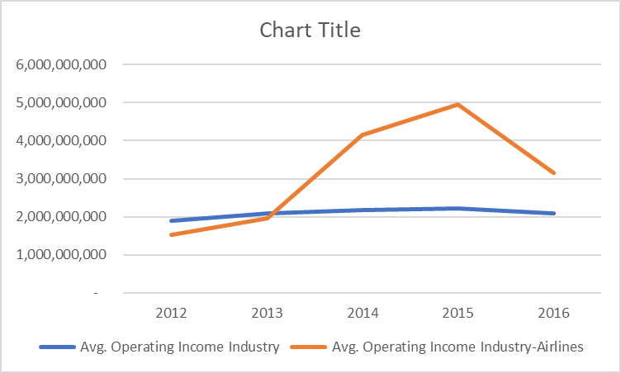
Does The Average Operating Income Show the Same Deduction?
EXPLANATION:
From the comparison between the average operating income of Airlines and The Overall Industry, we sort of reach the same deduction that the airlines industry does generate greater profit that the industry as a whole

