Slide 1


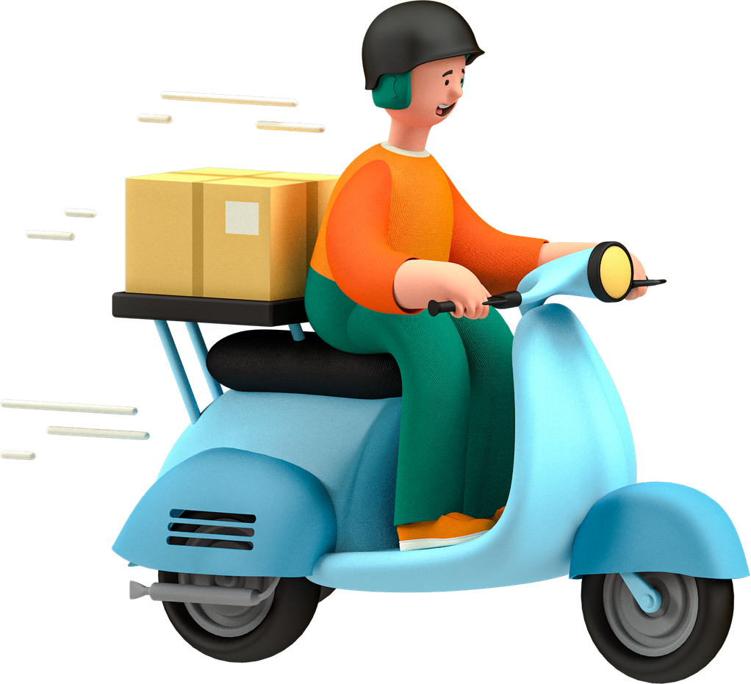


GoOrder
Presented by
Yigitalieva Mubina 20253721
Date
4 June 2026

Slide 2
Project Overview
GoOrder is a console-based food ordering platform.
Users:
• Customer
• Restaurant Owner
• Delivery Rider
• Admin
Main functions:
• Registration/Login
• Food Ordering
• Order Tracking
• Order Status Management

Slide 3
System Structure
We divided the system into separate classes according to their responsibilities.
User
├── Customer
└── DeliveryRider
Restaurant
MenuItem
Order
PaymentSystem

Slide 4
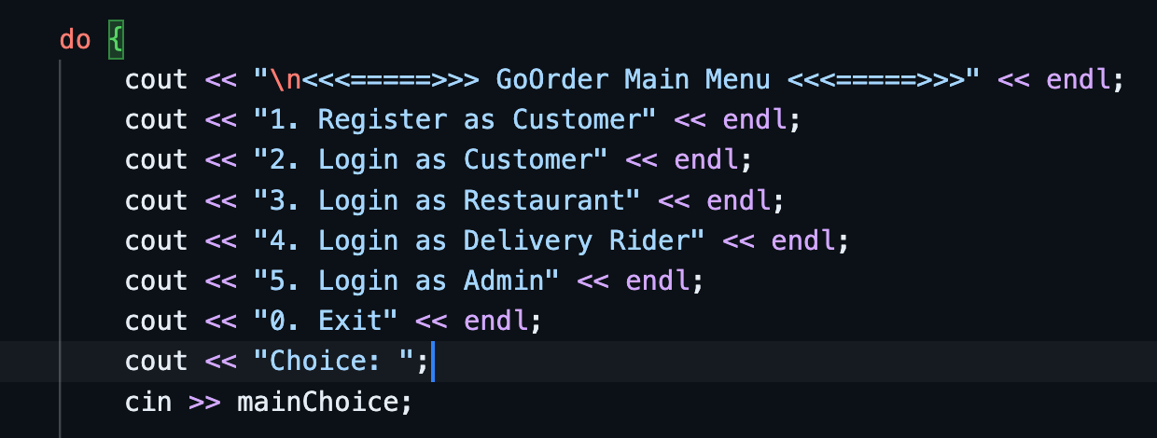
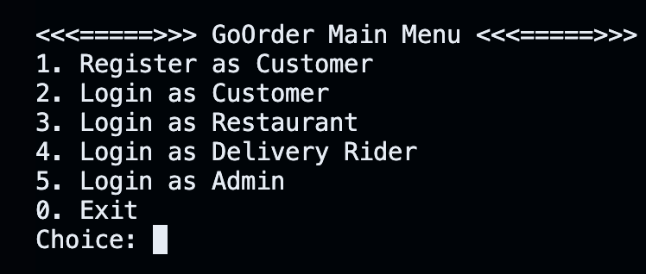
Main Menu View
Every user accesses the system through a different role.

Slide 5
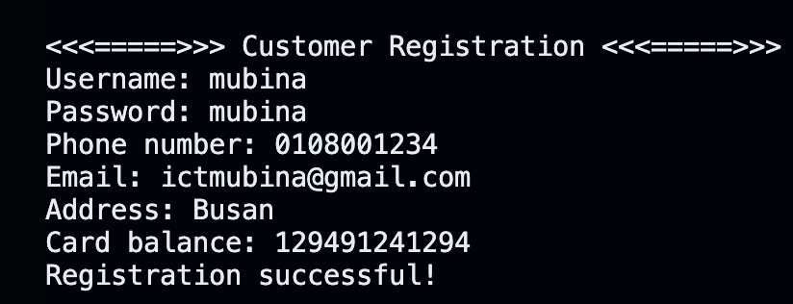
Customer Features
  choosing 1 → register as a customer

Slide 6
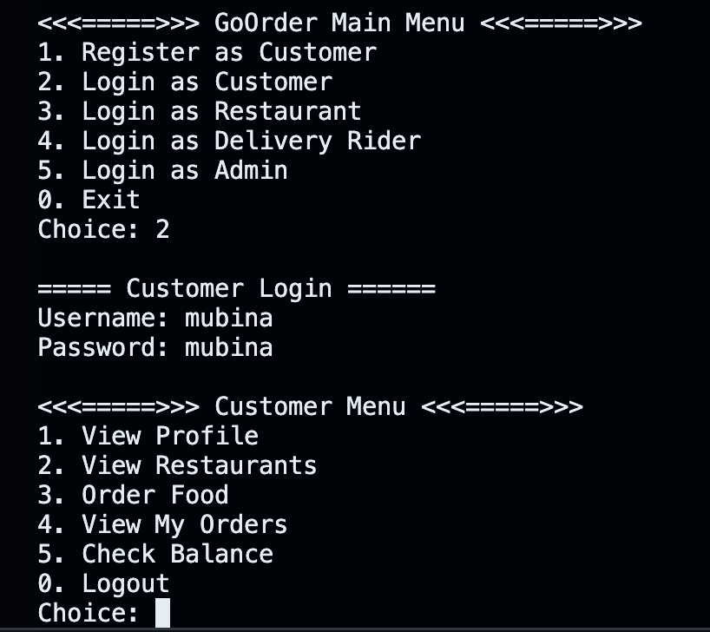
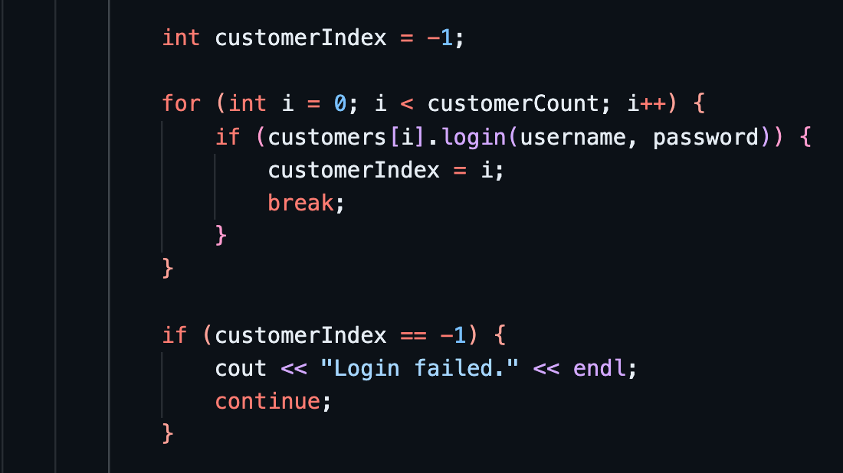
Customer Features
  choosing 2 → login as a customer
This code validates customer login credentials.

Slide 7
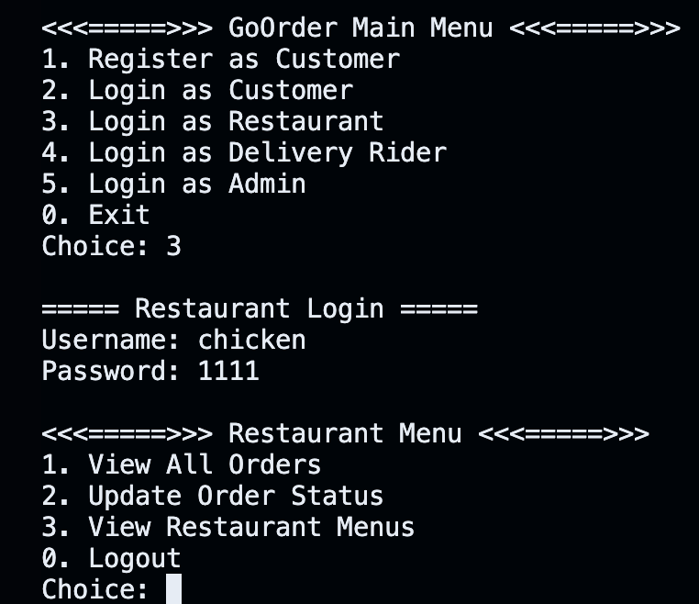
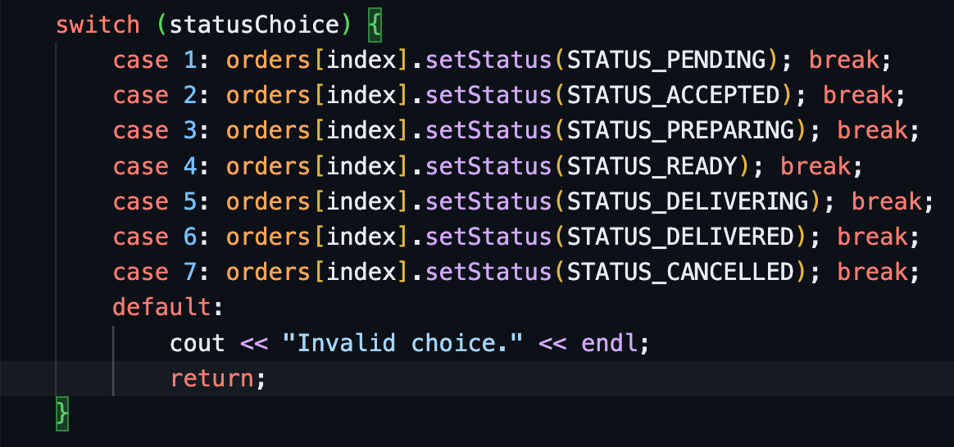
Restaurant Features
Restaurant owners can update order status during food preparation.
  code snippet: updateOrderStatus function

Slide 8
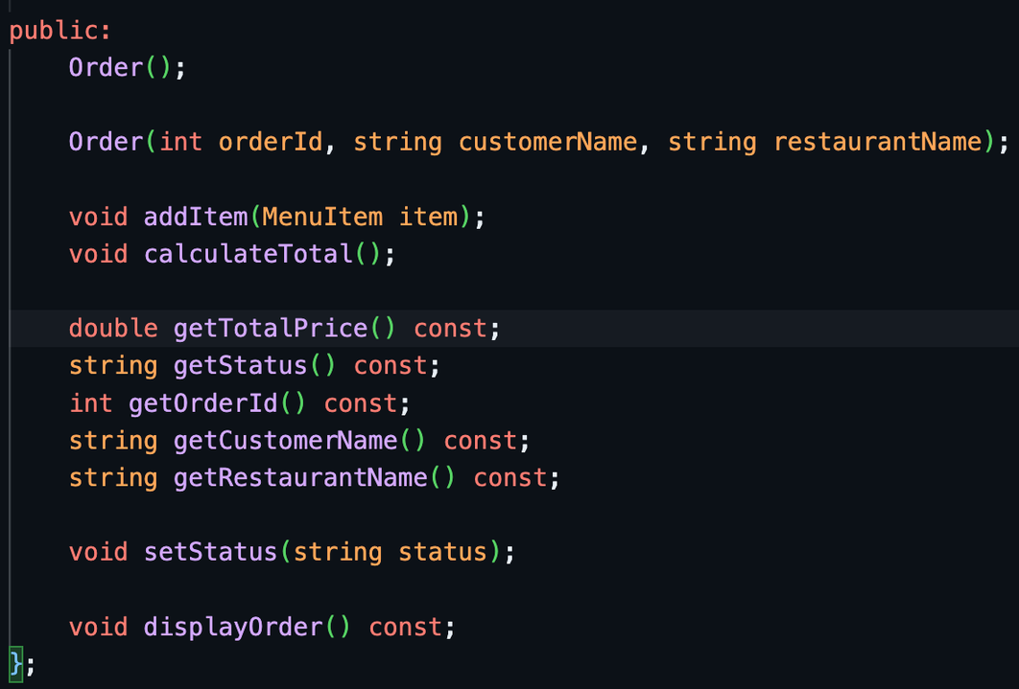
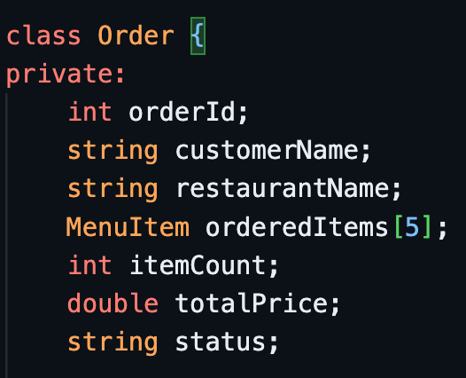
Order Class
Order is the core class that connects customers, restaurants and delivery processes.

Slide 9
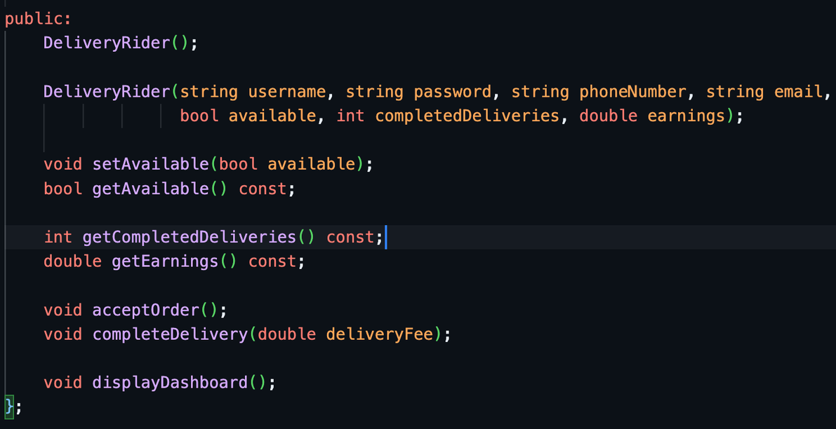
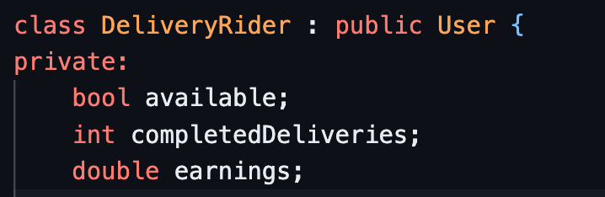
DeliveryRider Class
Riders can accept the order, update its status, view available orders.

Slide 10
FlowChart
Customer places order
↓
Restaurant updates status
↓
Rider accepts order
↓
Rider delivers order
↓
Admin views order

Slide 11


Code Running...

Slide 12
OOP Principles used
Principle | Example
Encapsulation | private data members
Inheritance | Customer : public User
Polymorphism | displayDashboard()
Abstraction | processPayment()

Slide 13
Thank You

