Slide 1

AURA TRAVEL
Luxury Travel Agency Platform
Presented by Aura Team

Slide 2
OUR TEAM
  Olimjon Eliboev
ID: 20253702
  Mubina Yigitalieva
ID: 20253721
  Mukhammad Umirzakov
ID: 20244181

Slide 3
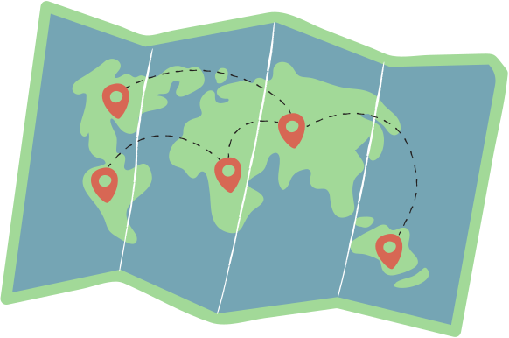
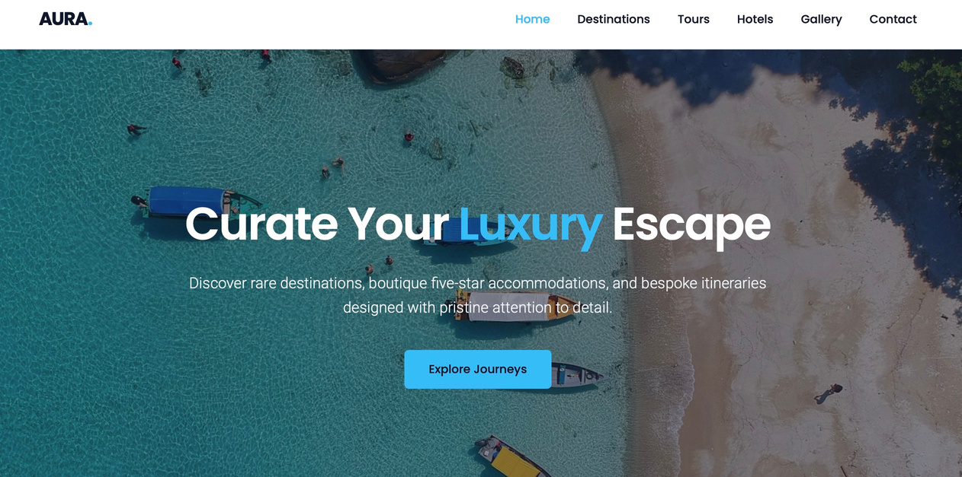
PROJECT PURPOSE
  Create a modern travel agency website
  Showcase destinations, tours, and hotels
  Provide an easy and attractive user experience
  Allow users to contact the agency
  Practice HTML, CSS, Flexbox, Grid, and responsive design

Slide 4
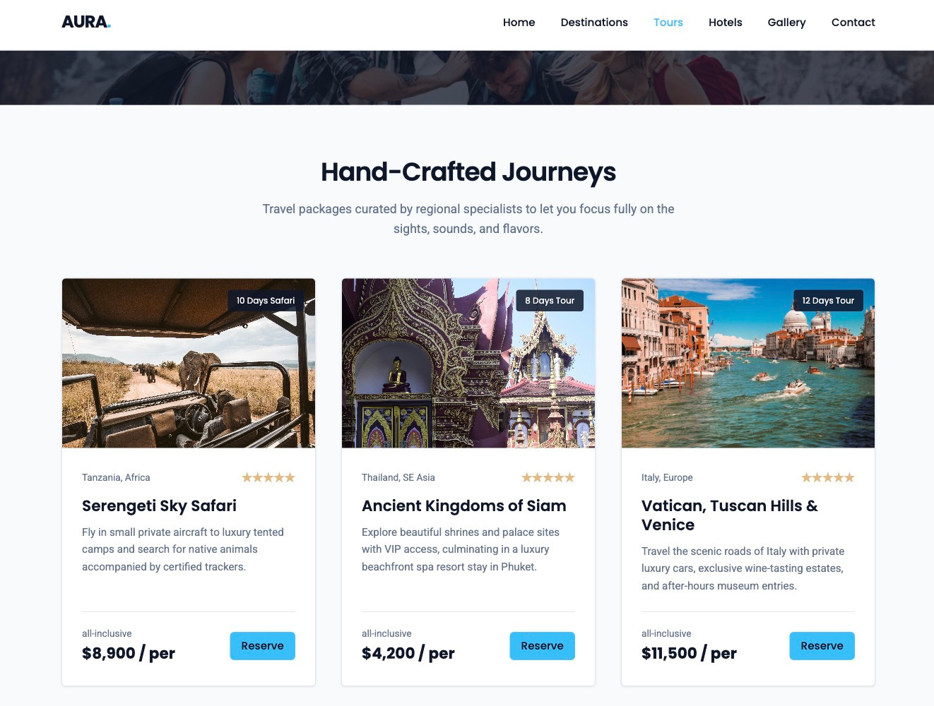
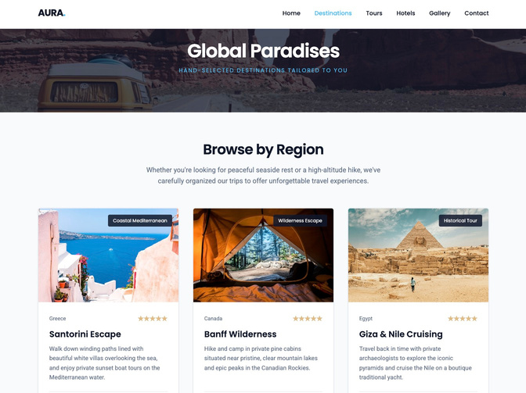
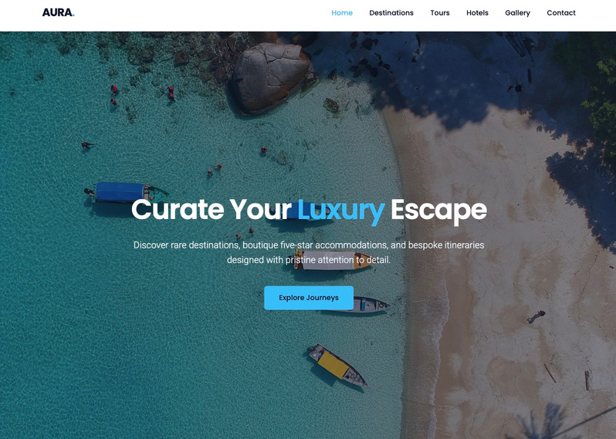
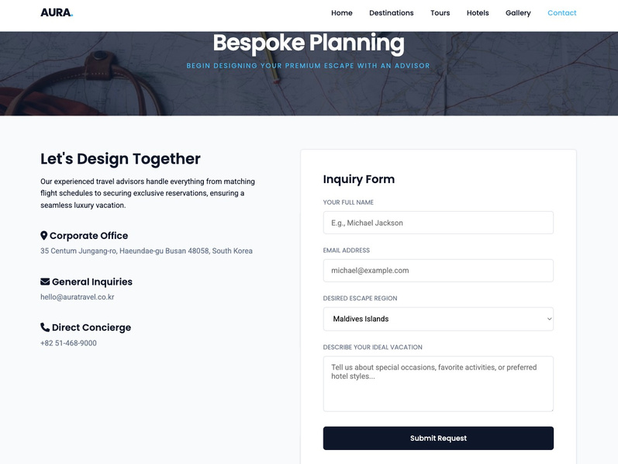
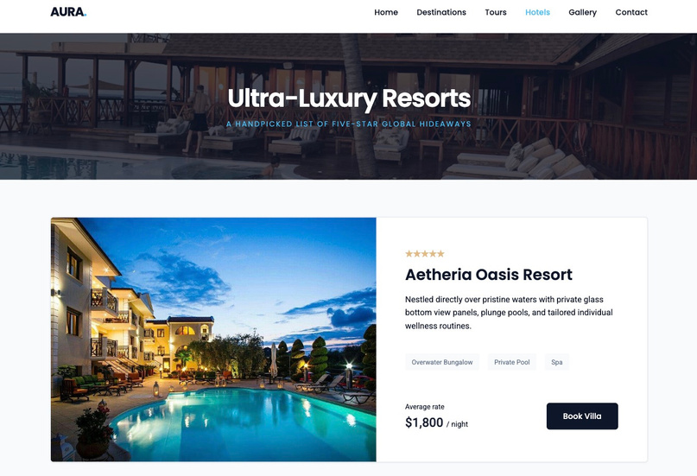
WEBSITE PAGES
Home
Destinations
Tours
Hotels
Gallery
Contact

Slide 5
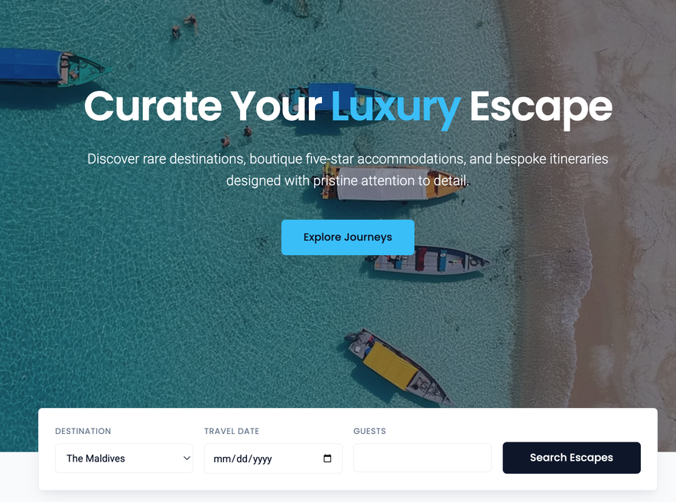
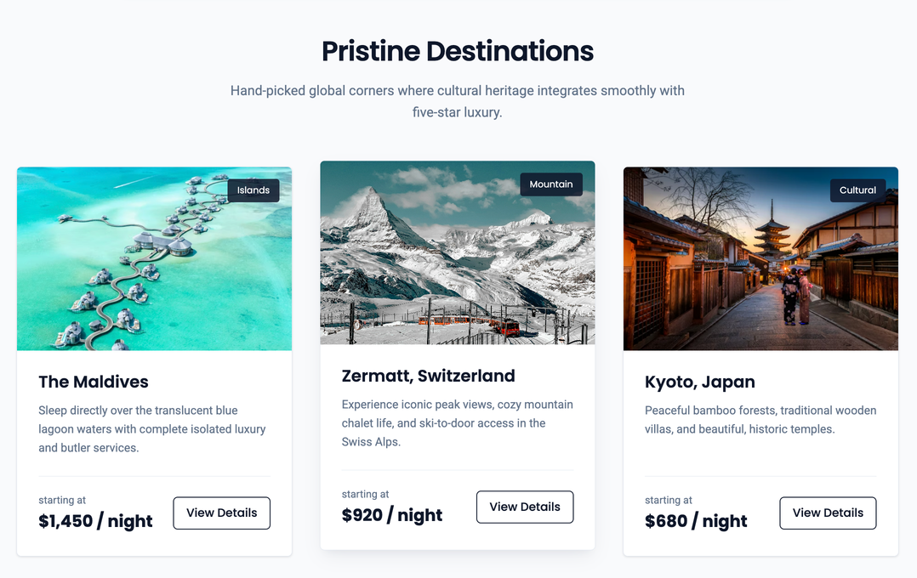
HOME PAGE
  Introduces the website
  Large hero image and main message
  Search box for destination, date, guests
  Button to explore journeys

Slide 6
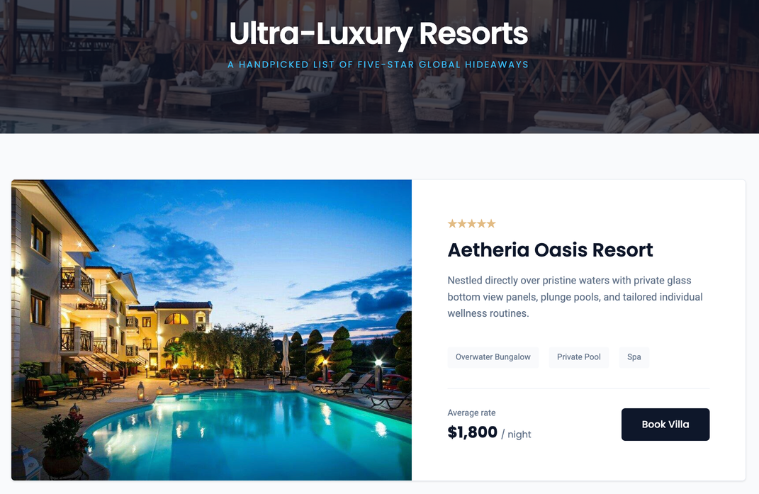
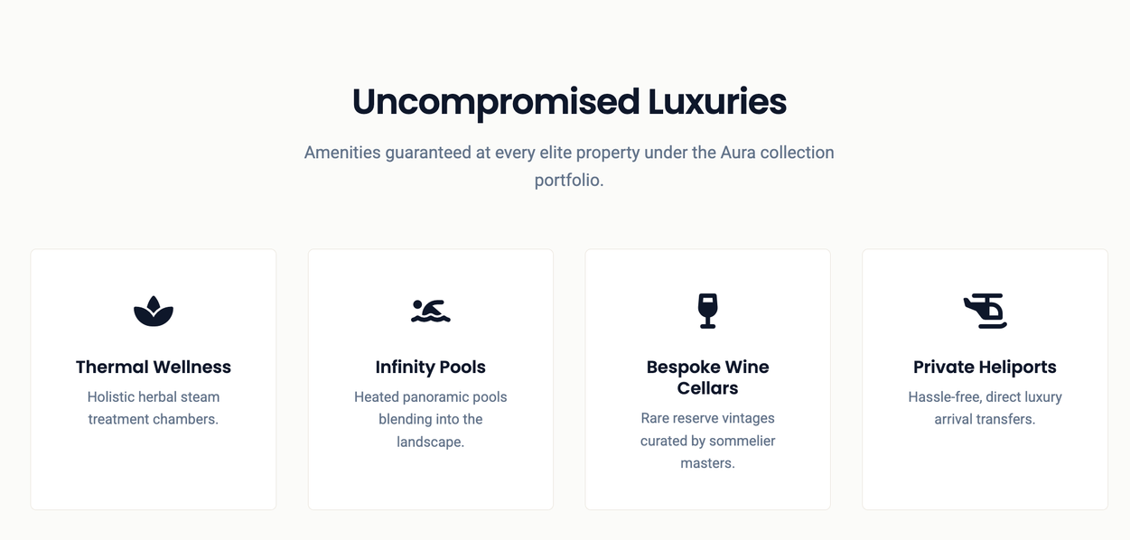
HOTELS PAGE
  Shows hotel options
  Each card has image, details, and price
  Buttons help users view or book hotels
  Amenities section shows hotel services
  Icons make services easy to understand

Slide 7
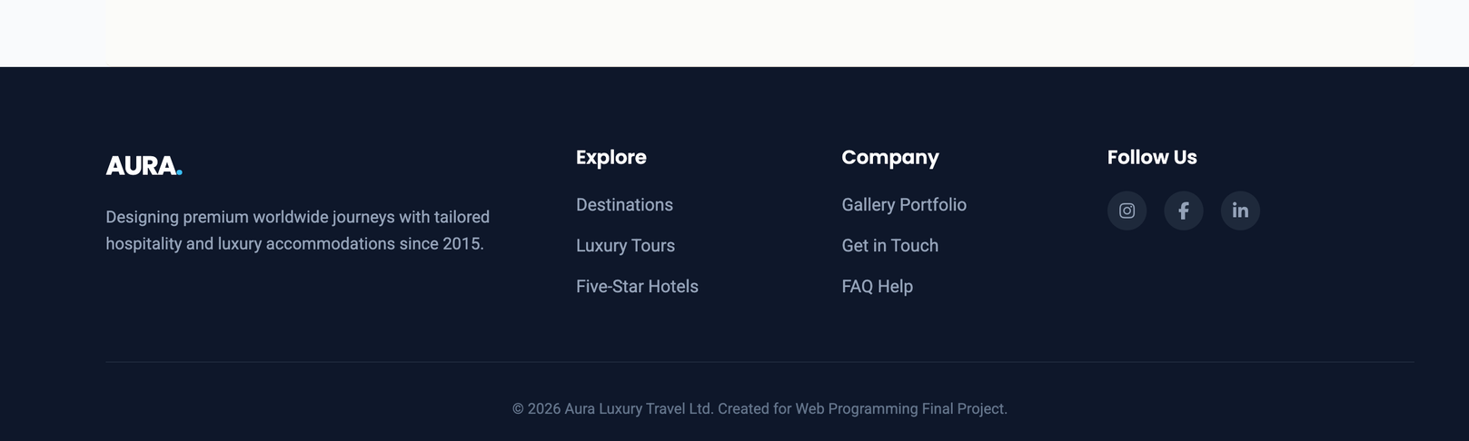
FOOTER SECTION
  Quick links
  Contact information
  Social media icons
  Same footer on all pages
  Website name / logo

Slide 8
HTML/CSS
HTML:
  section
  article
  img
  form
  input
  select
  footer
CSS:
  Flexbox / Grid
  Cards
  Buttons
  Hover effects
  Responsive layout

Slide 9
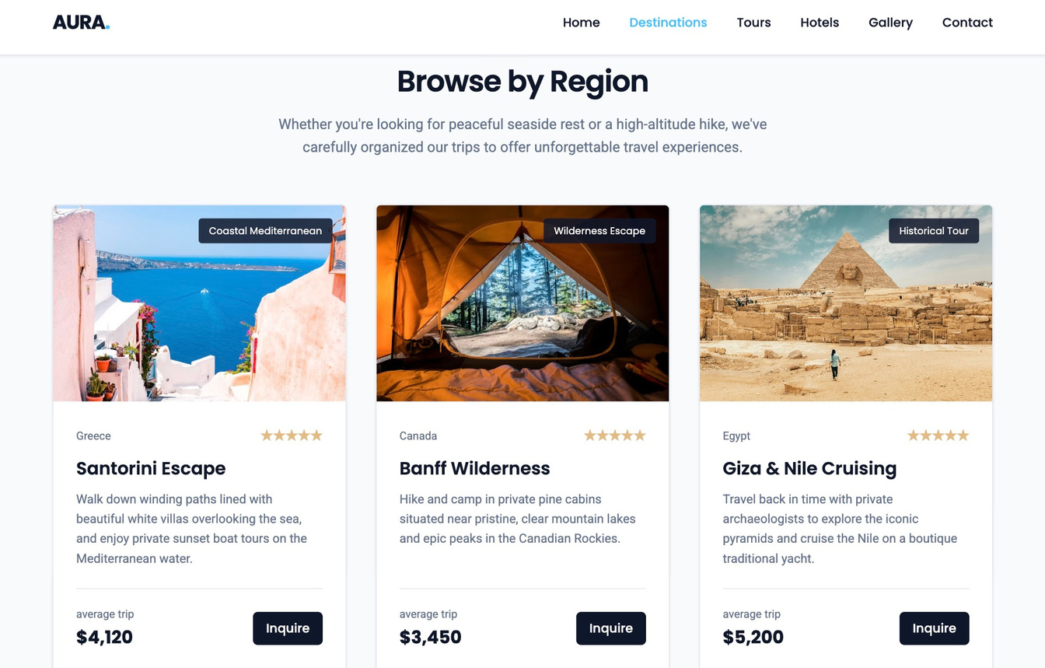
DESTINATIONS
  Travel destination cards
  Location images and
descriptions
  Ratings and pricing
  Explore button

Slide 10
TOURS
  Tour package cards
  Duration and price
information
  Travel highlights
  Booking button

Slide 11
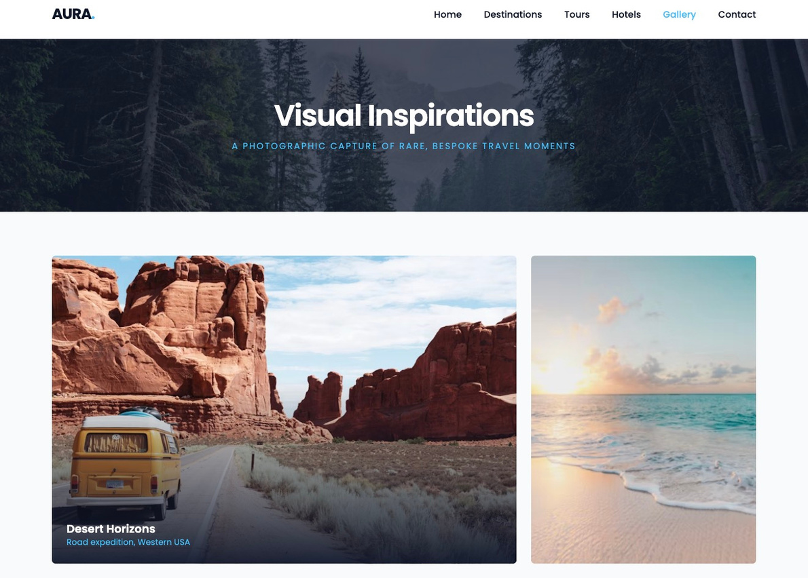
GALLERY PAGE
  Image grid layout
  Hover overlay effects
  Travel photography showcase
  Responsive design

Slide 12
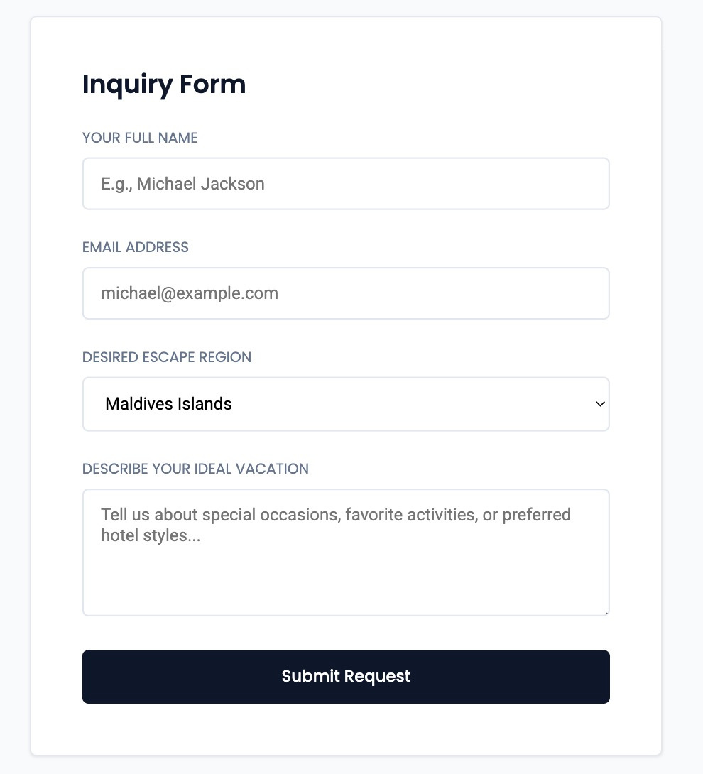
CONTACT US
  Name field
  Email field
  Destination selector
  Message box
  Submit button

Slide 13
THANK YOU
Aura Travel – Luxury Travel Agency Website

