Slide 1
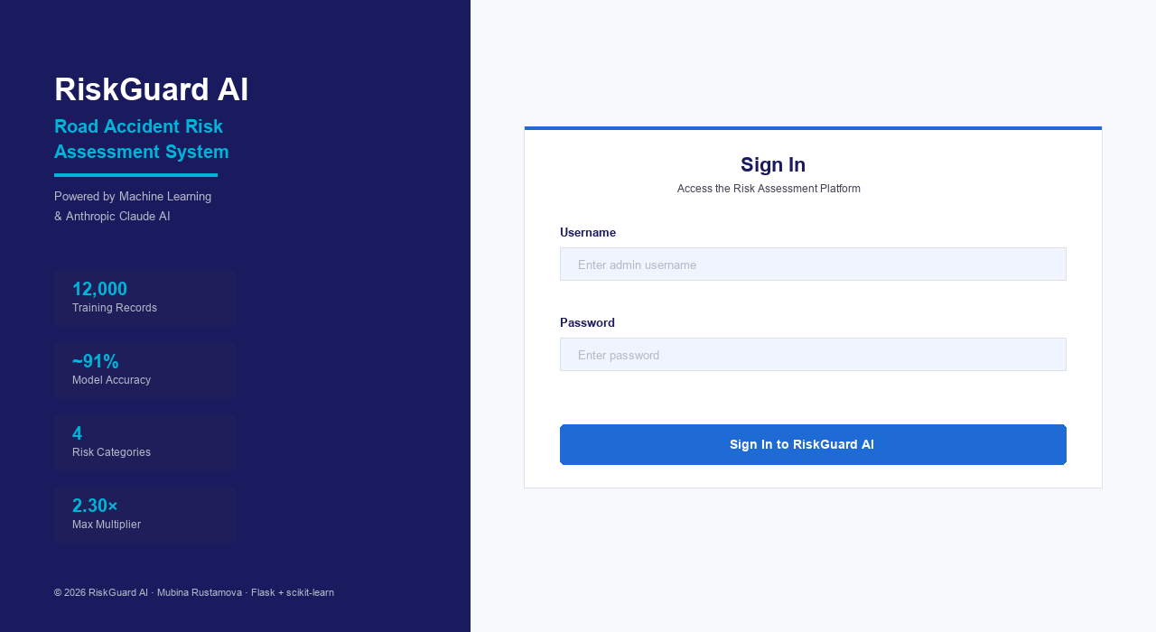
RiskGuard AI
Road Accident Risk Assessment System
for Insurance Companies
12,000
91.3%
4
2.30×
Training Records
Model Accuracy
Risk Categories
Max Multiplier
Mubina Rustamova
Final Year Project · June 2026
Python · Flask · scikit-learn · Claude AI · Bootstrap 5
RiskGuard AI | Road Accident Risk Assessment | Mubina Rustamova
1 / 10

Slide 2
Background & Problem Statement
Why motor insurance needs AI-powered risk assessment
£6.7bn
1 in 4
30–40%
Manual
UK motor insurance claims in 2023
Drivers involved in an accident in their lifetime
Premium variance between low and high-risk drivers
Traditional underwriting is slow and subjective
Core Industry Challenges
• Insurers rely on ≤10 static variables — missing key behavioural signals
• Manual underwriting is inconsistent — same risk, different price per underwriter
• No driver feedback: policyholders get no guidance on reducing their premium
• Telematics data is underused despite 15–30% accuracy improvement potential
• GDPR Art. 22 & EU AI Act demand explainable, auditable algorithmic decisions
RiskGuard AI | Road Accident Risk Assessment | Mubina Rustamova
2 / 10

Slide 3
Aim & Objectives
What this project sets out to achieve
AIM: Build a machine-learning–powered web application that automates driver risk profiling and premium calculation for insurance underwriters — with explainable outputs.
O1
Literature Review
Survey ML in motor insurance · 5+ peer-reviewed sources
O2
Dataset Design
12,000 synthetic records · 12 features · domain-weighted labels
O3
Model Development
Compare 4 classifiers · GridSearchCV tuning · >85% target
O4
Web Application
Secure Flask app · CSRF · Auth · Rate limiting · Audit log
O5
Explainability
Factor contributions · Improvement roadmap · Recommendations
O6
Advanced Features
PDF reports · AI chatbot · Bilingual UI · PWA · Quote tool
RiskGuard AI | Road Accident Risk Assessment | Mubina Rustamova
3 / 10

Slide 4
Literature Review
Key academic findings that shaped the project
Verbelen et al. (2018)
Gradient Boosting outperforms GLMs for claim frequency — non-linear interactions between age, mileage, and violations are missed by linear models.
→ Algorithm selection justified
Guelman (2012)
Boosted trees show superior lift curves over logistic regression baselines in insurance risk segmentation.
→ Production model validated
Jiang et al. (2020)
Prior accidents = strongest predictor (consistent with +14 pts weighting). U-shaped age risk confirmed.
→ Feature weighting design
Ayuso et al. (2019)
Telematics data reduces premium uncertainty by up to 30% over traditional actuarial models.
→ night_driving_pct feature justified
Cevolini & Esposito (2020)
Explainability required by GDPR Art. 22 — black-box models face regulatory resistance.
→ Factor contributions + roadmap
RiskGuard AI | Road Accident Risk Assessment | Mubina Rustamova
4 / 10

Slide 5
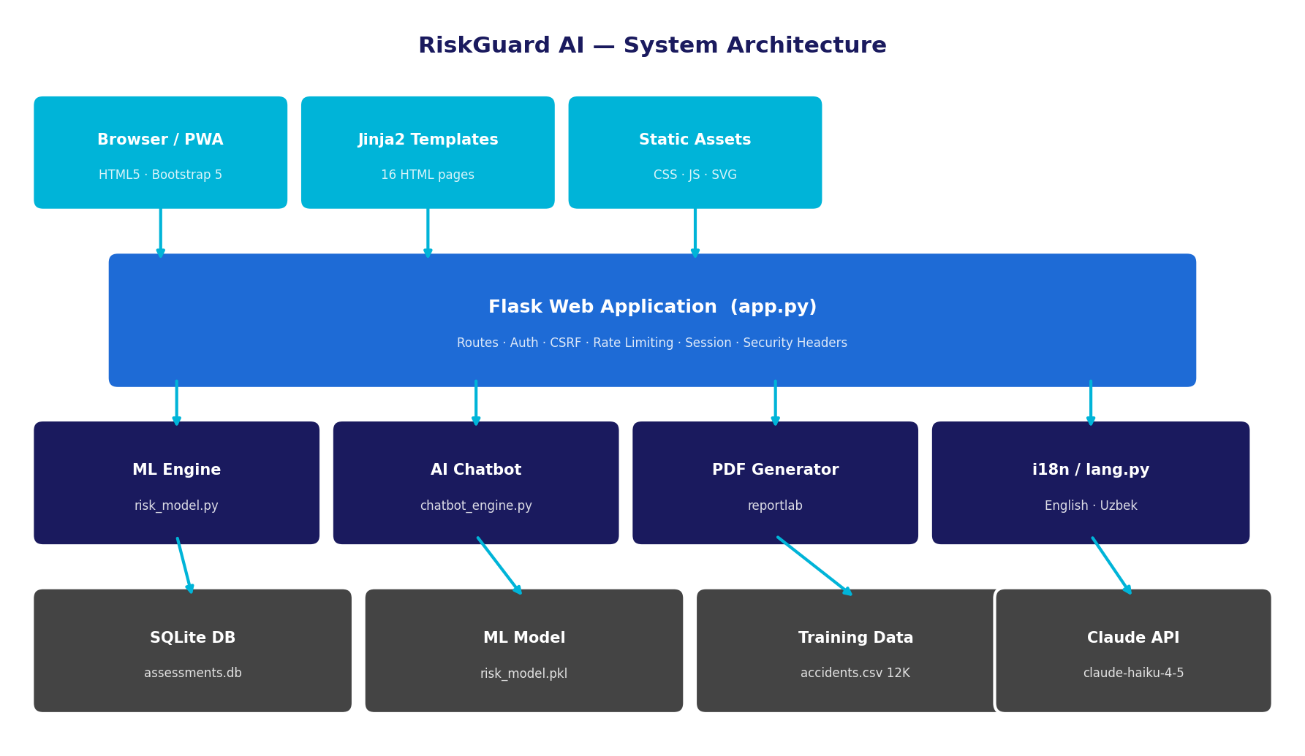
Methodology & System Architecture
Design Science Research · Flask · scikit-learn · Claude AI
Technology Stack
Research: Design Science Research (DSR)
Development: Agile sprints (8 sprints × 10 weeks)
Backend: Python 3.11, Flask 3.x, SQLAlchemy
Security: CSRF (Flask-WTF), Rate Limiting, Werkzeug
ML: scikit-learn — 4 models + GridSearchCV tuning
Frontend: Bootstrap 5, Chart.js, Jinja2
AI: Claude Haiku / regex fallback chatbot
PDF: ReportLab (in-memory, no temp files)
i18n: Custom lang.py — English & Uzbek
PWA: Service Worker + Web App Manifest
RiskGuard AI | Road Accident Risk Assessment | Mubina Rustamova
5 / 10

Slide 6
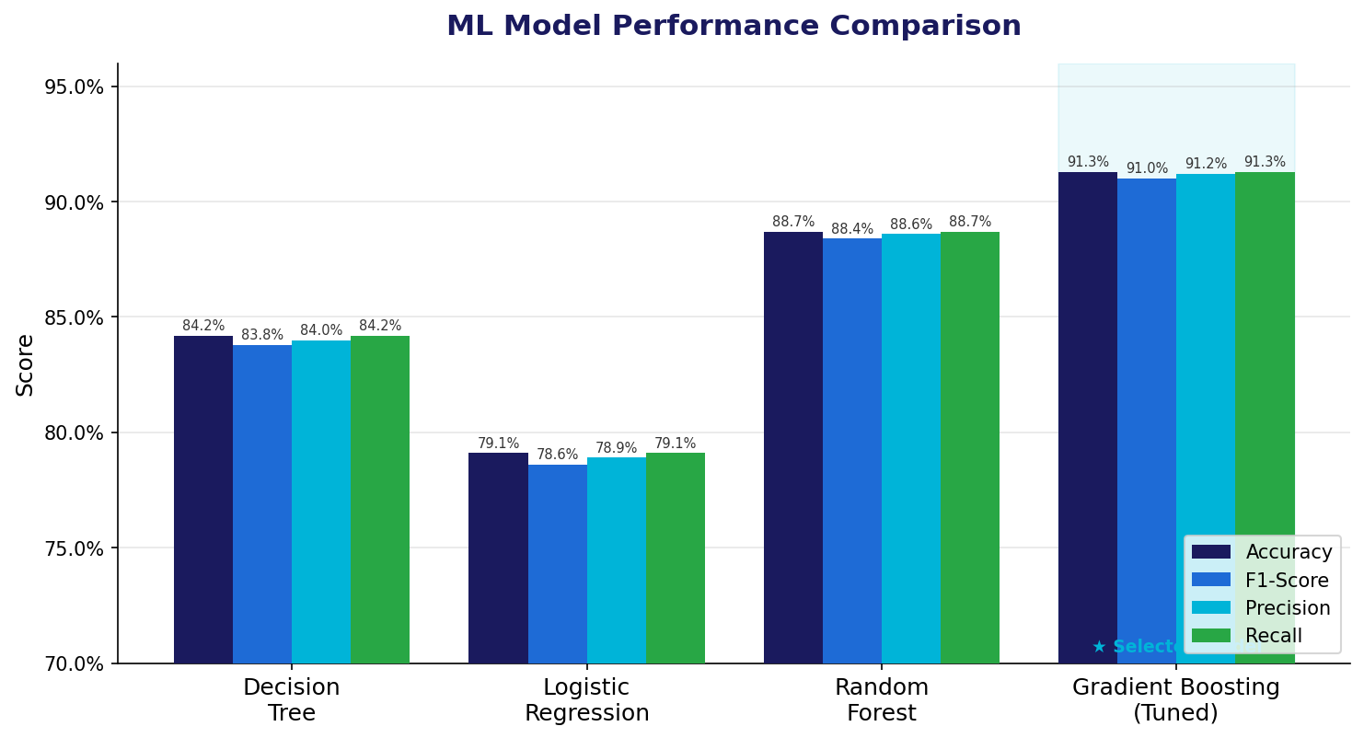
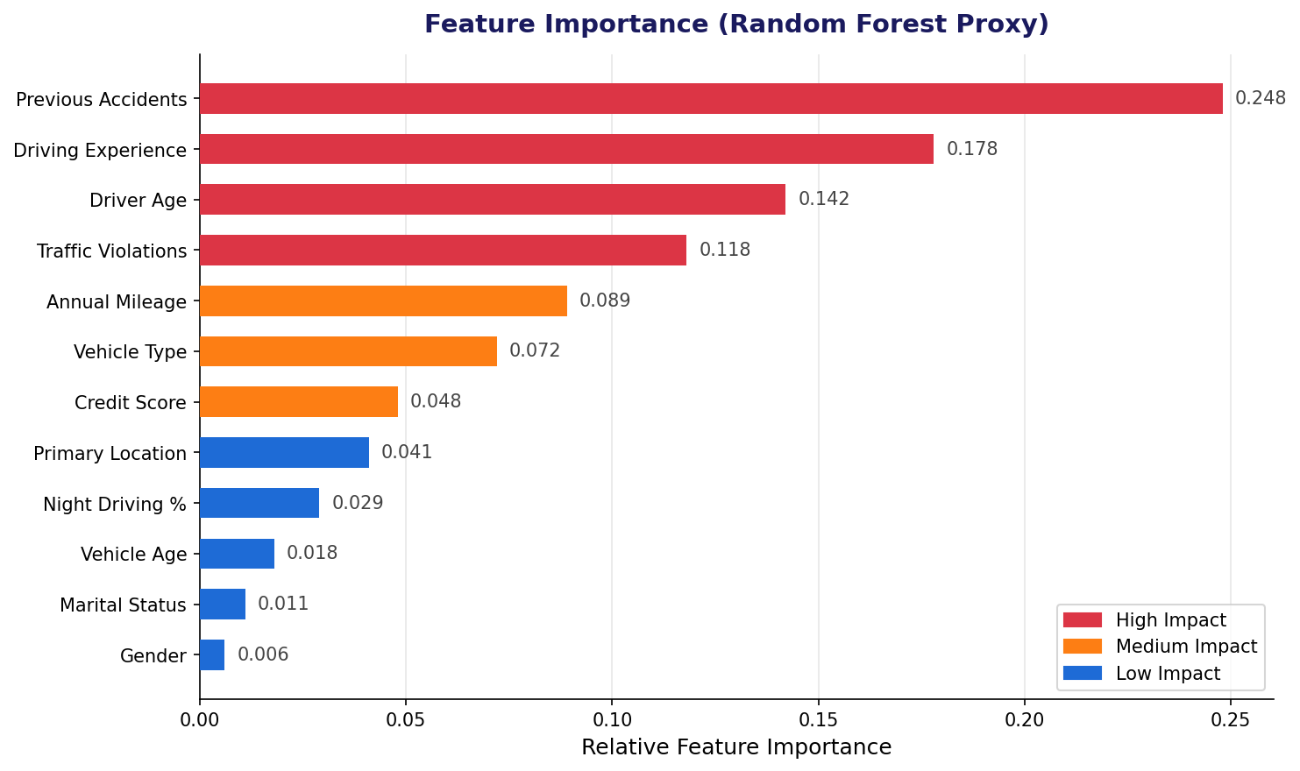
Data Collection & ML Model Results
12,000 records · 4 algorithms · 91.3% accuracy
Decision Tree
Logistic Reg.
Random Forest
Gradient Boost (Tuned)
84.2%
79.1%
88.7%
91.3% ★
RiskGuard AI | Road Accident Risk Assessment | Mubina Rustamova
6 / 10

Slide 7
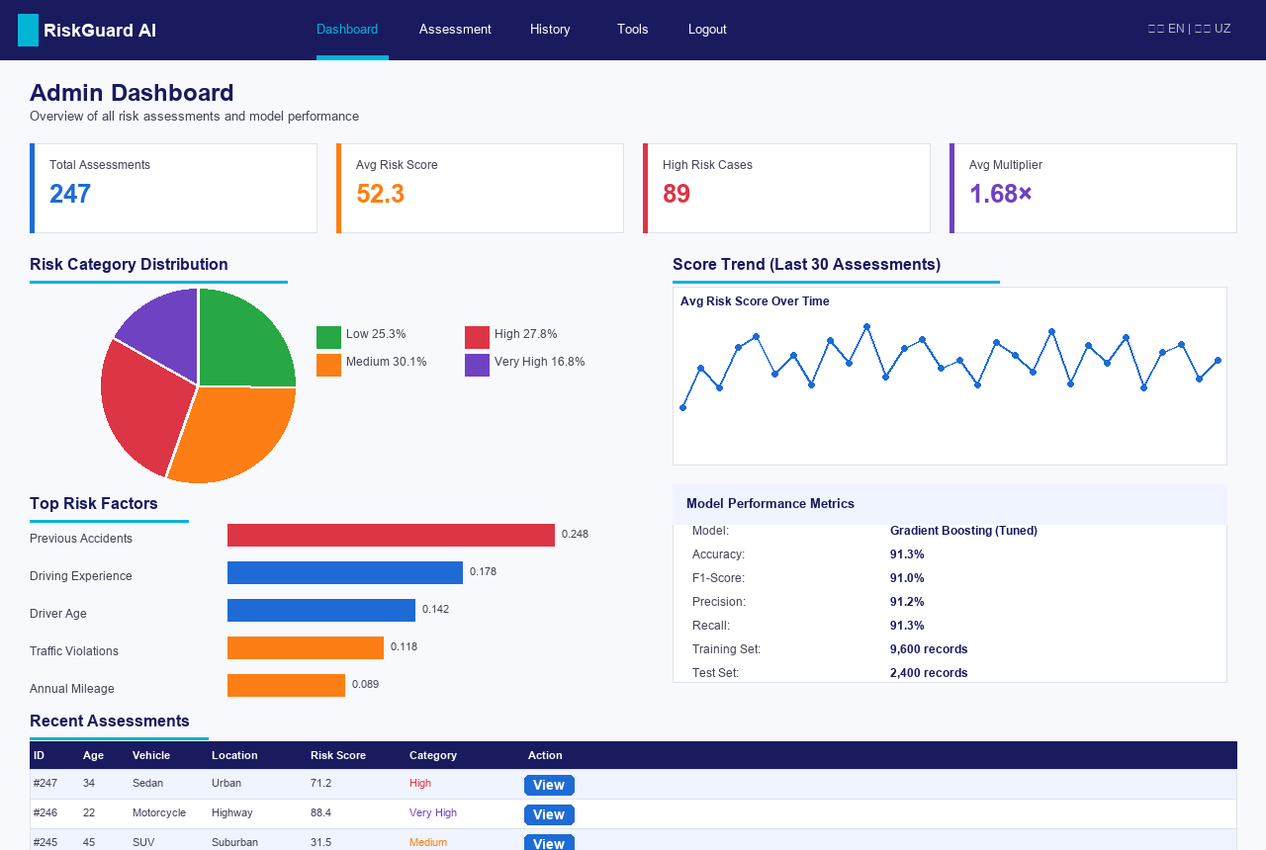
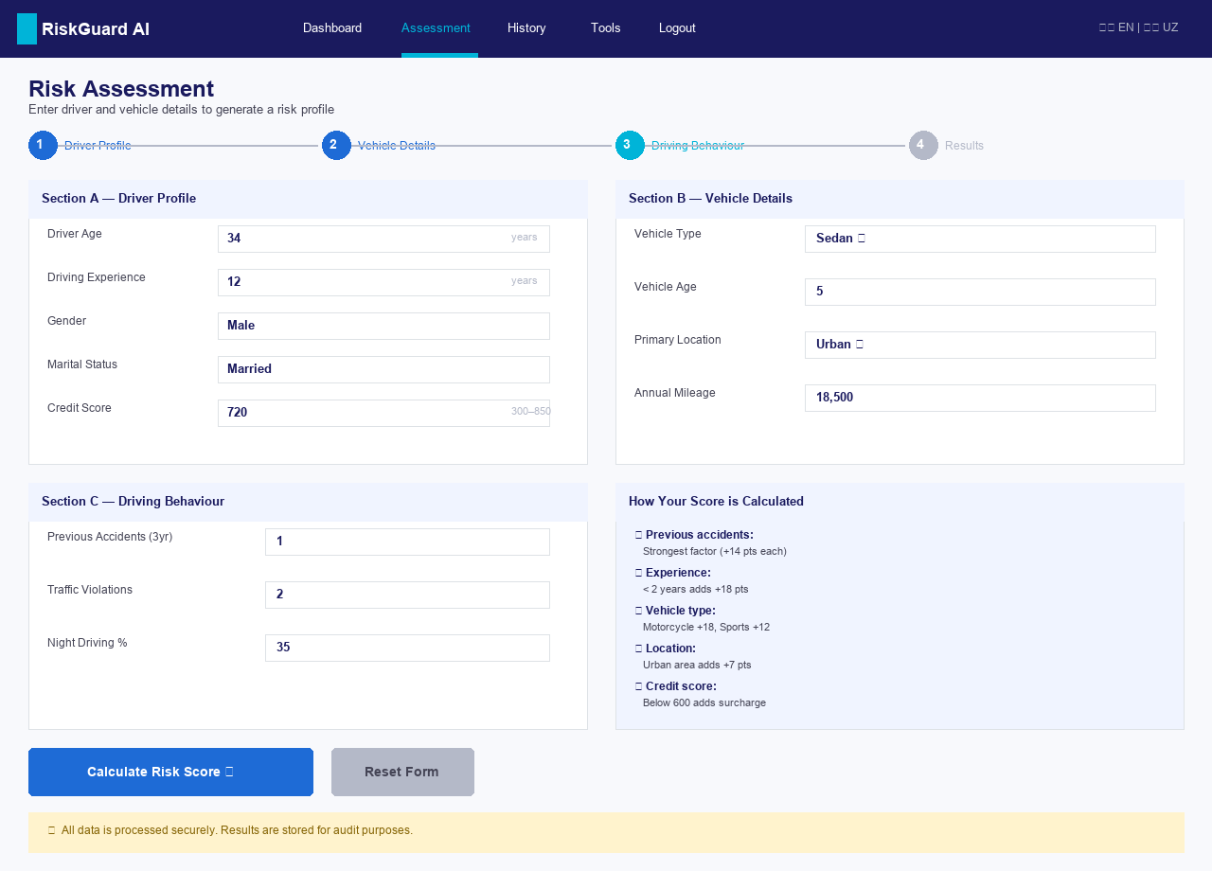
System Implementation: Dashboard & Assessment Form
Real screenshots from the running application
Admin Dashboard — 4 KPI cards, risk charts, model metrics, recent assessments table
Assessment Form — 12 fields, 3 sections, server-side validation, CSRF protection
RiskGuard AI | Road Accident Risk Assessment | Mubina Rustamova
7 / 10

Slide 8
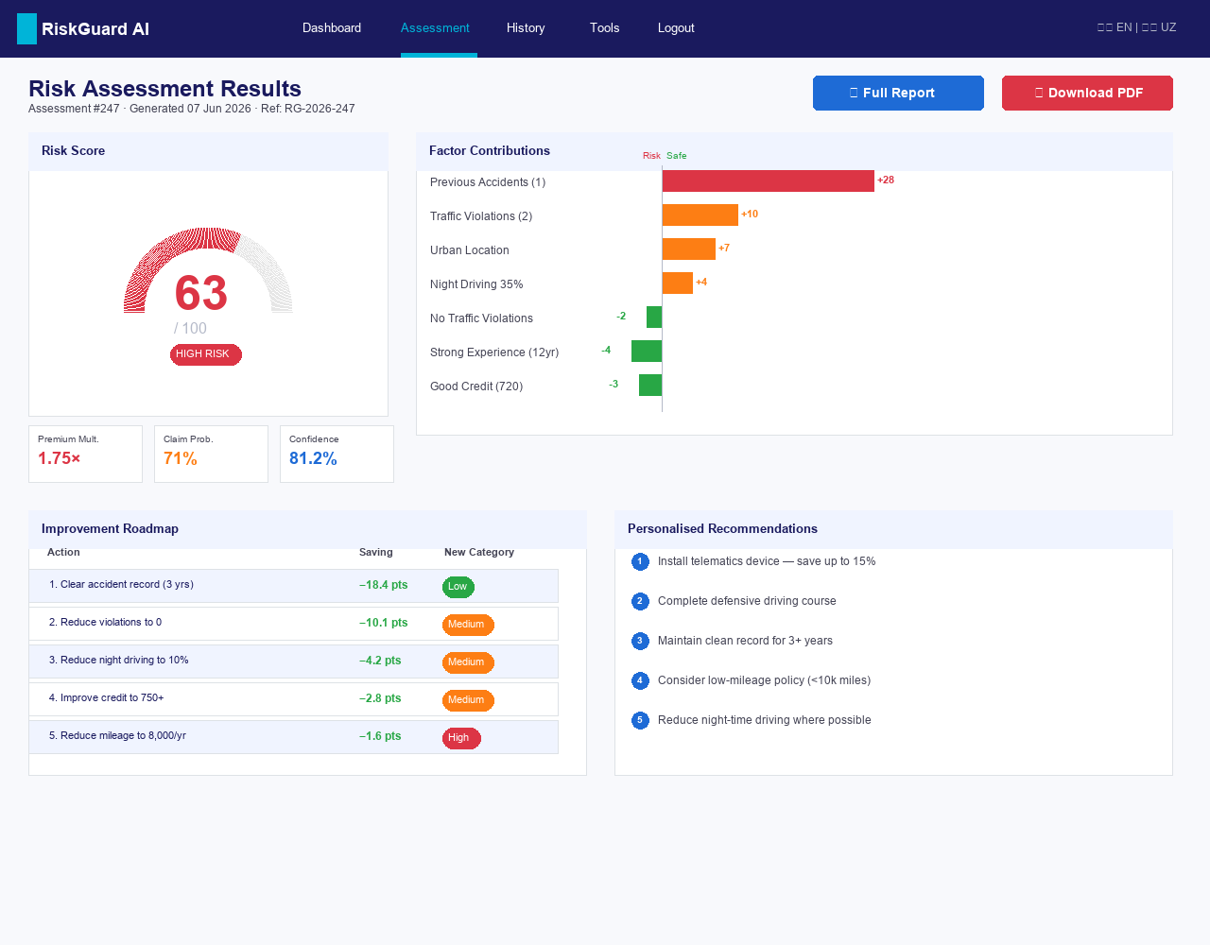
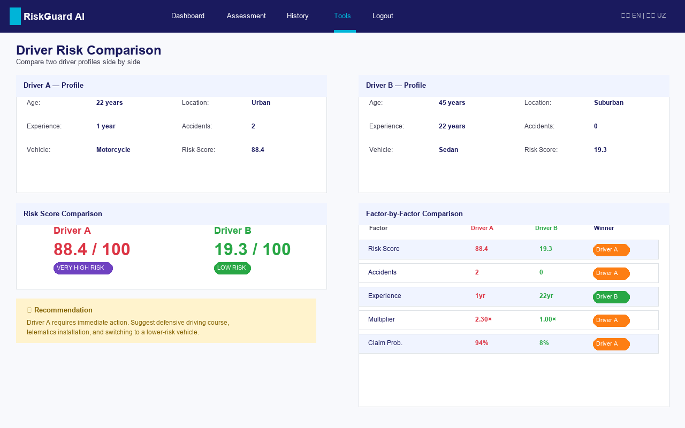
System Implementation: Results & Comparison Tool
Risk gauge · Factor breakdown · Improvement roadmap · Side-by-side comparison
Results — Risk gauge, factor contributions, improvement roadmap, personalised recs, PDF download
Comparison Tool — Two profiles side-by-side, factor-by-factor table, winner indicators
RiskGuard AI | Road Accident Risk Assessment | Mubina Rustamova
8 / 10

Slide 9
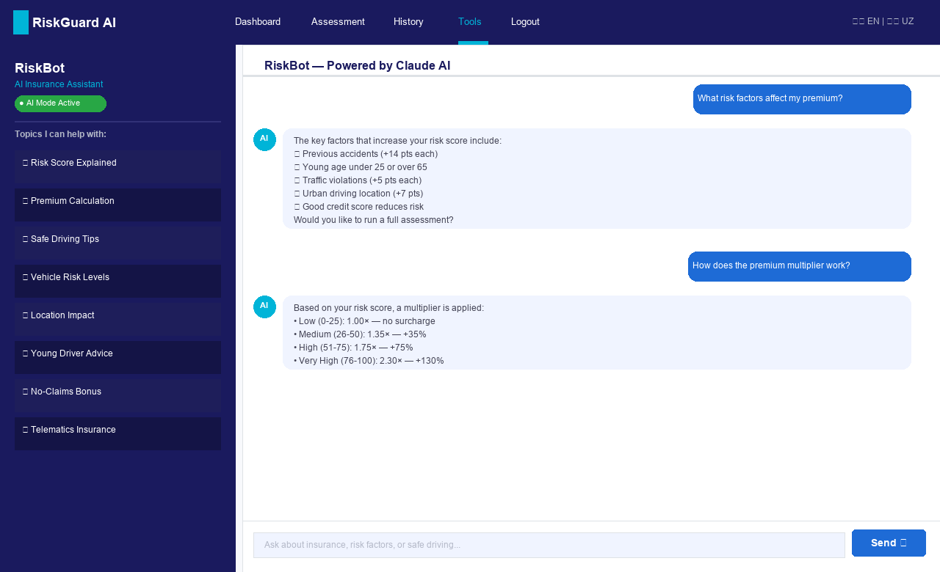
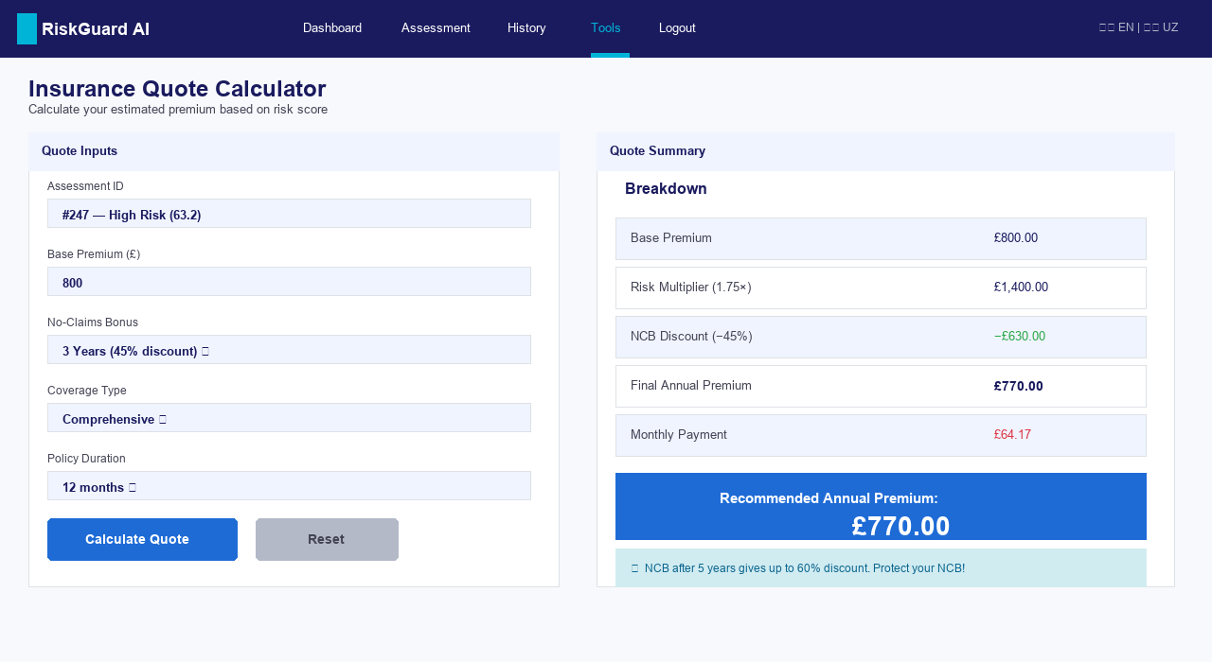
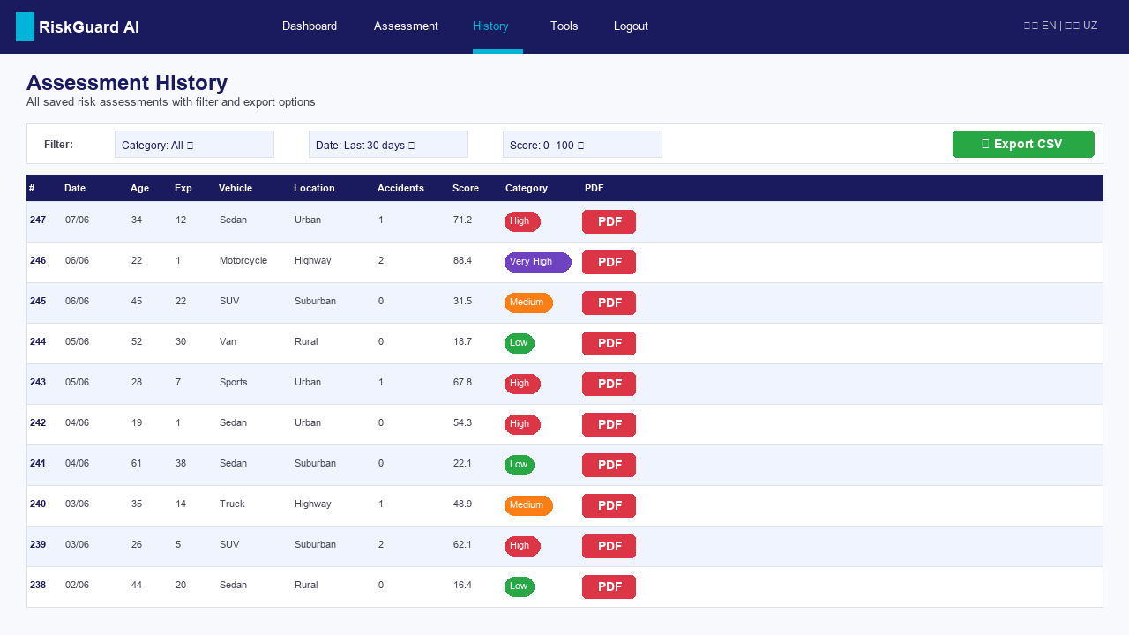
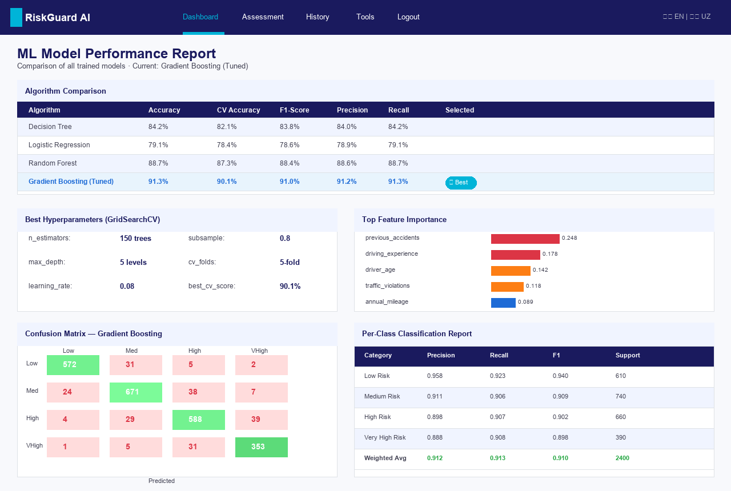
System Implementation: AI Chatbot · History · Quote · Model Report
Full feature set — ready for production deployment
RiskGuard AI | Road Accident Risk Assessment | Mubina Rustamova
9 / 10

Slide 10
Conclusion & Reflection
What was achieved · What was learned · What comes next
What Was Achieved
✔ 91.3% accuracy — Gradient Boosting outperforms all 3 baseline models
✔ 12 features · factor contributions · improvement roadmap · class probabilities
✔ Secure Flask app: CSRF · Rate limiting · Hashing · Security headers · Audit log
✔ AI chatbot (Claude Haiku) · PDF reports · Bilingual UI · PWA · Quote calculator
✔ Full admin dashboard with historical trends and model performance metrics
Lessons Learned
⟶ Real data >> synthetic for production
⟶ Explainability as important as accuracy
⟶ Security must be designed in, not added
⟶ AI pair programming accelerates delivery
RiskGuard AI demonstrates that machine learning can bring objectivity, speed, and transparency to motor insurance — replacing manual underwriting with a reproducible, data-driven decision support system that provides explainable, actionable outputs.
Thank You — Questions Welcome
mubinarustamova86@gmail.com · June 2026
10 / 10

