Slide 1
Rekomme
AI Shopping Assistant Powered by Real Community Opinions
Stop guessing. Start buying what real people actually recommend.

Slide 2
The Problem
95% of online shoppers read reviews before buying.
But 42% of those reviews are fake, paid, or manipulated.
Fake Reviews
Information Overload
No Trusted Source
Amazon, Google reviews
are gamed by sellers
100+ reviews per product.
No one reads them all.
Where do real users
honestly discuss products?
The real opinions are on Reddit, YouTube, and niche forums — but scattered and hard to find.

Slide 3
Our Solution
One AI assistant that reads thousands of real community discussions
and gives you trusted, sourced product recommendations in seconds.
Community Intelligence
Live Market Data
Expert + Video Reviews
Price Tracking
Analyzes Reddit threads,
forums, and discussions
Real-time prices from
Google Shopping + merchants
News articles and YouTube
reviews auto-attached
Track price trends and
find the best time to buy
Every recommendation cites its source — users can verify and trust.

Slide 4
Why Reddit?
Reddit is the largest collection of unfiltered, honest product opinions on the internet.
Google now prioritizes Reddit results for shopping queries. Reddit IPO'd at $6.5B on this data.
Unbiased Opinions
Long-Term Reviews
Community Validation
Reddit users have no financial
incentive. No affiliate links,
no sponsored posts, no seller
manipulation.
Users discuss products after
months of ownership — not
day-one hype. Real durability,
comfort, and quality insights.
Upvotes and downvotes act as
crowdsourced quality filters.
Bad advice gets buried,
good advice rises.
r/HeadphoneAdvice alone has 1M+ members sharing daily product comparisons and honest reviews.

Slide 5
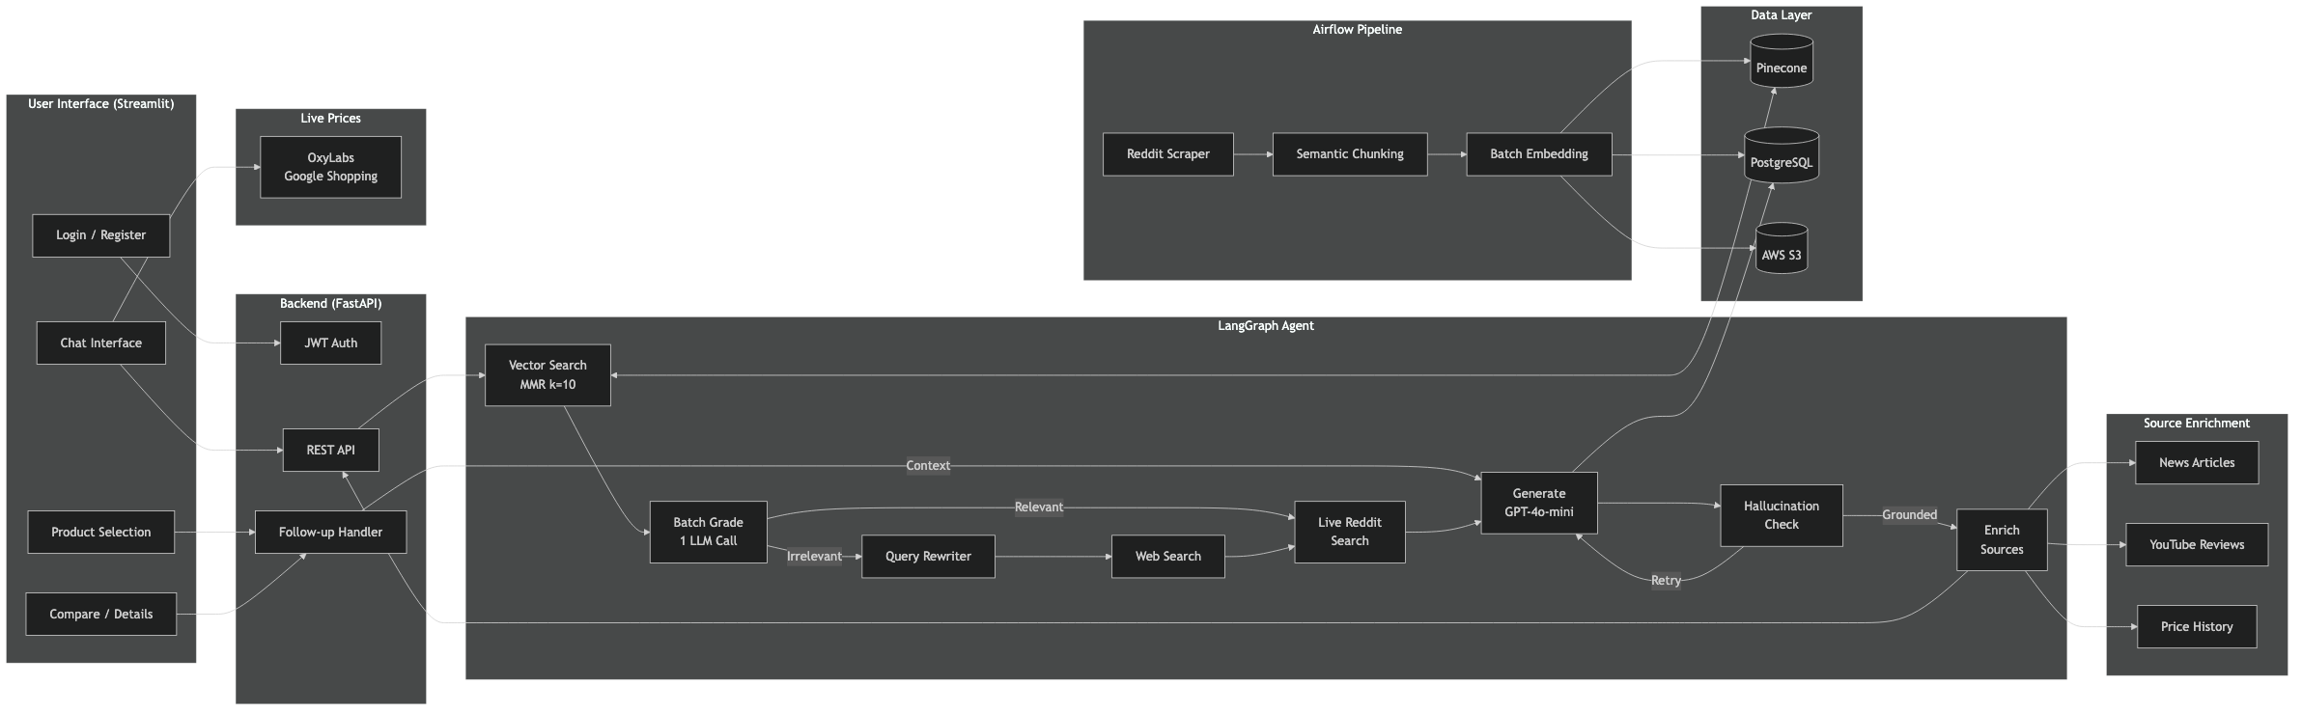
System Architecture
Streamlit UI > FastAPI Backend > LangGraph Agent > Multi-Source Enrichment > Data Layer

Slide 6
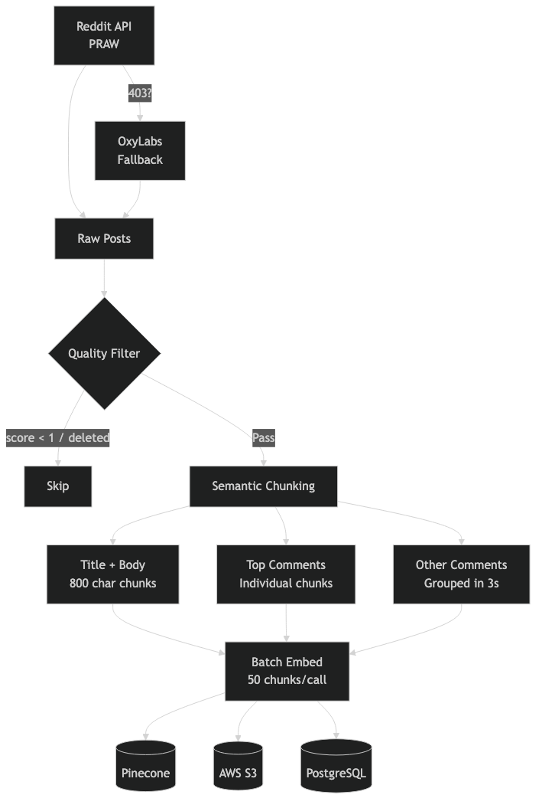
Data Pipeline

Slide 7
How We Scale
Phase 1: Headphones
Phase 2: Consumer Electronics
Phase 3: All Categories
Phase 4: Platform + API
Prove the model in one
high-engagement category.
r/HeadphoneAdvice = 1M+ members
Expand to laptops, keyboards,
cameras, smart home.
Same pipeline, new subreddits.
Fashion, skincare, fitness gear.
Any category with community
discussions.
Let other apps and AI agents
use Rekomme as a tool
via MCP / API.
Each new category = same tech stack + new data source. Scales horizontally with minimal effort.

Slide 8
MCP: The Distribution Play
Rekomme as an MCP Server = every AI assistant becomes a distribution channel.
User → Claude / GPT / Cursor → Calls Rekomme MCP Tool → Products + Reviews + Prices
AI Assistants
E-commerce Sites
Browser Extensions
Claude, GPT, Copilot
add shopping as
a native tool
Embed community-backed
reviews directly on
product pages
Show Reddit community
opinion while browsing
any store
Zero integration effort for end users — AI agents auto-discover and use the tool.

Slide 9
Rekomme
The shopping assistant that reads the internet
so you don't have to.
github.com/mubinmodi/AI-shopping-assistant
Built with LangGraph + GPT-4o-mini + Pinecone + Tavily

