Slide 1










Slide 2


















Slide 3
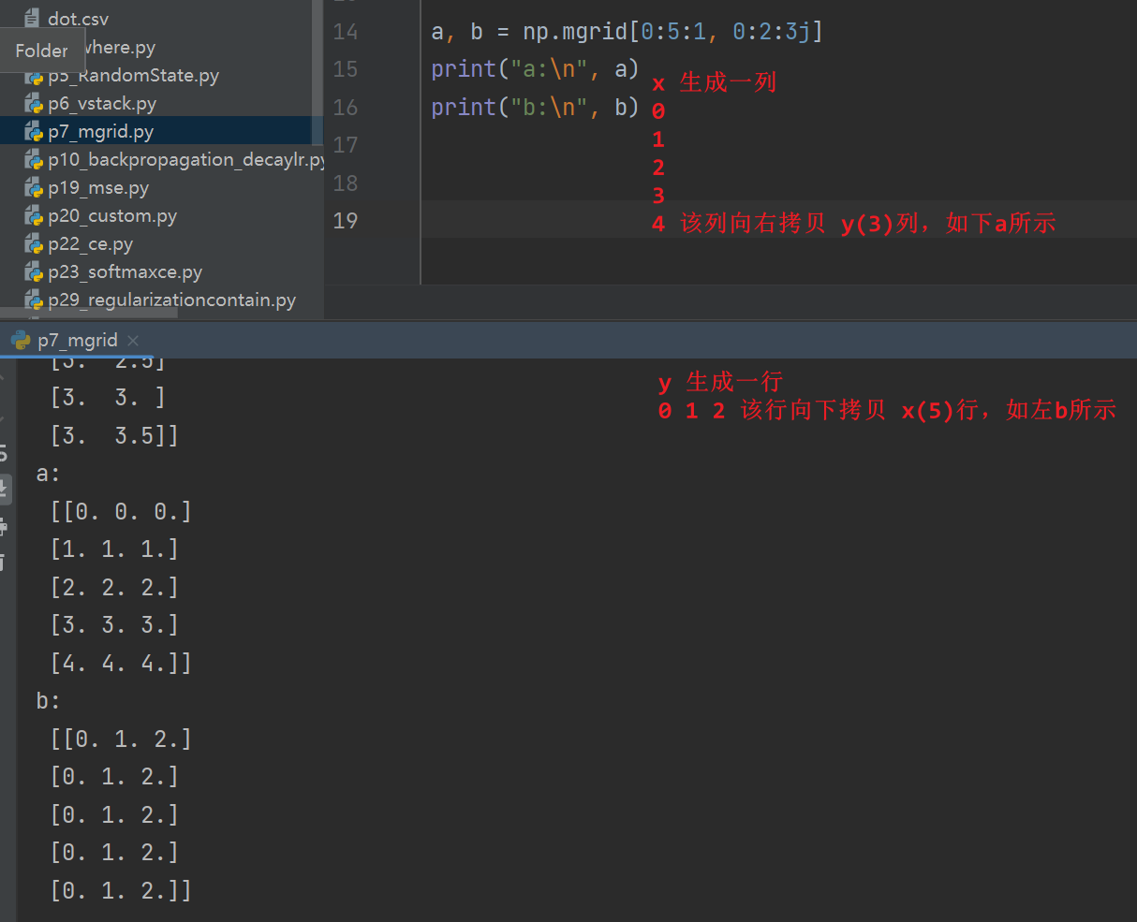

Slide 4
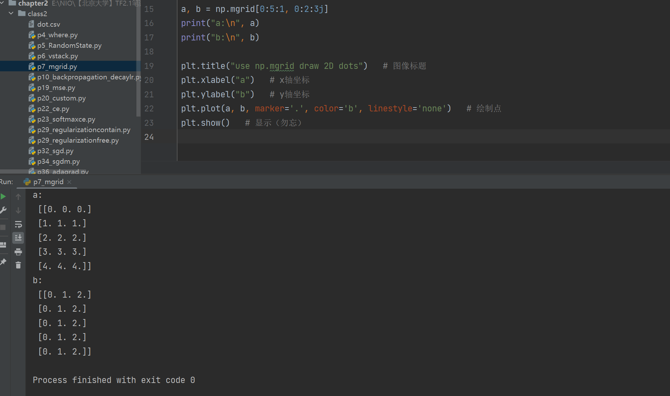
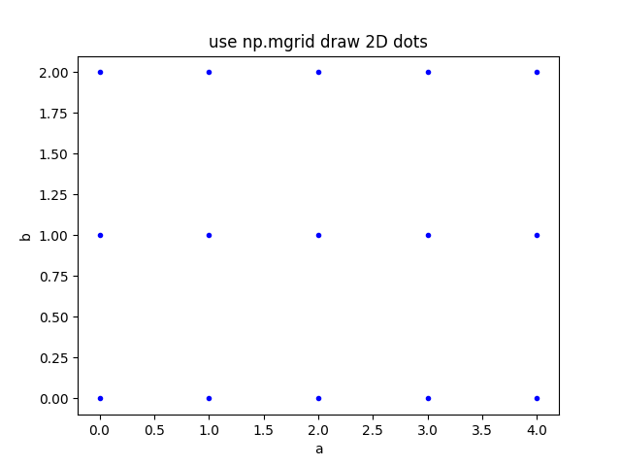
参考：
[1] https://xiaoiedu.blog.csdn.net/article/details/109526042
[2] https://blog.csdn.net/naruhina/article/details/106824118

