Slide 1
COM/BLM 376 Computer Architecture Chapter 1 Introduction
Asst. Prof. Dr. Gazi Erkan BOSTANCI
ebostanci@ankara.edu.tr
Slides are mainly based on
Computer Organization and Architecture: Designing for Performance by William Stallings, 9th Edition, Prentice Hall

Slide 2
Why Study Computer Organization and Architecture?
Computer Engineering 2004 Curriculum Guidelines
‘Computer architecture is a key component of computer engineering and the practicing computer engineer should have a practical understanding of this topic.’

Slide 3
Why Study Computer Organization and Architecture?
More reasons to consider:
Suppose a graduate enters the industry and is asked to select the most cost effective computer for use throughout a large organization. An understanding of the implications of spending more for various alternatives, such as a larger cache or a higher processor clock rate, is essential to making the decision.
Many processors are not used in PCs or servers but in embedded systems. A designer may program a processor in C that is embedded in some real-time or larger system, such as an intelligent automobile electronics controller. Debugging the system may require the use of a logic analyzer that displays the relationship between interrupt requests from engine sensors and machine level code.
Concepts used in computer architecture find application in other courses. In particular, the way in which the computer provides architectural support for programming languages and operating system facilities reinforces concepts from those areas.
Still not convinced? It is a MUST course in our curriculum! ☺

Slide 4
Organization and Architecture
In describing computers, a distinction is often made between computer architecture and computer organization.
Computer architecture refers to those attributes of a system visible to a programmer or, put another way, those attributes that have a direct impact on the logical execution of a program.
Computer organization refers to the operational units and their interconnections that realize the architectural specifications.
Examples of architectural attributes include the instruction set, the number of bits used to represent various data types (e.g., numbers, characters), I/O mechanisms, and techniques for addressing memory.
Organizational attributes include those hardware details transparent to the programmer, such as control signals; interfaces between the computer and peripherals; and the memory technology used.

Slide 5
Historically, and still today, the distinction between architecture and organization has been an important one. Many computer manufacturers offer a family of computer models, all with the same architecture but with differences in organization.
Consequently, the different models in the family have different price and performance characteristics.
Furthermore, a particular architecture may span many years and encompass a number of different computer models, its organization changing with changing technology.

Slide 6
Structure and Function
A computer is a complex system; contemporary computers contain millions of elementary electronic components. How, then, can one clearly describe them?
The key is to recognize the hierarchical nature of most complex systems, including the computer. A hierarchical system is a set of interrelated subsystems, each of the latter, in turn, hierarchical in structure until we reach some lowest level of elementary subsystem.

Slide 7
The hierarchical nature of complex systems is essential to both their design and their description.
The designer need only deal with a particular level of the system at a time.
At each level, the system consists of a set of components and their interrelationships. We are concerned with structure and function:
Structure: The way in which the components are interrelated.
Function: The operation of each individual component as part of the structure.
In terms of description, we have two choices: starting at the bottom and building up to a complete description, or beginning with a top view and decomposing the system into its subparts. Evidence from a number of fields suggests that the top-down approach is the clearest and most effective.

Slide 8
Function
The functioning of a computer are the basic functions that a computer can perform. In general terms, there are only four:
Data processing
Data storage
Data movement
Control

Slide 9
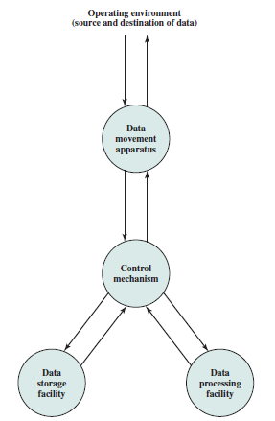
A Functional View of the Computer

Slide 10
The computer must be able to process data. The data may take a wide variety of forms, and the range of processing requirements is broad. However, we shall see that there are only a few fundamental methods or types of data processing.
It is also essential that a computer store data. Even if the computer is processing data on the fly (i.e., data come in and get processed, and the results go out immediately), the computer must temporarily store at least those pieces of data that are being worked on at any given moment. Thus, there is at least a short-term data storage function. Equally important, the computer performs a long-term data storage function. Files of data are stored on the computer for subsequent retrieval and update.

Slide 11
The computer must be able to move data between itself and the outside world. The computer’s operating environment consists of devices that serve as either sources or destinations of data. When data are received from or delivered to a device that is directly connected to the computer, the process is known as input–output (I/O), and the device is referred to as a peripheral. When data are moved over longer distances, to or from a remote device, the process is known as data communications.
Finally, there must be control of these three functions. Ultimately, this control is exercised by the individual(s) who provides the computer with instructions. Within the computer, a control unit manages the computer’s resources and orchestrates the performance of its functional parts in response to those instructions.

Slide 12
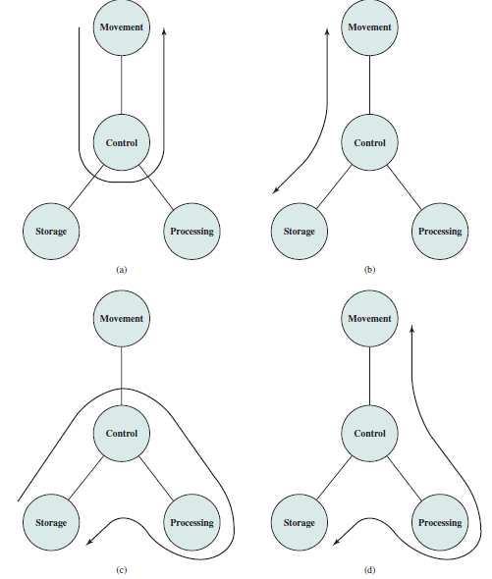
Possible Computer Operations
The computer can function as a data movement device (a), simply transferring data from one peripheral or communication line to another.
It can also function as a data storage device (b), with data transferred from the external environment to computer storage (read) and vice versa (write).
The final two diagrams show operations involving data processing, on data either in storage (c) or en route between storage and the external environment (d).

Slide 13
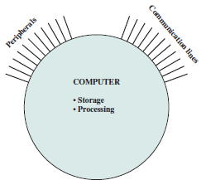
Structure
The computer interacts in some fashion with its external environment. In general, all of its linkages to the external environment can be classified as peripheral devices or communication lines.

Slide 14
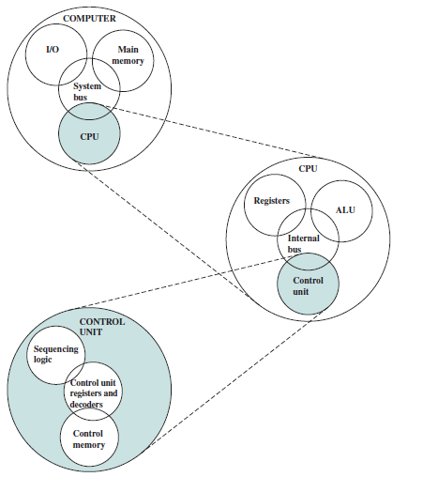
The Computer: Top-Level Structure
In this course, we are more interested in the internal structure

Slide 15
Main Structural Components
Central processing unit (CPU): Controls the operation of the computer and performs its data processing functions; often simply referred to as processor.
Main memory: Stores data.
I/O: Moves data between the computer and its external environment.
System interconnection: Some mechanism that provides for communication among CPU, main memory, and I/O. A common example of system interconnection is by means of a system bus, consisting of a number of conducting wires to which all the other components attach.

Slide 16
Traditionally, there has been just a single processor. In recent years, there has been increasing use of multiple processors in a single computer.
Each of these components will be examined later. However, for our purposes, the most interesting and in some ways the most complex component is the CPU. Its major structural components are as follows:
Control unit: Controls the operation of the CPU and hence the computer.
Arithmetic and logic unit (ALU): Performs the computer’s data processing functions.
Registers: Provides storage internal to the CPU.
CPU interconnection: Some mechanism that provides for communication among the control unit, ALU, and registers.

Slide 17
Each of these components will be examined later, where we will see that complexity is added by the use of parallel and pipelined organizational techniques.
Finally, there are several approaches to the implementation of the control unit; one common approach is a microprogrammed implementation.
In essence, a microprogrammed control unit operates by executing microinstructions that define the functionality of the control unit.

