Slide 1
Chapter 1
Databases and Database Users

Slide 2
Chapter 1 Outline
Introduction
An Example
Characteristics of the Database Approach
Actors on the Scene
Workers behind the Scene
Advantages of Using the DBMS Approach
A Brief History of Database Applications
When Not to Use a DBMS

Slide 3
Overview
Traditional database applications
Store textual or numeric information
Multimedia databases
Store images, audio clips, and video streams digitally
Geographic information systems (GIS)
Store and analyze maps, weather data, and satellite images

Slide 4
Overview (cont'd.)
Data warehouses and online analytical processing (OLAP) systems
Extract and analyze useful business information from very large databases
Support decision making
Real-time and active database technology
Control industrial and manufacturing processes

Slide 5
Introduction
Database
Collection of related data
Known facts that can be recorded and that have implicit meaning
Miniworld or universe of discourse (UoD)
Represents some aspect of the real world
Logically coherent collection of data with inherent meaning
Built for a specific purpose

Slide 6
Introduction (cont'd.)
Example of a large commercial database
Amazon.com
Database management system (DBMS)
Collection of programs
Enables users to create and maintain a database
Defining a database
Specify the data types, structures, and constraints of the data to be stored

Slide 7
Introduction (cont'd.)
Meta-data
Database definition or descriptive information
Stored by the DBMS in the form of a database catalog or dictionary
Manipulating a database
Query and update the database miniworld
Generate reports

Slide 8
Introduction (cont'd.)
Sharing a database
Allow multiple users and programs to access the database simultaneously
Application program
Accesses database by sending queries to DBMS
Query
Causes some data to be retrieved

Slide 9
Introduction (cont'd.)
Transaction
May cause some data to be read and some data to be written into the database
Protection includes:
System protection
Security protection
Maintain the database system
Allow the system to evolve as requirements change over time

Slide 10
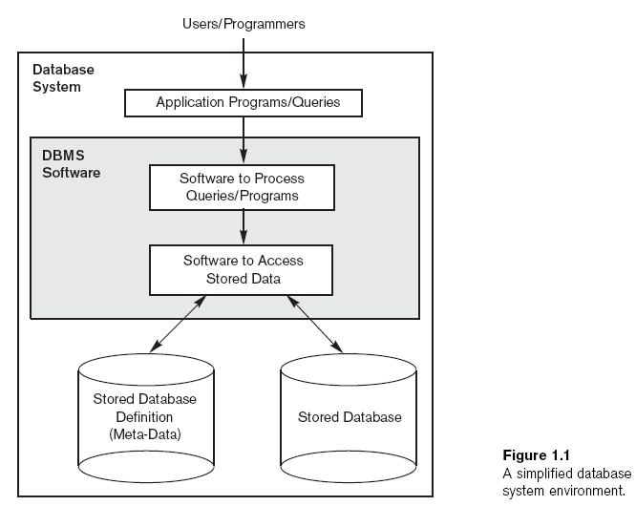

Slide 11
An Example
UNIVERSITY database
Information concerning students, courses, and grades in a university environment
Data records
STUDENT
COURSE
SECTION
GRADE_REPORT
PREREQUISITE

Slide 12
An Example (cont'd.)
Specify structure of records of each file by specifying data type for each data element
String of alphabetic characters
Integer
Etc.

Slide 13
An Example (cont'd.)
Construct UNIVERSITY database
Store data to represent each student, course, section, grade report, and prerequisite as a record in appropriate file
Relationships among the records
Manipulation involves querying and updating

Slide 14
An Example (cont'd.)
Examples of queries:
Retrieve the transcript
List the names of students who took the section of the ‘Database’ course offered in spring 2021 and their grades in that section
List the prerequisites of the ‘Database’ course

Slide 15
An Example (cont'd.)
Examples of updates:
Change the class of ‘Smith’ to sophomore
Create a new section for the ‘Database’ course for this semester
Enter a grade of ‘A’ for ‘Smith’ in the ‘Database’ section of last semester

Slide 16
An Example (cont'd.)
Phases for designing a database:
Requirements specification and analysis
Conceptual design
Logical design
Physical design

Slide 17
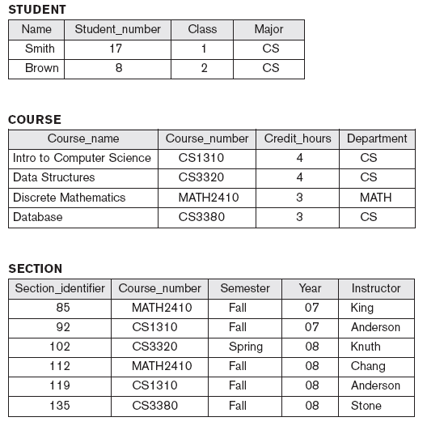
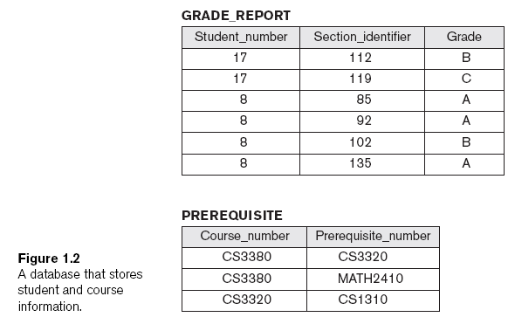

Slide 18
Characteristics of the Database Approach
Traditional file processing
Each user defines and implements the files needed for a specific software application
Database approach
Single repository maintains data that is defined once and then accessed by various users

Slide 19
Characteristics of the Database Approach (cont'd.)
Main characteristics of database approach
Self-describing nature of a database system
Insulation between programs and data, and data abstraction
Support of multiple views of the data
Sharing of data and multiuser transaction processing

Slide 20
Self-Describing Nature of a Database System
Database system contains complete definition of structure and constraints
Meta-data
Describes structure of the database
Database catalog used by:
DBMS software
Database users who need information about database structure

Slide 21
Insulation Between Programs and Data
Program-data independence
Structure of data files is stored in DBMS catalog separately from access programs
Program-operation independence
Operations specified in two parts:
Interface includes operation name and data types of its arguments
Implementation can be changed without affecting the interface

Slide 22
Data Abstraction
Data abstraction
Allows program-data independence and program-operation independence
Conceptual representation of data
Does not include details of how data is stored or how operations are implemented
Data model
Type of data abstraction used to provide conceptual representation

Slide 23
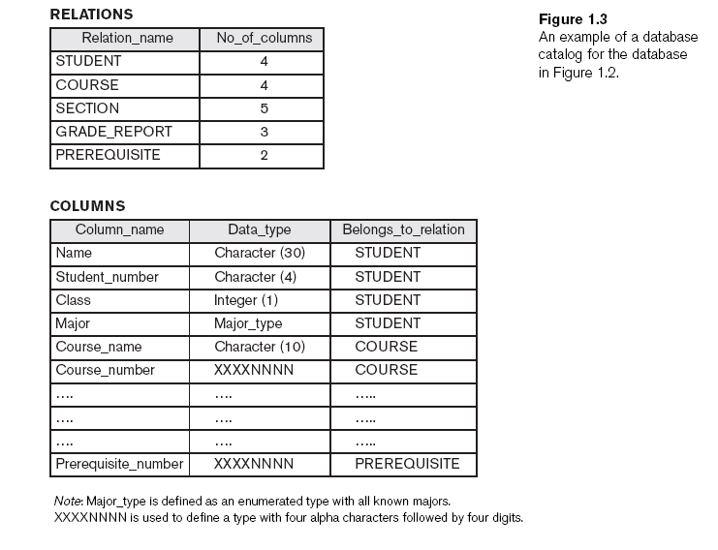

Slide 24
Support of Multiple Views of the Data
View
Subset of the database
Contains virtual data derived from the database files but is not explicitly stored
Multiuser DBMS
Users have a variety of distinct applications
Must provide facilities for defining multiple views

Slide 25
Sharing of Data and Multiuser Transaction Processing
Allow multiple users to access the database at the same time
Concurrency control software
Ensure that several users trying to update the same data do so in a controlled manner
Result of the updates is correct
Online transaction processing (OLTP) application

Slide 26
Sharing of Data and Multiuser Transaction Processing (cont'd.)
Transaction
Central to many database applications
Executing program or process that includes one or more database
Isolation property
Each transaction appears to execute in isolation from other transactions
Atomicity property
Either all the database operations in a transaction are executed or none are

Slide 27
Actors on the Scene
Database administrators (DBA) are responsible for:
Authorizing access to the database
Coordinating and monitoring its use
Acquiring software and hardware resources
Database designers are responsible for:
Identifying the data to be stored
Choosing appropriate structures to represent and store this data

Slide 28
Actors on the Scene (cont'd.)
End users
People whose jobs require access to the database
Types
Casual end users
Naive or parametric end users
Sophisticated end users
Standalone users

Slide 29
Actors on the Scene (cont'd.)
System analysts
Determine requirements of end users
Application programmers
Implement these specifications as programs

Slide 30
Workers behind the Scene
DBMS system designers and implementers
Design and implement the DBMS modules and interfaces as a software package
Tool developers
Design and implement tools
Operators and maintenance personnel
Responsible for running and maintenance of hardware and software environment for database system

Slide 31
Advantages of Using the DBMS Approach
Controlling redundancy
Data normalization
Denormalization
Sometimes necessary to use controlled redundancy to improve the performance of queries
Restricting unauthorized access
Security and authorization subsystem
Privileged software

Slide 32
Advantages of Using the DBMS Approach (cont'd.)
Providing persistent storage for program objects
Complex object in C++ can be stored permanently in an object-oriented DBMS
Impedance mismatch problem
Object-oriented database systems typically offer data structure compatibility

Slide 33
Advantages of Using the DBMS Approach (cont'd.)
Providing storage structures and search techniques for efficient query processing
Indexes
Buffering and caching
Query processing and optimization

Slide 34
Advantages of Using the DBMS Approach (cont'd.)
Providing backup and recovery
Backup and recovery subsystem of the DBMS is responsible for recovery
Providing multiple user interfaces
Graphical user interfaces (GUIs)
Representing complex relationships among data
May include numerous varieties of data that are interrelated in many ways

Slide 35
Advantages of Using the DBMS Approach (cont'd.)
Enforcing integrity constraints
Referential integrity constraint
Every section record must be related to a course record
Key or uniqueness constraint
Every course record must have a unique value for Course_number
Business rules
Inherent rules of the data model

Slide 36
Advantages of Using the DBMS Approach (cont'd.)
Permitting inferencing and actions using rules
Deductive database systems
Provide capabilities for defining deduction rules
Inferencing new information from the stored database facts
Trigger
Rule activated by updates to the table
Stored procedures
More involved procedures to enforce rules

Slide 37
Advantages of Using the DBMS Approach (cont'd.)
Additional implications of using the database approach
Reduced application development time
Flexibility
Availability of up-to-date information
Economies of scale

Slide 38
A Brief History of Database Applications
Early database applications using hierarchical and network systems
Large numbers of records of similar structure
Providing data abstraction and application flexibility with relational databases
Separates physical storage of data from its conceptual representation
Provides a mathematical foundation for data representation and querying

Slide 39
A Brief History of Database Applications (cont'd.)
Object-oriented applications and the need for more complex databases
Used in specialized applications: engineering design, multimedia publishing, and manufacturing systems
Interchanging data on the Web for e-commerce using XML
Extended markup language (XML) primary standard for interchanging data among various types of databases and Web pages

Slide 40
A Brief History of Database Applications (cont'd.)
Extending database capabilities for new applications
Extensions to better support specialized requirements for applications
Enterprise resource planning (ERP)
Customer relationship management (CRM)
Databases versus information retrieval
Information retrieval (IR)
Deals with books, manuscripts, and various forms of library-based articles

Slide 41
When Not to Use a DBMS
More desirable to use regular files for:
Simple, well-defined database applications not expected to change at all
Stringent, real-time requirements that may not be met because of DBMS overhead
Embedded systems with limited storage capacity
No multiple-user access to data

Slide 42
Summary
Database
Collection of related data (recorded facts)
DBMS
Generalized software package for implementing and maintaining a computerized database
Several categories of database users
Database applications have evolved
Current trends: IR, Web

