Slide 1
Chapter 2
Database System Concepts and Architecture

Slide 2
Chapter 2 Outline
Data Models, Schemas, and Instances
Three-Schema Architecture and Data Independence
Database Languages and Interfaces
The Database System Environment
Centralized and Client/Server Architectures for DBMSs
Classification of Database Management Systems

Slide 3
Database System Concepts and Architecture
Basic client/server DBMS architecture
Client module
Server module

Slide 4
Data Models, Schemas, and Instances
Data abstraction
Suppression of details of data organization and storage
Highlighting of the essential features for an improved understanding of data

Slide 5
Data Models, Schemas, and Instances (cont'd.)
Data model
Collection of concepts that describe the structure of a database
Provides means to achieve data abstraction
Basic operations
Specify retrievals and updates on the database
Dynamic aspect or behavior of a database application
Allows the database designer to specify a set of valid operations allowed on database objects

Slide 6
Categories of Data Models
High-level or conceptual data models
Close to the way many users perceive data
Low-level or physical data models
Describe the details of how data is stored on computer storage media
Representational data models
Easily understood by end users
Also similar to how data organized in computer storage

Slide 7
Categories of Data Models (cont'd.)
Entity
Represents a real-world object or concept
Attribute
Represents some property of interest
Further describes an entity
Relationship among two or more entities
Represents an association among the entities
Entity-Relationship model

Slide 8
Categories of Data Models (cont'd.)
Relational data model
Used most frequently in traditional commercial DBMSs
Object data model
New family of higher-level implementation data models
Closer to conceptual data models

Slide 9
Categories of Data Models (cont'd.)
Physical data models
Describe how data is stored as files in the computer
Access path
Structure that makes the search for particular database records efficient
Index
Example of an access path
Allows direct access to data using an index term or a keyword

Slide 10
Schemas, Instances, and Database State
Database schema
Description of a database
Schema diagram
Displays selected aspects of schema
Schema construct
Each object in the schema
Database state or snapshot
Data in database at a particular moment in time

Slide 11
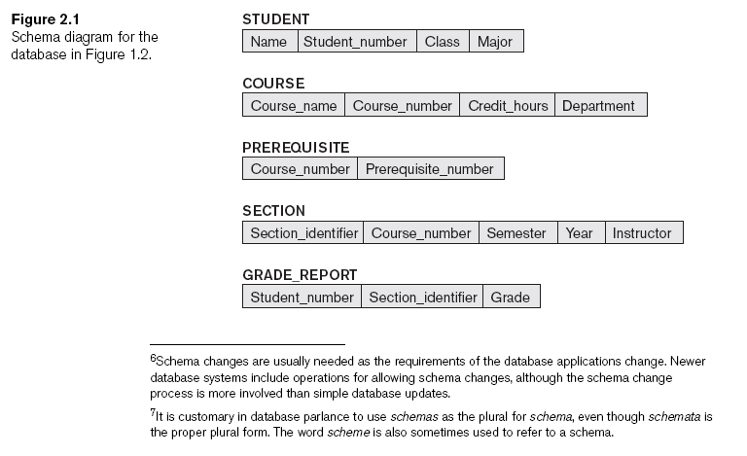
Schemas, Instances, and Database State (cont'd.)

Slide 12
Schemas, Instances, and Database State (cont'd.)
Define a new database
Specify database schema to the DBMS
Initial state
Populated or loaded with the initial data
Valid state
Satisfies the structure and constraints specified in the schema

Slide 13
Schemas, Instances, and Database State (cont'd.)
Schema evolution
Changes applied to schema as application requirements change

Slide 14
Three-Schema Architecture and Data Independence
Internal level
Describes physical storage structure of the database
Conceptual level
Describes structure of the whole database for a community of users
External or view level
Describes part of the database that a particular user group is interested in

Slide 15
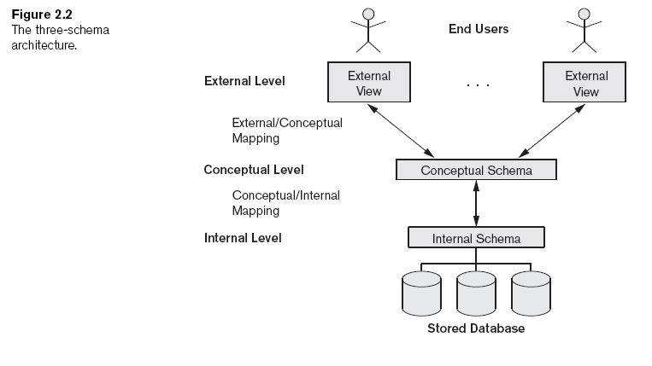
Three-Schema Architecture and Data Independence (cont'd.)

Slide 16
Data Independence
Capacity to change the schema at one level of a database system
Without having to change the schema at the next higher level
Types:
Logical
Physical

Slide 17
DBMS Languages
Data definition language (DDL)
Defines both schemas
Storage definition language (SDL)
Specifies the internal schema
View definition language (VDL)
Specifies user views/mappings to conceptual schema
Data manipulation language (DML)
Allows retrieval, insertion, deletion, modification

Slide 18
DBMS Languages (cont'd.)
High-level or nonprocedural DML
Can be used on its own to specify complex database operations concisely
Set-at-a-time or set-oriented
Low-level or procedural DML
Must be embedded in a general-purpose programming language
Record-at-a-time

Slide 19
DBMS Interfaces
Menu-based interfaces for Web clients or browsing
Forms-based interfaces
Graphical user interfaces
Natural language interfaces
Speech input and output
Interfaces for parametric users
Interfaces for the DBA

Slide 20
The Database System Environment
DBMS component modules
Buffer management
Stored data manager
DDL compiler
Interactive query interface
Query compiler
Query optimizer
Precompiler

Slide 21
The Database System Environment (cont'd.)
DBMS component modules
Runtime database processor
System catalog
Concurrency control system
Backup and recovery system

Slide 22
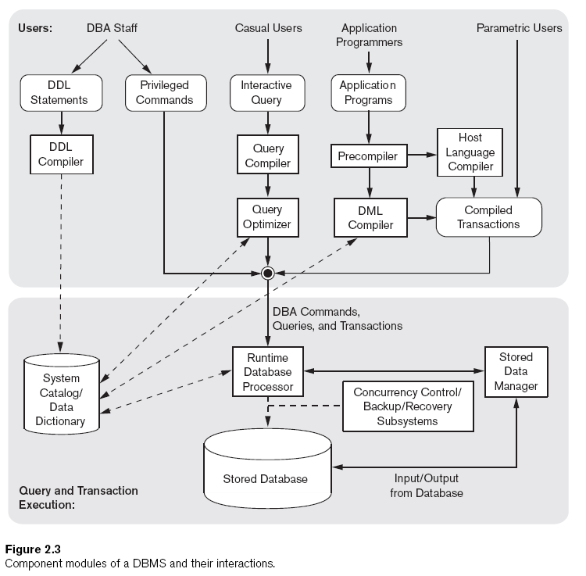

Slide 23
Database System Utilities
Loading
Load existing data files
Backup
Creates a backup copy of the database

Slide 24
Database System Utilities (cont'd.)
Database storage reorganization
Reorganize a set of database files into different file organizations
Performance monitoring
Monitors database usage and provides statistics to the DBA

Slide 25
Tools, Application Environments, and Communications Facilities
CASE Tools
Data dictionary (data repository) system
Stores design decisions, usage standards, application program descriptions, and user information
Application development environments
Communications software

Slide 26
Centralized and Client/Server Architectures for DBMSs
Centralized DBMSs Architecture
All DBMS functionality, application program execution, and user interface processing carried out on one machine

Slide 27
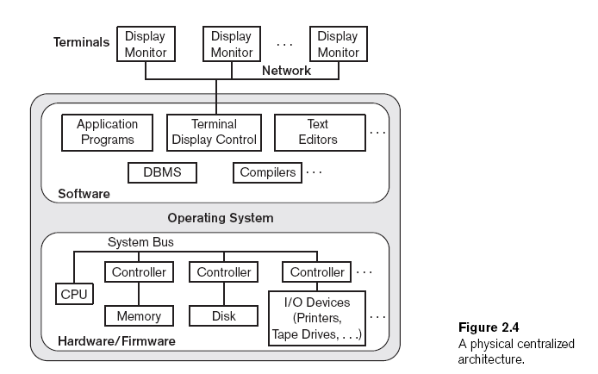

Slide 28
Basic Client/Server Architectures
Servers with specific functionalities
File server
Maintains the files of the client machines.
Printer server
Connected to various printers; all print requests by the clients are forwarded to this machine
Web servers or e-mail servers

Slide 29
Basic Client/Server Architectures (cont'd.)
Client machines
Provide user with:
Appropriate interfaces to utilize these servers
Local processing power to run local applications

Slide 30
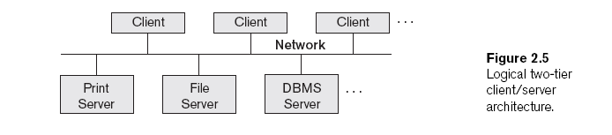
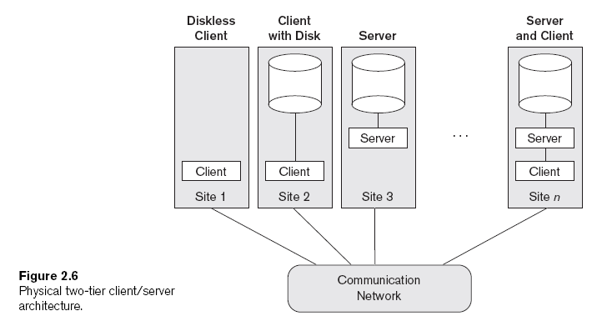

Slide 31
Basic Client/Server Architectures (cont'd.)
Client
User machine that provides user interface capabilities and local processing
Server
System containing both hardware and software
Provides services to the client machines
Such as file access, printing, archiving, or database access

Slide 32
Two-Tier Client/Server Architectures for DBMSs
Server handles
Query and transaction functionality related to SQL processing
Client handles
User interface programs and application programs

Slide 33
Two-Tier Client/Server Architectures (cont'd.)
Open Database Connectivity (ODBC)
Provides application programming interface (API)
Allows client-side programs to call the DBMS
Both client and server machines must have the necessary software installed
JDBC
Allows Java client programs to access one or more DBMSs through a standard interface

Slide 34
Three-Tier and n-Tier Architectures for Web Applications
Application server or Web server
Adds intermediate layer between client and the database server
Runs application programs and stores business rules
N-tier
Divide the layers between the user and the stored data further into finer components

Slide 35
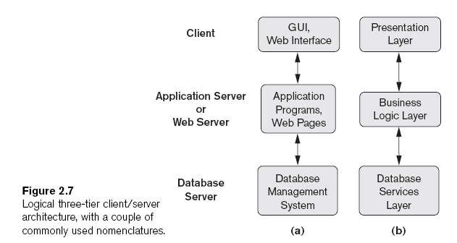

Slide 36
Classification of Database Management Systems
Data model
Relational
Object
Hierarchical and network (legacy)
Native XML DBMS
Number of users
Single-user
Multiuser

Slide 37
Classification of Database Management Systems (cont'd.)
Number of sites
Centralized
Distributed
Homogeneous
Heterogeneous
Cost
Open source
Different types of licensing

Slide 38
Classification of Database Management Systems (cont'd.)
Types of access path options
General or special-purpose

Slide 39
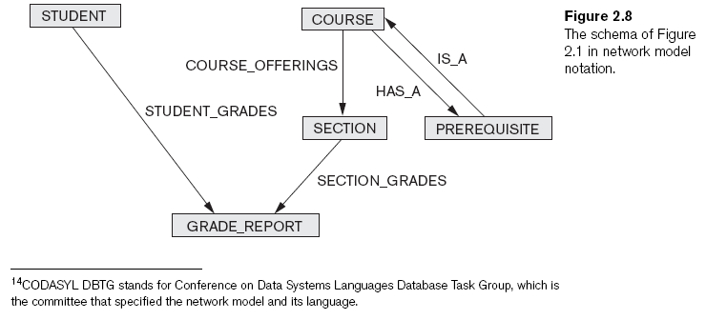
Classification of Database Management Systems (cont'd.)

Slide 40
Summary
Concepts used in database systems
Main categories of data models
Types of languages supported by DMBSs
Interfaces provided by the DBMS
DBMS classification criteria:
Data model, number of users, number of sties, access paths, cost

