Slide 1
Chapter 6
The Relational Algebra and Relational Calculus

Slide 2
Chapter 6 Outline
Unary Relational Operations: SELECT and PROJECT
Relational Algebra Operations from Set Theory
Binary Relational Operations: JOIN and DIVISION
Additional Relational Operations

Slide 3
Chapter 6 Outline (cont’d.)
Examples of Queries in Relational Algebra
The Tuple Relational Calculus
The Domain Relational Calculus

Slide 4
Chapter 6 Outline (cont’d.)
Examples of Queries in Relational Algebra
The Tuple Relational Calculus
The Domain Relational Calculus

Slide 5
The Relational Algebra and Relational Calculus
Relational algebra
Basic set of operations for the relational model
Relational algebra expression
Sequence of relational algebra operations
Relational calculus
Higher-level declarative language for specifying relational queries

Slide 6

Unary Relational Operations: SELECT and PROJECT
The SELECT Operation
Subset of the tuples from a relation that satisfies a selection condition:
Boolean expression contains clauses of the form <attribute name> <comparison op> <constant value>
or
<attribute name> <comparison op> <attribute name>

Slide 7
Unary Relational Operations: SELECT and PROJECT (cont’d.)
Example:
<selection condition> applied independently to each individual tuple t in R
If condition evaluates to TRUE, tuple selected
Boolean conditions AND, OR, and NOT
Unary
Applied to a single relation

Slide 8
Unary Relational Operations: SELECT and PROJECT (cont’d.)
Selectivity
Fraction of tuples selected by a selection condition
SELECT operation commutative
Cascade SELECT operations into a single operation with AND condition

Slide 9
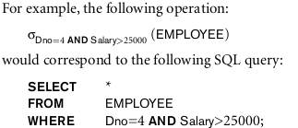
Unary Relational Operations: SELECT and PROJECT (cont’d.)

Slide 10


The PROJECT Operation
Selects columns from table and discards the other columns:
Degree
Number of attributes in <attribute list>
Duplicate elimination
Result of PROJECT operation is a set of distinct tuples

Slide 11
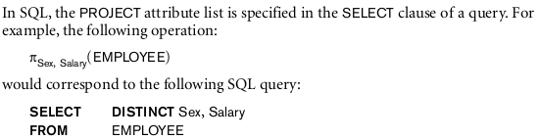
The PROJECT Operation

Slide 12
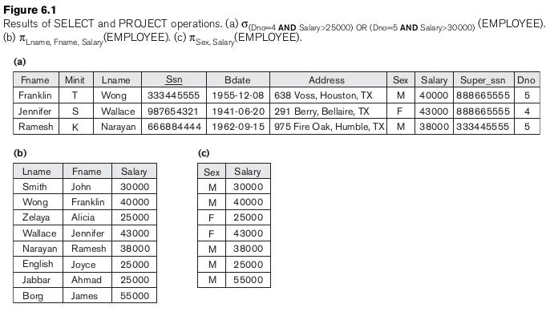

Slide 13



Sequences of Operations and the RENAME Operation
In-line expression:
Sequence of operations:
Rename attributes in intermediate results
RENAME operation

Slide 14
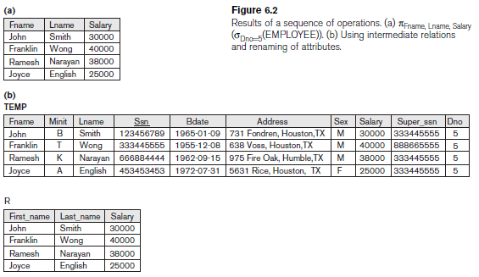
Sequences of Operations and the RENAME Operation

Slide 15
Relational Algebra Operations from Set Theory
UNION, INTERSECTION, and MINUS
Merge the elements of two sets in various ways
Binary operations
Relations must have the same type of tuples
UNION
R ∪ S
Includes all tuples that are either in R or in S or in both R and S
Duplicate tuples eliminated

Slide 16

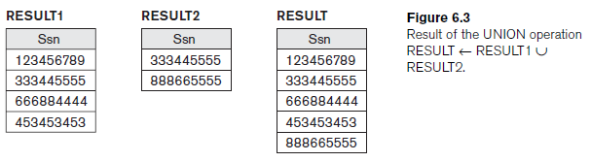
Relational Algebra Operations from Set Theory

Slide 17
Relational Algebra Operations from Set Theory (cont’d.)
INTERSECTION
R ∩ S
Includes all tuples that are in both R and S
SET DIFFERENCE (or MINUS)
R – S
Includes all tuples that are in R but not in S

Slide 18
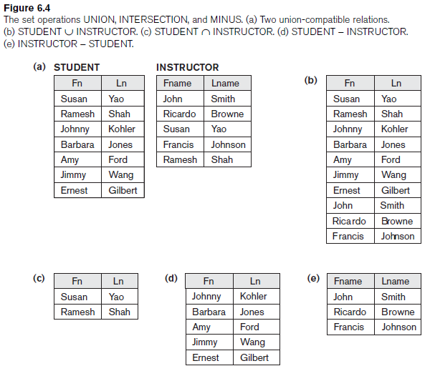
Relational Algebra Operations from Set Theory (cont’d.)

Slide 19
The CARTESIAN PRODUCT (CROSS PRODUCT) Operation
CARTESIAN PRODUCT
CROSS PRODUCT or CROSS JOIN
Denoted by ×
Binary set operation
Relations do not have to be union compatible
Useful when followed by a selection that matches values of attributes

Slide 20
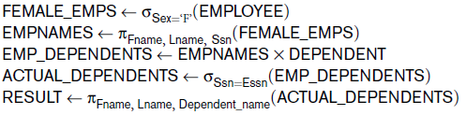
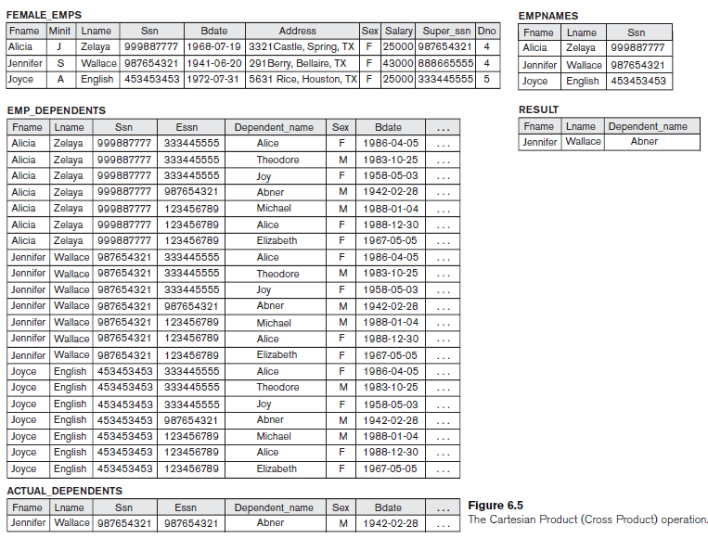

Slide 21



Binary Relational Operations: JOIN and DIVISION
The JOIN Operation
Denoted by
Combine related tuples from two relations into single “longer” tuples
General join condition of the form <condition> AND <condition> AND...AND <condition>
Example:

Slide 22
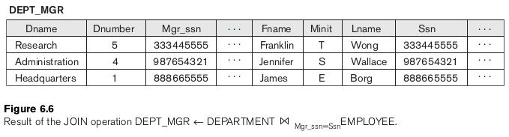
Binary Relational Operations: JOIN and DIVISION

Slide 23
Binary Relational Operations: JOIN and DIVISION (cont’d.)
THETA JOIN
Each <condition> of the form A_{i} θ B_{j}
A_{i} is an attribute of R
B_{j} is an attribute of S
A_{i} and B_{j} have the same domain
θ (theta) is one of the comparison operators:
{=, <, ≤, >, ≥, ≠}

Slide 24
Variations of JOIN: The EQUIJOIN and NATURAL JOIN
EQUIJOIN
Only = comparison operator used
Always have one or more pairs of attributes that have identical values in every tuple
NATURAL JOIN
Denoted by *
Removes second (superfluous) attribute in an EQUIJOIN condition

Slide 25

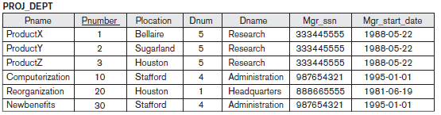
Variations of JOIN: The EQUIJOIN and NATURAL JOIN
=

Slide 26
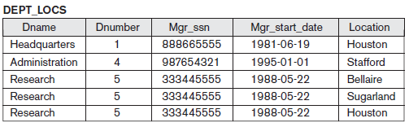
Variations of JOIN: The EQUIJOIN and NATURAL JOIN

Slide 27
Variations of JOIN: The EQUIJOIN and NATURAL JOIN (cont’d.)
Join selectivity
Expected size of join result divided by the maximum size n_{R} * n_{S}
Inner joins
Type of match and combine operation
Defined formally as a combination of CARTESIAN PRODUCT and SELECTION

Slide 28

A Complete Set of Relational Algebra Operations
Set of relational algebra operations {σ, π, ∪, ρ, –, ×} is a complete set
Any relational algebra operation can be expressed as a sequence of operations from this set

Slide 29
The DIVISION Operation
Denoted by ÷
Example: retrieve the names of employees who work on all the projects that ‘John Smith’ works on
Apply to relations R(Z) ÷ S(X)
Attributes of S are a subset of the attributes of R

Slide 30



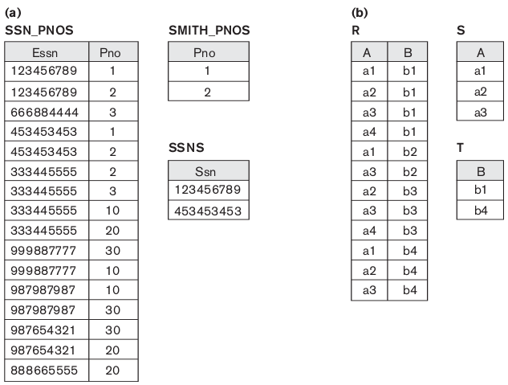

Slide 31
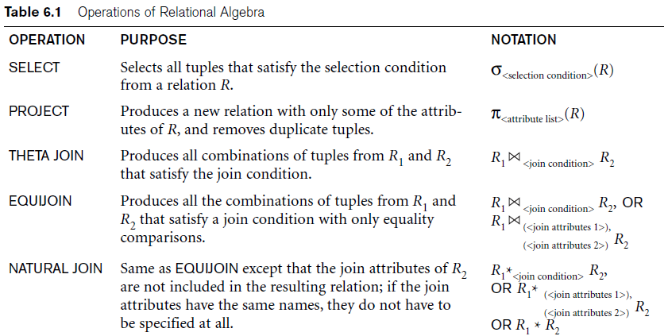
Operations of Relational Algebra

Slide 32
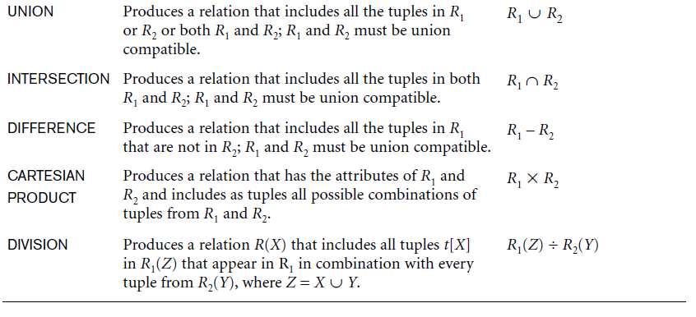
Operations of Relational Algebra (cont’d.)

Slide 33
Notation for Query Trees
Query tree
Represents the input relations of query as leaf nodes of the tree
Represents the relational algebra operations as internal nodes

Slide 34
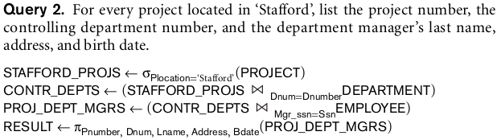
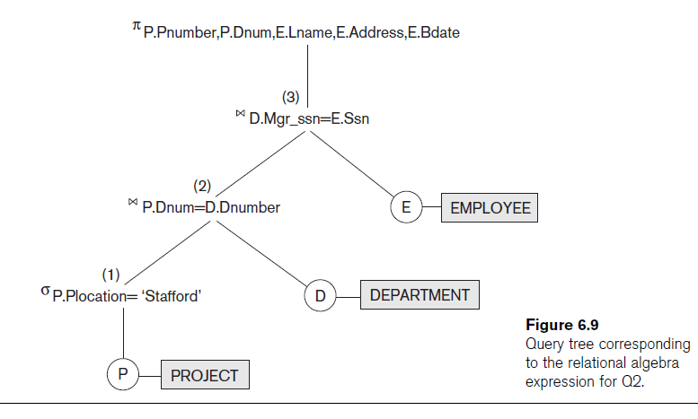

Slide 35

Additional Relational Operations
Generalized projection
Allows functions of attributes to be included in the projection list
Example:
Aggregate functions and grouping
Common functions applied to collections of numeric values
Include SUM, AVERAGE, MAXIMUM, and MINIMUM, COUNT

Slide 36

Additional Relational Operations (cont’d.)
Group tuples by the value of some of their attributes
Apply aggregate function independently to each group

Slide 37
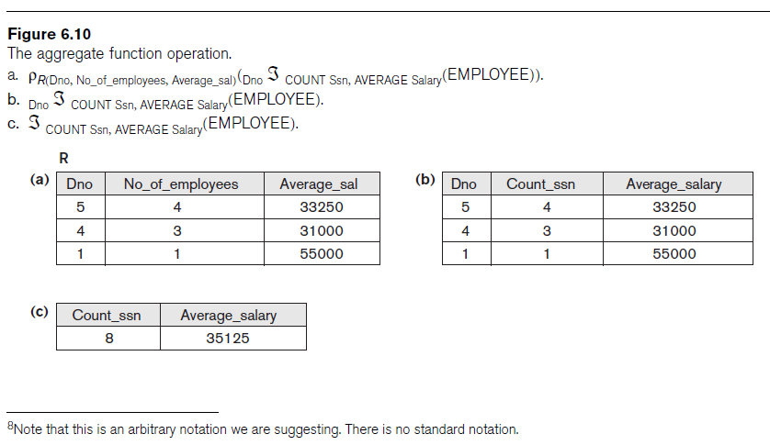

Slide 38
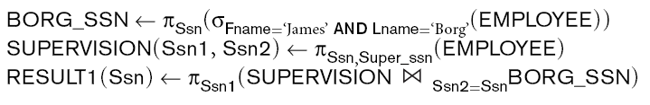
Recursive Closure Operations
Operation applied to a recursive relationship between tuples of same type
to specify the Ssn s of all employees e' directly supervised—at level one—by the employee e whose name is ‘James Borg
to retrieve all employees supervised by Borg at level 2—that is, all employees e'' supervised by some employee e' who is directly supervised by Borg

Slide 39
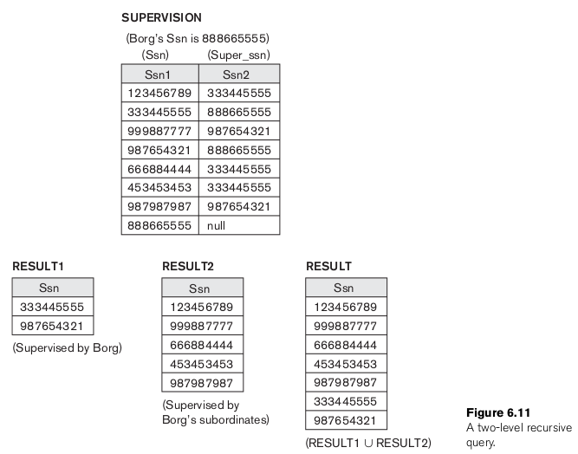

Slide 40
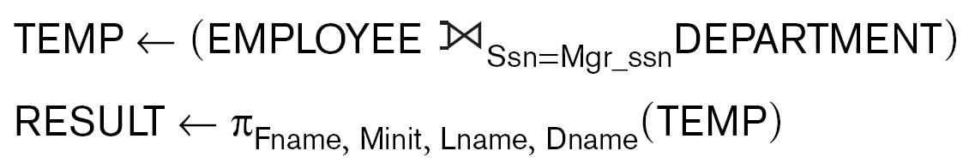
OUTER JOIN Operations
Outer joins
Keep all tuples in R, or all those in S, or all those in both relations regardless of whether or not they have matching tuples in the other relation
Types
LEFT OUTER JOIN, RIGHT OUTER JOIN, FULL OUTER JOIN
Example:

Slide 41

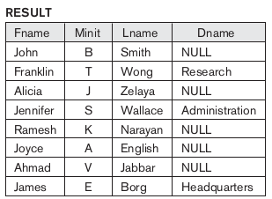
OUTER JOIN Operations

Slide 42
The OUTER UNION Operation
Take union of tuples from two relations that have some common attributes
Not union (type) compatible
Partially compatible
All tuples from both relations included in the result
Tuples with the same value combination will appear only once

Slide 43
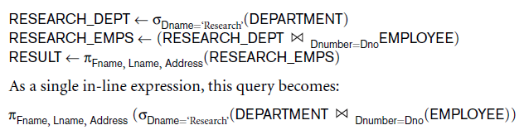
Examples of Queries in Relational Algebra

Slide 44
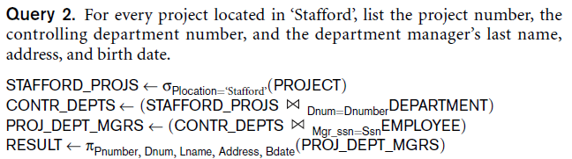
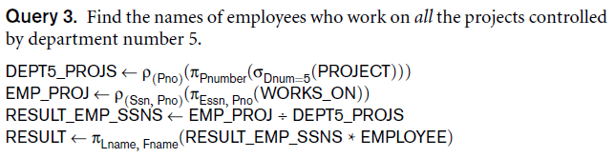
Examples of Queries in Relational Algebra (cont’d.)

Slide 45
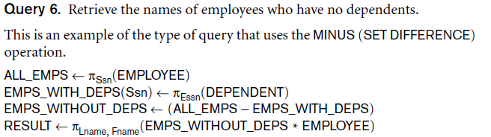
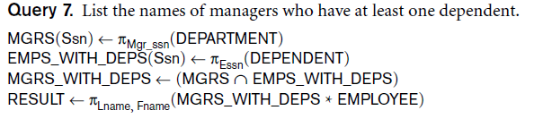
Examples of Queries in Relational Algebra (cont’d.)

Slide 46
Summary
Formal languages for relational model of data:
Relational algebra: operations, unary and binary operators
Some queries cannot be stated with basic relational algebra operations
But are important for practical use

