Slide 1
Chapter 7
Data Modeling Using the Entity-Relationship (ER) Model

Slide 2
Chapter 7 Outline
Using High-Level Conceptual Data Models for Database Design
A Sample Database Application
Entity Types, Entity Sets, Attributes, and Keys
Relationship Types, Relationship Sets, Roles, and Structural Constraints
Weak Entity Types

Slide 3
Chapter 7 Outline (cont’d.)
Refining the ER Design for the COMPANY Database
ER Diagrams, Naming Conventions, and Design Issues
Example of Other Notation: UML Class Diagrams
Relationship Types of Degree Higher than Two

Slide 4
Data Modeling Using the Entity-Relationship (ER) Model
Entity-Relationship (ER) model
Popular high-level conceptual data model
ER diagrams
Diagrammatic notation associated with the ER model
Unified Modeling Language (UML)

Slide 5
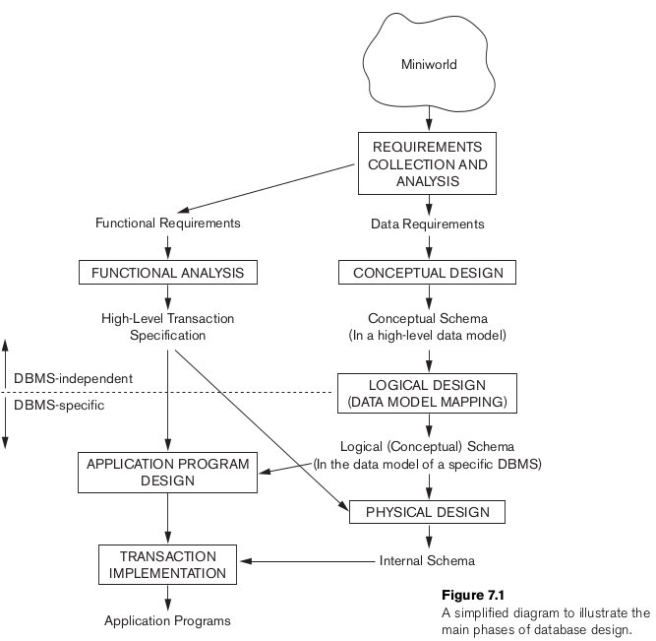

Slide 6
Using High-Level Conceptual Data Models for Database Design
Requirements collection and analysis
Database designers interview prospective database users to understand and document data requirements
Result: data requirements
Functional requirements of the application

Slide 7
Using High-Level Conceptual Data Models (cont’d.)
Conceptual schema
Conceptual design
Description of data requirements
Includes detailed descriptions of the entity types, relationships, and constraints
Transformed from high-level data model into implementation data model

Slide 8
Using High-Level Conceptual Data Models (cont’d.)
Logical design or data model mapping
Result is a database schema in implementation data model of DBMS
Physical design phase
Internal storage structures, file organizations, indexes, access paths, and physical design parameters for the database files specified

Slide 9
A Sample Database Application
COMPANY
Employees, departments, and projects
Company is organized into departments
Department:
has a unique name, a unique number, and a particular employee who manages the department.
may have several locations.
controls a number of projects
Keep track of the start date of the manager.
Project: has a unique name, a unique number, and a single location.

Slide 10
A Sample Database Application
COMPANY
Employee: store each employee’s name, Social Security number, address, salary, sex (gender), and birth date
An employee is assigned to one department, but may work on several projects
keep track of the current number of hours per week that an employee works on each project.
keep track of the direct supervisor of each employee
Keep track of the dependents of each employee (dependent’s first name, sex, birth date, and relationship to the employee)

Slide 11
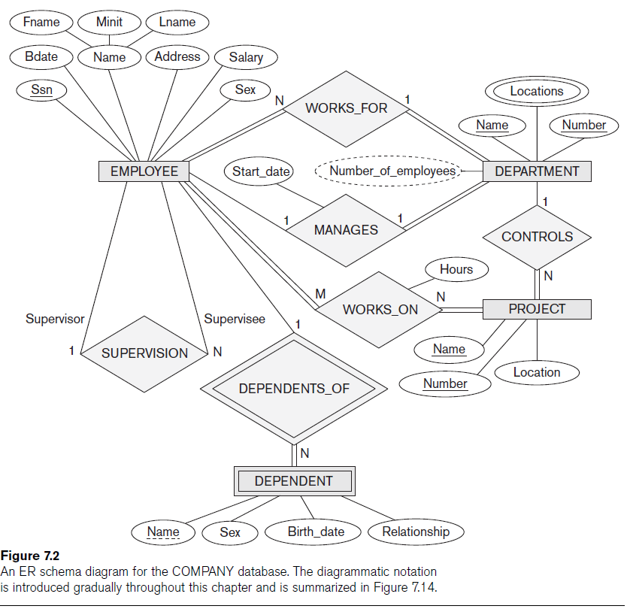

Slide 12
Entity Types, Entity Sets, Attributes, and Keys
ER model describes data as:
Entities
Relationships
Attributes

Slide 13
Entities and Attributes
Entity
Thing in real world with independent existence
Attributes
Particular properties that describe entity
Types of attributes:
Composite versus simple (atomic) attributes
Single-valued versus multivalued attributes
Stored versus derived attributes
NULL values
Complex attributes

Slide 14
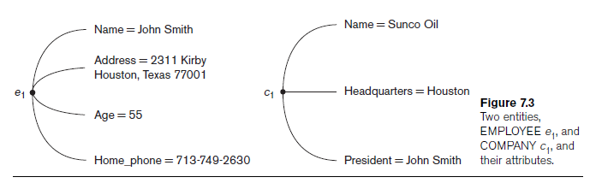
Entities and Attributes (cont’d.)

Slide 15
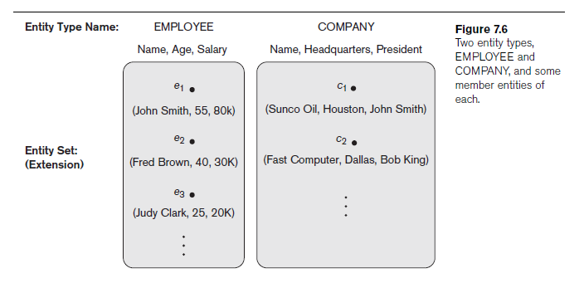
Entity Types, Entity Sets, Keys, and Value Sets
Entity type
Collection (or set) of entities that have the same attributes

Slide 16
Entity Types, Entity Sets, Keys, and Value Sets (cont’d.)
Key or uniqueness constraint
Attributes whose values are distinct for each individual entity in entity set
Key attribute
Uniqueness property must hold for every entity set of the entity type
Value sets (or domain of values)
Specifies set of values that may be assigned to that attribute for each individual entity

Slide 17
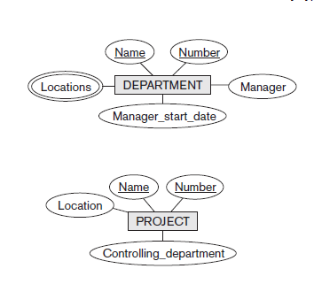
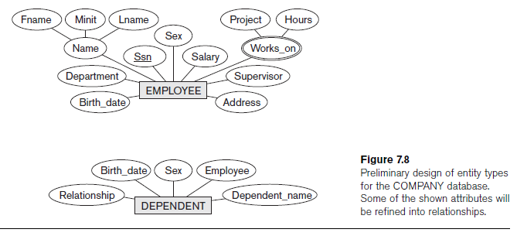
Initial Conceptual Design of the COMPANY Database

Slide 18
Relationship Types, Relationship Sets, Roles, and Structural Constraints
Relationship
When an attribute of one entity type refers to another entity type
Represent references as relationships not attributes

Slide 19
Relationship Types, Sets, and Instances
Relationship type R among n entity types E₁, E₂, ..., E_{n}
Defines a set of associations among entities from these entity types
Relationship instances r_{i}
Each r_{i} associates n individual entities (e₁, e₂, ..., e_{n})
Each entity e_{j} in r_{i} is a member of entity set E_{j}

Slide 20
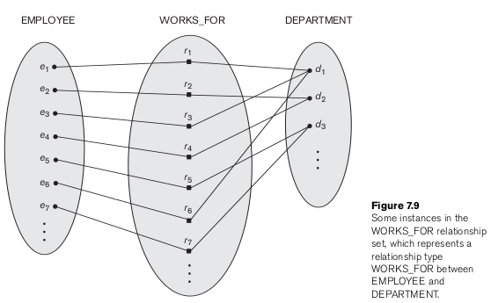
Relationship Types, Sets, and Instances

Slide 21
Relationship Degree
Degree of a relationship type
Number of participating entity types
Binary, ternary
Relationships as attributes
Think of a binary relationship type in terms of attributes

Slide 22
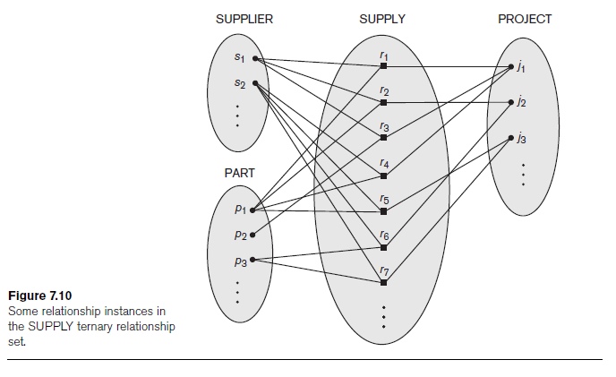

Slide 23
Role Names and Recursive Relationships
Role names and recursive relationships
Role name signifies role that a participating entity plays in each relationship instance
Recursive relationships
Same entity type participates more than once in a relationship type in different roles
Must specify role name

Slide 24
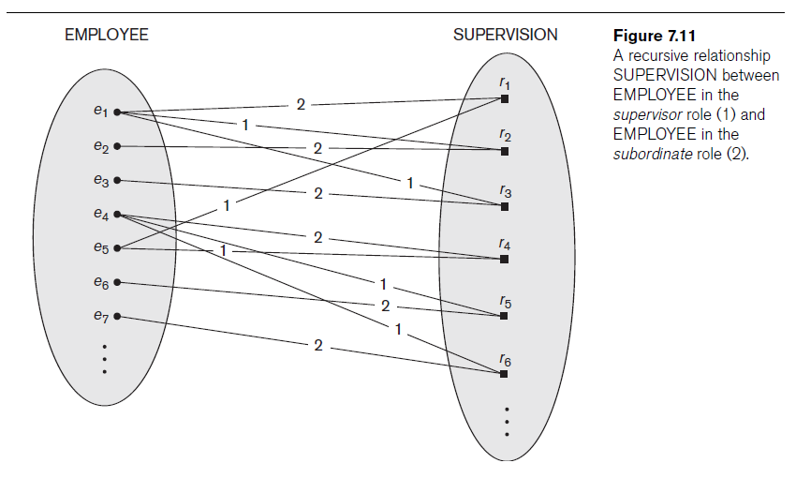

Slide 25
Constraints on Binary Relationship Types
Cardinality ratio for a binary relationship
Specifies maximum number of relationship instances that entity can participate in.
The possible cardinality ratios for binary relationship types: 1:1, 1:N, N:1, and M:N.
Participation constraint
Specifies whether existence of entity depends on its being related to another entity
Types: total and partial

Slide 26
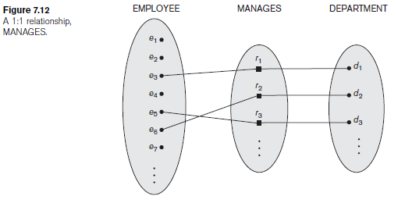
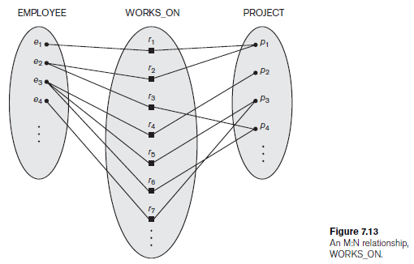

Slide 27
Attributes of Relationship Types
Attributes of 1:1 or 1:N relationship types can be migrated to one entity type
For a 1:N relationship type
Relationship attribute can be migrated only to entity type on N-side of relationship
For M:N relationship types
Some attributes may be determined by combination of participating entities
Must be specified as relationship attributes

Slide 28
Weak Entity Types
Do not have key attributes of their own
Identified by being related to specific entities from another entity type
Identifying relationship
Relates a weak entity type to its owner
Always has a total participation constraint

Slide 29
Refining the ER Design for the COMPANY Database
Change attributes that represent relationships into relationship types
Determine cardinality ratio and participation constraint of each relationship type

Slide 30
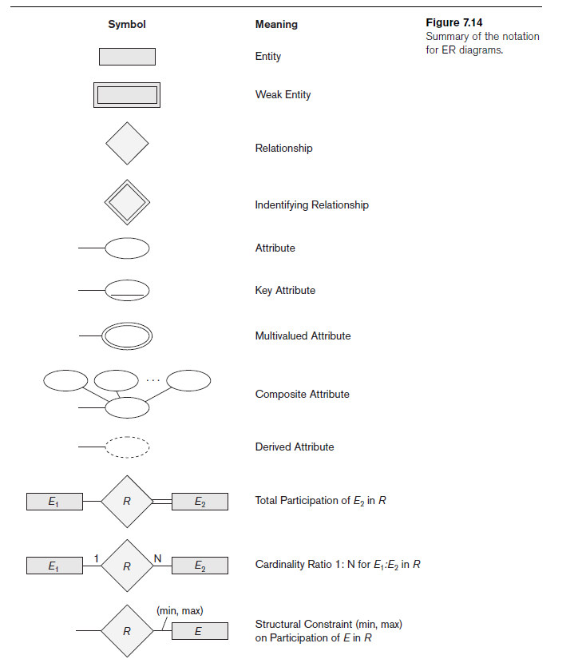
ER Diagrams, Naming Conventions, and Design Issues

Slide 31
Proper Naming of Schema Constructs
Choose names that convey meanings attached to different constructs in schema
Nouns give rise to entity type names
Verbs indicate names of relationship types
Choose binary relationship names to make ER diagram readable from left to right and from top to bottom

Slide 32
Design Choices for ER Conceptual Design
Model concept first as an attribute
Refined into a relationship if attribute is a reference to another entity type
Attribute that exists in several entity types may be elevated to an independent entity type
Can also be applied in the inverse

Slide 33
Alternative Notations for ER Diagrams
Specify structural constraints on relationships
Replaces cardinality ratio (1:1, 1:N, M:N) and single/double line notation for participation constraints
Associate a pair of integer numbers (min, max) with each participation of an entity type E in a relationship type R, where 0 ≤ min ≤ max and max ≥ 1

Slide 34
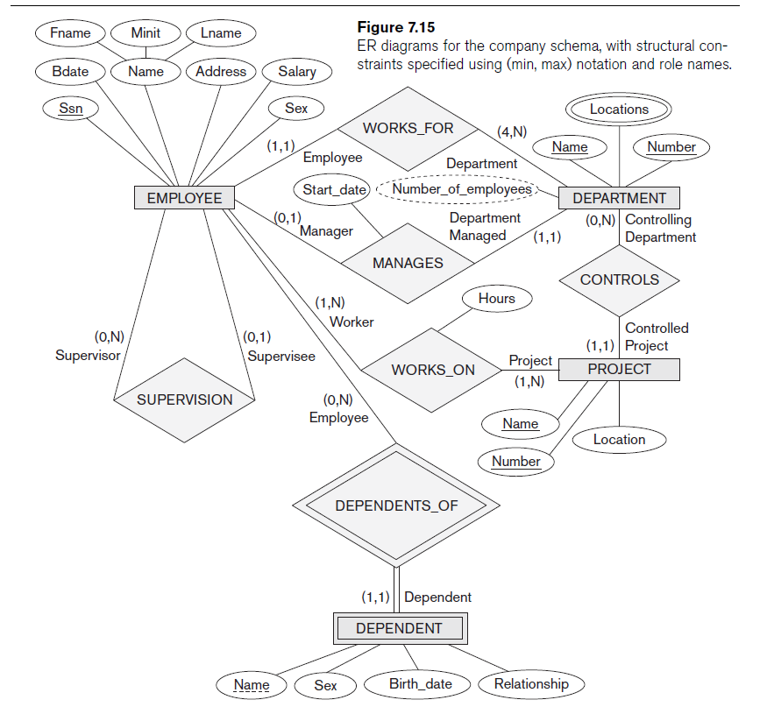

Slide 35
Example of Other Notation: UML Class Diagrams
UML methodology
Used extensively in software design
Many types of diagrams for various software design purposes
UML class diagrams
Entity in ER corresponds to an object in UML

Slide 36
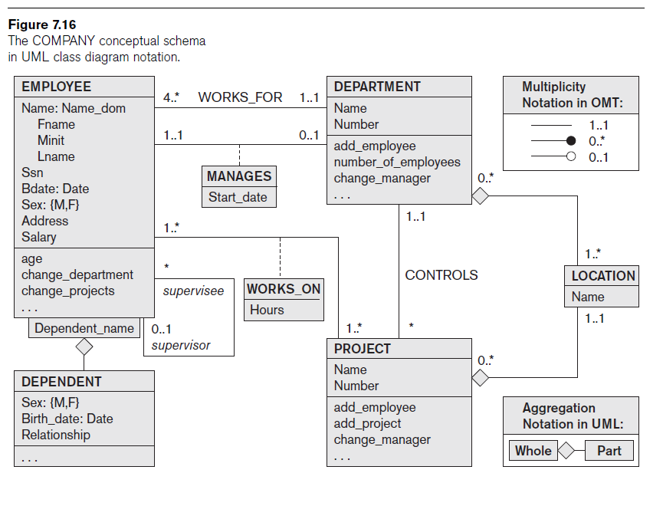

Slide 37
Example of Other Notation: UML Class Diagrams (cont’d.)
Class includes three sections:
Top section gives the class name
Middle section includes the attributes;
Last section includes operations that can be applied to individual objects

Slide 38
Example of Other Notation: UML Class Diagrams (cont’d.)
Associations: relationship types
Relationship instances: links
Binary association
Represented as a line connecting participating classes
May optionally have a name
Link attribute
Placed in a box connected to the association’s line by a dashed line

Slide 39
Example of Other Notation: UML Class Diagrams (cont’d.)
Multiplicities: min..max, asterisk (*) indicates no maximum limit on participation
Types of relationships: association and aggregation
Model weak entities using qualified association

Slide 40
Relationship Types of Degree Higher than Two
Degree of a relationship type
Number of participating entity types
Binary
Relationship type of degree two
Ternary
Relationship type of degree three

Slide 41
Choosing between Binary and Ternary (or Higher-Degree) Relationships
Some database design tools permit only binary relationships
Ternary relationship must be represented as a weak entity type
No partial key and three identifying relationships
Represent ternary relationship as a regular entity type

Slide 42
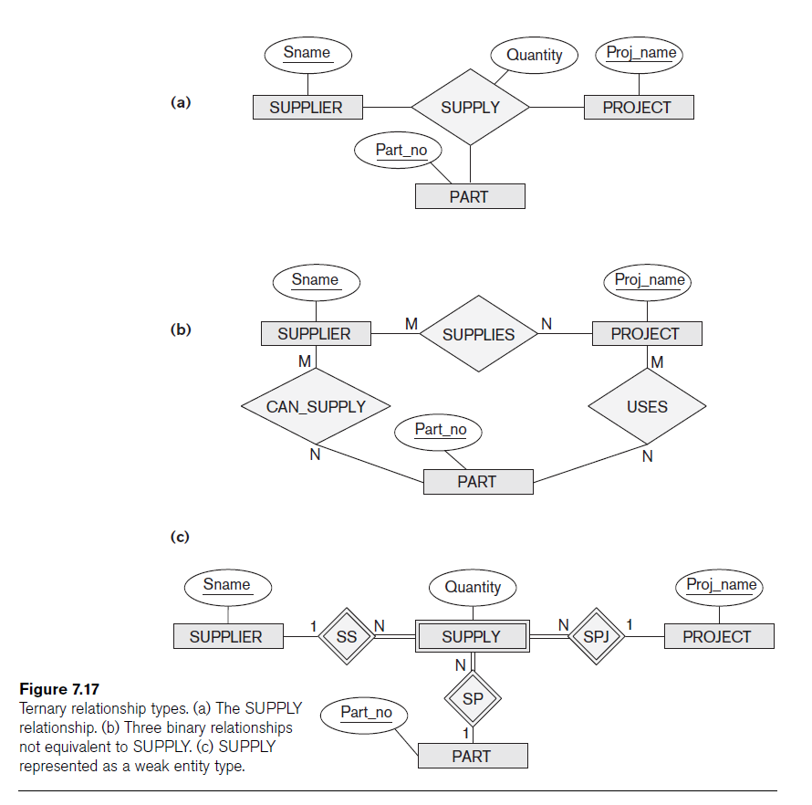

Slide 43
Constraints on Ternary (or Higher-Degree) Relationships
Notations for specifying structural constraints on n-ary relationships
Should both be used if it is important to fully specify structural constraints

Slide 44
Summary
Basic ER model concepts of entities and their attributes
Different types of attributes
Structural constraints on relationships
ER diagrams represent E-R schemas
UML class diagrams relate to ER modeling concepts

