Slide 1
Chapter 8
The Enhanced Entity-Relationship (EER) Model

Slide 2
Chapter 8 Outline
Subclasses, Superclasses, and Inheritance
Specialization and Generalizationz
Constraints and Characteristics of Specialization and Generalization Hierarchies
Modeling of UNION Types Using Categories
A Sample UNIVERSITY EER Schema, Design Choices, and Formal Definitions

Slide 3
The Enhanced Entity-Relationship (EER) Model
Enhanced ER (EER) model
Created to design more accurate database schemas
Reflect the data properties and constraints more precisely
More complex requirements than traditional applications

Slide 4
Subclasses, Superclasses, and Inheritance
EER model includes all modeling concepts of the ER model
In addition, EER includes:
Subclasses and superclasses
Specialization and generalization
Category or union type
Attribute and relationship inheritance

Slide 5
Subclasses, Superclasses, and Inheritance (cont’d.)
Enhanced ER or EER diagrams
Diagrammatic technique for displaying these concepts in an EER schema
Subtype or subclass of an entity type
Subgroupings of entities that are meaningful
Represented explicitly because of their significance to the database application

Slide 6
Subclasses, Superclasses, and Inheritance (cont’d.)
Terms for relationship between a superclass and any one of its subclasses
Superclass/subclass
Supertype/subtype
Class/subclass relationship
Type inheritance
Subclass entity inherits all attributes and relationships of superclass

Slide 7
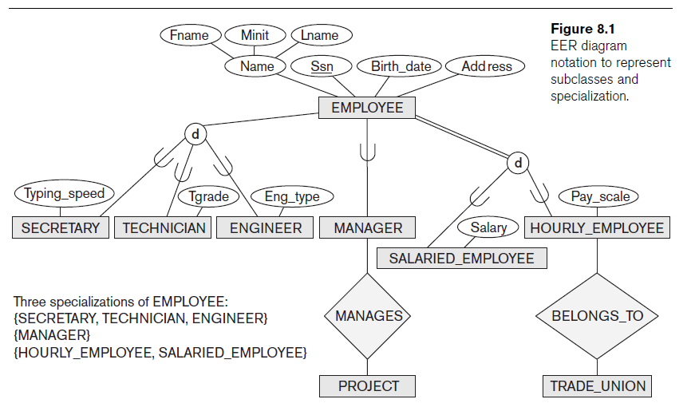

Slide 8
Specialization and Generalization
Specialization
Process of defining a set of subclasses of an entity type
Defined on the basis of some distinguishing characteristic of the entities in the superclass
Subclass can define:
Specific attributes
Specific relationship types

Slide 9
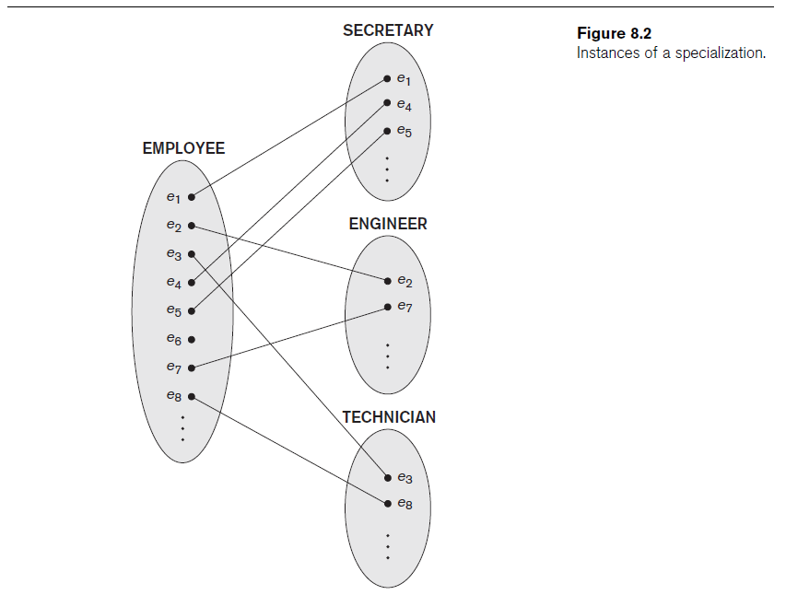

Slide 10
Specialization and Generalization (cont’d.)
Certain attributes may apply to some but not all entities of the superclass
Some relationship types may be participated in only by members of the subclass

Slide 11
Generalization
Reverse process of abstraction
Generalize into a single superclass
Original entity types are special subclasses
Generalization
Process of defining a generalized entity type from the given entity types

Slide 12
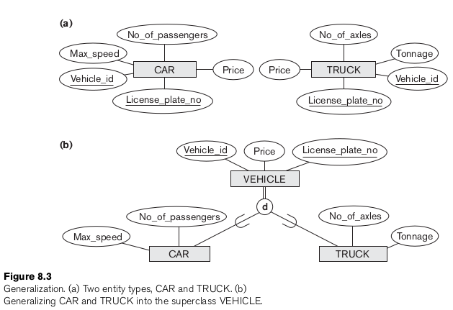

Slide 13
Constraints and Characteristics of Specialization and Generalization Hierarchies
Constraints that apply to a single specialization or a single generalization
Differences between specialization/
generalization lattices and hierarchies

Slide 14
Constraints on Specialization and Generalization
May be several or one subclass
Determine entity subtype:
Predicate-defined (or condition-defined) subclasses
Attribute-defined specialization
User-defined

Slide 15
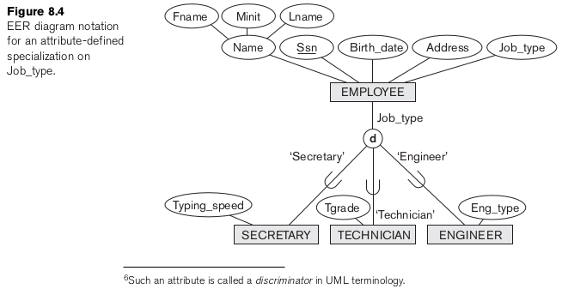

Slide 16
Constraints on Specialization and Generalization (cont’d.)
Disjointness constraint
Specifies that the subclasses of the specialization must be disjoint
Completeness (or totalness) constraint
May be total or partial
Disjointness and completeness constraints are independent

Slide 17
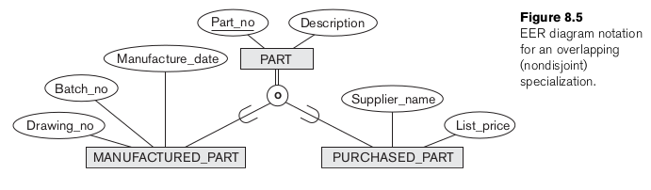

Slide 18
Specialization and Generalization Hierarchies and Lattices
Specialization hierarchy
Every subclass participates as a subclass in only one class/subclass relationship
Results in a tree structure or strict hierarchy
Specialization lattice
Subclass can be a subclass in more than one class/subclass relationship

Slide 19
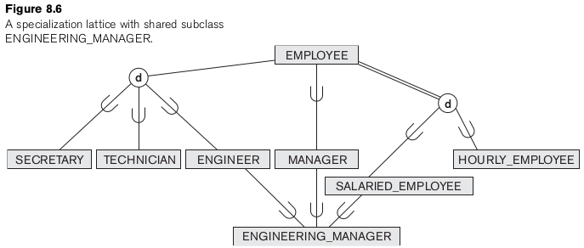

Slide 20
Specialization and Generalization Hierarchies and Lattices (cont’d.)
Multiple inheritance
Subclass with more than one superclass
If attribute (or relationship) originating in the same superclass inherited more than once via different paths in lattice
Included only once in shared subclass
Single inheritance
Some models and languages limited to single inheritance

Slide 21
Utilizing Specialization and Generalization in Refining Conceptual Schemas
Specialization process
Start with entity type then define subclasses by successive specialization
Top-down conceptual refinement process
Bottom-up conceptual synthesis
Involves generalization rather than specialization

Slide 22
Modeling of UNION Types Using Categories
Union type or a category
Represents a single superclass/subclass relationship with more than one superclass
Subclass represents a collection of objects that is a subset of the UNION of distinct entity types
Attribute inheritance works more selectively
Category can be total or partial
Some modeling methodologies do not have union types

Slide 23
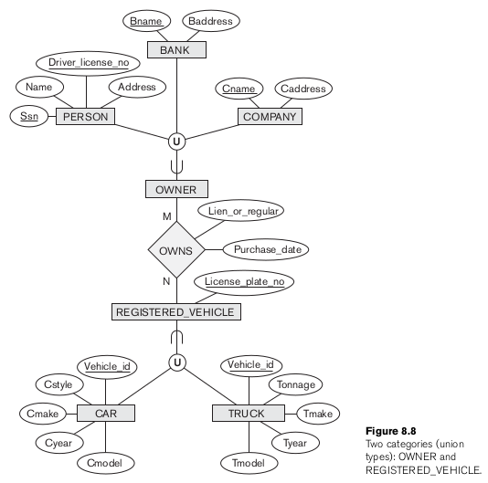

Slide 24
A Sample UNIVERSITY EER Schema, Design Choices, and Formal Definitions
The UNIVERSITY Database Example
UNIVERSITY database
Students and their majors
Transcripts, and registration
University’s course offerings

Slide 25
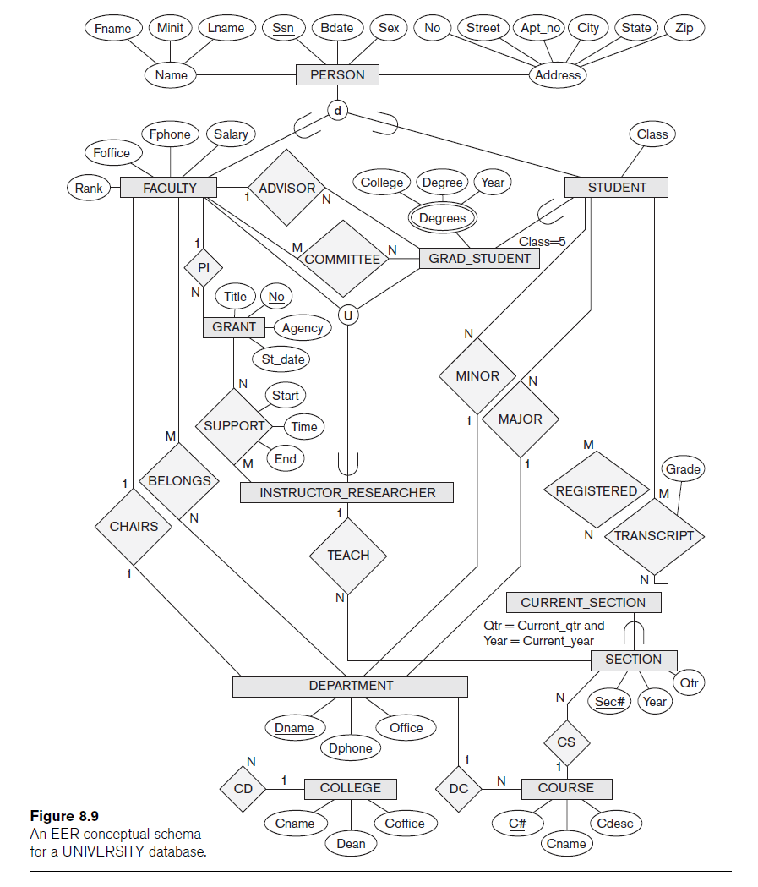

Slide 26
Design Choices for Specialization/Generalization
Many specializations and subclasses can be defined to make the conceptual model accurate
If subclass has few specific attributes and no specific relationships
Can be merged into the superclass

Slide 27
Design Choices for Specialization/Generalization (cont’d.)
If all the subclasses of a specialization/generalization have few specific attributes and no specific relationships
Can be merged into the superclass
Replace with one or more type attributes that specify the subclass or subclasses that each entity belongs to

Slide 28
Design Choices for Specialization/Generalization (cont’d.)
Union types and categories should generally be avoided
Choice of disjoint/overlapping and total/partial constraints on specialization/generalization
Driven by rules in miniworld being modeled

Slide 29
Formal Definitions for the EER Model Concepts
Class
Set or collection of entities
Includes any of the EER schema constructs of group entities
Subclass
Class whose entities must always be a subset of the entities in another class
Specialization
Set of subclasses that have same superclass

Slide 30
Formal Definitions for the EER Model Concepts (cont’d.)
Generalization
Generalized entity type or superclass
Predicate-defined
Predicate on the attributes of is used to specify which entities in C are members of S
User-defined
Subclass that is not defined by a predicate

Slide 31
Formal Definitions for the EER Model Concepts (cont’d.)
Category
Class that is a subset of the union of n defining superclasses
Relationship type
Any class can participate in a relationship

Slide 32
Summary
Enhanced ER or EER model
Extensions to ER model that improve its representational capabilities
Subclass and its superclass
Category or union type

