Slide 1
Chapter 9
Relational Database Design by ER- and EER-to-Relational Mapping

Slide 2
Chapter 9 Outline
Relational Database Design Using ER-to-Relational Mapping
Mapping EER Model Constructs to Relations

Slide 3
Relational Database Design by ER- and EER-to-Relational Mapping
Design a relational database schema
Based on a conceptual schema design
Seven-step algorithm to convert the basic ER model constructs into relations
Additional steps for EER model

Slide 4
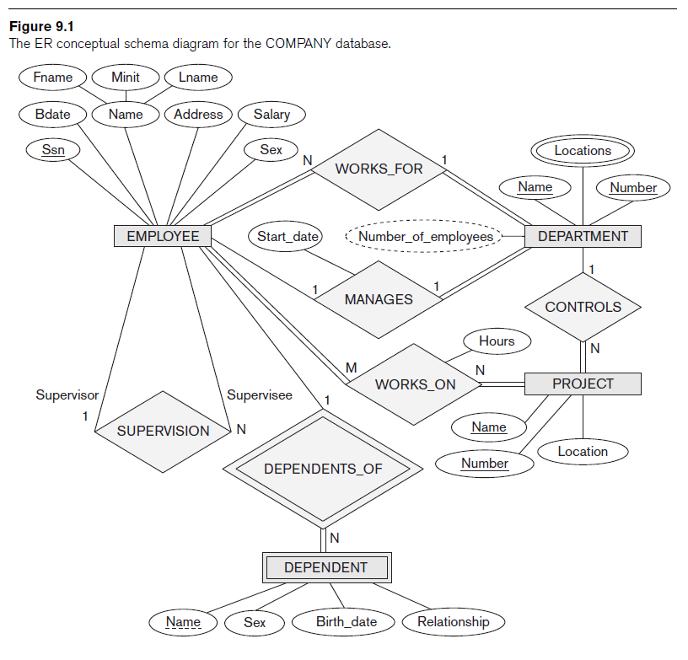
Relational Database Design Using ER-to-Relational Mapping

Slide 5
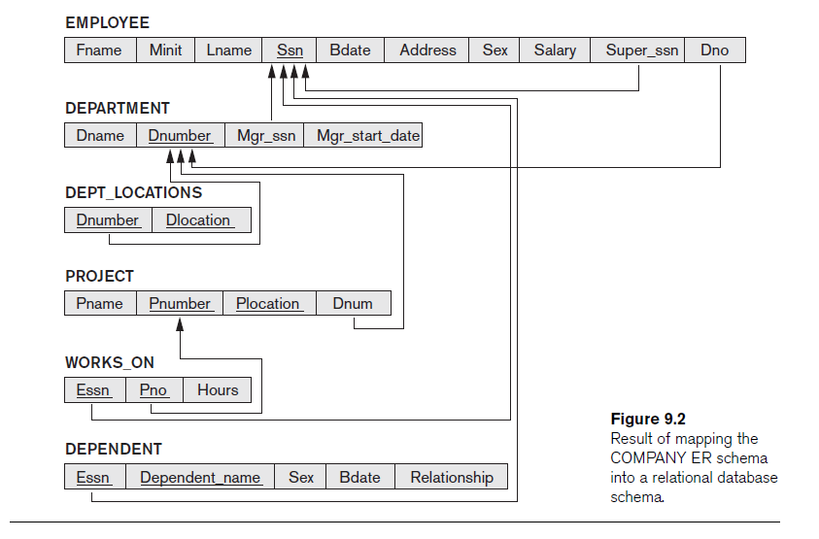

Slide 6
ER-to-Relational Mapping Algorithm
COMPANY database example
Assume that the mapping will create tables with simple single-valued attributes
Step 1: Mapping of Regular Entity Types
For each regular entity type, create a relation R that includes all the simple attributes of E
Called entity relations
Each tuple represents an entity instance

Slide 7
ER-to-Relational Mapping Algorithm (cont’d.)
Step 2: Mapping of Weak Entity Types
For each weak entity type, create a relation R and include all simple attributes of the entity type as attributes of R
Include primary key attribute of owner as foreign key attributes of R

Slide 8
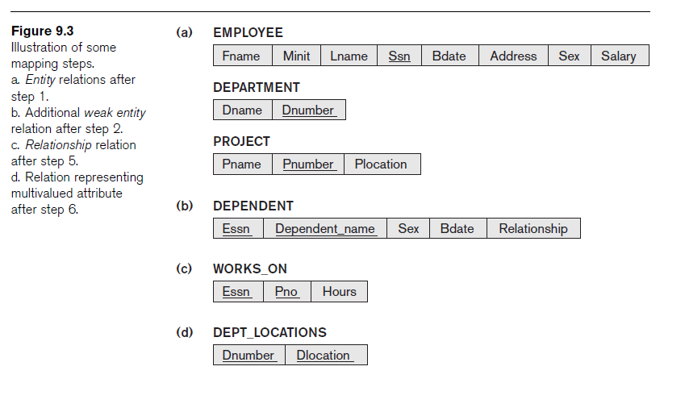
ER-to-Relational Mapping Algorithm (cont’d.)

Slide 9
ER-to-Relational Mapping Algorithm (cont’d.)
Step 3: Mapping of Binary 1:1 Relationship Types
For each binary 1:1 relationship type
Identify relations that correspond to entity types participating in R
Possible approaches:
Foreign key approach
Merged relationship approach
Crossreference or relationship relation approach

Slide 10
ER-to-Relational Mapping Algorithm (cont’d.)
Step 4: Mapping of Binary 1:N Relationship Types
For each regular binary 1:N relationship type
Identify relation that represents participating entity type at N-side of relationship type
Include primary key of other entity type as foreign key in S
Include simple attributes of 1:N relationship type as attributes of S

Slide 11
ER-to-Relational Mapping Algorithm (cont’d.)
Alternative approach
Use the relationship relation (cross-reference) option as in the third option for binary 1:1 relationships

Slide 12
ER-to-Relational Mapping Algorithm (cont’d.)
Step 5: Mapping of Binary M:N Relationship Types
For each binary M:N relationship type
Create a new relation S
Include primary key of participating entity types as foreign key attributes in S
Include any simple attributes of M:N relationship type

Slide 13
ER-to-Relational Mapping Algorithm (cont’d.)
Step 6: Mapping of Multivalued Attributes
For each multivalued attribute
Create a new relation
Primary key of R is the combination of A and K
If the multivalued attribute is composite, include its simple components

Slide 14
ER-to-Relational Mapping Algorithm (cont’d.)
Step 7: Mapping of N-ary Relationship Types
For each n-ary relationship type R
Create a new relation S to represent R
Include primary keys of participating entity types as foreign keys
Include any simple attributes as attributes

Slide 15
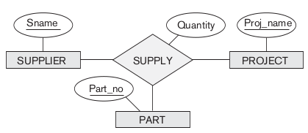
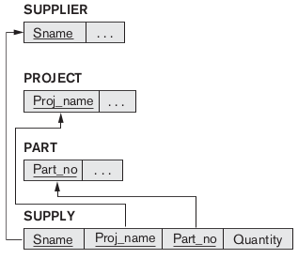

Slide 16
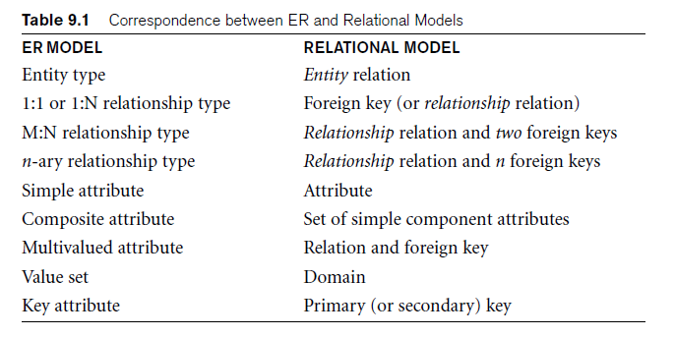
Discussion and Summary of Mapping for ER Model Constructs

Slide 17
Mapping EER Model Constructs to Relations
Extending ER-to-relational mapping algorithm

Slide 18
Mapping of Specialization or Generalization
Step 8: Options for Mapping Specialization or Generalization
Option 8A: Multiple relations—superclass and subclasses
For any specialization (total or partial, disjoint or overlapping)
Option 8B: Multiple relations—subclass relations only
Subclasses are total
Specialization has disjointedness constraint

Slide 19
Mapping of Specialization or Generalization (cont’d.)
Option 8C: Single relation with one type attribute
Type or discriminating attribute indicates subclass of tuple
Subclasses are disjoint
Potential for generating many NULL values if many specific attributes exist in the subclasses
Option 8D: Single relation with multiple type attributes
Subclasses are overlapping
Will also work for a disjoint specialization

Slide 20
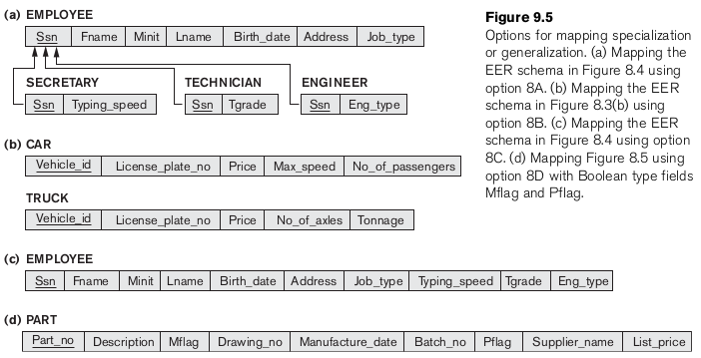

Slide 21
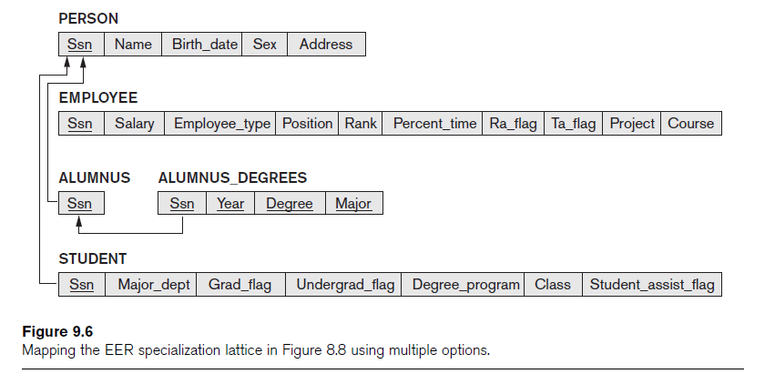
Mapping of Shared Subclasses (Multiple Inheritance)
Apply any of the options discussed in step 8 to a shared subclass

Slide 22
Mapping of Categories (Union Types)
Step 9: Mapping of Union Types (Categories)
Defining superclasses have different keys
Specify a new key attribute
Surrogate key

Slide 23
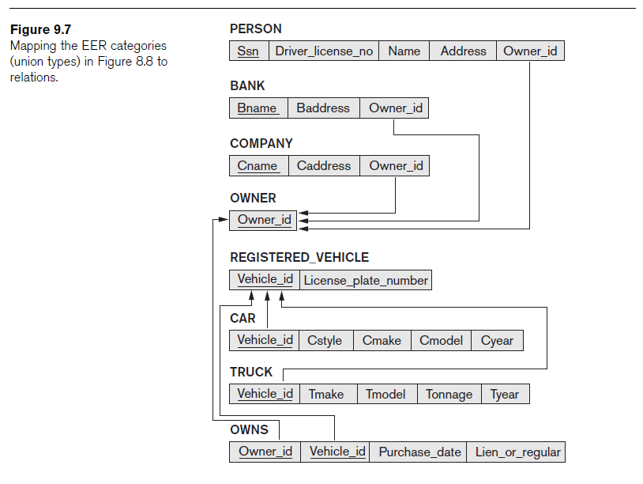

Slide 24
Summary
Map conceptual schema design in the ER model to a relational database schema
Algorithm for ER-to-relational mapping
Illustrated by examples from the COMPANY database
Include additional steps in the algorithm for mapping constructs from EER model into relational model

