Slide 1
COM234 ELECTRONICS
Kirchhoff’s Law

Slide 2
Kirchhoff's Laws
For circuit analysis Ohm's law may not be enough to provide a complete solution
Kirchhoff's laws are fundamental to circuit theory. They quantify how current flows through a circuit and how voltage varies around a loop in a circuit.
Kirchhoff's current law (1st Law) states that current flowing into a node (or a junction) must be equal to current flowing out of it. This is a consequence of charge conservation.
Kirchhoff's voltage law (2nd Law) states that the sum of all voltages around any closed loop in a circuit must equal zero. This is a consequence of charge conservation and also conservation of energy.

Slide 3
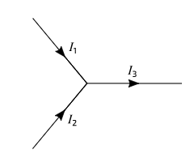
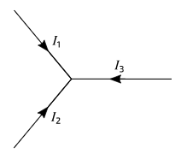
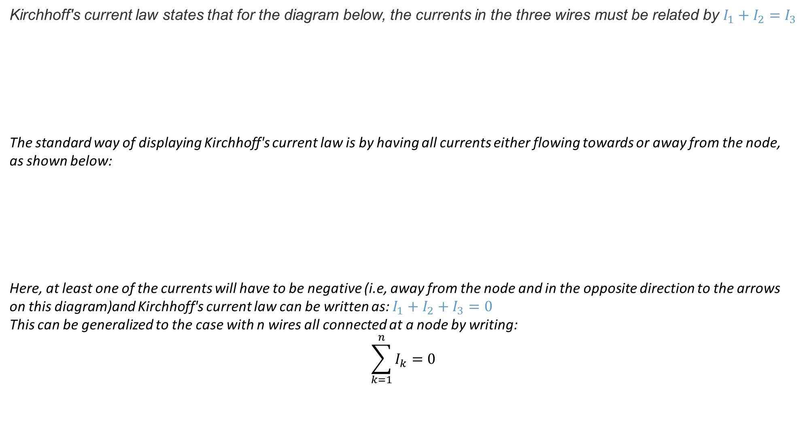
Kirchhoff's Current Law (KCL) (Conservation of Charge)
Kirchhoff's current law states that for the diagram below, the currents in the three wires must be related by $I_{1}+I_{2}=I_{3}$
The standard way of displaying Kirchhoff's current law is by having all currents either flowing towards or away from the node, as shown below:
Here, at least one of the currents will have to be negative (i.e, away from the node and in the opposite direction to the arrows on this diagram)and Kirchhoff's current law can be written as: $I_{1}+I_{2}+I_{3}=0$
This can be generalized to the case with n wires all connected at a node by writing:
$$\sum_{k=1}^{n}{I_{k}=0}$$

Slide 4
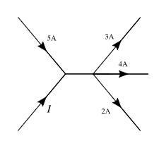
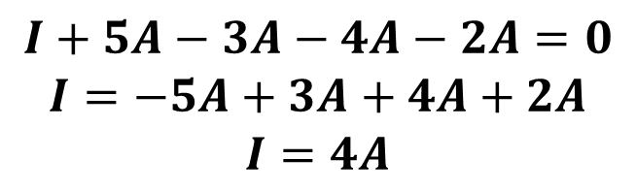
Kirchhoff's Current Law (KCL)
What is the value of I in the circuit segment shown below ?
What goes in must come out,
or
the total coming in is zero
Current in = Current out
Conservation of Charge
$$I+5A−3A−4A−2A=0$$
$$I=−5A+3A+4A+2A$$
$$I=4A$$

Slide 5
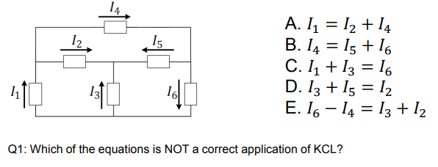
Kirchhoff's Current Law (KCL)
The algebraic sum of all the currents at any node in a circuit equals zero. !!!
KCL equations are often used at nodes, but can also be used for a sub-circuit

Slide 6
Kirchhoff's Voltage Law (KVL) (Conservation of Energy)
The algebraic sum of ALL the potential differences around the loop must be equal to zero as:
ΣV = 0
Note here that the term “algebraic sum” means to take into account the polarities and signs of the sources and voltage drops around the loop.

Slide 7
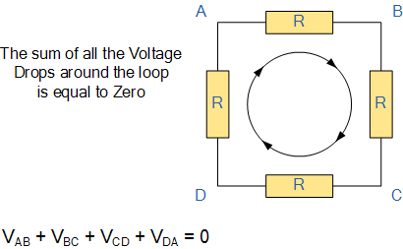
Kirchhoff's Voltage Law (KVL)

Slide 8
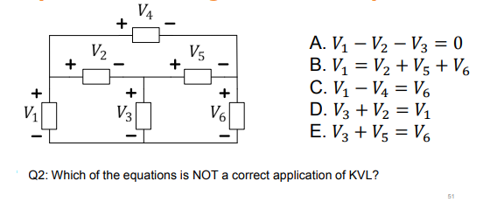
Kirchhoff's Voltage Law (KVL)
Keeping track of voltage drop polarity is important in writing correct KVL equations.
Q3. What are the values of the voltages 𝑉1 , 𝑉2 and 𝑉6 if
𝑉3 = 2 𝑉, 𝑉4 = 6 𝑉, 𝑉5 = 1 𝑉?
Notes:
A.3 From Eqs A and B → V2+V5+V6 –V2-V3=0 → V5+V6-V3=0 → V6=V3-V5=2V-1V=1V
From Eq C → V1-V4=V6 → V1=V6+V4= 1V + 6V= 7 V
From Eq D → V3+V2=V1 → V2= V1-V3= 7V-2V=5 V

Slide 9
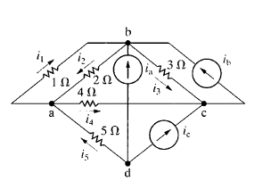
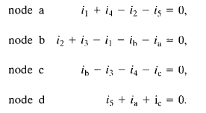
EXAMPLE (Using KCL)
Question:
Sum the currents at each node in the circuit shown in Fig. Note that there is no connection dot (•) in the center of the diagram, where the 4 ohm branch crosses the branch containing the ideal Current source Ia.
Solution
In writing the equations, we use a positive sign for a current leaving a node. The four equations are

Slide 10
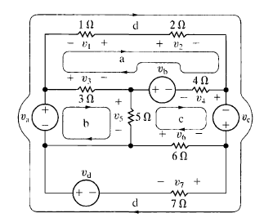
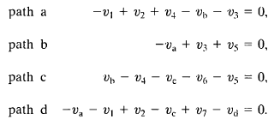
EXAMPLE (Using KVL)
Question:
Sum the voltages around each designated path in the circuit shown in Fig.
Solution
In writing the equations, we use a positive sign for a voltage drop. The four equations are

Slide 11
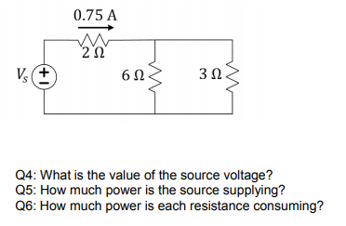
EXAMPLES
Use KCL, KVL and Ohm’s Law to solve below questions

Slide 12
Current and Voltage Dividers
• Series Connections, Equivalent Resistance, Voltage Divider
• Parallel Connections, Equivalent Resistance, Current Divider
• Power Dissipation in Series and Parallel Resistive Loads

Slide 13
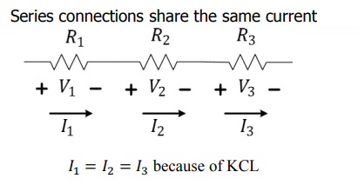
Series Connection
Series connections share the same current

Slide 14
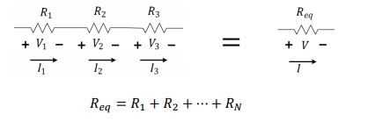
Equivalent Resistance of Series Resistors
Resistances in series add up

Slide 15
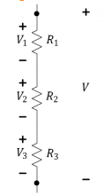

Voltage Divider Rule (VDR)
When a voltage divides across resistors in series, more voltage drop appears across the largest resistor

Slide 16
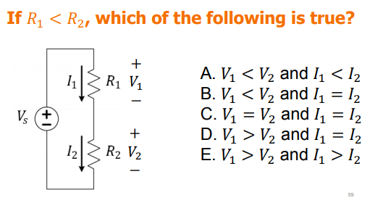
Example

Slide 17
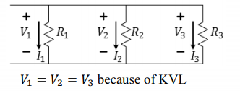
Parallel Connection
Parallel connections share the same voltage potentials at two end nodes (shared by the elements)

Slide 18
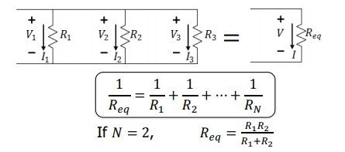
Equivalent Resistance of Parallel Resistors
Adding resistance in parallel always brings resistance down!

Slide 19
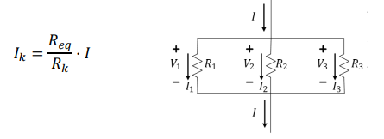
Current Divider Rule (CDR)
When a current divides into two or more paths, more current will go down the path of lowest resistance.

Slide 20
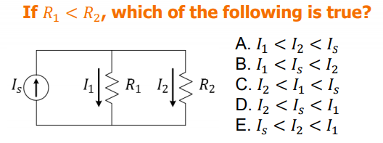
EXAMPLE

Slide 21
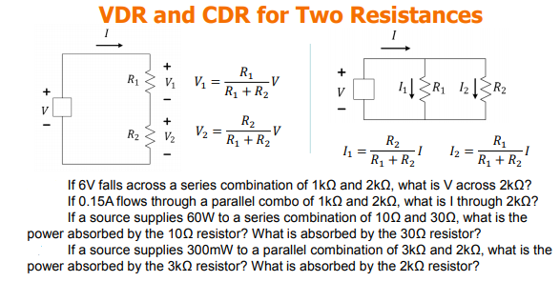
EXAMPLE

Slide 22
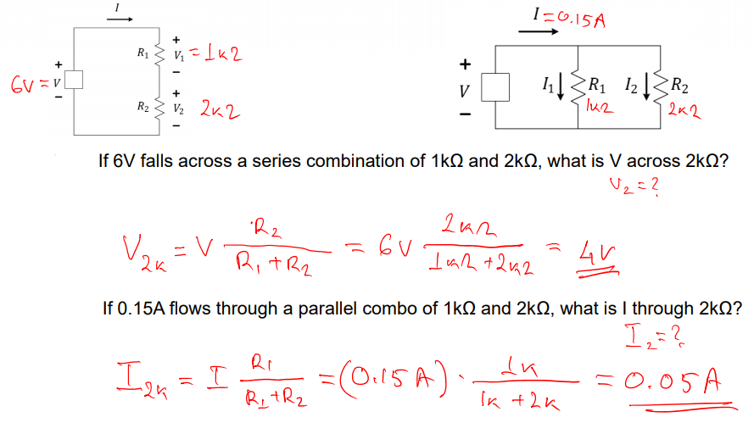
EXAMPLE

Slide 23
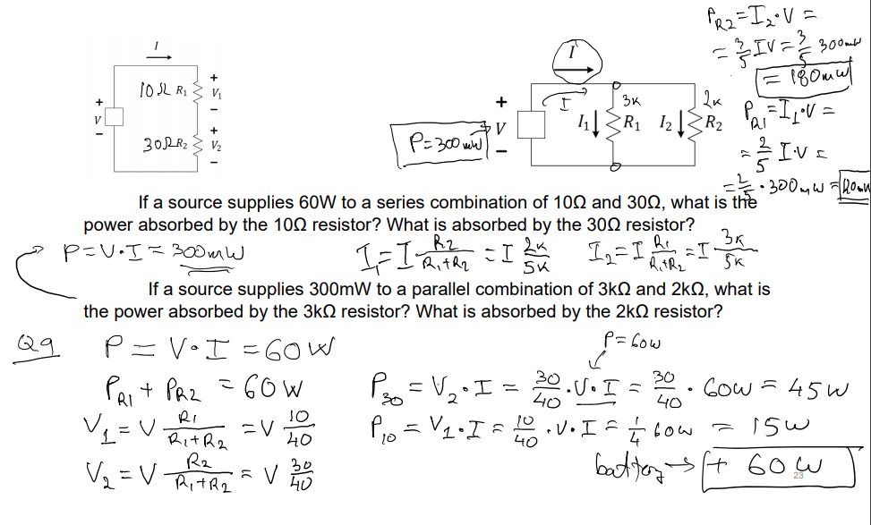
EXAMPLE

