Slide 1
COM234 ELECTRONICS
The Node Voltage Method

Slide 2
The Node Voltage Method
In this part, we will cover the following topics:
Some basic definitions
The steps for writing the Node-Voltage Equations
Tips on picking the best reference node
How to handle dependent sources

Slide 3
This material is covered in your textbook in the following sections:
Electric Circuits 10th Ed. by Nilsson and Riedel: Sections 4.1 through 4.3

Slide 4
Some Basic Definitions
Node – a place where two or more components meet
Essential Node – a place where three or more components meet
Reference Node – a special essential node that we choose as a reference point for voltages
You may be familiar with the word node from its use as a location in computer networks. It has a similar meaning there, a place where computers are connected.

Slide 5
Some Basic Definitions
A node is defined as a place where two or more components are connected.
The key thing to remember is that we connect components with wires. It doesn’t matter how many wires are being used; it only matters how many components are connected together.
How many nodes are there in this circuit here?
In the example circuit schematic given here, there are three nodes. These nodes are shown in yellow here.
Some students count more than three nodes in a circuit like this. When they do, it is usually because they have considered two points connected by a wire to be two nodes.
There are also three essential nodes. Each of these three nodes has at least 3 components connected to it.

Slide 6
The Node-Voltage Method (NVM)
The Node-Voltage Method (NVM) is a systematic way to write all the equations needed to solve a circuit, and to write just the number of equations needed. The idea is that any other current or voltage can be found from these node voltages.
This method is not that important in very simple circuits, but in complicated circuits it gives us an approach that will get us all the equations that we need, and no extras.
It is also good practice for the writing of KCL and KVL equations. Many students believe that they know how to do this, but make errors in more complicated situations. Our work on the NVM will help correct some of those errors.

Slide 7
The Node-Voltage Method (NVM)
The Node-Voltage Method steps are:
Find the essential nodes.
Define one essential node as the reference node.
Define the node voltages, the essential nodes with respect to the reference node. Label them.
Apply KCL for each non-reference essential node.
Write an equation for each current or voltage upon which dependent sources depend, as needed.

Slide 8
NVM – 1st Example
For most students, it seems to be best to introduce the NVM by doing examples. We will start with simple examples, and work our way up to complicated examples. Our first example circuit is given here.
The Node-Voltage Method steps are:
Find the essential nodes.
Define one essential node as the reference node.
Define the node voltages, the essential nodes with respect to the reference node. Label them.
Apply KCL for each non-reference essential node.
Write an equation for each current or voltage upon which dependent sources depend, as needed.

Slide 9
NVM – 1st Example
The Node-Voltage Method steps are:
Find the essential nodes.
Define one essential node as the reference node.
Define the node voltages, the essential nodes with respect to the reference node. Label them.
Apply KCL for each non-reference essential node.
Write an equation for each current or voltage upon which dependent sources depend, as needed.
There are three essential nodes, each of which is shown in red.

Slide 10
NVM – 1st Example
The Node-Voltage Method steps are:
Find the essential nodes.
Define one essential node as the reference node.
Define the node voltages, the essential nodes with respect to the reference node. Label them.
Apply KCL for each non-reference essential node.
Write an equation for each current or voltage upon which dependent sources depend, as needed.
We could choose any of the three essential nodes as the reference node. However, there are better choices. Remember that we need to write a KCL equation for each essential node, except for the reference node. The best idea, then, is to pick the node with the most connections, to eliminate the most difficult equation. Here this is the bottom node. It is labeled to show that it is the reference node.
This symbol is used to designate the reference node. There are different symbols used for this designation. This choice of symbols is not important. Making a designation is important.

Slide 11
NVM – 1st Example
The Node-Voltage Method steps are:
Find the essential nodes.
Define one essential node as the reference node.
Define the node voltages, the essential nodes with respect to the reference node. Label them.
Apply KCL for each non-reference essential node.
Write an equation for each current or voltage upon which dependent sources depend, as needed.
Note: As with any voltage, the polarity must be defined. We have defined the voltages by showing the voltages with a “+” and “-” sign for each. Strictly speaking, this should not be necessary. The words in step 3 make the polarity clear. Some texts do not label the voltages on the schematic. For clarity, we will label the voltages in these notes.
We have labeled the node voltages, v_{A} and v_{B}. They are shown in red. For clarity, we have also named the nodes themselves, A and B.

Slide 12
NVM – 1st Example
The Node-Voltage Method steps are:
Find the essential nodes.
Define one essential node as the reference node.
Define the node voltages, the essential nodes with respect to the reference node. Label them.
Apply KCL for each non-reference essential node.
Write an equation for each current or voltage upon which dependent sources depend, as needed.

Slide 13
NVM – 1st Example
The first term comes from Ohm’s Law. The voltage v_{A} is the voltage across R₁. Thus, the current shown in green is v_{A}/R₁, out of node A, and thus has a + sign in this equation.
The current through the current source is, by definition, given by the value of that current source. Since the reference polarity of the current is entering node A, it has a “-” sign.

Slide 14
NVM – 1st Example
This current expression also comes from Ohm’s Law. The voltage v_{X} is the voltage across the resistor R₂, and results in a current in the polarity shown.
To prove to yourself that v_{X} = v_{A} – v_{B}, take KVL around the loop shown. The voltage at A with respect to B, is v_{A} – v_{B}, where v_{A} and v_{B} are both node voltages.

Slide 15
NVM – 1st Example
The KCL equation for the A node was:
The KCL equation for the B node is:
Be very careful that you understand the signs of all these terms. One of the big keys in these problems is to get the signs correct. If you have questions, review this material.

Slide 16
NVM – 1st Example
The Node-Voltage Method steps are:
Find the essential nodes.
Define one essential node as the reference node.
Define the node voltages, the essential nodes with respect to the reference node. Label them.
Apply KCL for each non-reference essential node.
Write an equation for each current or voltage upon which dependent sources depend, as needed.
There are no dependent sources in this circuit, so we can skip step 5. We should now have the same number of equations (2) as unknowns (2), and we can solve.
Note that we have assumed that all the values of the resistors and sources have been given. If not, we will need to get more information before we can solve.

Slide 17
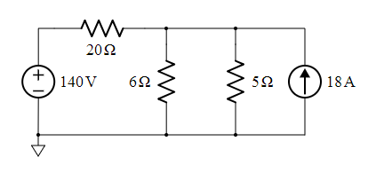
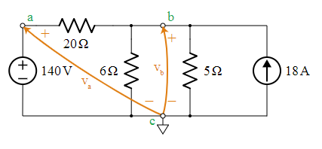
NVM 2nd Example
Our example circuit has three nodes, a, b and c, so N=3. Node c has 4 connections and it connects directly to both sources. This make it a good candidate to play the role of reference node. Node c has been marked with the ground symbol to let everyone know our choice for reference node.
We also call out N-1 =2 node voltages on the schematic, labeled in orange as Va and Vb
There is an obvious opprtunity here to simplify the two parallel resistors, 6 ohm with 5 ohm. We will not do that, because we want to study the Node Voltage Method procedure.

Slide 18
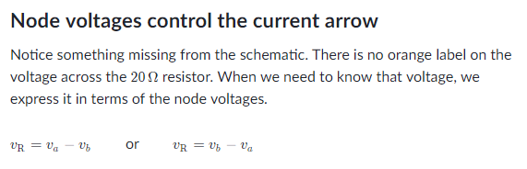
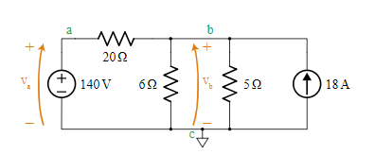
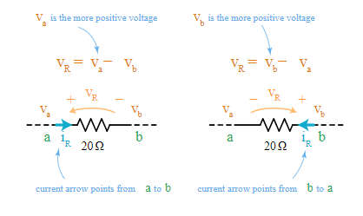
NVM 2nd Example

Slide 19
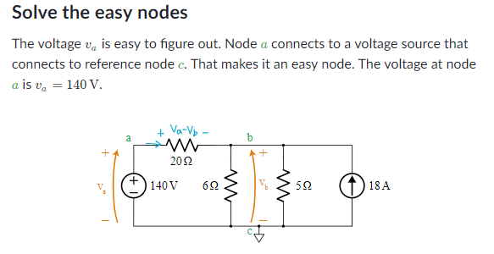
NVM 2nd Example

Slide 20
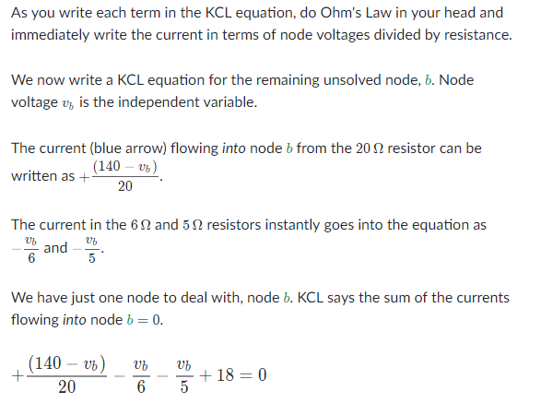
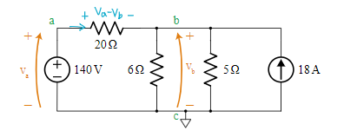
NVM 2nd Example

Slide 21
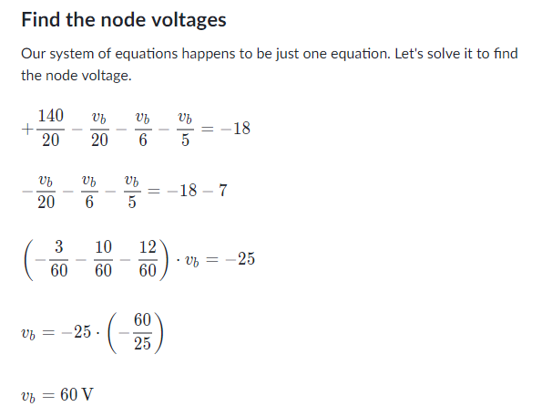
NVM 2nd Example

Slide 22
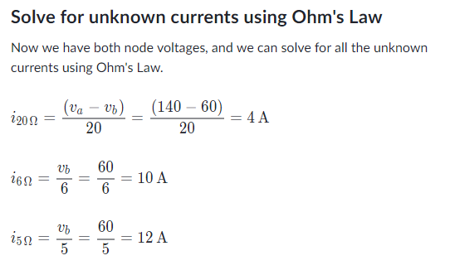
NVM 2nd Example

Slide 23
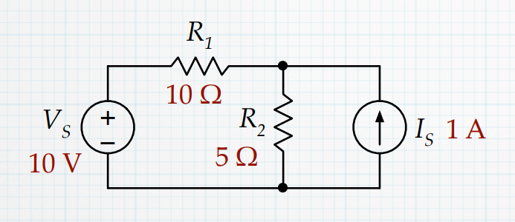
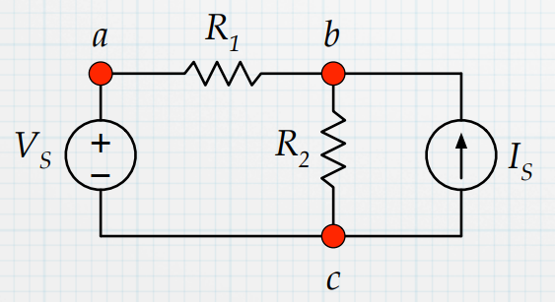
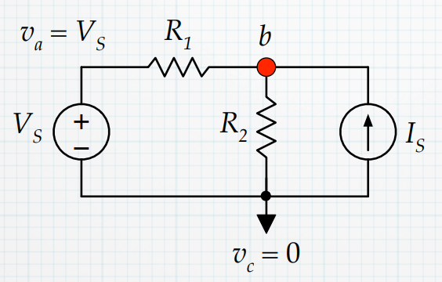
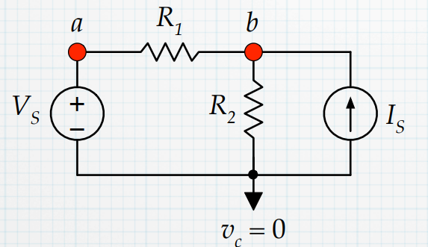

Slide 24

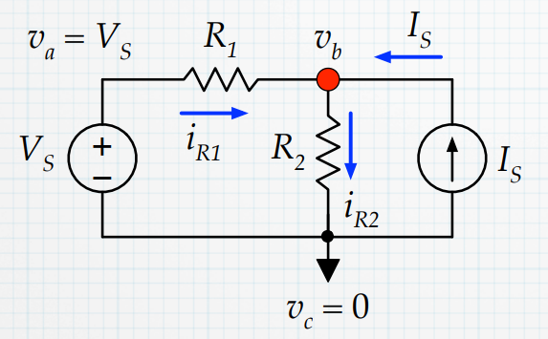
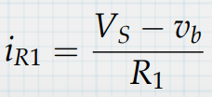
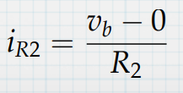
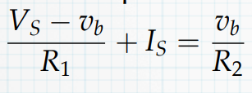

Slide 25
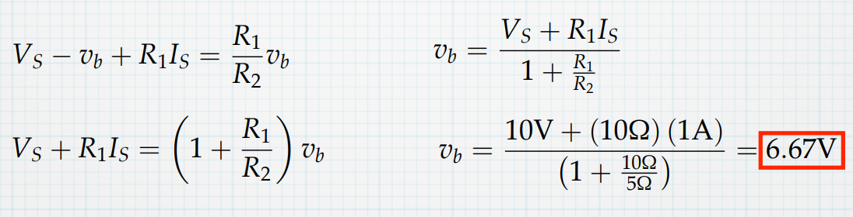
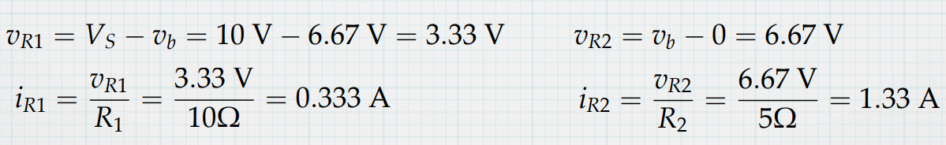

Slide 26
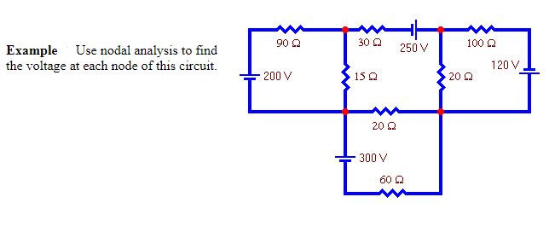

Slide 27
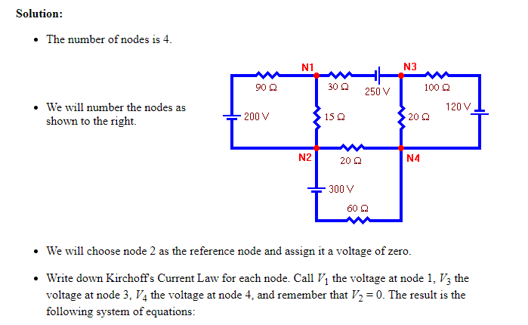
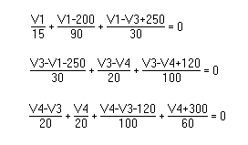

Slide 28
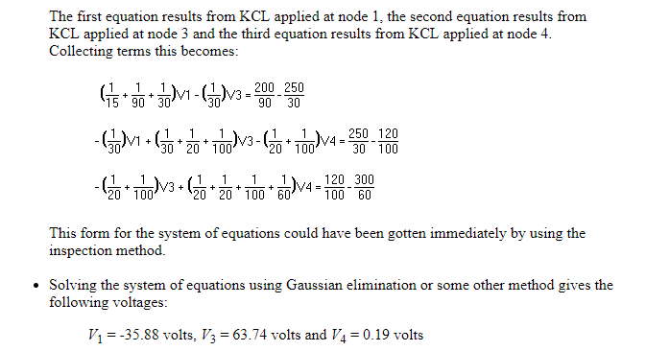

Slide 29
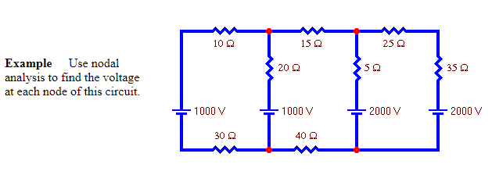

Slide 30
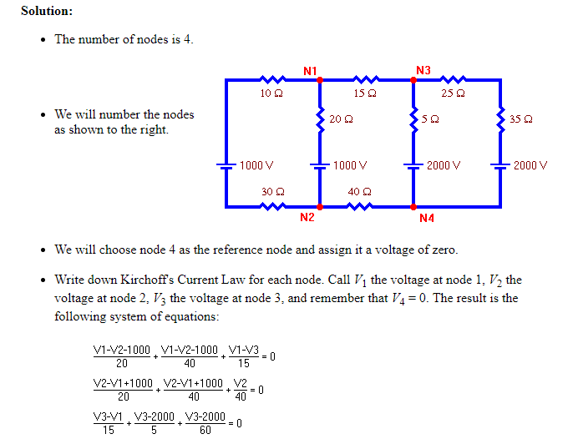

Slide 31
