Slide 1
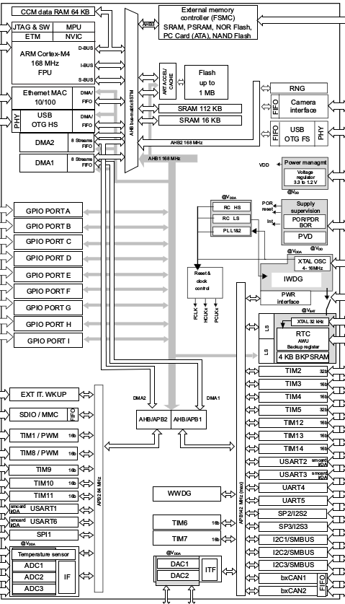
ARM Microcontroller Workshop

Slide 2
ARM Microcontroller Workshop

Slide 3
What is ARM
ARM does not sell chips
ARM sells IP cores
  See http://en.wikipedia.org/wiki/Semiconductor_intellectual_property_core

Slide 4
ARMx vs ARMvx
ARMx: Family of similar cores.
  ARM7: since 1998 (ARM7TDMI)
  ARM11: since 2002 (Raspberry Pi)
  CORTEX-{A,R,M}
ARMvx: Version of the instruction set
  ARMv6: Raspberry Pi v1, ARM7TDMI
  ARMv7-M: Microcontroller
  ARMv7-A: Smartphone, Raspberry Pi v2
  ARMv8-A: Server, future Smartphone (64 bit)

Slide 5
CORTEX-{A,R,M}
Latest architecture from ARM
  A: Application
  R: Real-Time
  M: Microcontroller
    M0
    M0+: Improved M0, the smallest core from ARM
    M1: For FPGAs
    M3: r0ket
    M4: latest midrange, with floating point
    M7

Slide 6
Thumb (2) vs. 32 bit ARM
Traditional ARM instructions are 32 bit long
Thumb mode was introduced to generate smaller code with 16 bit instructions
  Thumb2 can use use 16 bit and 32 bit instructions at the same time
All Cortex-Mx controllers use the thumb mode to execute code.

Slide 7
ARM Microcontrollers
The ARM core is only a small part of an ARM microcontroller
There are lots of different ways to implement the different peripherals
  Timers
  GPIOs
  DMA
  USB
  Ethernet
  NVIC
Manufacturers usually supply lots of libraries for these components

Slide 8
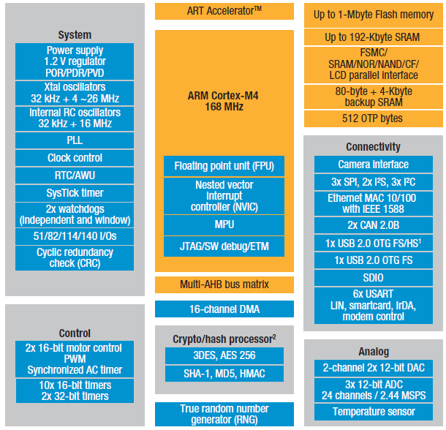
ARM Microcontrollers

Slide 9
Memory Maps
ARM presents itself as a von Neumann architecture
  Code, data and peripherals live in the same address space
To understand whats happening inside the MCU, you should know this memory map

Slide 10
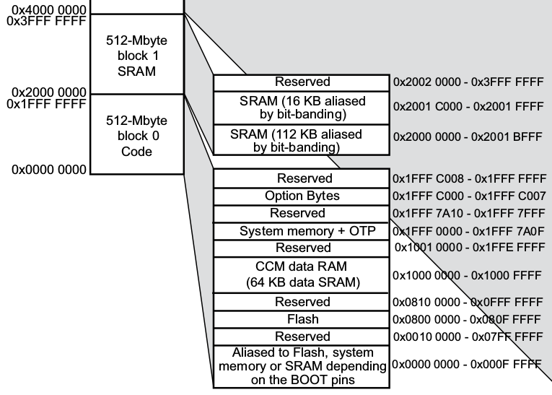
Memory Maps

Slide 11
Interrupts
Interrupts can be caused by hardware components
  They interrupt normal code execution and cause a jump to another code region
  Reset is also an interrupt!
The MCU needs to know where to jump to
The vector table contains a list of addresses
  Each entry corresponds to an interrupt source
After reset, the table is expected at the start of the flash memory
Initial stack pointer value is the first entry

Slide 12
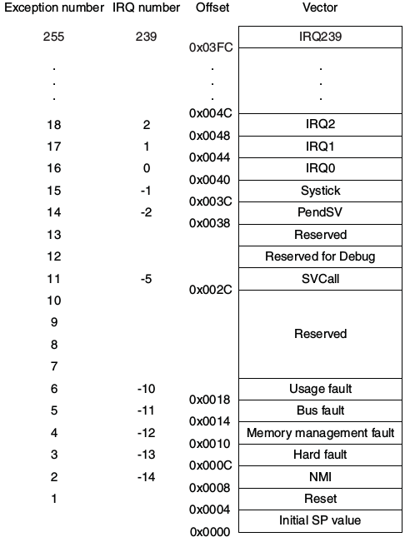
Interrupts

Slide 13
Memory Mapped I/O and Peripherals
All interaction with the GPIOs and other peripherals goes through memory mapped I/O
There are no special I/O instructions
Consult the datasheet for memory addresses of the different peripherals

Slide 14
Toolchains
Keil MDK-ARM
IAR Embedded Workbench
ARM Development Studio
gcc
  Focus of this workshop
  Patches maintained by ARM
  https://launchpad.net/gcc-arm-embedded

Slide 15
Setting up gcc for ARM
Grab the archive for your system from https://launchpad.net/gcc-arm-embedded/+download
Extract archive
Add gcc-arm-none-eabi-4_9-2014q4/bin to you PATH
Verify by calling arm-none-eabi-gcc -v

Slide 16
Setting up Chip tools
Grab stlink from https://github.com/texane/stlink
Build
Install udev rules (or run tools with sudo)
st-util acts as a gdbserver to allow debugging and flashing
See: http://www.wolinlabs.com/blog/linux.stm32.discovery.gcc.html

Slide 17
Contents of the project template
Makefile
  Build instructions for the project
Linker script
  Defines Memory layout and sections
Device specific headers and libraries
  Describe peripherals and chip properties
  CMSIS + STM32 drivers

Slide 18
Get datasheet, reference manual, programmers guide and errata
Hello world (blink an LED)
Compile
Flash
Profit

