Slide 1


Mitigating Ciphertext Side-Channel Attacks
against TEE-Shielded Neural Networks
Qianhui Dai¹, Zhen Huang¹, Guoxing Chen¹, Yan Meng¹, Yinqian Zhang², Haojin Zhu¹
¹Shanghai Jiao Tong University ²Southern University of Science and Technology
Notes:
[15 s] Hello everyone, I'm Qianhui Dai from Shanghai Jiao Tong University. This talk is about defending neural-network inference inside confidential VMs against ciphertext side-channel attacks.

Slide 2
Cloud-Based NNs Use Confidential Computing
Cloud Environment
Cloud host
Cloud Tenant
Confidential VM (CVM)
deploy
model
input
NN workload
input
model
input
NN workloads in the cloud often run inside CVMs for secure computation
Notes:
[20 s] Today many programs run in the public cloud, on servers we do not control. To protect them from the cloud host, providers such as Azure, Google Cloud and AWS offer confidential VMs: the program and its data run inside a CVM, isolated from the host.

Slide 3
Ciphertext Side Channels in CVMs
Confidential VMs
memory is encrypted
C =
Enc_{k}
(
text
,
address
,
counter
)
One address, over time
Attacker Capabilities
Time
Value (hidden)
Ciphertext (visible)
✓
see ciphertext of every write
t1
0.00
7f3a…
t2
1.37
9c11…
✓
know program binary
t3
0.00
7f3a…
✗
collision
obtain the encryption key
t4
0.00
7f3a…
✗
modify or replay memory
t5
2.05
04e8…
Notes:
[55 s] Here is the consequence. Watch one memory address over time. The host cannot read the values, but it sees that the ciphertext at t3 and t4 equals the one at t1. So the same value was written again. We call this a ciphertext collision.
The attacker is the cloud host, or anyone with a probe on the memory bus. It sees the ciphertext and address of every write and knows the model and the code; it cannot decrypt and cannot modify memory. This channel was first shown by CipherLeaks on AMD SEV, where it broke constant-time crypto.

Slide 4
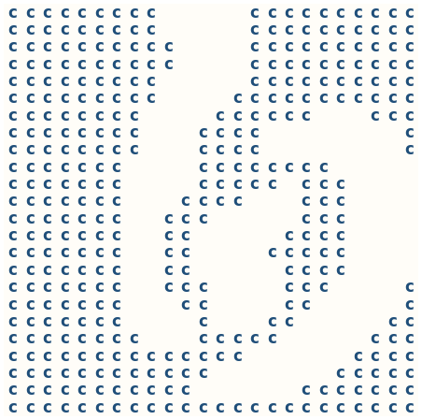
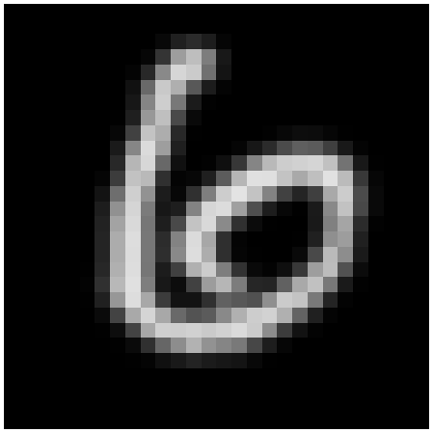
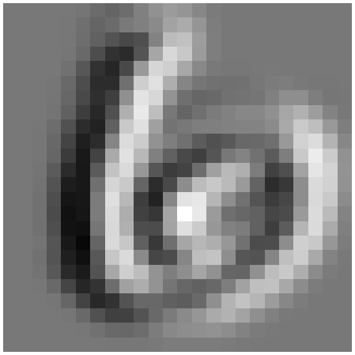
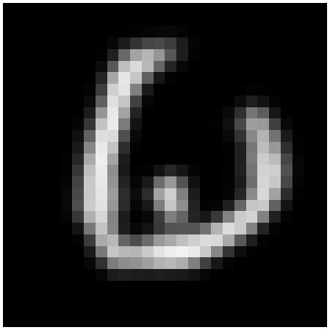
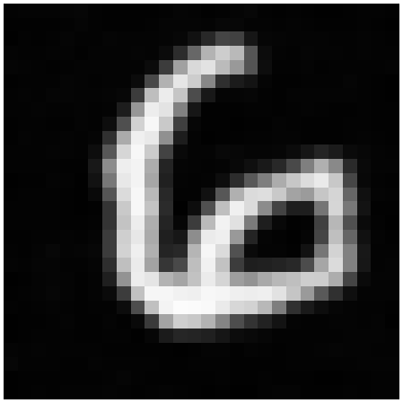
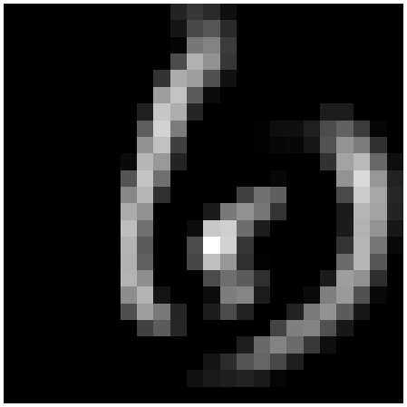
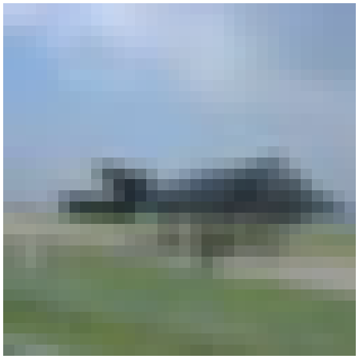
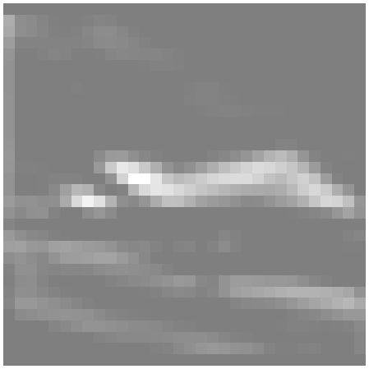
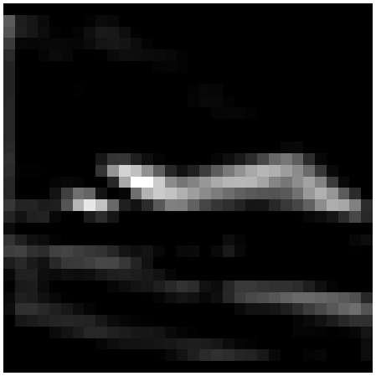
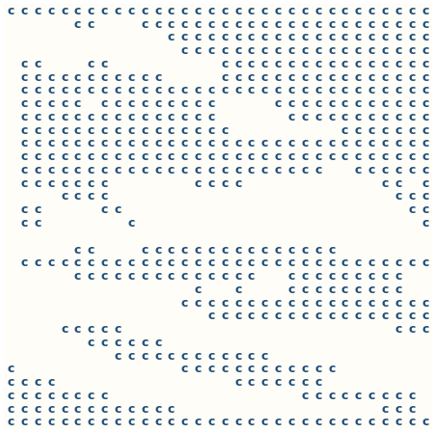

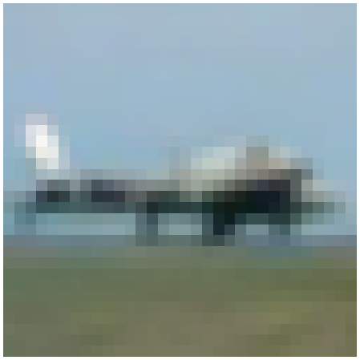
Ciphertext Side Channels in NNs
CipherSteal (S&P 25):
Collision Trace
Input x
Conv.
ReLU
c = collision
Sketch h
Recon. x*
black = 0
Compute
Generator
Weight W
Attack Pipeline
HyperTheft (CCS 24): the collision trace also leaks the weights W
Notes:
[80 s] This is how the leak becomes an attack, CipherSteal at S&P 2025, step by step.
The private input X and the weights W go through a convolution and a ReLU. ReLU writes every negative value as exactly zero. Every zero written to the same place gives the same ciphertext, so in the trace the host sees a dense pattern of repeated ciphertexts: the ones here.
Where ReLU writes zero follows the content of the image, so decoding this pattern gives the outline h: you can already see the deer and the boat.
The last step is not leakage: a generator, trained offline on the attacker's own images, turns the outline into a realistic picture x*. Keep this split in mind: the outline comes from the trace, the details come from the generator.
The same trace is also used to steal the model weights, in HyperTheft at CCS 2024; I'll only mention it.

Slide 5
Existing Defenses
CipherFix (USENIX Sec 23)
value
+
metadata
ZebraFix (RAID 25)
extra space
Generic hardening of every write
X
conv.
ReLU
conv.
ReLU
…
FC
Y
W
+692% ~ +2466% inference time
The general defense incurs high overhead
Notes:
[50 s] How do we defend? The generic answer is to remove every collision. In hardware that means putting the per-write counter back, which is exactly what CVMs removed for scale, so it is not what today's CPUs do.
In software, Cipherfix and Zebrafix find every write that depends on a secret and randomize it with masks or counters. In a network the input and the weights flow into every layer, so nearly every write is protected, and inference gets seven to twenty-six times slower. That is over-protection. So the question is: which collisions really need protection?

Slide 6
Protection from the Attacker's Perspective
Existing defenses
incur high overhead
Must every collision be protected?
Goal: no useful victim-specific information from the trace
What information does the collision trace reveal?
Assessment limited to attacker-provided outputs
CipherSteal Example: reconstructed image
?
Attack Output ⇒ Leakage?
Notes:
[65 s] The obvious yardstick is: does the attack still reconstruct a good image? It does not work. Top row: with the victim's real trace, CipherSteal returns a sharp airliner, but the victim was a fighter jet. Bottom row: we fed the attack an empty trace, with no victim information at all, and it still produced a sharp horse. The detail comes from the attacker's generator, not from the trace.
What is real is the outline, and with it the class of the object; the details are not a leak.
So we measure what the trace itself adds. Take the same attack with the same prior, and run it twice: once on the victim's trace, once on a mismatched trace recorded from another input. Whatever the attack still gets right with the wrong trace comes from its prior. The difference in score is the trace utility. It is a general definition: it works for any attack and any target, an image, a label or the weights. The defense goal is trace utility close to zero. And since the real leak is the class, our score is simply: does the attack's output give the victim's class?

Slide 7
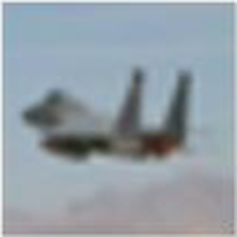
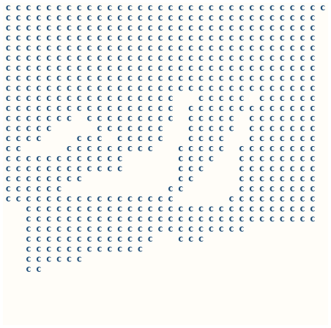
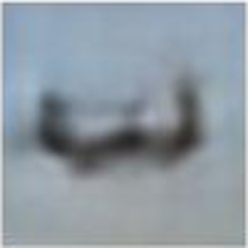

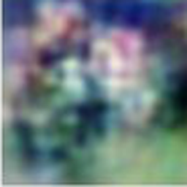
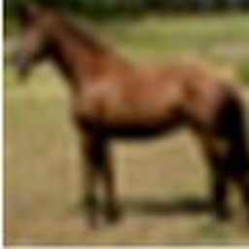
Attributing Attack Output
Victim-trace example
Reference
Input
Trace
Sketch
Attack Output
Reconstruction =
trace part + prior part
Empty-trace example
Reconstruction quality is not a valid criterion
No victim
information
Empty
trace
Our criterion: exclude the prior part, count only what the victim's trace adds
Notes:
[65 s] The obvious yardstick is: does the attack still reconstruct a good image? It does not work. Top row: with the victim's real trace, CipherSteal returns a sharp airliner, but the victim was a fighter jet. Bottom row: we fed the attack an empty trace, with no victim information at all, and it still produced a sharp horse. The detail comes from the attacker's generator, not from the trace.
What is real is the outline, and with it the class of the object; the details are not a leak.
So we measure what the trace itself adds. Take the same attack with the same prior, and run it twice: once on the victim's trace, once on a mismatched trace recorded from another input. Whatever the attack still gets right with the wrong trace comes from its prior. The difference in score is the trace utility. It is a general definition: it works for any attack and any target, an image, a label or the weights. The defense goal is trace utility close to zero. And since the real leak is the class, our score is simply: does the attack's output give the victim's class?

Slide 8
Measuring the Attacker's Gain
Trace utility (TU)
Trace-to-label attack
victim's trace
same
attack
prior part
leak
collision trace
trace classifier F_{c}
label ŷ
score
mismatched trace
prior part
TU
score
Cons: rate of ŷ = victim's prediction
TU = score_{victim} − score_{mismatch}
TU^{cons} = Cons_{victim} − Cons_{mismatch}
Defense goal: TU ≈ 0
Notes:
[65 s] The obvious yardstick is: does the attack still reconstruct a good image? It does not work. Top row: with the victim's real trace, CipherSteal returns a sharp airliner, but the victim was a fighter jet. Bottom row: we fed the attack an empty trace, with no victim information at all, and it still produced a sharp horse. The detail comes from the attacker's generator, not from the trace.
What is real is the outline, and with it the class of the object; the details are not a leak.
So we measure what the trace itself adds. Take the same attack with the same prior, and run it twice: once on the victim's trace, once on a mismatched trace recorded from another input. Whatever the attack still gets right with the wrong trace comes from its prior. The difference in score is the trace utility. It is a general definition: it works for any attack and any target, an image, a label or the weights. The defense goal is trace utility close to zero. And since the real leak is the class, our score is simply: does the attack's output give the victim's class?

Slide 9
Defense Design
Rewrite the low bits at every write
Time
t1
t2
t3
t4
t5
value
0
3.1
0
0.8
0
0
ψ1
3.1
0
ψ2
0.8
0
ψ3
written
kept
low bits: ψ
ψ ← ψ + Δ every write
Notes:
[55 s] The design is one rewrite at each protected write-back. We keep the sign, exponent and high mantissa bits and replace a small low-order window with a fixed signature and a payload that changes on every write. A ReLU zero becomes a tiny positive number whose bits differ every time.
Two effects. The single zero pattern becomes two-to-the-p patterns, so the repeated-zero collisions disappear. And because the perturbed zero flows downstream, accumulations that used to leave memory unchanged now change it. Nothing is stored on the side and nothing has to be unmasked. It is an LLVM pass in the TVM and Glow compilers; the perturbation is 5 times 10 to the minus 4, which the network tolerates.

Slide 10
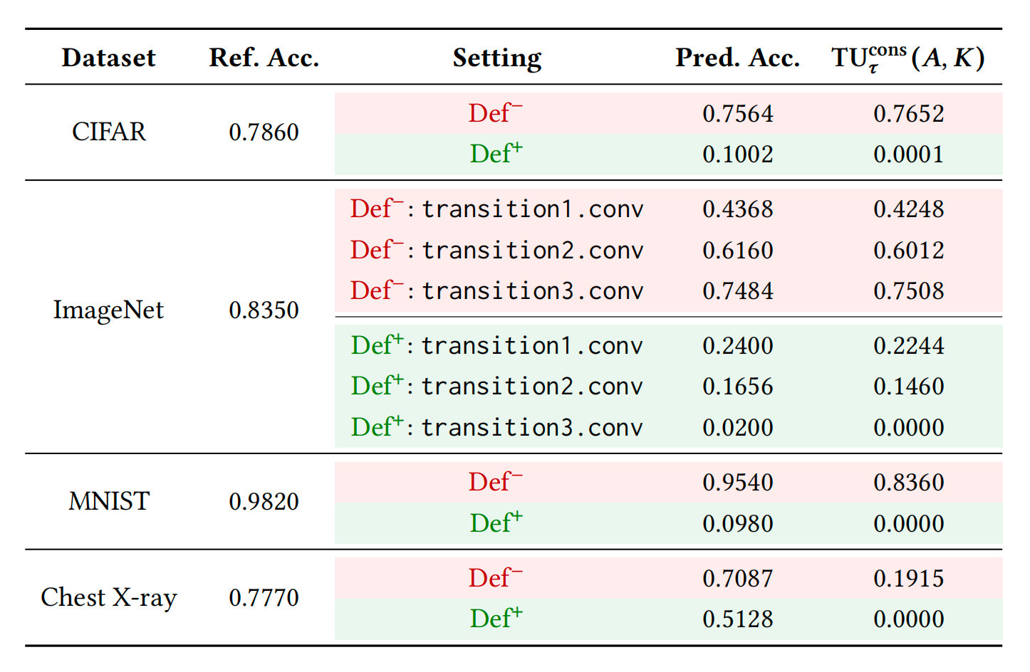
Trace Utility Results
TU^{cons} = Cons_{victim} − Cons_{mismatch}
Notes:
[40 s] The picture showed the outline is gone. Now the class, with the trace utility we defined: score with the victim's trace minus score with a mismatched trace, where the score is whether the attack gives the victim's class.
We use the most direct attack: no generator in between, a classifier reads the class straight from the trace. Without defense, the victim's own trace adds up to 0.84. With the defense, zero on all four datasets: the trace no longer tells the attacker anything about the victim's class.

Slide 11

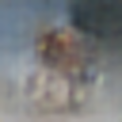


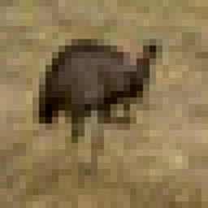
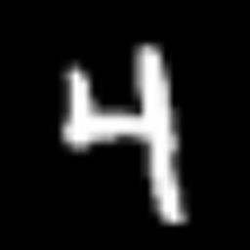
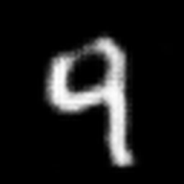
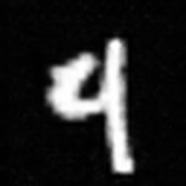
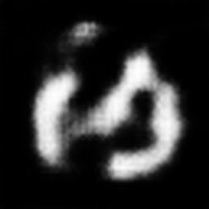
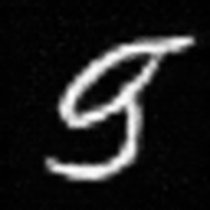
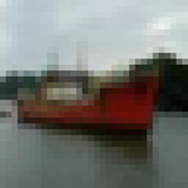


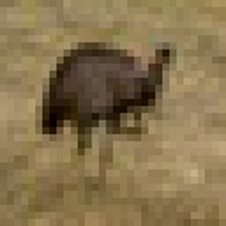

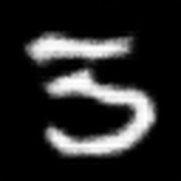
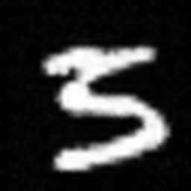
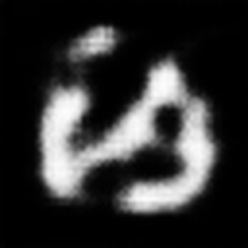
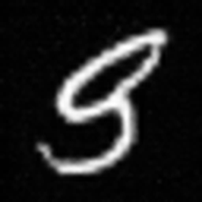


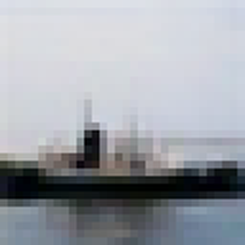

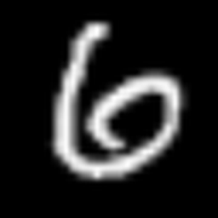
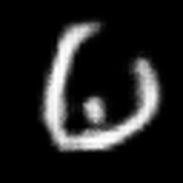
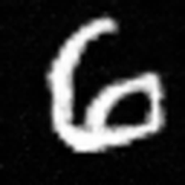
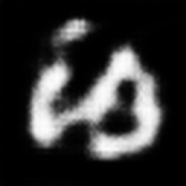
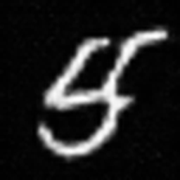
Reconstruction Results
CIFAR
MNIST
no defense
our defense
no defense
our defense
input x
h
x*
h
x*
input x
h
x*
h
x*
Consistent with TU ≈ 0: the attack output no longer depends on the input
Notes:
[50 s] Let's go back to the attack chain from the beginning, now with two rows. Top row, no defense: ReLU writes zeros, the zeros repeat in the ciphertext, and the deer and the boat get different outlines. That difference is what the trace leaks.
Bottom row, the same chain with our defense. ReLU no longer writes zeros; it writes a fresh small value each time. So nothing repeats, and the outline is the same blob for the deer and for the boat. The generator still outputs a realistic picture, the same bird for both. A realistic image is not evidence of a leak, so we do not judge this by the picture; we measure trace utility, next slide.

Slide 12
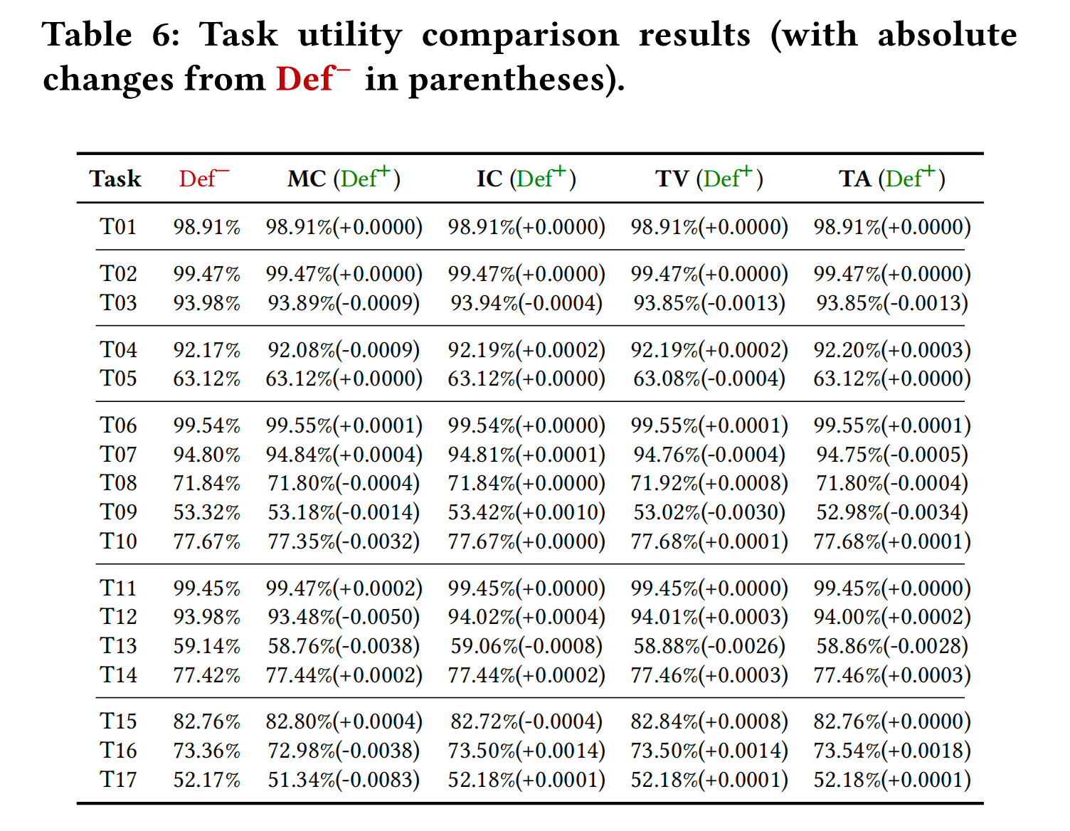
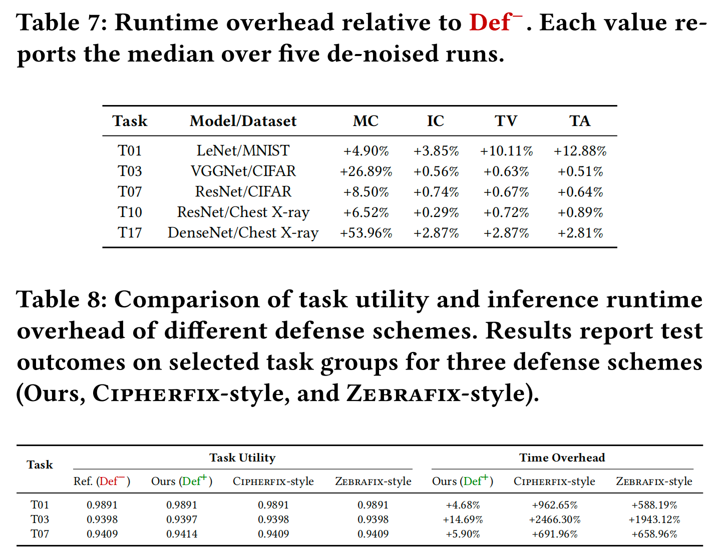
Further Evaluation
Task Utility
Runtime Overhead
Notes:
[40 s] Three more results. First, even though we did not set out to remove every collision, the collision rate itself drops: repeated-zero collisions go from 40 to 63 percent of ReLU writes to zero, and unchanged-update collisions from 14 to 52 percent to below one percent on most models.
Second, accuracy changes by less than one percent, in absolute terms, on all 17 tasks and all four compiler paths.
Third, runtime. On the same three models, Cipherfix- and Zebrafix-style protection costs 600 to 2500 percent, because they protect almost every write. Ours costs 5 to 15 percent: more than a hundred times less.

Slide 13
Thank you!
Notes:
[Q&A]

