Slide 1

UNIT LAYANAN BAHASA UNY
TOEFL ITP LEVEL 1
WORKSHOP
90 MINUTES
Reading
Comprehension
Skills 1-13
Longman Reading
Question types, Longman strategies, guided practice, and discussion
DRAFT v1
Notes:
Source: /media/miko/nextcloud-transit/TEMP/materi_protefl/3. LONGMAN 2001 - Complete Course_RDG Ed 190404.pdf; Workshop structure based on book pages 183-246 / PDF pages 1-64.
Draft cover. Replace presenter name and event date after confirmation.

Slide 2
UNIT LAYANAN BAHASA UNY
ORIENTATION
Alur workshop
0-16
Dasar Reading dan peta 13 skills
16-41
Ideas of the Passage dan Directly Answered Questions
41-65
Indirectly Answered dan Vocabulary Questions
65-73
Overall Review Questions
73-88
Optional full passage dan pembahasan
88-90
Final checklist dan closing
02
Notes:
Source: /media/miko/nextcloud-transit/TEMP/materi_protefl/3. LONGMAN 2001 - Complete Course_RDG Ed 190404.pdf; Workshop timing authored for this deck.
If time is short, skip slides 25-27 and go directly to slide 28.

Slide 3
UNIT LAYANAN BAHASA UNY
ORIENTATION
Dasar Reading Comprehension
Passage menyediakan bukti. Jenis pertanyaan menentukan cara mencarinya.
1.
Pertanyaan pilihan ganda harus dijawab dari passage.
2.
Line reference membatasi area baca, bukan memberi jawaban langsung.
3.
Keyword sering muncul sebagai sinonim atau restatement.
4.
Pilihan yang memakai kata sama dapat tetap salah secara makna.
5.
Strategi berbeda untuk main idea, detail, inference, vocabulary, dan overall review.
03
Notes:
Source: /media/miko/nextcloud-transit/TEMP/materi_protefl/3. LONGMAN 2001 - Complete Course_RDG Ed 190404.pdf; Synthesis of Longman Skills 1-13.
Avoid adding current test timing or item counts until verified against the current ETS bulletin.

Slide 4
UNIT LAYANAN BAHASA UNY
ORIENTATION
Peta 13 skills Longman
IDEAS
DIRECT
INDIRECT
VOCABULARY
OVERALL
1 Main Idea
2 Organization
3 Stated Detail
4 Unstated Detail
5 Pronoun Referents
6 Implied Detail
7 Transition Questions
8 Structural Clues
9 Word Parts
10 Difficult Words
11 Simple Words
12 Location
13 Tone, Purpose, Course
Urutan workshop mengikuti urutan sumber, bukan taksonomi baru.
04
Notes:
Source: /media/miko/nextcloud-transit/TEMP/materi_protefl/3. LONGMAN 2001 - Complete Course_RDG Ed 190404.pdf; Book pages 183-246 / PDF pages 1-64.

Slide 5
UNIT LAYANAN BAHASA UNY
ORIENTATION
Pola kerja umum
1
Kenali jenis pertanyaan
2
Ambil keyword atau ide kunci
3
Batasi area baca
4
Baca bukti dan konteks
5
Eliminasi pilihan
05
Notes:
Source: /media/miko/nextcloud-transit/TEMP/materi_protefl/3. LONGMAN 2001 - Complete Course_RDG Ed 190404.pdf; Synthesis of the repeated How to Answer the Question tables in Skills 1-13.

Slide 6
UNIT LAYANAN BAHASA UNY
IDEAS OF THE PASSAGE
Skill 1: Main Idea Questions
How to identify
topic | subject | main idea | main point | best title
Where to find the answer
The first sentence of each paragraph
Read the first lines, find the common theme, check the rest quickly, then eliminate choices that are too narrow or incomplete.
06
Notes:
Source: /media/miko/nextcloud-transit/TEMP/materi_protefl/3. LONGMAN 2001 - Complete Course_RDG Ed 190404.pdf; Book pages 183-184 / PDF pages 1-2.

Slide 7
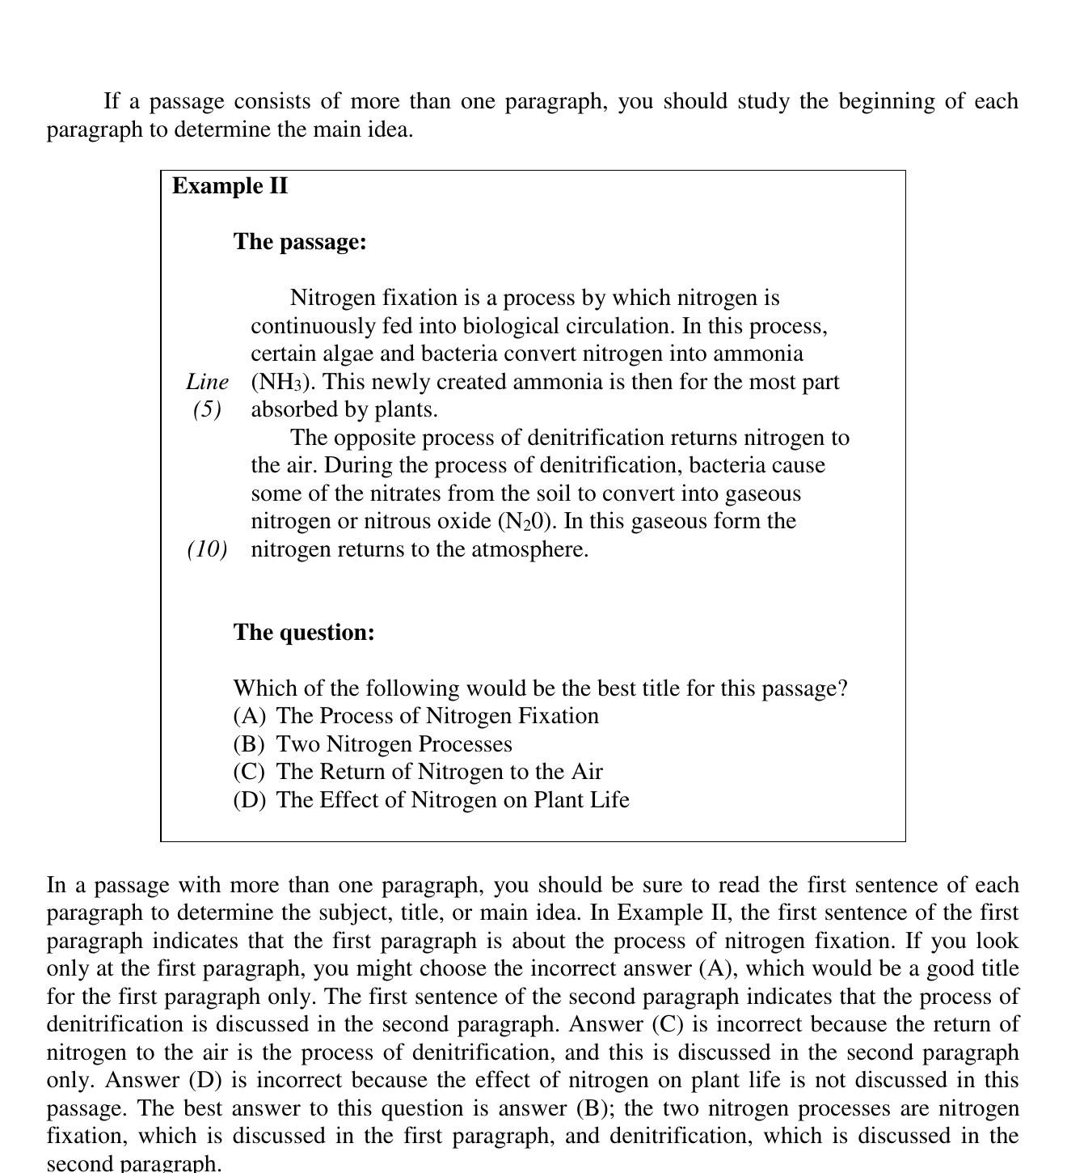
UNIT LAYANAN BAHASA UNY
IDEAS OF THE PASSAGE
Kerja bersama: main idea
Fokus
1.
Kalimat pertama paragraf 1
2.
Kalimat pertama paragraf 2
3.
Common theme
4.
Pilihan yang mencakup keduanya
Jawaban dibuka setelah bukti ditemukan.
07
Notes:
Source: /media/miko/nextcloud-transit/TEMP/materi_protefl/3. LONGMAN 2001 - Complete Course_RDG Ed 190404.pdf; Book page 184 / PDF page 2.
Answer: (B) Two Nitrogen Processes. Ask why A and C only cover one paragraph.

Slide 8
UNIT LAYANAN BAHASA UNY
IDEAS OF THE PASSAGE
Skill 2: Organization of Ideas
Tentukan main idea setiap paragraf, lalu identifikasi hubungannya.
supports
gives examples
explains an effect
continues a sequence
refutes
Contoh baseball
Paragraf 1 memberi kredit kepada Abner Doubleday. Paragraf 2 menyatakan bahwa sejarawan olahraga tidak menyetujui klaim tersebut.
Hubungan: the second paragraph refutes the idea in the first paragraph.
08
Notes:
Source: /media/miko/nextcloud-transit/TEMP/materi_protefl/3. LONGMAN 2001 - Complete Course_RDG Ed 190404.pdf; Book page 187 / PDF page 5.

Slide 9
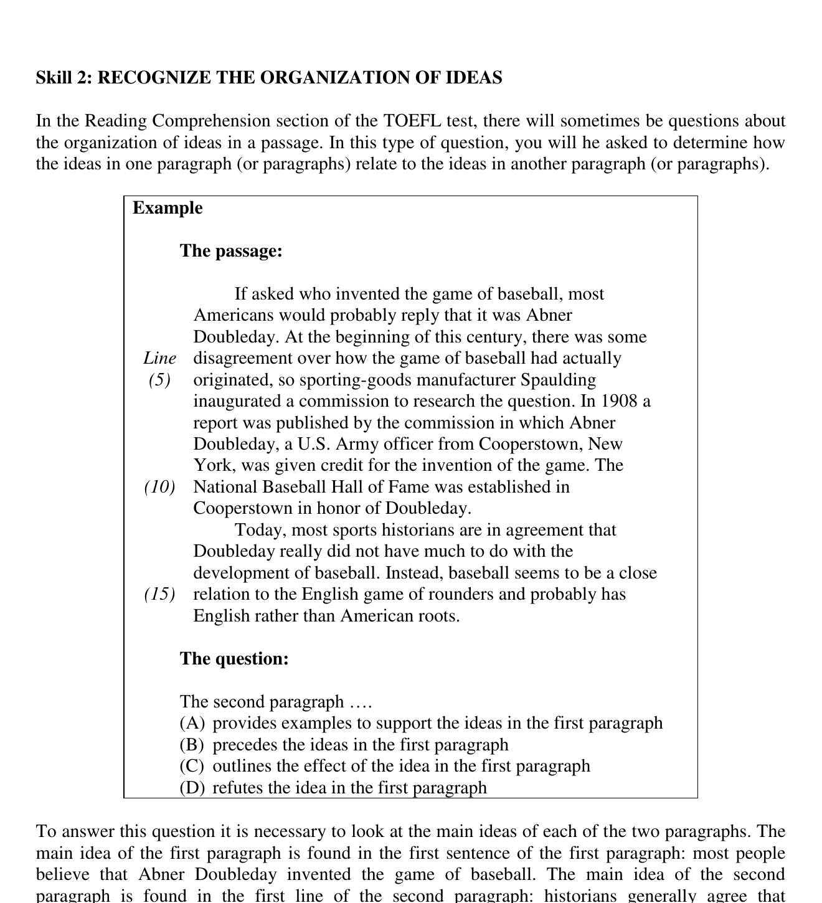
UNIT LAYANAN BAHASA UNY
IDEAS OF THE PASSAGE
Kerja bersama: hubungan antarparagraf
Pertanyaan diskusi
1.
Apa ide utama paragraf 1?
2.
Apa ide utama paragraf 2?
3.
Kata apa menandai perubahan arah?
4.
Hubungan mana paling tepat?
09
Notes:
Source: /media/miko/nextcloud-transit/TEMP/materi_protefl/3. LONGMAN 2001 - Complete Course_RDG Ed 190404.pdf; Book page 187 / PDF page 5.
Answer: (D) refutes the idea in the first paragraph.

Slide 10
UNIT LAYANAN BAHASA UNY
DIRECTLY ANSWERED
Skills 3-5: Directly Answered Questions
3
Stated Detail
Cari keyword dan restatement.
4
Unstated Detail
Buktikan tiga pilihan; jawab yang tidak dinyatakan.
5
Pronoun Referents
Cari noun sebelumnya; periksa makna dan singular/plural.
10
Notes:
Source: /media/miko/nextcloud-transit/TEMP/materi_protefl/3. LONGMAN 2001 - Complete Course_RDG Ed 190404.pdf; Book pages 191-205 / PDF pages 9-23.

Slide 11
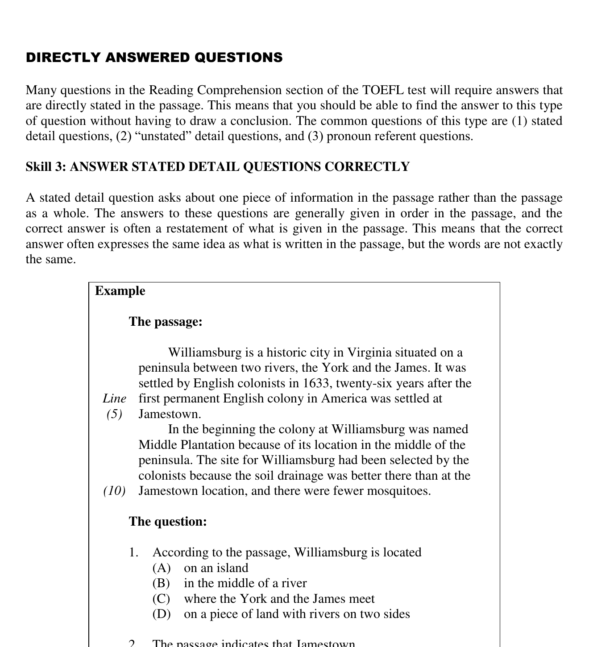
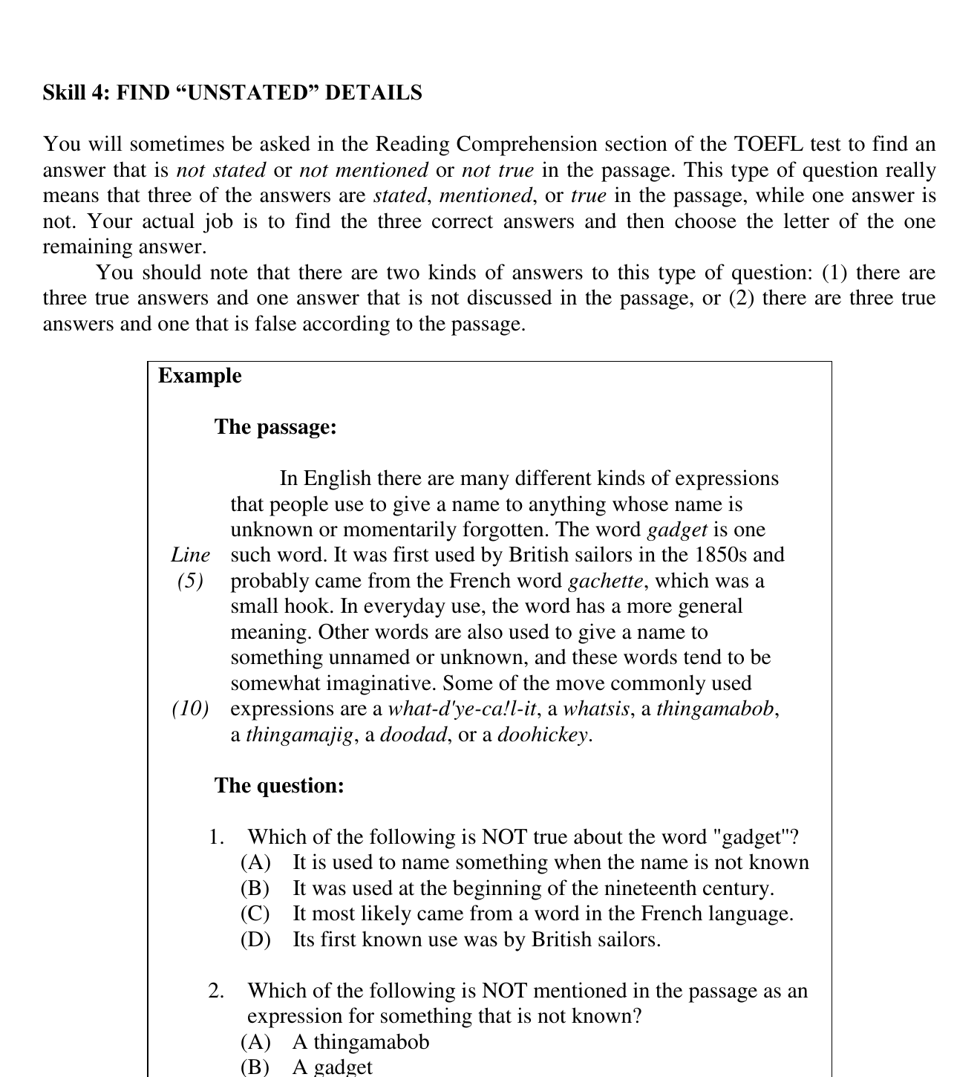
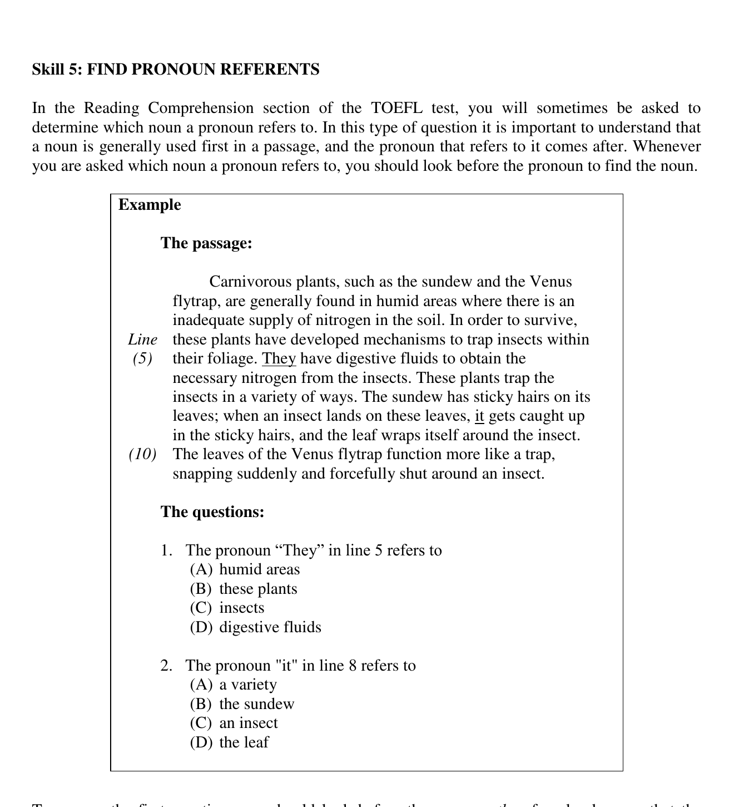
UNIT LAYANAN BAHASA UNY
DIRECTLY ANSWERED
Kerja bersama: keyword, NOT, referent
STATED
NOT / EXCEPT
REFERENT
11
Notes:
Source: /media/miko/nextcloud-transit/TEMP/materi_protefl/3. LONGMAN 2001 - Complete Course_RDG Ed 190404.pdf; Book pages 191, 195, 198 / PDF pages 9, 13, 16.
Use one representative question from each source page. Preserve the original A-D order.

Slide 12
UNIT LAYANAN BAHASA UNY
DIRECTLY ANSWERED
Pembahasan Skills 3-5
EVIDENCE
Kalimat atau line yang mendukung jawaban
RESTATEMENT
Hubungan kata pada pertanyaan dan passage
ELIMINATION
Alasan distractor tidak sesuai
Kata yang sama tidak menjamin makna yang sama.
12
Notes:
Source: /media/miko/nextcloud-transit/TEMP/materi_protefl/3. LONGMAN 2001 - Complete Course_RDG Ed 190404.pdf; Discussion framework authored from Longman answer explanations.

Slide 13
UNIT LAYANAN BAHASA UNY
INDIRECTLY ANSWERED
Skills 6-7: Indirectly Answered Questions
6
Implied Detail
Gabungkan fakta yang relevan. Pilih kesimpulan yang paling kuat didukung tanpa asumsi tambahan.
7
Transition Questions
Gunakan awal passage untuk preceding paragraph dan akhir passage untuk following paragraph.
13
Notes:
Source: /media/miko/nextcloud-transit/TEMP/materi_protefl/3. LONGMAN 2001 - Complete Course_RDG Ed 190404.pdf; Book pages 206-216 / PDF pages 24-34.

Slide 14
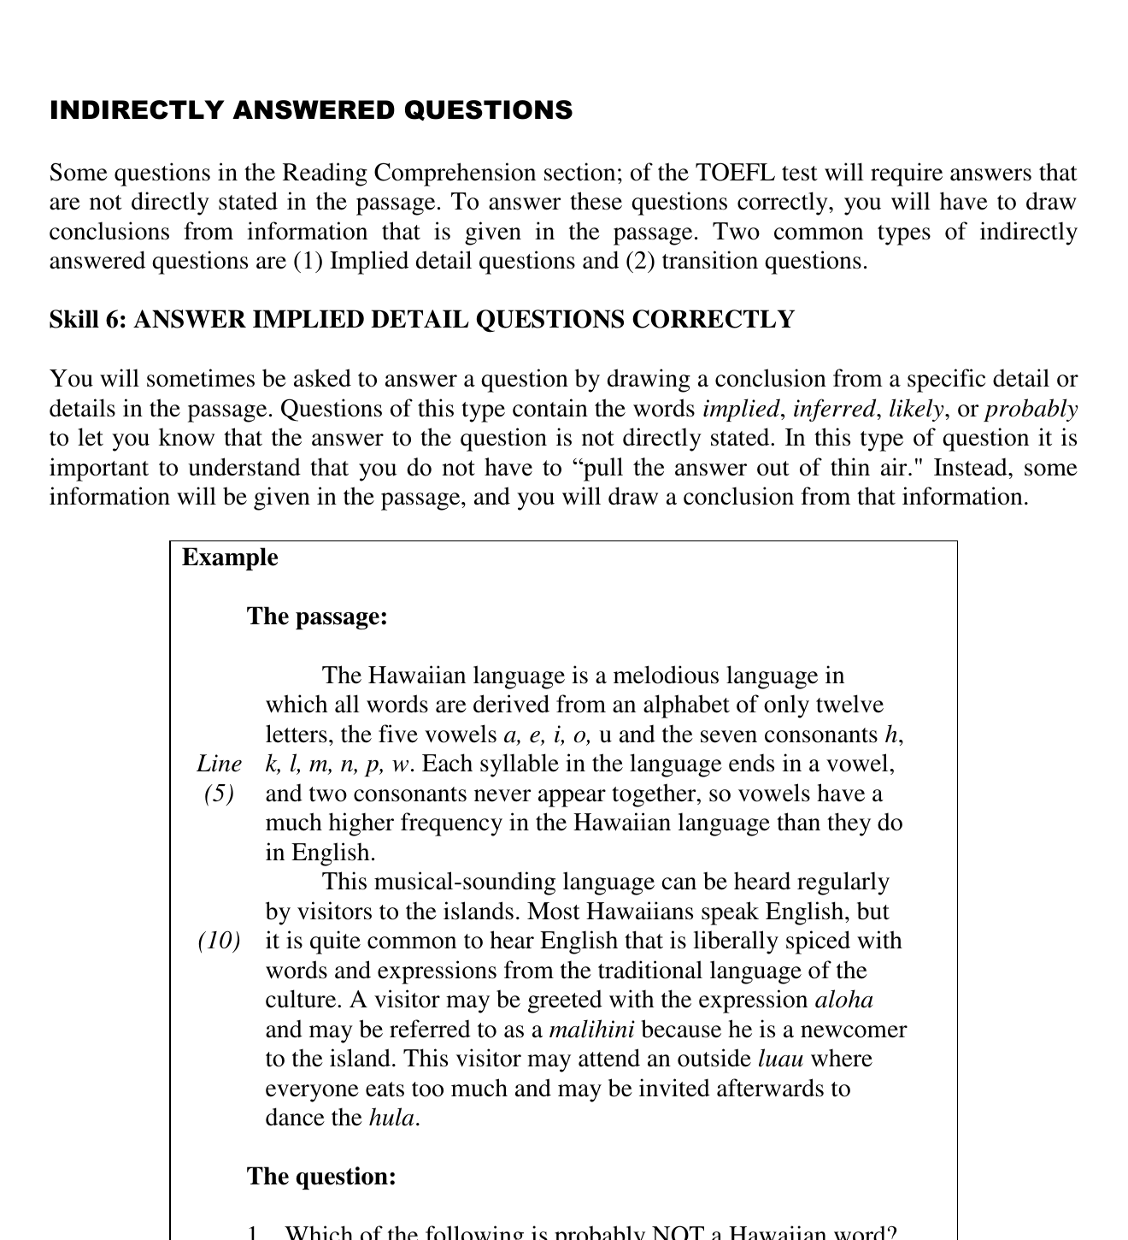
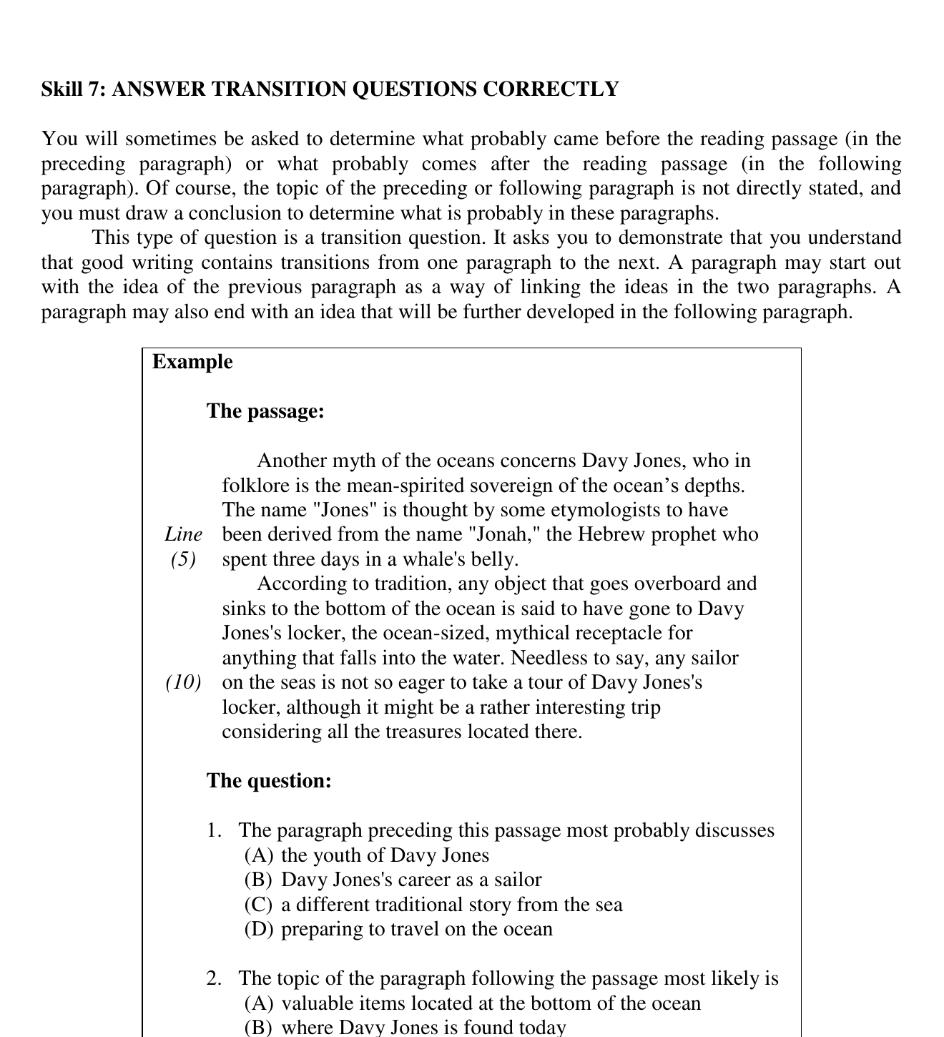
UNIT LAYANAN BAHASA UNY
INDIRECTLY ANSWERED
Kerja bersama: implication dan transition
SUPPORTED CONCLUSION
TOPIC BRIDGE
14
Notes:
Source: /media/miko/nextcloud-transit/TEMP/materi_protefl/3. LONGMAN 2001 - Complete Course_RDG Ed 190404.pdf; Book pages 206 and 209 / PDF pages 24 and 27.
Keep inference evidence separate from outside knowledge.

Slide 15
UNIT LAYANAN BAHASA UNY
INDIRECTLY ANSWERED
Pembahasan Skills 6-7
Stated detail
Informasi langsung atau restatement
Implied detail
Kesimpulan yang harus atau sangat kuat didukung
Transition
Jembatan topik di awal atau akhir passage
Possible belum tentu supported.
15
Notes:
Source: /media/miko/nextcloud-transit/TEMP/materi_protefl/3. LONGMAN 2001 - Complete Course_RDG Ed 190404.pdf; Synthesis of Skills 3, 6 and 7.

Slide 16
UNIT LAYANAN BAHASA UNY
VOCABULARY QUESTIONS
Peta strategi vocabulary
8
Structural clues
9
Word parts
10
Context for difficult words
11
Context for simple words
Periksa struktur dan konteks sebelum memilih terjemahan yang paling familiar.
16
Notes:
Source: /media/miko/nextcloud-transit/TEMP/materi_protefl/3. LONGMAN 2001 - Complete Course_RDG Ed 190404.pdf; Book pages 217-232 / PDF pages 35-50.

Slide 17
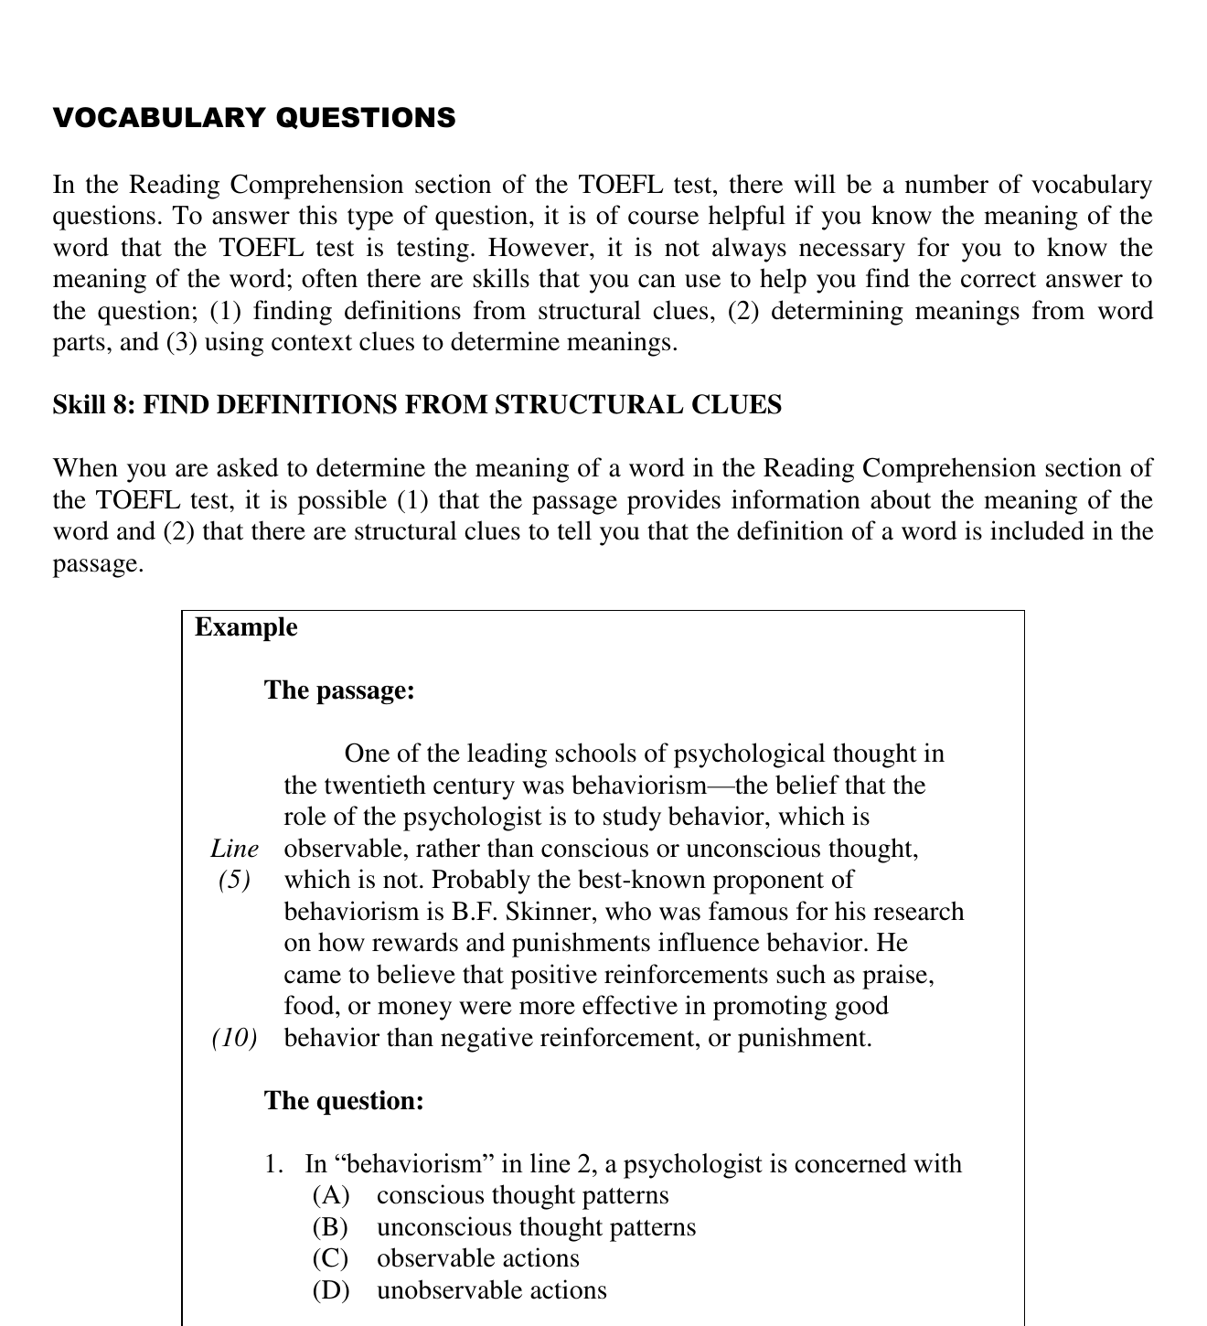
UNIT LAYANAN BAHASA UNY
VOCABULARY QUESTIONS
Skill 8: Structural Clues
Clue dapat muncul sebagai
1.
punctuation
2.
restatement
3.
examples
4.
surrounding explanation
Baca hubungan struktur, bukan kata target saja.
17
Notes:
Source: /media/miko/nextcloud-transit/TEMP/materi_protefl/3. LONGMAN 2001 - Complete Course_RDG Ed 190404.pdf; Book page 217 / PDF page 35.

Slide 18
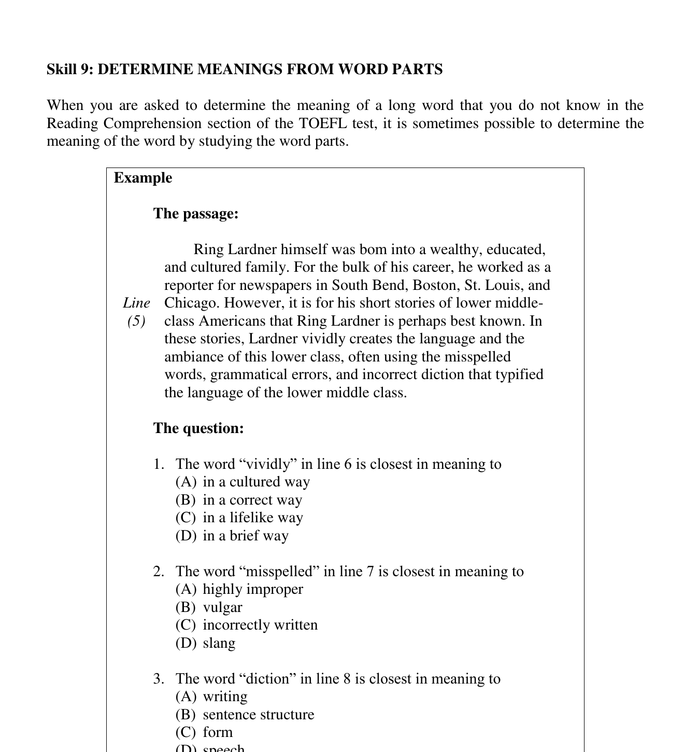
UNIT LAYANAN BAHASA UNY
VOCABULARY QUESTIONS
Skill 9: Meanings from Word Parts
Langkah
1.
Pisahkan prefix, root, atau suffix
2.
Prediksi makna gabungan
3.
Periksa kembali dalam kalimat
Daftar word parts ditampilkan dari tabel sumber agar bentuk dan contoh tetap utuh.
18
Notes:
Source: /media/miko/nextcloud-transit/TEMP/materi_protefl/3. LONGMAN 2001 - Complete Course_RDG Ed 190404.pdf; Book page 220 / PDF page 38.

Slide 19
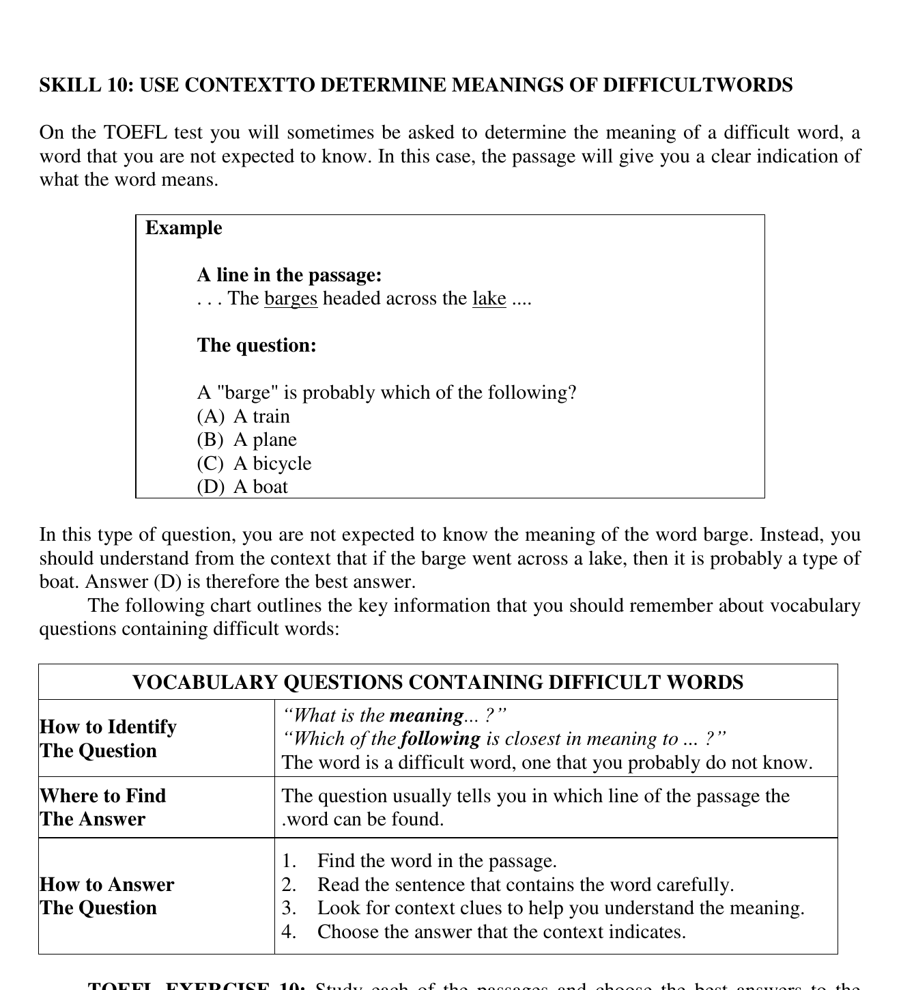
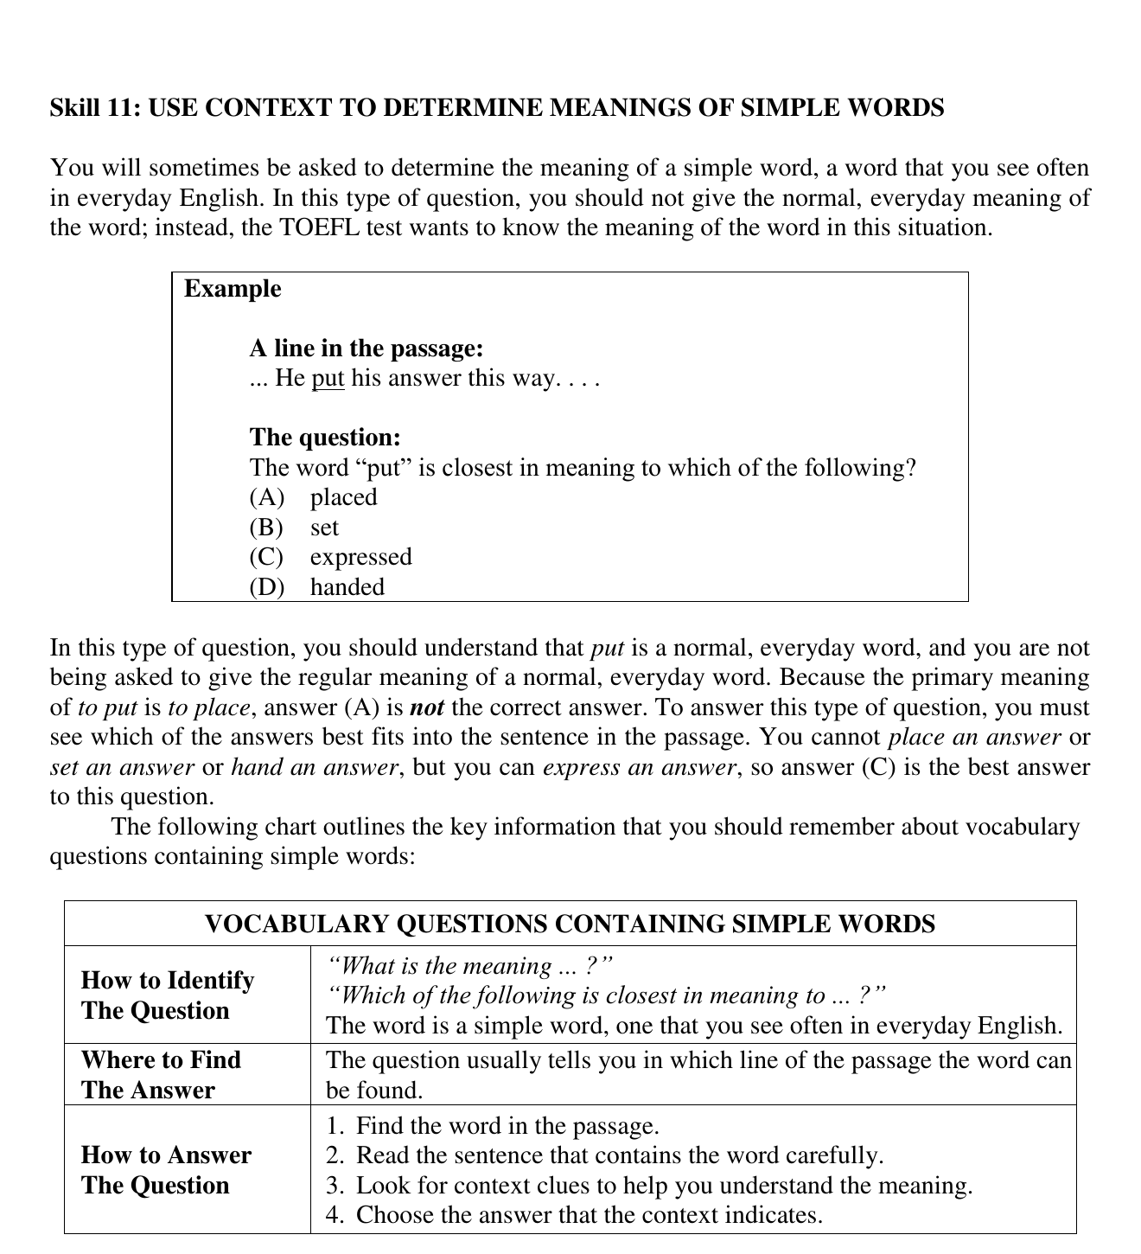
UNIT LAYANAN BAHASA UNY
VOCABULARY QUESTIONS
Skills 10-11: Meaning from Context
Satu prosedur
1.
Baca kalimat sekitar
2.
Prediksi makna
3.
Substitusikan pilihan
4.
Periksa kecocokan
19
Notes:
Source: /media/miko/nextcloud-transit/TEMP/materi_protefl/3. LONGMAN 2001 - Complete Course_RDG Ed 190404.pdf; Book pages 223 and 225 / PDF pages 41 and 43.

Slide 20
UNIT LAYANAN BAHASA UNY
VOCABULARY QUESTIONS
Kerja bersama: vocabulary
1
Structural clue
Temukan tanda baca, restatement, atau contoh yang mendefinisikan kata.
2
Word part
Pisahkan bagian kata, lalu periksa prediksi terhadap konteks.
3
Simple word
Jangan otomatis memilih arti yang paling umum.
Prediksi arti sebelum melihat pilihan A-D.
20
Notes:
Source: /media/miko/nextcloud-transit/TEMP/materi_protefl/3. LONGMAN 2001 - Complete Course_RDG Ed 190404.pdf; Guided practice structure based on Skills 8-11.

Slide 21
UNIT LAYANAN BAHASA UNY
VOCABULARY QUESTIONS
Pembahasan vocabulary
TARGET
Kata yang ditanyakan
CLUE
Struktur atau konteks di passage
MEANING
Makna yang cocok di kalimat
DISTRACTOR
Pilihan familiar yang gagal dalam konteks
21
Notes:
Source: /media/miko/nextcloud-transit/TEMP/materi_protefl/3. LONGMAN 2001 - Complete Course_RDG Ed 190404.pdf; Discussion framework authored from Longman vocabulary explanations.

Slide 22
UNIT LAYANAN BAHASA UNY
OVERALL REVIEW
Skills 12-13: Overall Review
12
Location of Information
Pilih keyword atau ide, skim line ranges yang tercantum, lalu temukan restatement.
13
Tone, Purpose, or Course
Tone menunjukkan sikap penulis. Purpose menjelaskan alasan menulis. Course menunjukkan bidang studi passage.
22
Notes:
Source: /media/miko/nextcloud-transit/TEMP/materi_protefl/3. LONGMAN 2001 - Complete Course_RDG Ed 190404.pdf; Book pages 233-246 / PDF pages 51-64.

Slide 23
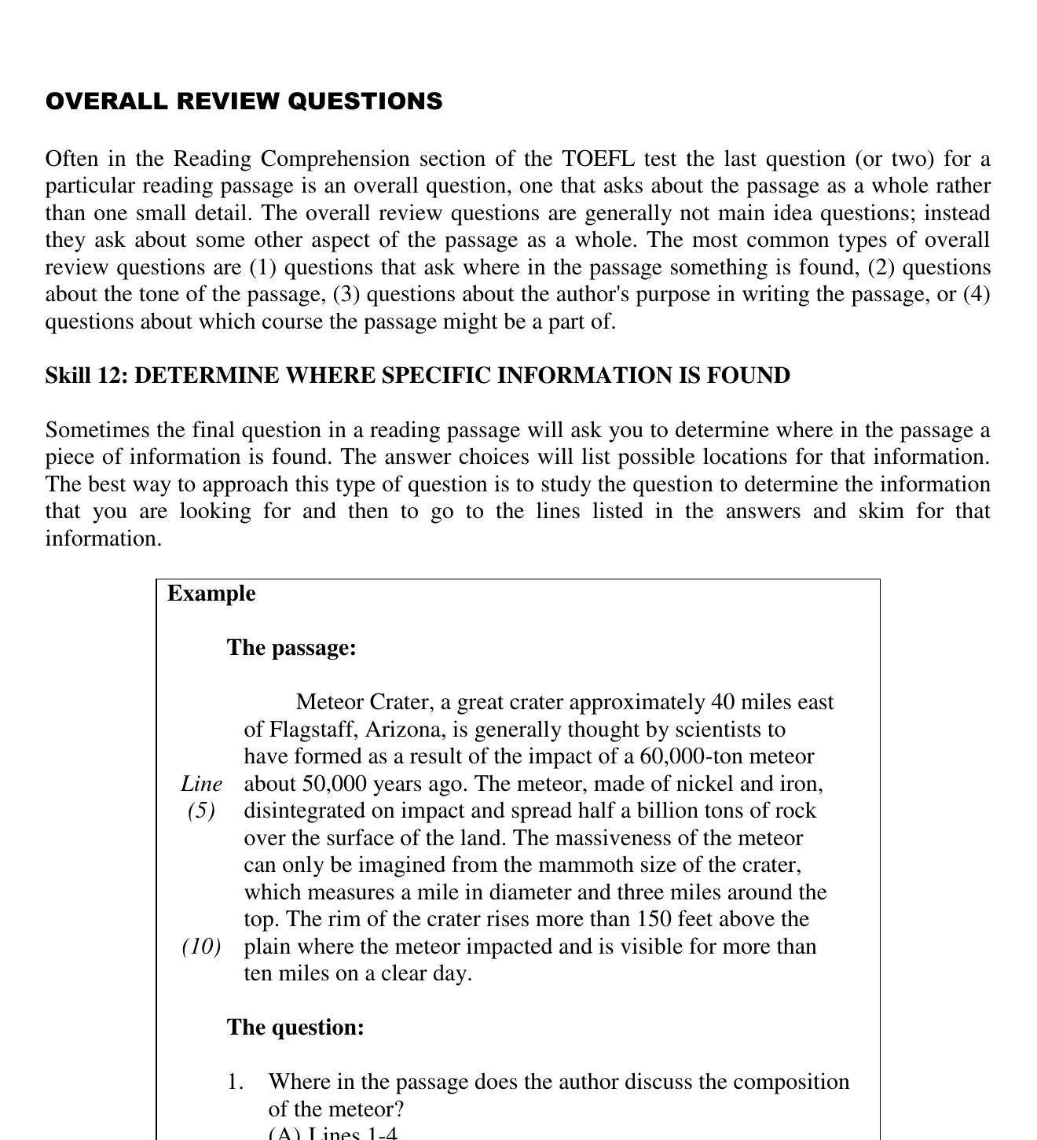
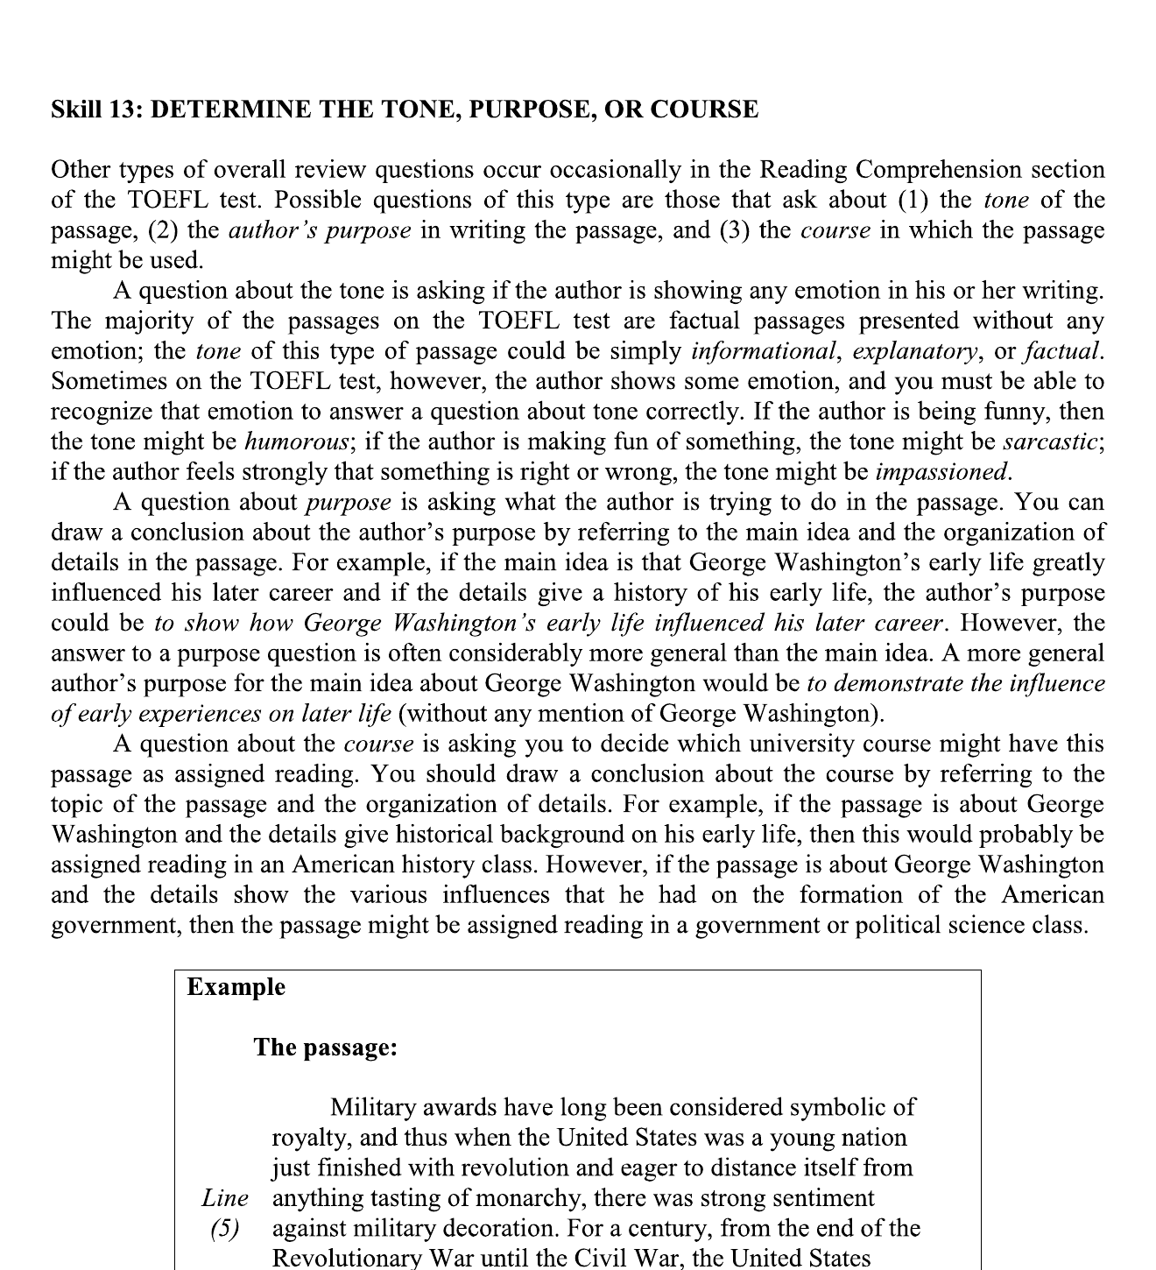
UNIT LAYANAN BAHASA UNY
OVERALL REVIEW
Kerja bersama: location, tone, purpose
23
Notes:
Source: /media/miko/nextcloud-transit/TEMP/materi_protefl/3. LONGMAN 2001 - Complete Course_RDG Ed 190404.pdf; Book pages 233 and 236 / PDF pages 51 and 54.
Location answers: composition in lines 4-6; visible distance in lines 10-11. Discuss tone and purpose separately.

Slide 24
UNIT LAYANAN BAHASA UNY
MIXED PRACTICE
Strategi sebelum full passage
1.
Preview semua pertanyaan.
2.
Labeli question type.
3.
Tentukan search area.
4.
Baca untuk mencari evidence.
5.
Pilih jawaban yang paling kuat didukung.
Jika waktu tersisa kurang dari 12 menit, lanjut langsung ke Slide 28.
24
Notes:
Source: /media/miko/nextcloud-transit/TEMP/materi_protefl/3. LONGMAN 2001 - Complete Course_RDG Ed 190404.pdf; Workshop instruction.
Slides 25-27 are optional backup. Keep this timing note in speaker view only during final polish.

Slide 25
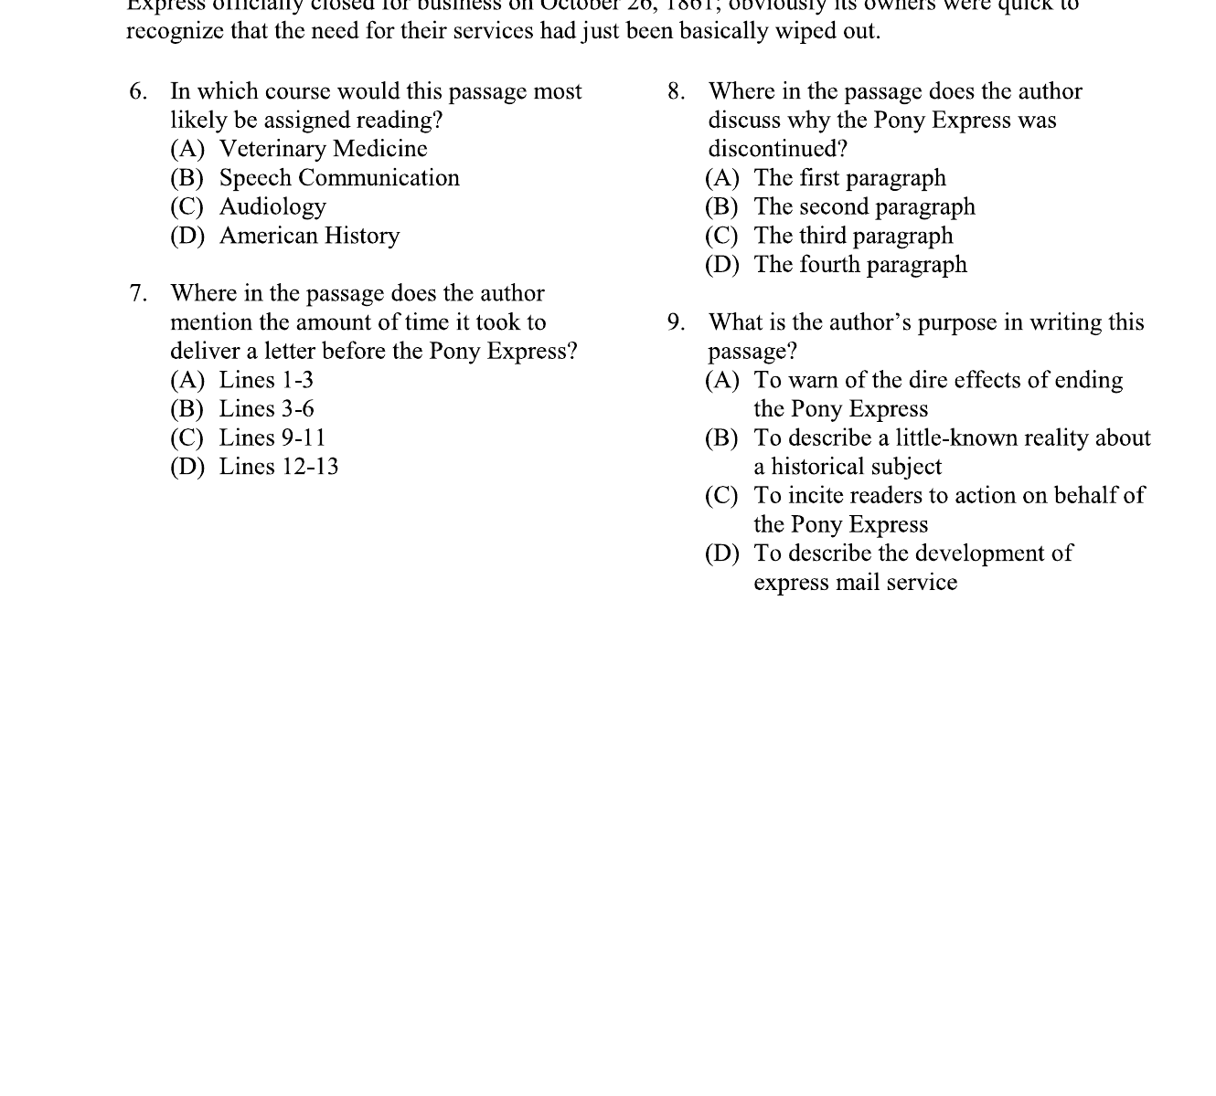
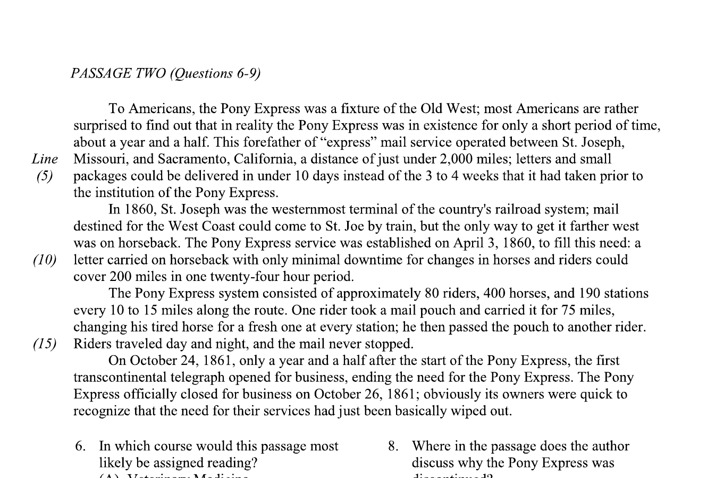
UNIT LAYANAN BAHASA UNY
OPTIONAL FULL PASSAGE
Full Passage Practice
Preview questions | Label question type | Mark search area | Answer with evidence
25
Notes:
Source: /media/miko/nextcloud-transit/TEMP/materi_protefl/3. LONGMAN 2001 - Complete Course_RDG Ed 190404.pdf; Book page 241 / PDF page 59.
Optional backup. The source page contains Passage Two about the Pony Express and Questions 6-9. Preserve the source order.

Slide 26
UNIT LAYANAN BAHASA UNY
OPTIONAL FULL PASSAGE
Evidence-Based Discussion
No.
Question type
Search area
Evidence
Answer
6
7
8
9
Isi tabel bersama peserta sebelum membuka kunci.
26
Notes:
Source: /media/miko/nextcloud-transit/TEMP/materi_protefl/3. LONGMAN 2001 - Complete Course_RDG Ed 190404.pdf; Book page 241 / PDF page 59.
Ask for question type and textual evidence before accepting an answer. Fill the table live; do not reveal the key first.

Slide 27
UNIT LAYANAN BAHASA UNY
OPTIONAL FULL PASSAGE
Strategy Check
1.
Jenis pertanyaan mana yang paling cepat dikenali?
2.
Pada soal mana kita membaca terlalu banyak?
3.
Distractor mana terlihat paling meyakinkan?
4.
Bukti apa yang awalnya terlewat?
5.
Strategi mana yang perlu lebih sering dilatih?
27
Notes:
Source: /media/miko/nextcloud-transit/TEMP/materi_protefl/3. LONGMAN 2001 - Complete Course_RDG Ed 190404.pdf; Workshop reflection prompts.

Slide 28
UNIT LAYANAN BAHASA UNY
CLOSING
Final Checklist
1.
Kenali jenis pertanyaannya.
2.
Tentukan area pencarian.
3.
Cari keyword, restatement, atau context clue.
4.
Cocokkan jawaban dengan bukti.
5.
Eliminasi pilihan yang tidak sepenuhnya didukung.
Passage provides the evidence. The question type tells you where and how to look.
28
Notes:
Source: /media/miko/nextcloud-transit/TEMP/materi_protefl/3. LONGMAN 2001 - Complete Course_RDG Ed 190404.pdf; Workshop synthesis based on Longman Skills 1-13.

