Slide 1
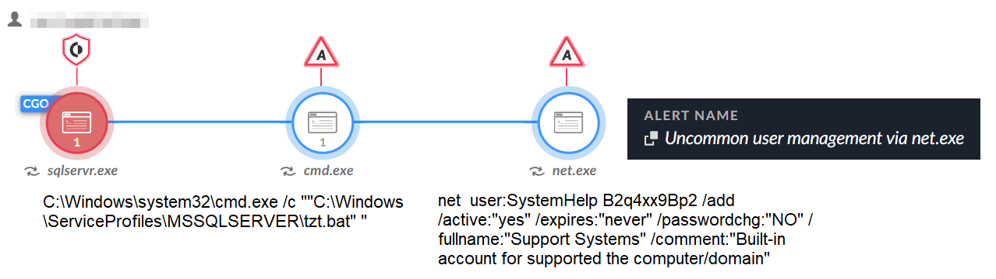

Slide 2
hxxp://2ndexample.com
test@something{dot}com
test@something {dot} com
test@something[dot]com
test@something [dot] com
test@something(dot)com
test@something (dot) com
test{at}something.com
test {at} something.com
test[at]something.com
test [at] something.com
test(at)something.com
test (at) something.com
test[.]something[.]com
test [.] something [.] com
1.1.1.1[/]24
1.1.1.1 [/] 24
C:[\]Windows[\]System32
C: [\] Windows [\] System32

Slide 3
http (://) example[.]something{dot}other(dot)com(/)this[/]file{.}html
Just some text and an image link
https://website.cdn.group-ib.com/wp-content/uploads/photo_2022-08-22_13-.webp

